Slide 1
Bacillus anthracis
Dr. Priyanka Chaturvedi
Assistant Professor

Slide 2
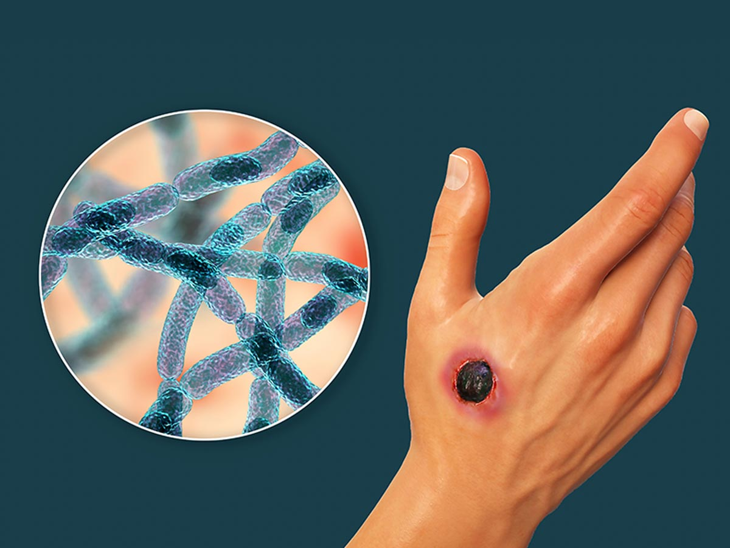
BACILLUS ANTHRACIS
Causative agent of anthrax.
Used as a BIOLOGICAL WEAPON.
First bacterium to be isolated in pure culture by Robert Koch and Koch’s postulate were made based on B. anthracis.
Anthrax vaccine was the first live attenuated bacterial vaccine.

Slide 3
BACILLUS ANTHRACIS
It was the first pathogenic bacterium seen under microscope (by Pollender, 1849).
It was the first communicable disease shown to be transmitted by inoculation of infected blood.

Slide 4
Introduction
Bacillus anthracis causes ANTHRAX
It is a non-motile aerobic Gram positive bacteria.
Large rectangular capsulated rods arranged in chains with non- bulging spores.
Pathogenic species:-
  B. anthracis
  B. cereus
  Bacillus species are generally motile (with peritrichous flagella) and non-capsulated except Bacillus anthracis.

Slide 5
Virulence Factors and Pathogenesis
Pathogenesis of anthrax is due to two important virulence factors-
  Anthrax toxin and
  Capsule.

Slide 6
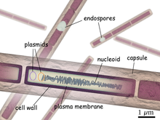
Virulence factors
A) Anthrax capsule:
Made up by polyglutamate
It inhibits complement mediated phagocytosis.
B) Anthrax toxin:
Tripartite toxin with three fragments
Edema factor: Increases cAMP and is responsible for edema
Protective factor: Helps to bind with host
Lethal factor: Causes cell death

Slide 7
Transmission
Modes of transmission:
Inoculation of spores (most common mode) : Spores enter through the abraded skin. Seen in people with occupational exposure to animals
Inhalation of spores
Ingestion of carcasses of animals dying of anthrax containing spores (manifested as bloody diarrhea).

Slide 8
Clinical Types
There are mainly three types of human anthrax:
  Cutaneous anthrax
  Pulmonary anthrax
  Intestinal anthrax

Slide 9
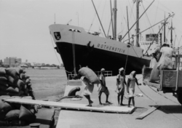
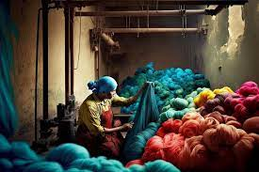
 | CUTANEOUS ANTHRAX | PULMONARY ANTHRAX
Other name | Hide porter’s disease | Wool sorter’s disease
Transmission | Through abraded skin | Through aerosols
Characterized by | Malignant pustule | Hemorrhagic anemia
Occupational exposure | Dock worker ,butcher, farmer | Workers of wool factory

Slide 10
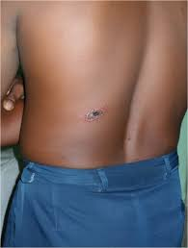
 | CUTANEOUS ANTHRAX | PULMONARY ANTHRAX
Occurrence | Most common | Rare
Prognosis | Rarely fatal | Fatal
Bioterrorism | Not associated with bioterrorism | Associated with bioterrorism

Slide 11





Slide 12
LABORATORY DIAGNOSIS
Specimen Collection:
  Pus or swab from malignant pustule
  Sputum in pulmonary anthrax
  Gastric aspirate, feces or food (in intestinal anthrax)

Slide 13
LABORATORY DIAGNOSIS
Staining :
  Gram’s stain
  McFadyean's reaction: Capsule appears as amorphous purple material surrounding blue bacilli.
  Spores : demonstrated by special stain like hot malachite green (Ashby’s method) or 0.25% sulphuric acid (spores are acid fast).

Slide 14
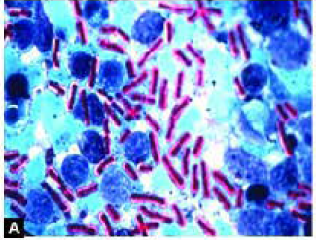
LABORATORY DIAGNOSIS
Mcfadyean's reaction- amorphous purple capsule surrounding blue bacilli (Polychrome Methylene Blue Stain)

Slide 15
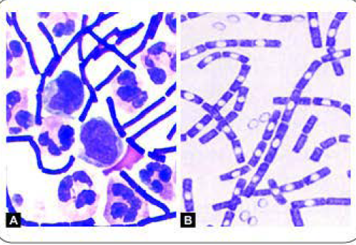
A. Direct smear shows Gram-positive, large rectangular bacilli and pus cells
B. Culture smear-Gram positive bacilli (bamboo stick appearance)

Slide 16
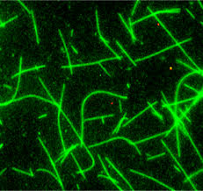
LABORATORY DIAGNOSIS
Direct immunofluorescence test (direct-IF): detects capsular antigen

Slide 17
CULTURE
Bacillus anthracis is aerobic, non-fastidious, grows in ordinary media and has a wide temperature range (12- 45⁰C) of growth.
Sporulation is promoted at 25-30⁰C and in presence of unfavorable conditions.

Slide 18
CULTURE
Nutrient agar: Colonies are 2-3 mm in size, irregular, round, opaque, greyish white with a frosted glass appearance.
Medusa head appearance: When colonies are viewed under low power microscope, the edge of colony which is composed of long interlacing chains of bacilli, appears as locks of matted hair.

Slide 19
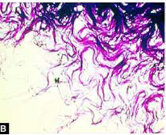
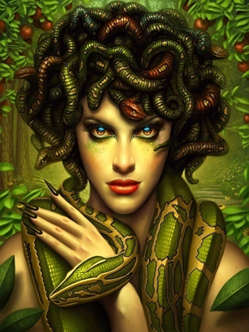
Medusa head colonies of Bacillus anthracis on nutrient agar ( lOx magnification)

Slide 20
CULTURE
Blood agar: Dry wrinkled, non-hemolytic colonies
Gelatin stab agar: inverted fir tree appearance (due to liquefaction of gelatin which occurs maximum at surface, and then slows down towards the bottom

Slide 21
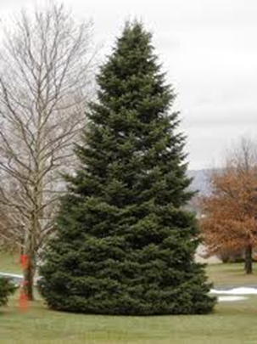
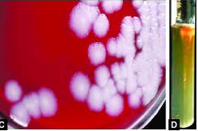
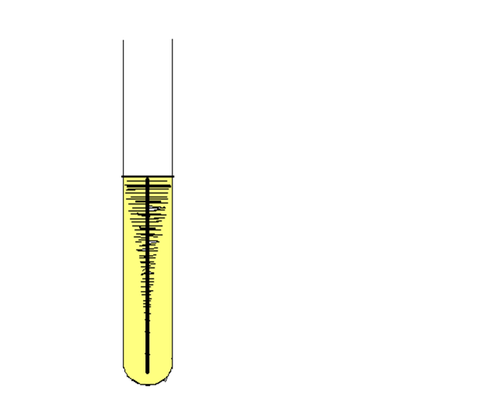
CULTURE
C. Non-hemolytic dry wrinkled colonies of Bacillus
anthracis on blood agar;
D. Gelatin stab agar-inverted fir tree appearance

Slide 22
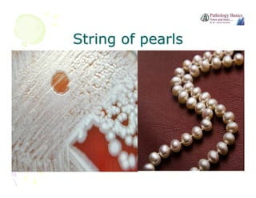
CULTURE
Selective media:
Solid medium with penicillin: Colonies have a string of pearl appearance look .
PLET medium: consists of POLYMYXIN, LYSOZYME, EDTA AND THALLOUS ACETATE added in heart infusion agar. It has been devised to isolate B. anthracis from mixtures of other spore bearing bacilli.

Slide 23
BIOCHEMICAL REACTIONS
Catalase positive
Glucose, maltose, sucrose – fermented – with production of Acid, but no gas
Nitrates – coverts to nitrites

Slide 24
Serology :
  ELISA
  Immunodiffusion in gel method
Molecular methods :-
  PCR

Slide 25
TREATMENT
Anthrax can be successfully treated if the disease is promptly recognized and appropriate therapy is initiated early .
Antibiotic regimen – Ciprofloxacin or Doxycycline, plus Clindamycin for 60 days

Slide 26
TREATMENT
Antibiotics for postexposure prophylaxis:
Raxibacumab: It is a monoclonal antibody that neutralizes anthrax toxin (protective antigen). It is intended for the prophylaxis and treatment of inhalational anthrax.

Slide 27
Prevention
Disposal of animal carcasses by burning or by deep burial in lime pits.
Decontamination ( usually by autoclaving) of animal products.
Protective clothing and gloves for handling potentially infectious materials.
Live Attenuated, Non-capsulated Spore Vaccine (Stern Vaccine): It is extensively used in animals
Alum Precipitated Toxoid Vaccine.

Slide 28

Thank you!

