Slide 1
Autoimmunity
Dr. Priyanka Chaturvedi
Assistant Professor

Slide 2
Autoimmunity
Condition in which the body’s own immunologically competent cells or antibodies act against its self-antigens resulting in structural or functional damage.
Normally immune system does not react to its own antigens due to a protective mechanism called TOLERANCE.
Any breach in tolerance mechanisms predispose to several autoimmune diseases.

Slide 3
Immunological Tolerance:
State in which an individual’s immune system is not against his own tissue antigens, like in a NORMAL INDIVIDUAL.
Mediated by two broad mechanisms:
  Central tolerance
  Peripheral tolerance

Slide 4
Central Tolerance
Refers to the deletion of self-reactive T and B lymphocytes during their maturation in central lymphoid organs.

Slide 5
Central Tolerance…
In thymus:
  During the T cell development in thymus, if any self-antigen is encountered → it is processed and presented by thymic antigen presenting cells (APCs) to the developing T cell.
  Any developing T cell that expresses a receptor for such self-antigen is negatively selected (i.e. deleted by apoptosis).

Slide 6
Central Tolerance…
In bone marrow: Self antigens are eliminated by
  Receptor editing - The B cells edit the antigen receptors present over them, so that a different B cell receptor is produced which no longer recognizes the self-antigen.
  Negative selection- If receptor editing fails, they undergo apoptosis.

Slide 7
Peripheral Tolerance
Back-up mechanisms that occur in the peripheral tissues to counteract the self-reactive T cells that escape central tolerance.

Slide 8
Peripheral Tolerance - Mechanisms
Ignorance- Self-reactive T cells might never encounter the self-antigen which they recognize.

Slide 9
Peripheral Tolerance - Mechanisms
Anergy:
  Defined as unresponsiveness to antigenic stimulus.
  The self-reactive T cells interact with the APCs presenting the self antigen, but the co-stimulatory signal is blocked.
  The B7 molecules on APC bind to CTLA-4 molecules on T cells instead of CD28 molecules.

Slide 10
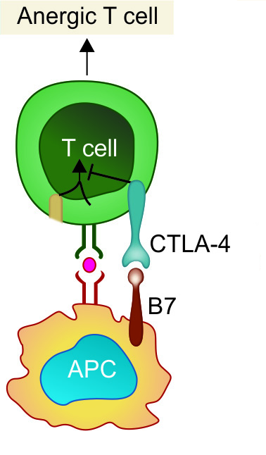

Slide 11
Peripheral Tolerance – Mechanisms
Phenotypic skewing:
  Self-reactive T cells interacting with APCs presented with self-antigens, undergo full activation.
  Secrete non-pathogenic cytokines and chemokine receptors profile.

Slide 12
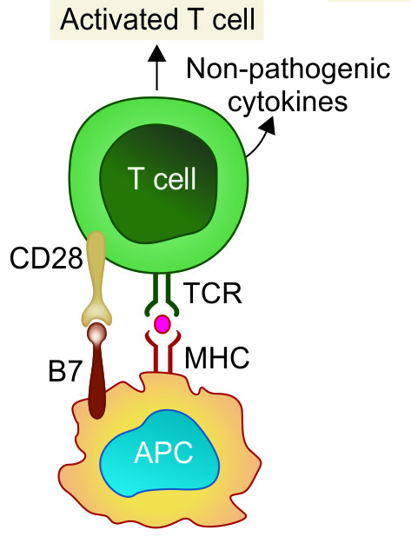

Slide 13
Peripheral Tolerance – Mechanisms
Apoptosis by AICD:
  Activation-induced cell death
  Activation of T cells induces upregulation of Fas ligand which subsequently interacts with the death receptor Fas leading to apoptosis.

Slide 14
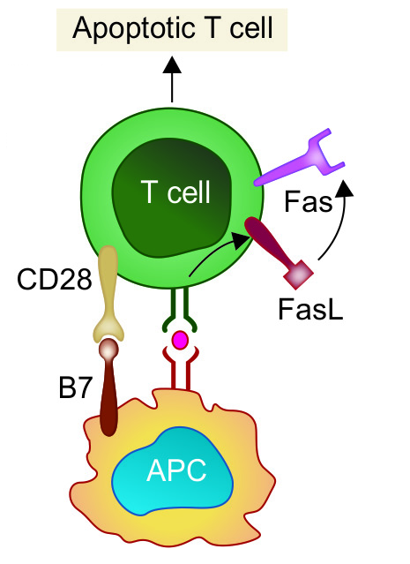

Slide 15
Peripheral Tolerance – Mechanisms
Regulatory T cells (T_{reg} cells):
  T_{reg} cells can down regulate the self-reactive T cells through secreting certain cytokines or killing by direct cell to cell contact.

Slide 16
Peripheral Tolerance – Mechanisms
Sequestration of self-antigen: Certain self-antigens can evade immune recognition by sequestration in immunologically privileged sites, e.g. corneal proteins, testicular antigens and antigens from brain.

Slide 17
MECHANISMS OF AUTOIMMUNITY
Autoimmunity results due to breakdown of one or more of the mechanisms of immunological tolerance.

Slide 18
Breakdown of T Cell Anergy
In the presence of tissue necrosis and local inflammation express co-stimulatory molecules (B7)
  Eg: Multiple sclerosis, rheumatoid arthritis and psoriasis

Slide 19
Failure of AICD
Failure of the auto reactive activated T cells to undergo activation induced cell death (AICD)
  Eg: SLE (systemic lupus erythematosus)

Slide 20
Loss of T_{reg} cells
Autoimmunity can result following the loss of regulatory T cell-mediated suppression of self-reactive lymphocytes.

Slide 21
Providing T Cell help to Stimulate Self-reacting B Cells
Antibody response to self-antigens occurs only when potentially self-reactive B cells receive help from T cells.

Slide 22
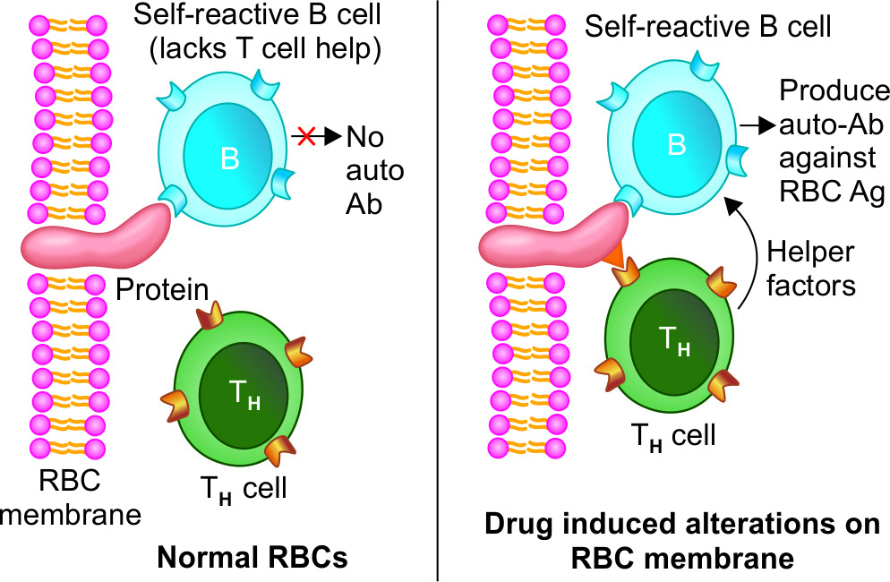

Slide 23
Release of Sequestered Antigens
Sequestered antigens -never been exposed to the tolerance mechanisms during development of immune system.
Injury to the organs leads to release of such sequestered antigens which are very well capable of mounting an immune response.
Spermatozoa and ocular antigens release can cause post vasectomy orchitis and post-traumatic uveitis.

Slide 24
Molecular Mimicry
Some microorganisms share antigenic determinants (epitopes) with self-antigens.
Immune response against such microbes would produce antibodies that can cross-react with self-antigen.
Example: Acute rheumatic fever and multiple sclerosis (molecular mimicry involving T-cell epitopes).

Slide 25
Polyclonal Lymphocyte Activation
Polyclonal T cell activation - Superantigens released from microbes (e.g. Staphylococcus aureus), polyclonally activate the T cells.
Polyclonal B cell activation can be induced by products of various microbes such as Epstein Barr virus, HIV, etc.

Slide 26
Epitope Spreading
Self-peptides released due to persistent inflammation induce tissue damage (as occurs in chronic microbial infection) and are processed and presented by APCs along with microbial peptides.
There may occur a spread of T cell recognition to self-epitopes rather than recognizing microbial epitope.

Slide 27
AUTOIMMUNE DISEASES

Slide 28
Autoimmune diseases and immune response produced with their clinical manifestations
Single Organ or Cell Type Autoimmune Diseases
Disease |  | Self-antigen present on | Type of immune response & Important features
Autoimmune anaemia
 | Autoimmune haemolytic anaemia | RBC membrane proteins | Auto-antibodies to RBC antigens triggers lysis of RBCs
 | Drug induced haemolytic anaemia | Drugs alter the red cell membrane antigens | Drugs such as Penicillin interact with RBCs so that the cells become antigenic
 | Pernicious anaemia | Intrinsic factor (a membrane-bound protein on gastric parietal cells) | Auto-antibodies to intrinsic factor block the uptake of vitamin B 12; leads to megaloblastic anaemia
Idiopathic Thrombocytopenic Purpura |  | Platelet membrane proteins (glycoproteins IIb-IIIa or Ib-IX) | Auto-antibodies against platelet membrane antigens leads to ↓platelet count (Thrombocytopenia)

Slide 29
Single Organ or Cell Type Autoimmune Diseases
Disease | Self-antigen present on | Type of immune response & Important features
Good-Pasture syndrome | Renal and lung basement membranes | Auto-antibodies bind to basement-membrane antigens on kidney glomeruli and the alveoli of the lungs followed by complement mediated injury leads to Progressive kidney damage and Pulmonary haemorrhage
Myasthenia gravis | Acetylcholine receptors | Blocking type of auto-antibody directed against Ach receptors present on motor nerve endings, leads to progressive weakening of the skeletal muscles
Graves’ disease | Thyroid-stimulating hormone (TSH) receptor | Anti TSH- auto-antibody (stimulates thyroid follicles, leads to hyperthyroid state)

Slide 30
Single Organ or Cell Type Autoimmune Diseases
Disease | Self-antigen present on | Type of immune response & Important features
Hashimoto’s thyroiditis | Thyroid proteins and cells | Auto-antibodies and T_{DTH} cells targeted against thyroid antigen leads to suppression of thyroid gland. Seen in middle aged females Hypothyroid state is produced (↓ production of thyroid hormones)
Post-streptococcal glomerulonephritis [PSGN] | Kidney | Streptococcal antigen- antibody complexes are deposited on glomerular basement membrane

Slide 31
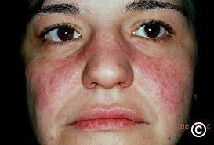
Systemic Autoimmune Diseases
Disease | Self-antigen present on | Type of immune response & Important features
Systemic lupus erythematosus [SLE] | Auto-antibodies are produced against various tissue antigens such as DNA, nuclear protein, RBC and platelet membranes. | Age & sex- Women (20-40 years of age) are commonly affected; female to male ratio is-10:1. Immune complexes (self Ag- auto Ab) are formed; which are deposited in various organs Major symptoms- Fever, butterfly rash over the cheeks, arthritis, pleurisy, and kidney dysfunction

Slide 32
Systemic Autoimmune Diseases
Disease | Self-antigen present on | Type of immune response & Important features
Rheumatoid arthritis | A group of auto-antibodies against the host IgG antibodies are produced called RA factor. It is an IgM antibody directed against the Fc region of IgG. | Age & sex- Women (40-60 years of age) affected Auto-antibodies bind to circulating IgG, forming IgM-IgG complexes that are deposited in the joints.

Slide 33
Systemic Autoimmune Diseases
Disease | Self-antigen present on | Type of immune response & Important features
Sjögren syndrome | Ribonucleoprotein (RNP) antigens SS-A (Ro) and SS-B (La) present on salivary gland, lacrimal gland, liver, kidney, thyroid | Auto-antibodies to the RNP antigens SS-A (Ro) and SS-B (La); leads to immune-mediated destruction of the lacrimal and salivary glands resulting in dry eyes (keratoconjunctivitis sicca) and dry mouth (xerostomia)

Slide 34
Systemic Autoimmune Diseases
Disease | Self-antigen present on | Type of immune response & Important features
Scleroderma (Systemic Sclerosis) | Nuclear antigens such as DNA topoisomerase and centromere present in heart, lungs, GIT, kidney, etc | Helper T cell (mainly) and auto-antibody mediated. Excessive fibrosis of the skin, throughout the body Two types- 1.Diffuse scleroderma- Auto-antibodies against DNA topoisomerase I (anti-Scl 70) is elevated 2.Limited scleroderma- ↑Anticentromere antibody, characterized by CREST syndrome-calcinosis, Raynaud phenomenon, esophageal dysmotility, sclerodactyly, and telangiectasia

Slide 35
Systemic Autoimmune Diseases
Disease | Self-antigen present on | Type of immune response & Important features
Seronegative Spondyloarthropathies | Sacroiliac joints & other vertebrae Several types- Ankylosing spondylitis Reiter Syndrome Psoriatic Arthritis Spondylitis With Inflammatory Bowel Disease Reactive arthritis | Common characteristics- They present as rheumatoid arthritis like features, but differ from it by- Association with HLA-B27 Pathologic changes begin in the ligamentous attachments to the bone rather than in the synovium Involvement of the sacroiliac joints, and/or arthritis in other peripheral joints Absence of RFs (hence the name "seronegative") Auto-Ab and immune complex mediated

Slide 36
Systemic Autoimmune Diseases
Disease | Self-antigen present on | Type of immune response & Important features
Multiple sclerosis | Brain (white matter) | Self-reactive T cells produce characteristic inflammatory lesions in brain that destroys the myelin sheath of nerve fiber; leads to numerous neurologic dysfunctions

Slide 37
Laboratory Diagnosis of Autoimmune Diseases
Autoimmune hemolytic anemia: Diagnosed by -
Coombs test - the red cells are incubated with an anti–human IgG antiserum.
If IgG autoantibodies are present on the red cells, the cells are agglutinated by the antiserum.

Slide 38
Laboratory Diagnosis of Autoimmune Diseases
Goodpasture syndrome:
Biopsies from patients are stained with fluorescent-labeled anti-IgG and anti-C3b - reveal linear deposits of IgG and C3b along the basement membranes

Slide 39
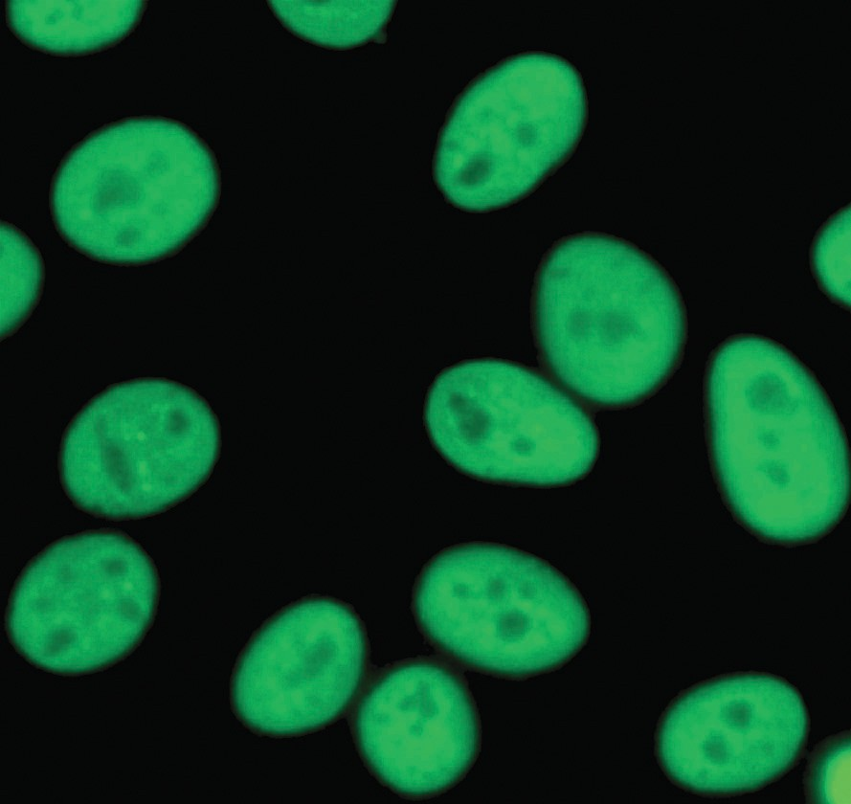
Laboratory Diagnosis of Autoimmune Diseases
SLE:
Detection of autoantibodies against various nuclear antigens by indirect immunofluorescence assay (most widely used) and ELISA-based techniques
  Antinuclear antibody (ANA)
  Anti-double stranded DNA (dsDNA)

Slide 40
Laboratory Diagnosis of Autoimmune Diseases
SLE:
Lupus band test- Direct immunofluorescence test - detect deposits of immunoglobulins and complement proteins in the patient's skin.

Slide 41
Laboratory Diagnosis of Autoimmune Diseases
Scleroderma: Anti-Scl 70 antibody is raised, detected by indirect immunofluorescence assay
Sjögren’s syndrome: Diagnosed by detection of SS-A (or anti-Ro) and SS-B (or anti-La) antibodies by indirect immunofluorescence assay

Slide 42
Laboratory Diagnosis of Autoimmune Diseases
Rheumatoid arthritis: Diagnosed by
RA factor (by latex agglutination test)
ACPA (Anti-citrullinated peptide antibodies)
Rose-Waaler test to detect RA factor is of historical importance.

Slide 43
THANK YOU!

