Slide 1


Slide 2
Antibody mediated immune response
Dr Priyanka Chaturvedi
Assistant Professor

Slide 3
Objectives
Concept of immune Response & its types
Antigen Presentation & APCs
Antibody mediated immune response

Slide 4
INTRODUCTION
IMMUNE RESPONSE:
A highly coordinated reaction of the cells of immune system and their products.

Slide 5
INTRODUCTION
Types of immune response:
Humoral or Antibody mediated Immune response (AMI)
Cell mediated immune response (CMI)

Slide 6
Humoral or Antibody mediated Immune response (AMI)
Protection of host by secreting Antibodies
Antibodies bind and neutralize the antigen (free or bound to any surface)
Have no role against Intracellular antigens

Slide 7
Cell mediated immune response (CMI)
Crucial in providing protection against intracellular microbes.
It is mainly T-cell mediated
Other components are: Natural killer (NK) cells, Macrophages & Granulocytes.

Slide 8
CMI and AMI are Interdependent
CMI and AMI cannot work individually, but they are highly dependent on each other
CMI regulates AMI by releasing cytokines from activated T cells that stimulate the B cells to transform into antibody secreting plasma cells.

Slide 9
CMI and AMI are Interdependent
There are few initial events that must take place before the induction of either CMI or AMI.
These events are common to both CMI and AMI.
These events include:
Antigen presentation to helper T cells
Activation and differentiation of helper T cells into either TH1 or TH2 subsets.

Slide 10
1. Antigen presentation
For induction of immune response, recognition of antigen by T cells is essential
T cells can’t recognize native and free antigens
Antigen is processed into smaller antigenic peptides containing specific epitopes which are subsequently combined with MHC molecules.

Slide 11
1. Antigen presentation
Antigen presentation refers to presentation of antigenic peptides to both T_{H} cells and T_{C} cells by complexing with MHC II and MHC I respectively
Antigen presenting cells: Strictly refers only to those cells that present the antigenic peptide along with MHC II to T_{H} cells
Target cells: Virus infected cells presenting antigenic peptides along with MHC I molecules to Tc cells

Slide 12
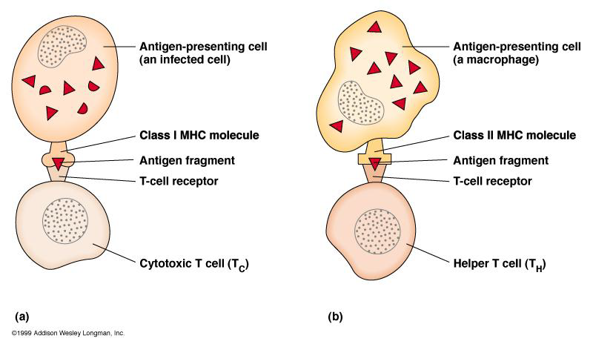
T CELLS ONLY RECOGNIZE ANTIGEN ASSOCIATED WITH MHC MOLECULES ON CELL SURFACES

Slide 13
Antigen presenting cells
Professional APCs | Non Professional APCs
Dendritic cells | Fibroblasts (skin)
Macrophages | Thymic epithelial cells
B cells | Pancreatic beta cells
 | Vascular endothelial cells
 | Glial cells (brain)
 | Thyroid epithelial cells
Notes:
Major professional apcs
Occasionally present antigen to helper t cells non professional apcs

Slide 14
Antigen processing pathways
For induction of immune response (both CMI and AMI) antigens must be presented to T_{H} cells

Slide 15
Antigen processing pathways
Cytosolic pathway: Endogenous/ intracellular antigen such as viral antigens and tumor antigens are processed and presented along with MHC class I molecules to T_{c} cells
Endocytic pathway: Exogenous antigens ( extracellular microbes and their products) are processed and complexed with MHC class II molecules and presented to T_{H} cells
Notes:
Are used by immune system which are different from each other in their mechanism and target antigen

Slide 16
ACTIVATION AND DIFFERENTIATION OF HELPER T CELLS
Central event that regulates both cell mediated and antibody mediated immune responses

Slide 17
A. ACTIVATION OF HELPER T CELLS
Activation occurs in two steps:
SIGNAL GENERATION
SIGNAL TRANSDUCTION

Slide 18
I. SIGNAL GENERATION
Requires of generation of three specific signals:
1. Antigen specific signal
2. Co-stimulatory signal
3. Cytokine signal

Slide 19
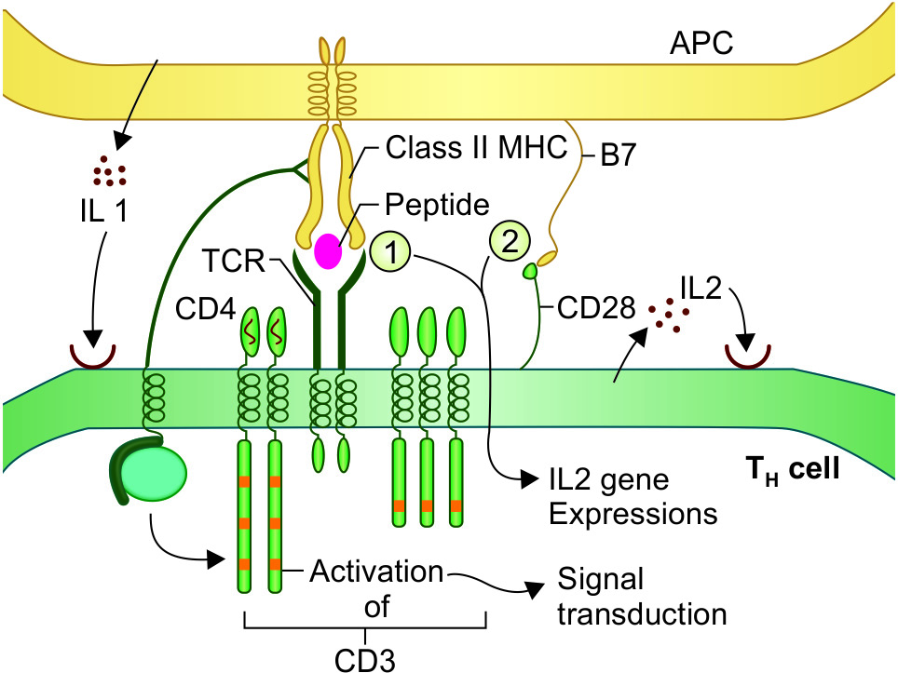
I. SIGNAL GENERATION

Slide 20
II. SIGNAL TRANSDUCTION:
Initiated at CD4 molecule which interacts with CD3 complex and transmit the signal
Activation of T_{H} cells

Slide 21
B. DIFFERENTIATION OF HELPER T CELLS:
Activated T_{H} cells secrete increased amount of IL-2 as well as IL-2 receptor
IL-2 binds to its receptor on the same T_{H} cell and also on other T_{H} cells and induce the naïve T_{H} cells to proliferate and differentiate
T_{H} cells get activated and subsequently differentiate into MEMORY AND EFFECTOR CELLS

Slide 22
EFFECTOR T HELPER CELLS
Derived either from the naïve T_{H} cells or pre-existing memory T_{H} cells following antigenic stimulus.
They are short-lived.
Further differentiate into either T_{H} 1 or T_{H} 2 subset

Slide 23
EFFECTOR T HELPER CELLS
Cytokines secreted by:
T_{H}1 cell stimulate T_{c} cells----CMI
T_{H}2 cell stimulate B cells----AMI

Slide 24
TH1 cytokines & their functions
IL-2 | 1. Promotes activation of T_{H} and T_{C} cells 2. Activates NK cells to become LAK (Lymphokine-activated Killer) cells
IFN-γ | 1. Activates the resting macrophages into activated macrophage 2. Activates B cells to produce IgG 3. Promotes inflammation of delayed type of hypersensitivity (along with TNF-β) 4. Inhibits T_{H}2 cell proliferation
TNF-β | Enhances phagocytic activity of macrophage
TH2 cytokines & their functions
IL-4 | 1. Inhibits T_{H}1 cell differentiation 2. Stimulates B cells to produce IgE and also IgG4 & IgG1
IL-5 | 1. Enhances proliferation of eosinophils 2. Both IL-4 & IL-5 together provide protection against helminthic infections and also mediate allergic reaction
IL-6 | Promotes B cell proliferation and antibody production
IL-10 | Inhibits T_{H}1 cell differentiation

Slide 25
MEMORY T CELLS
Derived from activated T_{H} cell
Longer life span (months to years)
Are in resting stage
Following subsequent antigenic stimulus, they become activated and differentiated into effector T_{H} cells

Slide 26
Humoral or Antibody-mediated Immune Response (AMI)
Antibodies are secreted to provide protection to the host…

Slide 27
Antibody-mediated Immune Response
AMI occurs through the following three steps:
  Activation of B cells
  Proliferation and differentiation of B cells into effector cells and memory cells.
  Effector function- Secret antibodies by plasma cells

Slide 28
1. Activation of B Cells
Antigens that activate B cells are divided into two categories.
a) Thymus dependent (TD) Antigen: (most common)
TD antigens are processed by APCs → presented to T_{H} cells following which the T_{H}2 cells → cytokines that in turn activate the B cells.

Slide 29
1. Activation of B Cells
b) Thymus Independent (TI) Antigen:
They are not processed by APC.
They can directly activate B cells without the help of T cell induced cytokines.

Slide 30
1. Activation of B Cells
Thymus dependent (TD) Antigen: (most common)
It includes:
Antigen presentation of B cells to activated TH cells
Signal Induction
Signal Transduction

Slide 31
Signal Induction
Signal-1 - Induced by the cross linking of mIg (membrane immunoglobulin) receptor on B cell membrane with the microbial antigen.
Signal-2 - Provided by binding of CD40 on B cell with CD40L on activated T_{H} cells.
Signal-3- Cytokine stimulus. Cytokines produced by the activated T_{H} cells bind to specific cytokine receptor on B cells

Slide 32
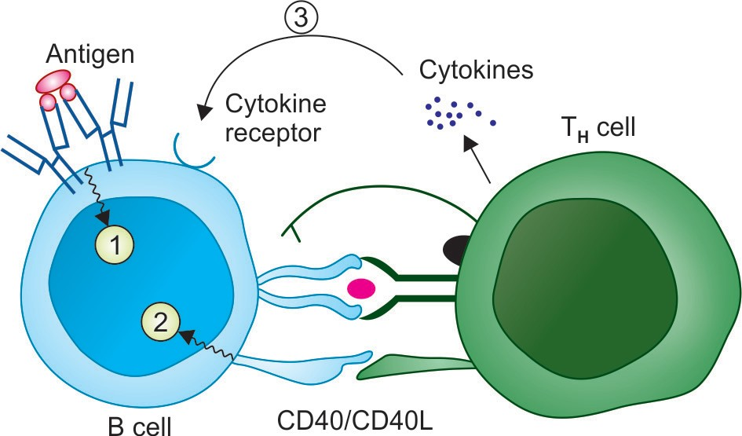
Antigen presentation of B cells to activated T_{H} cells and signal induction

Slide 33
Signal Transduction
Initiated by the B-cell receptor (BCR).
Transmits the signal leading to activation of B cells.

Slide 34
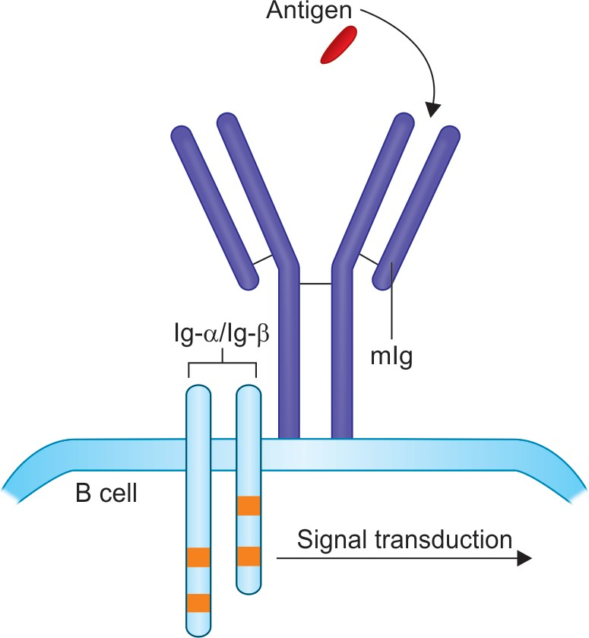
B cell signal transduction

Slide 35
Proliferation and Differentiation of B Cells
Naive B cells are discharged from the bone marrow and settle in the B cell regions of peripheral lymphoid organs (cortex of lymph nodes & marginal zone of spleen).
Primary lymphoid follicles are formed from naive B lymphocytes.

Slide 36
Proliferation and Differentiation of B Cells
Following activation of B cells, primary follicles are converted into secondary follicles
Secondary follicles bear a germinal center, which in turn has two areas:
Dark zone
Light zone

Slide 37
Differentiation of B cells in secondary lymphoid follicles

Slide 38
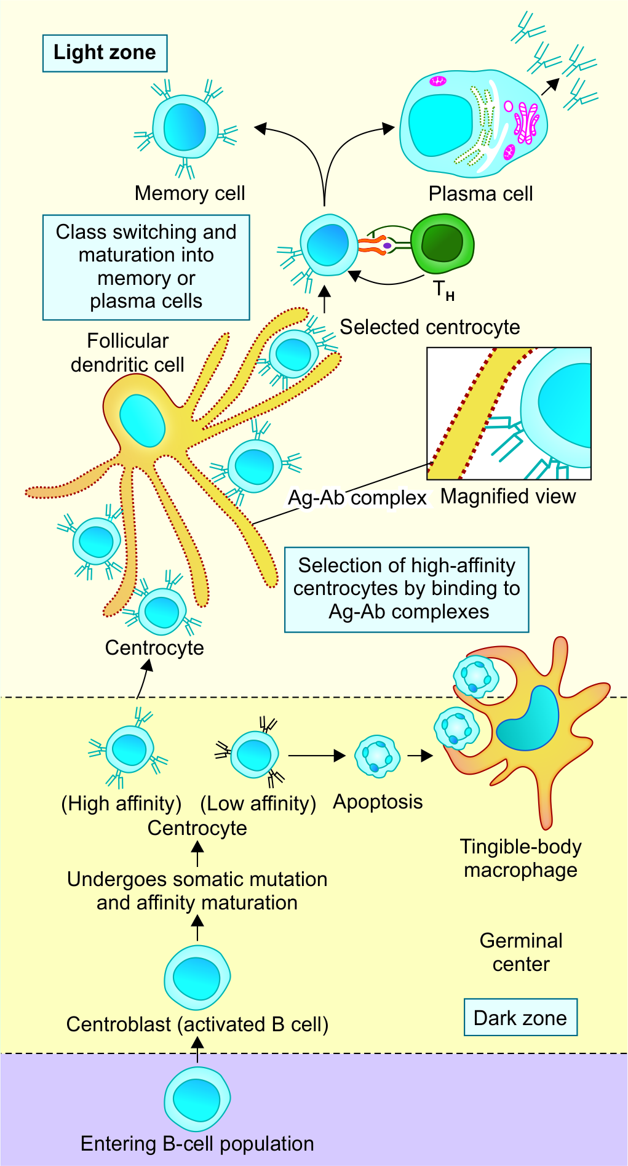

Slide 39
Cytokines secreted by T_{H} cells and the respective Ig class/subclass they induce
Cytokine(s) | Ig class produced
IFN-γ | IgG2a or IgG3
IL-5 + TGF-β | IgA or IgG2b
IL-4 | IgE or IgG1 or IgG4
IL-2,4,5 | IgM
IL-4,5,6 + IFN-γ | IgG

Slide 40
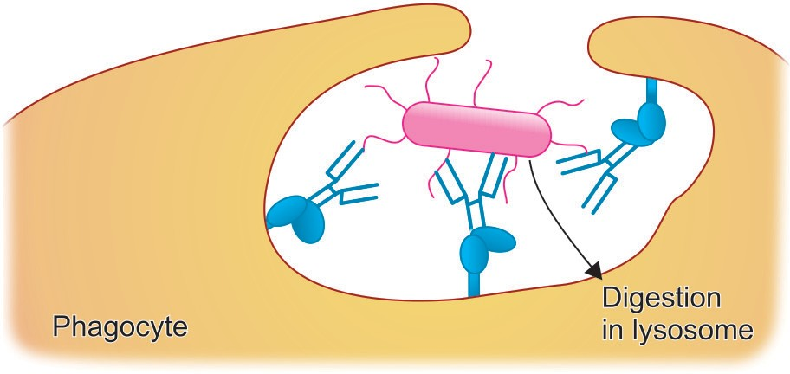
Effector Functions of AMI
Promotes opsonization
  Fc Receptors present on phagocyte surface recognize antibody coated microbes, bind to them and that leads to enhanced phagocytosis

Slide 41
Effector Functions of AMI
Transcytosis
  Poly Ig receptors are expressed on the inner surface of epithelial cells
  They bind to dimers of IgA and multimers of IgM antibodies and transfer them through the cell to their apical surface and into the lumen of an organ (e.g., the intestine).

Slide 42
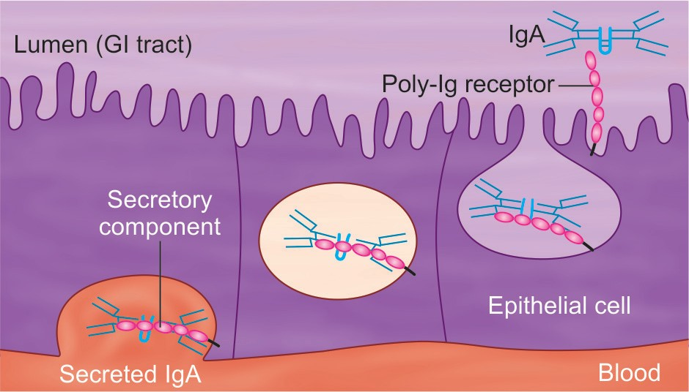

Slide 43
Effector Functions of AMI
Mediates mucosal immunity:
  Transcytosis of IgA to gut lumen provides mucosal immunity by neutralizing the microbes at local mucosal sites

Slide 44
MCQs

Slide 45
1. Professional antigen-presenting cells (APCs) include all, except:
Dendritic cells
Macrophages
Fibroblasts (skin)
B cells

Slide 46
2. Plasma cells are:
Activated B cells producing cytokines
Activated T cells producing Immunoglobulins
Activated B cells producing immunoglobulins
Activated T cells producing cytokines

Slide 47
3. Which of the following is correct. Cytokines secreted by:
1. T_{H}1 cell stimulate B cells----CMI
2. T_{H}2 cell stimulate B cells----AMI
3. T_{H}1 cell stimulate T_{c} cells----AMI
4. T_{H}2 cell stimulate B cells----CMI

Slide 48
Thank you

