Slide 1
AGENTS OF BACTERIAL MENINGITIS - 2
Dr. Priyanka Chaturvedi
Assistant professor

Slide 2
Definition
Meningitis is infection of the leptomeninges (arachnoid and pia mater) surrounding the brain and spinal cord, with involvement of the subarachnoid space.

Slide 3
Types
Types of meningitis
1. Acute
2. Chronic
OR
Pyogenic
Tubercular
Viral

Slide 4
Agents of Acute Meningitis
Streptococcus pneumoniae or pneumococcus :- most common
Neisseria meningitidis or meningococcus
Streptococcus agalactiae
Listeria monocytogenes
Haemophilus influenzae
Escherichia coli
Klebsiella Pneumoniae

Slide 5
Agents of Chronic Meningitis
  Mycobacterium tuberculosis
  Borrelia burgdorferi (Lyme disease)
  Treponema pallidum (tertiary syphilis)
  Nocardia
  Actinomyces
  Tropheryma whipplei
  Leptospira
  Brucella

Slide 6
Cytological and Biochemical Analysis
Characteristics | Normal individual | Pyogenic meningitis | Tuberculous meningitis | Viral meningitis
CSF pressure (mm of water) | Normal (50–150) | Highly elevated (>180) | Moderately elevated | Slightly elevated/normal
Total leukocyte count (per mm3) | 0–5 | 100–10,000 | 10–500 | 25–500
Predominant cell type | Lymphocytes | Neutrophils | Lymphocytes | Lymphocytes
Glucose (mg%) | 40–70 | decreased to absent | 20–40 mg/dL (slightly decreased) | Normal
Total proteins (mg%) | 15–45 | usually >250; markedly increased) | moderate to markedly increased | normal or slightly elevated

Slide 7
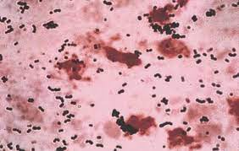
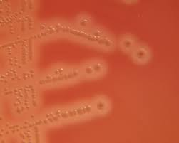
case
A 5 days old neonate developed high Grade fever with generalized tonic clonic seizures. The CSF biochemical analysis showed predominant neutrophils with CSF sugar: 10 mg% & CSF protein of 378mg%. The Gram stain smear of CSF showed Plenty Pus cells with Gram Positive cocci in short chain. The CSF culture shows growth of 1-2 mm mucoid colony with beta hemolysis.

Slide 8
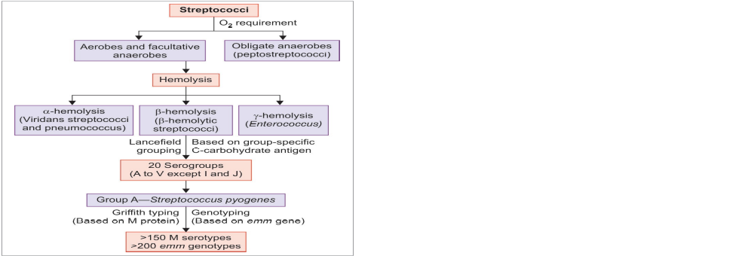

Slide 9
Pathogenesis and
Clinical Manifestations:
Approximately 5–40% of women - vaginal or rectal carriers of group B Streptococcus (GBS).
GBS infection - common in neonates and pregnancy.
Recognized as a major cause of neonatal sepsis and meningitis

Slide 10
Pathogenesis and Clinical Manifestations:
Infections in pregnancy - lead to peripartum fever, endometritis and puerperal sepsis.
Infections in adults - involve elderly or people with underlying chronic illness - diabetes mellitus or malignancy.
Isolation of GBS from blood culture and CSF culture - mainstay of diagnosis.
GBS - catalase negative

Slide 11
Clinical features
Early-onset: Occurs in the first week of life , transmission of organism from the maternal genital tract during or before birth
Late-onset: Occurs from 7-90 days of birth, transmitted by contact with a colonized mother or nursing personnel.

Slide 12
Early-onset v/s late onset
Characteristics | Early-onset disease | Late-onset disease
Age of onset | 0–6 days of birth | 7–90 days of birth
Increased risk following obstetric complications | Prematurity and prolonged labor | Not associated
Mode of transmission to the baby | During or before birth from the colonized maternal genital tract | Contact with a colonized mother and nursing personnel
Common clinical manifestations | Pneumonia or respiratory distress syndrome (most common), bacteremia and meningitis | Meningitis (most common) and bacteremia
Case fatality rate | 4.7% | 2.8%

Slide 13
LABORATORY DIAGNOSIS
SAMPLE: CSF
Colonies on BA: β-hemolytic, mucoid and slightly larger (2 mm)
CAMP positive: CAMP factor (Christie, Atkins, Munch-Petersen) – it is a phospholipase produced by GBS that enhances the hemolysis of S. aureus.
GBS - streaked on blood agar plate - perpendicular to S. aureus – enhanced arrowhead-shaped hemolysis - at their junction, pointing towards S. aureus streak line.

Slide 14
Characters | S. pyogenes | S. agalactiae
Lancefield grouping | Group A | Group B
Bacitracin sensitivity test | Sensitive | Resistant
CAMP test | Negative | Positive
β-hemolytic colonies | 0.5–1 mm, pin point | Mucoid, slightly larger (2 mm)

Slide 15
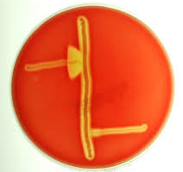
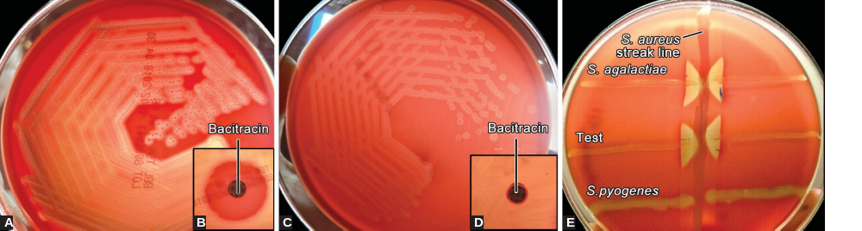
CAMP test positive

Slide 16
Treatment of Group B Streptococcal meningitis
Penicillin for a duration of 14 days.

Slide 17
Listeriosis

Slide 18
Listeriosis
Caused by Listeria monocytogenes.
Food-borne pathogen that can cause serious infections in neonates, pregnant women and elderly people.

Slide 19
Human Infection
Mode of transmission: through contaminated food, vertical transmission.
Age: Extremes of age (neonate and old age)
Use of proton pump inhibitors increases risk
Other risk factors: Pregnant women & immunocompromised individuals

Slide 20
Human Infection
Survive refrigeration (4°C)- Commonly found in stored foods.
Listeriosis is most often sporadic, although outbreaks do occur

Slide 21
Pathogenesis
Intracellular survival: After entry into the intestinal epithelium (with the help of Internalins) – the bacilli survives inside the host cell due to inhibition and lysis of phagosome by forming pores (mediated by listeriolysin O) - host cell actin polymerization - helps the bacterium to reach near the cell membrane.
Migrates to the adjacent epithelial cells/ macrophages by direct cell-to-cell spread - by listeriopods.

Slide 22
Clinical Manifestations
Depends on the age of the patient and other risk factors
Neonatal listeriosis: Early-onset and Late-onset neonatal disease
In pregnant women:
  Fetal complications - abortion, preterm delivery
  Maternal complications - flu-like symptoms, bacteraemia and meningitis

Slide 23
Clinical Manifestations
Adults:
Bacteraemia and meningitis
Risk factors - immunosuppression (steroid therapy, HIV, diabetes, malignancy)
Gastroenteritis following consumption of contaminated milk, meat and salads.

Slide 24
Differences between early- and late-onset neonatal listeriosis
Early onset neonatal disease | Late onset neonatal disease
Occurs <5 days of birth | Occurs >5 days of birth
Acquired from- maternal genital flora | Acquired from- environment
Associated with- Obstetrical complications - premature delivery & low birth weight | Not associated
Most common presentation- neonatal sepsis | Most common presentation - neonatal meningitis
Granulomatosis infantiseptica- miliary micro abscesses and granulomas | Not seen
Mortality rate >30% | Mortality rate <10%
Does not cause nosocomial outbreaks | Nosocomial outbreaks are seen

Slide 25
Laboratory diagnosis of listeriosis
Sample: CSF, BLOOD or Amniotic fluid
Gram stain: Gram positive short cocco-bacilli
Motility: TUMBLING MOTILITY at 25ºC but non motile at 37ºC (called as DIFFERENTIAL MOTILITY). It is due to temperature dependant flagella expression.

Slide 26
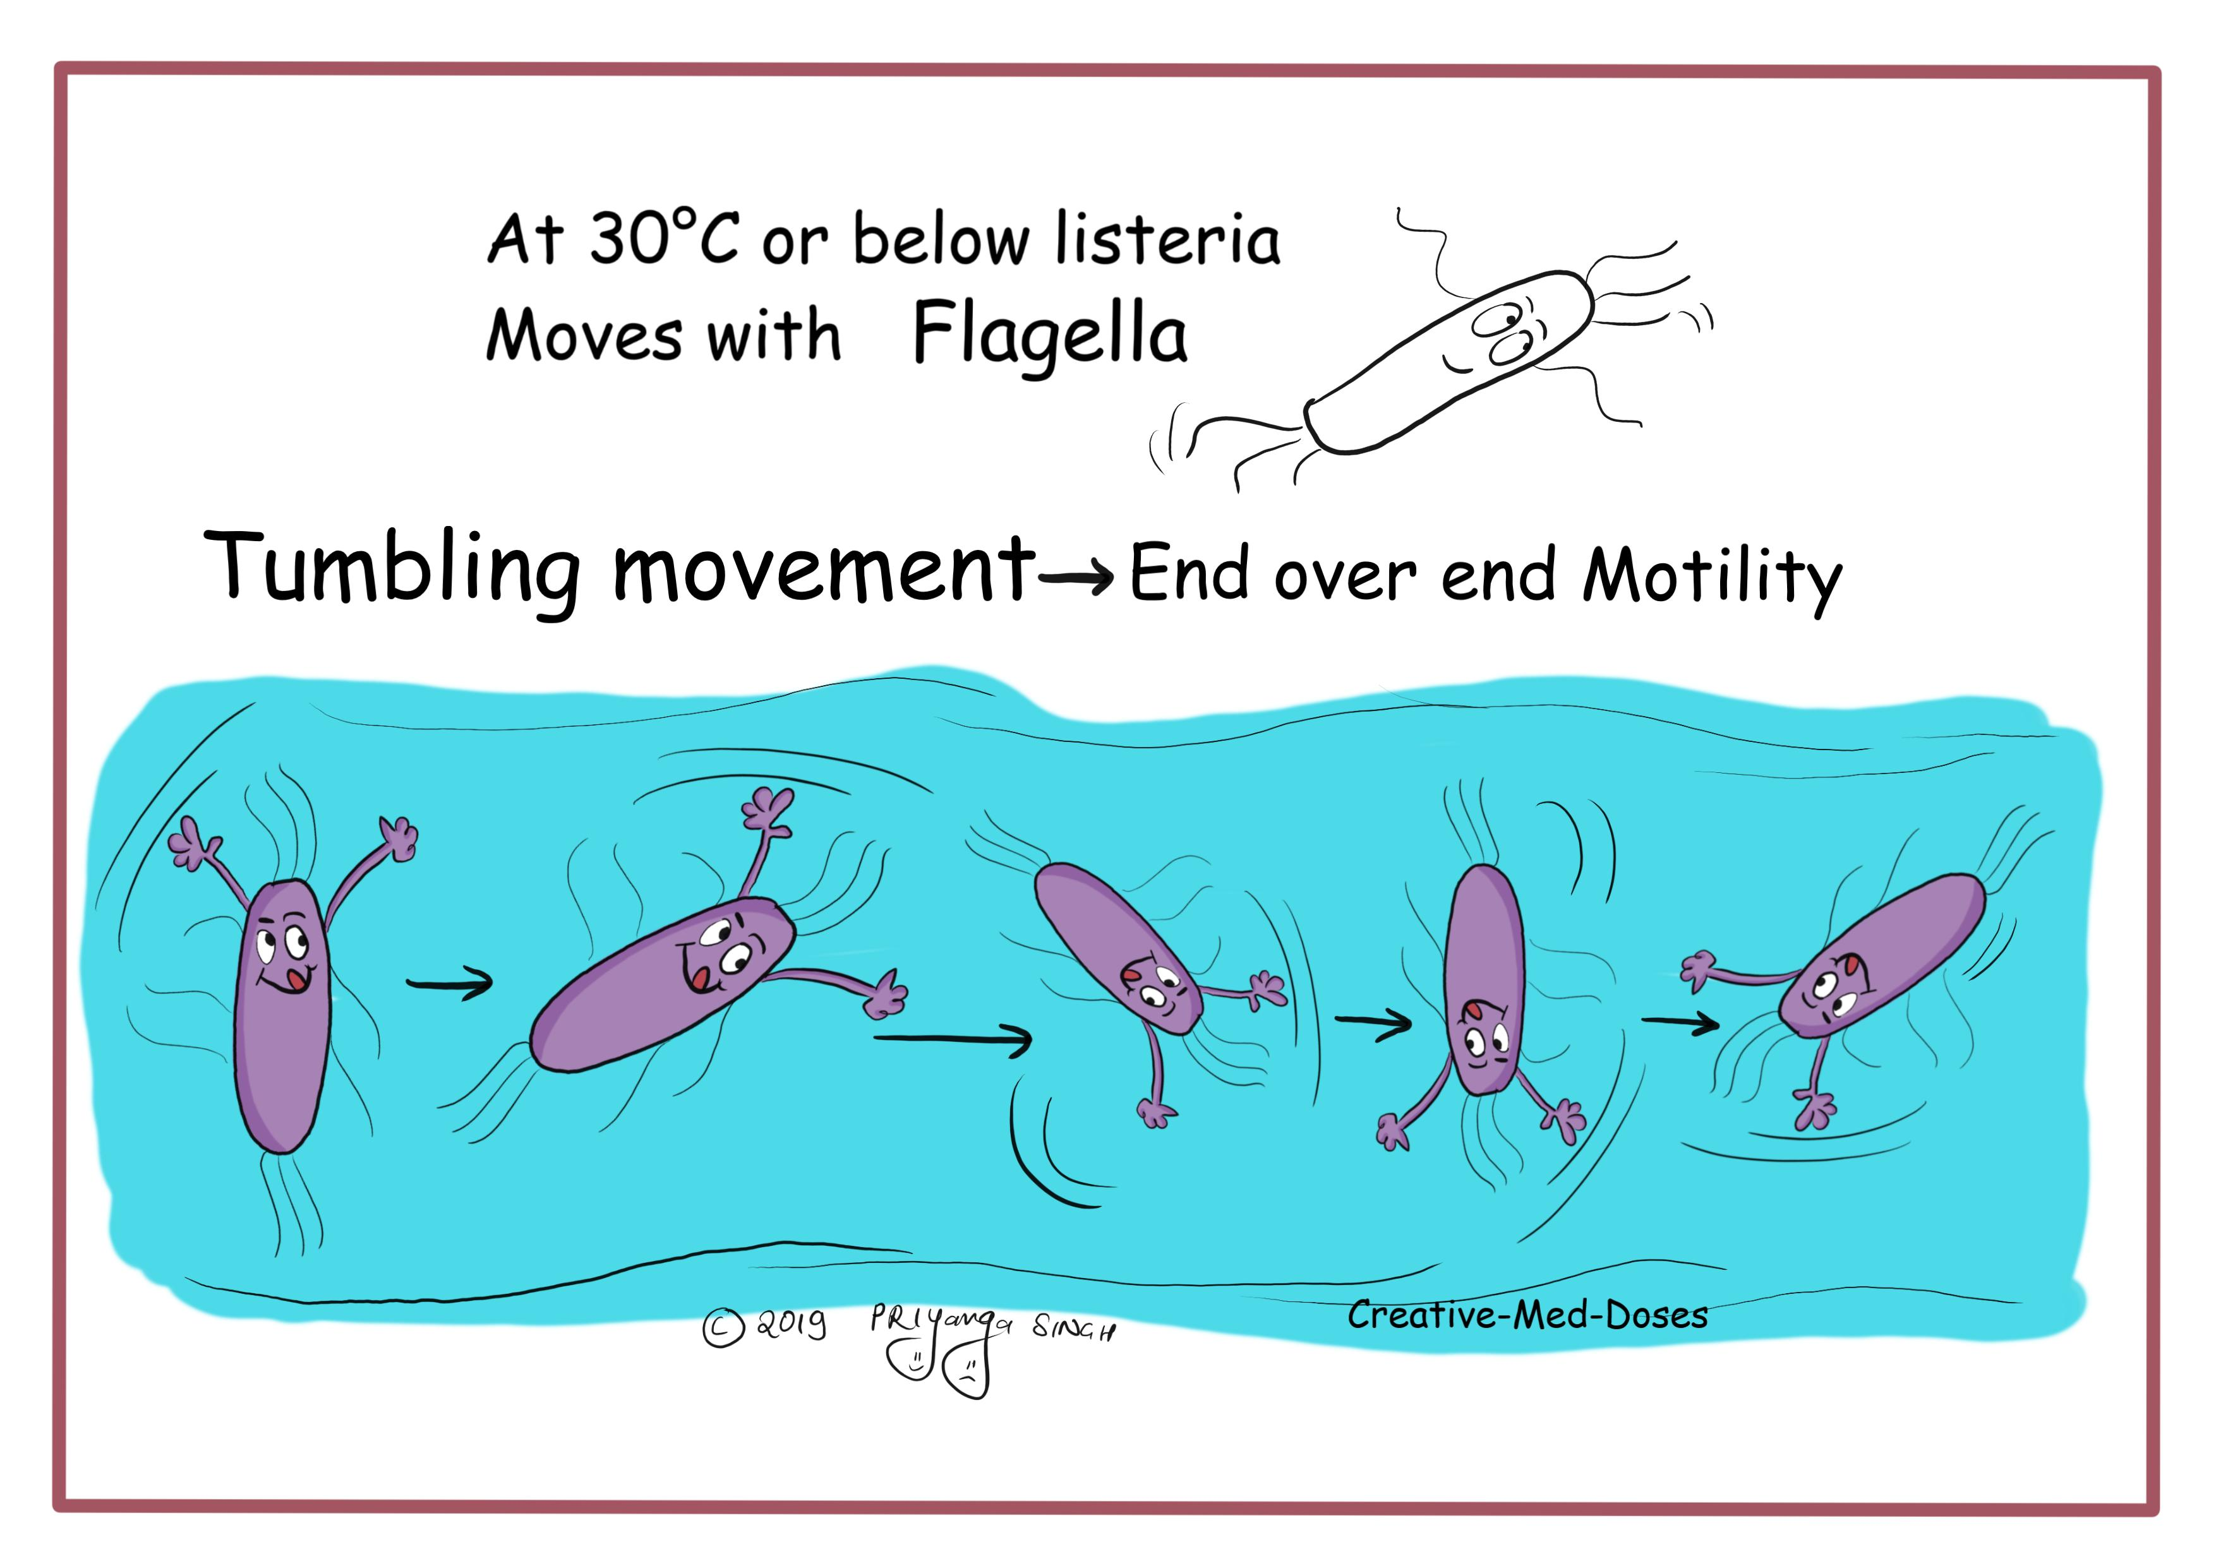

Slide 27
Laboratory diagnosis of listeriosis
Culture: Blood agar- beta hemolytic colonies
Selective media is PALCAM (Polymyxin, acriflavine, Lithium chloride, ceftazidime, aesculin and mannitol) agar
Growth improves on refrigeration at 4ºC (COLD ENRICHMENT) in trypticase soya broth followed by subculture on plates and incubated at 37ºC
Catalase positive and growth well at low pH and 10% salt,

Slide 28
Treatment of Listeriosis
Meningitis: Ampicillin - drug of choice, given for 2–3 weeks in combination with Gentamicin for synergistic effect
Cotrimoxazole is given for patients with penicillin allergy
In febrile gastroenteritis - Amoxicillin is recommended in immunocompromised, elderly or pregnant patients.

Slide 29
Mycobacterium tuberculosis Infections of CNS
Tuberculosis of the CNS - ~5% of extrapulmonary cases.
Presents in two clinical forms:
Tuberculous meningitis
Tuberculoma.

Slide 30
Tuberculous Meningitis (TBM)
TBM results from the hematogenous spread of primary.
Disease evolves within 1–2 weeks of primary infection.

Slide 31
Clinical Features
Headache, slight mental changes, low-grade fever, malaise, night sweat and anorexia
Evolve acutely with severe headache, confusion, lethargy, altered sensorium, and neck rigidity
Cranial nerves paresis (ocular nerves)

Slide 32
Clinical Features
Stroke - due to involvement of cerebral arteritis
Progresses towards coma, with hydrocephalus and intracranial hypertension.

Slide 33
Laboratory Diagnosis
CSF analysis:
High leukocyte count (up to 1,000/μL), mostly lymphocytic.
Neutrophils – elevated in the early stage
Protein content of 100–800 mg/dL
Low glucose concentration.

Slide 34
Laboratory Diagnosis
Cobweb coagulum: When CSF is kept in a tube for 12 hours - coagulum forms in the form of a cobweb due to higher fibrin content in the fluid
Acid-fast staining of CSF: Direct smear of CSF sediment - long slender beaded acid-fast bacilli.

Slide 35
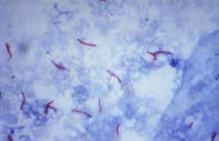
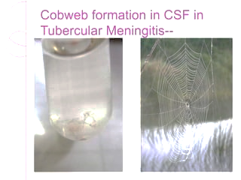

Slide 36
Laboratory Diagnosis
Culture of CSF:
Gold standard test
Lowenstein-Jensen medium by 4–8 weeks
Automated liquid culture by 2-3 weeks
(Mycobacteria Growth Indicator Tube (MGIT))
GeneXpert assay: Automated real-time PCR, sensitivity of up to 80%

Slide 37
Treatment of Tuberculous meningitis
Responds well to anti-tubercular therapy.

Slide 38
Tuberculoma (or Tuberculous Granulomas)
Presents as space-occupying lesions (firm nodule with central caseous necrosis) - causes seizures and focal signs.
CT or MRI - contrast-enhanced ring lesions.
Biopsy is necessary to differentiate it from malignancies.

Slide 39
THANK YOU

