Slide 1
Tuberculosis
Lab diagnosis & treatment

Slide 2
Learning objectives
At the end of the session, the students will be able to:
Discuss lab diagnosis of pulmonary & extra-pulmonary TB
Describe the treatment & drug resistance in TB
Discuss the prophylaxis of TB

Slide 3
Laboratory diagnosis of Tuberculosis
Specimen collection
  Pulmonary TB: Sputum (preferably early morning- 2 specimens; spot & early morning), gastric aspirate (in children)
  In EPTB: Specimens depending on site involved
Digestion, decontamination and concentration of specimen
Modified Petroff’s method (4% NaOH)
NALC (N-acetyl-L-cysteine) + 2% NaOH

Slide 4
Extrapulmonary specimens
Optimum specimens | CSF, pericardial fluid, synovial fluid, ascitic fluid Pleural fluid, blood (indicated only for disseminated TB co- infected with HIV)
Swabs | Laryngeal swabs: Collected early morning in empty stomach or Swab from discharging sinus
Urine | Three early morning specimens collected (500 mL/ specimen, centrifuged) on different days as TB bacilli in urine are shed intermittently
Stool | For disseminated TB in HIV infected patients & infants
Other respiratory specimens | Bronchial secretions (2- 5 mL), Bronchoalveolar lavage (20- 50 mL) Transbronchial biopsies (collected in sterile normal saline)
Gastric lavage | Children or ICU patients

Slide 5
Direct microscopy by acid-fast staining:
  Ziehl- Neelsen (ZN) technique- long, slender, beaded, less uniformly stained red color acid-fast bacilli
  Kinyoun’s cold acid- fast staining
  Fluorescent staining- it is more sensitive, rapid
  Interpretation
Negative result: At least 100 oil immersion fields (OIF) should be examined for 10- 15 min before giving a negative report
Positive result: M. tuberculosis appears as long, slender, beaded, less uniformly stained red colored acid-fast bacilli (AFB)

Slide 6
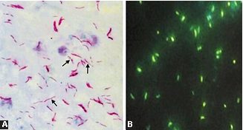
ZN staining of sputum smear showing long, slender beaded red colored acid- fast bacilli
Auramine phenol staining of sputum smear- Tubercle bacilli appear bright brilliant green against the dark background.

Slide 7
RNTCP grading is useful for ZN stained sputum smears:
  Monitoring t/t response of patients
  Assessing severity of disease
  Assessing infectiousness of patient: Higher the grade more is the infectiousness. Smear negative patients (<10,000 bacilli/mL of sputum) are less infectious.
No. of AFB seen | OIF to be screened | Grading | Result
No AFB in 100 OIF | 100 | 0 | Negative
1- 9/ 100 OIF | 100 | Scanty | Positive
10- 99/100 OIF | 100 | 1+ | Positive
1- 10/ OIF | 50 | 2+ | Positive
>10/ OIF | 20 | 3+ | Positive

Slide 8
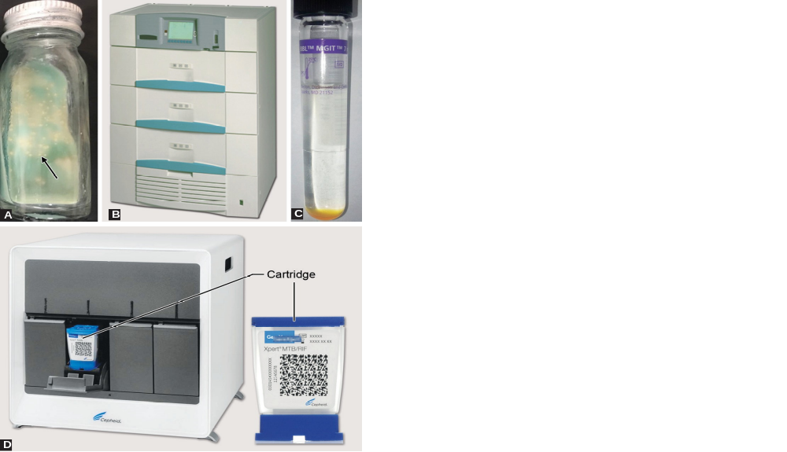
Conventional culture media- take 6- 8 wks
  Lowenstein Jensen (LJ) medium- shows rough, tough, buff colored colonies
More sensitive than microscopy with detection limit of 10- 100 viable bacilli; indicates viability
Automated culture method- take 3- 4 wks
MGIT (Mycobacteria growth indicator tube) system- Detects growth as well as resistance to antitubercular drugs
LJ medium
BACTEC MGIT
MGIT liquid culture medium

Slide 9
Culture identification
  Automated identification- MALDI TOF
  MPT 64 antigen detection- by ICT
Molecular methods- quicker, more sensitive, more useful for extra-pulmonary samples, detect resistance genes, epidemiological typing of strains
  PCR detecting IS6110 gene
  CBNAAT (GeneXpert) & Truenat
  Line probe assay

Slide 10
GeneXpert (CBNAAT)- endorsed by WHO & is used in India under RNTCP; especially for EPTB
Advantages: Rapid, turnaround time (2 hours) 
Principle: real-time PCR technique; simultaneously detects: (i) MTB complex DNA (88% sensitive, 99% specific ) (ii) rifampicin resistance (mutations of the rpoB gene) (95% sensitive, 98% specific)
Detection limit: 131 bacilli/mL of specimen
Disadvantages: (i) Very expensive, (ii) cannot further speciate MTB complex
Next generation GeneXpert (Xpert Ultra)- contains two additional molecular targets to detect TB (IS 6110, IS 1081);
Detection limit of 16 bacilli/mL

Slide 11
Chip Based NAAT (Truenat)- validated by Indian Council of Medical Research (ICMR), in 2017; Developed by Molbio Diagnostics
Advantages: automated battery operated device; can be used at level of primary health center, turnaround time is one hour
Disadvantages: (i) Very expensive (ii) cannot further speciate MTB complex (iii) tests limited samples (1- 4) at a time

Slide 12

Line Probe Assay (LPA)- probe- based detection of amplified DNA; turnaround time of 2- 3 d
Uses: Identification of MTB complex, speciation of MTB complex & NTM, detection of resistance to 1st/2nd line antitubercular drugs (ATDs)
Limitation: LPA is performed only on positive cultures or smear positive clinical specimens
GeneXpert system with cartridge

Slide 13
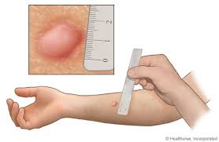
Diagnosis of latent tuberculosis
Tuberculin skin test (Mantoux test)
Antigens used: purified protein derivative for performing TST
Procedure: 0.1 mL of PPD containing 1 TU tuberculin unit is injected i.d into flexor surface of forearm
Reading: read after 48- 72 hr
If width of the induration is ≥ 10 mm: Positive (tuberculin reactors), 6- 9 mm: Equivocal/doubtful reaction, <5 mm: Negative reaction

Slide 14
Interpretation of result:
Adults: Positive TST in adults only indicates present or past exposure with tubercle bacilli but does not confirm presence of active disease
Prevalence of tuberculosis- all tuberculin reactors in a community
Incidence- new converters to TST in a community
Children: a positive test indicates active infection & used as a diagnostic marker
False-positive: BCG vaccination (after 8–14 weeks), Nontuberculous mycobacteria infection
False-negative: early or advanced TB, miliary TB, decreased immunity (HIV-infected people)

Slide 15
Interferon gamma release assay (IGRA) (QuantiFERON-TB Gold assay)
Uses M. tuberculosis antigens (CFP10 (culture filtrate protein) & ESAT6 (early secreted antigenic target 6)
Procedure: Sensitized T lymphocytes collected from suspected individuals, are exposed to ESAT-6/CFP-10 antigens, which lead to release of high level of IFN-γ from the T lymphocytes
Advantage: It is highly specific; there are no false positive results

Slide 16
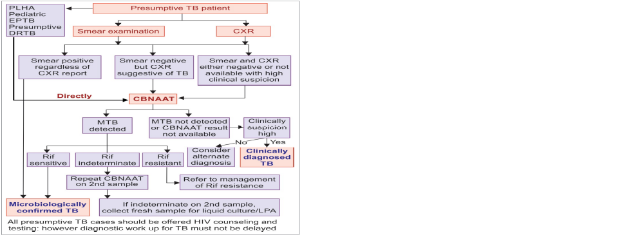
Diagnostic algorithm for PTB
Notes:
Presumptive pulmonary TB refers to a person with any of the following—
(i) cough >2 weeks, (ii) fever >2 weeks, (iii) significant weight loss, (iv) hemoptysis,
(v) any abnormalities in the chest X-ray.

Slide 17
DST (Drug Susceptibility Testing)
Phenotypic Methods
MGIT (1st & 2nd line drugs): Resistance is indicated by growth of TB bacilli in drug containing tube as compared to control tube
Proportion method (1st & 2nd line drugs): Resistance - growth of 1% or more - observed in the drug containing LJ medium compared to the control
LJ medium
Genotypic Methods
GeneXpert
Line probe assay (LPA)
Universal-Drug Susceptibility Testing (U-DST)- testing all TB patients for resistance to at least rifampicin (by CBNAAT)

Slide 18
Anti-tubercular drugs (ATDs)
ATDs for DS-TB | ATDs for DR-TB (Second-line agents)
First-line Agents Isoniazid (H) Rifampicin (R) Pyrazinamide (Z) Ethambutol (E) | Group A: Fluoroquinolones Levofloxacin (Lfx) Moxifloxacin (Mfx) Gatifloxacin (Gfx) | Group D: Add-on agents (not part of the core MDR-TB regimen) Group D1: First-line agents Pyrazinamide (Z) Ethambutol (E) High-dose isoniazid (Hh) Group D2: New agents Bedaquiline (Bdq) Delamanid (Dlm) Group D3: Other agents p-aminosalicylic acid (PAS) Imipenem-cilastatin (Ipm /Cls) Meropenem (Mpm) Amoxicillin-clavulanate (Amx-Clv) Thioacetazone (T)
 | Group B: Second-line injectable agents Amikacin (Am) Capreomycin (Cm) Kanamycin (Km) Streptomycin (S)
 | Group C: Other second-line agents Ethionamide/Prothionamide (Eto/Pto) Cycloserine/Terizidone (Cs/Trd) Linezolid (Lzd) Clofazimine (Cfz)

Slide 19
Multidrug therapy: Combination of drugs
Short course chemotherapy: 6 month
Two phase chemotherapy:
  Intensive phase: Multiple ATDs that rapidly kill bacilli making the smear negative
  Continuation phase: Aims at killing dormant bacilli & prevents relapse
DOTS strategy (Directly Observed Treatment, Short course): Recommend by RNTCP & WHO
  The entire treatment course is supervised to improve patient’s compliance
  Treatment response- monitored by sputum smear microscopy at the end of each phase

Slide 20
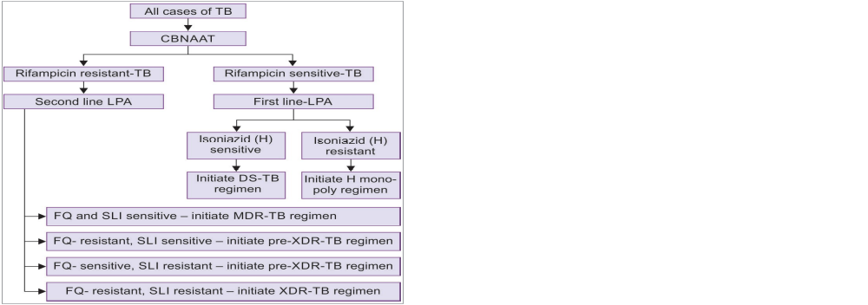
Treatment regimens based on DST

Slide 21
Drug regimens for tuberculosis
Type | Regimen name | Intensive phase | Continuation phase
DS-TB | No resistance | (2) H R E Z | (4) H R E
H mono/poly | H mono/poly DR-TB regimen | (3-6) Lfx Km R E Z | (6) Lfx R E Z
MDR-TB or RR-TB | Shorter MDR-TB regimen4 | (4-6) Mfxh Km Eto Cfz Z Hh E | (5) Mfxh Cfz Z E
 | Conventional MDR-TB regimen5 | (6-9) Lfx Km Eto Cs Z E | (18) Lfx Eto Cs E
Pre-XDR-TB | Regimen for MDR/RR + R/FQ class | (6-9) Km Eto Cs Z Lzd Cfz + (6) Bdq | (18) Eto Cs Lzd Cfz
 | Regimen for MDR/RR+ R/ SLI class | (6-9) Lfx Cm7 Eto Cs Z Lzd Cfz + (6) Bdq | (18) Lfx Eto Cs Lzd
XDR-TB | Regimen for MDR/RR-TB plus R/FQ and SLI | (6-12) Mfxh Cm7 Eto Cs Lzd Cfz Z E | (18) Mfxh Eto Cs Lzd Cfz E

Slide 22
Follow-up of treatment:
  Clinical follow- up: monthly
  Follow-up laboratory investigation: sputum smear done at end of intensive phase & at end of treatment sputum smear + culture done for every patient
  Long term follow-up up to 2 years
  Follow-up for MDR TB: Sputum smear + culture performed every month during intensive phase & every three months during continuation phase

Slide 23
Bedaquiline and delamanid - only two drugs developed specifically for the treatment of TB in the last 40 years.
New second line ATD of diarylquinoline class, approved for use as second line ATD since 2015.
Acts by inhibiting mycobacterial ATP synthase
Strongly mycobactericidal - no cross resistance with other ATDs
Significant benefit in improving the time to culture conversion in MDR-TB patients
Indication: Recommended for MDR-TB or XDR-TB cases - resistant to fluoroquinolones and/or second-line injectable drugs.
Contraindicated in pregnancy and age <18 years
Regimen: Bedaquiline containing regimen should contain four other second-line ATDs depending upon the sensitivity.

Slide 24
Delamanid- Derived from nitroimidazole class.
Mechanism of action: Acts by inhibiting mycolic acid synthesis of bacterial cell wall
Indication: Approved for use in the treatment of DRTB (MDR, XDR or mixed pattern DR-TB) in a combination regimen
Exclusion criteria:
  (i) Children under 6 years,
  (ii) pregnant and breastfeeding women,
  (iii) patients with prolonged QT interval, and
  (iv) if hypersensitivity develops

Slide 25
Resistance due to point mutation to ATDs
Primary/ pre-treatment drug resistance:
  Infection by drug resistant strain
  Not previously been treated
Acquired resistance (secondary/ post-treatment):
  Initially sensitive, becomes resistant later
  Due to inappropriate or inadequate treatment
Drugs | Drug-resistant genes
Isoniazid | inhA, katG, AhpC
Rifampicin | rpoB
Pyrazinamide | pncA
Ethambutol | rpsL
Streptomycin | rpsL, rrs, strA
Fluoroquinolones | gyr A & B

Slide 26
Failure to adhere to the multidrug regimen
Prolonged duration of regimen
Poor compliance of the patient
Development of toxicity to the drugs
Improper supervision and follow-up.

Slide 27
Resistance to Antitubercular Drugs (ATDs)
Mono resistance- resistance to one first-line ATD only
Poly resistance- resistance to >1 first-line ATD other than both isoniazid & rifampicin
Rifampicin resistance (RR)- rifampicin resistance with or without resistance to other ATDs; includes any resistance to rifampicin
MDR TB- Resistance to isoniazid and rifampicin with or without resistance to other first line drugs
Pre-XDR-TB- resistance to either fluoroquinolones (FQs) or second line injectable (SLI) agents, but not both
XDR- TB- MDR-TB cases which are also resistant to FQs and at least one second-line injectable agents

Slide 28
In 2018, 3.4% of new and 18% of previously treated cases are MDR/RR-TB
In 2018, MDR-TB rate in India was 6.19% in all TB patients.

Slide 29
Treatment of MDR-TB: Intensive phase of 4–9 months with 6–7 second-line
agents, followed by continuation phase of 5–18 months with 4 second-line agents.
DOTS-Plus program - initiated by RNTCP in the year 2000 - cover the diagnosis and treatment of MDR-TB cases.

Slide 30
XDR- TB- MDR-TB cases which are also resistant to FQs At least one second-line injectable agents (amikacin/ capreomycin/kanamycin). Epidemiology: In India (2018), XDR-TB accounted for 1.3% in all MDR-TB patients (2.3% in new and 0.91% in previously treated patients)

Slide 31
In 2018 (India), among MDR-TB cases, 21.8% were resistant to any FQs and 3.6% were resistant to any SLI agent.

Slide 32
Vaccine Prophylaxis Against Tuberculosis -
Bacillus Calmette- Guérin Vaccine (BCG)
BCG strain (Danish 1331 strain)
Reconstitution of BCG: Available in lyophilized form, reconstituted before administration
Administration of BCG: 0.1 mL (0.1 mg TU) of BCG vaccine given above insertion of left deltoid by i.d routeEfficacy: about 80%
Duration of immunity- 15- 20 yrs
Protection to infants & young children against EPTB

Slide 33
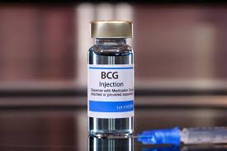
Complications- ulceration at vaccination site & regional lymphadenitis, keloid, osteomyelitis, progressive tuberculosis & disseminated BCG infection
Contraindications to BCG include:
HIV-positive child
Child born to AFB positive mother
Child with low immunity
Generalized eczema
Pregnancy

Slide 34
Chemoprophylaxis
T/t of selected high- risk tuberculin reactors (latent tuberculosis) aims at preventing active disease
Isoniazid or ethambutol for six months
Chemoprophylaxis has several shortcomings such as—
(1) it is expensive, (2) risk of developing tuberculosis is minimal in tuberculin reactors, and (3) side effects of the drugs. INH preventive therapy (IPT) - restricted to limited indications:
  Adults with HIV - unlikely to have active TB
  Children with HIV - no TB symptoms and unlikely to have active TB
  All children with HIV - successfully completed treatment for TB.

Slide 35
Nontuberculous mycobacteria infections
Diverse group of saprophytic mycobacteria isolated from birds, animals, environmental sources
Opportunistic pathogens, occasionally associated with human infection
Man-to-man transmission is not known
Runyon group | Property | Species
I. Photochromogens | Produce pigments only in light | M. marinum, M. asiaticum, M. simiae, M. kansasii, M. genavense
II. Scotochromogens | Produce pigments both in dark and light | M. scrofulaceum, M. szulgai, M. gordonae M. celatum, M. flavescens
III. Non-photochro- mogens | Do not produce pigments | M. avium-intracellulare complex (MAC), M. xenopi, M. ulcerans, M. paratuberculosis, M. malmoense
IV. Rapid growers | Grow within one week | M chelonae, M fortuitum, M. smegmatis, M. Abscessus

Slide 36
1. Photochromogens
M. marinum:
  Acquired from water sources (fish tanks, swimming) and enters through minor trauma
  Causes papules or ulcers known as swimming pool granuloma or fish tank granuloma.
M. asiaticum:
  Rarely associated with pulmonary disease and bursitis
M. simiae: Isolated from pulmonary lesions
M. kansasii: Causes chronic pulmonary disease resembling tuberculosis
M. genavense: Causes infection in patients with advanced HIV.

Slide 37
2. Scotochromogens
M. scrofulaceum: Causes scrofula (cervical lymphadenitis) in children
M. gordonae: Commensal in tap water - common contaminant of clinical specimens - rarely isolated from pulmonary specimens.
M. szulgai: Scotochromogen at 37°C and photochromogen at 25°C - occasionally cause pulmonary disease and bursitis
M. celatum: Rare cause of pulmonary infection.

Slide 38
3. Nonphotochromogens
M. avium-intracellulare complex (MAC):
  M. avium (Battey bacillus, isolated from birds) and M. intracelluare
  Opportunistic pathogens – HIV low CD4 T-cell count (<50/μL)
Lymphadenitis, respiratory infection and disseminated diseaseM. xenopi:
  Hospital water supplies, and associated with nosocomial outbreaks
  Rarely pulmonary disease in HIV-infected people.
M. ulcerans:
  Buruli ulcer - painless ulcers and nodules - necrotic later
  Osteomyelitis and limb deformities

Slide 39
4. Rapid Growers
M. fortuitum and M. chelonae: post-trauma injection abscess and catheter-related infections
M. abscessus: pulmonary infection

Slide 40
Clinical manifestations of nontuberculous mycobacteria (NTM)
Disease | Organisms
Pulmonary infection | M. avium-intracellulare (MAC), M. kansasii, M. xenopi, M. malmoense, M. szulgai, M. abscessus
Lymph node infection | M. avium-intracellulare (MAC) M. scrofulaceum—causes scrofula M. malmoense
Cutaneous infection | M. marinum—causes swimming pool or fish tank granuloma M. ulcerans—causes Buruli ulcer M. abscessus M. fortuitum and M. chelonae—cause injection abscess M. avium-intracellulare (MAC)
Disseminated infection | M. avium-intracellulare (MAC) M. kansasii

Slide 41
Laboratory Diagnosis
Specimens: Sputum, lymph node aspirate, pus or exudate, biopsy from skin lesions are the usual specimens - depending on type of infection
Microscopy by ZN staining: Shows red acid-fast bacilli
Culture on LJ media: Several species of NTM grow well on LJ medium.
Pigment production: LJ media - incubated in dark and light separately for distinguishing - photochromogens and scotochromogens
Identification:
  Negative for MPT64 antigen by ICT: differentiating it from M. tuberculosis.
  Newer methods: MALDI-TOF and PCR

Slide 42
Treatment of Nontuberculous mycobacteria infections
M. avium-intracellulare complex (MAC), M. kansasii and M. marinum infections - multidrug therapy with macrolide (clarithromycin or azithromycin), ethambutol, and a rifamycin (rifampin or rifabutin)
NTM - resistant to most of the first and second-line antitubercular drugs.

