Slide 1
Pseudomonas and other non-fermenters

Slide 2
Learning objectives
At the end of the session, the students will be able to understand:
Virulence factors, pathogenesis, clinical manifestations, lab diagnosis, treatment of infections by non fermenting GNB like Pseudomonas, Burkholderia, Acinetobacter

Slide 3
Introduction
Non-fermenting GNB do not ferment any sugars, utilize sugars oxidatively
Environmental commensals in hospitals that inhabit in moist environments, detergents, IV fluids
Resistant to multiple antibiotics

Slide 4
Include:
Pseudomonas aeruginosa
Burkholderia cepacia
Acinetobacter baumannii
Stenotrophomonas maltophilia
Elizabethkingia meningosepticum

Slide 5
Pseudomonas
General features
Oxidase positive, pigment producing, non-fermenting, gram-negative bacilli
Actively motile with single polar flagellum
Major pathogen among hospitalized patients, patients with cystic fibrosis

Slide 6
Species
Exposure to contaminated medical devices/ solutions; penetrating wounds; ingestion of contaminated food or water
Pseudomonas aeruginosa
P. fluorescens
P. putida
P. stutzeri
P. alcaligenes
P. pseudoalcaligenes
Exposure to contaminated medical devices/ solutions
Rarely encountered in clinical specimens

Slide 7
Virulence factors
Colonization (pili, single polar flagellum)
Toxin-mediated immune evasion & tissue injury:
  Non diffusible toxins (e.g. exotoxins S, U, T, Y)
  Diffusible toxins (e.g. exotoxin A, proteases, phospholipases, hemolysins, elastases, pyocyanin)
  Exotoxin A
Host's inflammatory response (via TLR4, 5)

Slide 8
Pigment production
Alginate coat (slime layer- biofilm- adhesion)
Capsule
Multidrug and multi-disinfectant resistance
Biofilm formation
Wide temperature range (5- 45C)

Slide 9
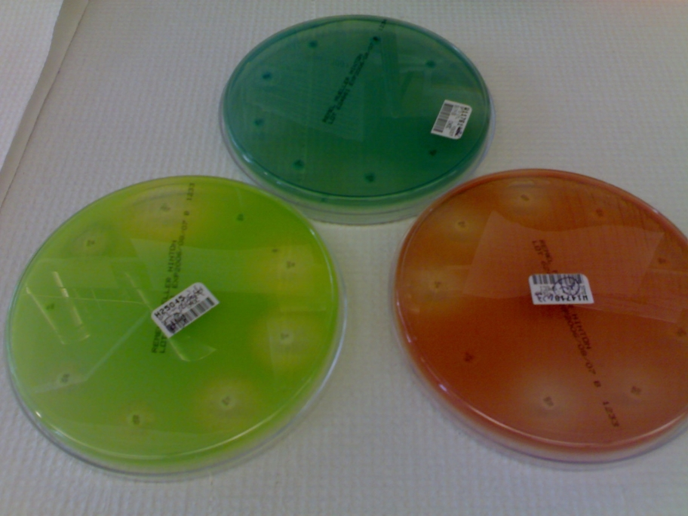
Pigment production
Pyocyanin: It is a blue green pigment, produced only by P.aeruginosa
Fluorescein (pyoverdin): it gives greenish yellow colour, to the colony produced by most of the species
Pyorubin (imparts red colour)
Pyomelanin (impart brown black colour)
Notes:
Pigment production can be enhanced in special media such as King's media.

Slide 10
CLINICAL MANIFESTATIONS- mc opportunistic pathogen
Healthcare-associated infections:
  ventilator associated pneumonia (VAP)
  central-line associated bloodstream infection (CLABSI)
  catheter-associated urinary tract infection (CAUTI)
  surgical site infection (SSI)
Chronic respiratory tract infections
Bacteremia leading to sepsis and septic shock
Infective endocarditis (native valves) - IV drug abusers
Ear infections - Swimmer's ear among children/ malignant otitis externa in elderly diabetic patients

Slide 11
Eye infections- corneal ulcers (in contact lens wearers) & endophthalmitis secondary to bacteremia
Shanghai fever - Mild febrile illness resembling typhoid fever
Skin and soft tissue infections- burns wound infection, ecthyma gangrenosum, green nail syndrome & cellulitis with blue-green pus
Other infections
  Osteomyelitis, septic arthritis
  Meningitis (in postoperative or post-traumatic patients)

Slide 12
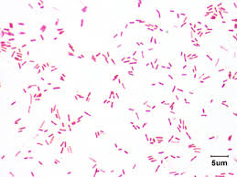
Lab diagnosis
Sample collection: Pus, wound swab, urine, blood, CSF, sputum depending on site of infection
Direct smear: slender GNB (1.5- 3 x 0.5 μm), occasionally capsulated

Slide 13
Culture: non-fastidious, obligate aerobe
Peptone water: uniform turbidity with surface pellicle
Nutrient agar:
  Large, opaque, irregular colonies with metallic sheen (Iridescence)
  Characteristic sweet ether/ alcohol-like fruity odour
  Pigments: pyocyanin, pyoverdin
Blood agar: beta hemolytic colonies (hemodigestion)
MacConkey agar: pale non-lactose fermenting colonies
Selective media- cetrimide agar to isolate organism from mixed growth in purulent specimens

Slide 14
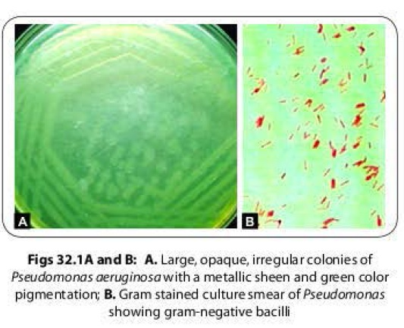
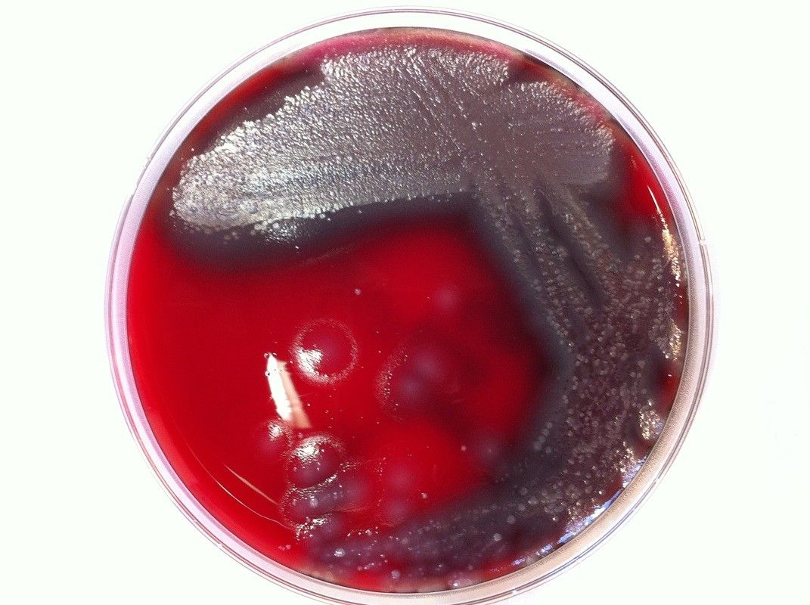
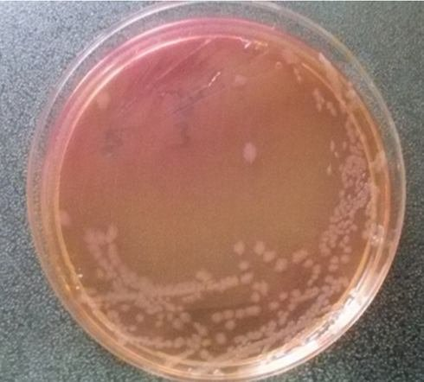
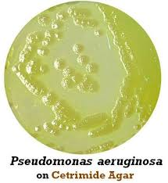

Slide 15
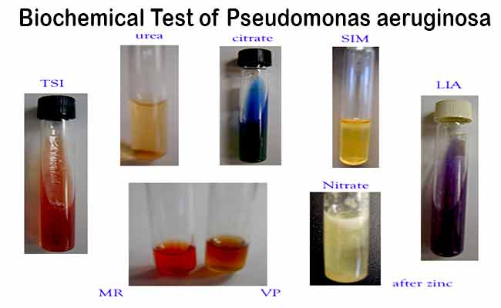
Biochemical Identification:
Catalase, oxidase positive
lndole(-), Citrate (+), Urease(-), TSl: K/K, gas(-),H₂S(-)
O/F test shows oxidative pattern (non-fermenter)

Slide 16
Typing Methods:
To find out relatedness between isolates; useful during outbreaks, to trace source of infection
  Bacteriocin (pyocin) typing (P. aeruginosa produces three types of bacteriocins (or pyocins) R, F and S)
  Antibiogram typing
  Serotyping (O and H antigen)
  Molecular methods (PFGE)

Slide 17
Treatment
Pseudomonas species are inherently resistant to most antibiotics
Only limited antimicrobial agents have antipseudomonal action, such as:
  Penicillins: Piperacillin, mezlocillin, ticarcillin
  Cephalosporins: Ceftazidime, cefoperazone, cefepime
  β-lactam/β-lactamase inhibitor combinations (piperacillin-tazobactam and cefoperazone-sulbactam)
  Carbapenems: lmipenem, meropenem
  Monobactam: Aztreonam
  Aminoglycosides: Tobramycin, gentamicin, amikacin
  Quinolones: Ciprofloxacin, levofloxacin
  Polymyxins: Polymyxin B, colistin

Slide 18
Drug resistance
Pseudomonas possesses various drug resistance plasmids which confer resistance to several antibiotics
Produce β lactamases, such as ESBL (extended spectrum β lactamases), carbapenemases, AmpC β lactamases
Many strains are resistant to aminoglycosides and quinolones
Intrinsically resistant to ceftriaxone, amoxicillin-clavulanate, ampicillin-sulbactam, ertapenem, tetracyclines, tigecycline, cotrimoxazole and chloramphenicol

Slide 19
Burkholderia
Oxidase positive non-fermenters similar to Pseudomonas
Differ by :
  Bipolar stain due to accumulation of poly b hydroxybutarate
  Resistant to polymyxin B
  Multitrichous flagella

Slide 20
Species:
Burkholderia pseudomallei- Southeast Asia, northern Australia, in India, reported from Tamil Nadu, Maharashtra, Orissa, West Bengal, Pondicherry Kerala
Burkholderia mallei: Africa, Asia, South America
Burkholderia cepacia- contaminate antiseptic solutions (chlorhexidine, cetrimide) causing outbreaks in hospitals
Respiratory equipment/ fluids/ iv lines
Resistant to most antimicrobials

Slide 21
Species | Habitat (reservoir) | Mode of transmission
B. cepacia | Environment (soil, water, plants) hospital environment, may colonize CF patients respiratory tract, not part of flora | Exposure to medical devices, solutions, person to person
B. pseudomallei | Environment (soil, surface water, rice paddies) not part of human flora | Inhalation, direct inoculation through disrupted epithelial, mucosal surfaces
B. mallei | Causes glanders in horses, mules, donkeys, not part of normal flora | Transmission to humans is rare, associated with close animal contact

Slide 22
Clinical manifestations
Burkholderia pseudomallei
Agent of bioterrorism
Causative agent of melioidosis (Vietnam time-bomb disease d/t long IP)
Pulmonary infection, skin ulceration, lymphadenopathy (‘great mimicker’)
Burkholderia mallei
Glanders (nasal discharge, ulcers in nasal septum)
Burkholderia cepacia
Most common
Cepacia syndrome: characterized by rapidly fatal respiratory infection, septicemia in patients with cystic fibrosis
Nosocomial pathogen
Farcy (skin lesions, lymph node involvement)

Slide 23
B. mallei & Bacillus anthracis were released by the Germans during the First World War to infect shipments of horses, mules, cattle, sheep to the Allies
Category B pathogens by NIH and CDC

Slide 24
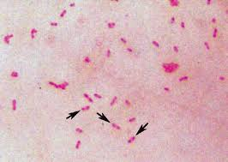
Lab diagnosis- containment level 3 required
Specimen: sputum, purulent discharge from lesion
Direct microscopy: GNB, bipolar or safety pin appearance when stained with methylene blue (Wayson Stain)

Slide 25
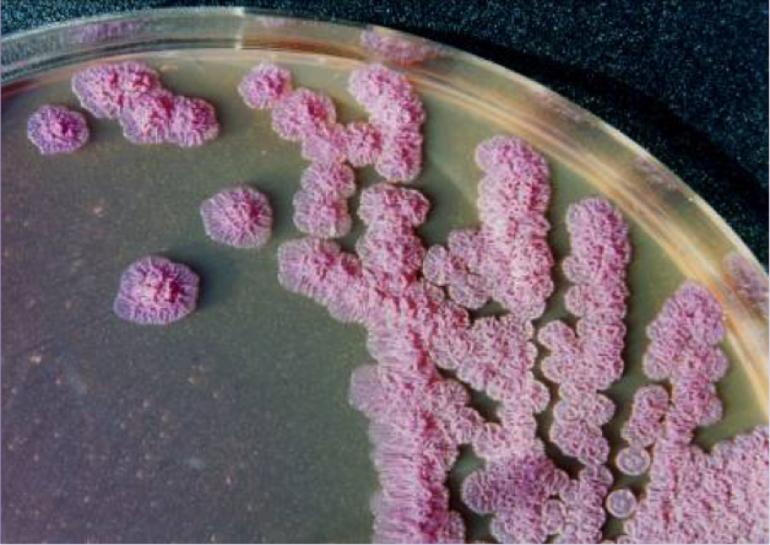
Culture: obligate aerobe
- Nutrient agar opaque, grayish-white, at first yellowish later reddish-purple color, colonies are rough, corrugated
- Ashdown's medium- selective medium, produces wrinkled purple colonies- B. pseudomallei

Slide 26
Identification- biochemical tests/ VITEK
B. mallei- non-motile & oxidase negative
B. pseudomallei- motile & oxidase positive
Latex agglutinaltion test- using specific antisera

Slide 27
Treatment
For B. pseudomallei & B. mallei: along with aggressive supportive treatment
  Intensive phase (2 weeks): Ceftazidime/ carbapenem
  Maintenance phase (12 weeks): Oral cotrimoxazole Doxycycline or Amoxy-clav are alternatives
** B. pseudomallei is intrinsically resistant to penicillin, 1st and 2nd generation cephalosporins, macrolides, rifamycin, colistin and aminoglycosides
PEP: Following exposure, combined treatment with cotrimoxazole + doxycycline recommended

Slide 28
For B.cepacia:
  Cotrimoxazole, meropenem & doxycycline
  Levofloxacin, Ceftazidime-avibactam, ceftolozane-tazobactam-alternate treatment
  Intrinsically resistant to ampicillin, amoxicillin, ampicillin-sulbactam, amoxicillin-clavulanate, ertapenem, polymyxins & fosfomycin

Slide 29
Acinetobacter
Saprophytic bacilli, present in environment (soil, water phytosphere)
Nosocomial pathogen
Species | Habitat (reservoir) | Mode of transmission
Acinetobacter spp. | Environment, hospitals, may become part of skin, respiratory flora | Colonization from environment in hospitals, medical devices/fluids

Slide 30
Species
  A. baumannii : most pathogenic species
  A. calcoaceticus :soil saprophyte
  A. lwoffii: commensal
Gram-negative, 1- 1.5 X 1.5- 2.5um
Catalase- positive, oxidase- negative
Commensals in axillae, groin, digit webs, of about 25 percent of the population
In hospital it colonizes irrigating fluid, iv solutions

Slide 31
Pathogenesis
Multidrug resistance
Various virulence factors
  Outer membrane protein A (OmpA): mediates adhesion, invasion and cytotoxicity through mitochondrial damage.
  LPS: induces inflammatory responses that leads to tissue injury
  Ability to form biofilm
  Siderophores (help in iron acquisition)

Slide 32
Increased risk for acquiring
Prior antibiotic exposure
ICU admission
Central line
Mechanical ventilation
Hemodialysis

Slide 33
Clinical manifestations
Hospital acquired infections
ICUs harbour carbapenem resistant Acinetobacter spp
Infection in organ transplant, febrile neutropenia
Ventilator associated pneumonia
Central line associated bloodstream infection
Post-neurosurgical meningitis
Catheter- associated UTI
Wound and soft tissue infections
Infections in burn patients

Slide 34
Lab diagnosis
Obligate aerobe, grows well on ordinary media
Specimens: depending on site of infection
Culture:
Blood agar (non-hemolytic colonies). 1–2 mm domed, smooth, opaque
MacConkey agar (lactose non-fermenting pale colonies)
Gram staining: Gram-negative coccobacilli, arranged singly or in pair, or chain

Slide 35
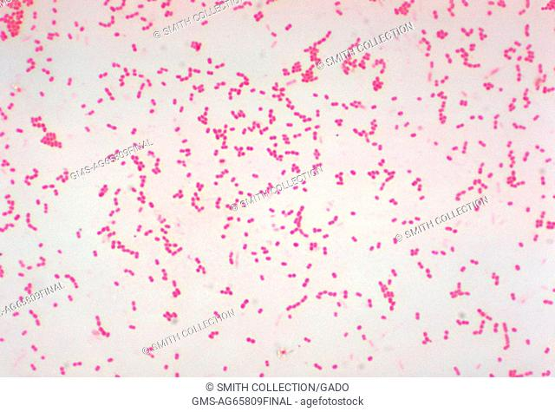
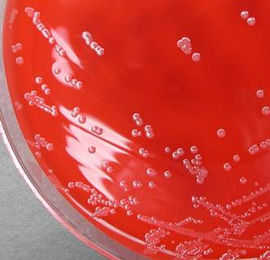
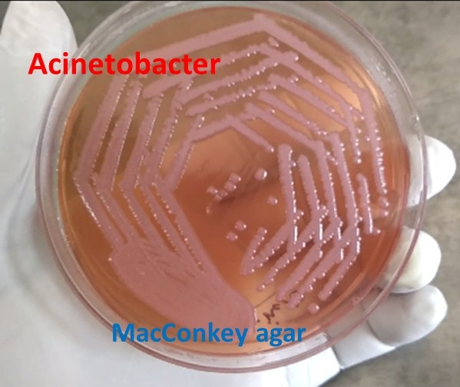

Slide 36
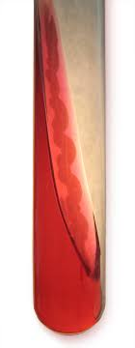
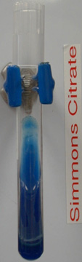
Oxidase negative and catalase positive
Non-motile
TSI: shows K/K with no gas and no H₂S
Negative for indole and urease test, nitrate reduction
TSI

Slide 37
Treatment
Β-lactam resistance due to production of β-lactamases such as metallo β -lactamases (MBL), AmpC β -lactamases and OXA type β lactamases
Choice of antibiotics should always be based on susceptibility reports
Common antibiotics indicated- β-lactam/ β-lactamase inhibitor combination (eg:- piperacillin-tazobactam, amikacin, tigecycline and colistin)

Slide 38
Prevention
Nosocomial pathogens have reservoirs In animate environment
Infection control measures
adherence to hand-hygiene recommendations are often <50%
improved hand hygiene
Cleaning, disinfection policies
Antimicrobial stewardship
Standard precautions
Intensive education
“bundling” of evidence-based interventions, use of checklists

Slide 39
Example of Evidence-Based “Bundled Interventions” to Prevent Health Care–Associated Infections
Prevention of UTI
Place bladder catheters only when absolutely needed (e.g., to relieve obstruction), not solely for provider’s convenience
Use aseptic technique for catheter insertion
Minimize manipulation or opening of drainage systems
Ask daily: Is the bladder catheter needed? Remove catheter if not needed

Slide 40
MCQs

Slide 41
1) Which of the following are not the general characteristics of Pseudomonas spp?
a) Rod-shaped, Gram negative
b) Motile
c) Found in soil and water and plants
d) Use sugars by fermentation
Key: d

Slide 42
2) P. aeruginosa is responsible for common nosocomial infections primarily seen in immunocompromised patients. Which of the following is /are various means by which bacteria can transfer and cause infection to the susceptible patient?
a) Surgical procedures, burns
b) Contaminated ventilators
c) Air droplets
d) All of the above
Key: d

Slide 43
3) P. aeruginosa is becoming more resistant to antibiotics over the years, select the important drugs used in the treatment of urinary tract infections caused by the bacteria
a) Azithromycin
b) Norfloxacin
c) Cephalosporin
d) Acetaminophen
Key:b,c

Slide 44
4) Acinetobacter baumannii is most commonly found in.......................
a) Chicken
b) Soil
c) Mice
d) Bats
Key:b

Slide 45
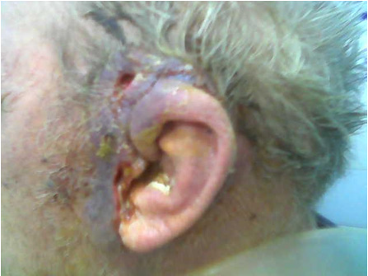
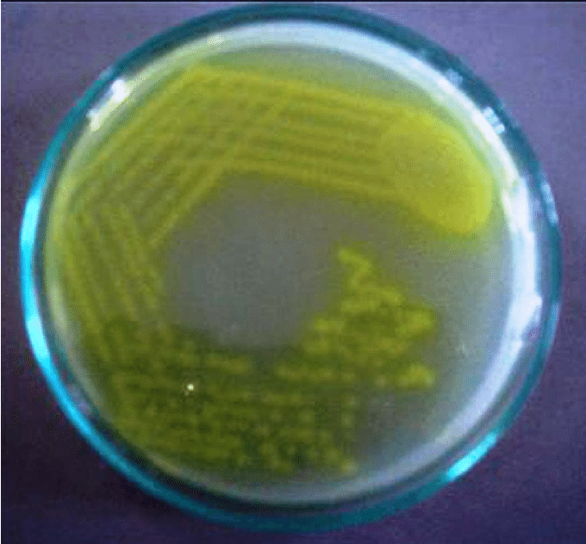
5) 85 y/M diabetic & hypertensive, was admitted with complaints of severe pain in left ear with greenish discharge since 3 weeks after trauma to ear canal. On examination, pt was febrile, confused. On bacterial pus culture showed following colony. Identify the organism
Staphylococcus aureus
Streptococcus pyogenes
Pseudomonas aeruginosa
Klebsiella pneumoniae
Key: c

Slide 46
6) Which of the following show bipolar staining on Gram stain?
Burkholderia mallei
Staphylococcus aureus
E. coli
Chlamydia trachomatis
Key: a

Slide 47
7) Vietnam time bomb disease is also known as
Glanders
Meliodosis
Shanghai fever
Infectious mononucleosis
Key: b

Slide 48
8) Which of the following is a category B pathogen according to CDC?
Bacillus anthracis
Francisella tularensis
Nipah virus
Burkholderia pseudomallei
Key: d

Slide 49
9) A person with which of the following is at risk of developing an Acinetobacter baumannii infection?
Chronic lung disease
Diabetes
Long-term antibiotics use
All of the above
Key: d

Slide 50
10) Hospital acquired infections can be prevented by which of the following?
By observing hand hygiene
By aggressive monitoring of environment reservoirs
By following care bundles in ICUs
All of the above
Key: d

