Slide 1
General parasitology & overview of parasitic infections

Slide 2
Learning objectives
Classify parasitic infections
Discuss life cycle of parasites
Describe laboratory diagnosis & treatment of parasitic infections

Slide 3
Parasite lives in or upon another organism (host)
Derives nutrients directly from it, w/o giving any benefit to host
Ectoparasites:
Inhabit surface of body of host w/o penetrating into tissues; infestation (eg. fleas /ticks)
Vectors transmitting pathogenic microbes
Endoparasites:
Live within body of host; infection (eg. Leishmania)

Slide 4
I. Protozoan infections
Unicellular, possess cellular organelles & metabolic pathways similar to eukaryotes
Only few are considered as human pathogens

Slide 5
Medically important protozoans
Amoeba Entamoeba histolytica Free-living amoebae: Naegleria, Acanthamoeba, Balamuthia
Flagellates Intestinal Flagellate: Giardia Genital Flagellate: Trichomonas Hemoflagellates: Leishmania & Trypanosoma
Apicomplexa Malaria parasites & Babesia Opportunistic coccidian parasites: Toxoplasma, Cryptosporidium, Cyclospora, Cystoisospora, Sarcocystis
Miscellaneous Protozoa: Balantidium coli, Blastocystis, Microsporidia

Slide 6
II. Helminths
Elongated flat/ round worm- like parasites measuring few mm to meters
Eukaryotic multicellular & bilaterally symmetrical
Two phyla;
Platyhelminths (flat worms)- cestodes (tapeworms) & trematodes (flukes)
Nemathelminths- intestinal & tissues nematodes
Three morphological forms: adult, larvae, eggs

Slide 7
Medically important helminths
Cestodes Diphyllobothrium, Taenia, Echinococcus, Hymenolepis
Trematodes or Flukes Schistosoma, Fasciola, Clonorchis, Opisthorchis, Fasciolopsis, Paragonimus
Intestinal Nematodes Trichuris, Enterobius, Hookworm, Strongyloides, Ascaris
Somatic Nematodes Filarial nematodes, Dracunculus, Trichinella

Slide 8
Differences between cestodes, trematodes, nematodes
Properties | Cestodes | Trematodes | Nematodes
Shape | Tape-like, segmented | Leaf-like, unsegmented | Elongated, cylindrical, unsegmented
Head end | Suckers present, some have attached hooklets | Suckers present. No hooklets | No sucker, no hooklets. Some have well developed buccal capsule
Alimentary canal | Absent | Present but incomplete | Complete from mouth to anus
Body cavity | Absent | Absent | Present
Sexes | Monoecious | Monoecious (except schistosomes) | Diecious

Slide 9
Classification of helminths based on habitat
Cestodes | Trematodes | Nematodes
Intestinal cestodes Diphyllobothrium Taenia solium, T. saginata Hymenolepis nana Dipylidium caninum | Blood flukes Schistosoma haematobium S. mansoni S. japonicum | Intestinal nematodes Trichuris trichiura Enterobius vermicularis Necator/ Ancylostoma Ascaris lumbricoides Strongyloides
 | Hepatic flukes Fasciola hepatica Clonorchis sinensis Opisthorchis

Slide 10
Cestodes | Trematodes | Nematodes
Somatic/tissue cestodes Taenia solium T. multiceps Echinococcus | Intestinal flukes Fasciolopsis buski | Filarial nematodes Wuchereria bancrofti Brugia malayi Loa loa Onchocerca Mansonella sp. Trichinella Dracunculus
 | Lung flukes Paragonimus westermani

Slide 11
Life cycle of parasites
Depends up on 3 factors: host, mode of transmission & infective form
Host: Organism harboring the parasite
Definitive host: parasite undergoes sexual cycle
Intermediate host: parasite undergoes asexual cycle
Direct/simple life cycle- parasite requires only one host to complete its development
Indirect/complex life cycle- parasite requires two/ three hosts (one definitive host, another one/ two intermediate hosts) to complete its development

Slide 12
Infective form: Morphological form of parasite which is transmitted to man
Autoinfection:
Few intestinal parasites may infect the same person by contaminated hand (external autoinfection) or by reverse peristalsis (internal autoinfection)
Eg. Cryptosporidium parvum, Taenia solium, Enterobius vermicularis, Strongyloides stercoralis & Hymenolepis nana

Slide 13
Protozoa | Host |  | Mode of transmission | Infective form
 | Definitive | Intermediate
Entamoeba & Giardia | Man | - | Ingestion | Cyst (quadrinucleated)
Trichomonas vaginalis | Man | - | Sexual | Trophozoites
Leishmania species | Man | Sandfly | Vector-borne | Promastigotes
Trypanosoma cruzi | Man | Reduviid bugs | Vector-borne | Trypomastigotes
Trypanosoma brucei | Man | Tsetse fly | Vector-borne | Trypomastigotes
Plasmodium spp | Anopheles | Man | Vector-borne | Sporozoites

Slide 14
Protozoa | Host |  | Mode of transmission | Infective form
 | Definitive | Intermediate
Toxoplasma gondii | Cat | - | Ingestion, blood transfusion, vertical | Tissue cysts, oocysts, tachyzoites
Cryptosporidium | Man | - | Ingestion, autoinfection | Oocysts (sporulated)
Cyclospora, Cystoisospora | Man | Sandfly | Ingestion | Oocysts (sporulated)

Slide 15
Cestodes | Host |  | Mode of transmission | Infective form
 | Definitive | Intermediate
Taenia solium (intestinal taeniasis) | Man | Pig | Ingestion | Cysticercus larvae
Taenia solium (cysticercosis) | Man | Man | Ingestion, auto-infection | Embryonated eggs
Taenia saginata | Man | Cattle | Ingestion | Cysticercus larvae
Echinococcus granulosus | Dog | Man | Ingestion | Embryonated eggs
Hymenolepis nana | Man | - | Ingestion, auto-infection | Embryonated eggs
Diphyllobothrium latum | Man | 1st- Cyclops, 2nd- Fish | Ingestion | Plerocercoid larvae

Slide 16
Trematodes | Host |  | Mode of transmission | Infective form
 | Definitive | Intermediate
Schistosoma species | Man | Snail | Skin penetration | Cercaria larvae
Fasciola hepatica Fasciolopsis buski | Man | 1st- Snail 2nd- Aquatic plants | Ingestion | Metacercaria larvae
Paragonimus spp. | Man | 1st- Snail, 2nd- Crab | Ingestion | Metacercari a larvae
Clonorchis spp., Opisthorchis spp. | Man | 1st- Snail, 2nd - Fish | Ingestion | Metacercari a larvae

Slide 17
Intestinal nematodes | Host |  | Mode of transmission | Infective form
 | Definitive | Intermediate
Ascaris, Trichuris | Man | - | Ingestion | Embryonated eggs
Enterobius spp. | Man | - | Ingestion, autoinfection | Embryonated eggs
Hookworm | Man | - | Skin penetration | L3 filariform larvae
Strongyloides stercoralis | Man | - | Skin penetration, autoinfection | L3 filariform larvae

Slide 18
Somatic nematodes | Host |  | Mode of transmission | Infective form
 | Definitive | Intermediate
Filarial worms | Man | Mosquito and flies | Vector- borne | L3 Filariform larvae
Dracunculus medinensis | Man | Cyclops | Ingestion | L3 larvae
Trichinella spiralis | Man /Pig | - | Ingestion | L1 larvae

Slide 19
Properties | Cestodes | Trematodes | Nematodes
Life cycle | Require two hosts; except Hymenolepis (one host) and Diphyllobothrium (three hosts) | Require three hosts; except Schistosomes (require two hosts) | Require one host (except filarial worms and Dracunculus—require two hosts)
Larva forms | Most cestodes have one stage larva such as—cysticercus, hydatid cyst, coenurus, cysticercoid Diphyllobothrium— has three larval stages; coracidium, procercoid and plerocercoid | Five larval stages: Cercaria, metacercaria, redia, miracidium and sporocyst Schistosoma—no metacercaria and redia stages | Four larval stages: known in various name such as Rhabditiform larva, filariform larva and microfilaria

Slide 20
Laboratory diagnosis of parasitic diseases

Slide 21
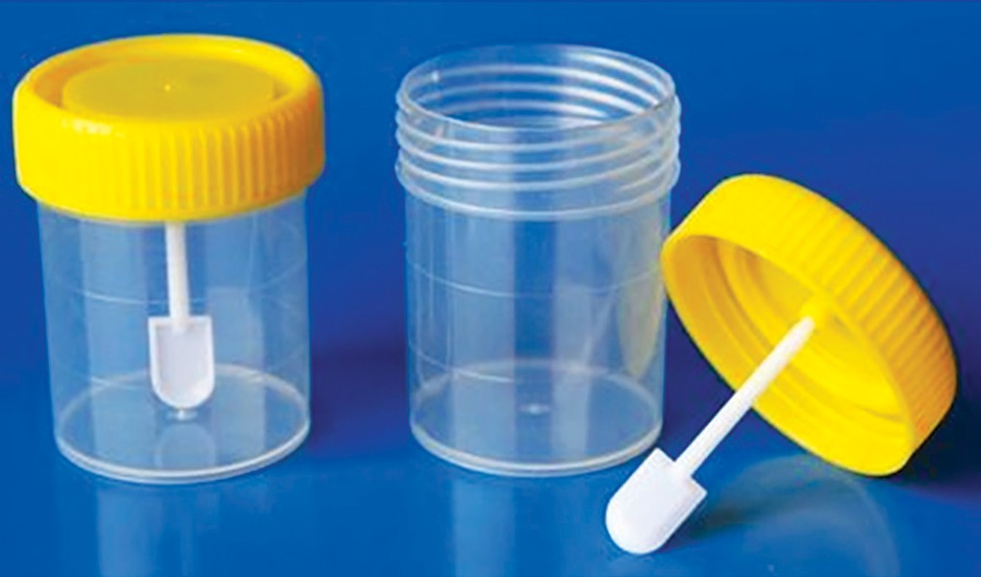
Stool specimens collected in wide-mouthed, clean, leak-proof, screw capped containers, should be handled carefully
Specimens other than stool:
Perianal swabs (cellophane tape or NIH swab)
Duodenal contents
Timing: Collected before starting anti-parasitic drugs
Frequency: At least 3 stool
specimens collected on alternate
days (within 10 days)

Slide 22
When to examine:
Liquid stool specimens: examined within 30 min
Semisolid stools: within 1hr
Formed stools: up to 24 hrs after collection
For monitoring response to therapy: Repeat stool examination 3- 4 wks after therapy for intestinal protozoan infection & 5- 6 wks for Taenia infection
If delay in transport:
Fecal specimens should be kept at RT
Preservatives (eg. 10% formalin) used to maintain morphology of parasitic cysts & eggs

Slide 23
Macroscopic examination
Mucoid bloody stool: acute amoebic dysentery
Color: Dark red stool- upper GIT bleed, bright red stool bleeding from lower GIT
Frothy pale offensive stool (containing fat); giardiasis
Microscopic examination
Includes direct wet mount examination
Permanent staining methods

Slide 24
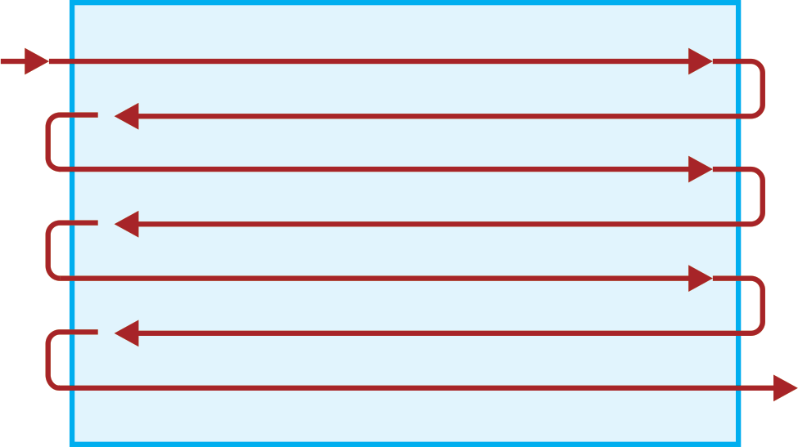
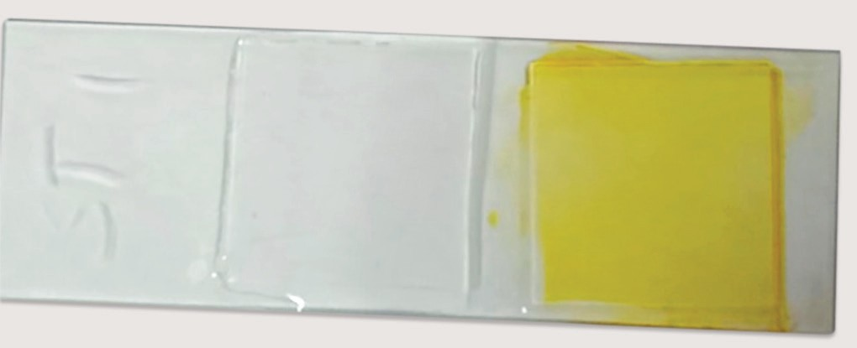
Direct Wet Mount (Saline and Iodine Mount)
Drops of saline & Lugol’s iodine are placed on left & right halves of the slide
Small amount of feces is mixed to form a uniform smooth suspension
Cover slip placed & examined under 10X for detection of helminths eggs & larvae; followed by 40X for protozoan cysts & trophozoites

Slide 25
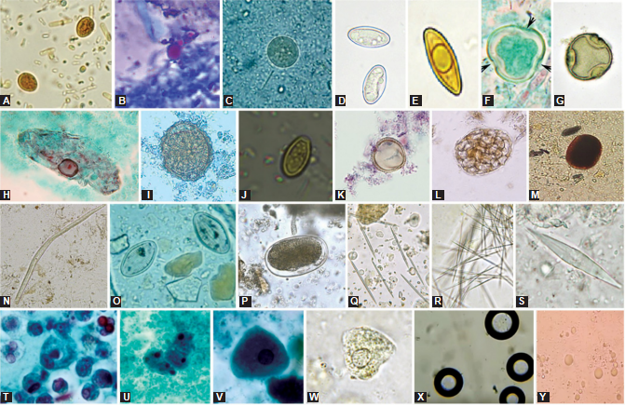
Normal constituents and artifacts found in stool in wet mount examination
(A and B) Yeast cell resembling: (A) Giardia cyst; (B) Cryptosporidium oocyst; (C to E) Fungal spore resembling: (C) Cyst of Entamoeba; (D and E) Cystoisospora oocyst; (F to K) Pollen grain resembling: (F) Blastocystis (Trichrome staining); (G) Blastocystis (saline mount); (H) Protozoan trophozoite; (I) Ascaris egg; (J) Clonorchis egg; (K) Taenia egg; (L and M) Plant cell resembling: (L) Helminth eggs; (M)Hookworm egg;

Slide 26
(N) Plant hair resembling Strongyloides larva; (O) Diatoms; (P) Mite egg resembling hookworm egg; (Q to S) Crystals: (Q and R) Pineapple juice crystals and kiwi crystals; (S) Charcot-Leyden crystals; (T to W) Human cells resembling trophozoites: (T) White blood cells; (U) Macrophages; (V and W) Epithelial cell; (X) Air bubbles; (Y) Fat globules

Slide 27
Saline mount: trophozoites, cysts of protozoa, eggs & larvae of helminths
Advantages
Motility of trophozoites & larvae
Bile staining property can be appreciated (appear golden brown) & non-bile stained eggs appear colorless

Slide 28
Iodine mount
Advantages: Nuclear details of protozoan cysts, helminthic eggs/ larvae are better visualized
Disadvantages:
Iodine kills parasites
Bile staining property cannot be appreciated

Slide 29
Permanent Stained Smear
Required for accurate detection of protozoan cysts, trophozoites by staining their internal structures
Commonly used methods are:
  Iron-hematoxylin stain
  Trichrome stain
  Modified acid-fast stain- useful for coccidian parasites

Slide 30
Concentration techniques
Direct examination may not detect parasites if yield is low
Useful in epidemiological analysis & for assessing t/t response
Sedimentation techniques
Floatation techniques
Zinc sulphate flotation concentration technique
Sheather’s sugar flotation technique

Slide 31
Morphological forms of parasites seen in stool specimens
Morphological form | Parasites
Trophozoite & cyst | Entamoeba histolytica, Giardia lamblia
Adult worm | Ascaris lumbricoides, Enterobius vermicularis
Adult worm segments | Taenia species, Diphyllobothrium latum
Egg | Diphyllobothrium latum, Taenia species, Hymenolepis nana, Schistosoma species, Fasciola hepatica, Fasciolopsis buski , Ascaris lumbricoides, Hookworm, Enterobius vermicularis, Trichuris trichiura
Larva | Strongyloides stercoralis

Slide 32
Egg Counting (Egg Quantification) Methods
Direct smear counting method of Beaver
Kato-Katz thick film method
Stoll’s method or dilution egg counting method

Slide 33
Examination of blood
Various methods of examination of blood are:
  Direct wet mount examination
  Examination of blood smears (thin smear, thick smear)
  Quantitative buffy coat (QBC)
  Concentration of blood

Slide 34
Microscopic examination of various specimens
Specimen | Morphological form | Parasite
Peripheral blood smear | Ring form, schizont gametocyte | Plasmodium spp.
 | Amastigote | Leishmania spp.
 | Trypomastigote | Trypanosoma spp
 | Microfilaria | Filarial nematodes
Bone marrow, liver, lymph node, splenic aspirate | Tachyzoite | Toxoplasma gondii
 | Amastigote | Leishmania donovani
Liver aspirate | Trophozoite | Entamoeba histolytica

Slide 35
Specimen | Morphological form | Parasite
Lymph node aspirate | Trypomastigote | Trypanosoma spp.
Lymph node biopsy | Adult worm | Wuchereria bancrofti, Brugia malayi
CSF | Trophozoite | Naegleria fowleri Acanthamoeba
 | Trypomastigote | Trypanosoma spp.
Urine | Trophozoite | Trichomonas vaginalis
 | Microfilaria | Wuchereria bancrofti
 | Egg | Schistosoma haematobium

Slide 36
Specimen | Morphological form | Parasite
Sputum | Adult worm | Paragonimus spp.
 | Egg | Paragonimus spp.
 | Larva (migrating) | Ascaris Strongyloides Hookworm
 | Trophozoite | Entamoeba histolytica
Duodenal aspirate | Trophozoite | Giardia lamblia
 | Larva | Strongyloides stercoralis
Corneal scrapings | Trophozoite | Acanthamoeba spp.

Slide 37
Specimen | Morphological form | Parasite
Skin | Amastigote | Leishmania spp.
 | Microfilaria | Onchocerca volvulus
 | Larva in skin ulcer fluid | Dracunculus medinensis
Muscle tissue | Encysted larva | Trichinella spiralis
 | Cysticercus cellulosae | Taenia solium
Perianal area | Egg | Enterobius

Slide 38
Immunodiagnostic Methods
Detection of parasite specific Ab
Circulating parasitic Ag in serum
Useful when:
  Parasites are detected only during early stages of disease
  Parasites occur in very small numbers
  Parasites reside in internal organs & morphological identification is not possible
  When other techniques like culture are time consuming

Slide 39
Antibody detection tests
Ab are detected in from serum or CSF (neurocysticercosis) or pleural fluid (paragonimiasis)
ELISA in amoebic liver abscess
Visceral leishmaniasis- immunochromatographic test (ICT)
Toxoplasmosis: Sabin-Feldman dye test, detection of specific IgM or IgA or IgG antibodies by ELISA
Cysticercosis: ELISA, Western blot
Hydatid disease: ELISA
Lymphatic filariasis: Flow-through assay

Slide 40
Antigen detection tests
Amoebiasis: ELISA in blood/ stool
Triage parasite panel: ICT detects 3 Ag in stool (Giardia, E. histolytica, Cryptosporidium)
Malaria: ICT
  Histidine rich protein-2 (Pf. HRP 2)- P. falciparum specific
  Parasite lactate dehydrogenase (pLDH) & aldolase
Lymphatic filariasis: ELISA & ICT

Slide 41
Molecular methods
PCR, real time PCR
LAMP assay
BioFire FilmArray: automated multiplex nested PCR. The gastrointestinal panel can simultaneously detect 22 enteric pathogens, including 4 parasites (E. histolytica, G. lamblia, Cryptosporidium, Cyclospora)

Slide 42
Other tests
Culture techniques
Imaging techniques
Intra-dermal skin tests
Xenodiagnostic technique
Animal inoculation methods

Slide 43
Anti-parasitic agents
Parasite | Anti-parasitic agents
Entamoeba histolytica | Metronidazole, tinidazole Diloxanide furoate
Giardia species | Metronidazole, tinidazole
Trichomonas | Metronidazole, tinidazole
Trypanosoma cruzi | Benznidazole, nifurtimox
Trypanosoma brucei | Pentamidine, suramin
Leishmania donovani | Amphotericin B, Antimonials Paromomycin, Miltefosine
Plasmodium species | Chloroquine, Quinine, Artemisinin derivative Primaquine, Mefloquine, Sulfadoxine-pyrimethamine Lumefantrine

Slide 44
Protozoa | Anti-parasitic agents
Cryptosporidium | Nitazoxanide
Cyclospora | Cotrimoxazole
Cystoisospora | Cotrimoxazole
Toxoplasma | Cotrimoxazole, spiramycin
Microsporidia | Albendazole
Balantidium coli | Tetracycline
Cestodes | Praziquantel, Niclosamide, Albendazole
Trematodes | Praziquantel, Triclabendazole for Fasciola hepatica
Intestinal nematodes | Mebendazole, albendazole, Pyrantel pamoate Ivermectin (for Strongyloides)
Filarial nematodes | Diethylcarbamazine (DEC) Albendazole, Ivermectin

