Slide 1
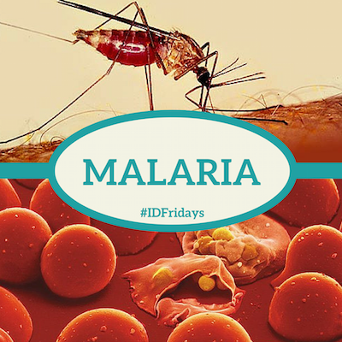

Slide 2
Objectives
At the end of the session, Phase II MBBS students must be able to:
Discuss laboratory diagnosis of malaria
Describe treatment and prevention of malaria

Slide 3
CLINICAL FEATURES & LAB DIAGNOSIS

Slide 4
Pathophysiology
In RBCs, merozoites mature to trophozoites & schizonts
Schizonts rupture & release merozoites to invade other RBCs; continue erythrocytic cycle
At the time of schizont rupture, release of malaria parasites & erythrocytic material into blood circulation induces pathophysiology process of malaria & onset of symptoms
Activation of cytokine cascade is responsible for symptoms, signs of malaria

Slide 5
Prepatent period- interval from time of infection until parasites become detectable in the blood
Incubation period (IP)- interval b/w infection & onset of symptoms
IP depends on parasite species, transmission route, immune status, antimalarials, parasite density
Species | IP
P. vivax | 14 days
P. falciparum | 12 days
P. malariae | 28 days
P. ovale | 17 days

Slide 6
Clinical features
Benign Malaria- Uncomplicated malaria; triad of febrile paroxysms, anemia & splenomegaly
1. Febrile paroxysms- Periodic bouts of fever, 3 successive stages-
cold stage (15- 60 min): intense cold, uncontrollable shivering
f/b hot stage (2- 6 hrs): temp ≥41°C
f/b sweating stage: patient drenched in profuse sweat, temp drops rapidly, patient usually falls into deep sleep
Notes:
malaise, anorexia, lassitude, dizziness, with a desire to stretch limbs and yawn, headache, backache in the lumbar and sacroiliac region, myalgias, nausea, vomiting

Slide 7
Febrile paroxysm synchronises with erythrocytic schizogony
Periodicity is 48 hours in tertian malaria (in P. vivax, P. falciparum, P. ovale) and 72 hours in quartan malaria (in P. malariae)
Quotidian periodicity, with fever occurring at 24 hour intervals may be due to mixed infection
Notes:
febrile paroxysm occurs every third day (tertian fever)f

Slide 8
Anemia
patient develops normocytic normochromic anemia d/t:
Parasite induced RBC destruction
Splenic removal of both infected RBC & uninfected RBC coated with immune complexes
Bone marrow suppression leading to decrease RBC production
Increased fragility of RBCs

Slide 9
Splenomegaly:
After a few weeks of febrile paroxysms, spleen gets enlarged & palpable
d/t massive proliferation of macrophages that engulf parasitized and non-parasitized coated RBCs

Slide 10
Malignant Tertian Malaria: Falciparum malaria
Pathogenesis
Sequestration of parasites in blood vessels of deep visceral organs leading to blockage of vessels, congestion, hypoxia
Cytoadherence- binding of ifnected RBCs to endothelial cells mediated by PfEMP-1 (falciparum erythrocyte membrane protein-1)
PfEMP-1 helps in binding of infected RBCs to uninfected RBCs (rosetting)

Slide 11
Malignant Tertian Malaria
Severe/ complicated malaria
Defined as one or more of following, occurring in presence of P. falciparum asexual parasitaemia
Impaired consciousness: Glasgow coma score < 11 in adults; multiple convulsions
Acidosis: respiratory distress
Hypoglycaemia: Blood glucose < 40 mg/dL
Severe malarial anaemia: Hb ≤ 5 g/ dL
Renal impairment

Slide 12
Jaundice
Pulmonary oedema- saturation < 92%
Significant bleeding
Shock
Hyperparasitaemia: P. falciparum parasitaemia > 10%
Most of severe malaria complications occur in non immune subjects with falciparum malaria

Slide 13
1. Cerebral Malaria:
m/c cause of death in malignant malaria
Schizonts of P. falciparum secrete a protein which promote aggregation of infected RBCs to other non-infected RBCs & capillary endothelial cells causing capillary plugging of cerebral microvasculature, vascular occlusion, cerebral anoxia
Diffuse symmetric encephalopathy with generalized convulsion
Muscle tone, tendon reflexes are reduced, retinal hemorrhages, neurologic sequelae, repeated seizures, and coma

Slide 14
2. Blackwater fever:
In patients, who have had previous infections & inadequate treatment with quinine
Antibodies develop against parasitized & quininized RBCs
With subsequent infection and quinine treatment, there is immune complex formation followed by complement mediated massive destruction of parasitized & non-parasitized RBCs, massive intravascular hemolysis, absorption of hemoglobin by renal tubules
Bilious vomiting, prostration, passage of dark red or blackish urine (black water) (hemoglobinuria)
Notes:
Patients with G6PD deficiency may develop this condition after taking oxidant drugs, even in the absence of malaria

Slide 15
3. Algid Malaria:
c/b peripheral circulatory failure, rapid thready pulse with low blood pressure, cold clammy skin
severe abdominal pain, vomiting, diarrhea, profound shock
4. Septicemic malaria:
c/b high continuous fever with dissemination of the parasite to various organs, leading to multiorgan failure
Death occurs in 80% of the cases
5. Pernicious malaria: Blackwater fever, algid malaria & septicemic malaria

Slide 16

Laboratory diagnosis

Slide 17
a. Demonstration of parasite by microscopy (Gold standard)
Blood can be taken from ear lobe/ finger tip prick
2 types of peripheral blood smears:
Thin smears: single layer of red cells, ending in tongue shape
used for detecting parasites, determining species
Thick smears: usually 3 drops of blood are spread over a small area (about 1-2 cm²)
amount of blood in thin smear is about 1–1.5 μL, thick smear it is 3–4 μL

Slide 18
Stained by Romanowsky stains- Leishman’s, Giemesa, Field’s, or JSB stain (named after Jaswant Singh and Bhattacharjee)
Thin film is examined first at the tail end, if parasites are found, no need for examining thick film
If parasites not detected in thin film, then thick film is examined
200 oil immersion fields should be examined before a thick film is declared negative

Slide 19
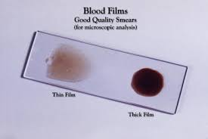

Slide 20
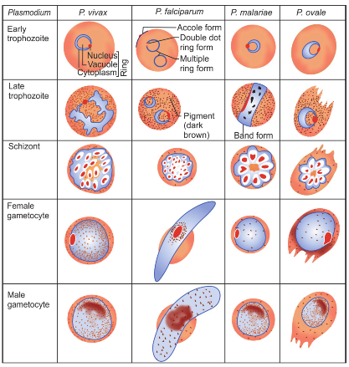
Speciation of malaria parasite

Slide 21
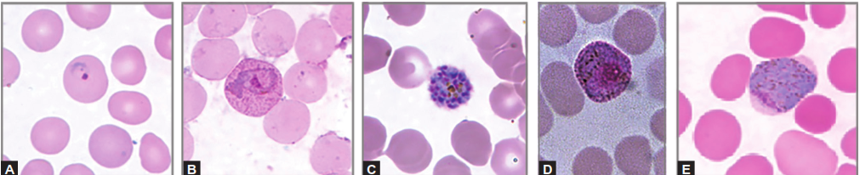
Various morphological forms of Plasmodium vivax
Thin blood smear showing different forms of Plasmodium vivax; (A) Ring form; (B) Amoeboid form; (C) Schizont; (D) Male gametocyte; (E) Female gametocyte

Slide 22
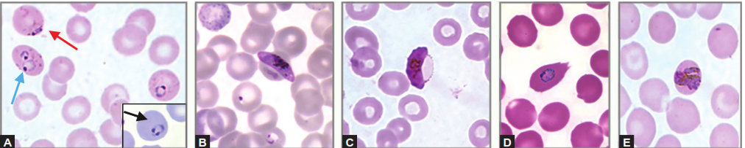
Morphological forms of other Plasmodium species
Thin blood smear showing: (A) P. falciparum ring forms such as multiple rings (blue arrow), accole form (red arrow) and head phone-shaped ring form (black arrow); (B) Female gametocyte of P. falciparum

Slide 23
Morphology in Giemsa-stained thin smears
 | P. vivax | P. ovale | P. malariae | P. falciparum
Size of infected cells | Enlarged | Enlarged | Smaller to Normal | Normal
Stippling | Schuffner’s dot | Jame’s dots | Ziemann’s dot | Maurer’s dot
Stages seen in peripheral blood | All | All | All | Ring & gametocytes
Schizont | 12-24 | 8-12 | 6-12 | Not seen in peripheral blood
Gametocyte | Round or oval | Round | Round | Crescent

Slide 24
Advantages & disadvantages of peripheral smear
simple, rapid and cheap
Thick smear is 40 times more sensitive than thin smear, can detect as low as 5–10 parasites per µL of blood
Quantification of parasitemia
Thin smear is useful in speciation of malaria parasite
Labour intensive and requires experienced personnel
Low sensitivity of thin films: detection limit of thin smear is >200 parasites per µL of blood

Slide 25
b. Quantitative Buffy Coat:
consists of three steps:
(1) concentration of blood by centrifugation
(2) staining with acridine orange stain
(3) examination under ultraviolet light source
Interpretation:
Acridine orange stains the nuclear DNA (parasitized RBCs) fluorescent brilliant green

Slide 26
Normal RBCs don’t take up stain (as they are anucleated)
Parasitized RBCs appear as brilliant green dots
WBCs also take up stain
Advantage: faster, more sensitive, quantification can be done
Disadvantage: less specific, is expensive, speciation cannot be done

Slide 27
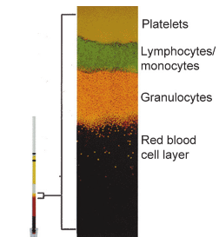
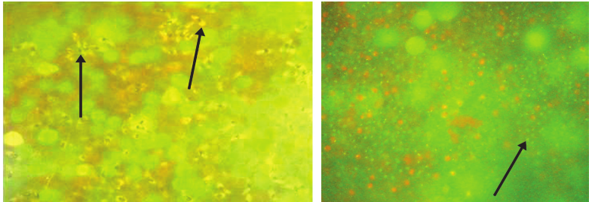
Interpretation of QBC
Crescent shaped gametocytes of
P. falciparum;
QBC capillary tube with
magnified view

Slide 28
Comparison b/w peripheral smear and QBC test
 | Peripheral smear | QBC
Method | Cumbersome | Easy
Time | Longer, 60 - 120 minutes | Faster, 15 - 30 minutes
Sensitivity | 5 parasites/µl in thick film and 200 / µl in thin film | Claimed to be more sensitive, at least as good as a thick film
Specificity | Gold standard | False positives, artifacts may be reported as positive by not-so-well-trained technicians
Species identification | Accurate, gold standard | Not possible
Cost | Inexpensive | Costly equipment
Availability | Everywhere | Limited

Slide 29
c. Fluoroscence Microscopy:
Fluoroscent dyes like acridine orange or benzothiocarboxy purine are used, which stain parasites in RBCs
stained slide is examined under fluorescent microscope
method is mainly used for mass screening in field laboratory

Slide 30
d. Rapid Antigen Detection Tests:
Immunochromatographic method:
1. Detection of histidine rich protein-2 (HRP-2) Ag produced by asexual stages of P. falciparum expressed on surface of RBC
2. Detection of pLDH – (parasite lactate dehydrogenase) produced by trophozoites and gametocytes of all plasmodium species
3. Aldolase: enzyme in glycosis pathway in malaria parasites; used as a panmalarial antigen target

Slide 31
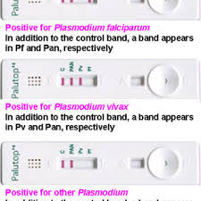
Advantages: high sensitivity & specificity
Disadvantages: cannot detect other 3 malaria species
remains positive months after cure

Slide 32
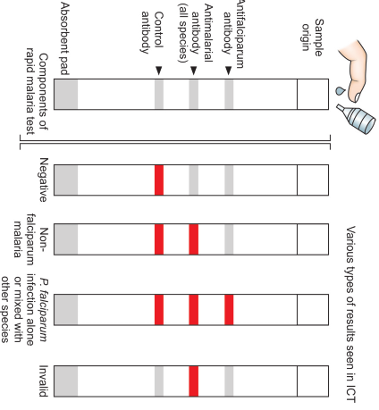
Schematic diagram
of rapid diagnostic test

Slide 33
Advantages and disadvantages of RDTs
Simple to perform, do not need extra equipment or trained personnel
can be performed within 10 minutes
>90% sensitive at >100 parasites/µL
pLDH is produced by viable parasites, used to monitor response for treatment
Intensity of band is directly proportional to parasitemia & severity of disease
Expensive
Cannot differentiate between the non­falciparum malaria species
False positive bands appear in rheumatoid arthritis factor positive cases

Slide 34
 | Peripheral Smear | Rapid Diagnostic Tests
Equipment | Microscope | Kit only
Training | TRAINED MICROSCOPIST | 'Anyone with a little training'
Test duration | 20-60 minutes or more | 5-30 minutes
Detection threshold | 5-10 parasites/µL of blood | 100-500/µL for P. falciparum, higher for non-falciparum
Species differentiation | POSSIBLE | Not possible
Quantification | Possible | Not possible
Disadvantages | Availability limited | Unpredictable efficiency, cross reactions
Differentiation between sexual and asexual stages | Possible | Not possible

Slide 35
e. Culture:
Used for preparation of malaria Ag
Trager and Jensen (1976) described simple method for continuous culture of P. falciparum using RPMI 1640 medium (Roswell Park Memorial Institute)
Notes:
and 1640 denotes the number of passages

Slide 36
f. Molecular Methods:
Nested multiplex PCR targeting 18S rDNA: for detection of all five human malaria parasites
detection limit of 10 to 100 copies/µL
can also be used to detect drug resistant genes
Real time PCR: useful for quantification and speciation of parasites
LAMP assay

Slide 37
g. Serodiagnosis for detection of Antibodies
Does not detect current infection, measures past exposure
Antibodies persist even after clinical cure
Government of India has banned use of antibody detection tests for malaria diagnosis
Used mainly for sero-epidemiological survey, identify infected donors to prevent transfusion malaria
tests used are indirect hemagglutination, IFA and ELISA

Slide 38
h. Other Tests
Measurement of hemoglobin and PCV
Total WBC and platelet count
Measurement of blood glucose
Coagulation tests
Urine for free hemoglobin, if blackwater fever is suspected
Blood urea and serum creatinine to monitor renal failure
Notes:
like measurement of anti-thrombin III level, plasma fibrinogen, fibrin degradation product, prothrombin time

Slide 39
Treatment
Anti-malarial drugs are used:
to eradicate the erythocytic cycle and clinical cure
to eradicate the exoerythrocytic cycle in liver to prevent relapse
to destroy gametocytes to prevent mosquito transmission and thereby reducing human reservoir
to prevent infections in non-immune person visiting endemic areas

Slide 40
m/c used antimalarials are :
Chloroquine/primaquine/ Quinine
Amodiaquin
Pyrimethamine
Doxycycline
Sulfadoxine
proguanil
Newer antimalarial like artemesinin, lumefantrine, mefloquine, halofantrin are now commonly used for multidrug resistant P. falciparum infections

Slide 41
Uncomplicated Malaria
Positive P. vivax, P. ovale and P. malariae cases are treated with chloroquine 25 mg/kg divided over 3 days
For prevention of relapse (in Vivax malaria), primaquine is given in a dose of 0.25 mg/kg daily for 14 days under supervision
In c/o choloroquine resistance: Quinine is given in a dose of 600 mg 8 hourly for 7 days along with doxycycline 100 mg/day

Slide 42
Complicated (Falciparum) Malaria
Artesunate x 3d + sulfadoxine- pyrimethamine (single dose, on day 1) + primaquine (single dose on day 2)
In northeastern states- Artemether- lumefantrine x 3d + primaquine (single dose, on day 2)

Slide 43
Prophylaxis
Malaria Vaccine
On 6 October 2021, WHO recommended widespread use of the RTS,S malaria vaccine
Vaccine targeting pre-erythrocytic stage- RTS, S/AS01
most successful malaria trial; started in 2005 in Africa by GlaxoSmithKline (GSK)
Consists of PfCSP (circum-sporozoite protein of P. falciparum), hepatitis B surface antigen (HBsAg), combined with a chemical adjuvant (AS01) to boost the immune system response
WHO recommends the RTS,S/AS01 malaria vaccine be used for the prevention of P. falciparum malaria in children living in regions with moderate to high transmission as defined by WHO.

Slide 44
1. For travelers visiting endemic areas, chemoprophylaxis provides effective protection (proguanil, chloroquin, or mefloquin weekly or doxycycline daily)
2. Antiadult measures:
Residual spraying: spraying of indoor surfaces of house with residual insecticides eg. DDT, malathion
Space Sprays are those where insecticidal formulation is sprayed into atmosphere in form of mist or fog to kill insects (pyrethrum extracts)
Use of repellants, protective clothing, bed net, preferably impregnated with long acting repellant, mosquito coils, and screening of house

Slide 45
Anti-larval Measures:
Larvicide: oiling the collection of standing water or dusting them with paris green/ mineral oil
Source reduction: reduce mosquito breeding sites, include drainage or filling
  Biological larvicide: Gambusia affinis (fish) and Bacillus thuringiensis (bacteria) can be used to kill the mosquito larva.

Slide 46
Thank you

