Slide 1
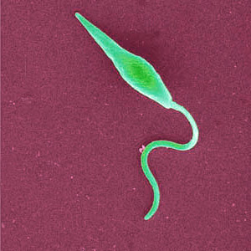
LEISHMANIA
BY:
DR DEEPIKA VERMA
MD

Slide 2
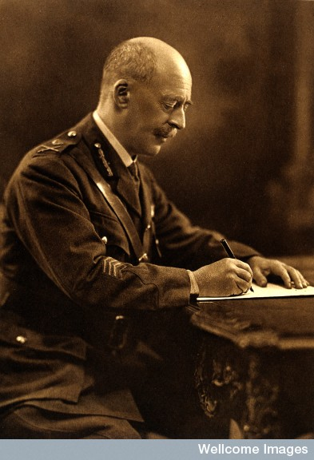
Sir William Leishman
1900 – Sir William Leishman discovered L. donovani in spleen smears of a soldier who died of fever at Dum-Dum, India. The disease was known locally as Dum-Dum fever or kala-azar.

Slide 3
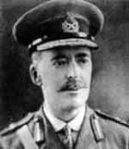
Charles Donovan
Charles Donovan also recognized these symptoms in other kala-azar patients and published his discovery a few weeks after Leishman.
After examining the parasite using Leishman's stain, these amastigotes were known as Leishman-Donovan bodies.

Slide 4
General characteristics
All members of the genus leishmania are obligate intracellular parasites that pass their life cycle in 2 hosts-
1)The mammalian host
2)Insect vector ,female sand fly
In humans and other mammalian host ,they multiply within macrophages-amastigote form-having an ovoid body containing a nucleus and a kinetoplast.
In the sandfly, they occur in the promastigote form ,with a spindle shaped body and a single flagellum arising from anterior end.

Slide 5
Across the tropics,3 different diseases are caused by various species of genus Leishmania:
Visceral Leishmaniasis:The species L.donovani complex infecting internal organs(liver,spleen and bone marrow) of human is the causative parasite.
Cutaneous leishmaniasis:The species L.tropica complex,L.aethiopica,L.major and L.mexicana complex are the causative parasite.
Mucocutaneous leishmaniasis:It is caused by the L.braziliensis complex.

Slide 6
Classification
The genus Leishmania includes a number of different varieties and subspecies ,which differ in several features such as antigenic structure,iso enzymes and other biochemical characteristics, growth properties,host specificity.
Leishmania has been classified on the basis of geographical distribution:

Slide 7
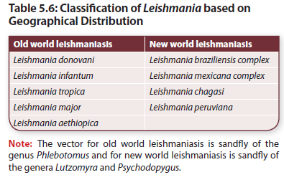
Classification of leishmania based on geographical distribution

Slide 8
Classification of Leishmania species
Species/sub species | Disease | Geographical distribution
Leishmania donovani L.d. donovani L.d.infantum L.d.chagasi | Visceral leishmaniasis of old and new world | Middle east,Africa,India, S.E.Asia. Found in S,America
L.Tropica L.Major L.aethiopica | Cutaneous leishmaniasis of old world | middle east ,mediterranean coast, Ethiopia,Africa,India
Leishmania braziliensis complex Leishmania mexicana complex | Cutaneous and mucocutaneous leishmaniasis of new world | C and S America,Amazon basin,Mexico,Western peru.

Slide 9
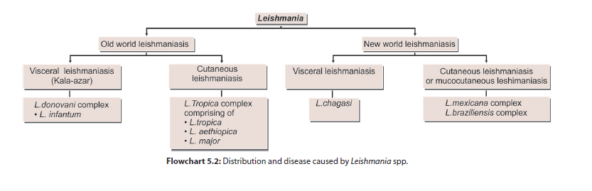

Slide 10
Old world leishmaniasis
L.donovani causes VL or Kala-azar .Also causes PKDL,the condition known as post kalazar dermal leishmaniasis.
Kala azar is a major public health problem,in many parts of the world.
According to WHO, a total of 500,000 cases of VL occur every year.
Of these 90% occur in indian subcontinent.
Resurgence of Kalaazar has been noted since mid 1970s.Initially confined to Bihar,cases are involving newer cases,west bengal./

Slide 11
Habitat:
The amastigote of L.donovani is found in RE system .Mostly found within the macrophages in the skin, intestinal mucosa and mesentric lymph nodes.

Slide 12
Morphology
The parasite exists in 2 forms
Amastigote form: in humans and other mammals.
Promastigote form: in the sandfly and in artificial culture.
Amastigote
The amastigote form (LD body) is an ovoid or rounded cell, about 2–4 μm in size.
It is typically intracellular, being found inside macrophages, monocytes, neutrophils, or endothelial cells.
They are also known as LD bodies.

Slide 13
Smears stained with Leishman, Giemsa, or Wright’s stain show a pale blue cytoplasm enclosed by a limiting membrane.
The large oval nucleus is stained red.
Lying at the right angles to nucleus, is the red or purple stained kinetoplast.

Slide 14
In well stained preparations, the kineloplast can be seen consisting of a parabasal body and a dot like blepharoplast with a delicate thread connecting the two.
The axoneme arising from the blepharoplast extends to the anterior tip of the cell.
Alongside the kinetoplast a clear unstained vacuole can be seen.
Flagellum is absent.

Slide 15
Promastigote:
It is a flagellar stage and is present in insect vector, sandfly and in cultures.
The promastigotes, which are intitially short, oval or pearshaped forms, subsequently become long spindle shaped cells, 15–25 μm in length and 1.5–3.5 μm in breadth.
A single nucleus is situated at the center. The kinetoplast lies transversely near the anterior end.
The flagellum is single, delicate, and measures 15–28 μm.
Giemsa or Leishman stained films show pale blue cytoplasm with a pink nucleus and bright red kinetoplast.
A vacuole is present near the root of the flagellum.
Promastigote forms, which develop in artificial cultures, have the same morphology as in the sandfly.

Slide 16
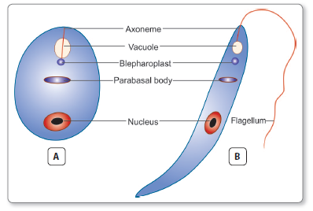

Slide 17
Modes of transmission
1. Humans acquire by bite of an infected female sandfly.
2. It can also be transmitted vertically from mother to fetus, by blood transfusion, and accidental inoculation in the laboratory.
Incubation period: Usually 2–6 months, occasionally it may be as short as 10 days or as long as 2 years.
The sandfly regurgitates the promastigotes in the wound caused by its proboscis.
These are engulfed by the cells of reticuloendothelial system (macrophages, monocytes, and polymorphonuclear leucocytes) and change into amastigote (LD body) within the cells.

Slide 18
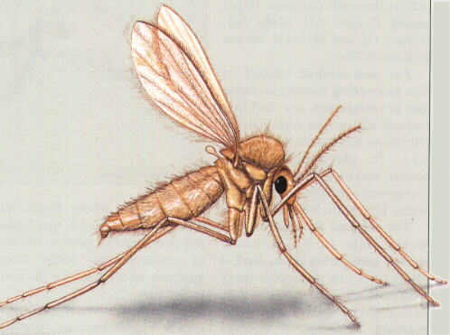
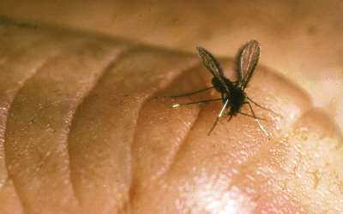
Sand fly- Vector

Slide 19
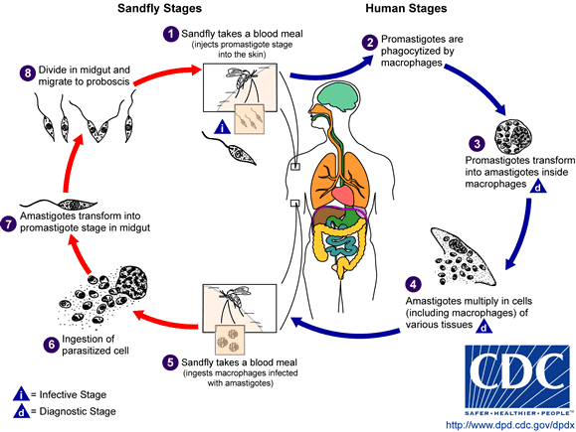
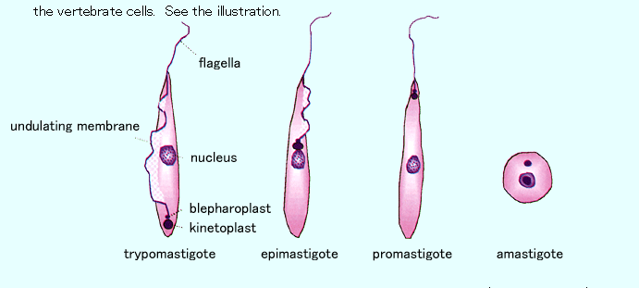
Different stages of Haemoflagellates

Slide 20

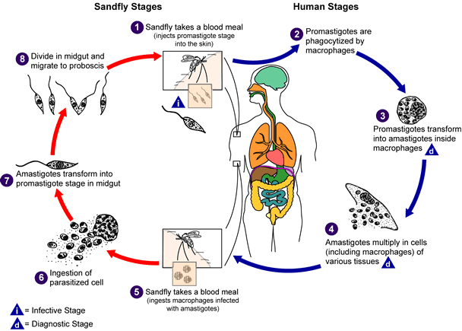
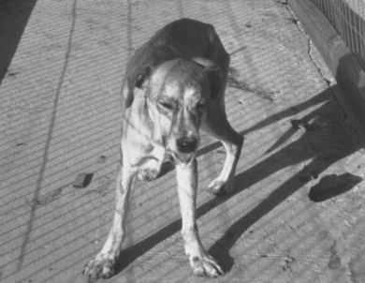
1- Sand-fly bites animal and ingests blood infected with Leishmania
2- Sandfly bites human and injects Leishmania into skin
4- Cycle continues when sandfly bites another human or animal reservoir
3- Another sandfly bites human and ingests blood infected with Leishmania

Slide 21
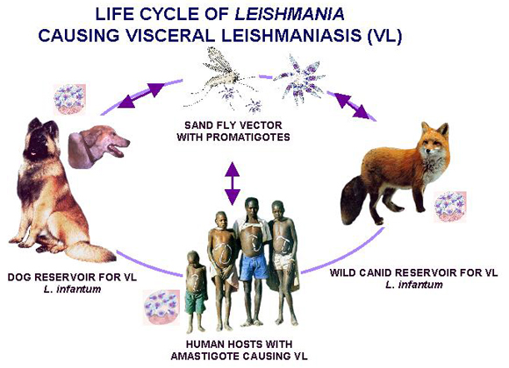

Slide 22
Pathogenicity
L.donovani causes visceral leishmaniasis or Kala-azar.
The parasitized macrophages disseminate the infection to all parts of the body.
In the spleen, liver, and bone marrow particularly,
the amastigotes multiply enormously in the fixed macrophages to produce a ‘blockade’ of the reticuloendothelial system.
This leads to a marked proliferation and destruction of reticuloendothelial tissue in these organs.

Slide 23
Spleen: spleen is the most affected organ. It is grossly enlarged and the capsule is thickened due to peri splenitis.Cut section is red or choclate in colour. Microscopically the reticulum cells are greatly increased in numbers and are loaded with LD bodies.
Liver:The liver is enlarged. The Kupffer cells and vascular endothelial cells are heavily parasitized.
Bone Marrow: The bone marrow is heavily infiltrated with parasitised macrophages,which may crowd the haematopoetic tissue.
Severe anemia with hemoglobin levels of 5–10 g/dL may occur in Kala-azar, as a result of infiltration of the bone marrow as well as by the increased destruction of erythrocytes due to hypersplenism.
Leukopenia with marked neutropenia and thrombocytopenia

Slide 24
What is Kala-Azar
Kala-azar means dark pigmentation which is characteristic of cases of visceral leishmaniasis.
It is widely prevalent in India in epidemic form in states of Bihar, Assam and Bengal.

Slide 25
Clinical Features of Kala-Azar:
1.The onset is typically insidious.
2.The clinical illness begins with fever, which may be continuous, remittent, or irregular.
3.Splenomegaly starts early and is progressive along with massive Hepatomegaly and lymphadenopathy .
4.Skin becomes dry, rough, and darkly pigmented
(hence, the name Kala-azar).
5.The hair become thin and brittle
6.Cachexia with marked anemia, emaciation, and loss of weight is seen.
Epistaxis and bleeding from gums are common.
Most untreated patients die in about 2 years, due to some intercurrent disease such as dysentery, diarrhea, and tuberculosis.

Slide 26
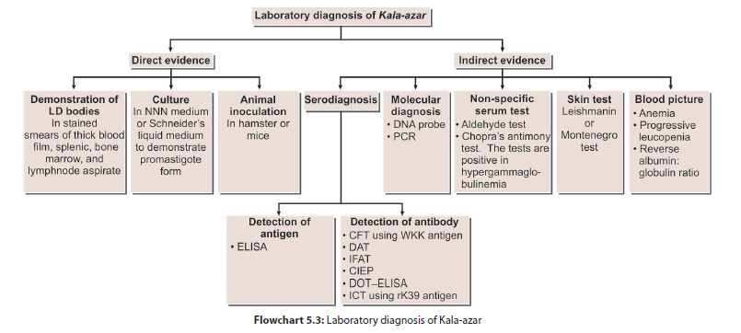
Diagnosis of visceral leishmaniasis

Slide 27
Direct Evidence
Microscopy
1. Demonstration of amastigotes in smears of tissue aspirates- gold standard for diagnosis of visceral leishmaniasis
Samples- Peripheral blood, Bone marrow, Splenic aspirate, Enlarged lymph node
Stain- Leishman, Giemsa, or Wright’s stains
Amastigote parasite seen within macrophages

Slide 28
Peripheral blood smear: amastigotes inside circulating monocytes
Chance of detection can be improved by:
-examination of thick blood film
-examine buffy coat

Slide 29
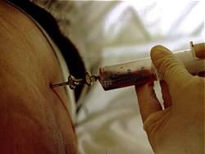
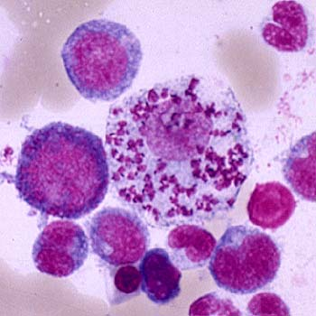
Bone marrow aspiration
Bone marrow amastigotes

Slide 30
Bone marrow aspirate:
Sternal marrow is aspirated by puncturing sternum at level of 2nd or 3rd intercoastal space, using a sternal puncture needle
Obtained by puncturing the iliac crest

Slide 31
Splenic aspirates:
Richer in parasites
Procedure can sometimes cause dangerous bleeding
Contraindicated in pts of prolonged PT or if platelet count is less than 40,000/mm3
Lymphnode aspirates:
Not useful in diagnosis of Indian Kala-azar

Slide 32
B) Culture
Tissue materials or blood are cultured on NNN medium (Novy Nicolle and Mc Neal)- rabbit blood agar slope consisting of 2 parts of salt agar and 1 part of defibrinated rabbit blood
Sample inoculated in water of condensation; incubated at 22°–24°C for 1–4 weeks
At end of each week, a drop of culture fluid is examined for promastigotes under high power objective or phase contrast illumination

Slide 33
C) Animal inoculation
Animal inoculation is not used for routine diagnosis
When necessary, done in Chinese golden hamster

Slide 34
Indirect evidences
A) Serodiagnosis
1. Detection of antigen: ELISA, PCR
2. Detection of antibodies: CFT; antigen human tubercle bacillus by Witebsky, Kliengenstein, and Kuhn (hence, called WKK antigen)
Positive early in the disease

Slide 35
Positive reaction also occurs in tuberculosis, leprosy, tropical eosinophilia
Specific leishmanial antigens prepared from cultures have been used to demonstrate specific antibodies
These tests include:
 Indirect immunofluroscent antibody test (IFAT)
 Counter immunoelectrophoresis (CIEP)
 ELISA and DOT ELISA
 DAT

Slide 36
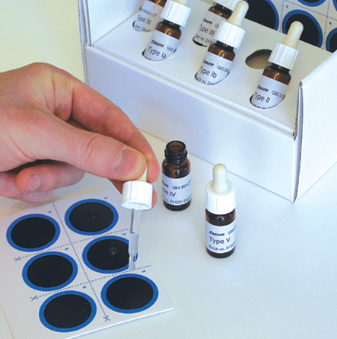
Direct agglutination test
Direct agglutination test (DAT) sensitivity 91-100% and specificity from 72 to 100%.

Slide 37
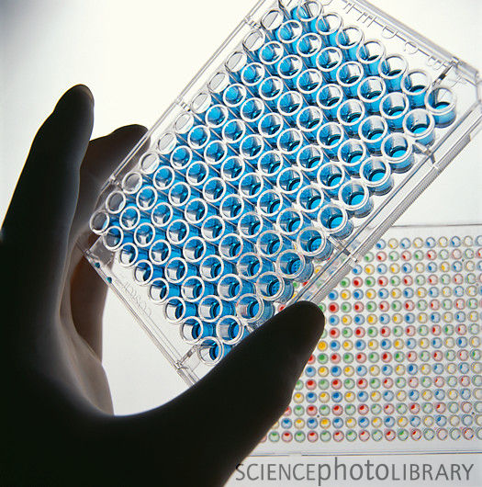
ELISA
ELISA is highly sensitive test

Slide 38
A specific rapid immunchromatographic dipstick (ICT) method for antibody has been developed using recombinant leishmanial antigen rk 39
The sensitivity of the test is 98% and specificity is 90%.

Slide 39
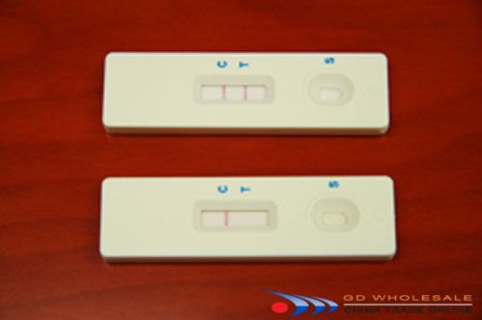
Chromatographic strip test
A ready to use immuno chromatographic strip test based on rk 39 antigen has been developed as a rapid test for diagnosis of kala azar.
This test is recommended by National vector borne disease control program in India.

Slide 40
Non specific Serum tests
Based on greatly increased globulin content of serum
1. Napier’s aldehyde or formogel test:
Patient serum taken in test tube, a drop of formalin (40% formaldehyde) is added, shaken
A positive reaction is jellification and opacification of test serum, resembling the coagulated white of egg appearing within 3–30 minutes

Slide 41
2. Chopra’s antimony test
0.2 mL of serum diluted 1:10 with distilled water in a Dreyer’s tube and overlaying with few drops of 4% solution of urea stibamine. Formation of flocculent precipitate indicates positive test
Both tests give false positive reactions in several other disease such as multiple myeloma, cirrhosis of liver, tuberculosis, leprosy, schistosomiasis, African trypanosomiasis, where hypergammaglobulinemia exists

Slide 42
Blood Picture:
Complete blood count shows normocytic normochromic anemia and thrombocytopenia
Leucocyte count reveals leucopenia accompanied by a relative increase of lymphocytes and monocytes
Serum shows hyper gamma globulinemia and a reversal of the albumin: globulin ratio
Liver function tests show mild elevations.

Slide 43
Post Kala-azar Dermal Leishmaniasis
Seen in 3-10% of patients of VL in endemic areas, when Leishmania donovani invades skin cells, resides and develops there and manifests as dermal leisions
Manifests as PKDL after about a year or a few years of treatment.
Seen only in India and east Africa

Slide 44
Nonulcerative lesion of skin. The lesions are of 3 types
1. Depigmented macules: These commonly appear on the trunk and extremities and resemble tuberculoid leprosy.
2. Erythematous patches: These are distributed on
the face in a 'butterfly distribution'.
3. Nodular lesion: Both of the above mentioned
lesions may develop into painless yellowish pink nonulcerating granulomatous nodules.
The parasite can be demonstrated in the lesions.

Slide 45
Diagnosis of PKDL
The nodular lesions are biopsied and amastigote forms are demonstrated in stained sections.
The biopsy material can be cultured or animal inoculation can be done.
Immunodiagnosis has no role in the diagnosis of PKDL.

Slide 46
Treatment
1) Pentavalent antimony (Pentostam): Two pentavalent antimonial (Sbv) preparations are available:
Sodium stibogluconate (100 mg of Sbv/mL)
Meglumine antimonate (85 mg of Sbv/mL).
Dosage: The daily dose is 20 mg/kg by rapid intravenous (IV) infusion or intramuscular (IM) injection for 20–30 days.
2) Amphotericin B: first line drug in Bihar
3) Miltefosine
Miltefosine is the first oral drug, approved for the treatment

Slide 47
Treatment of complications:
Anemia
Bleeding
Infections etc.

Slide 48
Kala-azar prevention
Multipronged approach is needed
Sand-flies are extremely sensitive to insecticides & vector control through insecticide spray is very important.
Mosquito nets or curtains treated with insecticides will keep out the tiny sand-flies.

Slide 49
In endemic areas with zoonotic transmission, infected or stray dogs should be destroyed
In areas with anthroponotic transmission, early diagnosis & treatment of human infections, to reduce the reservoir & control epidemics of VL, is extremely important.
Serology is useful for screening of suspected cases in the field.
No vaccine is currently available .

Slide 50
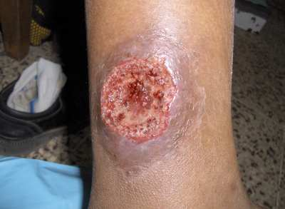
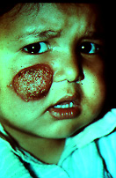
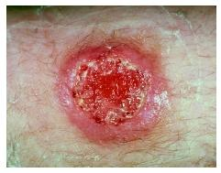
Cutaneous leishmaniasis

Slide 51
Old world Cutaneous Leishmaniasis
Caused by L. tropica, L. major, L. aethiopica
Reservoirs: humans, dogs, rodents
Also k/a Oriental sore, Delhi boil, baghdad boil, Aleppo evil.
Transmission: phlebotomus sand flies.
Life cycle: same as L. donovani except that the amastigote form of the parasites reside and multiply in skin macrophages and not in the viscera.

Slide 52
Clinical features
L. tropica- oriental sore or Delhi boil. A small papule develops at the site of bite which soon becomes raised nodule; ulcerates with a raised indurated edge
Lesion heals spontaneously.
L. aethiopica: Occurs in patients with little or no CMI. Its an incurable condition characterised by the formation of disfiguring nodules over the surface of the body.

Slide 53
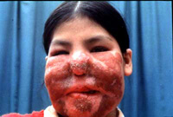
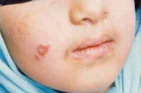
Diffuse cutaneous leishmaniasis

Slide 54
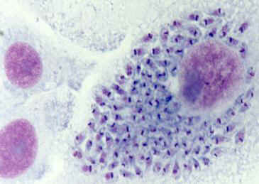
Diagnosis
Smear: Giemsa stain microscopy for LD bodies (Amastigote) from the material obtained by a puncture of the indurated edge of the sore or nodules.
Biopsy: microscopy for LD bodies or culture in NNN medium for promastigotes

Slide 55
Skin test (Leishmanin test): Ag used is killed culture forms (Promastigotes) of L. tropica, L. mexicana
0.1 ml of Ag intradermally is injected intradermally in the inner surface of forearm.
Result: Area of induration of 5mm in diameter after 48-72 hrs of inoculation indicates positivity.
Positive: in children under 10 years of age from endemic areas is highly suggestive of disease.
Negative: is seen in active leishmaniasis and DCL.

Slide 56
thanks

