Slide 1
Intestinal amoebiasis
Giardiasis

Slide 2
Learning objectives
At the end of the session, the students will be able to

Slide 3
Intestinal Protozoan Infections
Protozoan parasites which cause intestinal infection include:
Intestinal amoebae: Entamoeba histolytica
Intestinal flagellate: Giardia lamblia
Opportunistic intestinal coccidian parasites: Cryptosporidium, Cyclospora, and Cystoisospora
Others: Balantidium coli, Blastocystis hominis, Sarcocystis

Slide 4
Intestinal amoebiasis

Slide 5
Intestinal amoebiasis
Single-celled protozoan parasites, constantly change their shape due to presence of “pseudopodium”
Based on the habitat they are of two types
  (i) intestinal amoebae
  (ii) free-living amoebae

Slide 6
Entamoeba histolytica
Causes amoebic dysentery
Other species E. dispar, E. moshkovskii, E. bangladeshi are morphologically similar to E. histolytica
Largest burden of the disease in tropics of China, Central/ South America, Indian subcontinents
Third most common parasitic cause of death in the world

Slide 7
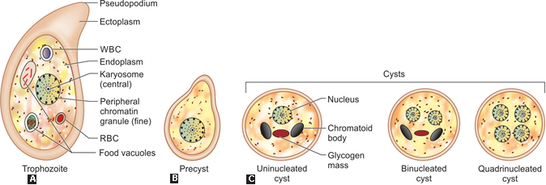
Morphology
Invasive, replicating form; found in feces of patients with active disease
Diagnostic form; found in feces of carriers & patients with active disease

Slide 8
Differences between trophozoite & cyst
Chracteristic | Trophozoite | Cyst
Present in | active disease | active disease & carriers
Size | 15-20 um | 12-15 um
Cytoplasm | clear ectoplasm, granular endoplasm, ingested RBC | chromatoid bodies (aggregation of ribosome) & a large glycogen mass (stains brown with iodine)
Nucleus | Single; central karyosome, fine peripheral chromatin granules lining nuclear membrane. The space between karyosome & nuclear membrane has spoke like radial arrangement of achromatic fibrils (cart wheel appearance) | 1- 4; nucleus internal structure same
Motility | Actively motile by pseudopodia | Non motile

Slide 9
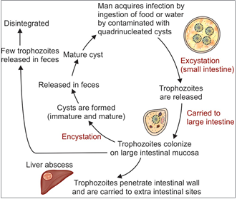
Life cycle
Infective form: Mature quadrinucleated cyst
Mode of transmission: feco-oral route, sexual, very rarely by vectors
IP- 1-4 wks

Slide 10
Virulence factors
Trophozoite are invasive; possesses virulence factors
  Amoebic lectin antigen
  Amoebapore- forms pores on target cell membrane causing leakage of ions
  Cysteine proteases & hydrolytic enzymes
  Neuraminidase & metallocollagenase

Slide 11
Pathogenesis
Colonization: trophozoites colonize intestinal mucosa; different fates can occur
Asymptomatic cyst passers (90%)
Amoebic dysentery
Invasive amoebiasis
Adhesion: trophozites penetrate mucus layer, adhere to glycoprotein receptors of large intestinal mucosa by Gal/GalNAc lectin molecules
Flask-shaped ulcers (m.c in caecum)
Invasion: Amoebae then invade the large intestinal wall & migrate to extraintestinal sites
Intestinal complications

Slide 12
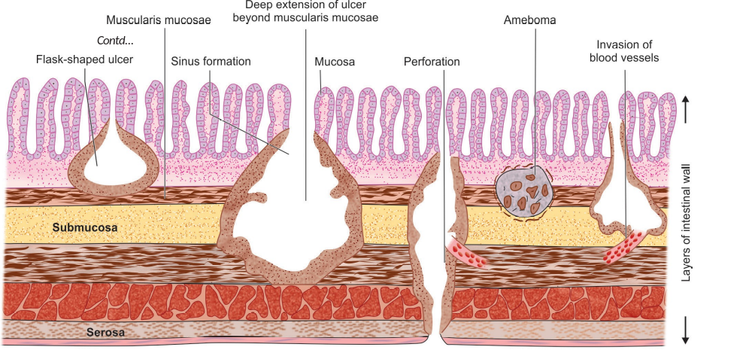
Complications

Slide 13
Complications
Fulminant amoebic colitis: generalized necrotic involvement of entire large intestine, more commonly in immunocompromised patients, pregnancy
Amoebic appendicitis- Intestinal perforation, amoebic peritonitis, toxic megacolon, intussusception
Amoebiasis cutis or cutaneous amoebiasis: perianal skin ulcers
Amoeboma (amoebic granuloma): diffuse pseudotumor like mass of granulomatous tissue found in rectosigmoid region
Chronic amoebiasis: thickening, fibrosis, stricture formation with scarring.

Slide 14
Clinical features
Amoebic dysentery- bloody diarrhea (up to 10 times/d) with mucus & pus cells, colicky abdominal pain, fever, prostration, weight loss
Amoebic appendicitis
Amoeboma- palpable abdominal mass
Fulminant colitis: intense colicky pain, rectal tenesmus, more than 20 motions/day, fever, nausea, anorexia, hypotension

Slide 15
Character | Amoebic dysentery | Bacillary dysentery
Pathology
Ulcer | Deep | Shallow
Margin | Ragged, undermined | Uniform
Intervening mucosa | Normal | Inflamed
Cellular response | Mononuclear | Polymorphonuclear
Character | Amoebic dysentery |  | Bacillary dysentery
Stool macroscopic feature
Number of motion | 6–10/day | > 10/day
Amount | Copious amount | Small quantity
Color | Dark red | Bright red
Odor | Offensive | Odorless
Reaction | Acidic | Alkaline
Consistency | Not adherent to container | Adherent to container

Slide 16
Character | Amoebic dysentery | Bacillary dysentery
Stool microscopic feature
Red blood cells (RBCs) | In clumps | Discrete or in rouleaux
Pus cells | Few | Numerous
Macrophages | Few | Numerous*
Eosinophils | Present | Absent or rare
Charcot-Leyden crystal | Present | Absent
Pyknotic body** | Present | Absent
Organism detected | E. histolytica cyst or trophozoite | Bacteria (e.g. Shigella)

Slide 17
Lab diagnosis
Samples- 3 stool samples collected on alternate days, rectal exudates, rectal ulcer tissues
- Examined immediately within 1- 2 hrs or e preserved in merthiolate iodine/ formalin & concentration must be done
Stool microscopy- wet mount (saline/ iodine mounts), permanent stains (trichrome stain/ iron hematoxylin)
Histology- Intestinal biopsies stained with PAS or H&E stains reveal trophozoites
Stool culture- not done routinely; polyxenic & axenic culture

Slide 18
Stool antigen detection (coproantigen)- ELISA (detecting 170-kDa of lectin Ag) & ICT (detecting 29-kDa surface Ag)
Serology
  Amoebic antigen- ELISA (170-kDa of lectin Ag) only present in acitve disease
  Amoebic antibody- ELISA IgG Ab against lectin Ag
Isoenzyme (zymodeme) analysis- not routinely used
Molecular diagnosis- Nested multiplex PCR, real time PCR, Biofire FilmArray

Slide 19
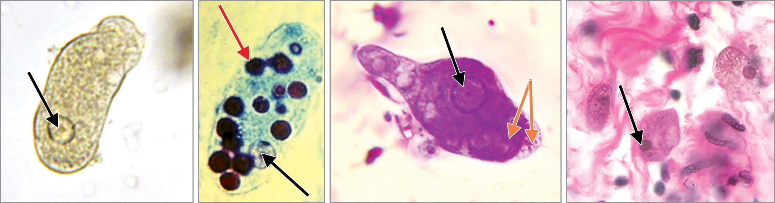
A
B
C
D
Entamoeba histolytica trophozoites: A. Saline mount; B and C. Trichrome stain, nsingle nucleus (black arrow) RBCs (red arrow) and ectoplasm and endoplasm (orange arrows);
D. Trophozoites in colon tissue stained with H&E.

Slide 20
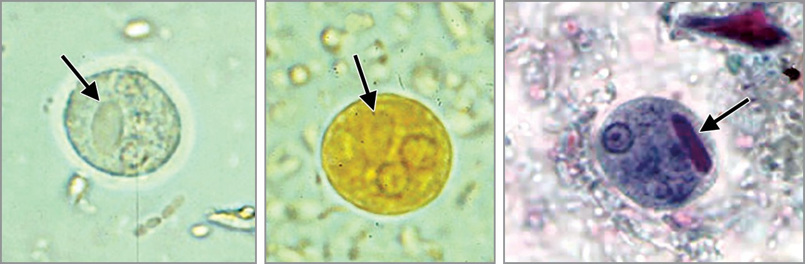
A
B
C
Cyst of E. histolytica: A. Saline mount; B. Iodine mount;
C. Trichrome stained smear. Note the chromatoid body with blunt ends (arrow).

Slide 21
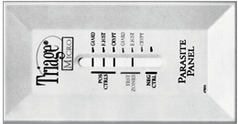
Triage parasite panel, positive for E. histolytica/E. dispar Ag
Giardia lamblia (alpha-1 giardin antigen)
E. histolytica/ E. dispar (29 kDa surface antigen)
Cryptosporidium parvum (protein disulfide isomerase antigen)

Slide 22
Treatment
Asymptomatic carriage:
Luminal agents
  Iodoquinol (for 20 days) or
  Paromomycin (for 10 days)
Amoebic dysentery:
Tissue agents
Metronidazole (for 5- 10 days) or tinidazole (for 3 days) plus
Luminal agents as above
Other measures include fluid & electrolyte replacement

Slide 23
Intestinal flagellate infections
Giardiasis

Slide 24
Giardiasis
Giardia lamblia (G. intestinalis/ G. duodenalis)
1st observed by AV Leeuwenhoek in 1681
Later, named after Dr F Lambl & Professor A Giard (1859)
Worldwide in distribution; warm tropics/ subtropics
One of m.c parasite which causes endemic & epidemic diarrhea
Genotypes: A & B
Inhabits crypts of duodenum & upper part of jejunum in man

Slide 25
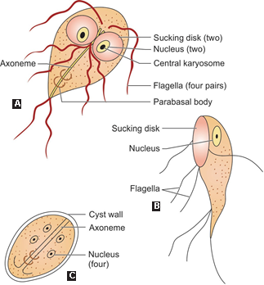
Morphology
A, B. Trophozoite- Pear-shaped trophozoite: pathogenic form & feeding stage
C. Cyst- Tetra-nucleated oval cyst: infective form & diagnostic form

Slide 26
Characteristics | Trophozoites | Cysts
Disease | Active stage | Active disease & carriers
Visualized in | in saline mount & permanent staining
Size | 10- 20 X 5- 15 μm | 11–14 μm X 7–10 μm
Shape | pear-shaped/ tear drop/ tennis racket shaped | oval-shaped
Motility | falling leaf-like | Non motile
Internal structure | bilaterally symmetrical, pair of nuclei, adhesive or sucking disk at its ventral surface, four pairs of flagella, pair of axonemes | four nuclei, pair of axonemes

Slide 27
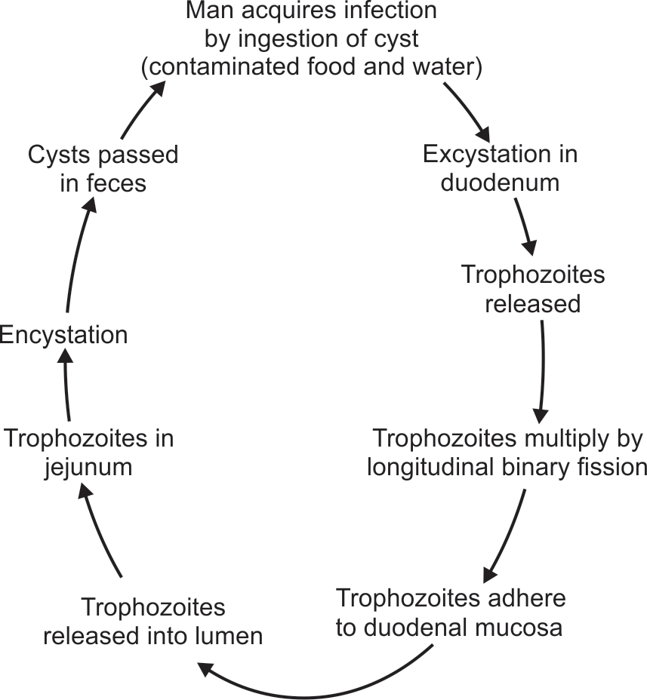
Life cycle
Host: one host
Infective form: Cysts
trophozoites are
excreted in stool

Slide 28
Pathogenesis
Infective dose: 10- 25 cysts
Risk factors: Children, elderly debilitated persons, poor hygiene, immunodeficient individuals
Trophozoites adhere to duodenal mucosa, cause disruption of intestinal epithelium & lead to increased permeability & malabsorption
Malabsorption of fat (steatorrhea)- leads to foul smelling profuse frothy diarrhea
Disaccharidase deficiencies (lactose, xylose)- leading to lactose intolerance

Slide 29
Malabsorption of vitamin A, B12, iron
Protein losing enteropathy
Antigenic variation: Giardia undergoes antigenic variations due to a cysteine rich protein on its surface (variant surface protein (VSP)), helps in evasion of host immune system; which leads to chronic recurrent illness

Slide 30
Clinical features
Asymptomatic carriers
Acute giardiasis: IP- 1 wk to 3 wks
diarrhea, abdominal pain, bloating, belching, flatus vomiting, steatorrhea
3. Chronic giardiasis: recurrent episodes of foul smelling diarrhea, profound weight loss, growth retardation, urticaria, arthritis, anterior uveitis

Slide 31
Lab diagnosis
1. Stool Examination: Gold standard for diagnosis
At least 3 concentrated stool samples examined to increase sensitivity
Detects cysts & trophozoites
2. Entero-test (String Test)- duodenal sampling with gelatin capsule attached to thread
3. Histopathology- Endoscopy-guided duodenal biopsy tissue stained by Giemsa stain to demonstrate trophozoites

Slide 32
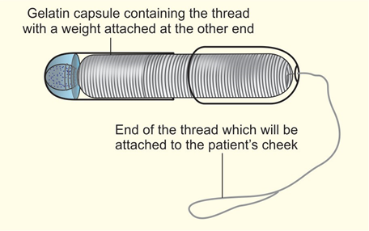
Entero-test equipment showing duodenal capsule

Slide 33
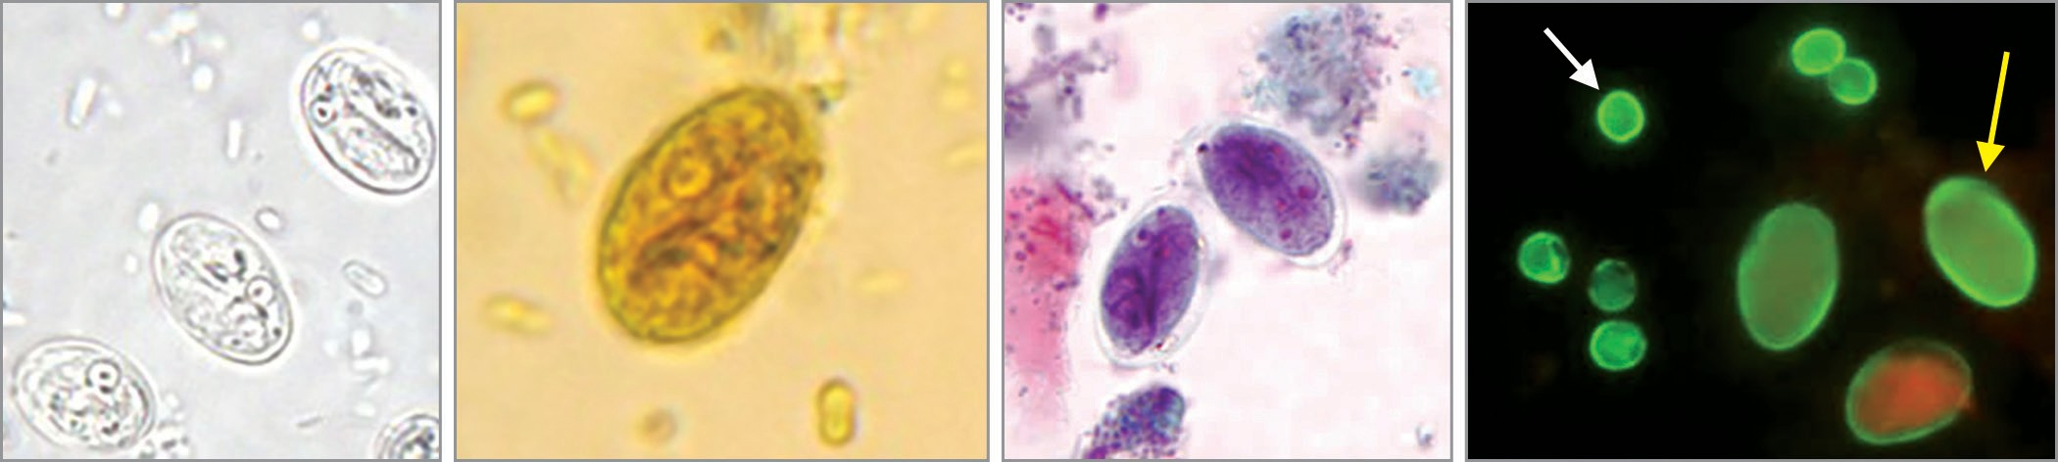
A
B
C
D
Cysts of Giardia lamblia: A. Saline mount; B. Iodine mount; C. Trichrome stain; D. Direct immunofluorescence assay.

Slide 34
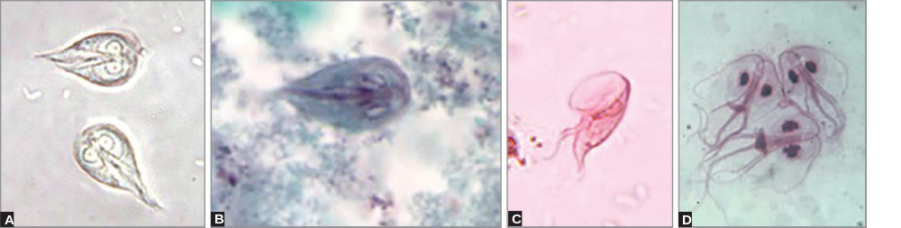
Trophozoites of Giardia lamblia: A. Saline mount front view; B. Trichrome stain front view; C. Merthiolate iodine formalin (MIF) stain lateral view (spoon shaped); D. Giemsa stained mucosal imprint (front view).

Slide 35
4. Antigen Detection in Stool (Coproantigen)- ELISA & direct fluorescent antibody tests (DFA), Rapid ICT (e.g. triage parasite panel)
5. Antibody Detection- Indirect fluorescent antibody (IFA) & ELISA; cannot differentiate b/w recent or past infections
6. Culture- axenic media (Diamond’s media)
7. Molecular Methods- PCR, Biofire Filmarray
8. Radiology- Fluoroscopy , X-ray after barium meal

Slide 36
Treatment
DOC- Tinidazole (2g once)
Or Metronidazole (for 5 d) or nitazoxanide (for 3 d)
Furazolidone in children
Auranofin, paromomycin in pregnancy
In AIDS patients & hypogammaglobulinemia, prolonged therapy with metronidazole (21 d)

