Slide 1
Bacterial genetics

Slide 2
Learning objectives
At the end of the session, the phase II MBBS students will be able to:
Describe the principles of bacterial genetics
Discuss the concept of transformation, transduction, lysogenic conversion

Slide 3
Principles
Deals with study of hereditary & genetic variation in bacteria
All hereditary characteristics are encoded in their DNA
Bacterial DNA is present in chromosomes & plasmids

Slide 4
Bacterial DNA
Single haploid chromosome
Super coiled double stranded DNA
Structure of DNA:
Each strand has three elements
Nucleoside = Sugar+ nitrogenous base
Nucleotide = sugar+ nitrogeneous base + phosphate
Four nitrogeneous bases:
Two purines: Adenine (A) & guanine (G)
Two pyrimidines : Thymine (T) & Cytosine(C)

Slide 5
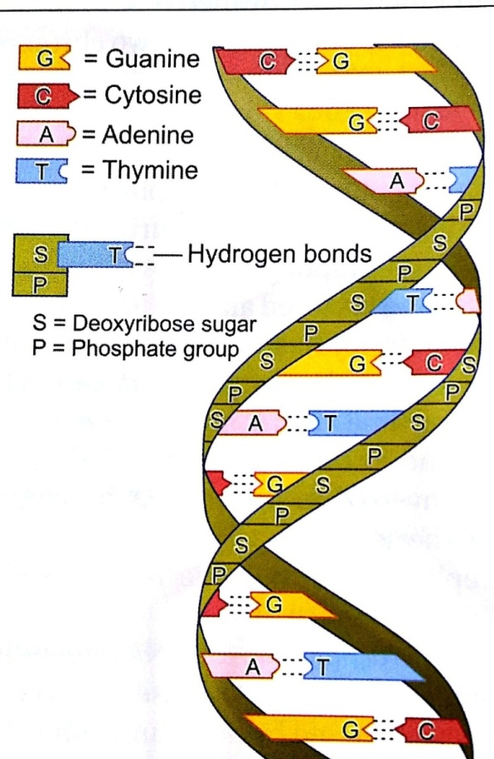
Pairing:
Two DNA strands held together by hydrogen bonds b/w nitrogenous bases
A-T & G-C
The ratio of A+T to G+C is constant for each species but varies from species to species

Slide 6
DNA replication
In eukaryotes, during RNA replication, two strands of double helix unwind from one another & separate
Each strand acts as a template for a new DNA strand
Synthesized through complementary base pairing A with T, G with C

Slide 7
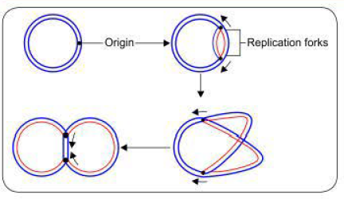
a. Bi-directional replication
Replication begins at a single point, the origin
DNA helix is unwound at replication fork
Here DNA synthesis occurs & individual strands are
replicated
Eg. In E. coli

Slide 8
Two replication forks move outwards from the origin until they have copied
The whole replicon & a structure shaped like the Greek theta (θ) is formed
Finally two chromosomes are separated

Slide 9
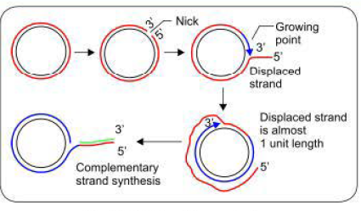
b. Rolling- circle mechanism
Occurs during bacterial conjugation & during reproduction of viruses & bacteriophages
Outer strand is nicked, free 3' end is extended by replication enzymes
The growing point rolls
around the circular inner
strand

Slide 10
5' end of the outer strand is displaced & forms a single-stranded tail
Which later may be converted to ds DNA by complementary strand synthesis

Slide 11
DNA replication is catalysed by several replication enzymes:
Enzyme | Function
Helicase | DNA unwinding
Topoisomerase | Relieves tension generated by rapid unwinding by removing super twists
DNA polymerase | Catalyses synthesis of DNA in the 5’ to 3’ direction Reading the DNA template in the 3’ to 5’ direction DNA polymerase III has role in replication
DNA ligase | Helps in joining fragments

Slide 12
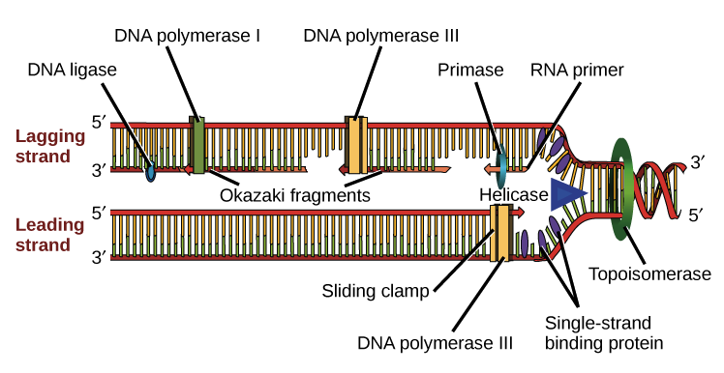

Slide 13
Bacterial RNA
Two differences
1. In sugars: Ribose is present instead of deoxyribose
2. In nitrogeneous base: uracil replaces thymine
Three different types of RNA are there in a cell
m-RNA, r-RNA, t-RNA
The main function of these is protein synthesis

Slide 14
Polypeptide synthesis
Gene- segment of DNA that stores information for a particular polypeptide synthesis
DNA is transcribed into RNA & then translated to form particular polypeptide
Genetic code:
Codons- 64
sequence of three nucleotide bases present on mRNA
Discovered by Nirenberg & Khorana (1968)

Slide 15
Sense codon:
61 are sense codons- direct production of a single amino acid
Non sense codon:
Three codons (UAG, UGA, UAA) do not code for any amino acids & are involved in termination of translation; called stop codons

Slide 16
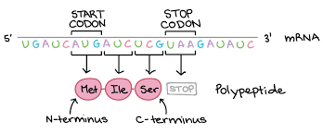
Start codon: First codon of mRNA from which the translation begins; eg. AUG
Anticodon: set of three nucleotide bases present on tRNA that is complementary to nucleotide bases of codon on mRNA

Slide 17
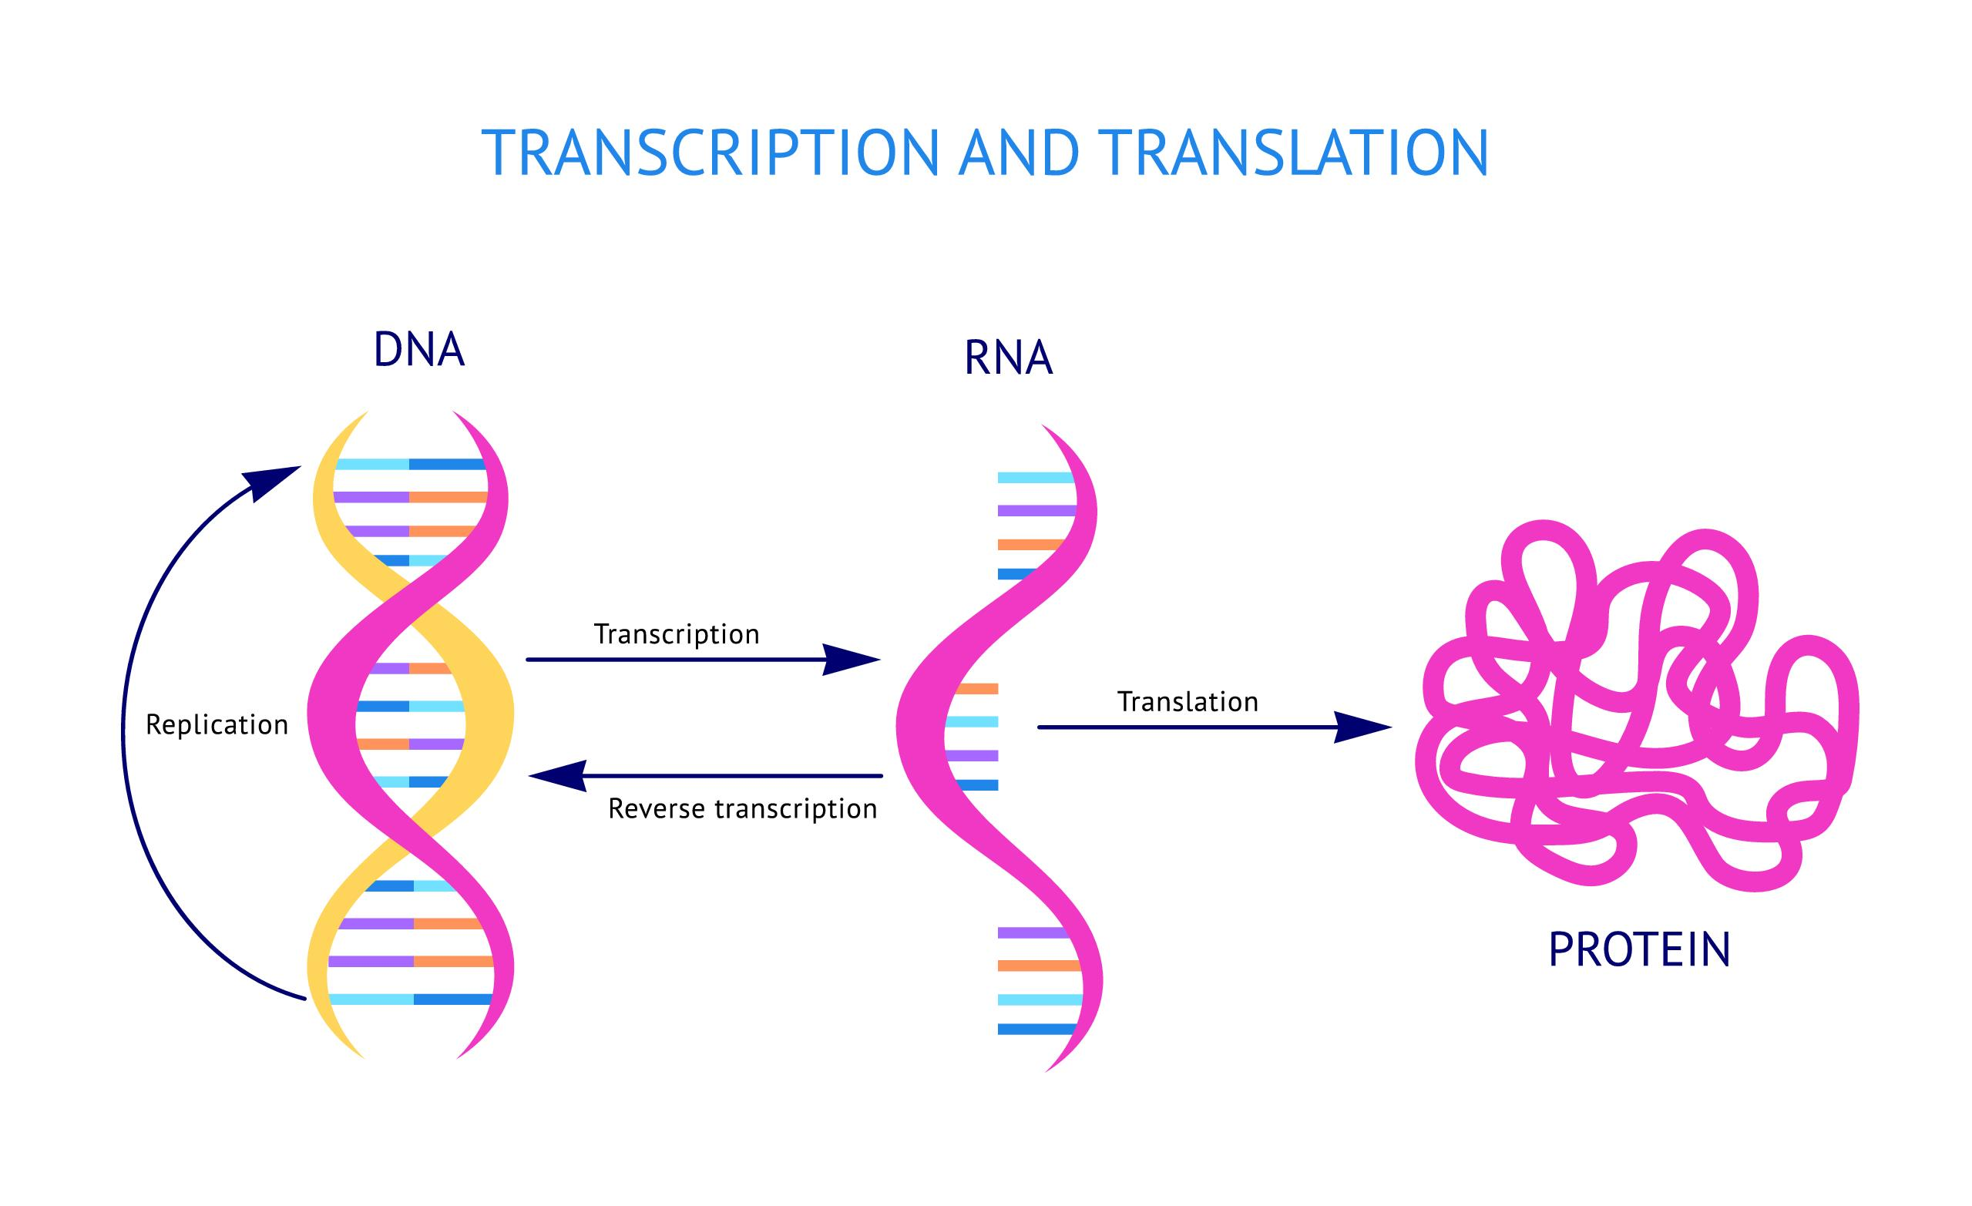
Transcription
Particular segment of DNA is copied into RNA by enzyme RNA polymerase
Bases in mRNA are complementary to that of DNA

Slide 18
Translation
Transcribed mRNA is decoded by a ribosome to form specific amino acid chain. Occurs in bacterial cytoplasm
Initiation:
Ribosome assembles around target mRNA
First tRNA is attached at start codon of mRNA
Elongation:
tRNA transfers an amino acid to the adjacent tRNA, corresponding to the next codon

Slide 19
Translocation:
The ribosome then moves to next mRNA codon to continue the process
Termination:
When a stop codon is reached, the ribosome releases the polypeptide

Slide 20
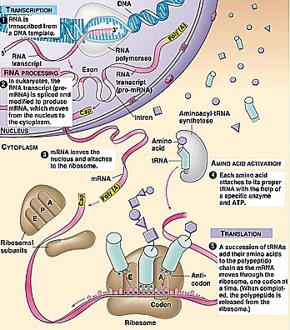

Slide 21
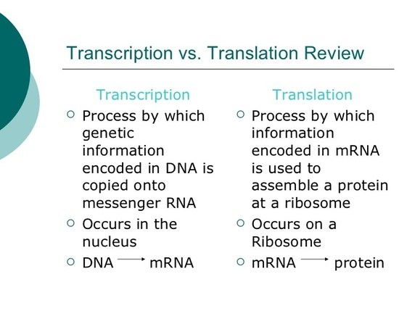

Slide 22
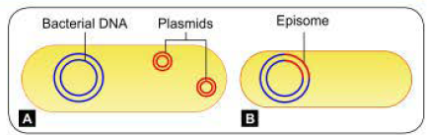
Plasmids
Extrachromosomal ds circular DNA molecules that exist in free state in cytoplasm of bacteria & in some yeasts
Not essential
Numbers: single/ multiple
Independent replication

Slide 23
Episome:
Plasmid may integrate with chromosomal DNA of bacteria
They replicate with bacterial chromosome

Slide 24
Curing : Eliminating the plasmid from bacteria
Spontaneously or induced by t/t of host cell with substances that inhibit plasmid replication without affecting the host cell (acridine, radiations, thymine, starvation & higher temperatures)

Slide 25
Classification of plasmids
1. Based on conjugation:
Conjugative plasmids:
Ability to transfer themselves to other bacteria- self conjugative plasmid
Non conjugative plasmid:
Can not transfer themselves

Slide 26
2. Based on compatibility between plasmid:
Compatible plasmid:
Different plasmids can exist in a single bacterial cell only if they are compatible with each other
Incompatible plasmid:
They will be rapidly lost from the cell
Share the same replication mechanism, hence compete with each other

Slide 27
3. Based on function:
Fertility plasmids/ F-plasmids:
They contain tro- gene which code for expression of sex pili that help in bacterial conjugation
R plasmids:
Code resistance to various antibiotics
Col plasmids: Code for bacteriocins

Slide 28
Virulence plasmids:
Code for certain virulence factors like heat labile & heat stable toxins of E. coli
Metabolic plasmids:
Enable host’s metablolic processes
Digestion of toluene, salicylate & camphor
urease synthesis
nitrogen fixation

Slide 29
Plasmid as vector:
Ability to transfer DNA from one cell to another (used in genetic engineering)
Contain sites where gene can be inserted artificially by recombinant DNA technology
Can be used for protein synthesis, gene therapy

Slide 30
Functions of plasmids
Resistance to antibiotics
production of toxins
synthesis of cell surface structures required for adherence or colonization

Slide 31
Bacterial variation
Phenotypic variation:
Variations in expression of various characters (synthesis of flagella, expression of enzymes)
Genotypic variation:
Change in genetic composition due to mutation

Slide 32
Mutation
Definition: Random unidirectional heritable variation caused by change in nucleotide sequence of cell genome
1. Spontaneous mutation: Occur naturally in any dividing cell (without adding any mutagens)
2. Induced mutation: occurs by exposure of organism to mutagen

Slide 33
Physical mutagens :
UV radiation: cytosine & thymine are more vulnerable to UV
Chemical agents: alkylating agents, acridine dye
Can affect properties of bacteria:
Sensitivity to bacteriophage
loss of ability to produce capsule or flagella
Loss of virulence
Alteration in colony morphology, pigment production
Drug susceptibility
Antigenic structure

Slide 34
Classification of mutation types
Small scale mutation:
More common
Point mutation- occurs at a single nucleotide
Addition or deletion of single nucleotide pair
Large scale mutation:
occurs in chromosomal structure
Include deletion or addition of several nucleotide base pairs

Slide 35
Forward mutations
Substitutions at single nucleotide base pairs
Silent
Missense
Nonsense
2. Addition/ deletion at a single or many nucleotide bp
- Frameshift mutations
Reverse mutations
True reversion
Equivalent reversion
Wild type mutation
Wild type
Suppressor mutations

Slide 36
Detection of mutants
Gene sequencing
Pheynotypic methods
Fluctuation test
Replication plating methods
Ames test

Slide 37
Gene transfer in bacteria
Vertical gene transfer- transmission of genes from
parents to offspring during cell division
Horizontal gene transfer- occurs by several methods
Transformation
Transduction
Lysogenic conversion
Conjugation (plasmid mediated)

Slide 38
1. Transformation
Definition:
Random uptake of free/ naked DNA fragment from the surrounding medium by a bacterial cell & incorporation of this DNA fragment into its chromosome in a heritable form
Natural transformation occurs in Streptococcus, Bacillus, Haemophilus, Neisseria, Acinetobacter & Pseudomonas

Slide 39
Mechanism of transformation
Large amount of dsDNA is released into surrounding environment on bacterial lysis
Competent bacteria present in surroundings uptake DNA
Competent bacteria express competence factors; they can uptake any DNA fragment(Eg. Streptococcus pneumoniae)
Non competent bacteria can also uptake DNA from closely related species (Eg. Haemophilus influenzae)

Slide 40
1. A long dsDNA fragment comes in contact with a competent bacterium
binds to DNA- binding protein present on its surface &
One strand is degraded by recipient cell exonucleases
2. The other strand associates with a competence specific protein & is internalized
3. Then it is integrated into host chromosome

Slide 41
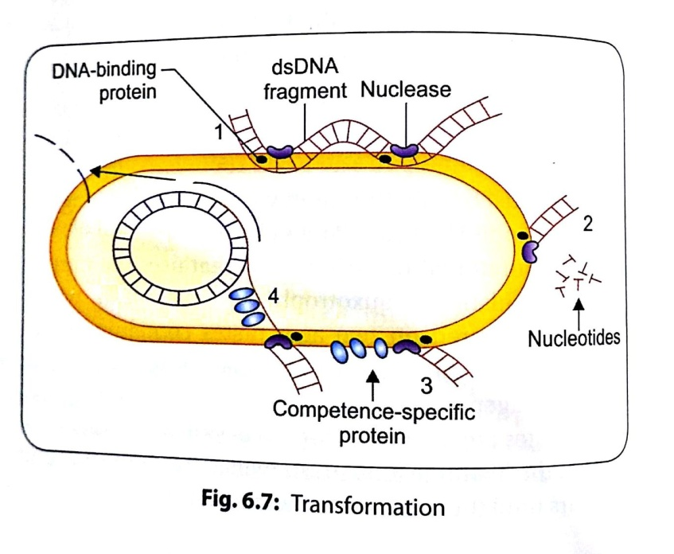

Slide 42
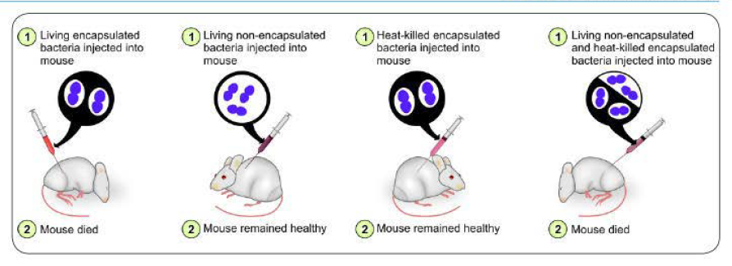
GRIFFITH EXPERIMENT of Transformation (1928); Later confirmed by Avery, Maclead, McCarty in 1944

Slide 43
2. Transduction
Definition: transmission of a portion of DNA from one bacterium to another by a bacteriophage (virus that infects & multiplies in bacteria)
The phage acts as a vehicle carrying bacterial genes

Slide 44
Mechanism:
a. Lytic or virulent cycle:
Bacteriophage multiplies in host cytoplasm, produces large amount of progeny phages which are released causing cell death & lysis
b. Lysogenic or temperate cycle:
The phage DNA remains integrated with bacterial chromosome as the prophage, which multiplies synchronously with bacterial DNA & bacterium is unharmed

Slide 45
TYPES OF TRANSDUCTION
Generalized transduction
Involves transfer of any part of donor bacterial genome into recipient bacteria
Errors may occurs due to defective assembly of the daughter phages during lytic cycle
The resulting bacteriophage injects donor DNA into another bacterial cell but does not initiate a lytic cycle as the original phage DNA is lost
`

Slide 46
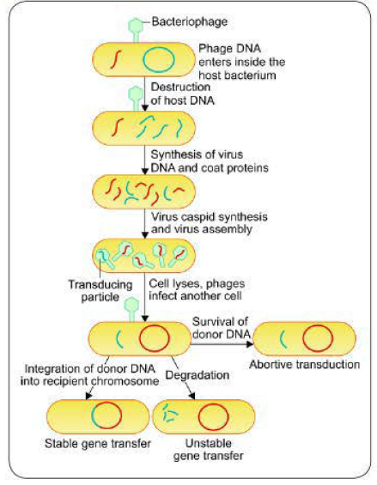

Slide 47
2. Restricted or specialized transduction
Capable of transducing only a particular genetic segment of bacterial chromosome that is present adjacent to phage DNA
Occurs as a result of defect in the disintegration of the lysogenic phage DNA from the bacterial chromosome
Studied intensively in lambda phage of E. coli

Slide 48
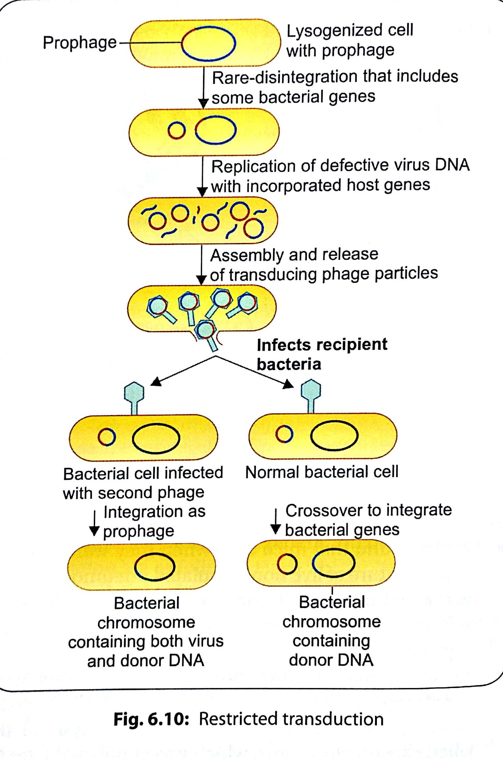

Slide 49
Role of transduction
Drug resistance: E.g. plasmid coded penicillin resistance in staphylococci
Treatment: Method of genetic engineering in the treatment of some inborn metabolic defects

Slide 50
3. Lysogenic conversion
During temperate/ lysogenic life cycle, phage DNA remains integrated with bacterial chromosome as prophage which multiplies synchronously with the bacterial DNA
Transferred to daughter cells
Phage DNA itself behaves as new genetic elements in contrast to transduction
Imparts toxigenicity to bacteria

Slide 51
Eg. Corynebacterium diptheriae toxin is coded by lysogeneic phage DNA
Phage coded toxins:
Diptheria toxin
Cholera toxin
Verocytotoxin of E. coli
SPE- A & C
Botulinum toxin C & D

Slide 52
4. Conjugation
Transfer of genetic material from one bacterium to another bacterium by mating or contact with each other & forming conjugation tube
Discovered by Lederberg & Tatum
F+ X F- Mating
HFR x F- Mating
F’ x F- mating

Slide 53
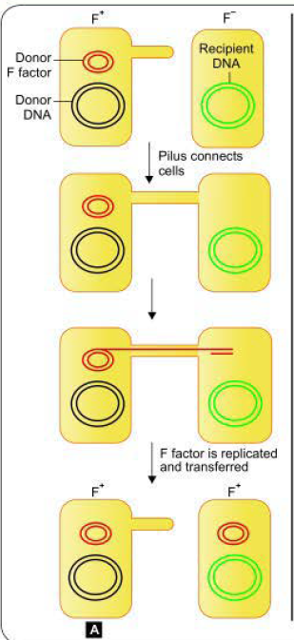
a. f+ X f- Mating
F+ cell (donor/ male bacterium) contains F factor or fertility factor
F- cell (female or recipient bacteria) lacks F factor
F factor- conjugative plasmid; carries genes that encode for the formation of sex pilus

Slide 54
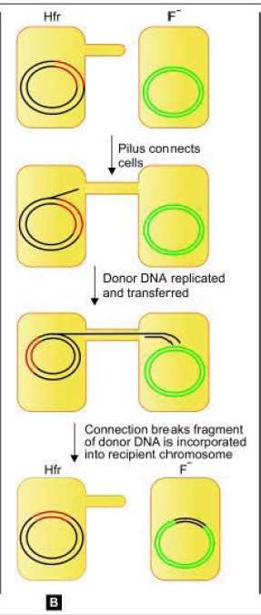
b. HFR x F- Mating
F factor plasmid may integrate with bacterial chromosome & behave as episome
Such cells are able to transfer chromosomal DNA to recipient cells with high frequency
HFr cells (high frequency of recombination)
F recipient cells do not become F + cells

Slide 55
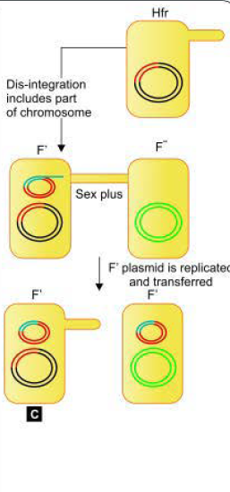
c. F’ x F- mating
Conversion of F+ cell into a Hfr cell is reversible
When the F factor reverts from the integrated to free state
It may sometimes carry with it some chromosomal DNA from adjacent site of its attachment
Such an F factor carrying some chromosomal DNA is named as F’ factor (F prime factor)
Recipient becomes F+ cell

Slide 56
Important role in transfer of plasmids coding for antibacterial drug resistance (resistance transfer factor (RTF)
R factor plasmid = RTF+ r determinants (each encodes resistance to one drug)
Bacteriocin production (Colicinogenic (Col) factor] Bacteriocins are antibiotic-like substances produced by one bacterium that inhibit other bacteria. E.g Coliform bacteria produce colicin

Slide 57
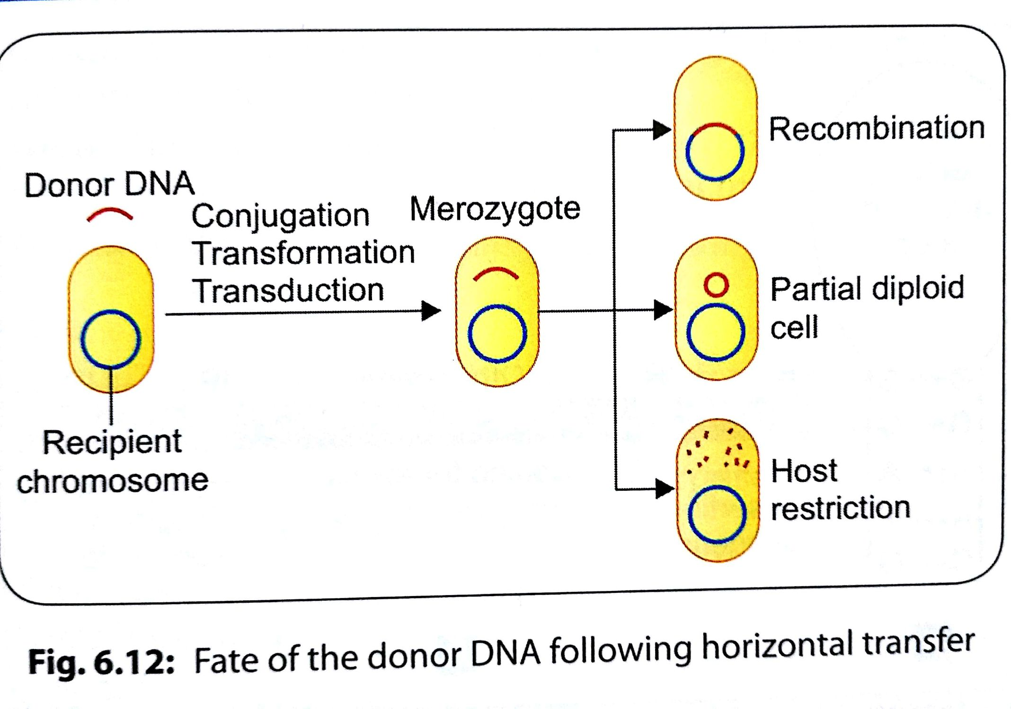

Slide 58
Transposition
Transposons- Genes capable of intracellular transfer b/w chromosomes plasmids & plasmid to chromosome or vice-versa
Also called jumping genes or mobile genetic elements as transposons move around genome in a cut & paste manner
Not self replicating, dependent on chromosomal or plasmid DNA replication

Slide 59
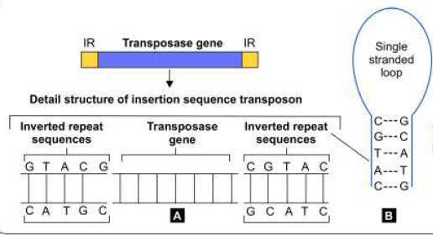
Types of transposons:
Insertion sequence transposon: 1-2 kbp, consists of a transposasegene, flanked at both ends by inverted repeat sequences of nucleotides

Slide 60
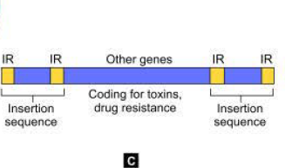
- Composite transposon: Larger carrying additional genes, (for antibiotic resistance or toxin production in the center) & both ends are flanked by insertion sequences that are identical or very similar in sequence

Slide 61
Gene transfer by artificial methods
Genetic engineering:
Deliberate modification of an organism’s genetic information by directly altering its nucleic acid genome
Gene coding for any desired protein is isolated from an organism & then inserted into suitable vectors
Cloned in such a way that it can be expressed in the formation of specific protein

Slide 62
Recombinant DNA technology- Steps
1. Treatment with restriction enzymes: DNA extracted & then cleaved by enzymes called restriction endonucleases to produce mixture of DNA fragments
2. Southern blot: The fragment containing desired gene is isolated form mixture of DNA fragments
Electrophoresis: DNA fragments are electrophoretically separated by agar gel electrophoresis
Transfer to nitrocellulose membrane
Detection of desired gene:By adding specific DNA probe
Isolation:The band containing desired gene is isolated by DNA extraction & then, is subjecting to electrophoresis in a different gel

Slide 63
Recombination with a vector: The isolated DNA fragment is annealed with vector by DNA ligase enzyme
Introduction of vector into bacteria: The vector is introduced into bacteria usually by transformation & by phage vector by transduction
Cloning: Culture of bacteria containing the desired gene gives the desired protein

Slide 64
Application of genetic engineering
Production of vaccine: By producing desired antigen to be used in vaccine. Eg: vaccine for hepatitis B
Production of antigens used in diagnostic kits
Production of proteins used in therapy. Eg. Human growth hormone, insulin, IL2, TNF, factor VIIITransgenic animals/ genetically modified animals: artificially introduce a foreign DNA into the genome of animal (transfection). Eg. Transgenic mice for biotechnological applications
Gene therapy: replacing defective gene by introducing normal gene into patient

Slide 65
Vector- Small piece of DNA into which a foreign DNA fragment can be inserted
Can be stably maintained in an organism
Used for cloning purposes
Plasmids
Bacteriophages
Cosmids
Artificial chromosome

Slide 66
Blotting techniques
Method of transferring DNA, RNA or proteins from gel on to a carrier. e.g. nitrocellulose membrane, followed by their detection by
using specific nucleic acid probes (for DNA or RNA detection)
Enzyme immmunoassay (for protein detection)
Southern blot is used to detect DNA
Northern blot is used to detect RNA
Western blot is used to detect proteins
Eastern blot: modification of Western blot for analyzing proteins for post-translational modifications

Slide 67
Thank you

Slide 68
Detection & Isolation of Mutants
Fluctuations in mutation are wide when small volume sub cultures are made (which leads to more frequent mutations),
As compared to large volume subcultures (where !he mutations occur less frequently).

Slide 69
Detection & Isolation of Mutants
Replica Plating Method
Replica plating method is used to detect auxotrophic mutants; described by Lederberg in 1952.
It differentiates between the normal strains from auxotrophic mutants
Based on their ability to grow in the absence of a particular nutrient on which the mutant is dependent.

Slide 70
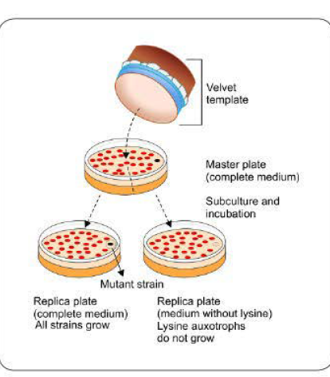
Detection & Isolation of Mutants
lysine auxotroph will grow on lysine-supplemented media but not on a medium lacking lysine
Using a velvet template, mixture of colonies (some normal strain, some auxotroph mutants) of an organism are transferred from a master plate, onto two subculture plates
0ne of the plate is lacking a limiting nutritional substance, e.g. lysine

Slide 71
Detection & Isolation of Mutants
After incubation, colonies similar to those on master plate are formed with relative position of all the colonies retained on the subculture plates,
Except for the lysine auxotroph which do not grow on the media lacking lysine

Slide 72
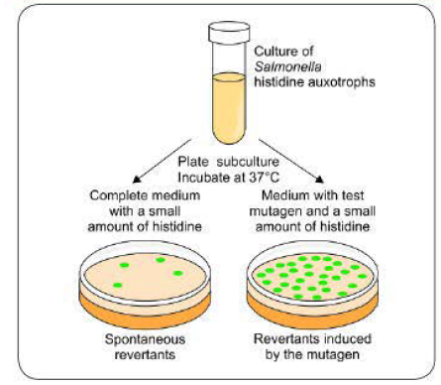
Detection & Isolation of Mutants
Ames Test (Carcinogenicity Testing)
It is a mutational reversion assay that uses the mutant strains (histidine auxotroph) of Salmonella which are subcultured on two agar plates containing small amount of histidine;
one of the plate is added with the test mutagen

Slide 73
Detection & Isolation of Mutants
The plates are incubated for 2-3 days at 37'C.
All of the histidine auxotrophs will grow for the first few hours until the histidine is depleted
Once !he histidine supply is exhausted, only revertants that have mutationally regained the ability to synlhesize histidine will grow

Slide 74
Detection & Isolation of Mutants
Reversed mutation may be induced due to carcinogen (can affect large number of strains) or occur spontaneously (affect only few strains)
The relative mutagenicity of the carcinogen can be estimated by counting the colonies-the more colonies, the greater is the mutagenicity

Slide 75
BACTERIAL RECOMBINATION
Recombination takes place between the donor DNA & recipient chromosome in two ways-
General recombination
& Site specific recombination.

Slide 76
General or Homologous Recombination
This is the most common form, can occur at any place on the recipient's chromosome in general.
& occurs between DNA of similar sequences (homologous).
Rec genes:
The rec genes present in recipient's chromosome & their products, such as the recA proteins are crucial to bringout recombination

Slide 77
General or Homologous Recombination
Crossing-over:
The donor & recipient DNA str&s breakage takes place followed by their reunion by crossing-over of str&s
Reciprocal vs Nonreciprocal General Recombination
Most of the donor DNA fragments entering into the recipient cell by horizontal gene transfer are double str&ed; except those transferred by transformation which are single str&ed

Slide 78
General or Homologous Recombination
Reciprocal exchange:
In most cases (except in transformation), the general recombination usually involves a reciprocal exchange between a pair of homologous DNA sequences between donor & recipient str&s
Nonreciprocal exchange:
In bacterial transformation, a nonreciprocal form of general recombination takes place.
The single str& of donor DNA is inserted into the host chromosome (by replacing a piece of host chromosome) to form a stretch of heteroduplex DNA

Slide 79
General or Homologous Recombination
Site Specific Recombination
In restricted transduction, the integration of bacteriophage DNA into bacterial chromosome is site-specific.
The donor DNA is not homologous with the chromosome it joins, &
The enzymes responsible for this event are specific for the particular bacteriophage & its host bacterium

Slide 80
NUCLEIC ACID PROBE
Nucleic acid probes are radiolabeled or fluorescent labeled pieces of single str&ed DNA or RNA, which can be used for the detection of homologous nucleic acid by hybridization
Hybridization is the technique in which two single str&s of nucleic acid come together to form a stable double str&ed molecule

Slide 81
NUCLEIC ACID PROBE
There are two types of nucleic acid probes-
DNA probes (hybridizes with DNA) &
RNA probes (hybridizes with RNA)

Slide 82
NUCLEIC ACID PROBE
Nucleic acid probes are used to detect the specific nucleic acid either-
Directly in the clinical sample or
Following amplification of small quantity nucleic acid present in the clinical sample (e.g. in real lime PCR) or
Following enzymatic digestion of the extracted nucleic acids
so that it detects only the specific DNA fragment from the mixiure (e.g. in Southern blot).

