Slide 1
ANTIGEN ANTIBODY REACTIONS

Slide 2
Learning objectives
At the end of the session, Phase II MBBS students must be able to:
Enumerate newer techniques of detecting Ag-Ab reactions
Describe the principle, procedure & types of ELISA
Describe principle, procedure & types of rapid tests (Point of care tests)
Discuss the applications of newer techniques in diagnosis

Slide 3
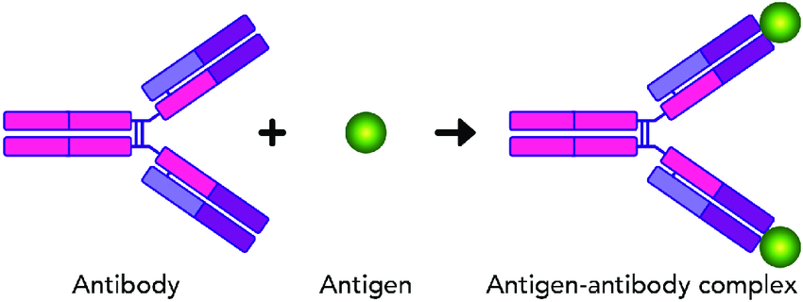
Introduction
Antigen (Ag)- antibody (Ab) interaction is biomolecular association where Ag & Ab combine with each other specifically & in an observable manner; does not lead to an irreversible alteration in Ab/ Ag
Notes:
(similar to enzyme substrate interaction)

Slide 4
Ag/ Ab combine specifically, in an observable manner
In vivo, Ag/ Ab reactions form basis of Ab mediated immunity
In vitro, help in diagnosis of infections, in identification of infectious agent
Ag-Ab reactions in vitro are k/a serological reactions

Slide 5
General features of Ag- Ab reaction
Specific- Interaction b/w epitope of Ag with corresponding paratope of its homologous Ab
Exception- cross reactions due to sharing of epitopes among different antigens
Ab against one Ag can cross react with a similar epitope of a different Ag
Entire molecules react (not fragments); combination occurs at surface

Slide 6
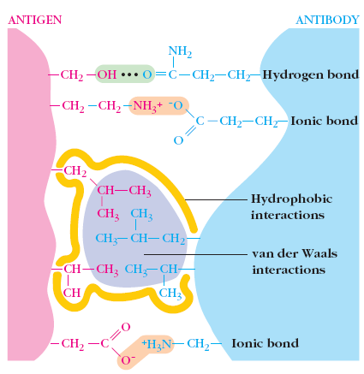
For strong reaction-
large number of non- covalent interactions
  Hydrogen bonds
  Electrostatic interactions
  Hydrophobic interactions
  Van der Waals forces.
Very close fit between Ag/Ab

Slide 7
Strength: Firmness of association is decided by affinity & avidity of Ag-Ab interaction
Affinity: sum total of non covalent interactions between a single epitope of an Ag with its corresponding paratope present on Ab
Avidity: Affinities of all binding sites when multivalent Ab reacts with complex Ag carrying multiple epitopes; better indicator of strength of an antigen-antibody reaction.
Eg- pentameric IgM has lower affinity than IgG, but high avidity (more effective binding with Ag)

Slide 8
Cross-Reactivity: Sometimes Ab elicited by one Ag can cross-react with unrelated Ag, if two different Ags share identical epitope
Eg- Streptococcus pyogenes expresses cell-wall proteins called M antigens. Abs produced to streptococcal M antigens cross-react with myocardial/ skeletal muscle proteins, cause heart/ kidney damage following infections

Slide 9
Qualitative vs Quantitative Immunoassays
Qualitative: Undiluted specimen containing Ab is directly mixed with Ag suspension; result is read as ‘positive’ or ‘negative’ based on presence/ absence of Ag/Ab in clinical specimen
Quantitative: When qualitative test turns positive, exact amount of Ab in serum can be estimated by serial dilution of serum & mixing each dilution with a known quantity of Ag; expressed in terms of titer

Slide 10
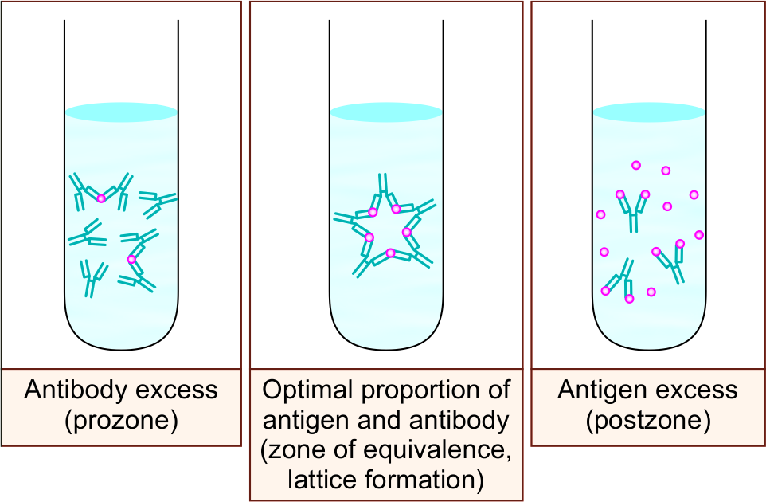
Marrack’s Lattice Hypothesis
Ag-Ab reaction is weak or fails to occur when no. of Ag & Ab are not proportionate to each other.
Prozone phenomenon- In earlier test tubes, Ab are excess, hence the Ag-Ab reaction does not occur
Post zone phenomenon- In later test tubes, Ag is excess, hence the Ag-Ab reaction fails to occur
In prozone/post zone- Lattice does not enlarge, due to inhibition of lattice formation by excess Ab/ Ag respectively

Slide 11
Types of Ag-Ab reactions
Conventional techniques -
Precipitation reaction
Agglutination reaction
Complement fixation test
Neutralization test
Newer techniques -
Enzyme linked immunosorbent assay (ELISA)
Enzyme linked fluorescent assay (ELFA)
Immunofluorescence Assay (IFA)
Chemiluminescence-linked immunoassay (CLIA)
Immunohistochemistry
Rapid tests- Lateral flow assay (Immunochromatographic test) Flow through assay
Western blot
Immunoassays using electron microscope

Slide 12
Precipitation reactions
Soluble Ag combines with its Ab in presence of electrolytes (NaCl) at suitable temp/ pH, insoluble precipitate is formed
When instead of sedimenting, precipitate remains suspended as flocules, reaction is k/a floculation
Antibodies that aggregate soluble antigens are called precipitins
Ab must be bivalent; Ag must be bivalent/polyvalent

Slide 13
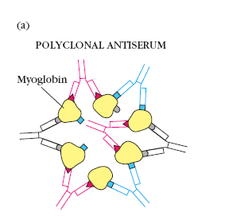
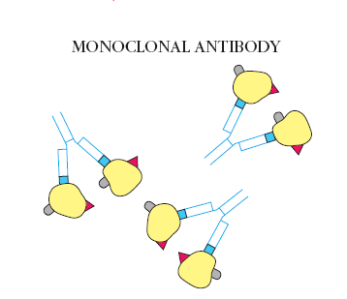

Slide 14
Applications
1. Ring test
Ascolis thermoprecipitin test for Anthrax
Grouping of Streptococci by Lancefield’s technique
2. Slide test
VDRL test for syphilis
3. Tube test
Kahn test for syphilis

Slide 15
Mechanism of precipitation
Zinsser’s unitarian hypothesis: Ag gives rise to only one Ab producing all different reactions depending on nature of Ag, conditions of reaction
Lattice hypothesis by Marrack: Precipitation results when large lattice is formed consisting of alternating Ag/ Ab molecules

Slide 16
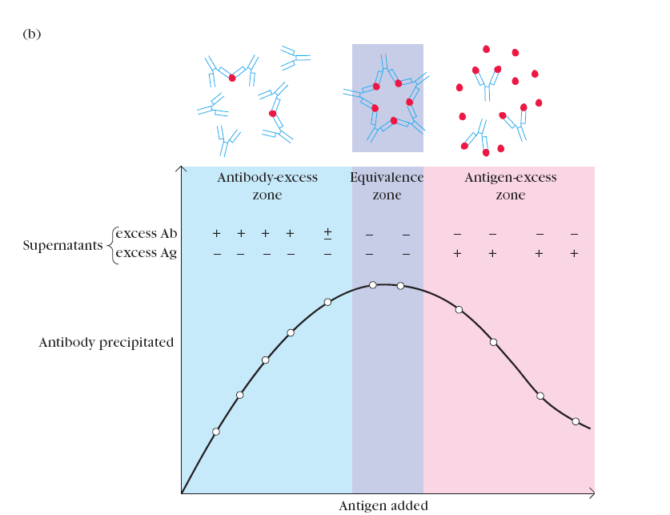
Precipiation reaction in fluid yields a precipitin curve

Slide 17
Precipitation reaction in gel yield visible precipitin lines
Visible as distinct band of precipitate which is stable
As each Ag-Ab reaction gives rise to precipitin line, different Ags in reacting mixture can be observed
Immunodiffusion indicates identity, cross identity, non identity b/w different Ags

Slide 18
Single diffusion in one dimension (Oudin’s procedure)
Double diffusion in one dimension (Oakely-Fulthrope procedure)
Single diffusion in two dimensions (Radial immunodiffusion)
Double diffusion in two dimensions (Ouchterlony procedure)
Immunoelectrophoresis

Slide 19
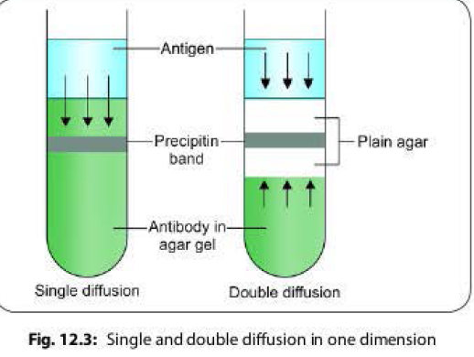
1. Single diffusion in one dimension: Oudin procedure
Ab is incorporated in agar gel in test tube
Ag solution is layered over it

Slide 20
2. Double diffusion in one dimension: Oakley Fulthrope Procedure
Column of plain agar is placed between Ag layer/ Ab layer
both Ag, Ab move towards each other in opposite directions
precipitate band is formed when they meet in plain agar

Slide 21
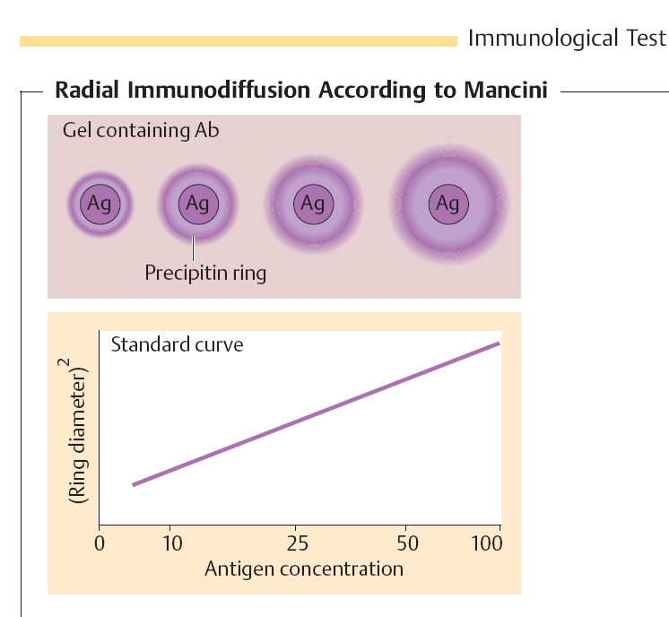
3. Single diffusion in two dimensions: Radial immunodiffusion
Ag is placed in well, allowed to diffuse into agar containing suitable solution of antiserum
A precipitin ring is formed around well
Area of ring is proportional to concentration of Ag

Slide 22
4. Double diffusion in two dimensions: Ouchterlony procedure
Agar gels are poured onto slides and allowed to set
Test solution of Ag/Ab are added to wells
Solution diffuses out, precipitin line forms where Ag/Ab meet

Slide 23
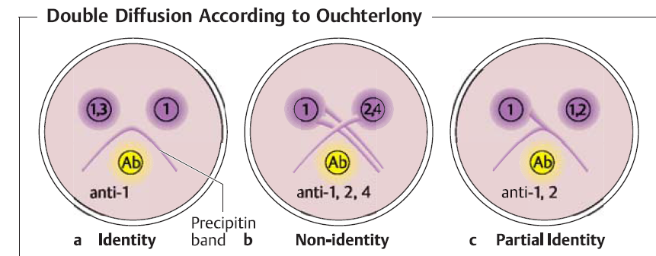

Slide 24
Ag/Ab move very slowly in gel, several days to finish procedure
Movement can be made faster if immunodiffusion is carried out in presence of electric current

Slide 25
ELECTROIMMUNODIFFUSION
When electric current is applied to slide layered with gel, serum proteins (antigen mixture) in well are separated into individual antigen components
Antiserum present in trough moves towards antigen components, forming separate precipitation lines in 18-24 hrs
Helps in identificalion, approximate quantification of various proteins present in serum

Slide 26
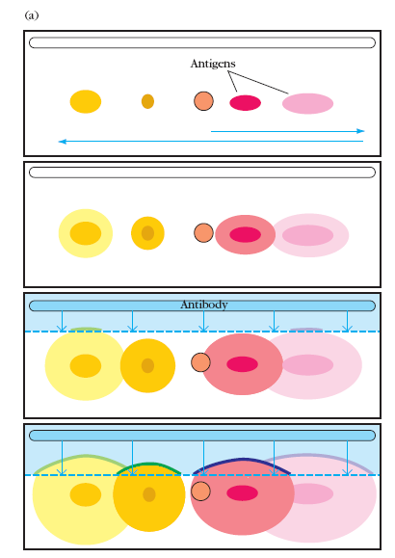
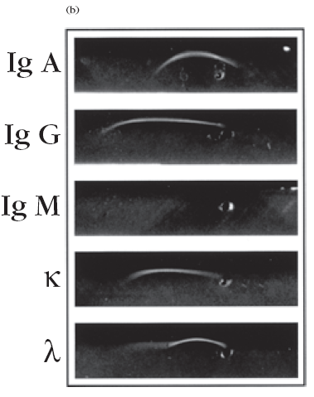
Ag mixture
Immunoelectrophoretic patterns of human serum from patient with myeloma.
patient produce large amount of monoclonal IgG (light-chain-bearing) antibody
anti-IgG and anti- antibodies produced lines of precipitation

Slide 27
Electroimmunodiffusion
Counterimmunoelectrophoresis (CIE)
One dimensional single elecroimmunodiffusion (Rocket electrophoresis)
Laurell’s Two dimensional electrophoresis

Slide 28
Counterimmunoelectrophoresis (CIE)
Faster (30 minutes), more sensitive
Involves simultaneous electrophoresis of Ag/Ab in gel in opposite directions resulting in band formation
Detection of alpha fetoprotein in serum, capsular antigens of Cryptococcus, meningococcus in cerebrospinal fluid

Slide 29
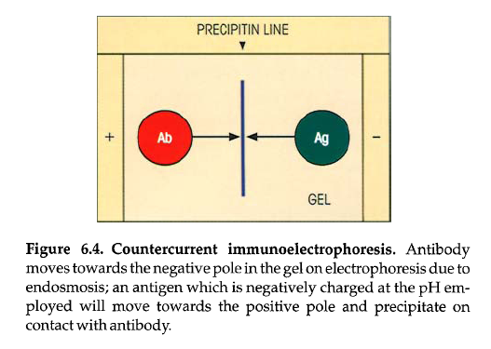

Slide 30
Rocket Electrophoresis
Main application is quantitative estimation of Ag
pH of gel is chosen so that Ab are immobile, Ag is negatively charged
Precipitin rockets form
Height of rocket is proportional to Ag concentration

Slide 31
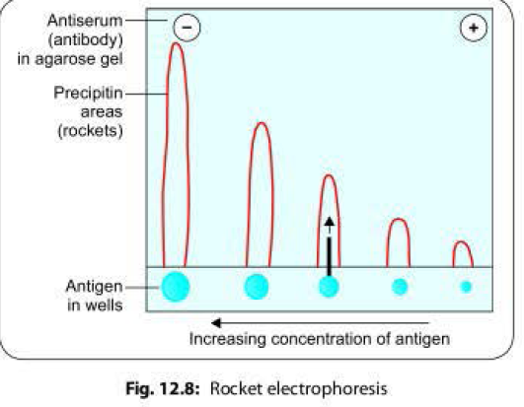

Slide 32
Agglutination reactions
When particulate Ag is mixed with its Ab in presence of electrolytes at suitable temp/ pH, particles are clumped/ agglutinated
Antibodies that produce such reactions are called agglutinins
Agglutination is more sensitive than precipitation for detection of Ab
Principle: same as precipitation

Slide 33
Prozone effect
excess Ab inhibits agglutination reactions; k/a prozone effect
high Ab concentrations, no. of Ab binding sites may exceed no. of epitopes
antiserum may contain high concentrations of incomplete Ab (IgG); Ab that bind to Ag, but do not induce agglutination

Slide 34
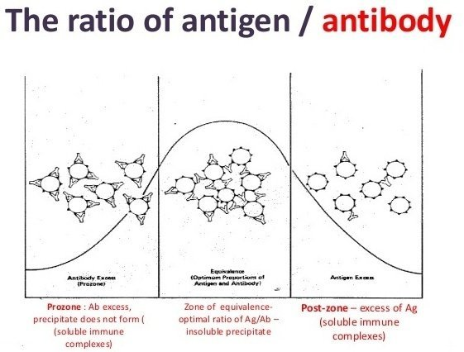
Agglutination can be
Slide Agglutination test
Tube Agglutination test

Slide 35
Slide Agglutination test
When agglutination tests are performed on slide/ tile
Positive result: clumping together of particles
Reaction facilitated by mixing Ag, antiserum with loop or gently rocking slide
Depending on titre of serum, agglutination may occur instantly or within seconds
Clumping occuring after 1 minute or due to drying is disregarded
Suitable control- to see autoagglutination

Slide 36
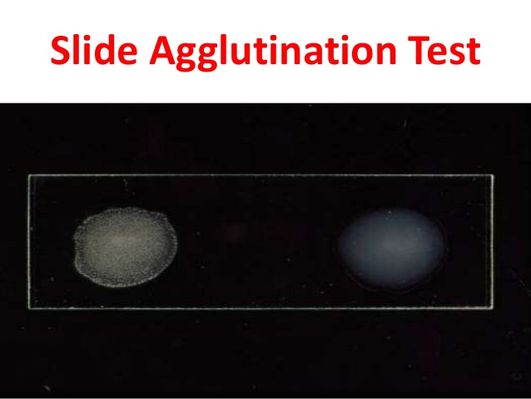
Applications
Blood grouping/ cross matching
Test for enteric fever
ASO titre
CRP
RA factor
Tests for Ab to Francisella tularensis
Ab to Brucella
Detection of Ab to Leptospira
Rapid, convenient but antiserum used is mostly undiluted so it may give nonspecific agglutination

Slide 37
Tube agglutination test
Standard quantitative method for measurement of Ab
Fixed volume of particulate Ag suspension is added to equal volume of serial dilution of an antiserum in test tubes
Agglutination titre of serum can be estimated- reciprocal of highest serum dilution that gives positive agglutination
More sensitive because longer incubation period can be used

Slide 38
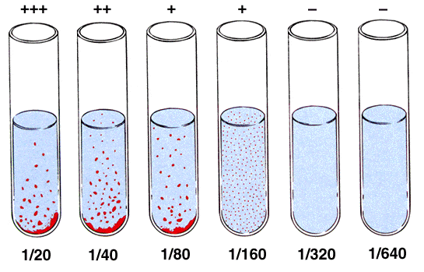
Applications
Widal test for diagnosis of enteric fever
Brucellosis screening

Slide 39
Types of agglutination tests
Passive LAT
By attaching soluble Ag to surface of carrier particles it is possible to convert precipitation tests into agglutination
carrier particles- human/ sheep RBCs, latex particles, bentonite, tannic acid
Use of synthetic beads/ latex
Eg- ASO, CRP, RA
Particle agglutination test
- Agglutination of artificial carrier particle with specific Ag bound to its surface
  Size of carrier enhances visibility of agglutination
Eg.
  Latex particles: Latex agglutination test
  Passive agglutination test- Latex agglutination test
  Reverse passive latex agglutination
  Treated Red blood cells i.e. Hemagglutination
  Whole bacterial cells- coagglutination
  Reverse passive latex agglutination
Ab is coated on carrier molecule which detects Ag in patient's serum
Used for detection of toxins

Slide 40
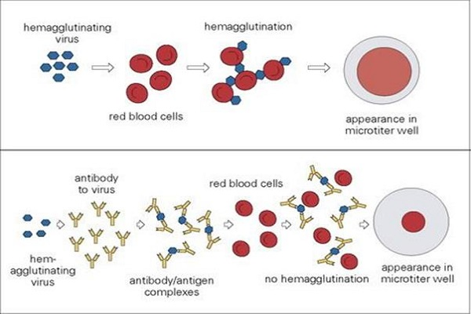

Eg of haemagglutination test
  Treponema Pallidum haemagglutination assay
  Passive hemagglutination tests for Ab to extracellular antigen of Streptococci
  Hemagglutination inhibition test for Avian Influenza

Slide 41
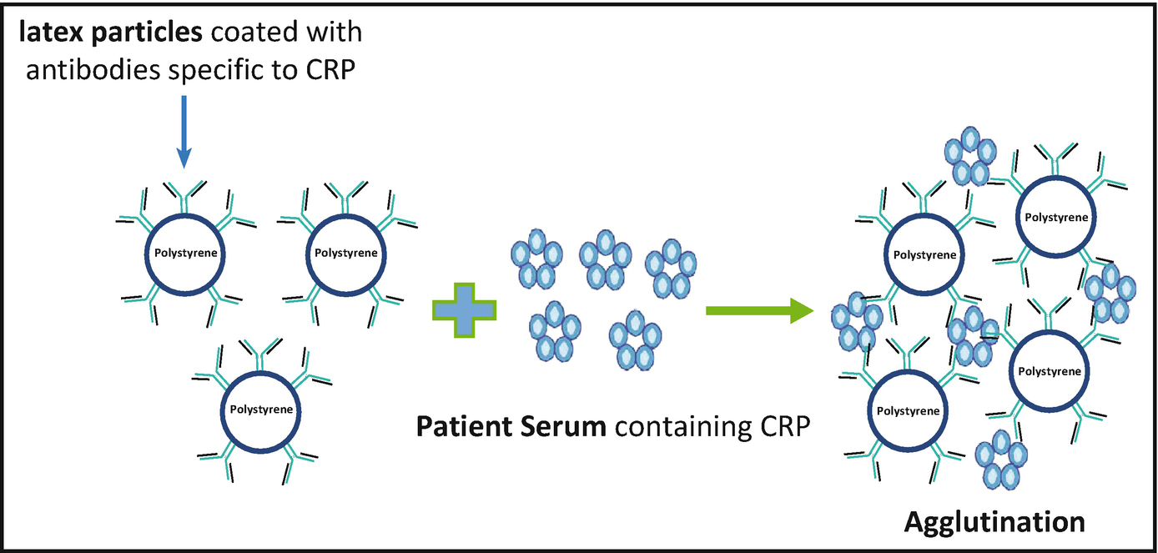
Eg. of latex agglutination test
detecting capsular Ag of
H. influenzae
N. meningitidis
Streptococcus spp.
C. neoformans
detection of Ab to
  Cytomegalovirus
  Rubella virus
  Varicella-zoster virus

Slide 42
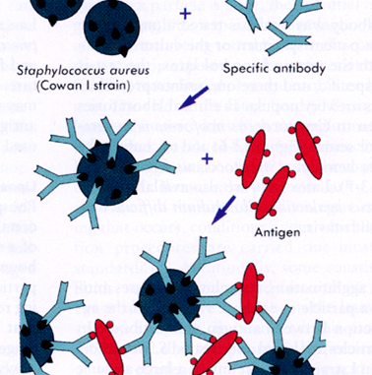
Coagglutination (COAG)
Antibody COAG Reagent + Antigen in specimen = Staphylococcal cells (Agglutinated)

Slide 43
Coomb’s Test (antiglobulin test)
Coombs, Mourant, Race 1945
To diagnose Rh incompatibility by detecting Rh antibody from mother/ baby's serum
anti Rh Ab (IgG) do not agglutinate Rh positive RBCs
When treated with rabbit antiserum against human gammaglobulin (Coomb’s serum), cells are agglutinated
“bridge” between Ab coating RBCs, causing agglutination

Slide 44
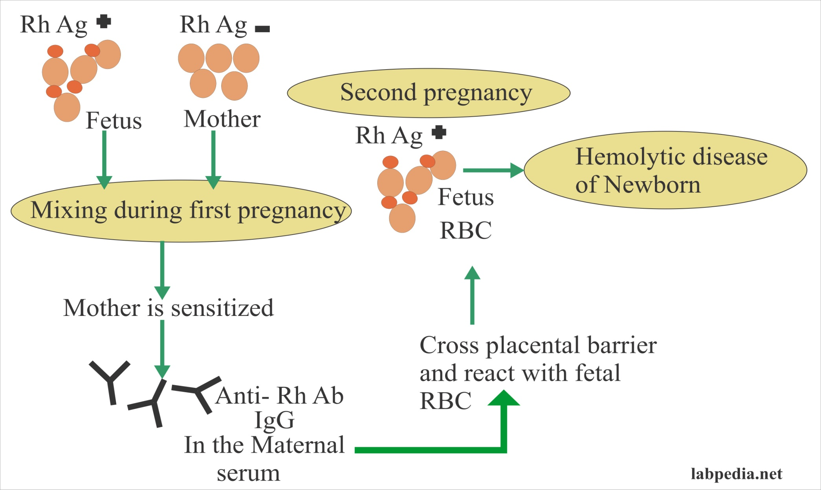
Direct Coombs test
Indirect Coombs test
RBCs coated with IgG do not agglutinate

Slide 45
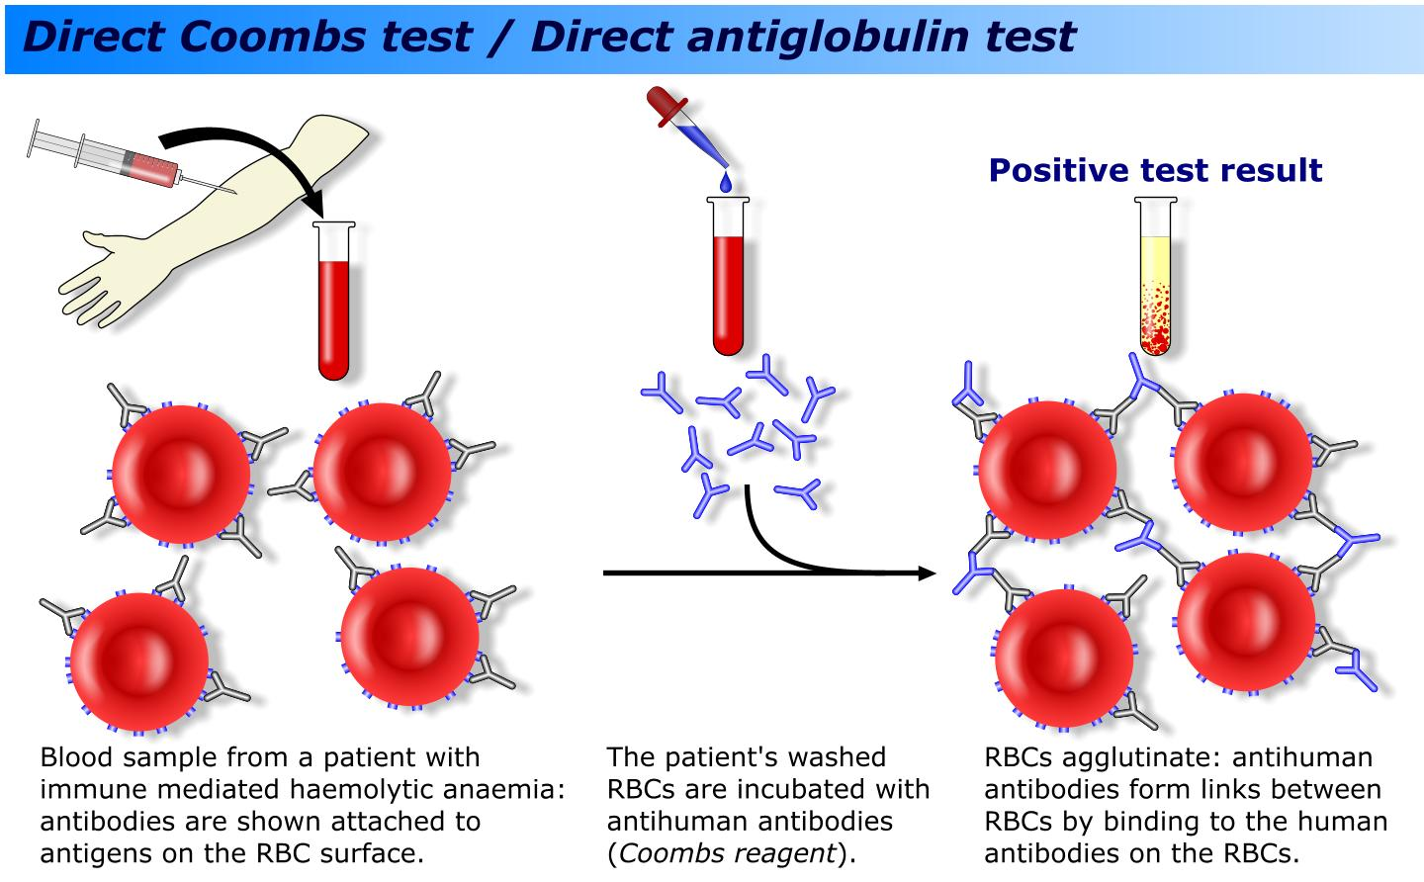
Direct Coomb’s test:
To detect Rh Ab bound to RBCs in vivo, present in fetus/baby's serum by directly adding Coombs reagent

Slide 46
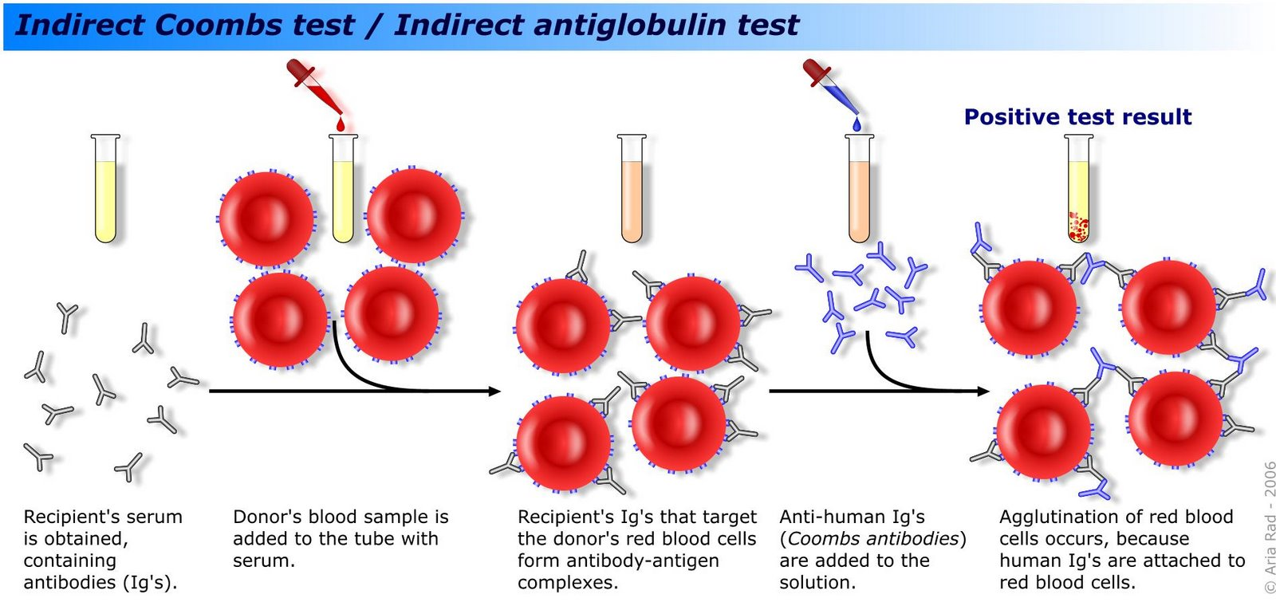
Indirect Coomb’s Test: used to screen pregnant women for antibodies that may cause hemolytic disease of newborn
sensitisation of red cells with Ab globulin is performed in vitro

Slide 47
Complement fixation test
Complement is absorbed (fix) during combination of Ag with their Ab
In presence of Ab, complement lyses bacteria, kills, immobilizes motile organisms
Ability of Ag-Ab complex to fix complement is used in CFT
2 steps
5 reagents
Ag
Ab
Complement (guinea pig)
sheep erythrocytes (target cell)
Amboceptor- hemolysin (rabbit Ab to sheep RBC)

Slide 48
Uses a detector molecule to label antibody or antigen which in turn detects the corresponding antigen or the antibody in the sample by producing a visible effect

Slide 49
Newer techniques
Use detector molecule to label antibody (Ab) or antigen (Ag) which in turn detects the corresponding Ag/Ab in sample by producing a visible effect
Techniques differ by type of labelled molecule used & type of visible effect produced

Slide 50
Immunoassay method | Molecules used for labeling | Type of visible effect
Enzyme linked immunosorbent assay (ELISA) | Enzyme- substrate- chromogen complex | Color change detected by spectrophotometer
Enzyme linked fluorescent assay(ELFA) | Enzyme- substrate | Fluorometric detection
Immunofluorescence Assay (IFA) | Fluorescent dye | Emits light, detected by fluorescence microscope
Radioimmunoassay (RIA) | Radioactive isotope | Emits β/ γ radiations, detected by β/ γ counters

Slide 51
Chemiluminescence-linked immunoassay (CLIA) | Chemiluminescent compounds | Emits light, detected by luminometer
Immunohistochemistry (IHC) | Enzyme or Fluorescent dye | Color change or Fluorescence microscope
Western blot (WB) | Enzyme | Color band
Rapid tests Immunochromatographic test Flow through assay | Colloidal gold or silver Protein A conjugate | Color band Color band

Slide 52
ENZYME-LINKED IMMUNOSORBENT
ASSAY (ELISA)
Detects antigen/ antibodies in patient specimen, using enzyme- substrate- chromogen system
Principle
Immunosorbent- Absorbing material used (e.g. polystyrene, polyvinyl) that specifically absorbs Ag/ Ab in serum
Enzyme- to label components (Ag/Ab) of immunoassay
Substrate- chromogen system

Slide 53
Substrate-chromogen system
Added at final step
Enzyme- substrate reaction in turn activates chromogen to produce color
Color change is detected by spectrophotometry in ELISA reader
Intensity of color is directly proportional to amount of detected Ag/ Ab present in test serum
(Ag- Ab complex)- enzyme + substrate → activate
chromogen → color change → detected by
spectrophotometry

Slide 54
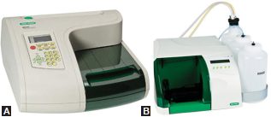
Procedure
Performed on a microtiter plate (polystyrene) having 96 wells
ELISA kits contain reagents such as enzyme conjugate, dilution buffer, substrate/chromogen, etc
A series of steps done sequentially; at each step, a reagent is added - then incubated, followed by washing of the wells [manually or by an automated ELISA washer

Slide 55
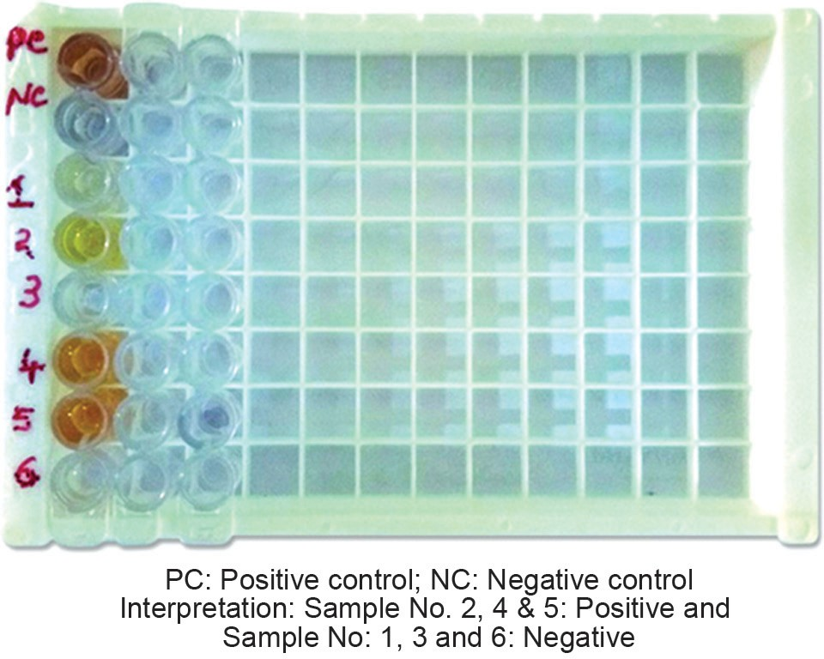

Slide 56
Types of ELISA
Direct ELISA
Indirect ELISA
Sandwich ELISA
IgM Antibody Capture (MAC) ELISA
Competitive ELISA
ELISPOT Test

Slide 57
1. Direct ELISA: to detect Antigen in serum
Primary antibody (targeted against serum Ag) is labeled with the enzyme
Step 1: Test serum (containing Ag) is added into wells; Ag becomes attached to well by passive adsorption
Step 2: After washing, the enzyme-labeled primary antibodies are added; incubated
Step 3: After washing, a substrate- chromogen system is added & color is measured

Slide 58
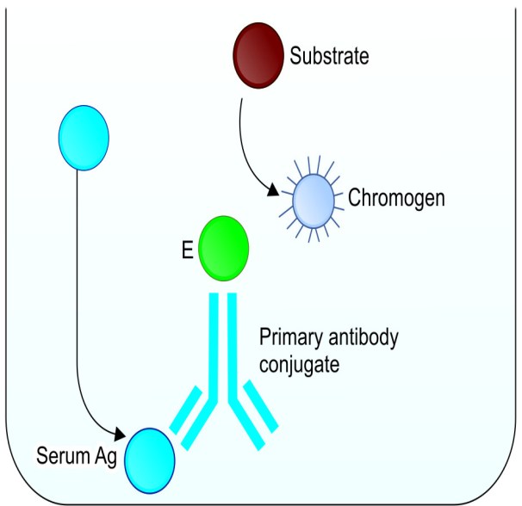
Well + Ag (test serum) + primary Ab-Enzyme + substrate-chromogen → Color change

Slide 59
2. Indirect ELISA: to detect Antibody in serum
Secondary antibody (Ab targeted to Fc region of human Ig) is labelled with enzyme
Step 1: Wells are precoated with Ag
Step 2: Test serum (containing primary Ab specific to the Ag) is added; Ab gets attached to the Ag
Step 3: After washing, enzyme-labeled secondary Ab (anti-human immunoglobulin) is added
Step 4: After washing, a substrate- chromogen system is added & color is developed

Slide 60
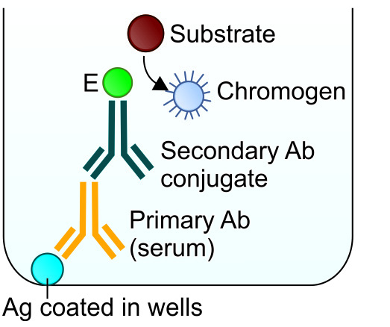
Wells are coated with Ag + primary Ab (test serum) + secondary Ab- Enzyme + substrate- chromogen → development of color

Slide 61
3. Sandwich ELISA: to detect antigen in test serum
Antigen gets sandwiched b/w capture Ab & detector Ab
Step 1: Well is precoated with capture antibody targeted against test antigen
Step 2: Test serum is added to wells; Ag gets attached to capture antibody
Step 3: After washing, an enzyme labeled primary ‘detector antibody’ specific for antigen is added
Step 4: After washing, a substrate–chromogen system is added & color is developed

Slide 62
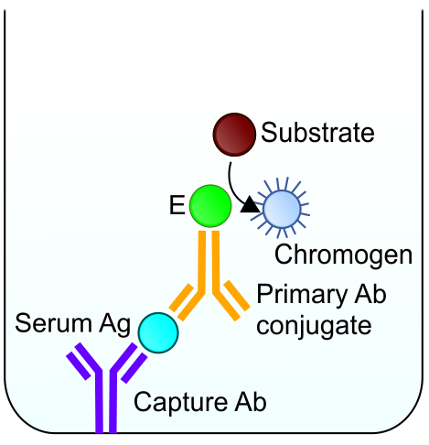
Wells coated with capture Ab + Ag (test serum) + primary Ab- enzyme + substrate- chromogen → color

Slide 63
4. IgM Antibody Capture (MAC) ELISA
Enzymatically amplified sandwich- type immunoassay
Used for dengue, Japanese encephalitis virus, scrub typhus, leptospirosis, toxoplasmosis
Based on capturing primary IgM Ab (in test serum) on a microtiter plate pre-coated with anti-human-IgM Ab, followed by addition of recombinant antigen
Subsequently, enzyme labelled secondary antibody specific for Ag is added, followed by addition of substrate-chromogen system.
Avidin-biotin system helps in amplifying signal generated b/w enzyme- antibody complex, increases sensitivity

Slide 64
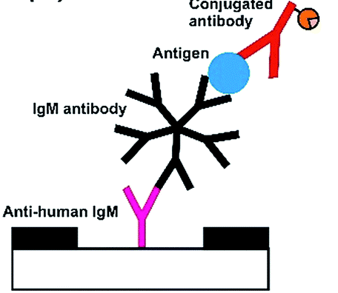
Wells coated with capture anti-IgM Ab + IgM Ab (test serum) + recombinant antigen + secondary Ab- biotin + avidin- enzyme + substrate- chromogen → color

Slide 65
5. Competitive ELISA
Ag in test serum competes with another antigen of same type coated on well to bind to primary antibody
Step 1: Primary antibody is incubated with serum sample containing the test antigen
Step 2: Antigen- antibody mixture is added to microtiter well precoated with same type of antigen
Step 3: Free antibodies bind to antigen coated on well.
Step 4: After washing (to remove free antibodies and antigens), enzyme-conjugated secondary antibody is added
Step 5: After washing, substrate- chromogen system is added & color is developed

Slide 66
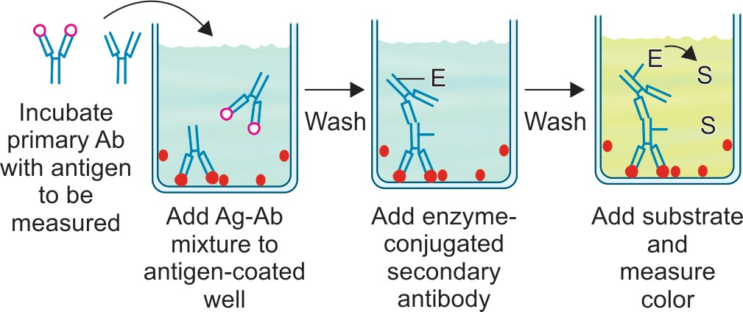

Slide 67
6. ELISPOT Test
Modification of ELISA
Quantitative detection of cells producing Ab (plasma cells) or cytokines (e.g. lymphocytes or macrophages)
ELISPOT is used in IGRA (interferon gamma assay), for diagnosis of latent tuberculosis

Slide 68
IgG Avidity ELISA
Useful for differentiating recent from past infection
In situations where both (IgM/IgG) antibodies are present, IgG avidity test is useful to differentiate recent from past infection
Principle:
Avidity of an antibody indicates how firmly it is bound with its antigen (reflects maturity of Ab)
Low avidity IgG- recent infection
High avidity IgG- Past infection
Applications:
Diagnosis of rubella, CMV, VZV, toxoplasma

Slide 69
Advantages of ELISA
Method of choice for detection of Ag/ Ab in serum
Takes 2- 3 hrs
High sensitivity
Recombinant, synthetic antigens, monoclonal antibodies- ELISA has become more specific
Disadvantages of ELISA
In small laboratories rapid tests are preferred over ELISA
Takes more time (2- 3 hours) compared to rapid tests
Needs expensive equipment; ELISA washer, reader

Slide 70
Applications of ELISA
Antigen detection -hepatitis B [hepatitis B surface antigen (HBsAg), NS1 antigen for dengue
Antibody detection against hepatitis B, hepatitis C, HIV, dengue, toxoplasmosis, leishmaniasis

Slide 71
ENZYME-LINKED FLUORESCENT
ASSAY (ELFA)
Modification of ELISA
  Automated system, all steps are performed by instrument
  Ag-Ab-enzyme complex is detected by fluorometric method
VIDAS and mini VIDAS are commercially available systems based on ELFA technology

Slide 72
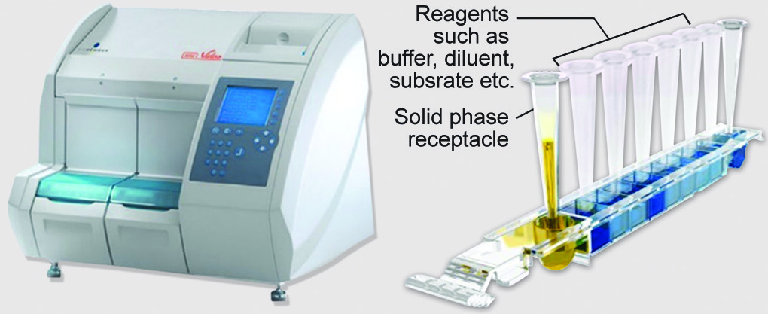

Slide 73
Advantages:
  (i) automated system
  (ii) easy to perform
  (iii) less contamination chance
  (iv) gives quantitative results
  (v) more sensitive and specific
Disadvantages:
  (i) Expensive
  (ii) can run only 12–24 number of tests at a time

Slide 74
Use:
Infectious diseases: Hepatitis viruses, HIV (Ag and Ab), Ab to TORCH infection, measles, mumps, varicella, H. pylori and antigen to C. difficile, rotavirus, etc
Other uses: Biomarkers (e.g. procalcitonin), hormones (e.g. thyroid), tumor markers, cardiac markers and screening for allergy

Slide 75
Immunofluorescence assay (IFA)
Technique similar to ELISA
  Fluorescent dye is used instead of enzyme for labelling of antibody
  Detects cell surface antigens or antibodies bound to cell surface antigens
Fluorescent dye is used to conjugate the antibody; used to detect the antigens or antigen–antibody complexes on the cell surface

Slide 76
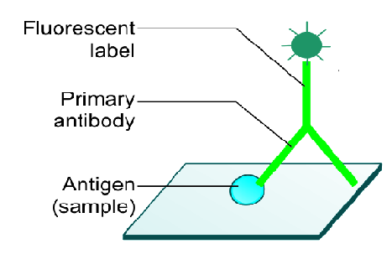
Types
Direct Immunofluorescence Assay
Step 1: Sample containing cells carrying surface antigens is smeared on a slide
Step 2: Primary antibody specific to antigen, tagged with fluorescent dye is added
Step 3: Slide is washed; then viewed under fluorescence microscope

Slide 77
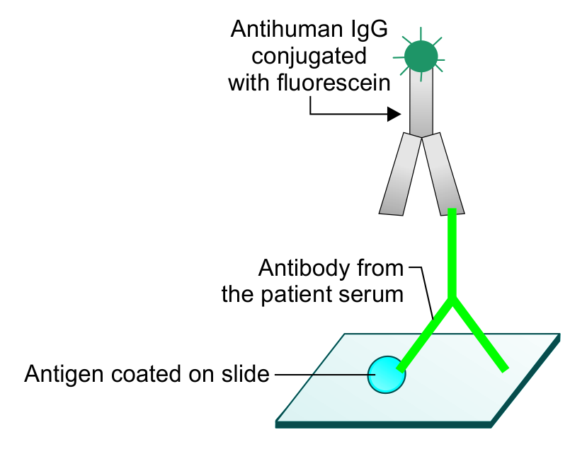
2. Indirect Immunofluorescence Assay
Detects antibodies in sample; slides smeared with cells carrying known antigens are commercially available
Step 1: Test serum containing primary antibody is added to slide
Step 2: Slide is washed; a secondary antibody (antihuman antibody conjugated with fluorescent dye) is added
Step 3: Slide is washed; viewed under a fluorescence microscope

Slide 78
Applications:
Detection of autoantibodies (e.g. antinuclear antibody) in autoimmune diseases
Detecting microbial antigens, e.g. rabies antigen in corneal smear
Detection of viral antigens in cell lines inoculated with the specimens

Slide 79
Flow Cytometry
Laser-based technology that quantitatively analyses & separates the cells as they pass through laser beam
Used to analyze multiple parameters of cells (e.g. leukocytes) such as cell counting, cell sorting, analysis of size, shape, granularity, DNA or RNA content of a cell
Applications:
CD4 T cell count in HIV infected patients
Detection of leukocytes with specific markers for the diagnosis of various lymphomas

Slide 80
Immunohistochemistry
Process of detecting antigens (e.g. proteins) in cells of tissue section by using labelled antibodies binding specifically to antigens in biological tissues
Based on principles of ELISA or IFA
Widely used in the diagnosis of abnormal cells (e.g. tumor cells)

Slide 81
Chemiluminescence-linked immunoassay
(CLIA)
Emission of light (luminescence), as a result of a chemical reaction
Principle: chromogenic substance (ELISA) is replaced by chemiluminescent compounds (e.g. luminol) that generate light during a chemical reaction (luxogenic)
Light (photons) can be detected by a photomultiplier

Slide 82
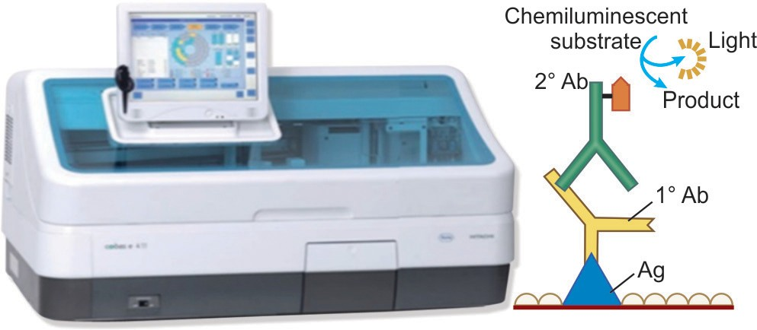
(Ag-Ab complex)- enzyme + chemiluminescent substrate → product + light (photons) → detected by luminometer or photomultiplier

Slide 83
Advantages of CLIA
More sensitive than ELISA
No 'background' signal, i.e. luminol compounds do not themselves emit light
Measurement of chemiluminescence is not a ratio
Available for detection of antigens or antibodies against various infections such as hepatitis viruses, HIV, TORCH infections and biomarkers such as procalcitonin

Slide 84
Western blot
Detects specific proteins (antibodies) in a sample containing mixture of antibodies each targeted against different antigens of same microbe
Comprises of three basic components:
SDS PAGE- to separate Ag mixture into individual fragments
NCM blotting- fragments transferred to nitrocellulose membrane sheet
Enzyme immunoassay- reaction with patient serum sample to form colored bands

Slide 85
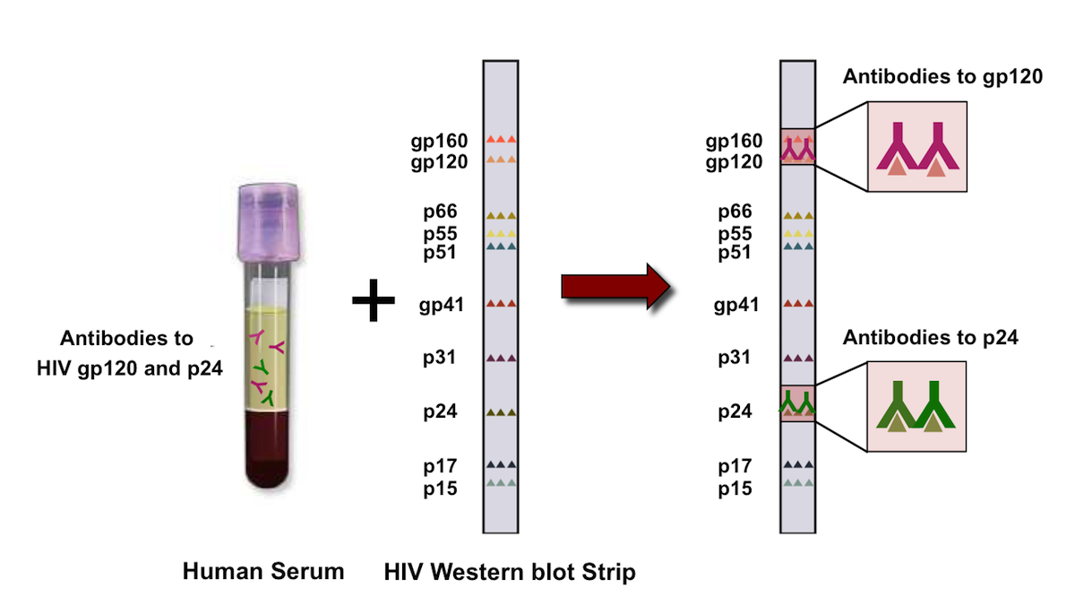

Slide 86
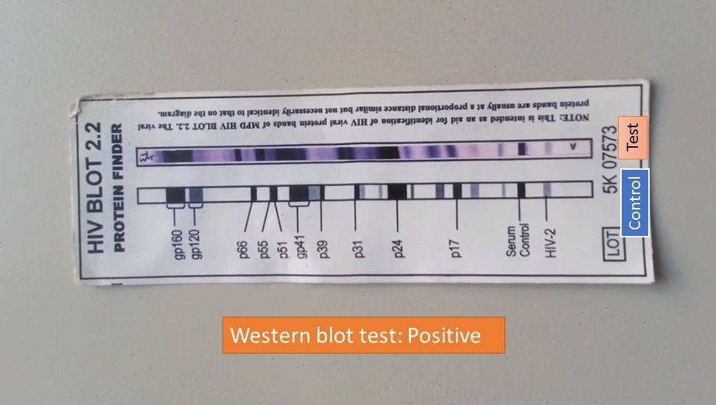

Slide 87
Applications
Excellent specificity
Used as a supplementary test to confirm result of ELISA or other immunoassays having higher sensitivity
Western blot formats are available to detect antibody in various diseases such as HIV, Lyme’s disease, Herpes simplex virus infection, cysticercosis, hydatid disease and toxoplasmosis

Slide 88
Rapid tests
Point of care (POC) tests; can be performed independent of laboratory equipment, deliver instant results
Two principles of rapid tests are available:
  Lateral flow assay
  Flow through assay
Available for diagnosis of malaria, hepatitis B, hepatitis C, HIV, leptospirosis, Helicobacter pylori, syphilis

Slide 89
1. Immunochromatographic Test (Lateral Flow Assay)
Simple, low-cost
Can be used for both Ag/Ab detection in sample
Principle
Consists of nitrocellulose membrane (NCM) & absorbent pad
Available as cassette/ strip
Test band: Ag + specific Ab (labeled with colloidal gold) complex is immobilized in monoclonal Ab on test line to form colored band
Control band: Free colloidal gold labeled Ab moves further, binds to anti-human Ig in control line to form color control band

Slide 90
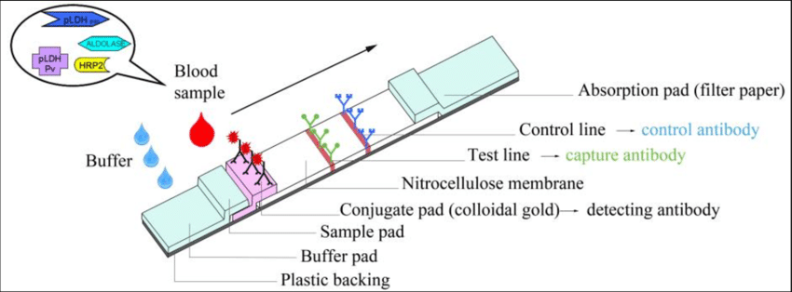
anti-human Ig

Slide 91
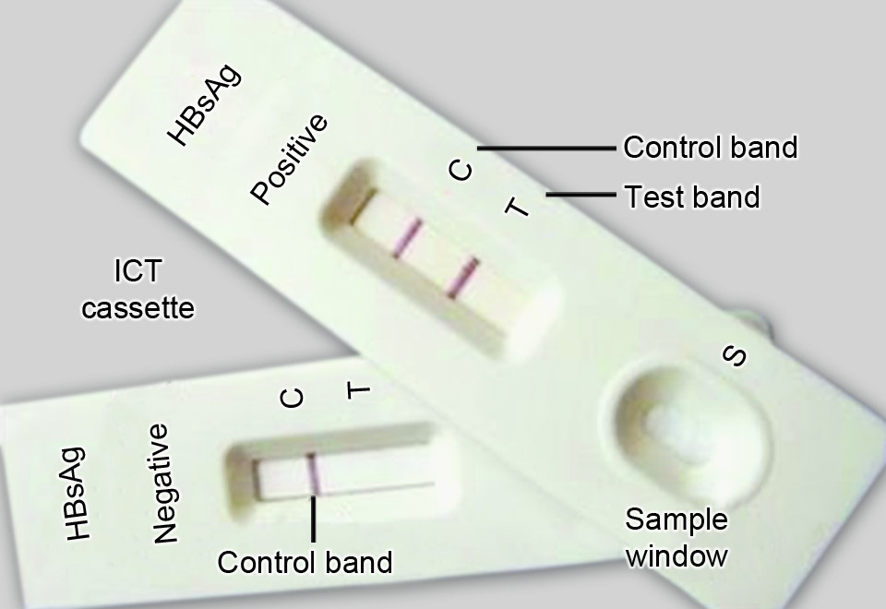
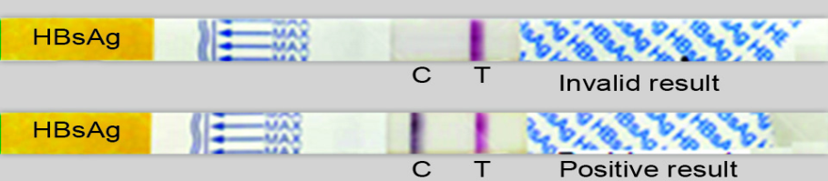
If control band is not formed, then test is considered invalid irrespective of whether test band is formed or not

Slide 92
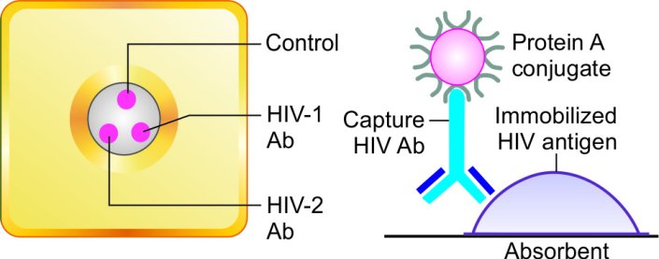
2. Flow-through Assay
  Protein A is used for labeling antibody instead of gold conjugate
  Sample flows vertically through nitrocellulose membrane
Can be used for both Ag/Ab detection; eg. HIV TRIDOT test
Detects antibodies to HIV-I & II separately in patient’s serum
Cassette format

Slide 93
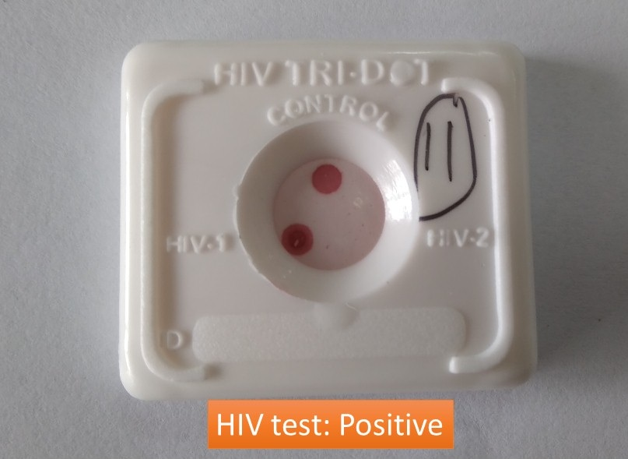
Principle
Sample & buffer reagents are added sequentially from top ; they pass through membrane, fluid is absorbed into underlying absorbent pad
As the patient’s sample passes through the membrane, HIV antibodies, if present bind to immobilized antigens

Slide 94

Test dots- Protein A conjugate (buffer) binds to Fc portion of HIV Ab pinkish purple DOT(s) separately for HIV-1 & 2 Abs
Control dot- Protein-A binds to any IgG in serum; IgG-protein A complex binds to antihuman Ig at control line pinkish purple DOT

Slide 95
Complement Fixation
Serum with
antibodies
Serum without
antibodies
Antigen binds
to antibodies
Unbound
antigen
Day 1
Complement
binds to Ag/Ab
complex
Presence of specific Ab is indicated by absence of hemolysis
Unbound
complement
Hemolysin sensitized
red blood cells
serve as an indicator
Hemolysin sensitized
red blood cells
serve as an indicator
Absence of specific Ab is indicated by presence of hemolysis
Day 2
No lysis
Positive
Lysis
Negative

Slide 96
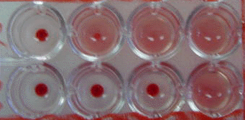
Complement Fixation
Eg Wasserman CFT for syphilis

Slide 97
Thank you

