Slide 1
CM 7.7 Describe and Demonstrate
Principles and steps of an epidemic / outbreak investigation and its Control Measures

Slide 2
What is an outbreak?
Unexpected increase in cases in a specific place and time
Exceedance of a predefined alert threshold
Two or more cases of disease linked to the same source

Slide 3
What is an waterborne outbreak? - WHO definition
At least two people experience a similar illness after exposure to the source e.g. water and the evidence suggests a probable source e.g. water

Slide 4
(Large water supply) waterborne outbreaks
Associated with watershed events:
  Defects in the water-treatment process or distribution system
  Exceedance of water-quality parameters
Sudden, rapid and widespread occurrence of gastrointestinal consultations
Clustering of cases in a particular water-supply zone

Slide 5
When to investigate a waterborne outbreak?
The outbreak is likely to continue if no intervention
Unknown source
Unknown cause
Severe and/or unusual disease
Large number of cases

Slide 6

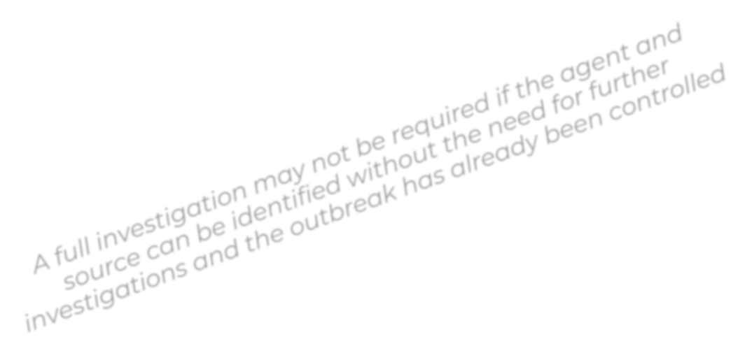

When to investigate a waterborne outbreak?
The outbreak is likely to continue if no intervention
Unknown source
Unknown cause
Severe and/or unusual disease
Large number of cases
However, it will still be important to identify the cause and contributing factors in order to prevent new outbreaks

Slide 7
Outbreak investigation objectives
Confirm the outbreak
Identify the source and contributing factors
Implement control measures
→ In order prevent further cases

Slide 8
Outbreak investigation steps
Differ from outbreak to outbreak
Simultaneous and in parallel
Control measures as early as possible
Communication on an ongoing basis

Slide 9
10 step approach
Detect and confirm the outbreak and agent
Rapid Response Team (RRT)
Define cases
Identify cases and obtain information
Descriptive epidemiological investigation (time, place, person)
Additional studies (environmental, risk assessments, laboratory)
Interview cases and generate hypotheses
Evaluate the hypotheses
Inform risk managers and implement control measures
Communicate findings, make recommendations and evaluate the outbreak response
Communication Measures

Slide 10
Step 1. Detect and confirm the outbreak and agent
Health-care systems
Detection by surveillance systems
  Indicator and event based surveillance
  Epidemiological
  Microbiological
Health-care facilities reports
Other signals
Absenteeism from work, schools
Increased sales of certain medications
Media reports
Water quality
Routine samples with faecal bacteria
Water treatment or distribution failures
User complaints

Slide 11
Step 1. Detect and confirm the outbreak and agent
Is the outbreak real? → More cases than expected?
Seasonal variations?
Notification artefacts?
New surveillance system?
Diagnostic bias?

Slide 12
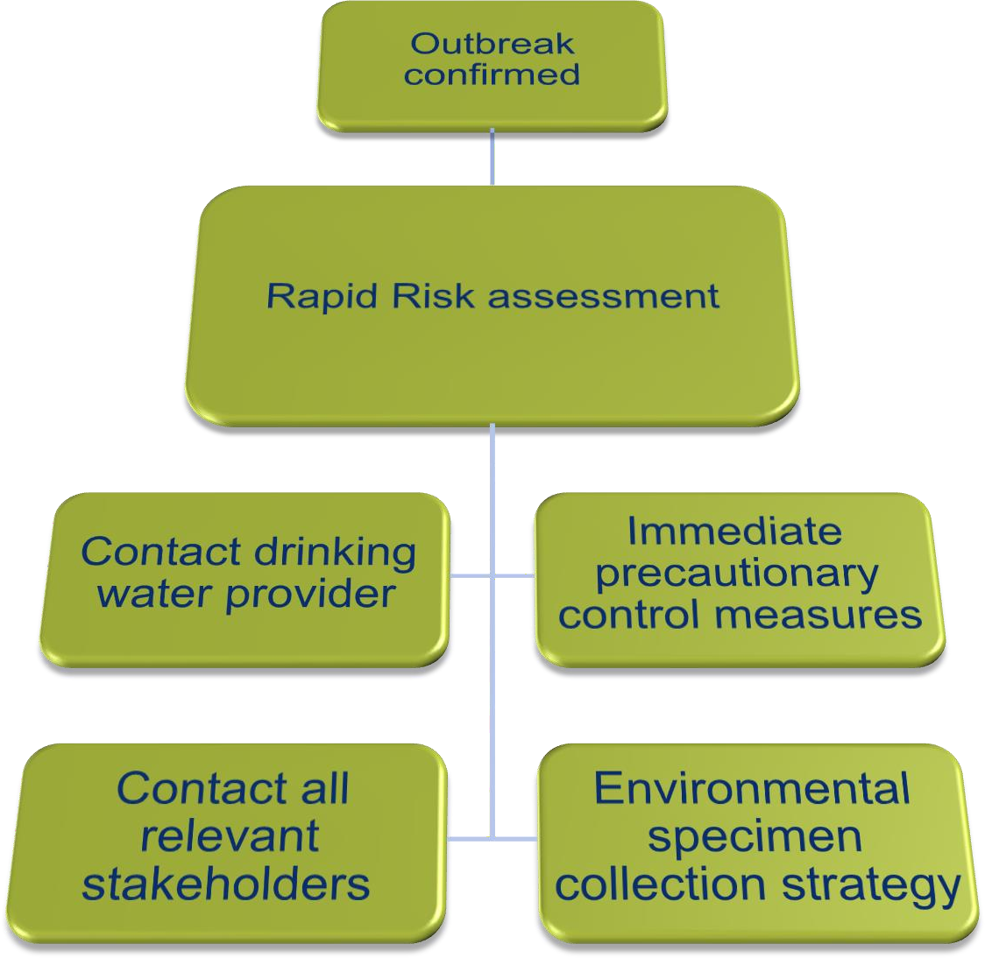
Step 1. Detect and confirm the outbreak and agent

Slide 13

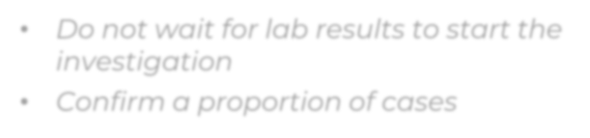
Step 1. Detect and confirm the outbreak and agent
Identifying the microorganism helps to:
develop a hypothesis about the source (previous events)
identify time of exposure (incubation period)
choose control measures
Do not wait for lab results to start the
investigation
Confirm a proportion of cases

Slide 14
Step 1. Detect and confirm the outbreak and agent
Time between the contamination event and the outbreak detection
  Long incubation periods
  Few cases go to the doctor (“peak of the inceberg”)
Longer delay → lower probability of detecting the agent in water
Relevant water samples may no longer be available

Slide 15
Country example
From the 12 to 15 September 2023, the Ministry of Health and Family Welfare, Government of India, reported six laboratory-confirmed Nipah virus cases, including two deaths, in Kozhikode district, Kerala.
Large waterborne Campylobacter outbreak in Norway in 2019
Over 2 million cases have been reported since 2005. Chikungunya disease has now been identified in over 110 countries in Asia, Africa, Europe and the Americas.

Slide 16
Step 1. Detect and confirm the existence of the outbreak and confirm the causative agent
Country example
6 June 2019, Askøy, Norway.
In 24 h, 10 people hospitalized with fever, abdominal pain and diarrhea, and 30 consultations from out-of-hours primary healthcare services.
Many patients presenting with gastroenteritis had home addresses near each
other
→ drinking-water?
One person tested positive for Campylobacter
Medical Officer in Askøy reports the outbreak to the Norwegian Institute of Public Health.
Hyllestad et al. (2020): Large waterborne Campylobacter outbreak: use of multiple approaches to investigate contamination of the drinking water supply system, Norway, June 2019. Eurosurveillance, https://doi.org/10.2807/1560-7917.ES.2020.25.35.2000011

Slide 17
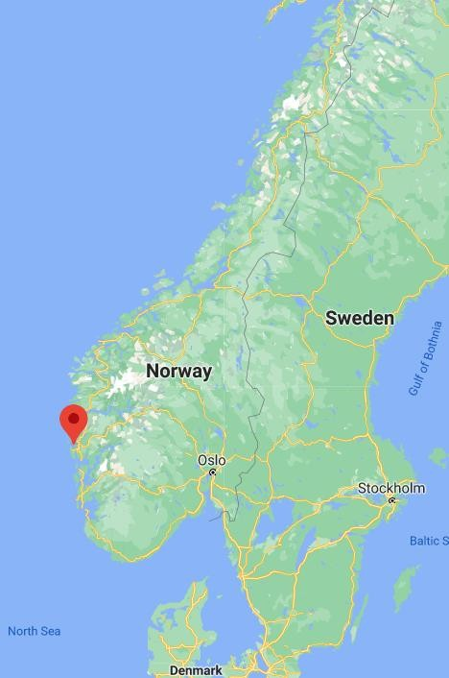
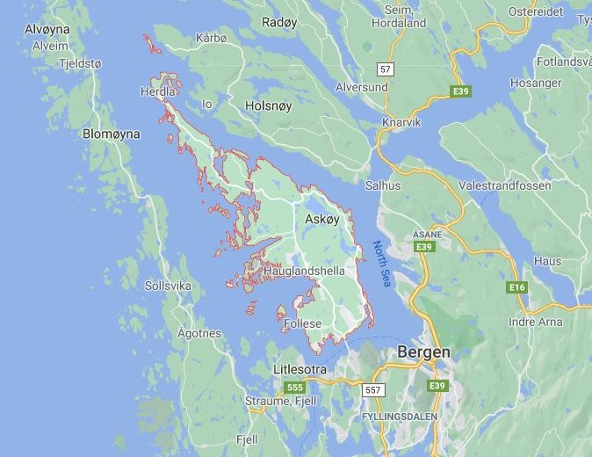
Outbreak context
Country example
Island municipality Askøy, Norway
29,500 inhabitants
Hyllestad et al. (2020): Large waterborne Campylobacter outbreak: use of multiple approaches to investigate contamination of the drinking water supply system, Norway, June 2019. Eurosurveillance, https://doi.org/10.2807/1560-7917.ES.2020.25.35.2000011

Slide 18
Outbreak context
Country example
Three different water supply systems in Askøy: A,B,C
Water Supply System A (WSS-A) from the 1950s, serves ca. 12,000 people in
the south of the island.
WSS-A has 9 reservoirs, including 3 built as unlined mountain caverns.
One of these reservoirs was reservoir X
Hyllestad et al. (2020): Large waterborne Campylobacter outbreak: use of multiple approaches to investigate contamination of the drinking water supply system, Norway, June 2019. Eurosurveillance, https://doi.org/10.2807/1560-7917.ES.2020.25.35.2000011

Slide 19
Step 1. Detect and confirm the existence of the outbreak and confirm the causative agent
Country example
Immediate precautionary control measures taken once outbreak detected
6 June: Boil Water Advice issued
7 June: Reservoir X taken out of service
Hyllestad et al. (2020): Large waterborne Campylobacter outbreak: use of multiple approaches to investigate contamination of the drinking water supply system, Norway, June 2019. Eurosurveillance, https://doi.org/10.2807/1560-7917.ES.2020.25.35.2000011

Slide 20






Step 2. Form the Rapid Response Team (RRT)
Outbreak
confirmed
Investigation needed
Form the Rapid
Response team

Slide 21
Step 2. Form the Rapid Response Team (RRT)
Stakeholder | Role
Local/regional public Health agency | Overall coordination
Food/water authority | Environmental investigation
Water supplier | Control measures implementation
Health- care providers | Case management
Laboratory | Microbiological investigation
Communication experts!!

Slide 22
Step 2. Form the Rapid Response Team (RRT)
Coordinating activities across agencies can be difficult
Clear roles and responsibilities
Teams before an outbreak occurs
Contact meetings and exercises between crisis

Slide 23
Step 2. Form the Rapid Response Team (RRT)
Country example
Complete investigation planned
  Epidemiological
  Microbiological
  Environmental
Municipal services
Norwegian Food Safety Authority
Norwegian Institute of Public Health
Hyllestad et al. (2020): Large waterborne Campylobacter outbreak: use of multiple approaches to investigate contamination of the drinking water supply system, Norway, June 2019. Eurosurveillance, https://doi.org/10.2807/1560-7917.ES.2020.25.35.2000011

Slide 24


Step 3: Define cases
Case definition components
Time
Place
Person
Possible
Probable
Confirmed
Case
Classification

Slide 25
Step 3: Define cases
“A person (who?) living in town XXXX (where?), with diarrhoea (≥ 3 loose stools in 24 hours) and any one of the following symptoms – abdominal pain, nausea and vomiting (who?) – and date of onset of symptoms from 1 August 2020 (when?) and not travel history (who?, where?).”

Slide 26
Step 4: Identify cases and obtain information
In order to:
Estimate the size of the outbreak and its distribution
Determine the population at risk
Enroll patients
  hypothesis-generating pilot interviews
  descriptive and analytical epidemiology
Identify patients who need treatment

Slide 27
Step 4: Identify cases and obtain information
How?
Passive case finding→ Existing surveillance system.
Active case finding
  Additional laboratories not part of national surveillance systems
  Public and private hospitals or primary healthcare centers
  People at risk: school children, nursing homes, mass gatherings
  Invitation lists, reservation lists, guest lists

Slide 28
Step 4: Identify cases and obtain information
Line List
Basic information on each case
  ID, age, type of case, sex, phone number, residence, clinical information….
One line per case
Spreadsheet
Updated as the investigation develops
Facilitates systematization of the information
Provides an overall picture

Slide 29
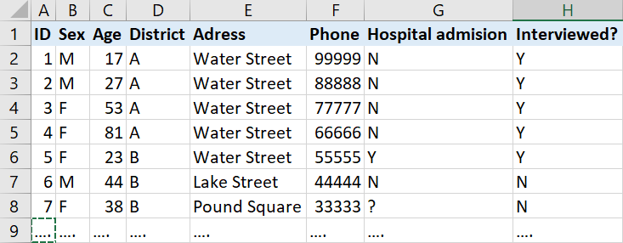
Step 4: Identify cases and obtain information

Slide 30
Step 4: Identify cases and obtain information
Pilot interviews
Standardized questionnaire:
  clinical information, risk factors and demographics
Comprehensive: all relevant exposures
Few interviewers
Sample of cases
Obvious common exposures?
Exclude exposures?

Slide 31
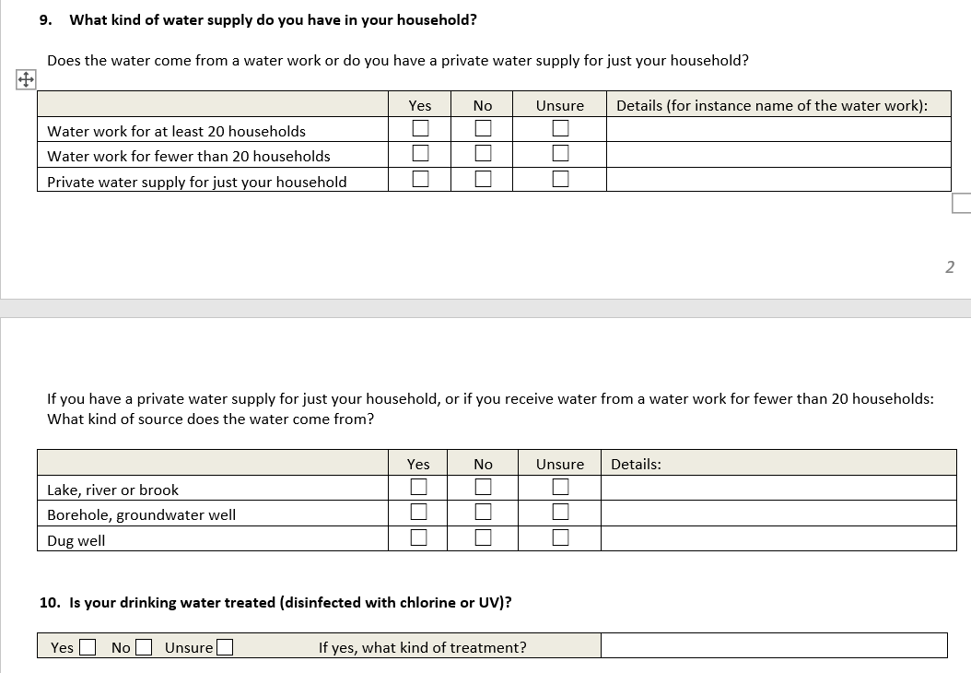
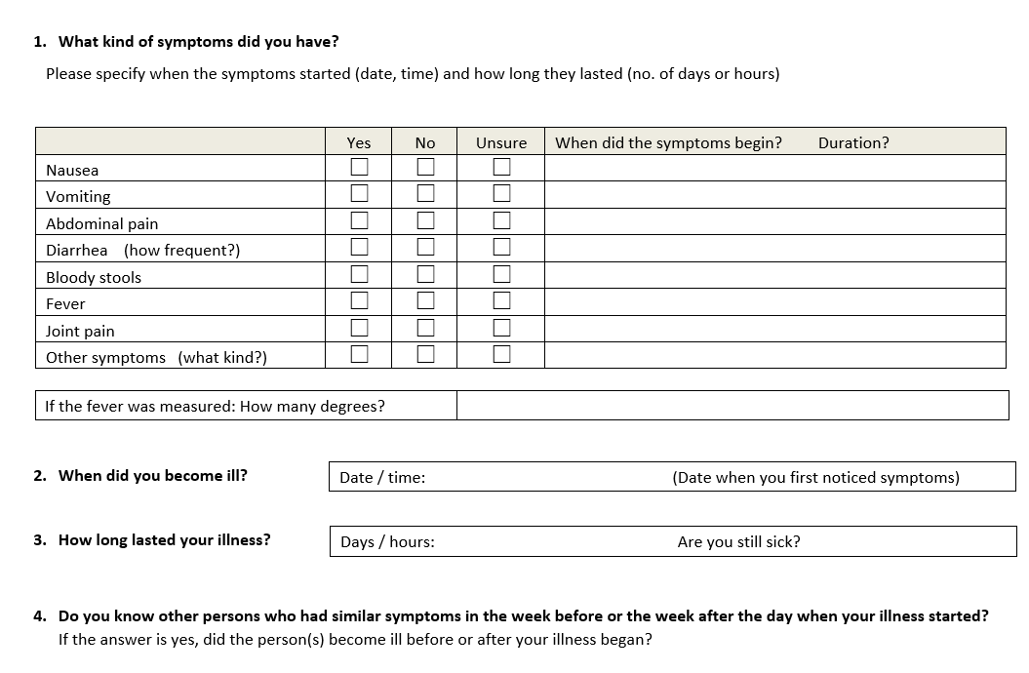
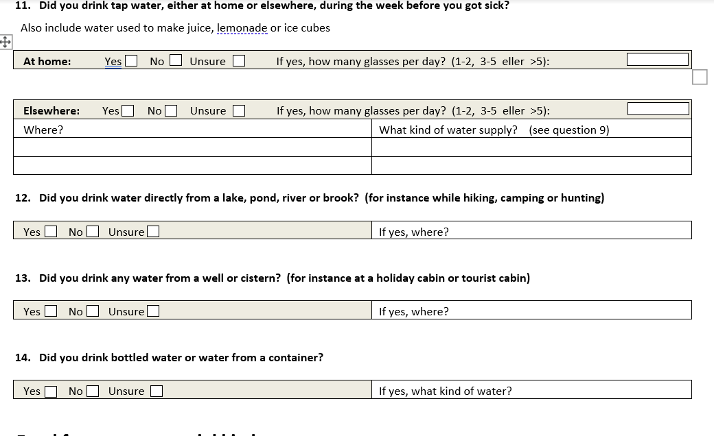
Step 4: Identify cases and obtain information

Slide 32
Step 4: Identify cases and obtain information
Questionnaires distribution
Email
Web questionnaires
Telephone interviews
Paper questionnaires by mail
Social media

Slide 33
Step 5: Descriptive epidemiological investigation
What do cases have in common? → Generate hypothesis
Time
When were they infected?
Place
Where were they infected? Where do they live?
Person
What are the symptoms and etiology? Who was infected?

Slide 34
Step 3: Define cases
Step 4: Identify cases and obtain information Step 5: Descriptive epidemiological investigation
Outbreak monitoring → Determine the extend of the outbreak
  Case finding: gastroenteritis consultations
  Map gastroenteritis consultations
  Trawling questionnaires to first campylobacteriosis cases
Survey childcare centres → Ascertain start and distribution of the outbreak and document absence for illness
Country example

Slide 35
Step 4: Identify cases and obtain information Step 5: Descriptive epidemiological investigation
Step 3: Define cases
Country example
Outbreak monitoring → Determine the extend of the outbreak
Case finding: Gastroenteritis consultations (who?) at primary care in
Askøy (where?) between 3 June and 15 June (when?)
Map consultations by household address and water supply
Trawling questionnaires to first campylobacteriosis cases
  Food consumption
  Animal contact
  Environmental exposures
  Clinical and demographical information

Slide 36
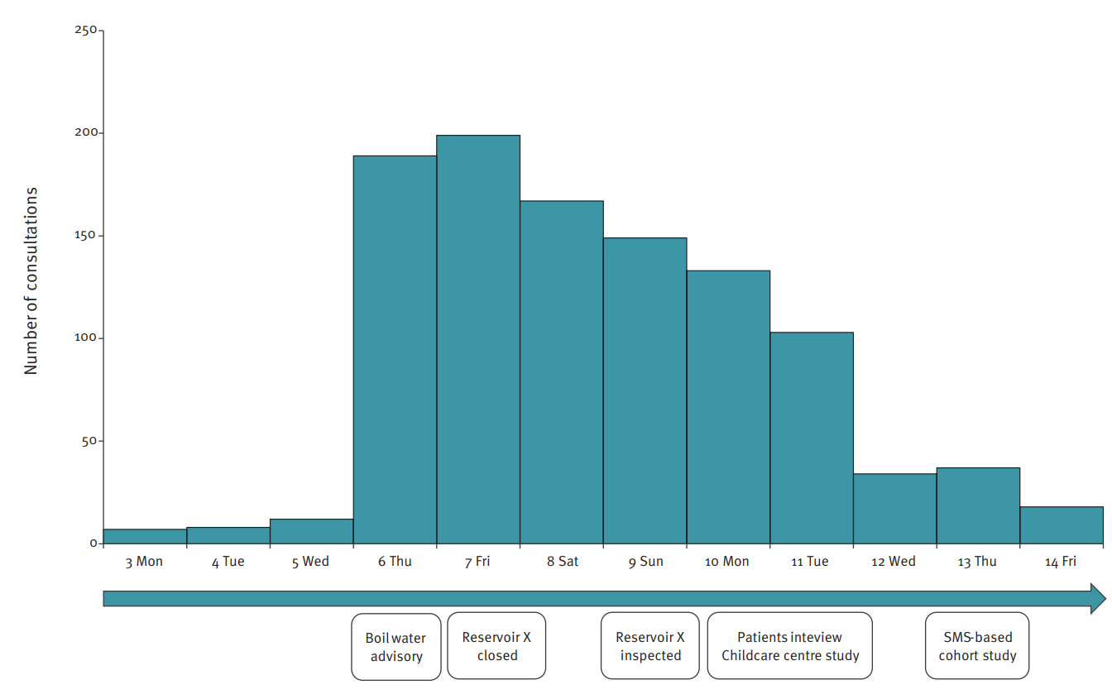
Step 3: Define cases
Step 4: Identify cases and obtain information Step 5: Descriptive epidemiological investigation
Number of gastroenterititis consultations at general practitioner and out-of-hours primary healthcare services

Slide 37
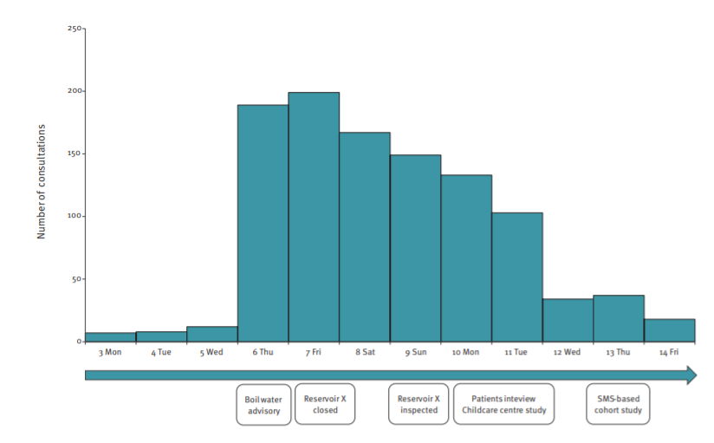
Step 4: Identify cases and obtain information Step 5: Descriptive epidemiological investigation
Step 3: Define cases
Outbreak monitoring
Sharp increase in gastroenteritis
consultations
(from 12 to 182 consultations) on Thursday 6 June
Consultations evenly distributed among all age
groups, although in-person consultations were
primarily for children

Slide 38
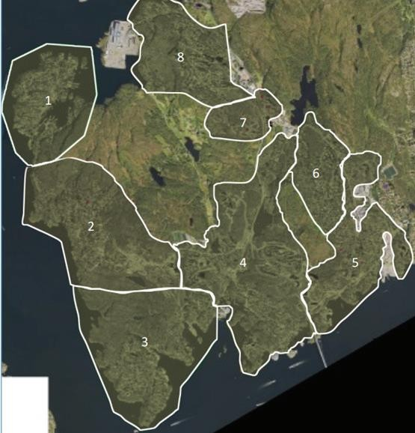
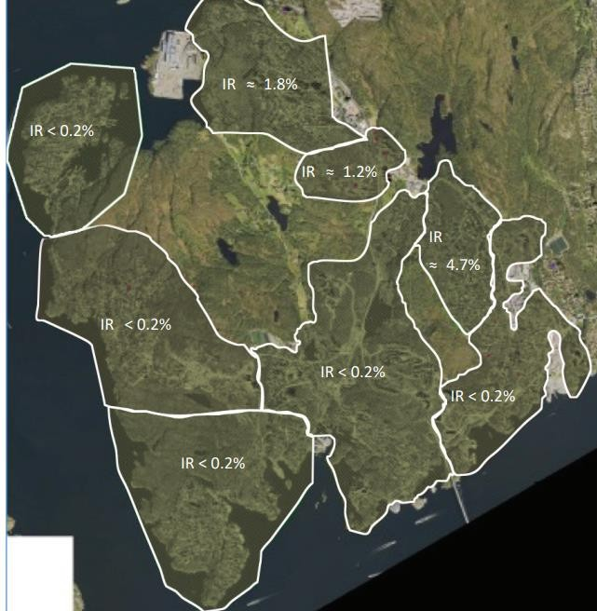
Step 3: Define cases
Step 4: Identify cases and obtain information Step 5: Descriptive epidemiological investigation
Country example
Water supply zones of water supply system WSS-A defined by different reservoirs Zones 6, 7 and 8 were served by Reservoir X.
Estimated incidence rates for gastroenteritis consultations linked to reservoir supply zones

Slide 39
Step 3: Define cases
Step 4: Identify cases and obtain information Step 5: Descriptive epidemiological investigation
Country example
Outbreak monitoring
Gastroenteritis patients’ residences were coincided with three water supply zones served by Reservoir X.
The three zones with Incidence Rate > 1 are the ones served by Reservoir X.

Slide 40
Step 3: Define cases
Step 4: Identify cases and obtain information Step 5: Descriptive epidemiological investigation
Outbreak monitoring
Trawling questionnaires to five campylobacteriosis cases.
  Diarrhoea, stomach pain and fever (onset 4-5 June)
  Tap water at home in the week before symptom onset
  Attendance to events, food items, contact with animals or recreational water not common to all five cases
Country example

Slide 41
Step 3: Define cases
Step 4: Identify cases and obtain information Step 5: Descriptive epidemiological investigation
Survey of childcare centres
Case definition: any person absent from the childcare centre (child or employee) because of diarrhoea or vomiting (who?, where?) between 28 May and 7 June (when?)
Comparison of attack rates in childcare centres served/not served by Reservoir X
Country example

Slide 42
Step 4: Identify cases and obtain information Step 5: Descriptive epidemiological investigation
Step 3: Define cases
Country example
Survey of childcare centres
All childcare centres (n=27) in the municipality participated in the study. Eight (769 children and employees) in areas supplied by Reservoir X and 19 ( 1,761 children and employees) in areas supplied by other reservoirs.
  Childcare centres in affected areas: Attack rate: 20%
  Childcare centres in unaffected areas: Attack rate 2%
Absences started to increase at the childcare centres in affected areas on 3 June (n=26) and peaked on 7 June with 81 absences

Slide 43
Step 6: Additional studies (environmental, laboratory)
→ Environmental investigation
→ Laboratory investigation of the water supply system

Slide 44
Environmental investigation
Step 6: Additional studies
Description of the water supply system
  Water source
  Abstraction points and distribution network
  Treatment processes
  Storage tanks
  Distribution network
  Location of potential contamination sources

Slide 45
Environmental investigation
Step 6: Additional studies
2) Rapid system assessment → Hazardous events? Control measures in place?
Interview water-supply system personnel
Review outcomes of sanitary surveys
Assess water quality information and weather records
Operational records and procedures: any problems compromising control measures?
Customer complaint reports
Non-piped systems: Review water collection, transport and handling
Map potential exposures of interest

Slide 46
Step 6: Additional studies
Laboratory investigation of the water-supply system
Provides strong evidence on the link between the source and cases
Still possible to demonstrate that water is the source of an outbreak even if
the agent is not isolated from the water-supply system

Slide 47
Laboratory investigation of the water-supply system
Step 6: Additional studies
Increase frequency of sampling
Increase the number of sampling sites
  Suspected sources of pollution
  Critical points in the treatment plant
  Water and sediment from storage reservoirs and the distribuition
system
  Stored water

Slide 48
Laboratory investigation of the water-supply system
Step 6: Additional studies
Microorganisms may not be detected in the water-supply system due to:
Time between the contamination event, exposure and sampling.
Transient contamination
Disinfection of the system as a preliminary measure
Special sampling needed to isolate enteric viruses or protozoa

Slide 49
Step 6: Additional studies (environmental, laboratory)
Country example
Environmental investigation – Description of the water supply network
Under normal conditions, Reservoir X supplies Zone 6 (1,350 residents)
Before the outbreak, a valve opened from Reservoir X to ensure replacement of water in response to customer complaints about the water quality.
This led to a connection between zone 6 and zones 7 and 8 (3,558 residents) with drinking water from both Reservoir X and others
Consultations indicated a higher IR in these zones The valve was closed on 6 June

Slide 50
Step 6: Additional studies (environmental, laboratory)
Country example
Environmental investigation – Visual inspection of Reservoir X
Basin constructed as an unlined rock cavern. Its entrance sealed by a locked door
400 m3 of water, located above a residential area in mountainous terrain
Natural cracks located in the back of the reservoir, leaks in the concrete construction and
water running from inside the roof.
Large antenna with power lines above the reservoir, were birds could gather
  Risk of bird faeces contaminating the area below
No animals observed
No unusual malfunctions reported before the outbreak

Slide 51
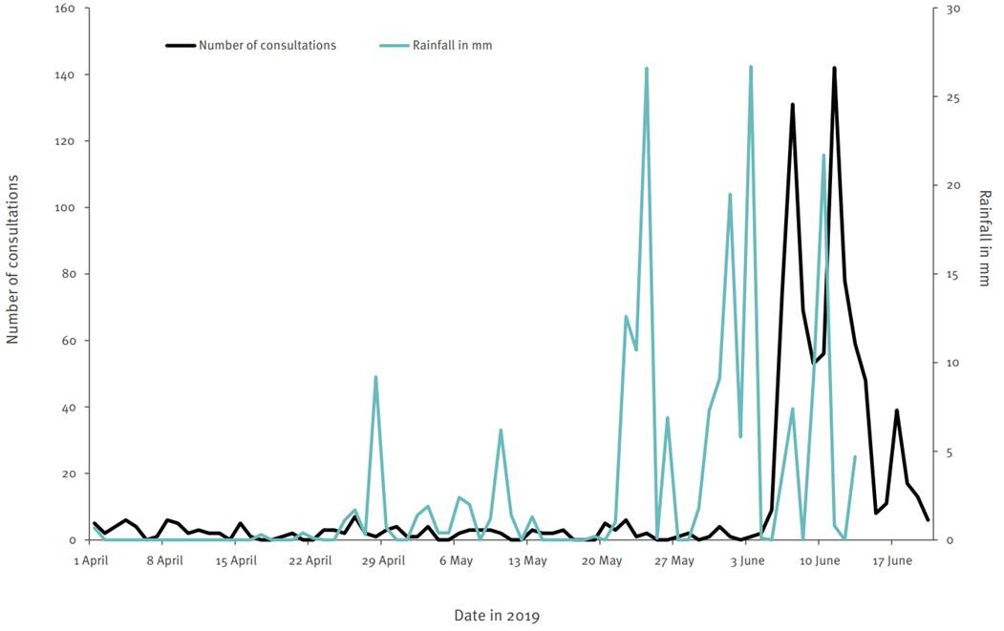
Step 6: Additional studies (environmental, laboratory)
Country example
Environmental investigation –
Weather records.
Weather data from a nearby weather station indicated heavy rainfall.
This coincided with registered consultations of gastroenteritis in the Norwegian Syndromic Surveillance System.

Slide 52
Step 6: Additional studies (environmental, laboratory)
Country example
Analysis of water in WSS-A or in Reservoir X.
Routine samples prior to the outbreak did not detect any faecal indicator bacteria after the outbreak, extra sampling in WSS-A was conducted
Routine samples for WSS-A on 3 June were also negative
On 6 June, samples collected from Reservoir X and areas supplied by Reservoir X were contaminated.
Several samples positive for Campylobacter (7 June).

Slide 53


Step 7: Generate hypotheses
Descriptive
epidemiology
Age
Sex
Residence
Work place
Routines
Microbiology
Incubation period
Mode of transmission
Previous
outbreaks
Environment
Risk assessments
Inspections

Slide 54
Step 8: Evaluate the hypotheses
Analytical studies
Assessing the strength of evidence
Analytical studies may generate stronger evidence to support the hypothesis and to quantify the strength of the association
Compare exposure between cases and non-cases and identify risk factors
Cohort studies Case-control studies

Slide 55
Step 8: Analytical studies- Considerations
Challenges when collecting water usage exposure:
Time elapsed between the exposure and the investigation
Respondents may have changed water use as part of control measures
Exposure to different water sources: home, workplace, sport center…
Household members may be exposed to different water sources.

Slide 56
Step 8:
Analytical studies- Considerations
Everyone is exposed to the same water source?
Measure Dose response Risk increases with increasing
amounts of water

Slide 57
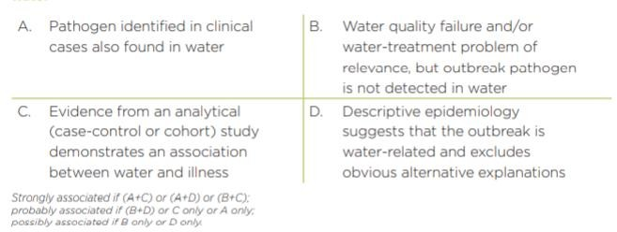
Step 8: Evaluate the hypotheses
Assessing the strength of evidence
Source: Tillet et al

Slide 58
Step 8: Evaluate the hypotheses
Analytical studies Assessing the strength of evidence
Cohort study of households
All residents who received water from WSS-A were included Exposed: people in households receiving water from Reservoir X Case definition: person with gastroenteritis with symptom onset
between
01 and 19 June 2019
Country example

Slide 59
Step 8: Evaluate the hypotheses
Analytical studies Assessing the strength of evidence
Country example
Cohort study of households
SMS with link to a questionnaire sent to all households served by WSSA One person should respond on behalf of all household members.
The questionnaire included items on illness and tap water consumption

Slide 60
Step 8: Evaluate the hypotheses
Analytical studies Assessing the strength of evidence
Cohort study of households
Information available from 2,526 persons who responded on behalf of 6,108 household members
Coverage of 51% (6,108/11,995) of the residents supplied by WSSA
Country example

Slide 61
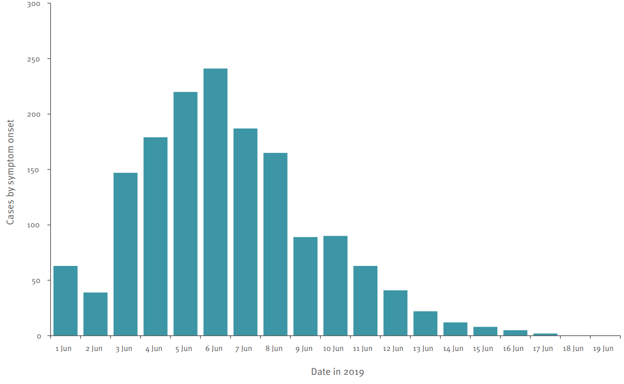
Step 8: Evaluate the hypotheses
Analytical studies Assessing the strength of evidence
Country example
Cohort study of households
Mean age : 34 years (0- 93)
50% were female
1,573 respondents met the case
definition
Attack rate: 26%.
Number of cases peaked on 6 June
and decreased gradually thereafter

Slide 62
Step 8: Evaluate the hypotheses
Analytical studies Assessing the strength of evidence
Country example
Cohort study of households
Attack rates and risk ratio for areas supplied by Reservoir X and other areas

Slide 63
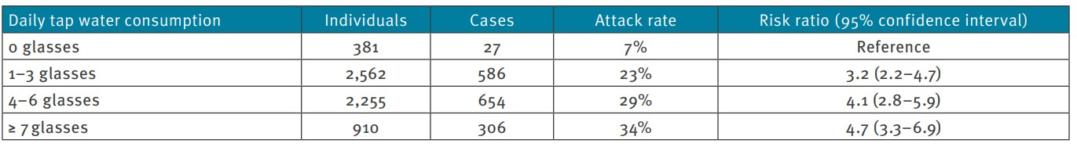
Step 8: Evaluate the hypotheses
Analytical studies Assessing the strength of evidence
Country example
Cohort study of households
Risk of gastrointestinal illness by consumption of tap water

Slide 64
Step 9: Implement control measures
Implemented immediately
  Boil water advisory
Evaluated and adjusted continuously throughout the outbreak
Control measures should also target the underlying causes of the outbreak
  Insufficient policy or tools?
  Inadequate training of waterworks personnel?
  Inadequate maintenance of the water distribution system?
The outbreak may prompt policy changes

Slide 65
Step 9: Implement control measures
Country example
Immediate precautionary control measures
Boil water advice issued
Reservoir X taken out of service
Emergency water supply distribution from water tanks located in
public areas
Infection control measures in public services were strengthened

Slide 66
Important considerations
The triangulation of epidemiological, genomic, geographical and water systems data was essential for confirming the role of Reservoir X
Rationale for the early decisions was based on local knowledge and
mapping of cases rather than epidemiological studies.
The use of mixed methods allowed to identify contributing factors, such as inclement weather conditions.

Slide 67
Important considerations
Water contamination through cracks in a mountain reservoir,
because of heavy rainfall
Water supply systems, in particular ageing infrastructure, are generally vulnerable to contamination especially as external risks such as climate factors are changing.
Importance of conducting water safety planning, updating the infrastructure and performing risk-based surveillance to mitigate risks.

Slide 68
Step 10
Communicate findings, make recommendations and evaluate the outbreak response
Communication should begin early
  What is already known?
  What is being done?
Control measures should be communicated continuously to relevant stakeholders
The public should receive regular updates
Detailed outbreak report

Slide 69
Step 10
Communicate findings, make recommendations and evaluate the outbreak response
After-action review:
Outbreak detection and alert
Suitability and speed of implementation of control measures
Outbreak reporting and communication
What worked well
What could be improved

