Slide 1
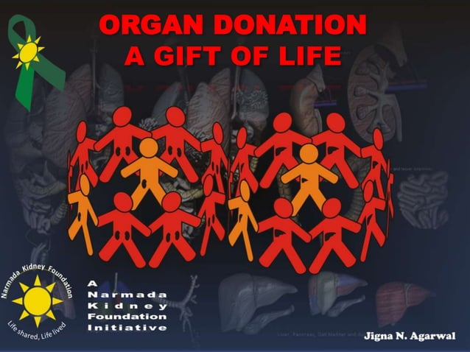
Department of Community Medicine

Slide 2
Donate Organ . Save Lives.
Every donation is critical and you can make a lifesaving difference.
Patients with trauma, undergoing surgery, or with conditions that require organ donation \ blood transfusions (such as sickle cell disease, need blood and blood products).
YOU CAN HELP.

Slide 3
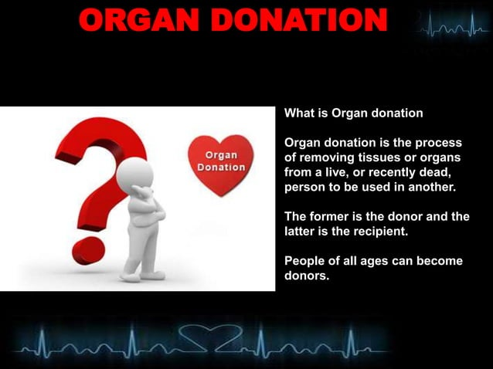

Slide 4
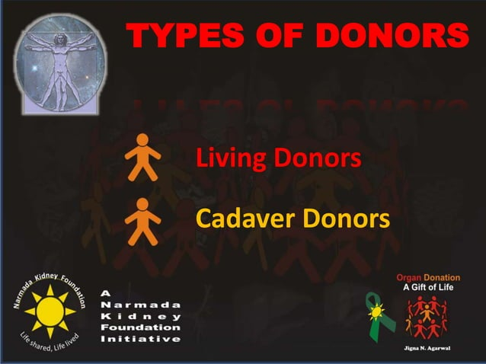

Slide 5
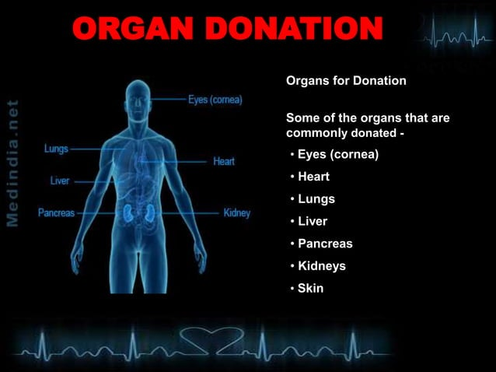

Slide 6
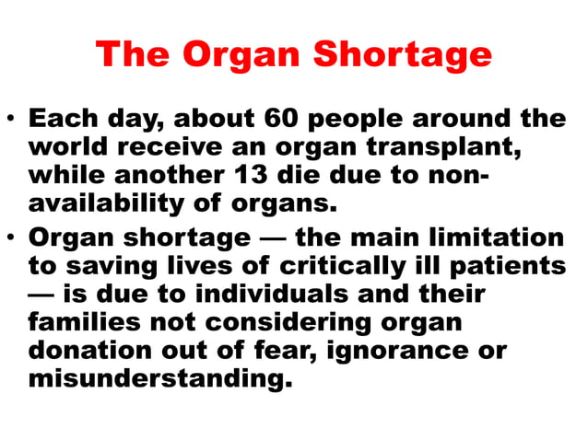

Slide 7
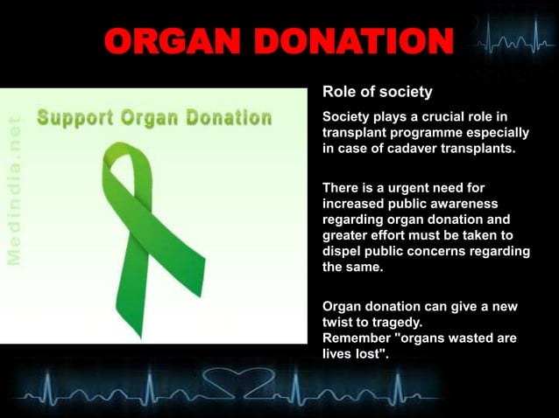

Slide 8
Blood Donation

Slide 9
Blood donation
Type O±
Type A±
Type AB±
Type B±
O
A
AB
B

Slide 10
DID YOU KNOW?
About every 2 seconds, someone needs blood.
Only 3% of age-eligible individuals give blood each year.
Most blood types fall into one of the four major groups: A, B, AB, O.
However, some people have rare blood types that fall outside the major groups, and for these patients, we need a more diverse blood supply.

Slide 11
Who can donate blood
We all present here can donate blood
(Most people can donate blood).
Volunteers should be in good health,
at least 16 or 17 years old (depending on the state they live in),
and weigh at least 110 pounds.
They should also have healthy levels of hemoglobin, which is a protein that carries oxygen in the blood.

Slide 12
Where can I donate blood
At any near by blood donation centre

Slide 13
What to donate
The human body contains five liters of blood, which is made of several useful components i.e. Whole blood, Platelet, and Plasma.
Each type of component has several medical uses and can be used for different medical treatments. your blood donation determines the best donation for you to make.
For plasma and platelet donation you must have donated whole blood in past two years.

Slide 14
Blood donation
 | Donor
Recipient | O- | O+ | B± | A± | AB- | AB+
A±
AB±
B±
O±

Slide 15
“Step up to volunteer; need more organ donors to fill the lacunae”.
By becoming an organ donor, you can save the lives of others.
Please consider becoming an organ donor today.

Slide 16
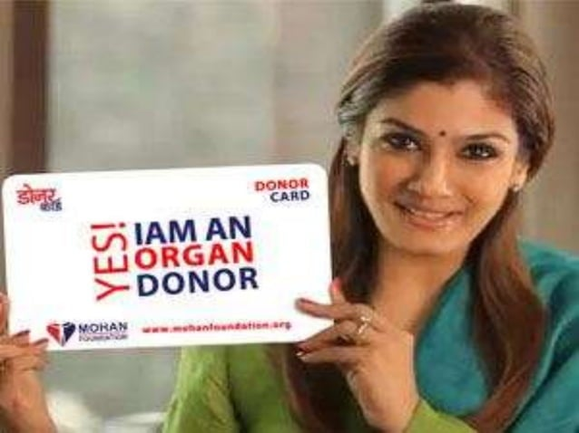
Pledge to be an Organ Donor
All pledges are registered with the National Organ & Tissue Transplant Organization (NOTTO).
Registering as an Organ donor is merely an expression of your intent to be an Organ donor.

Slide 17
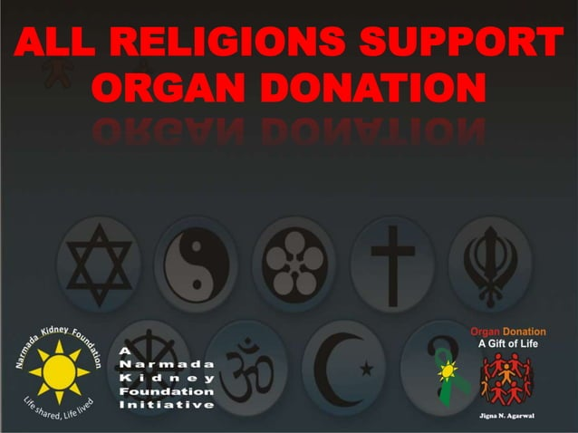

Slide 18
