Slide 1
Previous Year Questions
Discuss in details the services indicated as essential and desirable that should be provided at CHC as per IPHS with special emphasis on National health programs through CHC. 2017
What are IPHS for health centers (SC). Write current status of those norms met by 3 tier system of health care in India. 2015, 2016
IPHS for PHC. 2016,2013

Slide 2
IPHS 2022

Slide 3
OVERVIEW
What is IPHS?
Evolution
Objectives
Priciples
Components of Revised IPHS
Differences between the two versions
SWOT analysis of IPHS 2022
Key barriers and state-level initiatives
Haryana

Slide 4
INDIAN PUBLIC HEALTH STANDARDS
A set of uniform standards to provide norms and benchmarks for quality public health facilities at all levels
Deliver quality services to all citizens with dignity and respect.
Reference point for public health care infrastructure planning and upgradation in the States and UTs.
Designed to provide guidance on the health system components such as infrastructure, human resource, drugs, diagnostics, equipment, quality, and governance requirements for delivering health services at these facilities

Slide 5
Evolution over the years
IPHS first drafted in 2007 : need for these standards. Continuous improvement of quality, improving infrastructure and human resource
In 2012 : Evolving protocols of existing National Health Programmes, for NCDs and prevailing epidemiological situation in the country
In 2022: NHP 2017 and SDG third goal Added focus areas

Slide 6



CURRENT CRITICISMS OF HEALTHCARE
Predominantly Urban Curative Caters to a small population

Slide 7

Objectives
Uniform benchmark for high quality services that are accountable, responsive and sensitive to the needs.
Minimum assured (essential) and achievable (desirable) services.
Strengthening components of health systems
Facilitate monitoring and supervision of the facilities
Achieve and maintain an acceptable standard of the quality.
Provide guidance and tools for governance, leadership and evaluation.

Slide 8
INDIAN PUBLIC HEALTH STANDARDS 2022
MAJOR ADDITIONS
Health and Wellness Centres
Urban Health
Critical Care
Time to Care
Screening and Surveillance

Slide 9
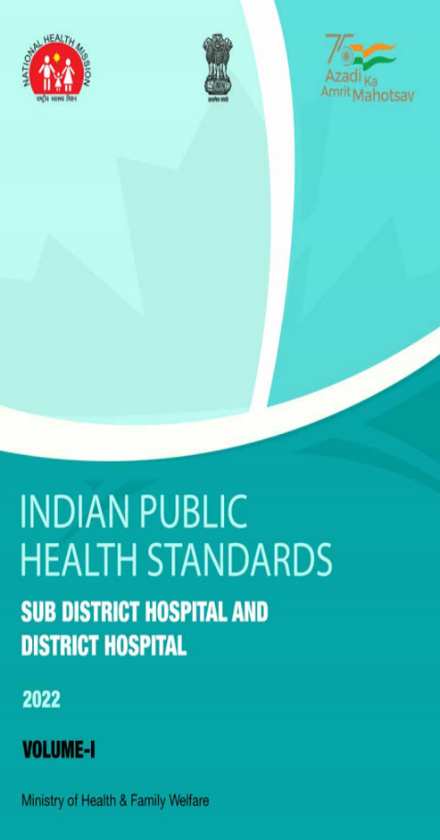


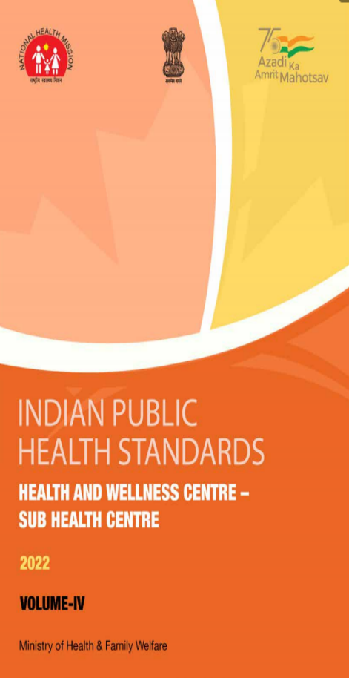

Slide 10
General Principles of IPHS 2022
FACILITIES :
Number of in-patient hospital beds in a district should be based on population of the district against the standards for bed requirement
MCH wing should only be proposed if available beds are unable to fulfill the requirement of maternal and child health needs
Services
Services as per IPHS must be assured and then states are free to add more services based on local needs
Requirement of infrastructure, HRH, drugs, diagnostics and equipment should be based on list of services
AYUSH services have been retained in IPHS 2022 as desirable
Standards and regulations
Citizen’s charter should be prominently displayed near the entrance of the facility

Slide 11
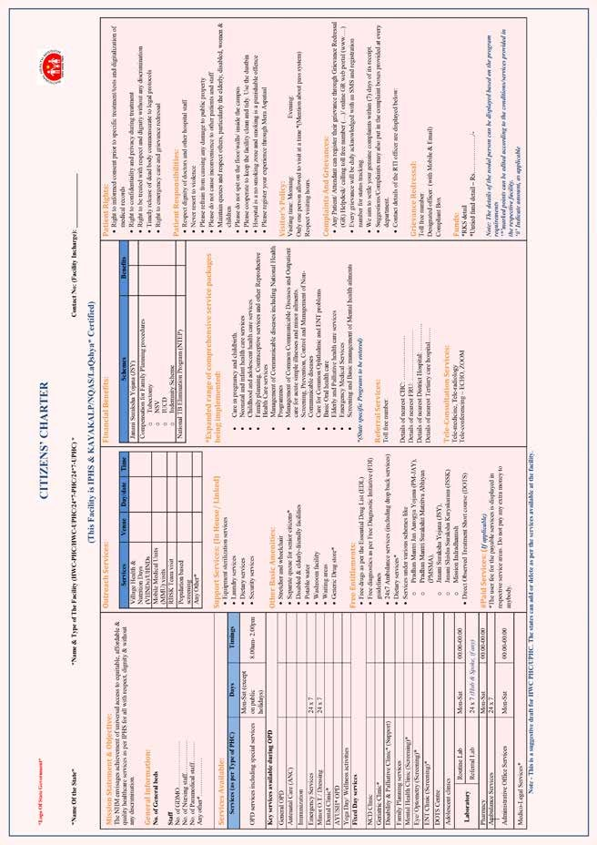

Slide 12
INDIAN PUBLIC HEALTH STANDARDS 2022
SALIENT FEATURES
Human
Resources
Health Systems Approach
GDMO
Nurses
Infrastructure
Disable friendly
Green and climate resistant
Services
Speciality services
Free drugs and diagnostics
Patient friendly services

Slide 13
Implementation of IPHS
Risk management
Evidence based care
Patient involvement
Internal
Clinical Audit
Clinical Governance
RKS
Monitoring
External
Governance
Accountability
Grievance redressal
Patient centered services
Compliance with norms
Training, education

Slide 14




Quality assurance under IPHS
QoC in Labour Room and Maternity OT
Inputs to identify “Dissatisfiers” and further actions to mitigate them
Award scheme where facilities are assessed at three levels
Ensuring child friendly health services

Slide 15
INDIAN PUBLIC HEALTH STANDARDS 2022
COMPLIANCE
Support to states for ensuring IPHS compliance by monitoring through coniditionality framework
Output indicator of achieving IPHS compliance in 50% of facilities by the end of 2025-26 added under NHM

Slide 16
The twelve packages envisaged under Comprehensive Primary Healthcare services (CPHC) are:
Care in Pregnancy and Childbirth
Neonatal and Infant Health Care Services
Childhood and Adolescent Health Care Services
Family Planning, Contraceptive Services, and other Reproductive Health Care Services
Management of Communicable Diseases: National Health Programmes
General Out-patient Care for Acute Simple Illnesses and Minor Ailments

Slide 17
Screening, Prevention, Control and Management of Non-communicable Diseases
Care for Common Ophthalmic and ENT Problems
Basic Oral Health Care
Elderly and Palliative Health Care Services
Emergency Medical Services including Burns and Trauma
Screening and Basic Management of Mental Health Ailments

Slide 18
Population Norms
Health and Wellness Centers-Sub Health Centre
Health and Wellness Centers-
Primary Health Centre
Rural Sub Health Centers
(SHC)
Urban SHC
Rural PHC
Urban PHC
Urban
Polyclinics
5000- Plains
3000- Hilly/ Tribal
15,000 to
20,000
30,000-Plains 20,000-Hilly/Trib
50,000
2.5 to 3 Lakh
CHCs
SDH/DH
Rural CHCs
Urban CHCs
<5 Lakh Functional DH
5 to 10 Lakh
1,20,000- Plains
80,000- Hilly/ Tribal
5Lakh- Metros
2.5 Lakh – Non-metro
SDH
No SDH

Slide 19
IPHS 2022 - Classification
 |  |  |  | DH
 |  |  | SDH
 | PHC | CHC
Sub-Centre |  |  |  | Bed Strength based on Population norms: <2 lakhs -50 2-5 lakhs -100 5-10 lakhs - 200 10-20 lakhs - 300 20-30 lakhs - 400 >30 lakhs - 500
 |  |  | Up to 100 beds <5 lakh population - no SDH. 5-10 lakh - one SDH. Thereafter, every 10-lakh population – one SDH
 |  | Rural Facilities: 1. Non- FRU (30 beds) 2. FRU (30-50 beds) Urban Facilities: 1. UCHC (50 beds)
 | Now known as Health and Wellness Centre Rural Facilities: 1. PHC 2. 24/7 PHC Urban Facilities: UPHC 24*7 UPHC Polyclinics
Now known as Health and Wellness Centre : Rural and Urban HWCs

Slide 20
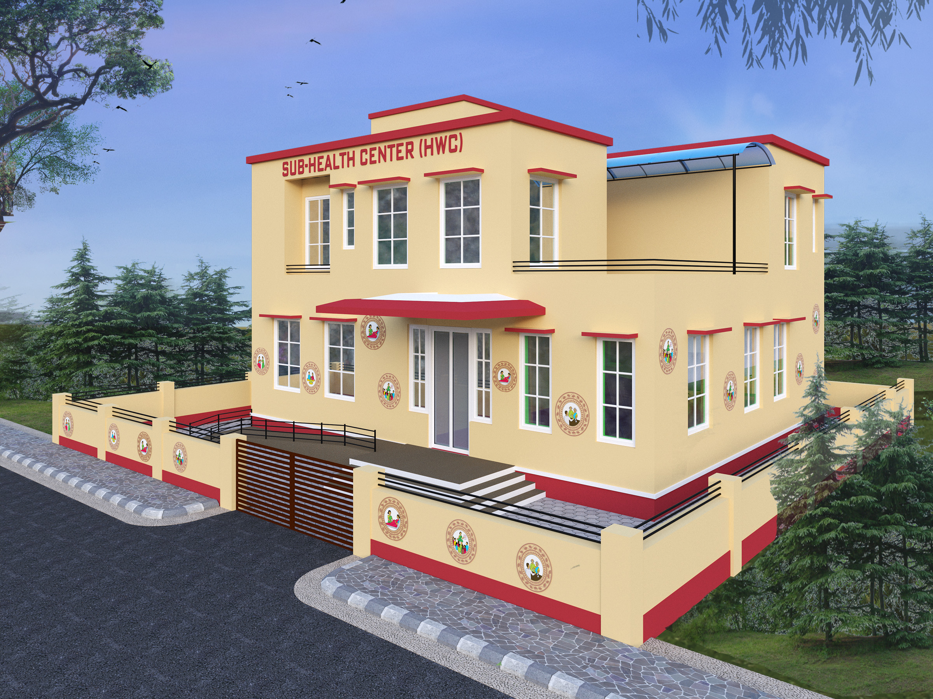

Slide 21
Health And WELLNESS Centre – Sub Health Centre
Infrastructure
AB-HWC Branding
Health and Wellness Room
Examination Room
Day-Care Room
Laboratory
Human Resource
CHO ( Community Health Officer)
MPHW (one female + one male)
Outreach Services
Mental health
Elderly
Palliative care
Population-based screening
Clinical Services
Outpatient care
Teleconsultation for comprehensive services
Diagnostics & Medicines
18 tests and various models of delivery including Hub and Spoke
Essential List of Medicines
Community Participation
Jan Arogya Samiti

Slide 22
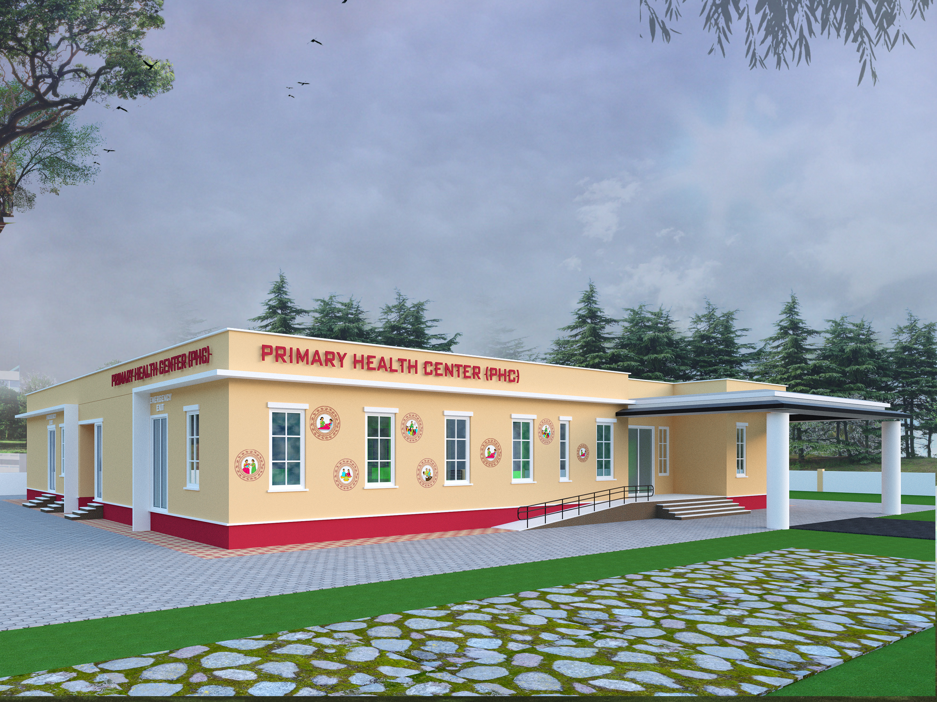

Slide 23
PRIMARY HEALTH CENTRE
Bed Requirement at Primary Health Centres
Number of Beds | PHC |  | UPHC |  | 24x7 PHC/UPHC
 | Essential | Desirable | Essential | Desirable | Essential | Desirable
 | 2 Beds | 4 Beds | 2 Day care Beds | 4 Day care Beds | 6 Beds | 4 Beds

Slide 24
Specialist related services
Multi-speciality polyclinics at UPHC
Provision of Dental, Physiotherapy, Optometrist services
Diagnostics
Fixed day rotational multi-speciality OPD for a minimum of 6 specialities
Obstetrics and Gynaecology
Psychiatry
Medicine
Dermatology
Paediatrics
Ophthalmology

Slide 25
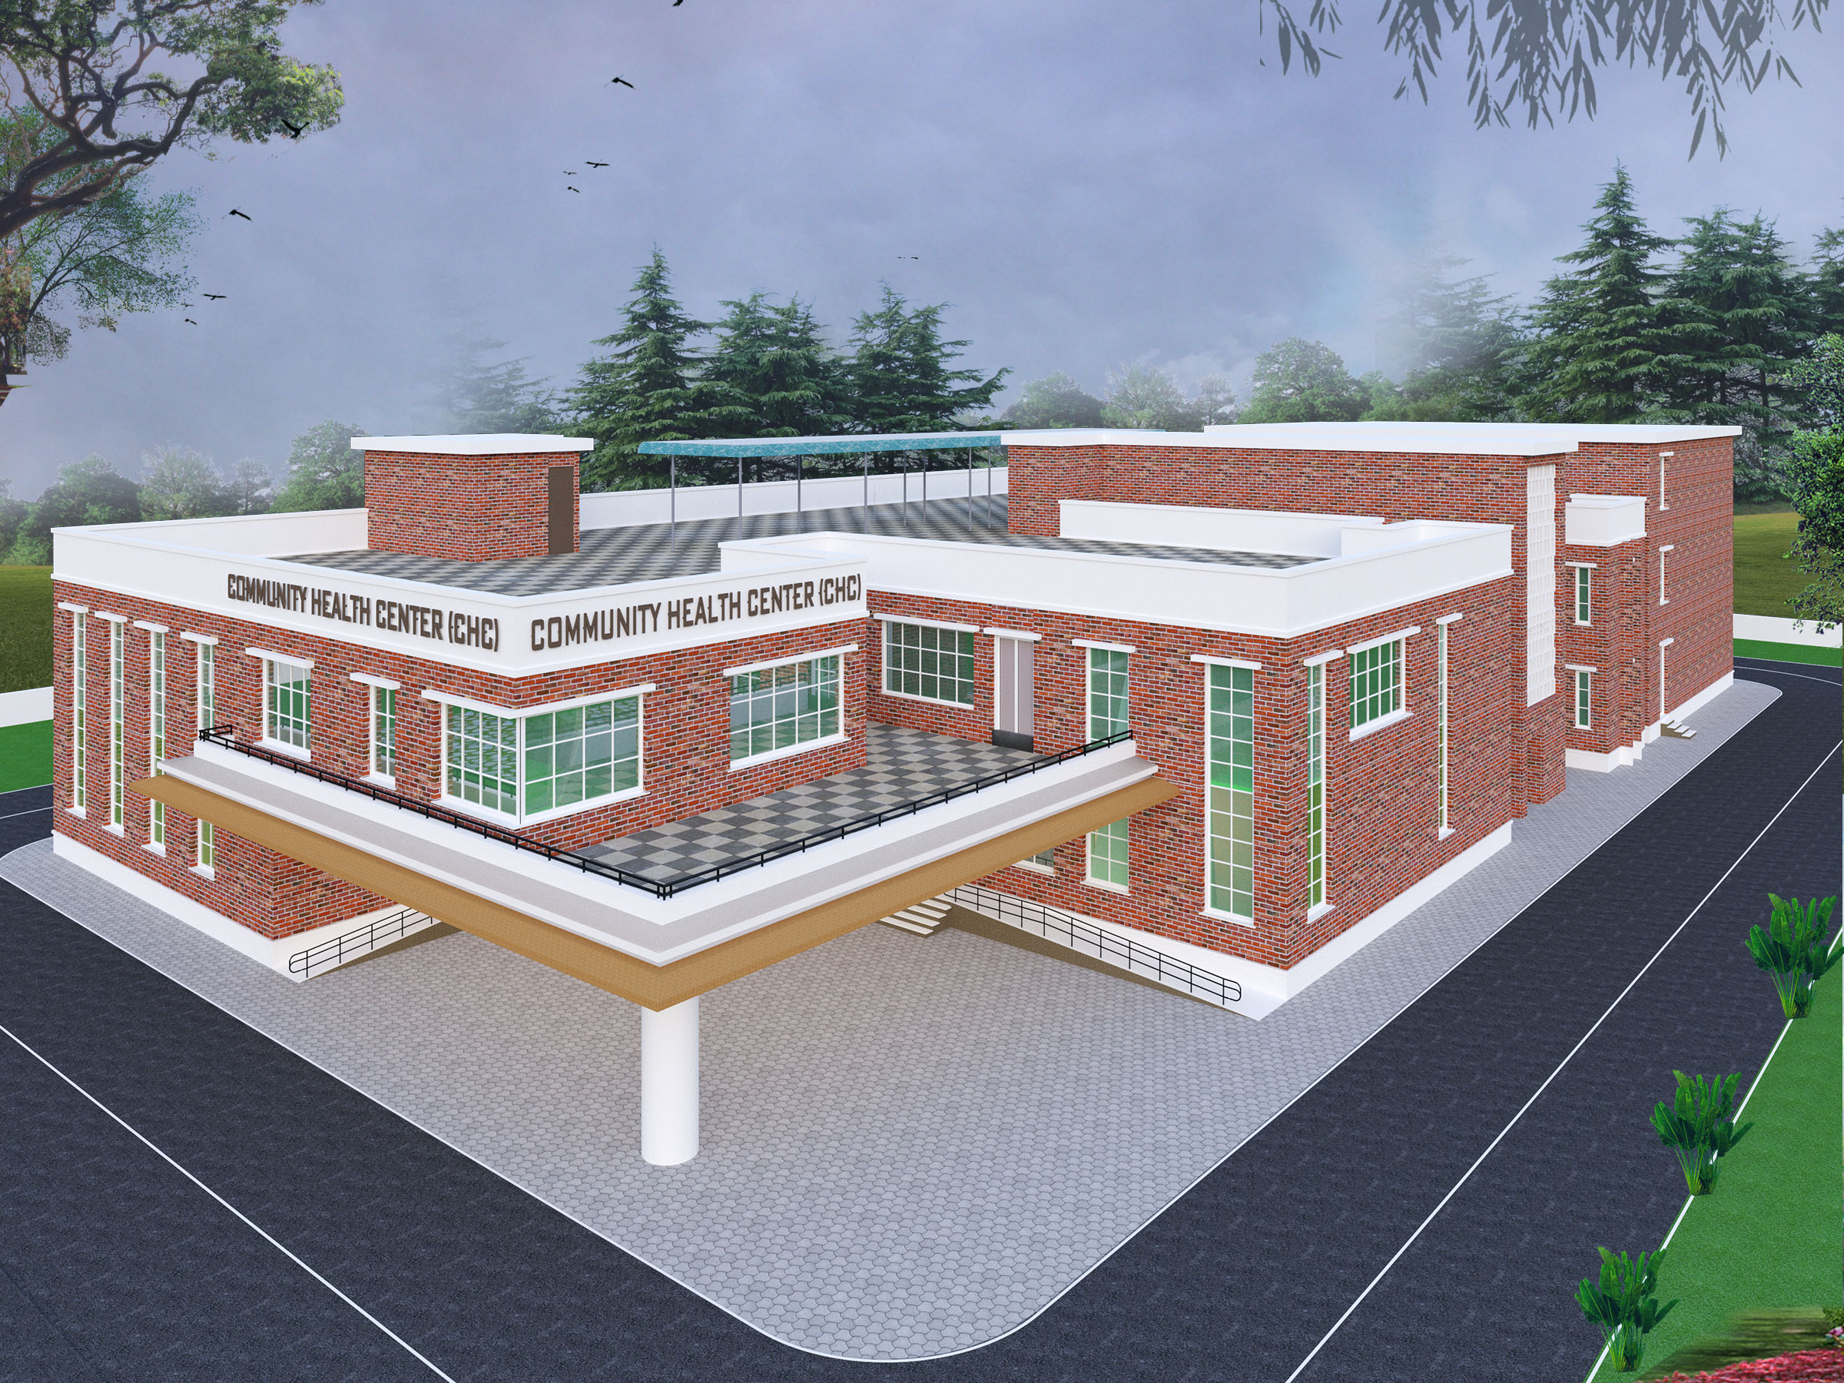

Slide 26
COMMUNITY HEALTH CENTRE
CLASSIFICATION
Non-FRU CHCs (rural)
FRU CHCs (rural and urban)
CHCs in rural areas can be either non-FRU CHC or FRU CHC, the UCHC in urban areas will function only as FRU UCHCs.
For FRU CHCs in rural areas, 30 beds, maternity and surgical services will be essential while in a 50 bedded FRU CHC, additional ophthalmic, orthopaedic, and ENT services will be desirable.

Slide 27
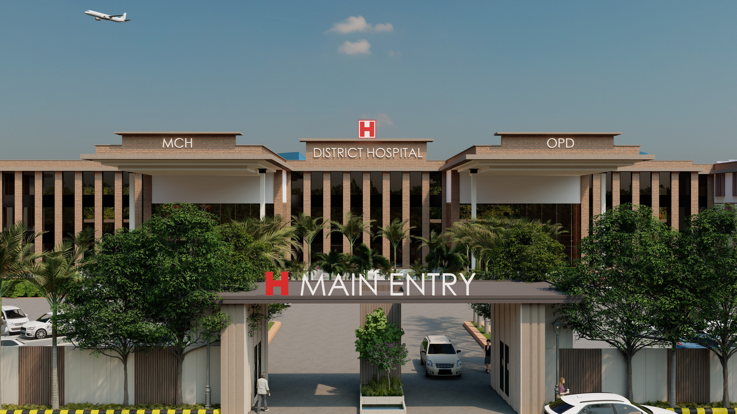

Slide 28
DISTRICT HOSPITAL
Bhore Committee (1946) - 1/1000 population. Essential
National Health Policy (2017) - 2/1000 population. Desirable
(several states are yet to achieve this!)

Slide 29
DISTRICT HOSPITAL
Population | Essential beds | Desirable beds
< 2 lakh | 50 + 15 additional (Emergency and day care beds) | 100
2–5 lakh | 100 beds + 25 | 200
5–10 lakh | 200 beds + 38 | 300
10–20 lakh | 300 beds + 49 | 400
20–30 lakh | 400 beds + 60 | 500
> 30 lakhs | 500 beds + 65 | 700

Slide 30
DISTRICT HOSPITAL
Three pillars;
  Clinical care
  Knowledge hub
  Public health programme

Slide 31
IPHS 2022 and IPHS 2012 differences between the two versions.
S NO | IPHS 2012 | IPHS 2022
1. | Scope and Coverage focused on primary healthcare services and the infrastructure | includes surveillance, health promotion, disease prevention, emergency response.
2. | Holistic Approach limited focus | addressing social determinants of health.
3. | Inclusivity and Participation did not explicitly highlight the need for inclusive engagement of stakeholders. | encourages involving local communities, stakeholders, and civil society organizations in the process.
4. | Implementation Strategies did not have the same level of emphasis | acknowledges the need for countries to develop plans, allocate resources, and set targets to achieve the standards.
5. | COVID-19 Considerations did not explicitly address pandemic preparedness and response. | provides guidelines for countries to strengthen their systems to prevent, detect, and respond to outbreaks and emergencies.

Slide 32
In summary, IPHS 2022 represents an expansion and improvement upon IPHS 2012.
It takes a more comprehensive and holistic approach to public health, addresses social determinants, emphasizes inclusivity and participation, and incorporates lessons learned from the COVID-19 pandemic.
These changes reflect a recognition of the evolving challenges and opportunities in public health and aim to guide country in building resilient and effective systems

Slide 33
SWOT analysis of IPHS 2022
Strengths
Weakness
Shift of focus from creation of strong infrastructure to improving the quality of health care delivery
Responsive to changes in policies and goals/ priorities.
It is forward looking.
Shortage of human resource
Lack of willingness to serve in the rural areas
Absence of transparent transfer policy

Slide 34
OPPORTUNITY
CHALLENGES
Increase in use of Information technology and innovations in healthcare delivery
Government’s commitment to achieve UHC through insurance schemes, etc
Community Ownership for health
Expanding network of Medical colleges
Inadequate funds
Implementation challenges at state level
Overcrowding of secondary and tertiary care facilities
Operationalizing various services at different facilities

Slide 35
Some List of key barriers and state-level initiatives to address them
Infrastructure (Beyond Health sector)
Lack of electricity in peripheral health facilities
  Silko foundation work in the area of solar energy.
  Silko has agreed to power 100 SHCs with solar lights through Corporate Social Responsibility (CSR) funds wherein the contribution by the private player was fixed at 40% and the government would fund the remaining 60%. (Meghalaya)
Lack of local identity to health facilities
  Branding of AB-HWC as “Tandurust Punjab Sehat Kendra” in Punjabi to give local identity and ownership. (Punjab)

Slide 36
Health Promotion & Community Participation
Lack of Yoga trainer for Yoga sessions in HWCs
    Training in Yoga provided to CHOs for conducting training sessions in the HWC (Uttar Pradesh, Sikkim, Gujarat)
Non-adoption of healthy lifestyle
    “Jawabdar Kutumb” – Responsible Family to be scored based on one indicator for each package of services. Families doing well will be felicitated. (Maharashtra)
Lack of Community Participation
    Community mobilization by orientation of village leaders on PHC with emphasis on community participation through VHNSCs. Committees mobilized local funds, monitored constructions. Has increased community ownership. (Nagaland, Manipur)

Slide 37
Expanded range of services
Lack of access to emergency care
    104 Mobile medical services with a centralized roster of doctors for making monthly visit to all SHC-HWCs. (Andhra Pradesh)
    Bike ambulances used to provide emergency medical interventions in field. These bikes are available for carrying medicines, vaccines, diagnostics and other field travel. “First responder” role has been added to it. (Arunachal Pradesh, Chhattisgarh, Assam)
Lack of Integrated care
      Aarogya Samanvay – Integration of Allopathy and Ayurveda/ Yoga by training of the CHOs to integrate them. (Gujarat)

Slide 38
HARYANA
Under Ayushsman Bharat, provision of additional human resource for Sub Health Centre level Health & Wellness Centres has been made; who are Community Health Officers (i.e. BAMS or BSc. Nursing with 6 month certificate course in community health).
Presently, Total 1285 Community Health Officers are working at the Sub Centre level Health & Wellness Centres.
The exam for next phase of recruitment of 527 CHOs has been conducted and consequently their joining at respective SC-HWC is under process.
source: National Health Mission, Haryana (nhmharyana.gov.in)

Slide 39
As on 06/06/2023, Total 2055 Ayushman Bharat-Health & Wellness Centres are operational in the State:
  1466 are Sub Centres
  391 are Rural PHCs
  107 are Urban PHCs and
  91are UHWCs.

Slide 40
In Aspirational District Mewat / Nuh, all standalone 17 Rural-PHCs and 44 Sub Centres have been transformed into HWCs in 2018-19, itself.
Best HWCs were facilitated at National Level by MoHFW on Universal Health Coverage Day i.e. 12.12.2020
  SC Shekrawa (Mewat)
  PHC, Wazirabad (Gurugram)
  UPHC, Chabyana (Ambala)

Slide 41
E- Sanjeevani Tele- consultation --- E- Sanjeevani HWC Tele-consultation services have been initiated among all the Districts in the State. Approx. 2,23,921 Tele-consultation have been conducted till date i.e., 06-06-2023 through AB-HWCs. (Source: esanjeevani.mohfw.gov.in)
45 SC: HWCs have been taken up for NQAS Certification by HSHRC. 73 PHCs and 11 UPHCs are NQAS certified.
Total Kayakalp Award winning PHCs has been increased from 128 to 143 and SHCs from 39 to 105 for the FY 2022-23 in the state.

Slide 42
6 specialized MCH hospitals are being established in the state at:
  1. District Civil Hospital Panchkula,
  2. District Civil Hospital, Panipat and
  3. Shaheed Hasan Khan Mewati Govt Medical College, Nalhar, Nuh.
  4. District Civil Hospital Faridabad
  5. District Civil Hospital Palwal
  6. District Civil Hospital Sonipat
Also in 2023-24, 2 new MCH Wings at Kaithal and Sirsa have been approved.
Till date, 8 obstetric HDU/ICUs are being established in the State.
5 at govt. Medical Colleges and 3 at Civil Hospitals- Faridabad, Panchkula and Sector 10 Gurugram
Obs. ICU/HDU at MAMC Agroha, BPSGMC Sonipat, CH Faridabad and CH Sector 10 Gurugram are functional. At PGIMS, Rohtak Obs. HDU is functional.

Slide 43
Way Forward
Regional/State Level Workshops
National and State Level Action Plans through dedicated team for implementation of IPHS
Advocacy for Public Health Management Cadre for improved compliance
Regular Follow Up and Support to the States along with monitoring through conditionality framework.

Slide 44
REFERENCES
Park K.Textbook of Preventive and Social Medicine, 27 ed. Jabalpur(India): Banarsidas Bhanot Publishers; 2022.
IPHS Revised Guidelines 2022 Vol 1-4 [Internet]. [cited 2022 June]. Available from: https://nhm.gov.in/index1.php?lang=1&level=2&sublinkid=971&lid=154
MOHFW. AB- Health and Wellness Report 2022 .
IPHS 2022. IAPSM econnect. 11 Aug 2022

Slide 45
THANK YOU

