Slide 1
Role of Vaccine in disease control

Slide 2
Disease control
Disease control-It means reducing the number of new infections, the number of people currently infected, and the number of people who become sick or die from a disease in local settings.

Slide 3
Elimination vs eradication
Elimination of an infectious disease is declared when the disease is no longer found or transmitted at a sustained rate within a geographic area.
Eradication of an infectious disease is declared when the disease is not found or transmitted anywhere in the world.

Slide 4
Vaccine
A vaccine is a biological preparation that provides active acquired immunity to a particular infectious or malignant disease.
The agent stimulates the body's immune system to recognize the agent as a threat, destroy it, and recognize further and destroy any of the microorganisms associated with that agent that may encounter in the future.

Slide 5
The efficacy or performance of the vaccine is dependent on several factors:
the disease itself (for some diseases vaccination performs better than for others)
the strain of vaccine (some vaccines are specific to, or at least most effective against, particular strains of the disease)
idiosyncratic response to vaccination; some individuals are "non-responders" to certain vaccines, meaning that they do not generate antibodies even after being vaccinated correctly.
Other factors such as ethnicity, age, or genetic predisposition

Slide 6
Types of vaccines
Types | Vaccine
Live attenuated vaccine | BCG, OPV, Measles, MMR, Rotavirus,
Killed or inactivated vaccine | IPV, Rabies, Hepatitis A, Influenza
Sub-unit (purified antigen) | Hepatitis-B, Hib (Haemophillus influenzae type-B), Pnumococcal
Toxoid | Tetnus toxoid, Diphtheria toxoid

Slide 7
First vaccine developed - Small pox
First vaccine was developed by - Edward Jenner

Slide 8
Immunization
Def:-
“Immunization is the administration of all or part of a pathogen or preformed antibodies to elicit an immunological response that protects from disease.”
Considered one of the most cost effective health interventions of all times.

Slide 9
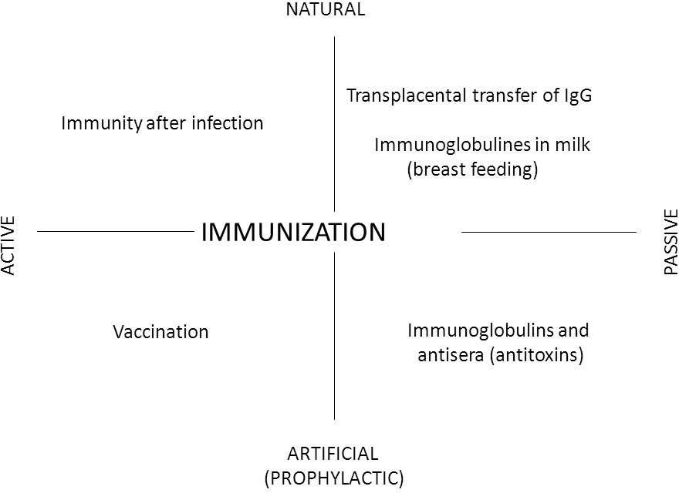

Slide 10
Herd immunity
It is a type of immunity that occurs when the vaccination of a portion of population provides protection to unprotected individual.
The higher the number of immune individuals, the lower the like hood that a susceptible people will come in contact with an infectious agent.
Resistance to spread of infectious disease in a group because of few susceptible members, making transmission unlikely.

Slide 11
VPDs?

Slide 12
Vaccine Preventable Diseases:
Vaccine | Disease
BCG | Tuberculosis
OPV | Poliomyelitis
Hepatitis | Hepatitis-B
Rota viruse | Rota virus diarrhoea
Pentavalent | Diphtheria, Tetanus, Pertusis. Hepatitis-B, Influenza
Measles-Rubella | Measles-Rubella
Japanese encephalitis | Japanese encephalitis
Vitamin - A | Night Blindness
Tuberculosis

Slide 13
National Immunization Schedule

Slide 14
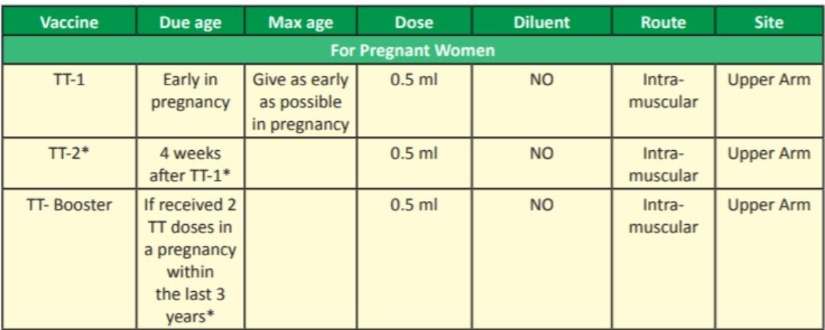
National Immunization Schedule. For pregnant women

Slide 15
NIS. for Infants
Vaccine | Due age | Max age | Dose | Diluent | Route | Site
BCG | At birth | Till one year | (0.05ml until 1 month) 0.1ml beyond 1 month | Nacl | Intra-dermal | Upper left arm
Hepatitis-B | At birth | Within 24 hours | 0.5ml | No | Intra muscular | Anto-lateral side of mid thigh
OPV-0 | At birth | Within first 15 days | 2 drops | - | Oral | Oral
OPV 1,2,3 | At 6, 10, 14 weeks | Till 5 years of age | 2 drops | - | Oral | Oral
Pentavalent 1, 2, 3 | At 6, 10, 14 weeks | Till 1 years of age | 0.5ml | No | Intra muscular | Anto-lateral side of mid thigh
Rotaviruse | At 6, 10, 14 weeks | Till 1 years of age | 5drops | No | Oral | Oral
IPV | At 6, 14 weeks | Till 1 years of age | 0.1ml | No | Intra-dermal | Upper arm Right

Slide 16
NIS. for Infants cont..
Vaccine | Due age | Max age | Dose | Diluent | Route | Site
Measles/ MR-1st dose | At 9-12 month | 5 years of age | 0.5ml | Sterile water | Sub-cutaneous | Upper arm right
Japnese encephalitis | At 9-12 month | 15 years of age | 0.5ml | Phosphate buffer solution | Sub-cutaneous | Upper arm left
Vit-A | At 9 months | 5 years of age | 1ml | - | Oral | Oral

Slide 17
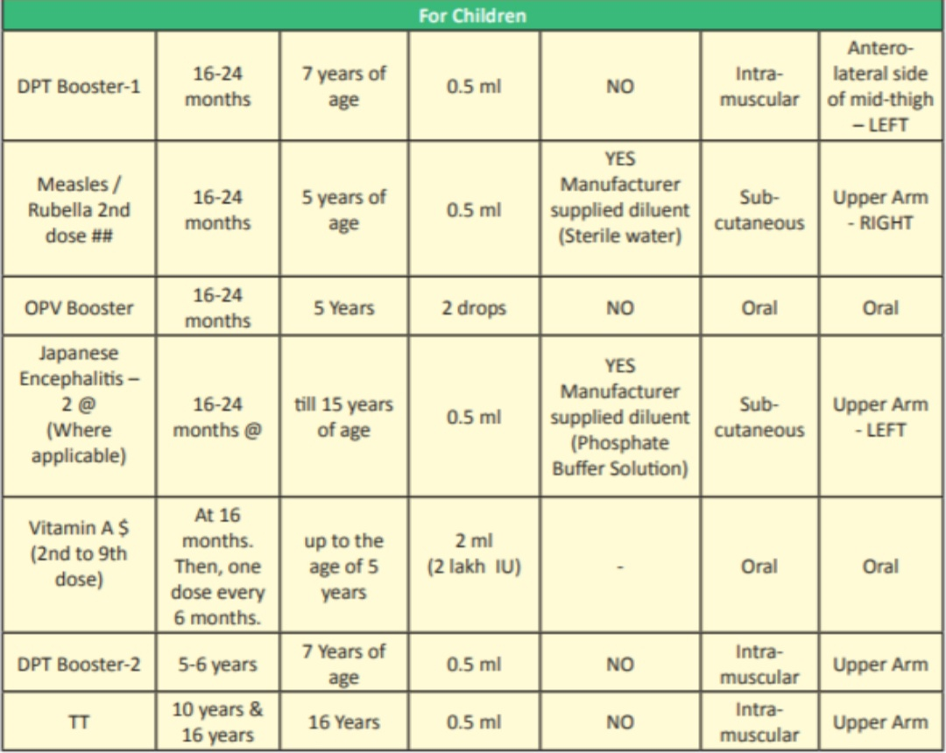
NIS. for children cont..

Slide 18
Adverse reactions
&
Contraindication

Slide 19
Bacillus Calmette Guerin (BCG) vaccine
Adverse reactions | Local ulceration or discharging sinus; axillary lymphadenitis; disseminated infection, osteomyeltis (in immunodeficient recipient)
Contraindication | Cellular immunodeficiency; symptomatic HIV
Storage | 2-8°C; sensitive to heat and light; discard unused vaccine after 4 hr

Slide 20
Oral poliovirus (OPV) vaccine
Adverse reactions | Vaccine derived poliovirus; vaccine associated paralytic poliomyeltis
Contraindication | Inherited or acquired immunodeficiency; symptomatic HIV
Storage | Storage 2-8°C; sensitive to heat; use vaccine vial monitor

Slide 21
Pentavalent vaccine
Adverse reactions | Local pain, swelling, fever
Contraindication | (i) Progressive neurological disease (administer DT or dT instead); (ii) anaphylaxis after previous dose; (iii) encephalopathy within 7 days of previous dose
Storage | 2-8°C; sensitive to light

Slide 22
Measles Vaccine
Adverse reactions | Fever, transient macular rash ('measles like' illness) 5-10 days later
Contraindication | (i) Immunosuppressive therapy (e.g. high dose corticosteroids); (ii) malignancy; (iii) severe immunodeficiency (iv) untreated tuberculosis
Storage | 2-8°C; sensitive to heat and light; use within 4-6 hrs of reconstitution

Slide 23
Rotavirus vaccine
Adverse reactions | Intussusception (rare)
Contraindication | Past history of intussusception; severe immunodeficiency
Storage | 2-8°C; do not freeze; protect from light; use immediately after reconstitution or opening

Slide 24
Immunization Programme

Slide 25
Mission Indradhanush
To strengthen and re-energize the immunization programme and achieve full coverage at rapid pace, The Govt. of India launched ‘Mission -Indradhanush’ in December 2014.
It aims to immunize all children under the age of 2 years, as well as all pregnant women, against seven vaccine preventable diseases.

Slide 26
7 colours of Indradhanush represents prevention against 7 diseases i.e.
S.no | Disease
1 | Diphtheria
2 | Tetanus
3 | Pertusis
4 | Polio
5 | Tuberculosis
6 | Measles
7 | Hep-B

Slide 27
Newer vaccines added in Mission Indradhanush are:
IPV
Rota viruse
Japanese encephalitis
Pnuemococcal vaccine
Haemophilus influenzae type B

Slide 28
Intensified Mission-Indradhanush
To further intensify immunization programme, Govt. of India launched ‘Intensified Mission-Indradhanush’ in 2017. Which aims to reach each every child upto 2 years of age and all those pregnant women who have been left uncovered under routine immunization programme.

Slide 29
Other vaccines-
Typhoid vaccine (vipolysaccharide vaccine ) | Age above 2 years , single dose , repeat every 3rd year.
Cervical cancer vaccine (Cervarix) | People aged 9 to 14 years can be given two doses, six months apart. Above 15 years three dose recomanded
Cholera vaccine (Dukoral) | Mainly used for travellers, all individuals over the age of 2 years, 2 dose (gap not more than 06 months)
Rabies vaccine | At any age. (post exposure)0,3,7,14,28
Covid vaccine | Age above 6months . 1dose.
Pneumococcal vaccine | Babies, (1st dose at 12 weeks and a booster dose at 1 year) Adults (65 and above 1 dose.)

Slide 30
End

