Slide 1
HEALTH EDUCATION

Slide 2
HEALTH EDUCATION
“Process of bringing scientific knowledge on health to the people to bring about changes in their knowledge, attitude and behavior for betterment of their health and health of community in which they live.”

Slide 3
OBJECTIVES
To encourage the people to adopt healthy lifestyles.
To encourage them to make best use of available health services.
To encourage them to change their attitude towards their own health.
To improve health of family and community at large.

Slide 4
HEALTH EDUCATION VERSUS HEALTH PROPAGANDA
HEALTH EDUCATION | HEALTH PROPAGANDA
Knowledge is actively acquired | Knowledge is passively acquired
Makes people to think before acting | Prevents thinking because of readymade information
Mainly concerned with betterment of life. | Concerned with sale of product.
Appeals to reason. | Appeals to consumer emotions.
Aims at improvement of health. | Aims to derive profit.
Aims at changing attitude and behavior of people. | Does not aims at changing attitude and behavior of people.
Discipline primitive desires. | Stimulates primitive desires
Behavior concerned. | Information concerned.
Appeals people with reason | Appeal people with emotion.
Develops refractive behavior. | Develops reflexive behavior.

Slide 5
APPROACHES IN HEALTH EDUCATION
Regulatory approach.
Service approach
Health education approach
Primary health care approach

Slide 6
REGULATORY APPROACH
Legal approach but Government to alter behavior of people for betterment of their health..
Vary from prohibition to impairment
MERIT:- Simplest and quickest way.
DEMERITS:-Disease may be controlled but not eradicated, cannot force people to act.

Slide 7
SERVICE APPROACH
Providing healthcare services to individual doors based on assumption that people would use them to improve health.
People may not accept even if provided free of cost unless felt-need resulting in failure

Slide 8
HEALTH EDUCATION APPROACH
Many health problems can be solved only through health education.
Results slow but enduring..
Attitudes and behavioral patterns formed early in life, health education started early in school and behavioral patterns more easily controlled among young population than adults.

Slide 9
PRIMARY HEALTHCARE APPROACH
New approach.
Heath-care service- Basic, essential, utilization provided by non medical persons starting from the people, by the people, of the people and for the people based on principles like equitable distribution, community participation, Intersectoral approach and appropriate technology .

Slide 10
CONTENTS OF HEALTH EDUCATION
Human biology
Personal hygiene
Nutrition
Environment
Prevention of accidents
Prevention of communicable diseases
Reproductive health
Population control
Mental health.

Slide 11
PRINCIPLES OF HEALTH EDUCATION
CREDIBILITY:- Degree to which message perceived as trustworthy.
CONTENT (INTEREST):- People listen only which are of their interest, meaningful and felt-need
CONTEXT:- Should be relevant to receiver.
CLARITY:- Message should be in clear terms.
CONSISTENCY:- Consistent to penetrate into mind.
CHANNELS:-Existing channels use.
CAPABILITY OF AUDIENCE:-Must be capable to understand.

Slide 12
8. PARTICIPATION:- Motivated for participation.
9. MOTIVATION:-Awakening desire among people to learn- by giving incentives (negative or positive.
10. COMPREHENSION:-Educating people at level can understand and in same language and avoid difficult and strange words.
11. REENFORCEMENT:-Repetition of same message periodically in different ways.
12.LEARNING BY DOING:-”If I hear, I forget, if I see I remember and I do I know”
13. KNOWN TO UNKNOWN:-To people from a level what they know and understand and then proceeded to new knowledge, how ever long process.

Slide 13
14. SETTING AN EXAMPLE:-Himself should practice what he preaches.
15. GOOD HUMAN RELATIONS:- Building good human relation with audiences.
16. FEEDBACK:- Getting feedback
17. LEADERS:-Involvement of local leaders

Slide 14

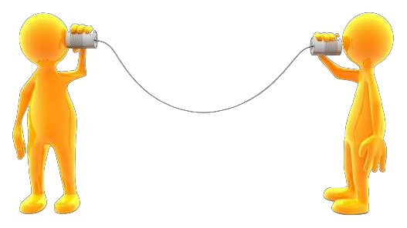
COMMUNICATION
Communication is regarded as a two way process of exchanging or shaping ideas, feelings and information to bring about desired changes in human behavior.

Slide 15

DEFINITION:-
Health communication is defined as a key strategy to inform the public about health concern and to maintain important health issues on the public agenda. The use of the mass and multi media and other technological innovations to disseminate useful health information to the public, increases awareness of specific aspects of individual and collective health as well as importance of health in development.

Slide 16
Communication is essentially the transfer of ideas, messages or information from one person to another.
In this process a cycle of communicating messages is formed between the sender and the receiver.
The sender is required to conceive the message he wishes to send, encode this message and then transmit.
The receiver then is require to receive this message, decode and clarify his/her understanding of the messages.

Slide 17
COMPONENTS OF COMMUNICATION
The components of communications are:-
SENDER:
He is the originator of the message.
His objectives should be clearly defined.
He should know the interests and needs of his audience.
He should know the message.
He should know the channels of communication.
He should know his abilities and limitation.

Slide 18
RECEIVER
Audience may be a single person or a group.
Two types of audience are
CONTROLLED-It is held together by a common interest. It is a homogenous groups.
UNCONTROLLED-It is a group which has gathered together because of curiosity.

Slide 19
MESSAGE
It is the information transmitted by the communicator to the recipient.
A good message must be
In line with the objective.
Based on felt needs.
Clear and understandable.
Specific and accurate.
Timely and adequate.
Interesting.
Culturally and socially appropriate.

Slide 20
CHANNELS OF COMMUNICATION
It is the media used for communication
The media chosen should be
Efficient in transmitting the message
Attractive to the audience
Easily understandable by the people
Able to bring about good response and interaction by the people
The most common channel of communication is interpersonal or face-to-face communication

Slide 21
FEEDBACK
It is the flow of information from the audience to the sender.
It provides an opportunity to modify the message and render it more acceptable
Eg:- opinion polls, interviews, questionnaire surveys

Slide 22




TYPES OF COMMUNICATION
One way and two way communication.
Verbal and non verbal communication
Formal and informal communication

Slide 23


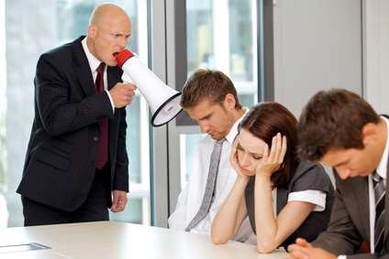
ONE WAY COMMUNICATION-
Flow of information is one way, from the sender to the receiver. The draw backs are
Knowledge is imposed
Learning is authoritative.
There is little audience

Slide 24

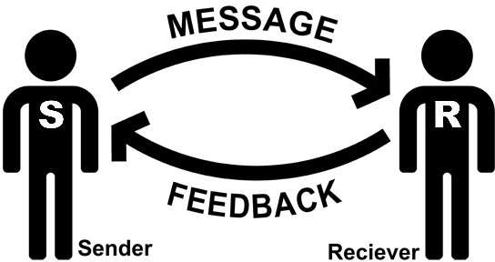
TWO WAY COMMUNICATION
Participation from both the sender and the receiver.
Learning is active and democratic
It is more likely to influence behavior

Slide 25

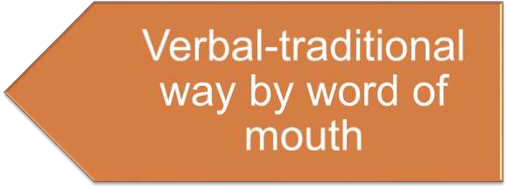
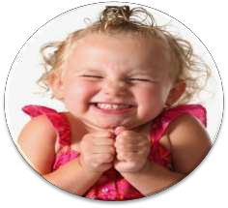
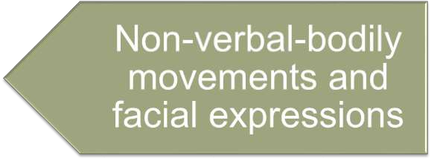
VERBAL AND NON VERBAL COMMUNICATION

Slide 26


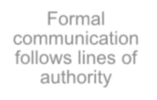

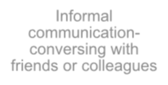
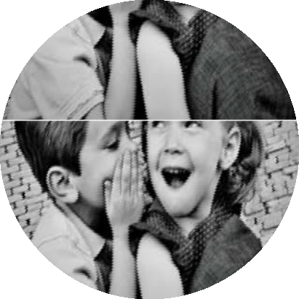
FORMAL AND INFORMAL COMMUNICATION
Formal communication follows lines of authority
Informal communication- conversing with friends or colleagues

Slide 27

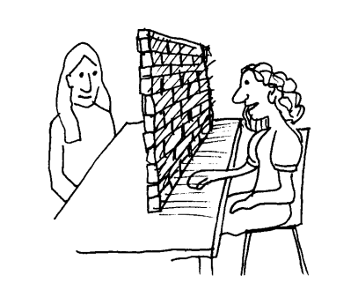
BARRIERS IN COMMUNICATION
1.Psychological barriers
2.physiological barriers
3.Environmental barriers
4.Cultural barriers

Slide 28
PSYCHOLOGICAL BARRIERS
Emotional disturbances, depression, neurosis, psychosomatic disorder
Special methods and utmost care should be adopted to convey the message
PHYSIOLOGICAL BARRIERS
Difficulties in self expression, hearing, seeing, understanding
Channels of communication should be selective

Slide 29
congestionENVIRONMENTAL BARRIERS
Excessive noise, difficulties in vision and
It can be overcome by making small groups and using appropriate channels for communication
CULTURAL BARRIERS
Patterns of behavior, habits, beliefs, customs, attitudes, religion

Slide 30



COMBINATION OF AUDIO- VISUAL AIDS
Sound and sight can be combined together
Televisions
Tape and slide combinations
Video cassette players and records
Motion pictures or cinemas
Multimedia computers
These also include traditional media-folk dance, folk songs, puppet shows, dramas

Slide 31
Definition of Health Education.
Aim and Specific Objectives of Health Education.
Main principles of Health Education.
Types of Health Education.
Different approaches in Health Education.
Stages of Health Education.

Slide 32
Health education is any combination of learning experiences designed to help individuals and communities improve their health, by increasing their knowledge or influencing their attitudes.

Slide 33
DEFINITION
“Health education comprises consciously constructed opportunities for learning involving some form of communication designed to improve health literacy, including improving knowledge, and developing skills which are conducive to individual and community health”
-WHO health promotion glossary

Slide 34



WHO HEALTH PROMOTION GLOSSARY1998
“Health literacy represents the cognitive and social skills which determine the motivation and ability of individuals to gain access to, understand and use information in ways which promote and maintain good health”

Slide 35

NATIONAL CONFERENCE ON PREVENTIVE MEDICINE IN USA
“health education is a process that informs, motivates, and helps people to adopt and maintain healthy practices and lifestyles, advocates environmental changes as needed to facilitate this goal and conducts professional training and research to the same end”

Slide 36
HEALTH EDUCATION PRINCIPLES AND CONCEPTS
Teaching process providing basic knowledge
and practice of health, so as to be interpreted into proper health behaviour.

Slide 37
HEALTH EDUCATION PRINCIPLES AND CONCEPTS
HEALTH PROMOTION AND DISEASE PREVENTION.
Aims of Health
education
EARLY DIAGNOSIS
AND
MANAGEMENT.
UTILIZATION OF AVAILABLE
HEALTH SERVICES.

Slide 38
SPECIFIC OBJECTIVES OF HEALTH EDUCATION
To increase knowledge of the factors that affect health.
To encourage behaviour which promotes and maintains health.
To enlist support for public health measures, and when necessary, to press for appropriate governmental action.
To encourage appropriate use of health services especially preventive services.
To inform the public about medical advances, their uses and their limitations.

Slide 39
WHAT ARE THE MAIN PRINCIPLES OF HEALTH
EDUCATION ….. ?

Slide 40
MAIN PRINCIPLES
Supported by the latest knowledge from research.
A systematic, comprehensive and consistent
activity.
Adapted to age, gender, education and particular
health, mental or social problems of an individual
or community.
Encourages personal investment of an individual.
Respects environment/culture of an individual.

Slide 41


PRINCIPLES OF HEALTH
EDUCATION
1.CREDIBILITY
2.INTEREST
3.PARTICIPATION
4.MOTIVATION
5.COMPREHENSION
6.REINFORCEMENT
7.LEARNING BY DOING
8.KNOWN TO UNKNOWN
9.SETTING AN EXAMPLE
10.GOOD HUMANRELATIONS
11.FEEDBACK
12.COMMUNITY LEADERS
13.SOIL, SEED, SOWER

Slide 42

CREDIBILITY
It is the degree to which the message is perceived as trustworthy by the receiver
It should be scientifically proven, based on facts and should be compatible with local culture and goals

Slide 43
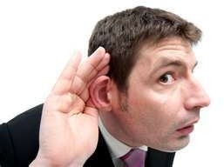
INTEREST
If the health education topic is of interest to the people, they will listen to it.
Health educator should identify the “felt needs” of the people and then prepare a program that they can actively participate in to make it

Slide 44

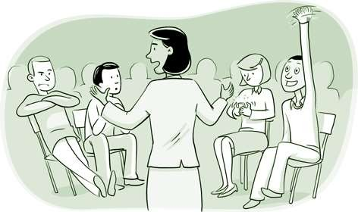
PARTICIPATION
Health educator should encourage people to participate in the program
Once the people are given a chance to take part in the program it leads to their acceptance of the program
Methods like group discussion, panel discussions etc. provide opportunities for people’s participation

Slide 45

MOTIVATION
“the fundamental desire for learning in an individual”
Health education can be facilitated by the motivation provided by the desire to achieve individual goals
Eg:-for a teenager, esthetics might be a motive to take care of his teeth whereas for an adult, the expenses of undergoing restorative care

Slide 46

COMPREHENSION
Level of understating of the people who receive the health education
Should first determine the level of literacy and understanding of the audience and act accordingly
words that are strange or new to the people should not be used
Use of technical terms or medical

Slide 47
Eg:-A statement saying “Eat food items that are cariogenic” may not be comprehensive to the layman. A better way of explaining would be “ Avoid food stuffs which are sweet and which stick to your teeth like toffees and pastries. Eat food items like fruits and raw vegetables which in addition to being healthy, also help in keeping your teeth clean.

Slide 48


REINFORCEMENT
This is the principle that refers to the repetition needed in health education
It is not possible for the people to learn new things in a short period of time
So repetition is a good idea
This can be done at regular intervals and it helps people to understand new ideas or practice better
“booster dose in health education”

Slide 49
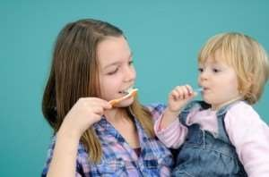
LEARNING BY DOING
If the learning process is accompanied by doing new things it is better instilled in the minds of people
“if I hear, I forget; if I see, I remember; if I do, I know”

Slide 50


KNOWN TO UNKNOWN
Before the start of any health education program, the health educator should find out how much the people already know and then give them the new knowledge.
The existing knowledge of the people can be used as the basic step up on which new knowledge can be placed
Eg:-A health education program with the aim of introducing a toothbrush to a rural population will be better appreciated if the communicator start
the program with “what are you using to clean your teeth at present” and then going in to details like “why are you using it” and then connecting it to the tooth brush and then providing details about the tooth paste.

Slide 51


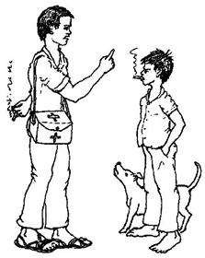
SETTING AN EXAMPLE
The health educator should follow what he preaches.
He should set an example to others to follow
Eg:- A health educator who participate in a program highlighting the ill effects of tobacco should not be seen smoking since it sends a wrong signal and seriousness of the situation is lost

Slide 52

GOOD HUMAN RELATIONS
This principle states that the health educator should have good personal qualities and should be able to maintain friendly relations with the people
The health educator should have a kind and sympathetic attitude towards the people and should always be helpful to them in clarifying doubts or repeating what is not understood

Slide 53

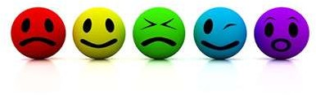
FEEDBACK
For any program to be successful it is necessary to collect feedback to find out if any modifications are needed to make the program more effective

Slide 54


COMMUNITY LEADERS
Community leaders can be used to reach the people of the community and to convince them about the need for health education
Leaders can also be used to educate the people as they will have a rapport and will be familiar with the people of their community
The leader will have an understanding of the needs of the community and advice and guide them

Slide 55
SOIL, SEED, SOWER
Soil is the community
Seed is information
Sower is the person giving the information

Slide 56
TYPES OF HEALTH EDUCATION
Primary Health Education.
Secondary Healthy Education.
Tertiary Health Education.

Slide 57
APPROACHES TO ACHIEVE HEALTH
LEGAL OR REGULATORY APPROACH
Make use of the law to protect the health of the public
Government makes laws and regulations
Eg:-Epidemic diseases act
-Pollution act
-Food adulteration act
-Environmental act

Slide 58
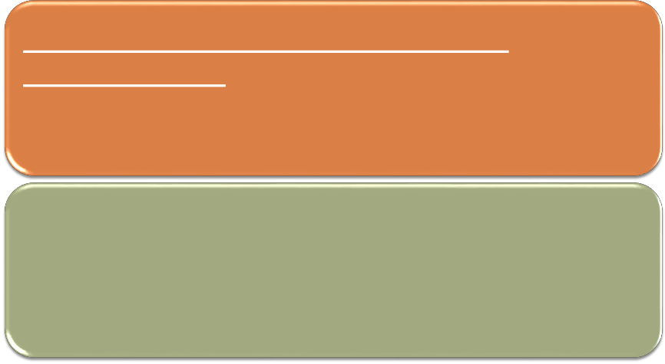
APPROACHES TO ACHIEVE HEALTH
ADMINISTRATIVE OR SERVICE
APPROACH: This approach intends to provide all the health facilities to the people with the hope that they will use it
it becomes a failure if the service is not based on the felt needs of the people

Slide 59
APPROACHES TO ACHIEVE HEALTH
EDUCATIONAL APPROACH:
Most effective means for achievement of changes in the health practices and lifestyles of the community.
Components –motivation, communication and decision-making
Result obtained from this approach is slow but permanent and enduring
Sufficient time should be allowed for the individual to bring about the desired changes in his behaviour

Slide 60
APPROACHES TO ACHIEVE HEALTH
PRIMARY HEALTH CARE APPROACH:
It involves full participation and active involvement of the people starting from the planning stage till the delivery of the health services.
This is based on principles of primary health care-community participation
This can be achieved by providing the necessary guidance to help people identify their health problems and to find solutions to these problems

Slide 61
APPROACHES TO HEALTH EDUCATION
GROUP APPROACH
MASS APPROACH
INDIVIDUAL APPROACH
RADIO-T.V
LECTURES
COUNSELING
NEWS PAPER
GROUP OR PANNEL DISCUSSION
INTER-CLINIC CONSULTATION
PRINTED MATERIAL
ON LINE VISIT
SEMINARS OR WORKSHOP
INTERNET

Slide 62
INDIVIDUAL APPROACH
PROS | CONS
Credible | Expensive
Permit 2 way discussion. | Time consuming.
Can be motivational, influential and supportive. | Limited audience.
Most effective for teaching, care and helping.

Slide 63
GROUP APPROACH
PROS | CONS
Familiar, trusted and influential. | May not provide personal attention.
Provide motivation/ support more than media alone. | Needs approval from organization.
Can be inexpensive. | Can be costly and time consuming.
Offer shared experiences.
Reach large intended audience in one place.

Slide 64
MASS APPROACH
MASS MEDIA | PROS | CONS
Newspapers | Reach braid intended audience rapidly. Can convey health news /break thoughts more thoroughly than T.V. Intended audience has the chance to clip, reread, contemplate and pass along materials. | Larger circulating papers may take only paid advertisement. Exposure is limited only to one way. Article placement requires contacts and may be time consuming. 17

Slide 65
MASS APPROACH
MASS MEDIA | PROS | CONS
Radio | Range of intended audiences with known listening preference. Opportunity for direct intended audience involvement. Distribution is inexpensive. Advertisement can be inexpensive. | Reaches smaller intended audiences than TV. Public service ads run infrequently and at low listening times. Many stations have limited formats that may not be conducive to health messages. Difficult for intended audiences to retain or pass on material. 18

Slide 66
MASS APPROACH
MASS MEDIA | PRONS | CONS
TV | Reaches potentially the largest and widest range. Combination of audiovisual is effective in emotional appeals and demonstration of behaviors. Can reach low in come audience. Specific programs can reach specific intended audience. Opportunity for direct intended audience involvement. | Advertisement is expensive to produce. Running infrequently and in low viewing times. Message can be obscured by commercial culture. Some stations reach small intended audience. Promotion can result in huge demand. Difficult to retain or pass on 19 materials.

Slide 67
MASS APPROACH
MASS MEDIA | PRONS | CONS
Internet | Reach large number of people rapidly. Updated and disseminated information. Control information provided. Tailor information specifically for intended audience. Can be interactive. Demonstration can be by audiovisual and graphs. Can use banner advisement to direct intended audience. | Can be expensive. Many people do not have access to internet. Intended audience must be proactive. May require monitoring. May require maintenance over time. 20

Slide 68
HOW WE CAN SELECT THE APPROPRIATE
APPROACH ….?

Slide 69













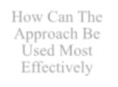

THE GOAL AND OBJECTIVES
COST
TARGET GROUP
SETTINGS AND ACTIVITIES
CURRENT INTEREST
HEALTH NEEDS
HOW CAN THE APPROACH BE USED MOST EFFECTIVELY

Slide 70
Stages For Health Education
Stage of Sensitization
Stage of Publicity
Stage of Education
Stage of Attitude change
Stage of Motivation and Action
Stage of Community Transformation (social change)

Slide 71
EDUCATIONAL AIDS USED IN
HEALTH EDUCATION
The aids used for transmitting health education are the main constituent of the armamentarium of health education process
1.Auditary aids
2.Visual aids
3.A combination of audi-visual aids

Slide 72
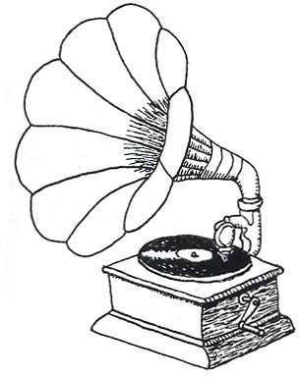
AUDITORY AIDS
Based on the principles of sound, electricity and magnetism
Useful in reproducing any kind of words spoken and also helps in repeating the same
Megaphones
Microphones
Gramophone records and discs
Tape records
Radios
Sound amplifiers

Slide 73
VISUAL AIDS
Based on the principles of projection
Helps individuals to understand better
It is of 2 types
1.projected aids
2.non-projected aids

Slide 74

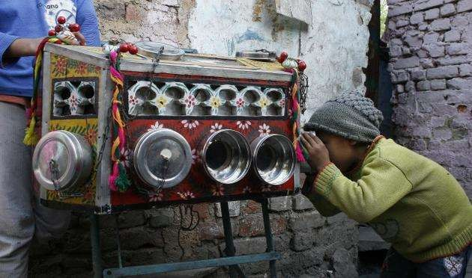
PROJECTED AIDS
Needs projection from a source on to the screen
Films or cinemas
Film stripes
Slides
Overhead projectors
Transparencies
Bioscopes
Video cassettes
Silent films

Slide 75
ADVANTAGES
Real life situations can be enacted in films
Self explanatory
Creates a special interest among the audience to watch a film
Situational effects can be shown in a film

Slide 76

NON PROJECTED AIDS
Do not require any projection
Black board
Pictures, cartoons, photographs
Flip charts, flashcards Flannel boards
Printed materials- leaflets, pamphlets, folders, booklets, brochures
Models, specimens

Slide 77
COMBINATION OF AUDIO- VISUAL AIDS
Sound and sight can be combined together
Televisions
Tape and slide combinations
Video cassette players and records
Motion pictures or cinemas
Multimedia computers
These also include traditional media-folk dance, folk songs, puppet shows, dramas

Slide 78

METHODS OF HEALTH EDUCATION
1.Individual approach
2.Group approach
-chalk and talk
-symposium
-Group discussions
-Panel discussions
-Work shop
-conferences or seminars
-role playing/ socio drama
-demonstrations
3.Mass approach

Slide 79
INDIVIDUAL APPROACH
When an individual comes to the dental clinic or health centre because of illness, the opportunity should be used to educate him on matters of interest such as the cause and nature of his illness, its prevention, beneficial diets, oral hygiene etc.
This approach can also be used by public health personnel, since they will be visiting homes and can interact with the individual and

Slide 80
ADVANTAGES
Can be done in a dentist’s consultation room
Discussion, argument and persuasion of an individual to change his behavior is possible
Opportunity for the individual to ask questions and clearing doubts
DISADVANTAGES
Small number can benefit
Health education is given to only who come in contact with the dental surgeon or with public health personnel

Slide 81

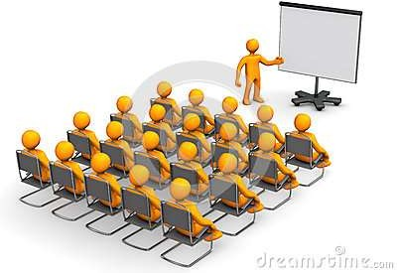
GROUP APPROACH
CHALK AND TALK (LECTURES)
“A carefully prepared oral presentation of facts, organized thoughts and ideas by a qualified person”
Should have an opening statement
Group should not be more than 30 people
Duration of talk should not exceed 15-20 minutes
Should be based on topics of current
interest
Its effectiveness depends on ability of speaker to write and draw legibly
Disadvantage-one way communication
,learning is passive

Slide 82
SYMPOSIUM
A series of speeches on a selected topic
Each speaker presents a brief aspects of the topic
There is no discussion among speakers
In the end, the audience may ask questions
The chairman makes a summary at the end of the session

Slide 83

GROUP DISCUSSIONS
A group is an aggregation of people interacting in a face-to-face situation
Process of identifying problems and finding solutions collectively by members of group
Consist of 6-12 members
Participants are seated in a circle
Group leader initiates the subject, prevents side conversations, encourages everyone to participate and sums up the discussion
There should be a recorder who prepares a report on issues discussed and agreements reached

Slide 84
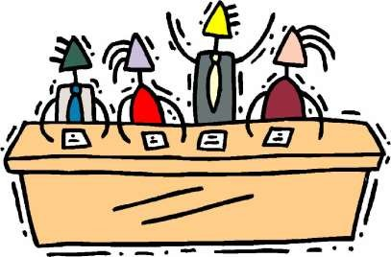
PANEL DISCUSSIONS
Panel of 4 to 8 experts sit and discuss a topic in front of an audience
Headed by a chairman who opens the session, introduces the speakers and keeps the discussion going
Audience are allowed to ask questions
Chairman sums up the different views presented

Slide 85
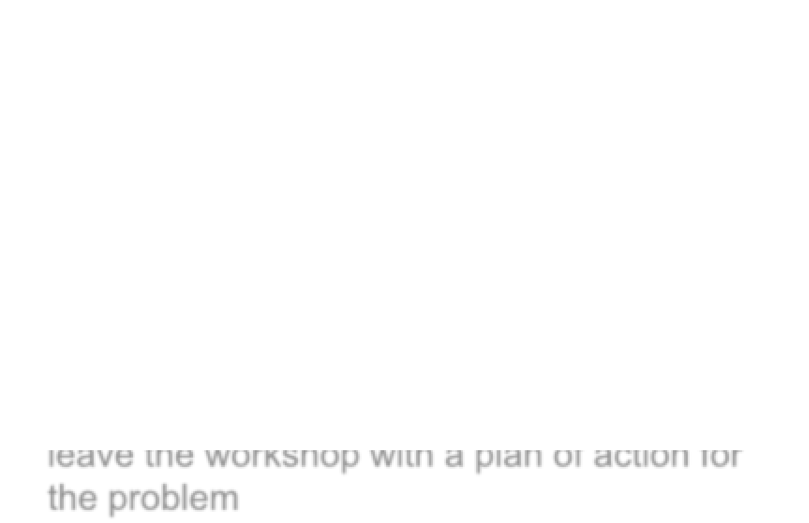

WORKSHOP
It consist of series of meetings with emphasis on individual work with the help of resource persons
Total work shop is divided in to small groups and each groups will select a chairman and a recorder
The individuals work, solve a part of the problem, contribute to group discussions and leave the workshop with a plan of action for the problem

Slide 86




CONFERENCES OR SEMINARS
Program range from half day to one week Held on a regional, state or national level They usually have a theme

Slide 87

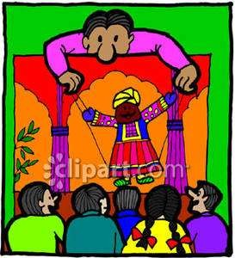
ROLE PLAYING/SOCIO DRAMA
Size of the group should be 25
The audience should take part
Situation is dramatized to make communication more effective
It is followed by a discussion on the problem
Puppet shows is a type of socio drama
Useful for children’s health

Slide 88
DEMONSTRATIONS
Procedure is carried out step-by-step in front of sn audience
Method involves the audience in discussion and has a high motivational value
The audience can then carry out the procedure themselves with expert help

Slide 89
MASS APPROACH
Communication is given to a community where the people gathered together do not belong to one particular group
ADVANTAGES:
Large number of people can be reached
People of all socio-economic status have access to health education
DISADVANTAGE :
One way communication

Slide 90
VARIOUS MASS MEDIA USED ARE
Television
Radio
News papers/press
Documentary films
Posters
Health exhibition
Health magazines
Health information booklets
Internet

Slide 91
HEALTH PROMOTION
“process of enabling people to increase control over, and to improve health”
-Ottawa Charter for Health Promotion, First International Conference on Health Promotion, Ottawa 21November 1986

Slide 92
THE FIVE PRIORITY ACTION AREAS FOR HEALTH PROMOTION
Building healthy public policy
Creating supportive environments for health
3.Strengthening community action for health
4.Developing personal skills 5.Re-orienting health services

Slide 93
BUILDING HEALTHY PUBLIC POLICY
Health promotion put health on the agenda of policy makers in all sectors and at all levels, directing them to be aware of the health consequences of their decisions and to accept their responsibilities for health

Slide 94
CREATING SUPPORTIVE ENVIRONMENTS FOR HEALTH
Health promotion generates living and working conditions that are safe, stimulating, satisfying and enjoyable
The protection of the natural and built environments and the conservation of natural resources must be addressed in any health

Slide 95
STRENGTHENING COMMUNITY ACTION FOR HEALTH
Health promotion works through concrete and effective community action in setting priorities, making decisions, planning strategies and implementing them to achieve better health.
At the heart of this process is the empowerment of communities

Slide 96
DEVELOPING PERSONAL SKILLS
Health promotion supports personal and social development through providing information, education for health, and enhancing life skills.
Eg:-Increasing patient’s knowledge about the role of sugar and plaque in the etiology of dental diseases and to develop tooth brushing skills and promote self care

Slide 97
RE-ORIENTING HEALTH SERVICES
Reorienting health services require a stronger attention to health research as well as to changes in professional educating and training
There must be a change of attitude and organization of health services, with the health sector moving increasingly in a health promotion direction, beyond its responsibility for providing clinical and curative services
Eg:-Dentists can be encouraged and rewarded for effective prevention and research activities

Slide 98
CONCLUSION
Health education have the potential to tackle the underlying. Determinants of oral health and thereby improve the oral health of all sections of society. It has an immediate impact on behaviour. It is vital to the practice and prevention and is the channel for reaching the people and alerting them to health services and resources. The focus of health education is on people &their actions through planning and team work. Its goal is to make realistic

Slide 99
BEHAVIOUR CHANGE COMMUNICATION
(BCC)

Slide 100

BEHAVIOUR CHANGE COMMUNICATION(BCC)
Studies revealed that traditional IEC methods have stopped giving information and creating awareness but BCC is characterized by its direct approach towards changing behavior.

