Slide 1
Excreta Disposal in
unsewered areas

Slide 2
SERVICE TYPE (Conservancy System) - The collection and removal of night soil from bucket or pail by human agency is called service type or conservancy system, and the latrines are called service latrines.

Slide 3
2. NON -SERVICE TYPE OF LATRINES : Sanitary Latrines
A sanitary latrine is one which fulfils the following criteria:
(1) Excreta should not contaminate the ground or surface water
(2) Excreta should not pollute the soil
(3) Excreta should not be accessible to flies, rodents, animals (pigs, dogs, cattle, etc.) and other vehicles of transmission.
(4) Excreta should not create a nuisance due to odour or unsightly appearance.

Slide 4
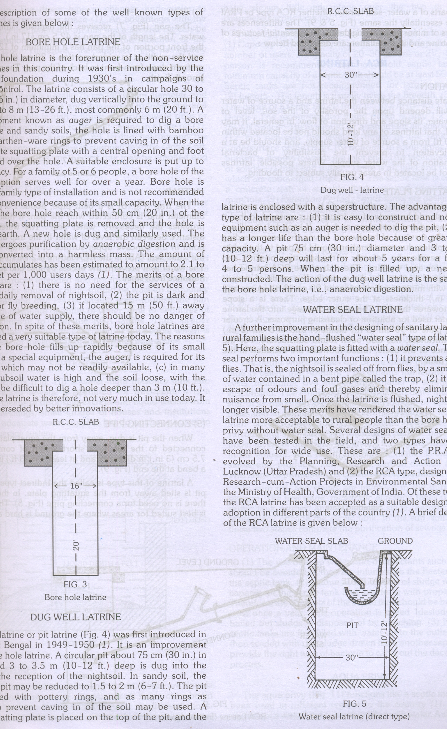
Methods of excreta disposal –
BORE HOLE LATRINE –
It was first introduced by the Rockefeller foundation during 1930's in campaigns of hookworm control.
The latrine consists of a circular hole 30 to 40 cm (12-16 in.) in diameter, dug vertically into the ground to a depth of 4 to 8 m (13-26 ft.), most commonly 6 m (20 ft.).
A special equipment known as auger is required to dig a bore hole.
In loose and sandy soils, the hole is lined with bamboo matting or earthen -ware rings to prevent caving in of the soil .

Slide 5
DUG WELL LATRINE –
A circular pit about 75 cm (30 in.) in diameter and 3 to 3.5 m (10-12 ft.) deep is dug into the ground for the reception of the nightsoil.
In sandy soil, the depth of the pit may be reduced to 1.5 to 2 m (6 - 7 ft.).
A concrete squatting plate is placed on the top of the pit, and the latrine is enclosed with a superstructure.

Slide 6
WATER SEAL LATRINE –
Squatting plate is fitted with a water seal. The water seal performs two important functions:
(1) Nightsoil is sealed off from flies, by a small depth of water contained in a bent pipe called the trap,
(2) it prevents escape of odours and foul gases and thereby eliminates the nuisance from smell.
Water seal latrine are two type:
(i) Direct or PRAI Type
(ii) Indirect or RCA Type

Slide 7
PRAI Type Latrine
It is direct type latrine.
It is developed by Planning Research and Action Institute, Lucknow .
The trap below the pan is turned in and opens directly into the pit.
There is no connecting pipe because the pit is directly under the squatting plate and not away from it.
It is cheaper than RCA type of latrine.
It is simple, sanitary, hand-flush waterseal latrine, need about 1-2 liters of water per user to flush out the excreeta.

Slide 8
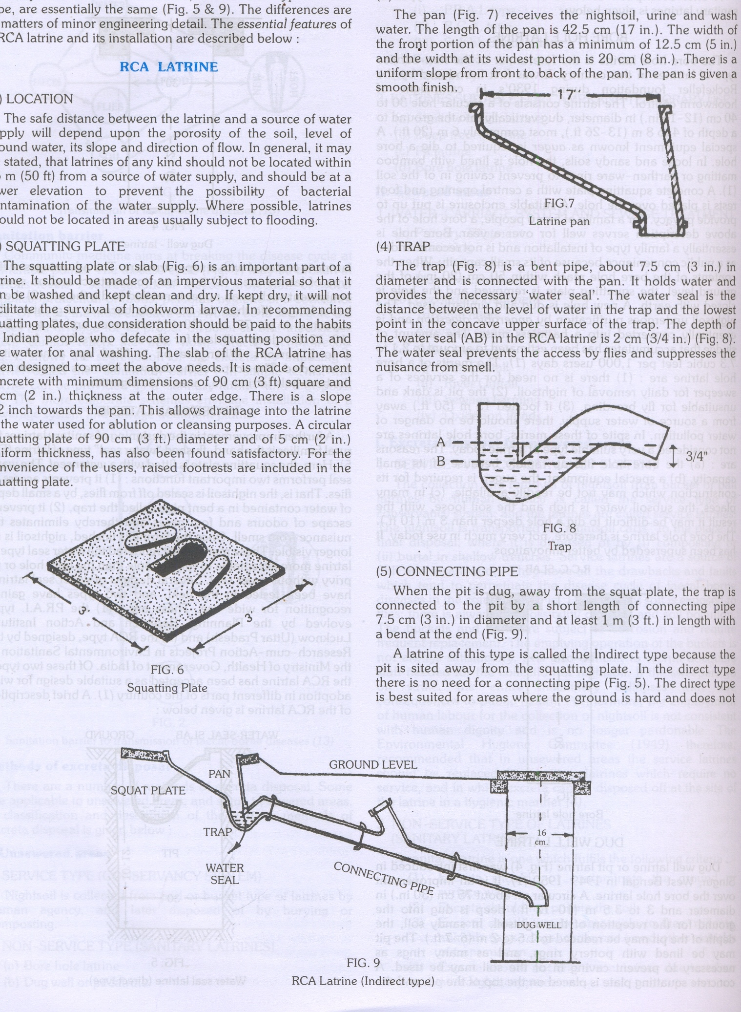
The parts of a water-seal latrine, whether RCA type or PRAI type, are essentially the same .

Slide 9
RCA LATRINE –
It is indirect type latrine

Slide 10
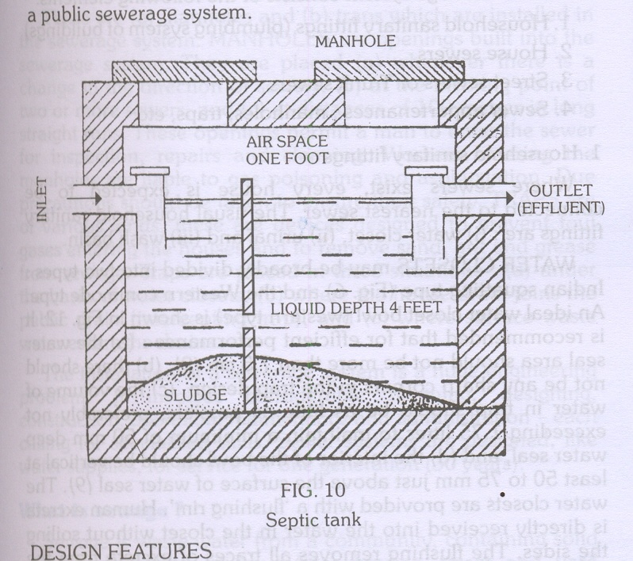
SEPTIC TANK –
Septic tank is water-tight masonry tank into' which household sewage is admitted for treatment.
It is a satisfactory means of disposing excreta and liquid wastes from individual dwellings, small groups of houses and institutions which have adequate water supplies but do not have access to a public sewerage system

Slide 11
WORKING OF A SEPTIC TANK –
Solids settle down in the tank, to form "sludge", while the lighter solids including grease and fat rise to the surface to form "scum".
Solids are attacked by the anaerobic bacteria and fungi and are broken down into simpler chemical compounds.
This is the first stage of purification, called anaerobic digestion.
The sludge is much reduced in volume as a result of anaerobic digestion. A portion of the solids is transferred into liquids and gases (principally methane) which rises to the surface in the form of bubbles.

Slide 12
The liquid which passes out of the outlet pipe from time to time is called the "effluent".
It contains numerous bacteriae, cysts, helminthic ova and organic matter in solution or fine suspension.
The effluent is allowed to percolate into the sub­soil. There are millions of aerobic bacteria in the upper layers of the soil, which attack the organic matter present in the effluent.
As a result, the organic matter is oxidised into stable end-products, i.e., nitrates, carbon dioxide and water. This stage of purification is sailed aerobic oxidation.

Slide 13
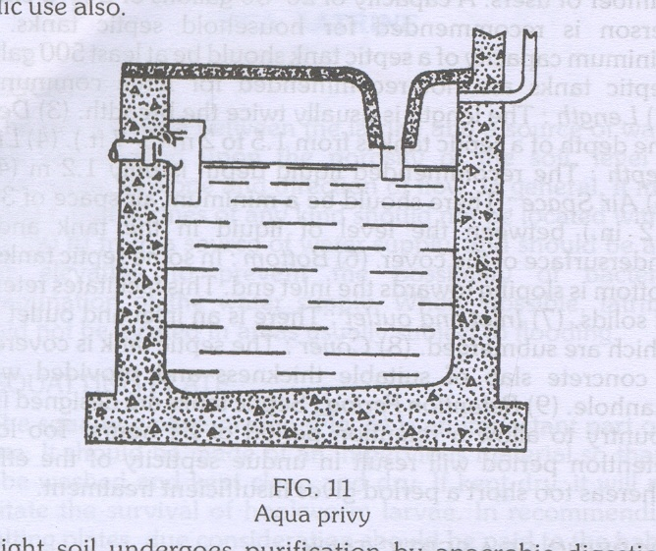
AQUA PRIVY –
The aqua privy functions like a septic tank. The privy consists of a water-tight chamber filled with water. A short length of a drop pipe from the latrine floor dips into the water. The shape of the tank may be circular or rectangular.
The size of the tank depends upon the number of users. A capacity of one cubic metre (35 cu.ft.) is recommended for a small family, allowing 6 years.

Slide 14
SULABH SHAUCHALAYA –
The "Sulabh Shauchalaya" model, is a low cost pour-flush, water-seal type of latrine.
It is an improved version of the standard hand flush latrine (e.g., RCA type). It consists of a specially designed pan and a water-seal trap.
It is connected to a pit 3 feet square and as deep. Excreta undergoes bacterial decomposition and is converted to manure (compost). The method requires very little water.
Their usual structure is a lavatory block of several dozen seats, with a bathing block adjoining.

Slide 15
CHEMICAL CLOSET –
It has very limited use under Indian conditions. The closet consists of a metal tank containing a disinfectant fluid.
The active ingredients of the fluid are formaldehyde and quaternary ammonium compounds.
In addition, a harmless water dye and a deodorizing substance are usually incorporated .
A seat with a cover is placed directly over the tank. Nothing except the toilet paper should be thrown into the chemical closet.

Slide 16
SHALLOW TRENCH LATRINE –
This type of latrine is intended for camps of short duration about one week.
This is simply a trench dug with ordinary tools.
The trench is 30 cm (1 ft.) wide and 90-150 cm (3-5 ft.) deep. Its length depends on the number of users: 3-3.5 m (10-12 ft.) are necessary for 100 people.
Separate trenches should be provided for men and women. The earth from the trench should be piled up at the side.
People should be instructed to cover faeces with earth each time they use the latrine.

Slide 17
DEEP TRENCH LATRINE –
This type of latrine is intended for camps of longer duration, from a few weeks to a few months.
The trench is 1.8 to 2.5 m (6-8 ft.) deep and 75-90 cm (30-35 in.) wide.
Depending upon the local customs, a seat or a squatting plate is provided.
A superstructure is built for privacy and protection.
Other requirements are the same as for shallow trench latrine .

