Slide 1
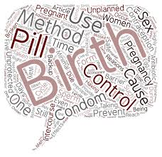
CONTRACEPTIVE METHODS
Dr Gauri

Slide 2

India’s Contribution to World Population

Slide 3
Source: Census 2011

Slide 4

The practice of controlling the number of children one has and the intervals between their births, particularly by means of contraception or voluntary sterilization

Slide 5
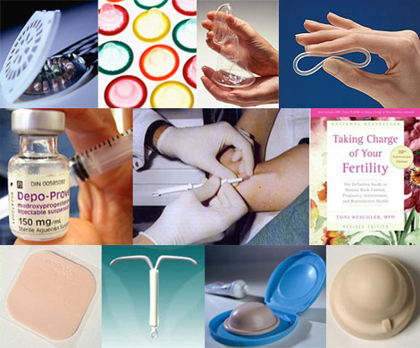
Definition
Mechanism which are intended to reduce likelihood of fertilization of an ovum by a spermatozoon

Slide 6
What is Conventional Contraceptives ?
Methods that require action at the time of sexual intercourse eg. condoms,spermicides etc....
Cafeteria choice ?

Slide 7
Criterias for Ideal Contraceptive
Safe
Effective
Acceptable
Inexpensive
Reversible
Simple to administer
Independent of coitus
Long lasting enough to obviate frequent administration
Requires little or no medical supervision

Slide 8
Classification
A. Spacing Methods
B. Terminal Methods

Slide 9
Spacing methods terminal methods
Barrier methods
Intrauterine contraceptive devices
Hormonal methods
Post conceptional methods
Miscellaneous
Male sterilization (Vasectomy )
Female sterilization(Tubectomy )
I.Laparoscopy
II. Minilap

Slide 10
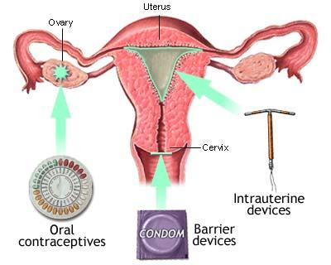

Slide 11
1.Barrier methods
A.Physical methods –a.Condom
I. Male condom
2. Female condom
b.Diaphragm ( Dutch cap)
c.Vaginal Sponge( Today)
B.Chemical methods- a. Foams
b.Creams /Jellies/Pastes
c.Suppositories
d.Soluble films

Slide 12
2. Intrauterine devices
I Non medicated/ Inert IUD,s ( 1st generation)
1) Lippes loop
2) Grafenberg’s ring
ii Medicated /Bioactive IUD’s
1)Metal ions ( cupper) ( 2nd generation)
a) Earlier devices
1.Copper -7
2.Copper T-200

Slide 13
b) Newer devices
1. Variant of the T device
a. Cu-T 220-B ( B is for size )
b. Cu-T 380-A ( A is for Ag of silver)
2. Nova T ( silver core)
3. Multiload device
a. ML-Cu-250
b. ML-Cu-375

Slide 14
2) Hormones( progestogens) ( 3rd generation)
I Progestesert
II LNG -20 / Mirena

Slide 15
3. HORMONAL Methods
Oral pills
1) Combined pills
2) Progestogens only pills (POP)
3) Post coital pills
i IUD’s
ii Hormonal
4) Once a month pill
5) Male pill ( Gossypol)

Slide 16
2. Depot ( slow release) formulation
1)Injectables
I. Progestogens only
i.DMPA
ii NET-EN ( Norethisterone Enanthate)
II. Combined ( Cyclofem/Cycloprovera /Mesigyna)
2) Sub dermal implants
I. Norplant
II. Norplant R-2
3) Vaginal rings

Slide 17
4.Post conceptional methods
Menstrual regulation
Menstrual induction
Oral abortificant

Slide 18
5. Miscellaneous
Abstinence
Coitus interruptus
Safe periods ( Rhythm method/ Calendar method )-

Slide 19
d. Natural family planning methods –
1) basal body temperature ( BBT) – rise of body temperature at the time of ovulation due to increase in production of progesterone
- Rise of 0.2-0.5 degree C during ovulation

Slide 20
2) Cervical mucus methods ( Billing method or Ovulation method)-
At the time of ovulation- cervical mucus becomes watery clear resembling raw egg white, smooth , slippery
After ovulation – under the influence of progesterone, the mucus thickens and lessens in quantity

Slide 21
3) Symtothermic methods- combines temperature, cervical mucus and calendar techniques
- More effective
e. Breast feeding
f. Birth control vaccine

Slide 22
Barrier methods

Slide 23
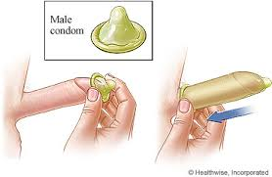
Barrier methods
1.Physical methods
I. Condom
i. Male Condom ( Nirodh)
.Made of latex
.Failure rate -2 to 40 per 100 women years
. Most common cause of failure is incorrect usage
Advantage
-Protection against PID and STD’s
-safe and inexpensive
- No side effect

Slide 24
ii Female Condom
                Worn internally by the receptive partner
                Pouch made of polyurethane
                Pre- lubricated with silicone
                Failure rate- 4-20 per 100 women years
                Less effective than male condom
                Advantages ….
                Types
                1. FC- made of polyurethane
                2. FC-2-made of nitrite polymer
                3.Latex

Slide 25
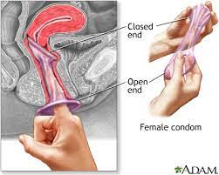

Slide 26
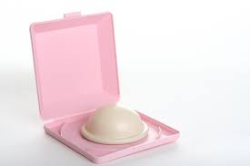
II Diaphragm ( Dutch cap)
    Inserted before intercourse and must remain in place for not less than 6 hours after sexual intercourse
    Failure rate --6-12 per 100 women years
    Protection against –PID ,HPV etc
    Disadvantages ?
    Variations of diaphragm
    i Dumas or vault cap
    ii Vimule cap
    iii Cervical cap

Slide 27
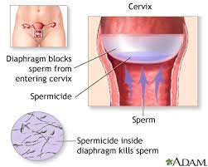

Slide 28
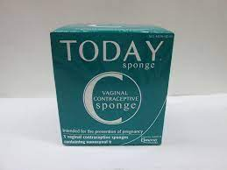
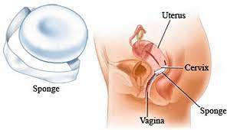
III Vaginal sponge ( Today)
combines barrier and spermicidal method to prevent conception
Made up of polyurethane ( size 5cm× 2.5 cm )
Spermicide -1000mg Non-oxynol-9
Sponges are inserted vaginally prior to intercourse
Must be placed over cervix
Must be left in place for 6 hours after ejaculation
Disadvantages
Failure rate -20-40 per 100 women years (P)
9-20 per 100 women years

Slide 29
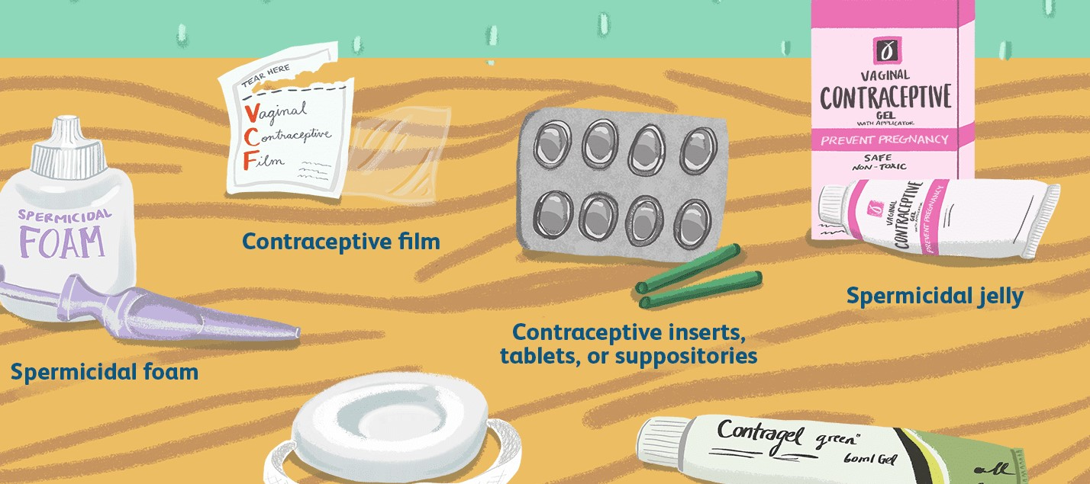
2. Chemical methods
                Foams
                Creams /Jellies/ Pastes
                Suppositories
                Soluble films

Slide 30
Spermicides /Vaginal chemical contraceptive
MOA- Surface active agents attach themselves to spermatozoa and inhibit oxygen uptake and kill sperm
Disadvantages – may causes burning /irritation and taratogenic affect on feotus
Best use with barrier methods

Slide 31
Intrauterine devices

Slide 32
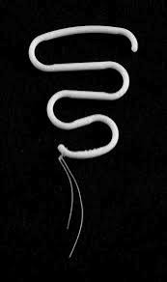
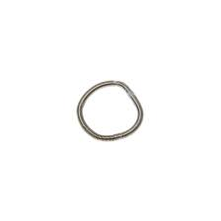
1. Non medicated
i lippes loop
Double S shaped device made up of
Polyethylene
Contains Barium Sulphate to allow x rays observation
4 sizes ....
Failure rate( lippes loop ) – 3%
Life span as long as required if there is no adverse effect
ii Grafenberg’s ring

Slide 33
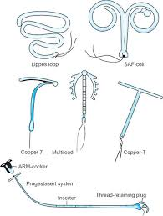
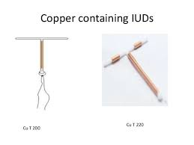
2.Medicated / bioactive iud’s
1.Metal ions ( Cupper) ( 2nd generation)
?

Slide 34
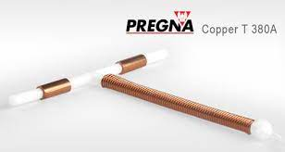
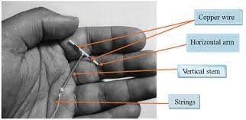
Cu-T 380-A
      Failure rate – 0.5-0.8%
      Life span- 10 years
      Gynefix ??????

Slide 35
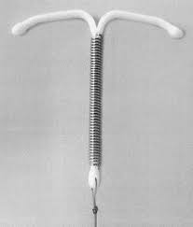
Nova T

Slide 36
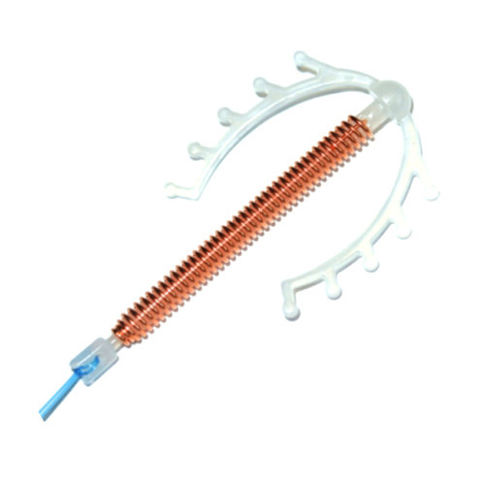
Multiload device

Slide 37
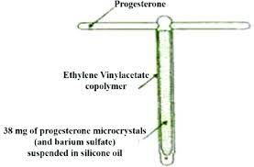
2. Hormones
I. Progestasert
T shaped
38mg progesterone (loading dose)than 65 mcg daily
First hormonal uterine device developed in 1976
Failure rate -1.5%
Life span – 1 year
Lowest expulsion and lowest
removal rate

Slide 38
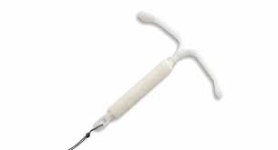
II LNG-20/ Minera
T shaped
20mcg daily
Failure rate -0.2% ( lowest pregnancy rate and highest removal rate

Slide 39
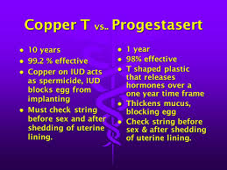

Slide 40
MOA-
Cupper
          Enhance cellular response in endometrium and affects enzymes in uterus
          Alter biochemical composition of cervical mucus
          Affects sperm motility and its survival
2. hormonal
        Increase viscosity of cervical mucus which prevent sperms from entering the cervix
        Maintains high level of progesterone & low level of estrogen making endometrium unfavourable to implntation
3. Foreign body reaction

Slide 41
Adverse Effect of IUD’s
Bleeding
Pain
Uterine perforation
Pelvic infection
Ectopic pregnancy
Pregnancy with IUD’s in situ
Expulsion

Slide 42
Contraindication of IUD’s
Suspected pregnancy
PID
Vaginal bleeding
Ca cervix / uterus / pelvic tumours
Previous ectopic pregnancy

Slide 43
Timing of IUD Insertion
Interval insertion
Anytime during menstrual cycle if woman is not pregnant
Postpartum insertion
Immediately after vaginal or cesarean delivery if no infection or bleeding (within 48 hours)
Insertions after abortion
Immediately if no infection
Post puerperal insertion
6-8 wk after delivery
Notes:
43
An interval insertion can be performed anytime during the menstrual cycle, as long as the woman is not pregnant. Some providers recommend the IUD be inserted during the last few days of menstruation when the cervical opening is a little larger than usual and it is certain the woman is not pregnant. However, it is easier to examine for signs of reproductive tract infections when a women is not menstruating. Therefore, IUDs can be inserted at the client’s convenience if the provider can be reasonably sure she is not pregnant. █
An IUD can be inserted postpartum. This assumes the provider has received adequate training in the procedure, the woman has been counseled appropriately prior to delivery, and there is no infection or bleeding. The IUD can be placed manually in the uterus immediately after a cesarean section delivery or a vaginal delivery. An IUD insertion following a vaginal delivery can be done during the first 10 minutes after delivery of the placenta. Early postpartum insertions within the first 48 hours are also considered safe. Otherwise, it is best to wait until the woman is four to six weeks postpartum, when the uterus returns to its normal size. █
An IUD can be inserted immediately after a first-trimester abortion if there is no infection. However, if the pregnancy was 16 weeks or more, IUD insertion should be performed by a specially trained provider or be delayed for six weeks.²⁴ █
Note to facilitator:
Take this opportunity to introduce the Checklist for Screening Clients Who Want to Initiate Use of the Copper IUD , included with the course materials. Mention that they will have opportunities to practice with these checklists during the counseling activities later in the training.
Reference:
24. World Health Organization (WHO). Selected practice recommendations for contraceptive use. Second Edition. Geneva: WHO, 2004.

Slide 44
Hormonal methods

Slide 45
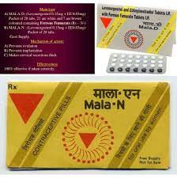
I Oral pills
Combined Pills
        Levonorgestril 0.15mg & Ethinil oestradiol 0.03mg
        28 pills- 21 OCP + 7 brown ferrous fumarate (60mg) tablets
        Beginning on the 5th day of menstrual cycle
        OCP is method of choice for Newly Married couple
        2 Types
        MALA N
        Free of cost (under national programme)
        Ethinyl estradiol -0.03 mg
        Levonorgestrel -0.15 mg
        MALA D
        Rs 3 per packet
        All same

Slide 46
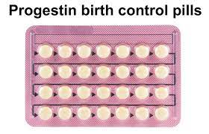
2) Progestogens only pills ( PoP)
  Minipill/Micropill
  Only Progestogen
  Ectopic pregnancy may be seen
  Can be used for lactating mother under RCH

Slide 47

  POST COITAL PILLS ( POST-COITAL CONTRACEPTION/EMERGENCY CONTRACEPTION)
      IUD’s
      Hormonal
      Morning after pill
      Recommended within 72 hours of unprotected intercourse
      Failure rate < 1%

Slide 48
Moa
Combined pill
Prevents release of ovum from ovary by blocking pituitary secretion of gonadotropin
Progesterone only pills
Makes Cervical mucus thick & scanty , therefore inhibiting sperm penetration
- Inhibit Tubal Motility , thus delay transport of ovum

Slide 49
Adverse effects ( OCP)
General effects
  Weight gain
  Headache and migraine
  Bleeding disturbances
  Breast tenderness
  Premature cessation of lactation or decline in milk volume
  2. Metabolic effects
  Increased B.P.
  Increased blood sugar
  Increased plasma insulin
  Dyslipidemia

Slide 50
3. Cancers
Ca cervix
Breast cancer
Hepatocellular adenoma
4. Other effects
Gallbladder disease
Cholestatic jaundice
5. Cardiovascular effects
Atherosclerosis
Hypertension
Deep vein thrombosis
Myocardial infarction
Stroke

Slide 51
Contraindication of ocp
Suspected pregnancy
h/o thromboembolism
Cardiac abnormalities
Abnormal vaginal bleeding
Breast cancer
Genital cancer
Renal disease
Liver disease
Congenital hyperlipidemia
Epilepsy
Lactating mother

Slide 52
Non contraceptive benefits of ocp
Give protection against
Benign breast disorder( fibrocystic diseases, fibroadenoma)
Dysmenorrhea
Irregular menstrual cycle
Pelvic inflammatary disease
Dysfunctional uterine bleeding
Adenomyosis
Iron deficiency anemia
Endometriosis
Ectopic pregnancy
Poly Cystic Ovarian syndrome (PCOS)
Endometrial cancer
Ovarian cyst and cancer
Colorectal malignancy

Slide 53
II depot formation
A. Injectables
i. Progestogens only ( depot formation)
a. DMPA
depot medroxyprogesterone acetate (Depot provera)
150 mg I/M every 3 months
for female > 35 years
b. NET –EN
Norethisterone enantate
200 mg I/M every 2 month
Contraindications
- Suspected pregnancy
- abnormal vaginal bleeding
- DVT
-Carcinoma Cervix

Slide 54
ii Combined
Cyclofem
Cycloprovera
Mesigyna
Given at monthly intervals
Failure rate 0.2%
0.4%
B. Sub Dermal Implants
1. Norplant
- 6 silicon plastic capsules
- containing 35 mg ( each) of Levonorgestrel
2. Norpalnt R-2
- 2 capsules
- 75 mg each of Levonorgestril

Slide 55
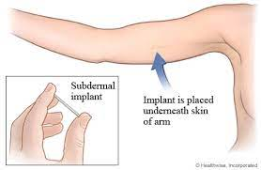
Implanted beneath the skin of the forarm/ upper arm
Life span – 5 years
Pregnancy rate -0.7%
Side effects- irregularities in menstrual bleeding

Slide 56

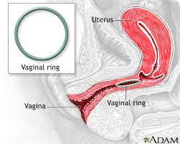
C. Vaginal rings
Levonorgestrel – Slowly absorbed through vaginal mucosa
Worn in vagina for 3 weeks of the cycle and removed for the 4th week
Combined hormonal contraceptive vaginal ring
Etonogestrel & Ethinyl estradiol
Prevent ovulation

Slide 57
Post conceptional methods
1. Menstrual regulation
–Aspiration of uterine contents 6 to 10 days of a missed period
2. Menstrual induction
- Intrauterine application of 5 mg of Prostaglandin F2
3. Oral abortificant
-Mifepristone 200 mg orally on day 1 followed by Misoprostol 800 mg vaginally within 8 hours

Slide 58
Abortion

Slide 59
Miscellaneous methods
Birth Vaccines
For gamete production- GnRH vaccine ,LH vaccine, FSH vaccine
For gamete function – Zona pellucida vaccine,& sperm vaccine
For gamete outcome – HCG vaccine ( phase 3 trial )

