Slide 1

Cervical Cancer and its Public Health Prospects in India
By Dr. Hasan Zaidi

Slide 2

Introduction
Cervical cancer in India is a signiﬁcant public health concern, impacting the lives of many women.
This presentation will explore the challenges and opportunities for addressing this issue from a public health perspective.
The World Health Organization (WHO) advocates for a threefold intervention strategy that includes
Immunization of a minimum of 90% of 15-year-old girls against human papillomaviruses (HPV).
Screening 70% of 35- and 45-year-old women utilizing a highly efficient test
Treating a minimum of 90% of pre-cancerous and aggressive tumour cancers that are discovered.

Slide 3
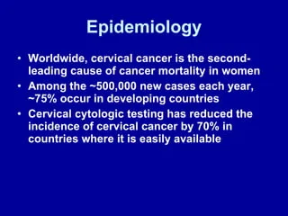
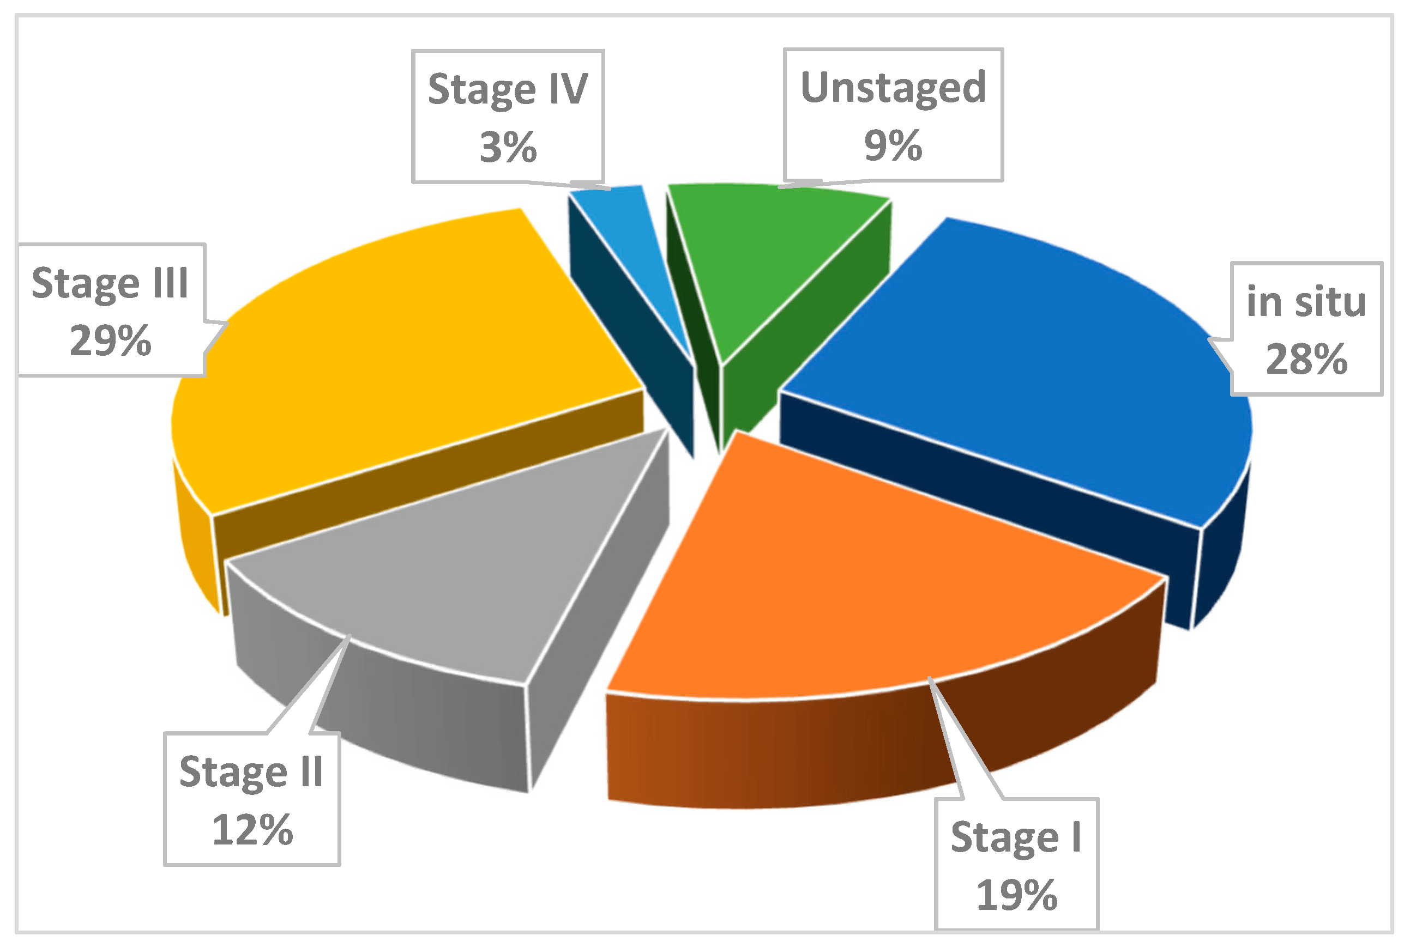
Cervical Cancer Epidemiology

Slide 4

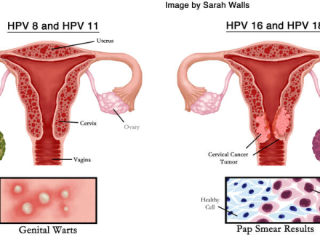
Risk Factors and Symptoms
HPV
Women are generally infected with HPV in their 20s, 30s.
Cervical cancer can develop up to 20 years after HPV infection
Smoking
Immunosuppressants
Imbalance of Free radicals & Antioxidants

Slide 5
FEATURES
Unusual discharge from the vagina.
Bleeding after menopause.
Bleeding or pain during intercourse.
Anemia because of abnormal vaginal bleeding.
Ongoing pelvic, leg, or back pain.
Urinary problems because of blockage of a kidney or ureter.
Bleeding from the rectum or bladder.
Weight loss.

Slide 6
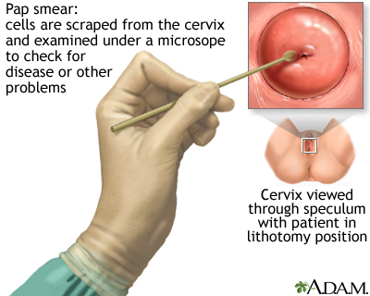
Screening and Early Detection
Age Pap smear frequency
<21 years old, none needed
21-29 every 3 years
30-65 every 3 years or an HPV test
every 5 years or a Pap test and HPV
test together every 5 years
5. 65 and older you may no longer need
Pap smear tests.

Slide 7
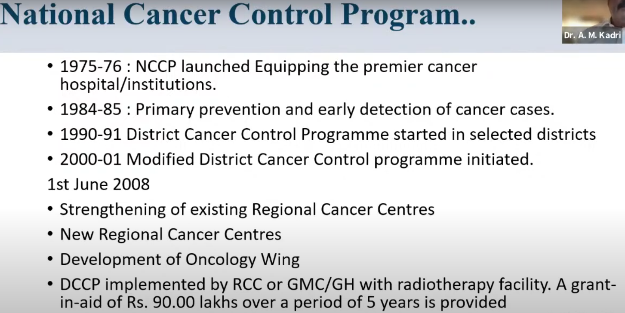

Slide 8


Slide 9


Slide 10
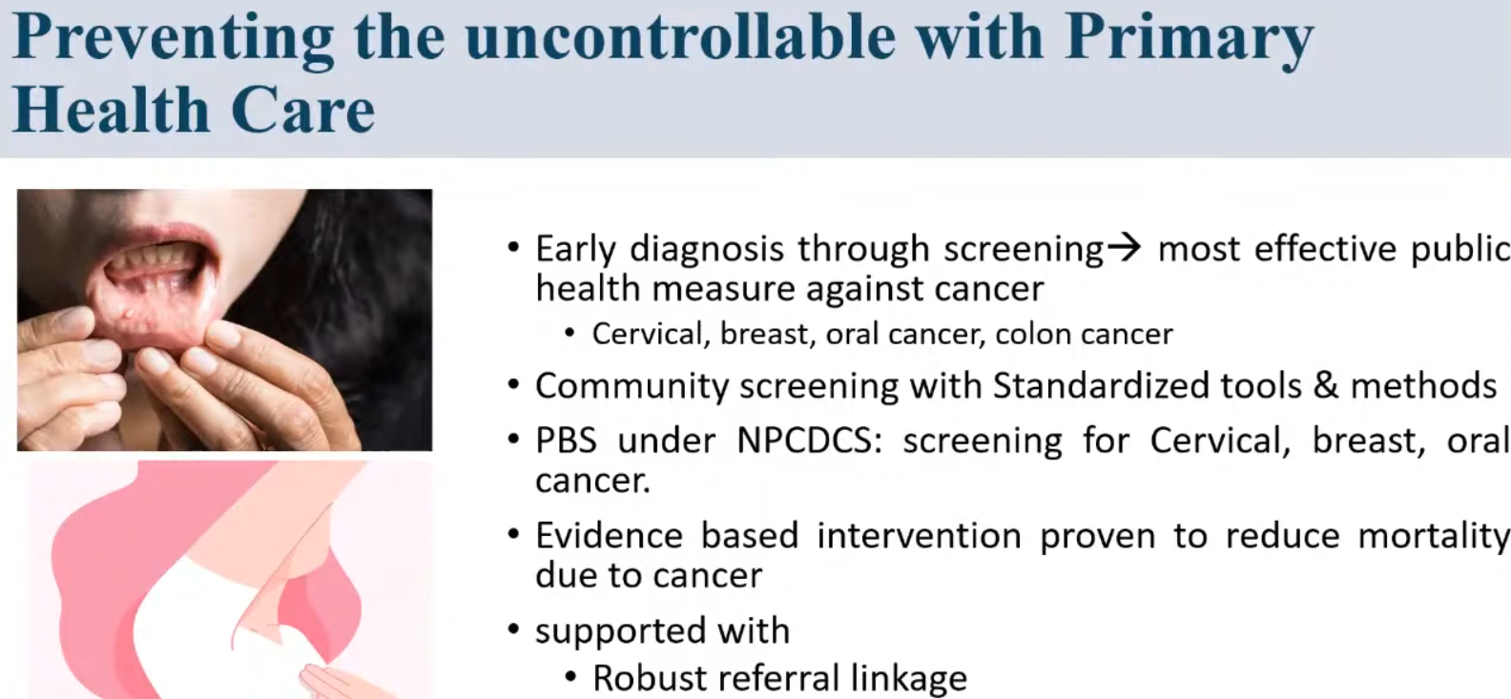

Slide 11
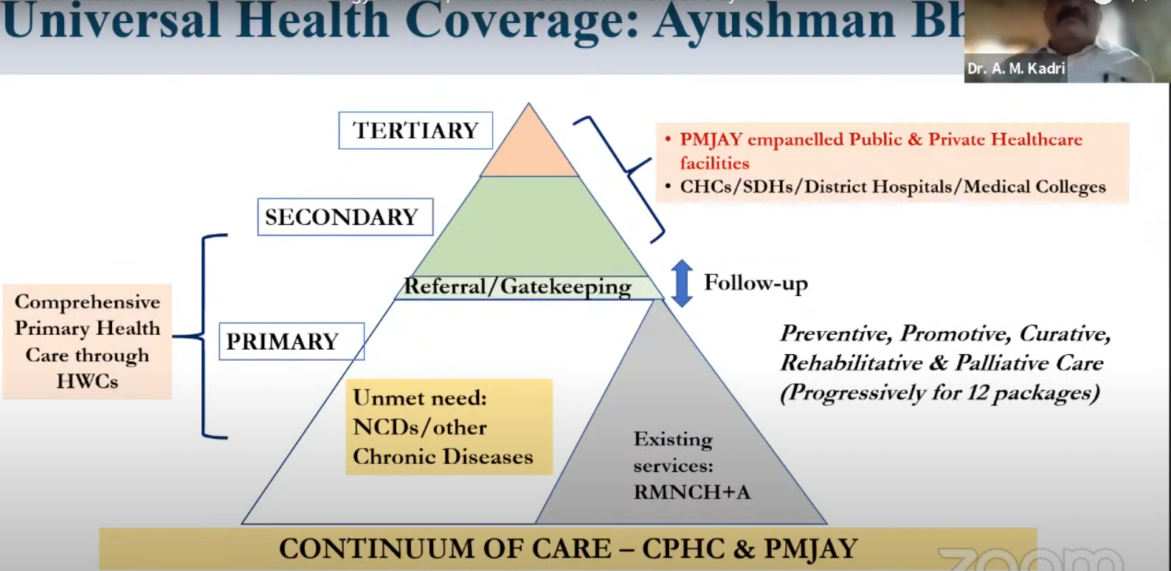

Slide 12
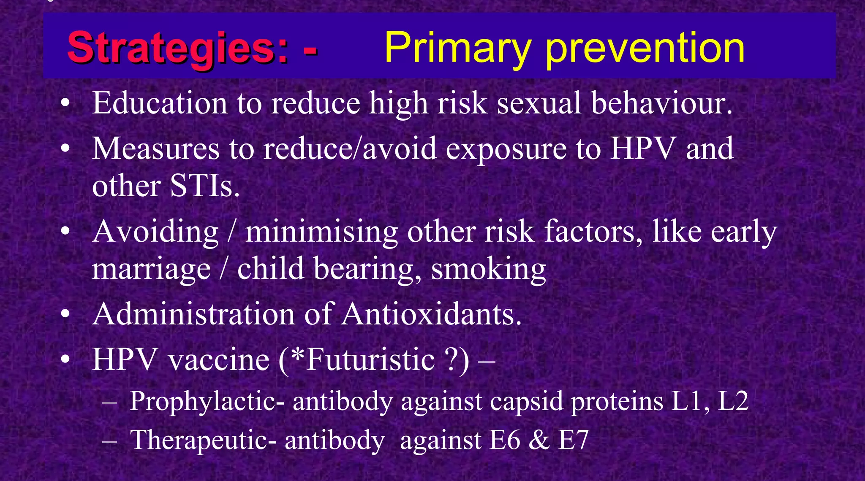

Slide 13
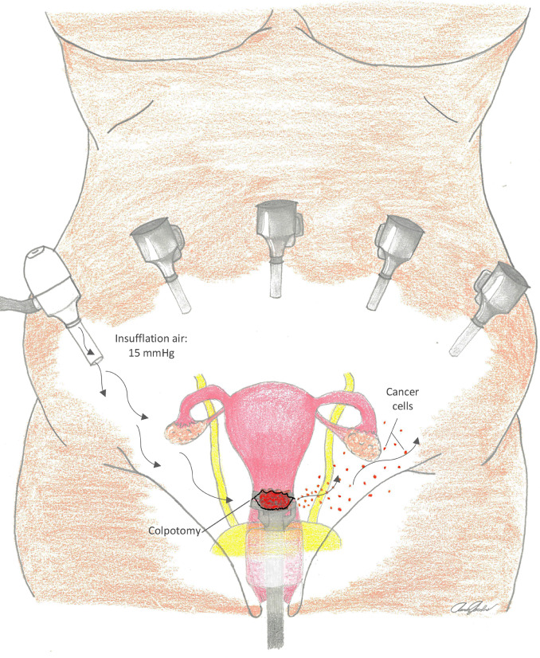
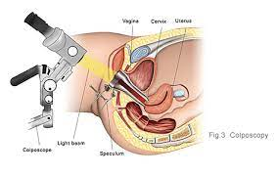
Tertiary prevention involves treatment of cervical cancer (surgery, radiation therapy, chemotherapy and the use of other methods), as well as measures that allow a woman to return to a full life after treatment.

Slide 14
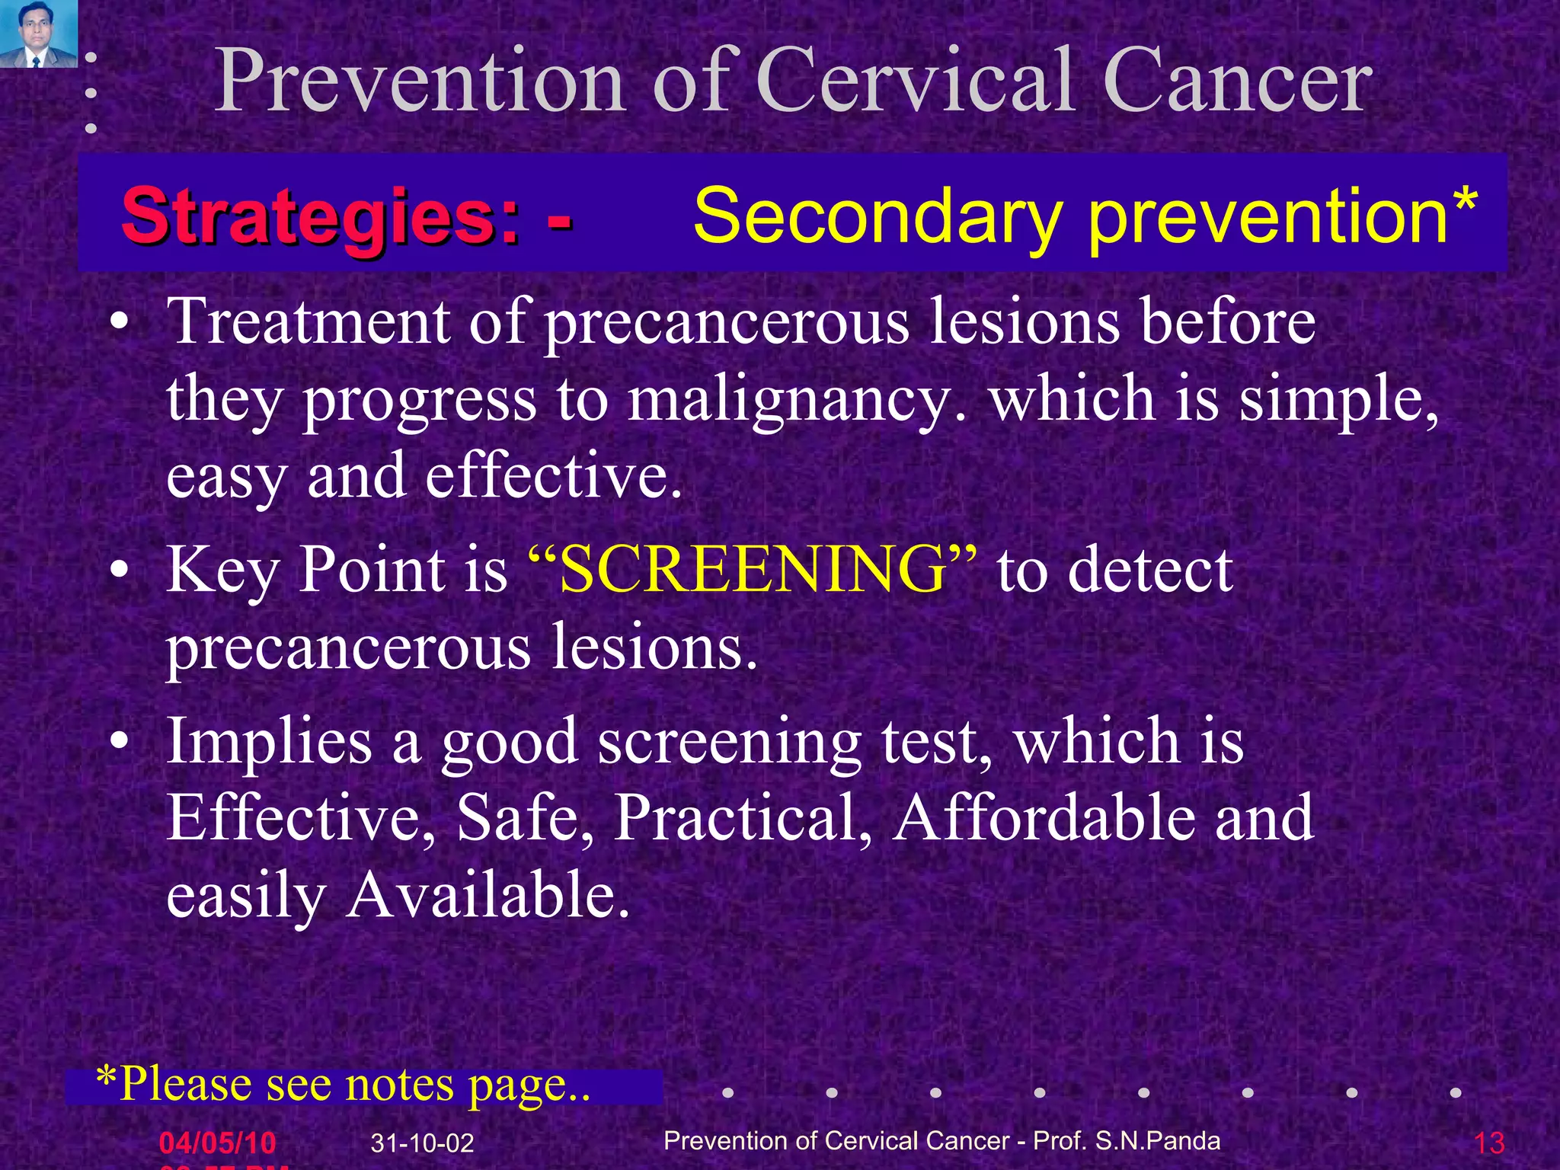
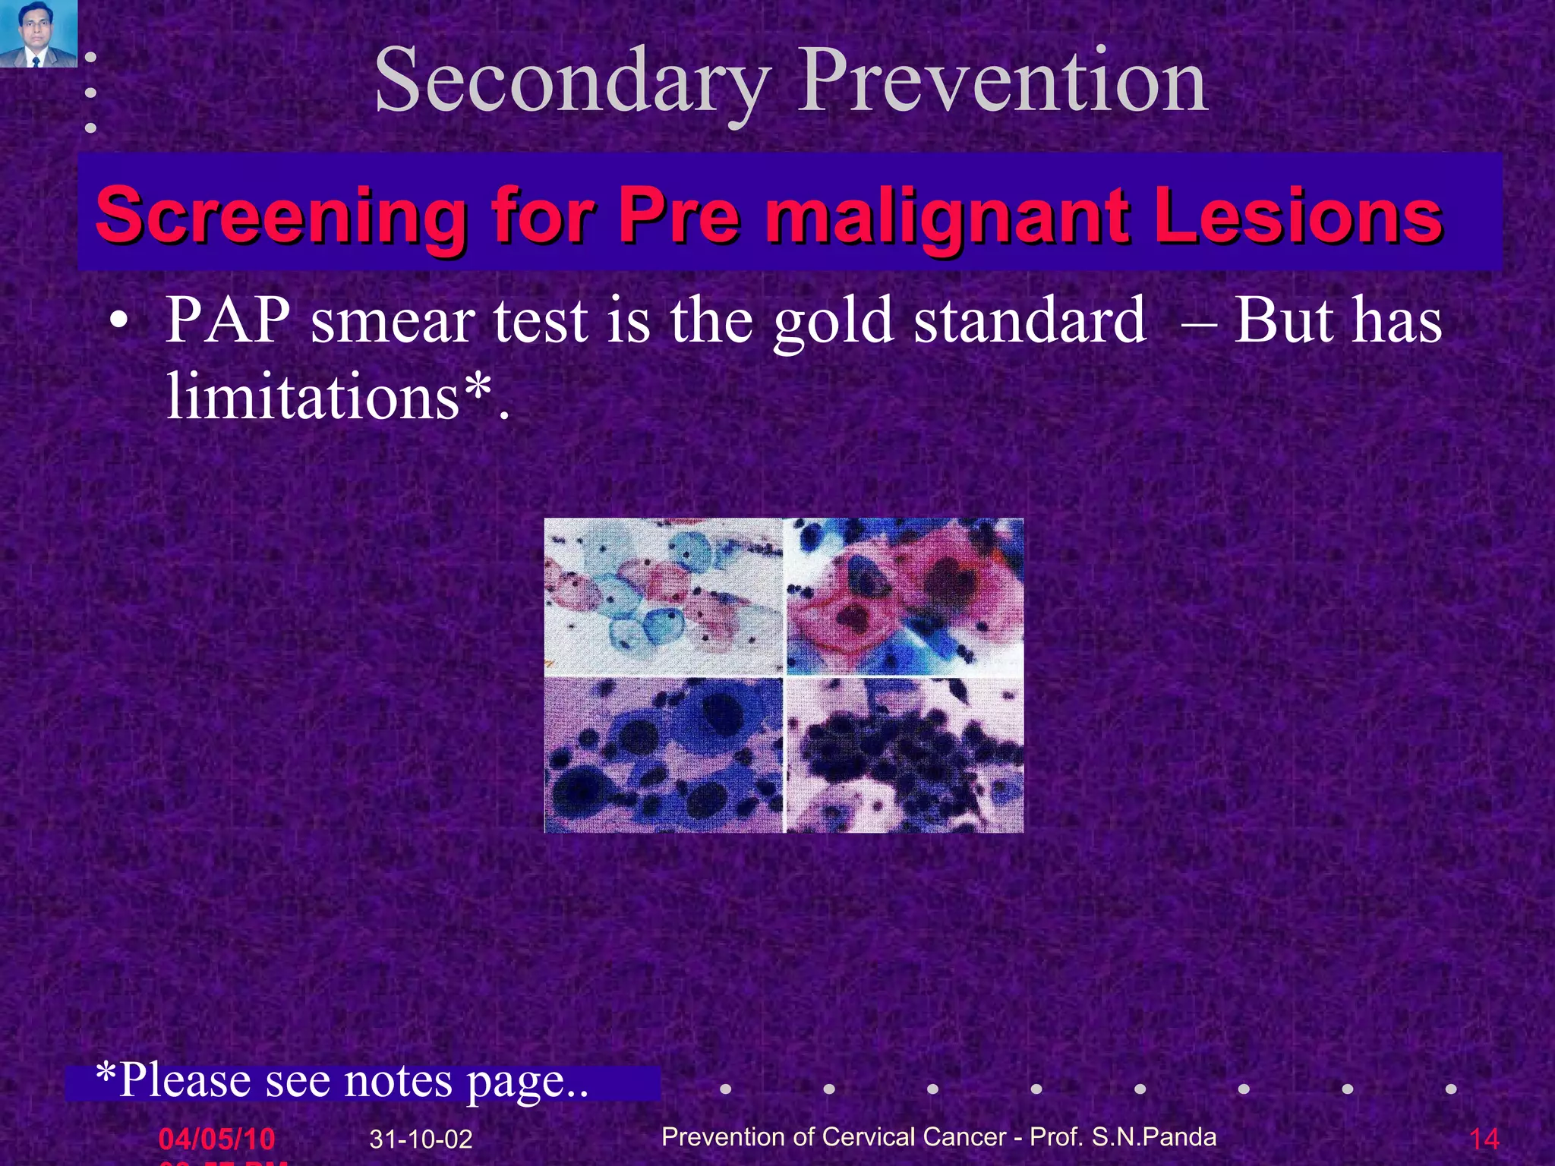

Slide 15
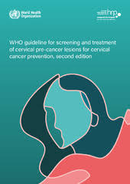
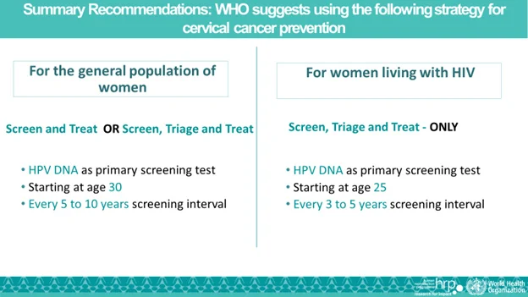
Public Health Interventions

Slide 16
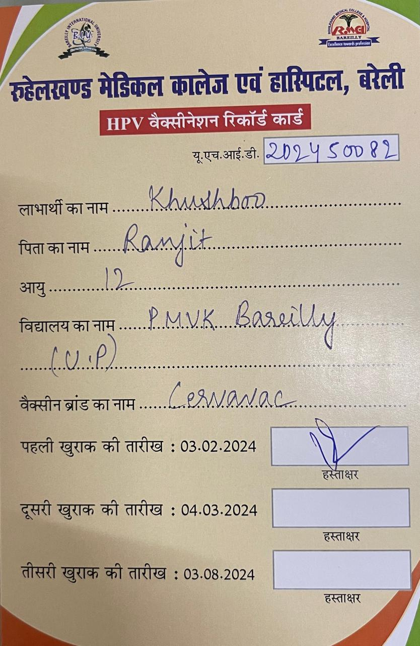
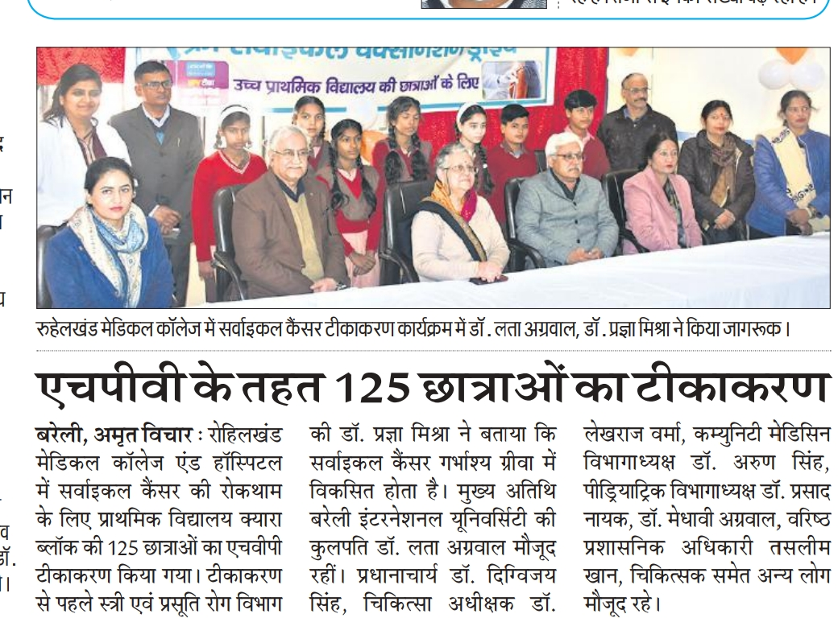

Work at RMCH

Slide 17



Slide 18
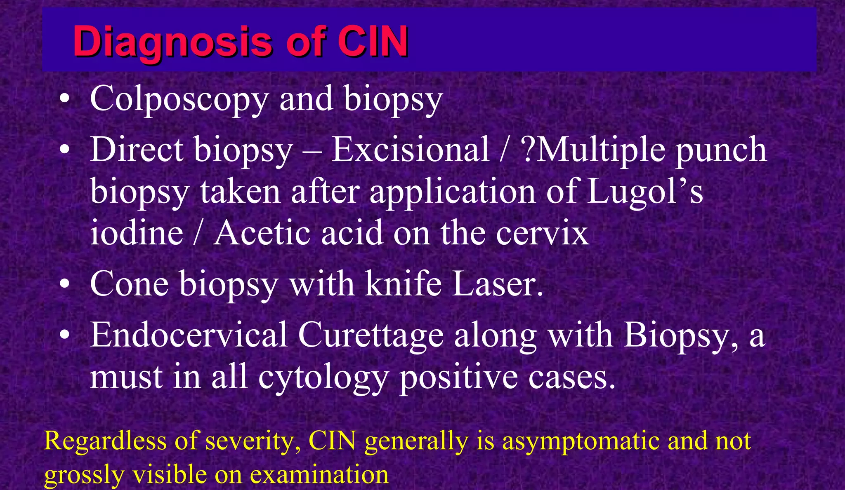

Slide 19
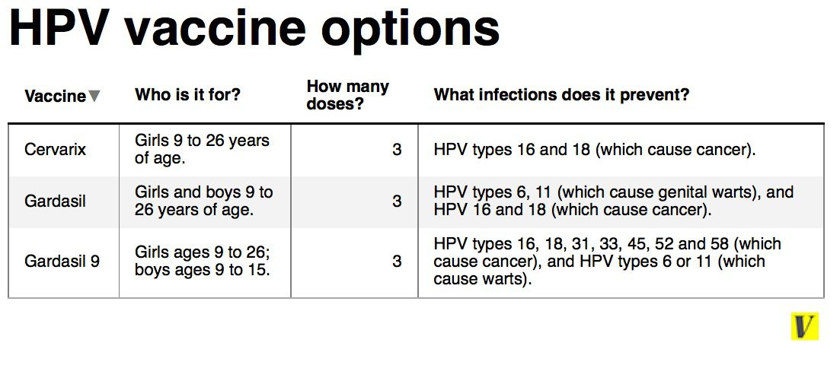

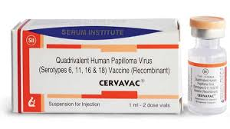
Vaccine Prevention

Slide 20
Conclusion
Stage for stage, little progress has been made in lowering mortality rates from cervical cancer.
However the overall mortality rate is decreasing because more patients are having their cancers diagnosed in early states of disease.
The opportunity is there for all physicians to make an early diagnosis in Ca Cx and to protect the women from this dreadful disease.

Slide 21

Thank You

