Slide 1
Developing RI micro-plans; step wise approach…..
State Workshop on Routine Immunization Microplanning and Strengthening - Uttar Pradesh –Nov’2023

Slide 2
Microplan..??
A microplan is defined as an integrated set of components prepared to support a particular health care subsystem
WHO
WHERE
WHEN
HOW
WITH WHAT

Slide 3
RI Microplans..
Micro planning is the basis for the ensured delivery of routine immunization services to a community.
Availability of updated and complete micro-plans at a planning unit (urban/rural) demonstrates preparedness of the unit and directly affects the quality of services provided through it.
Micro-plans are prepared for a one-year period but reviewed at least every 6 months.

Slide 4
RI Microplans - Issues
  No micro-plan available, sessions conducted unplanned
  Micro-plans prepared by ANMs/ FLWs not reviewed
  Lack of clear area demarcation (Peri-urban, Urban wards and between ANMs)
  Vacant SC/ HWC or Urban ANM areas not considered
  Migratory population or HRA information not updated
  Not aware about methods for estimation of due beneficiaries
  Updated micro-plan in computer / health center but older version is used
  Supervision plan not available or poorly followed
  Less or no availability of vaccinator (ANM vacancy)
  No availability of ASHA, Link workers especially Urban, HRAs, developing areas
  Suitable & accessible session site not available in urban area
This list is expandable……

Slide 5
Improving the RI micro-plan helps to
Define the catchment area and population covered by each SC / urban ANM Area
Prevents left outs
Prevents/reduces dropouts
Identifies HRAs (eg: Nomadic, Brick kiln, Riverine, Slums, Unauthorized settle populations)
Increases the RI coverage
Strengthens capacity for use data for action

Slide 6
RI Microplan Component
The RI microplan is a holistic concept
Must address all aspects
  Enumeration
  Infrastructure
  Manpower
  Mobilization & Communication
  Monitoring
  Distribution
Levels – Sub Centre / Block / District

Slide 7
Microplanning: basic principles
Review and revise, existing micro plans; ensure all components are included
Analyze the currently available microplans along with
  Basic data
  Coverage data
  Monitoring data
ANM with inputs from ASHA, AWWs, link worker mobilizer, PRI are responsible for developing RI microplans for their sub center areas
Block Medical Officer/MOIC should review and refine microplans with support of key assistants: IO, ICC, LHV, supervisors, BCPM, BPM etc
DIO & other Distt Nodal Officers to visit high priority blocks/PHCs/areas to review RI Microplans

Slide 8
Bottom-up planning approach
State: SEPIO
Sub-Centre: ANM
Village: ASHA/ AWW/PRI
District: DIO
Block: MOIC
PHC: Medical Officer

Slide 9
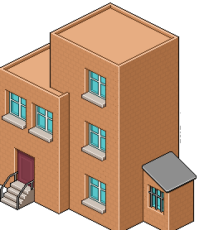

Immunization Microplan - Components
PHC Plan – Medical Officer
PHC/CHC Microplan
Map of Primary Health Centre
Compiled sub center plans
Alternate Vaccine Delivery Plan and route chart
Supervision and cold chain contingency plan
Waste disposal plan
IEC and social mobilization plan
Training plan and budget preparation
PHC
Sub Centre Microplan
Rural: name list of all villages, tola, majra
Urban: all wards/sub wards/mohalla
ASHA/AWW/Mobilizer for the area with clear area demarcations
Estimation of beneficiaries on the basis of head count and updated due list
Map of sub center area
Communications and social mobilization plan
ANM workplan
Sub Centre Plan – Health Worker

Slide 10
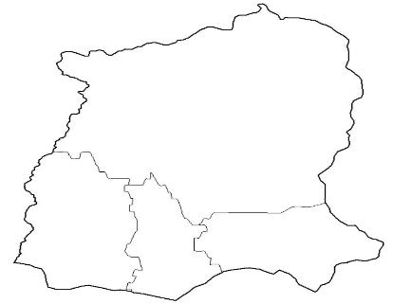
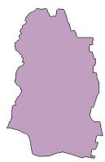
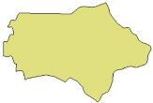

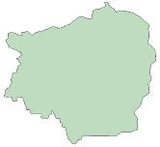
Immunization Microplan - Components
State
Compiled district plans
State-specific activities
  Plan for State task force for immunization
  Training of DIOs, MOs, Cold Chain Mechanics
  IEC, media sensitization
  Supervision
  Cold chain
State Plan
District
Map of district
Compiled microplans from blocks & urban
Plan for DTFIs & supervision plan of district officials
Distribution and maintenance of vaccines, cold chain and logistics
District-specific activities for intensification of RI
IEC and social mobilization plan
Training plan and budget preparation
District Plan – DIO

Slide 11
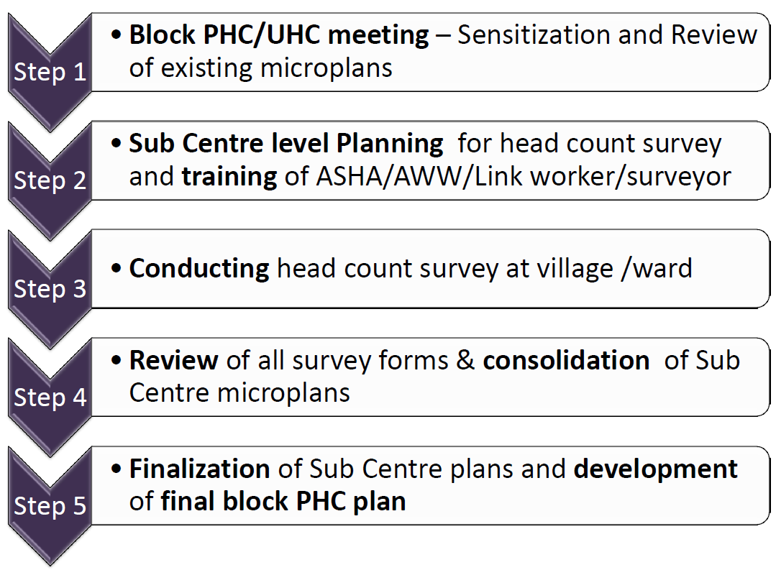
Actions to be followed for RI micro planning at block/PHC

Slide 12
Steps in the process of developing RI microplans
BLOCK/PHC Review of RIMP Step 1
Sub-centre / PHC meeting
Step 2
Training of ASHA / AWW
BLOCK/PHC RI microplan
Head counting in area - Step 3
SC RI microplan
BLOCK/PHC finalization of RIMP Step 5
Sub-centre meeting
Step 4

Slide 13
Action 1 a: RI microplan review meeting at PHC
Participants: MOI/c, PHC MOs, Health Supervisors, LHV, ANMs, key persons assisting MOIC (IO, ICC, ARO), BPM, BCPM, CDPO, ICDS supervisors etc.
  Immunization partners where applicable
Objectives:
  Ensure inclusion of all
    Villages and their hamlets
    Urban/peri-urban areas and their wards/sub wards/mohalla
    Migratory and non migratory high-risk settlements (slums, constructions sites, nomads, brick kilns etc)
  Clear area demarcation for each sub center and ANM area
  Develop plan for missed areas, vacant sub centers including plans for areas without ANMs
  Training on how to conduct headcount and generate due list
  Develop a communication plan & to Prepare maps of areas

Slide 14
Action 1a - Data for RI microplan review at PHC
Data required
Geographic | List & map of villages including hamlets /urban areas/wards (SC catchment)
Demographic | Total & beneficiary population (Census/ revenue records, service records, Head counts), migrants
Programmatic | Existing RI microplans, Polio & IMI microplans, monitoring feedback, List of HRAs & Refusals / VAB / Vaccine hesitancy Missed areas & children
Administrative | Staff vacancy, ASHA/ Mobilisers, AWW/ helper list
Epidemiologic | VPD outbreaks
Social mapping | NGOs / CSOs, Practitioners, Community centres, schools Influencers, PRI, Possible session sites List of ICDS centres
Notes:
Create table of who will bring what including ICDS – network and beneficiaries

Slide 15
Action 1 b: Inclusion of ALL areas in RI microplan
Match village and hamlet/urban area lists from all sources and review existing plans
Share information on areas not covered/ poorly covered
Ensure
  All areas are included with clear demarcation for all sub centres & ANMs
  When 2 ANMs are posted in the same sub centre, their areas should be clearly demarcated
  High risk status & geographic, administrative, epidemiological & other factors are taken into consideration

Slide 16
Action 1 c: Record sub centre wise information
Form 1: Name list of Areas (village / Mohalla) & estimation of beneficiaries format
Record other considerations for microplanning:
  HRA including type of HRA
  Terrain, accessibility, mobilization issues including presence of mobilizer
  Distance from ILR / Cold Chain Point
Form 2: Session planning information on ASHA, AWW, Mobilizer in the area

Slide 17
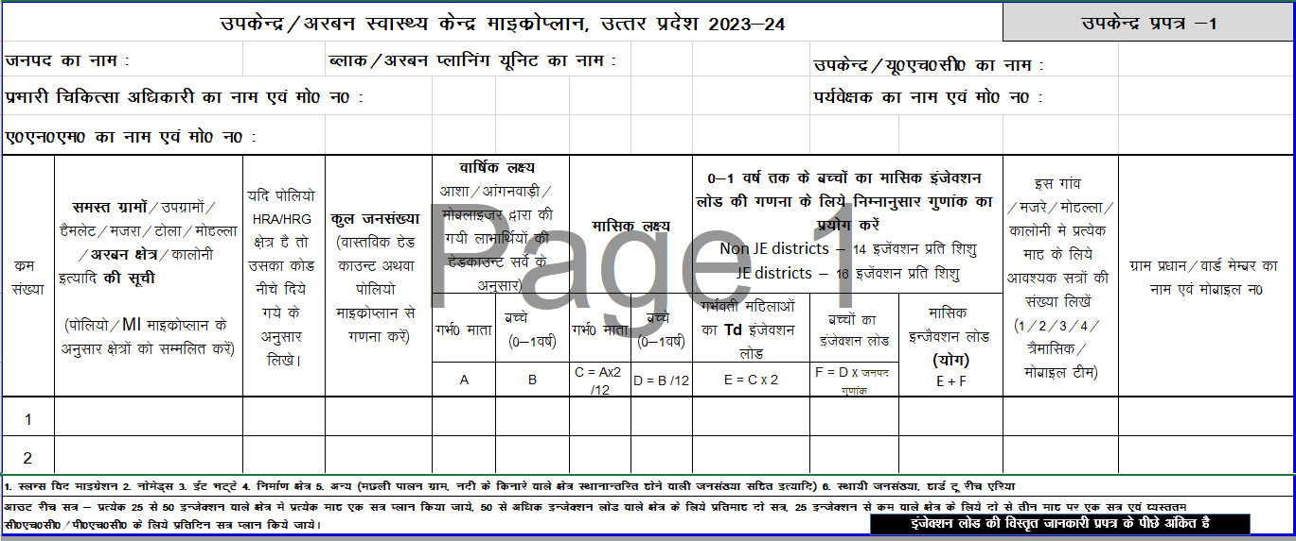
Estimation of area wise beneficiaries and injection load
Faizpur
1
1150
17
32
3
3
6
42
48
1
Guddu Pradhan Ji

Slide 18
Action 1 c: Recording information on Format 1
Record total population of each area based on:
  Actual headcount (ideal)
  Other data: Polio Microplan extrapolated Population, ASHA / AWW survey
  Census 2011 population projections
Estimate targeted no of beneficiaries (pregnant women and infants) BASED ON ACTUAL HEAD COUNT by ASHA /AWW / Mobilisers
  For pregnant women, multiply the headcount by 2 to arrive at an estimate for 12 months

Slide 19
Action 1 d: Calculate injection load and assess if existing RI sessions are adequate & appropriately placed especially for HRAs
Guidelines for planning RI sessions:
Outreach sites (SC/ AWC- without vaccine storage facility)
  Plan 1 session per month: for every 25-50 injections
  Plan 2 sessions per month: for > 50 injections
  Plan a session every alternate month: for < 25 injections
Fixed sites (PHC/CHC/District Hospital or others with vaccine storage facility)
  Plan 1 session per month: for every 40-70 injections
  Plan 2 sessions per month: for more than 70 injections
  Plan daily sessions: For a busy CHC/RH
Hard to reach areas with population of less than 1000
  Plan minimum of 4 sessions in a year (one session every quarter)

Slide 20
Action 1 e: Assess adequacy of RI sessions & develop a revised RI roster for each sub centre
Assign health workers for vacant sub centres & left out areas; examples
  Utilize the other days of the week, 5th week of the month
  Redistribution of work areas, hiring of alternate vaccinator, out source to NGO
  Immunization Mobile Vans, Teeka express etc

Slide 21
Action 1 f: Deciding the number, location and schedule of sessions
Session site; decide the basis of available place and feasibility of mobilization of beneficiaries, seasonal considerations e.g. floods, waterlogging
Session frequency; based on Injection load / no. of villages in the SC, may need to club catchment areas or divide if big village
Decide type of session as outreach, Mobile vans etc
Decide the convenient day and time in consultation with the AWW, ASHA, TBAs, PRI , community and VHND in the area

Slide 22
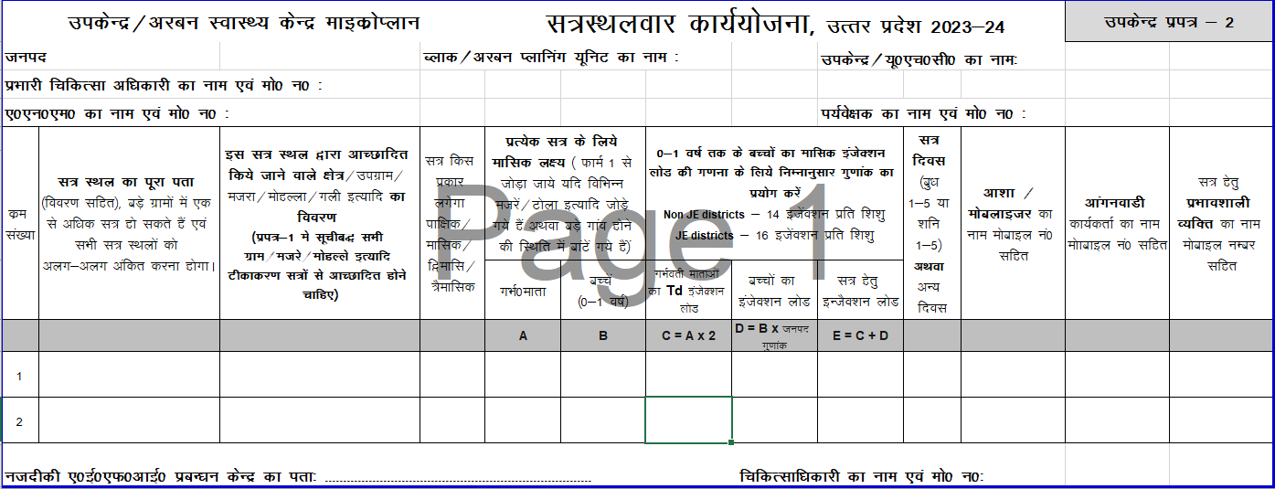
Session Planning
Saleema AWW House
monthly
WED 3
Fatima 12345
Salima 12345
Guddu Pradhan 98007
Faizpur
3
3
6
42
48

Slide 23
Action 1 g: Prepare work plan/roster for each health worker
Day (Wed / Sat 1-5) of immunization session
Location/address of the session site
Names of all areas to be catered by the session
Session frequency (Fortnightly /Monthly / Alternate month)
Session wise calculation of beneficiaries
Name and mobile no. of ASHA, AWW/mobilizer
Address and mobile number of AEFI management centre
Remember to follow the “Fixed Day, Fixed Site” principle

Slide 24
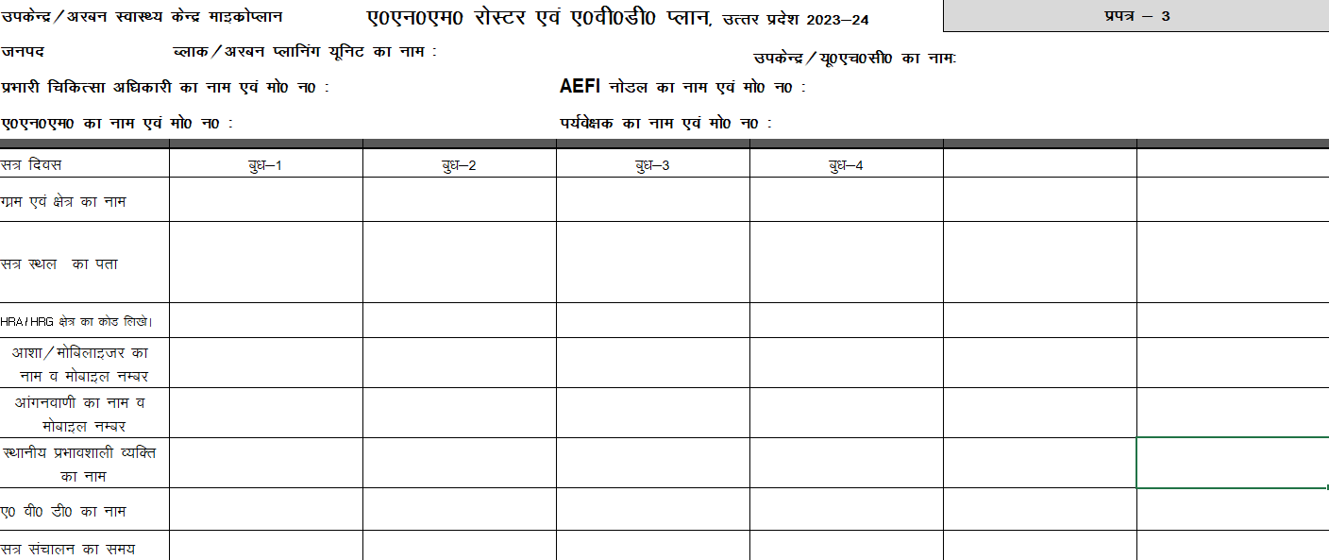
ANM Immunization Roster
Bajpur SC
Harrah
Faizpur
Milak
Saleema AWW House
1
Fatima 2345
Salima 12345
Guddu Pradhan 98007
RAJENDER
9 - 4
Some Sessions may come for alternate month or once in a quarter.
ANM may have additional charge of any village from near by vacant sub centre

Slide 25
Action 1 h: Calculate the requirement of vaccine vials and Vitamin A for each session
Vaccine vials count = Beneficiaries per session X 1.11*
(under Open Vial policy) 10 (no. of doses in a vial)
BCG; max wastage allowed 50% (2 WMF)
MR ; 25% (1.33 WMF)
Vit A = {(monthly target of infants x 1 ml) + (monthly target of infants x 2 ml x 8)} x 1.11 (10% wastage rate or 1.11 WMF)
Calculate the requirement of syringes :
0.1 ml ADS = Beneficiaries for BCG & fIPV x 1.11*
0.5 ml ADS = Beneficiaries for (TT+ Penta + DPTB+ MR+ JE) x 1.11*
Reconstitution Syringes = (BCG + MR) X 1.11*
* Syringes = 10% wastage rate or 1.11 WMF (Wastage Multiplication Factor)

Slide 26
For each session, ensure that
Minimum 10 doses of each vaccine is available
Open vial policy is followed
For BCG & MR an unopened vial with bundled diluent is used

Slide 27
Action 2: Meeting at sub center to plan for head count, generation of due list & train ASHA/AWW
Participants: Sector Medical Officer, LHV, HS, BCPM, BPM ANM, ASHA, AWW & Mobiliser (Link worker)
Objective:
  Area demarcation between ASHA, AWW & mobiliser
    Plan to walk through areas to ensure clear area demarcation
  Training of ASHA/ AWW to undertake head count & generate due beneficiary list
    30-50 houses to be covered each day (with house marking)
    Process should be completed in 5-7 days
  Mapping of area (mobiliser/session wise)

Slide 28
Action 3: Head count by ASHA/ AWW
Head count by ASHA/AWW every 6 months essential for generation of due list with left out & drop out
Head count and due list generation must be supervised by health worker, ICDS supervisors, PHC supervisors & ASHA Sangini
Supervision, monitoring & regular feedback for corrective actions
Duelist must be updated after and before every RI session – children not turned up, next due doses, age specific due children, newly born babies / identified pregnant / new residents / tenants/temporary migrants, booster doses, missed doses up to 5 years

Slide 29
Action 4 a: Sub center wise second RI planning meeting
Participants: Sector MOs, LHV, HS, BCPM, BPM ANM, ASHA, AWW, Link worker
Objective :
Review of head count & due list generation (quality and completeness)
Review and refine RI sessions plans as per actual head counts & identification of any missed (migratory/ settled) pocket in sub center area
Develop ANM Roster, Mobilization plans etc.

Slide 30
Action 4 b: Sub center wise second RI planning meeting
Update the map of sub-centre/urban health centre showing:
All HRAs, villages with hamlets, urban areas with wards, sub wards & mohallas
All session sites and session days including Anganwadi centres
Landmarks as panchayat bhawan, school, roads etc
Demarcate ASHA/mobilizer wise areas for social mobilization on map
Communication plan must be developed and incorporated in the sub center microplan.

Slide 31
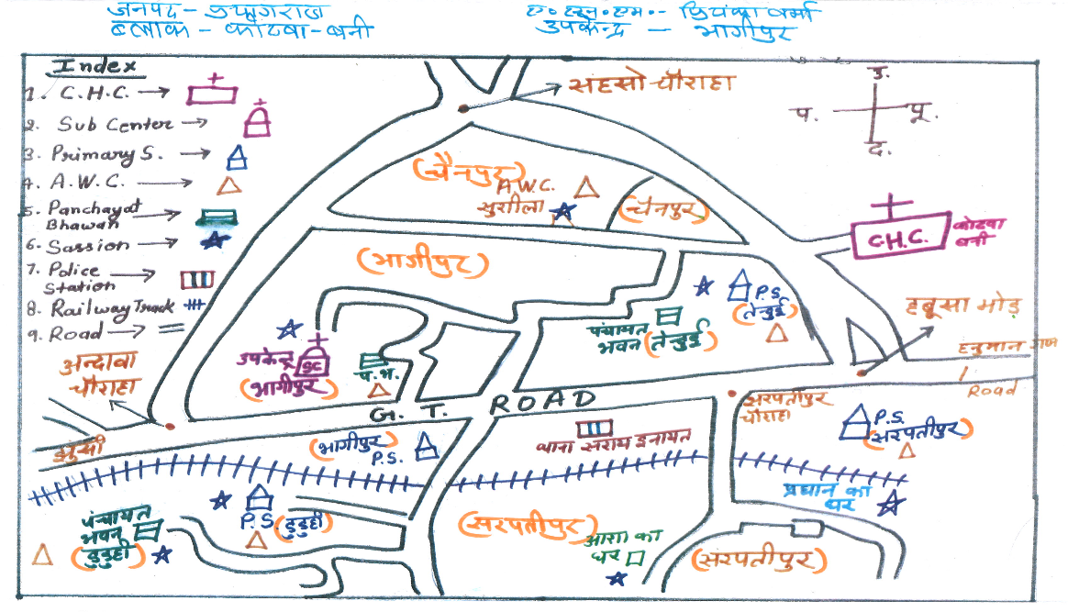
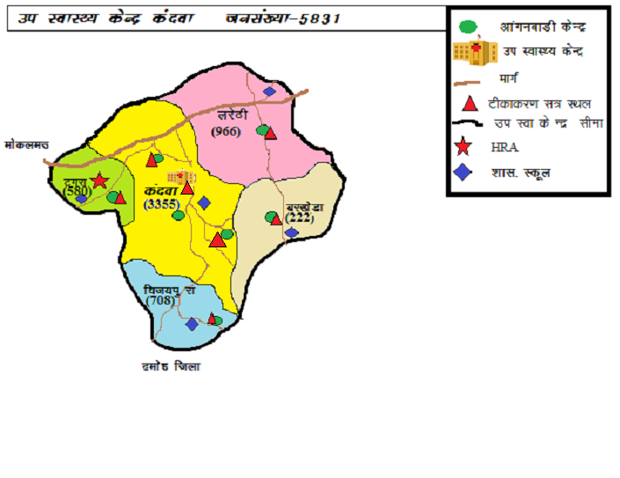
Sub Center Map Showing all Landmarks & RI session sites

Slide 32
Action 5: MOI/c to organize second RI planning meeting
Review of sub center plans by MOIC for
    Adequate session planning
    Inclusion of all HRAs, Special plans for difficult areas
    Alternate plan for Vacant SC
    Adequate mobilisers deployment
    ANM roster review & finalization
  Compile plans from all sub centers to develop block plan & Consolidated Roster of ANMs
  Prepare AVD, Supervision plan & Communication plan
  Recalculate vaccine and logistics requirement

Slide 33
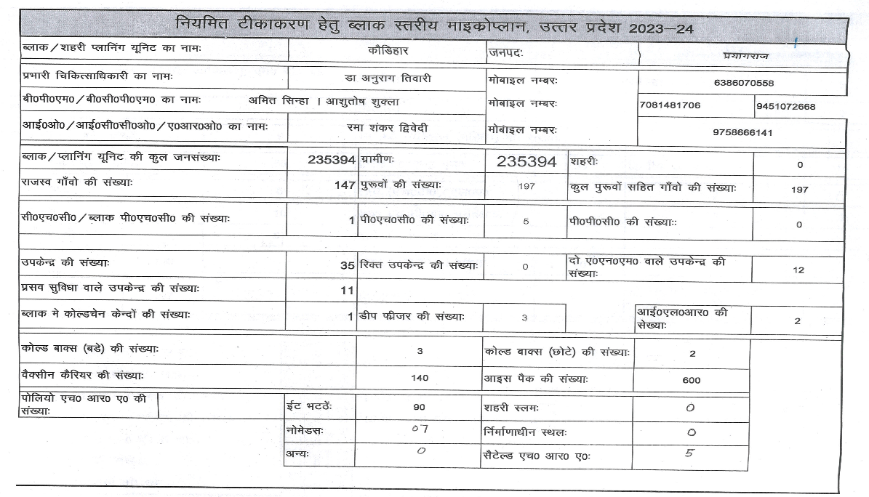
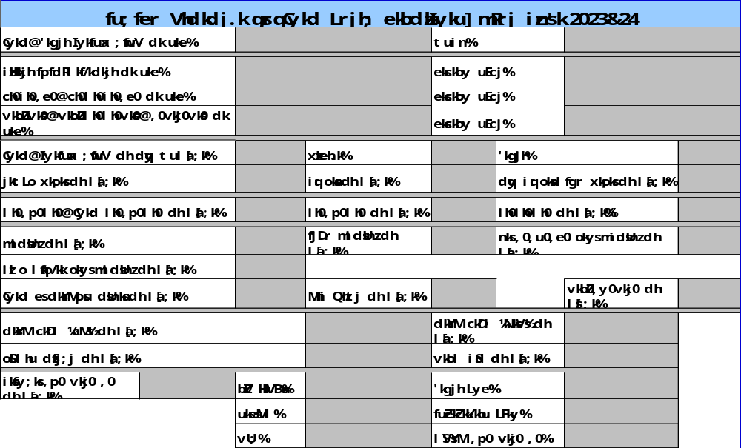

Slide 34
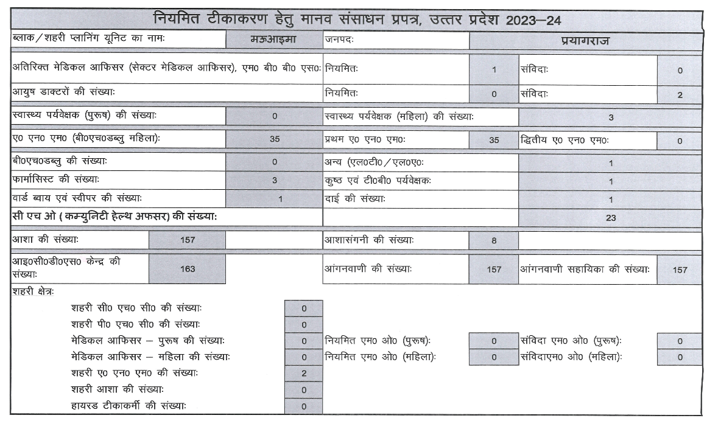
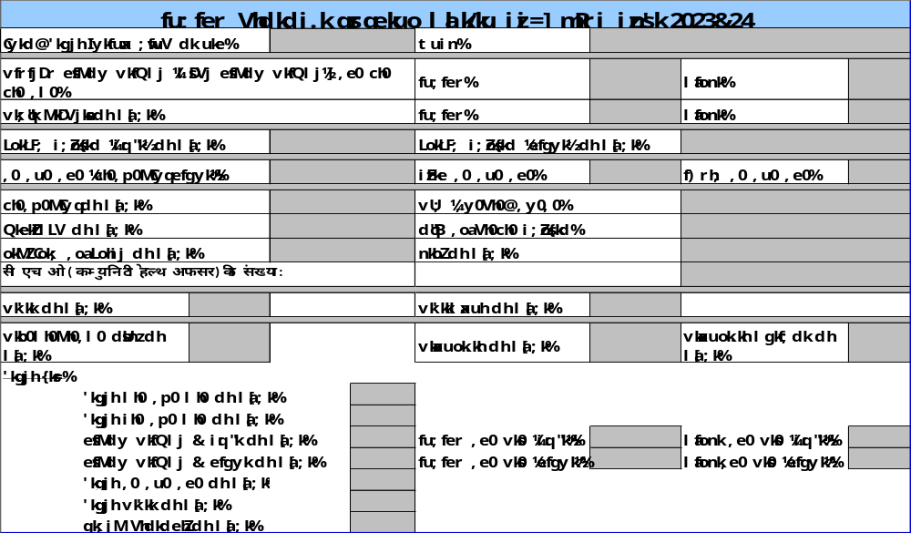

Slide 35
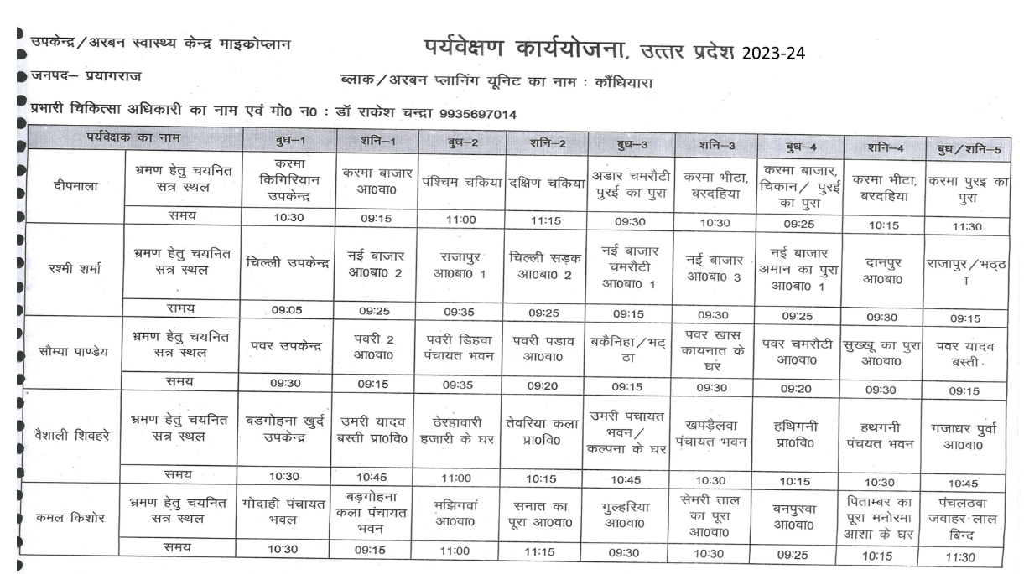
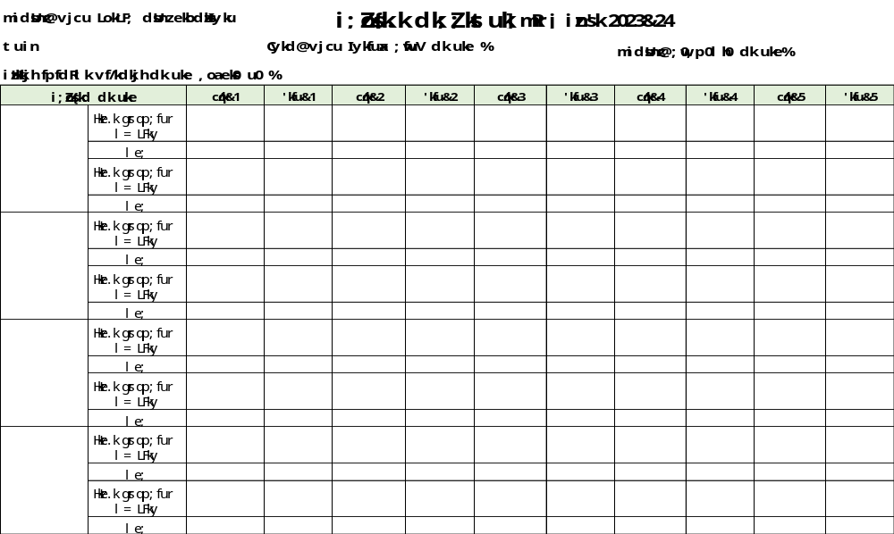

Slide 36
Vacant Sub Center planning
Additional Charge must be given to any one ANM – fix responsibility
Sub center planning forms 1 & 2 to be made
Fix day, fix site approach to be adopted for these area’s session plan
ANM/LHV to be assigned for village/s based on availability and plan
These ANMs to be tagged with local AHSAs & AWWs and must be made accountable for that area’s vaccination status
Alternate session plan to be reviewed on weekly basis for tracking of sessions planned V/s held

Slide 37
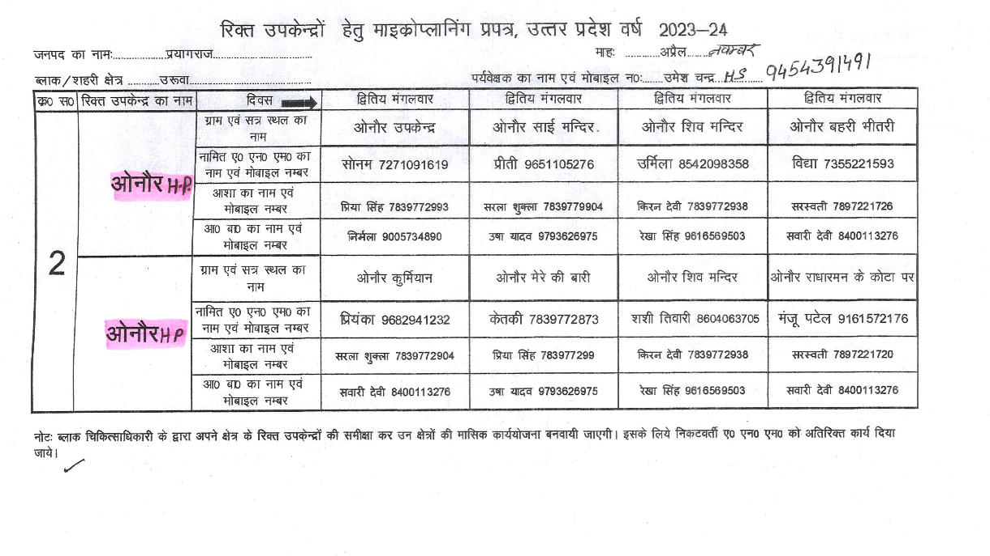
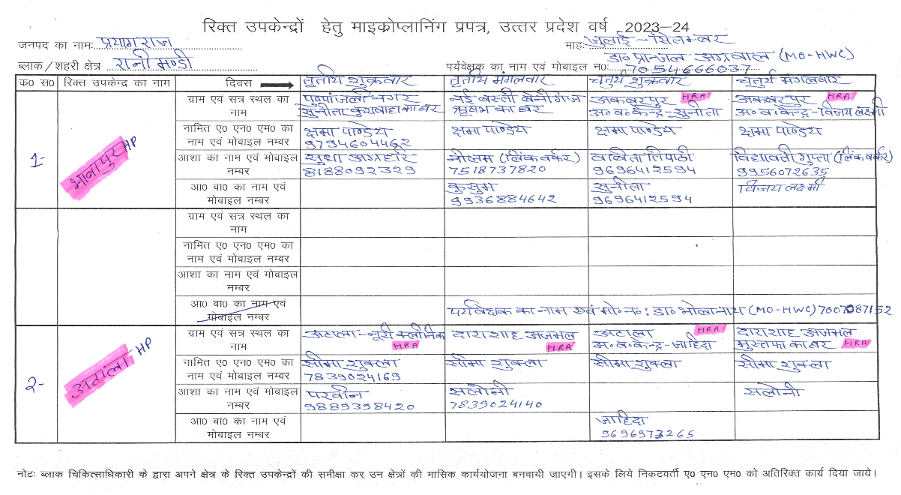
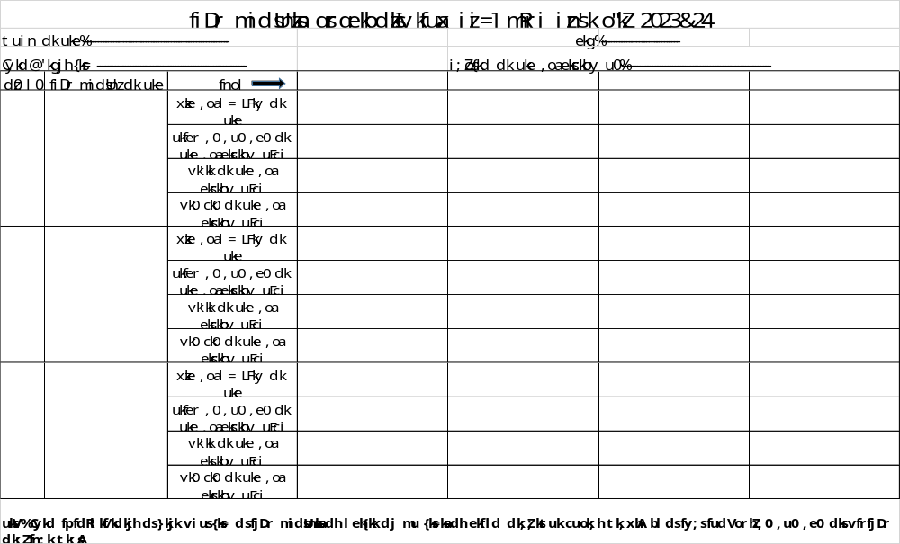

Slide 38
Review and update the micro plans twice a year
Update the available list of all the High Risk / Priority Areas in the block/urban area every 6 months; check whether these areas are part of the existing RI micro-plan
Ensure integration of IMI sessions in RI Microplan - additional days / alternate months / Quarterly sessions / Session shifting / Split session
Review monitoring reports to identify issues
Facilitate block level review and revision under guidance of DIO in priority blocks

Slide 39
Urban area microplanning
Planning process is similar to that described earlier
It needs to be modified as per available infrastructure – involve NGOs & other organizations
Fixed Immunization session site plan (Medical college/DH/UCHC/UPHC)
Focus on HRAs for organization of RI sessions
Flexible timings as per availability of beneficiaries
Mobile units may be required to cover multiple HRAs, small scattered populations, homeless populations

Slide 40
Meetings & Mobilization
Conduct DTFI, CTFI/UTFI, TTF & BTF to involve all concerned officials on mobilization
Take help of Panchayat leaders / officers, Ward members, Brick kiln owners, / Munshis, opinion leaders, religious leaders etc. for social mobilization
Prior to the session day, ASHA/AWW/Mobilizer should conduct house‑to‑house visits to prepare due list of beneficiaries and inform them about the place and timing of the sessions
Engagement of Mahila Arogya Samiti (MAS) members
USE OF BULAWA PARCHI

Slide 41
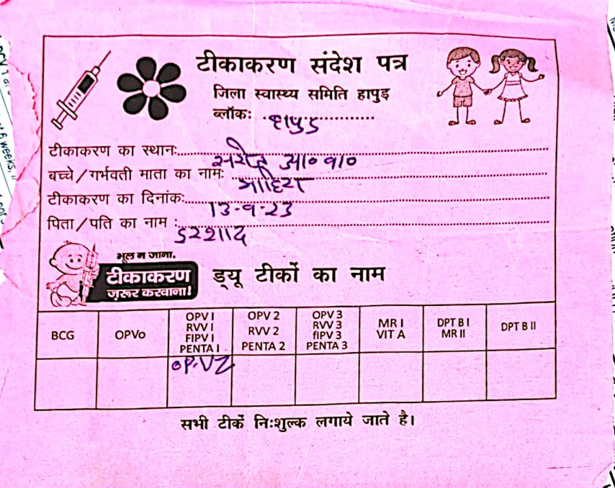
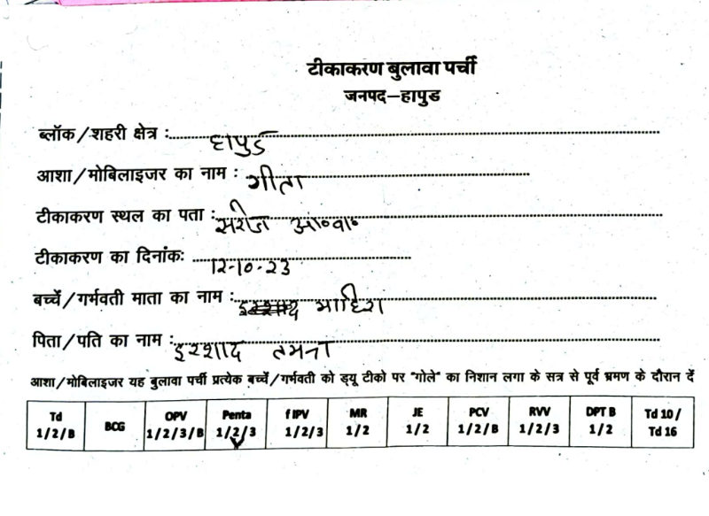
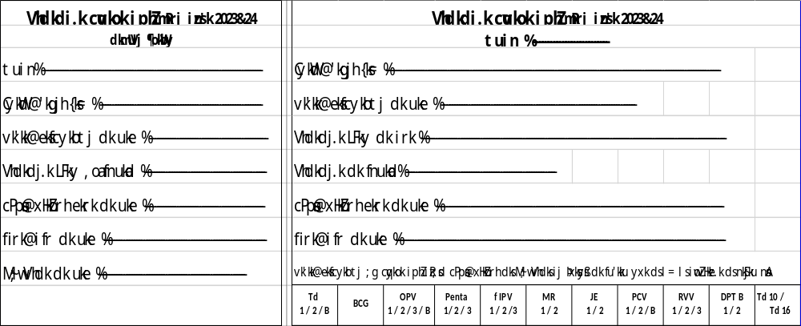
Bulawa Parchi
ASHAs / Mobilisers to ensure distribution of these slips before each session.
Counter foils may be used to check the distribution.

Slide 42
Supervision
All supervisors such as DIO, Deputy CMOs, MOIC, other medical officers, AYUSH doctors, NRHM managers and development partners should be assigned to monitor at least 2 sessions on each RI day
Supervision should be done on designated format
Daily evening meeting on RI days for feedback review at block & district should be done

Slide 43
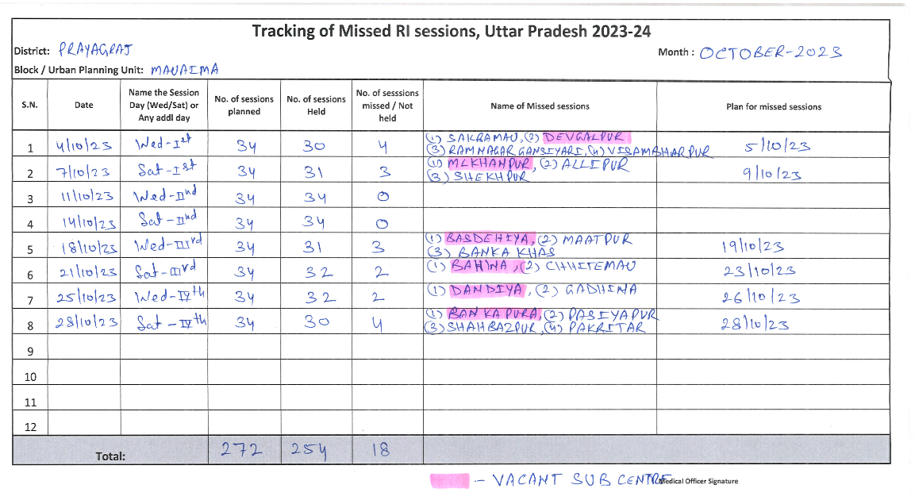
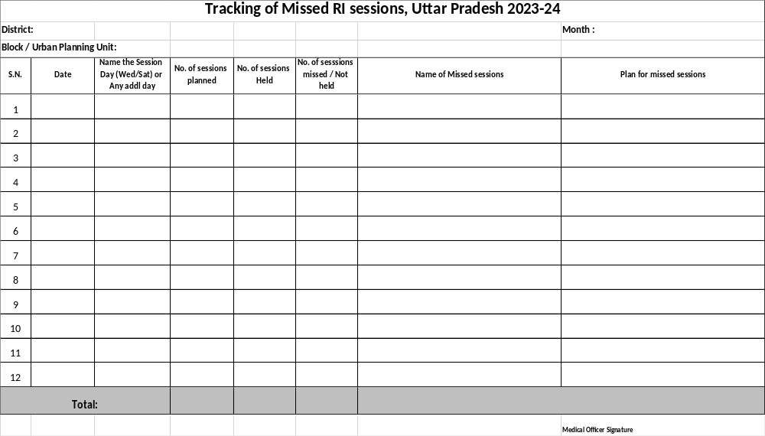
Tracking of Missed RI sessions

Slide 44
Essentials of RI Micro-planning
Base unit for RI microplanning is the Sub-center / Urban ANM area
Review and revise existing micro-plans; list of all Villages/ majra / or urban mohalla, colony, wards in each SC / urban ANM area
Update head count survey (PWs and 0-1 Yr age) against each listed area on Form 1
Calculate village / area wise injection load using “Multiplication factor” on Form 1
Plan the sessions according to injection load guidelines on RI days / additional on Form 2 (Big village; >1 session, small one clubbing/alternate month)
Ensure: Fixed Day- Fixed site – Fixed Time approach
Finalize the ANM wise roaster and other details (AVD etc.) on Form 3
Compile each SC/ ANM area plan at block / UPHC level
Vacant SC plans, Supervision, AVD, Maps of SC/ANM area, block formats to be made to complete RI microplan

Slide 45
Summary
Quality microplans with all components essential for achieving high coverage
Role of district & Blocks is critical in microplanning
  Build capacity of MOs, health workers & supervisors
  Visit PHCs & sub centres to validate quality
  Track progress particularly in HR districts & blocks
  DTFI must review progress and help to overcome issues of coordination
Thank you

