Slide 1
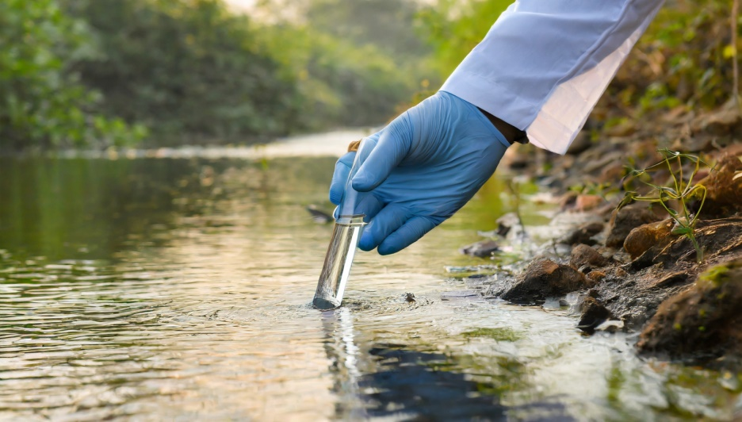
WATER SURVEILLANCE
PRESENTED BY: Dr. Deepak Sharma
Junior Resident 2
MODERATOR: Dr. Medhavi Agarwal
Professor
Deptt. Of Community Medicine,RMCH

Slide 2
“ Continuous and vigilant public health assessment
and overview of the safety and acceptability of drinking-water supplies”(WHO-1976)

Slide 3


🞂​ Quality
🞂​ Quantity
🞂​ Accessibility
🞂​ Affordability
🞂​ Continuity of drinking-water supplies

Slide 4
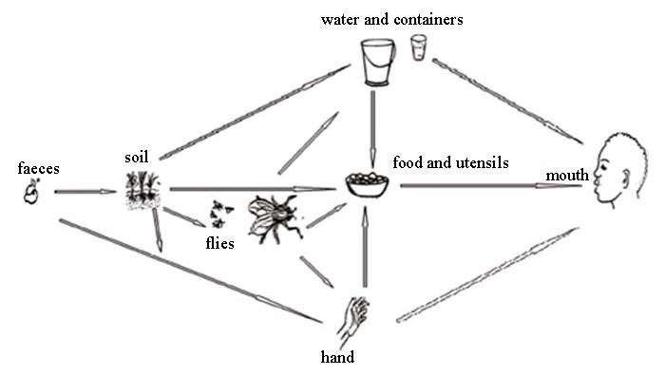
At home
Source
Safe source
Ways to prevent

Slide 5
🞂​ Identify & evaluate factors associated with drinking water which could pose a health risk
🞂​ To take both preventive & remedial action
🞂​ For development of rational strategies for improvement of quality of water supply services
🞂​ To meet agreed national standards & institutional targets

Slide 6




Direct Assessment
Audit approach
Information regarding system performance
Review records to ensure data is reliable.

Slide 7
Approval of new sources(Including private owned)
Watershed protection
Approval-construction & operating procedures of water works
  disinfection of the plant & distribution system
  periodic flushing programmes & cleaning of water storage facilities
  certification of operators
  regulation of chemical substances
  Cross-connection control ,back flow
prevention ,leak detection control

Slide 8
Sanitary surveys
Monitoring programmes
Development of codes of practice for well construction ,pump installation and plumbing
Inspection quality control in bottled water

Slide 9
Sanitary Survey
Sampling
Bacteriological Surveillance 1)Presumptive Coliform Test
- Multiple Tube Method
Membrane Filtration Technique 2)Detection Of Faecal Strep &
Cl.Perfringes
3)Colony Count
Biological Examination
Chemical Surveillance

Slide 10

🞂​ A sanitary survey defined as
“an on-site inspection and evaluation by a qualified person of all the conditions, devices, and practices in the water supply system which pose a danger to the health and well being of the water consumer ”

Slide 11
🞂​ A new source is being contemplated
🞂​ Laboratory analysis indicates hazard to health
🞂​ An outbreak occurs
🞂​ To interpret bacteriological, chemical and physical analyses of samples
🞂​ When any change takes place that can affect the water system, e.g. industries coming up in watershed and
🞂​ On a regular basis

Slide 12

🞂​ Ensure no external contamination
🞂​ Asepsis Glass bottles with securely fitting stoppers or caps with non toxic liners.
🞂​ Sample for general analysis= 2 litres(non-acidified)
🞂​ Bacteriological analysis=250 ml (sterilized bottle)
🞂​ Metals analysis=1000 ml (acidified sample)

Slide 13

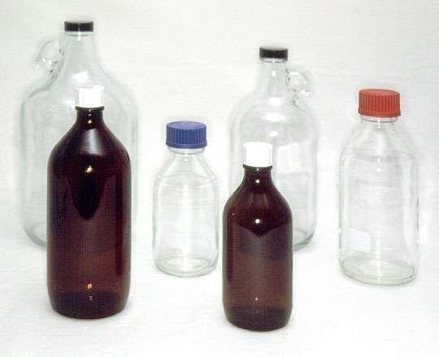
🞂​ Sampling done by sampling assistant

Slide 14
🞂​ Water from a tap in a distribution system
🞂​ Water from watercourse (river, lake,well etc)

Slide 15

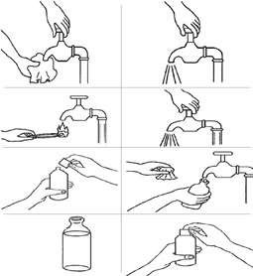

Slide 16

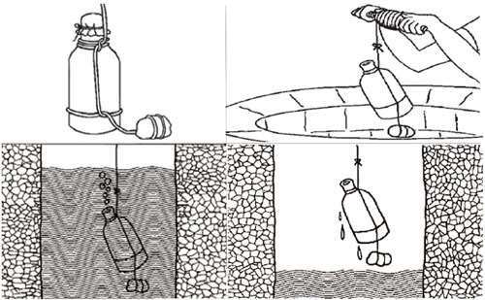

Slide 17
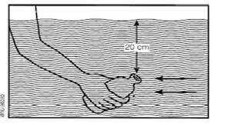

Slide 18
🞂​ Date
🞂​ Time of collection
🞂​ Despatch
🞂​ Source
🞂​ Rainfall
🞂​ Findings

Slide 19
🞂​ Take the positive tube from the presumptive test
🞂​ Incubate one plate at 37°C for 24 hours and another at 44.5°C for 24 hours.
🞂​ Look for typical colonies in the media ; blue black with green metallic sheen colonies are of E. coli

Slide 20
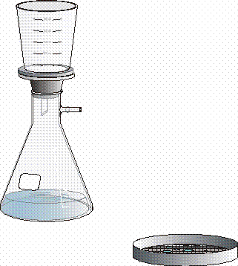
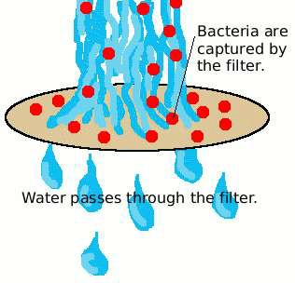
🞂​ Lactose Tegritol agar
🞂​ Membrane lauryl sulfate lactose

Slide 21
🞂​ Nutrient agar at 37 deg C and 22 deg C
🞂​ An estimate of the general bacterial purity of water.
🞂​ Same source at frequent intervals may be of considerable value.
🞂​ A sudden increase in the colony count may give the earliest indication of contamination.

Slide 22
Water at the point of consumption | Plate count after 2 days at 37 deg C | Plate count after 3 days at 22 deg
( i ) Disinfected | 0 | 20
(ii) Not - disinfected | 10 | 100
🞂 The recomme
nded plate counts are

Slide 23
​ The National Water Supply & Sanitation Programme was initiated in 1954 with the objective of providing safe water supply and adequate drainage facilities for the entire urban and rural population of the country.
​ In 1972 a special programme known as the Acceelerated Rural Water Supply Supply Programme was started as a supplement to the above mentioned programme.
Renamed as Rajiv Gandhi National Drinking Water Mission in 1991.

Slide 24
Swajaldhara Programme was launched on
25th December 2002.
Bharat Nirman Programme was launched in 2005, priority
was given to cover water quality problem.
Jal Jeevan Mission launched on 15/Aug/2019.

Slide 25
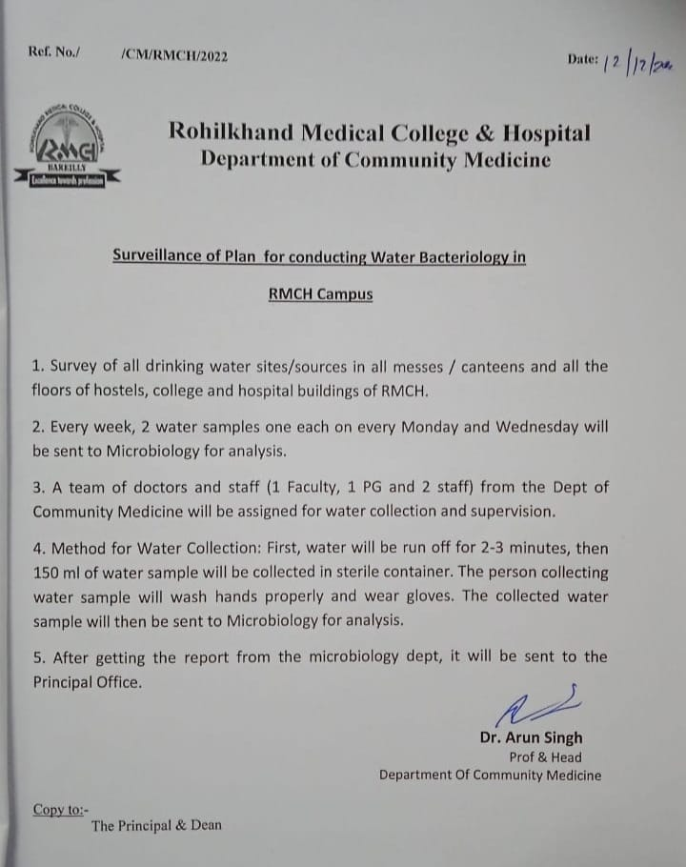

Slide 26

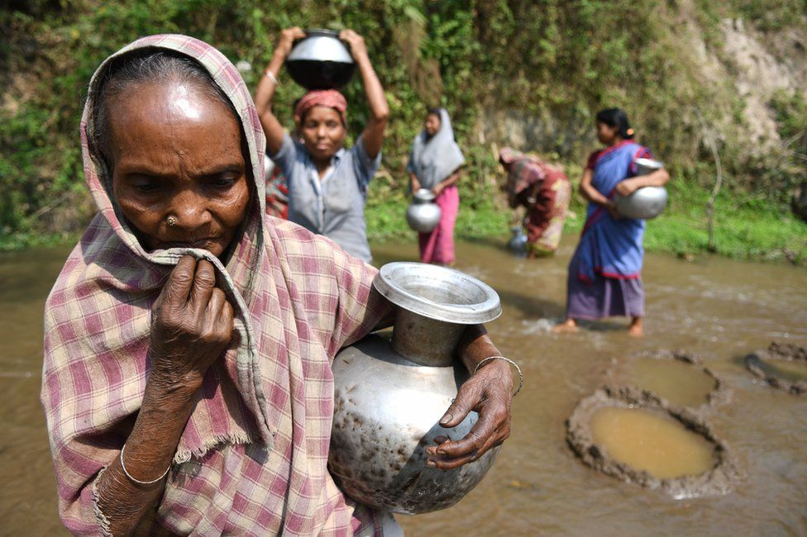
JAL HAI TO KAL HAI

