Slide 1
Water Quality Assessment
Dr. Gauri Sarswat

Slide 2
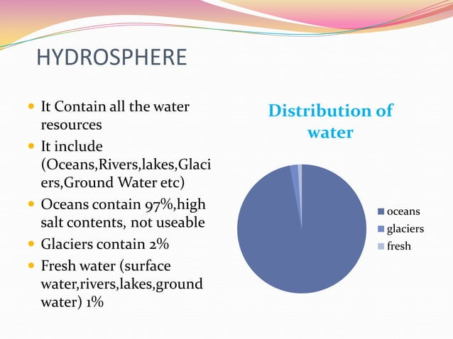

Slide 3
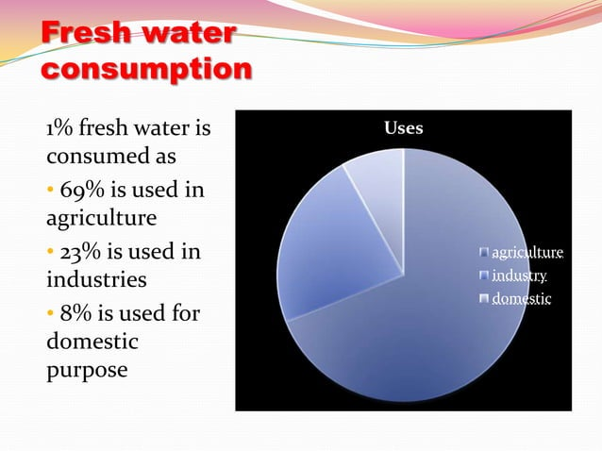

Slide 4
Guidelines for drinking water quality recommended by WHO relate to following variables
Acceptability aspects
Microbiological aspects
Chemical aspects
Radiological aspects

Slide 5
A. Acceptability aspects
Physical parameters
Turbidity
4NTU
Colour
15TCU
Inorganic constituents
Chlorides-600mg\litre
Hardness -100-300 mg\litre
Ammonia-0.2 mg\litre
PH-6.5 to 8.5
Hydrogen sulphide-0.05 to 0.1mg\litre
Iron-0.3 mg \litre
Sodium -200mg\litre
Sulphate-250 mg\litre
Total dissolved solids -600 mg\litre
Zinc-4 mg\litre
Manganese-0.1 mg \litre
Dissolved oxygen [DO]
Copper -1mg\litre
Aluminium -0.2mg\litre
Temperature
Taste and odour

Slide 6
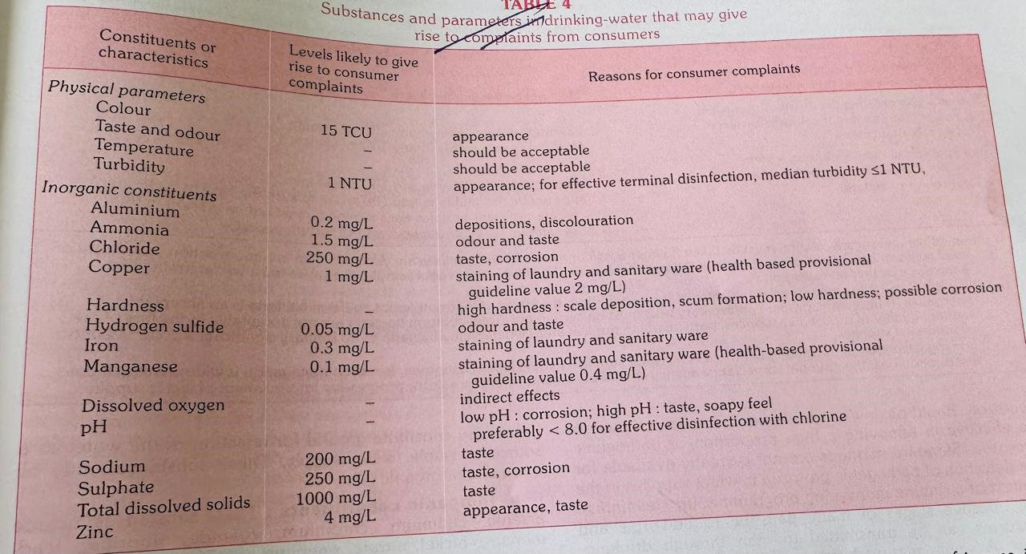

Slide 7
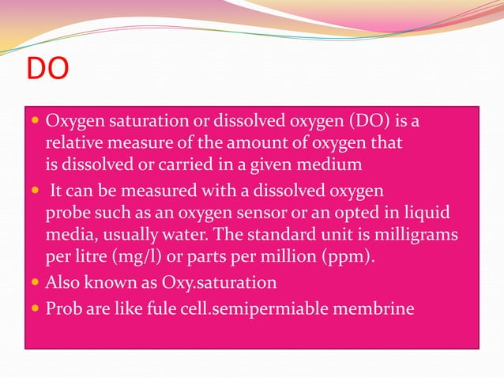

Slide 8
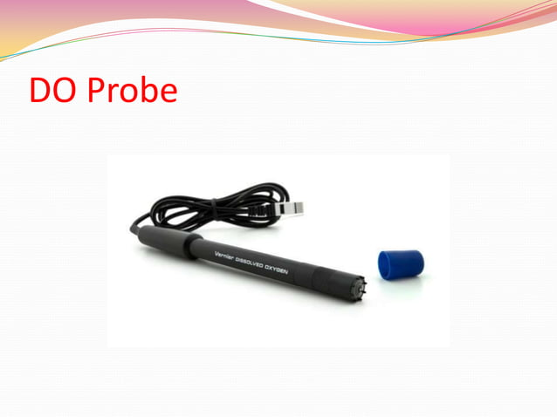

Slide 9
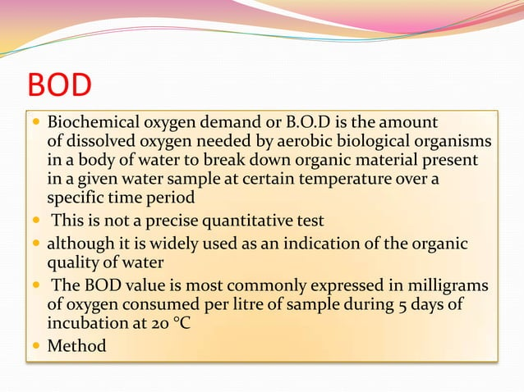

Slide 10
B.Mcrobiological aspects
Bacteriological
Coliform organisms
Faecal streptococci
Biological
Virological
Cl.Perfringens

Slide 11
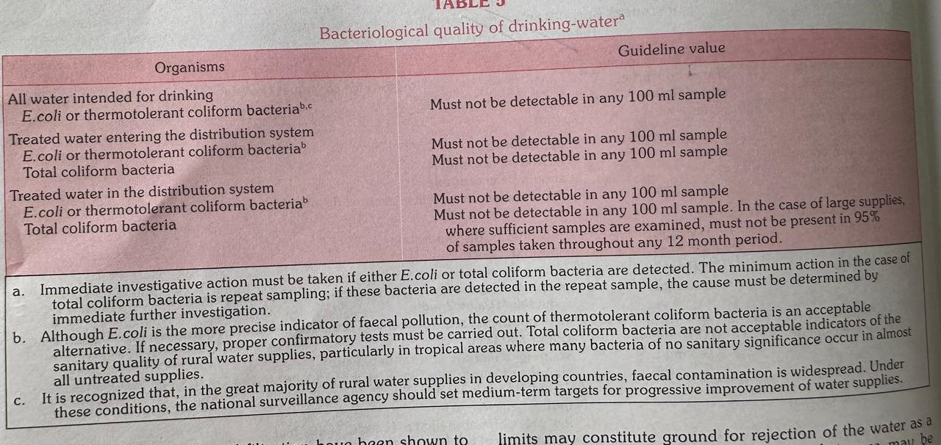

Slide 12
Virological aspects
It is recommended that, to be acceptable, drinking water should be free from any viruses infections for man.
Disinfection with 0.5 mg \L of free chlorine residual after contact period of at least 30 minutes at a Ph of 8.0 is sufficient to inactivate virus.

Slide 13
Biological aspects
Protozoa- Entamoeba histolytica, Giardia spp.and rarely, Balantidium coli.
Helminths- Dracunculus medinensis and human schistosomes
Free living organisms-fungi, algae

Slide 14
C. Chemical aspects
Inorganic constituents
Organic constituents

Slide 15
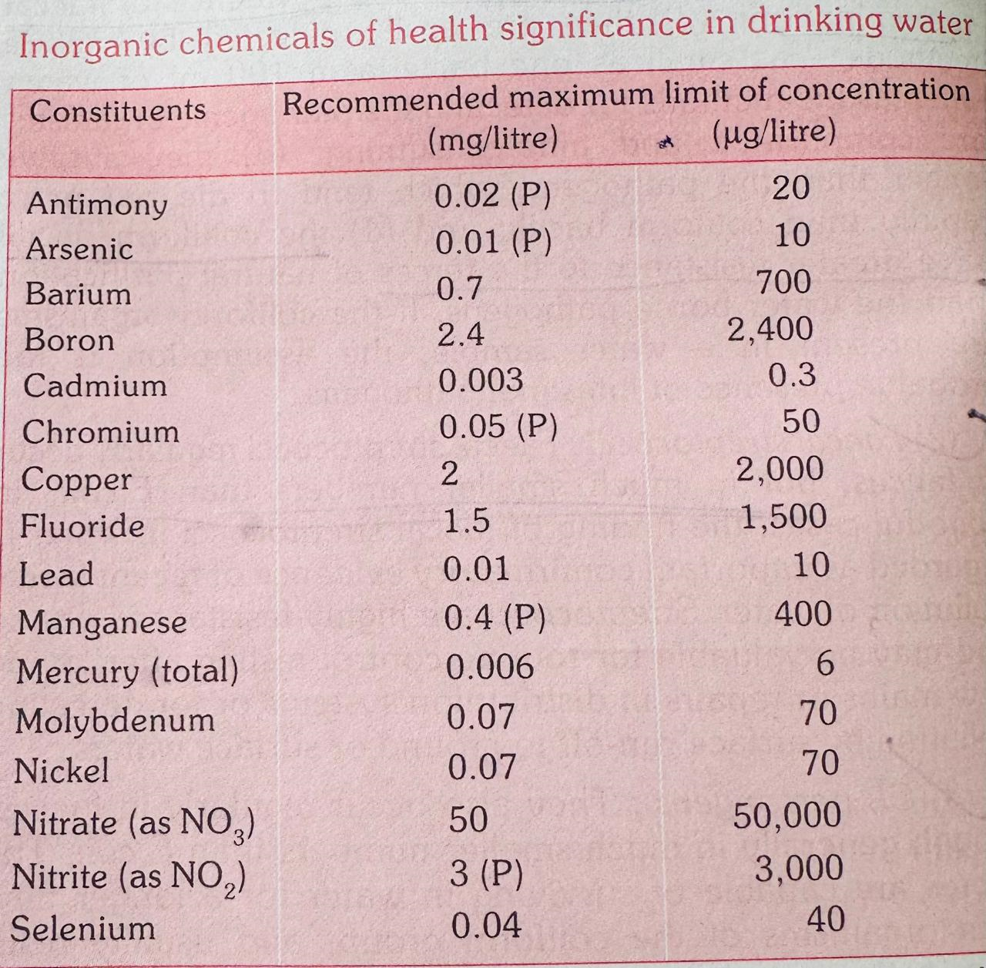

Slide 16
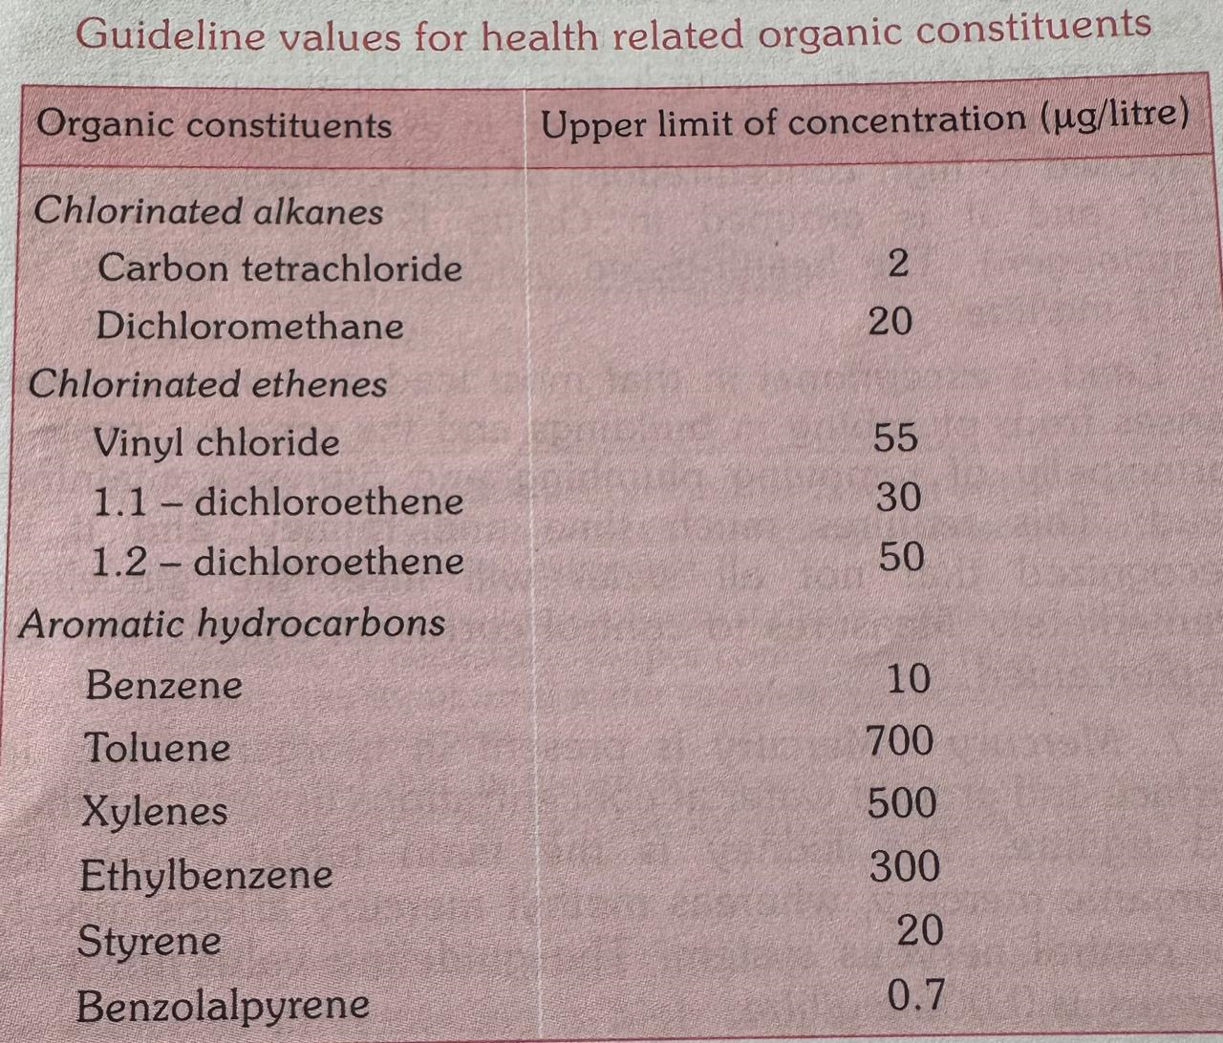

Slide 17
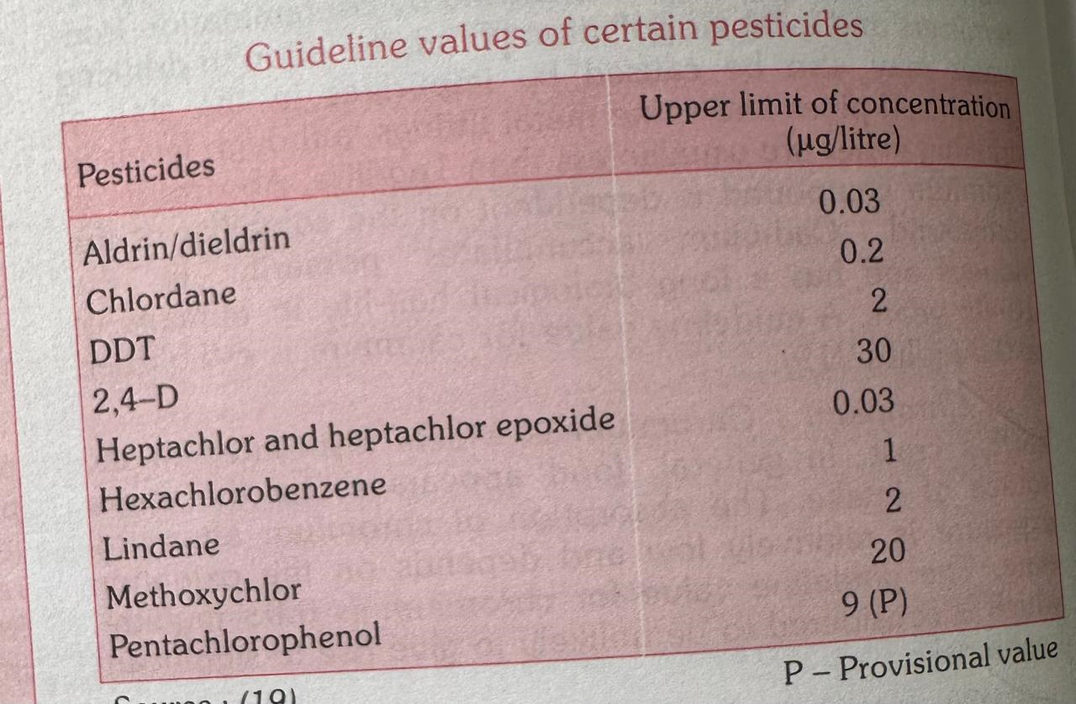

Slide 18
D. Radiological Aspects
The effects of radiation exposure are called somatic.
Radioactivity in drinking water should not only be kept within limits, it should also,within those limits, be kept as low as is reasonably possible.
The proposed guidelines values are
gross alpha activity 0.5 Bq\L
gross beta activity 1.0 Bq\L

Slide 19
Thank You

