Slide 1
VOLUNTARY HEALTH AGENCIES

Slide 2

VOLUNTARY HEALTH AGENCIES

Slide 3

INTRODUCTION
2
An organization that is administered by an autonomous board which hold meeting, collects funds for its support chiefly from private sources & expends money, whether with or without paid workers, in conducting a programme directed primarily to furthering the public health by providing health services or health education, or by advancing research or legislation for health, or by a combination of these activities’’

Slide 4
Non-political, non-profit based, independent organization having an autonomous body consisting of a group of members, which holds meeting periodically, collects funds from private sources, philanthropists, government , etc.., spend money for one of following intentions-
Religious or missionary organization-promotion of a religion
Welfare organization-social relief and welfare
Professional body-Protection of interests of profession-IMA
Voluntary health agency-provision of health services

Slide 5
4
The United States of America - 20,000 voluntary agencies functioning
Voluntary health agencies – motor trucks
Official agencies – railway truck lines

Slide 6

HISTORY
5
Health care in India has a long tradition of voluntarism.
For centuries, traditional healers have taken care of the health needs of their own community.
Then, the institutionalized voluntarism evolved during the colonial era.

Slide 7
Christian missionaries started work
6
Verrier Elwin, keen to civilize primitive tribes
Built school, health centers, hostels, churches.
Gandhian Era- active in tribal areas
Emphasis on khadi, village industries, land co- operatives, health and education.

Slide 8
ADVANTAGES:
7
Better accepted
Community participation is better in programs
Programs are flexible and not rigid
Not handicapped by bureaucratism and red tapism
Work at fast pace and low operative costs
Provide opportunity to individuals interested in social work

Slide 9
LIMITATIONS:
8
Programs are related to non-critical health problems
Services not always targeted to those who are in greatest need or area which needs them most
Programs often do not run according to modern principles and techniques of management

Slide 10
FUNCTIONS :
9
1.Supplementing the work of government agencies
2.Pioneering- ways & means of doing new things
3.Education
Demonstration
Guarding the work of government agencies 6.Advancing health legislation

Slide 11


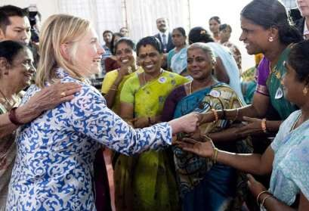
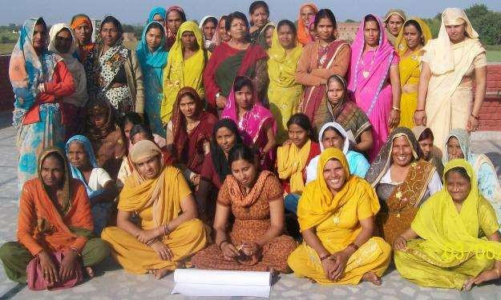
NON GOVERNMENTAL ORGANIZATIONS (NGOS) IN INDIA

Slide 12
ORGANIZATIONS
10
FOR COMMUNICABLE DISEASES
Tuberculosis Association of India(TAI)
Hind Kusht Nivaran Sangh(HKNS)

Slide 13
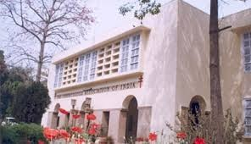

TUBERCULOSIS ASSOCIATION OF INDIA(TAI)
11
Established on Feb 23, 1939
Incorporating the King Emperor's Anti- Tuberculosis Fund and King George Thanks- giving (Anti-Tuberculosis) Fund.
Headquarters – New Delhi, branches in all states

Slide 14
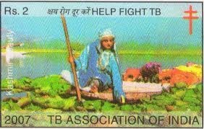
12
ACTIVITIES:-
  Organizing a T.B. Seal campaign every year to raise funds
  Training of doctors & health workers in the control of TB
  Publishes periodicals related to TB
Conducts annual conferences, encouraging research on TB

Slide 15
13
FOLLOWING INSTITUTIONS ARE UNDER THE MANAGEMENT:
The New Delhi Tuberculosis Centre
The Lady Linlithgow Sanatorium at Kasauli
The King Edward v11 Sanatorium at Dharampur
Tuberculosis Hospital at Mehrauli

Slide 16

HIND KUSHT NIVARAN SANGH
14
Found in 19 Aug 1949
Headquarters - New Delhi, branches all over India
Precursor – Indian Council of the British Empire Leprosy Relief Association (B.E.L.R.A)

Slide 17
15
ACTIVITIES :-
  Financial assistance to leprosy homes & clinics
  Health education through publications & posters
  training to medical workers & physiotherapists
  Conducts research & field investigations
  Holds periodic leprosy conferences
  Quarterly journal “ Leprosy in India”

Slide 18

16
FOR NON-COMMUNICABLE DISEASES
ALL INDIA BLIND RELIEF SOCIETY
Established – 1946
Main function – relief of blind
Works in co-ordination with different institutions working for the blind

Slide 19
ACTIVITIES :
17
-Eye camps for identification of preventable blindness
Cataract surgery camps(recently with IOL implantation)
Free spectacles for refractory correction

Slide 20
18
FOR RCH
1.Indian Council for Child Welfare
2.Central Social Welfare Board
3.The Kasturba Memorial Fund
4.All India Women’s Conference
5.Child Relief & You (CRY)

Slide 21


INDIAN COUNCIL FOR CHILD WELFARE
19
Established -1952, single largest agency, promoting development services for child.
Network all over India
Focus- Child welfare & development
Promote enactment of legislation & reform Programmes:-

Slide 22
20
Advocating Children's Rights
Creches for children of working and ailing mothers
Training programmes for child care workers
Sponsorship for School Education of under- privileged children
Projects for Street and Working children
Scrutiny of Adoption Cases
Rehabilitation of Abandoned Children

Slide 23
21
Institutional and day care services for differently abled children
Programmes for children in difficult circumstances
Programmes with special focus on the girl child
Education Centres and Support Services
Honouring Children for Bravery
Honouring Child Artists
National Integration Camps/ Adventure Camps

Slide 24

CENTRAL SOCIAL WELFARE BOARD
22
Established – august 1953
The founder Chairperson of the Board, Dr. Durgabai Deshmukh
Autonomous body under Ministry of education

Slide 25
23
FUNCTIONS :-
Surveying the needs & requirements of voluntary welfare organizations
  Promoting & setting up of social welfare
  Financial aid to deserving organizations
“ Family & Child Welfare Services ”- initiated 1968

Slide 26
24
Short stay home programme-started in 1969 to provide temporary shelter to women and girls,
Who are forced into prostitution
Family tension or discord made to leave homes due to marital disputes
Sexually assaulted
Scheme of industrial co-operatives –lower middle class women

Slide 27
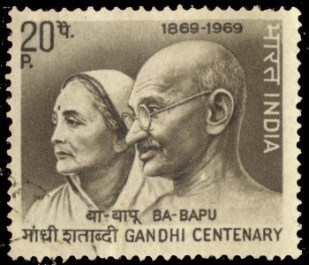

THE KASTURBA MEMORIAL FUND
25
Created 1945
Commemoration of Smt. Kasturba Gandhi
Activities- improving the lot of women(rural) through gram-sevikas
Various other welfare projects

Slide 28

ALL INDIA WOMEN’S CONFERENCE
26
Only women’s welfare organization
Established – 1926, Margaret Elizabeth
Dedicated for upliftment & betterment of women & children
Running – MCH clinics
adult education centre(female literacy) milk centres
family planning clinics

Slide 29

CHILD RELIEF & YOU (CRY)
27
Founded – 1981 Rippan Kapur
Street children, bonded children, children of CSW, children of remand homes
Helps in schooling as well as sports
Raises funds through – greeting cards

Slide 30

28
FOR RESCUE & RELIEF
INDIAN RED CROSS SOCIETY
Established - 1920, commendable in alleviation of human suffering
Young Swiss businessman, Jean Henry Dunant
During the first world war in 1914, India had no organization for relief services to the affected soldiers
Over 400 branches throughout country

Slide 31
29
Creation of better society where vulnerable lead life of social & economic security & dignity
ACTIVITIES :-
1.Relief Work
2.Milk & medical Supplies 3.Armed forces
4.Maternal & child welfare societies 5.Family planning
  6.Blood bank & first aid- St John Ambulance Association

Slide 32

30
FOR FAMILY WELFARE PLANNING
FAMILY PLANNING ASSOCIATION OF INDIA
Founded in Bombay 1949
Devoted to promoting knowledge family planning as basic human right & population policies
Voluntary commitment to advocate for SRH, Rights and choices.

Slide 33
31
HEAD QUARTERS-Mumbai
38 branches,4 project areas,30 integrated rural project
FPAI- programme on information, education, motivation. MCH, training & research
ACTIVITIES – education of school college students & youth workers

Slide 34
32
Help couples to plan spacing & number of children
FPAI-Organizes conferences, seminars, workshop
Set up Family Life And Marriage Counselling
Address reproductive & sexual concerns
STD/AIDS prevention

Slide 35
33
Sex education, counselling, research, training/therapy (SECRT) centres
Specialised services on family life, marriage & sex counselling . Prevention and counselling of STI/AIDS
Sexual health programme for youth, parents, educators, disabled & mentally handicapped
Training courses & workshop on human sexuality

Slide 36
34
Sexual Health- integrated into FPAI
FPAI- co-operates with government in formulation of policies & programmes.
In 1991,FPAI created network of NGOs for Development Environment & Population called INENGODEP, a fast expanding, seeks mutually reinforcing strategies to improve quality of life.

Slide 37
35
FPAI founder member of International Planned Parenthood Federation, London- 150 member
Funding sources are government grants, donations, international funds.

Slide 38

36
FOR RURAL HEALTH
BHARAT SEVAK SAMAJ
Is a non official non political organization
Set up in 1952
Helps people to achieve health by the own efforts & actions
Main activity- improvement of sanitation in villages

Slide 39

37
FOR COMMUNITY DEVELOPMENT
VOLUNTARY HEALTH ASSOCIATION OF INDIA
Is non-profit, formed 1970
Federation of 24 state voluntary health association, linking 4000 health institution & grass root community health programs
Objectives-make health a reality by promoting community health, social justice and human rights related to health care in India.

Slide 40
38
Works for women health & development
Sex determination female foeticide & gender violence
Adolescent health major concern
Relief and rehabilitation in areas affected by disasters and calamities

Slide 41
39
FOR PROFESSIONAL ACTIVITIES
Indian Medical Association
Indian Dental Association
Trained Nurses Association of India

Slide 42

INDIAN MEDICAL ASSOCIATION
40
The Association was started in 1928 on the occasion of the 5th all India Medical Conference at Calcutta with the objectives:
  Promotion and Advancement of Medical and allied sciences in all their different branches.
  The improvement of public Health and Medical Education in India.
  The maintenance of honour and dignity of medical profession.

Slide 43
41
HEADQUARTERS – New Delhi
1650branches with a total membership of 2,15,000 throughout the country.
Publishes a Scientific Journal called ‘Journal of the Indian Medical Association’
“Your Health” in english and “Aap Ka Swasthya” in hindi are published regularly and cater to health education needs of the lay public.

Slide 44
42
Relief camps during natural calamities
health check up camps blood donation camps
screening camps

Slide 45
INDIAN DENTAL ASSOCIATION
43
Setting up quality standards in professional education in dental profession
Dental check ups, awareness programmes are conducted

Slide 46
TRAINED NURSES ASSOCIATION OF INDIA
44
Formed – 1952
OBJECTIVES :-
  Nursing care of children
  Nursing care of elderly
  Blood donation camps
  First aid facility
  Vocational rehabilitation
  Relief work with Red Cross, IMA

Slide 47
INTERNATIONAL VOLUNTARY HEALTH ORGANISATION
45
ROTARY INTERNATIONAL- is a service club, formed in 1905
Head quarters in Illinois & Paul P.Harris was the founder
Brings together business & professional bodies for humanitarian service

Slide 48
46
Motto is ‘SERVICE ABOVE ALL’’
Current global project is POLIO PLUS
Other programme- Rotary Youth Exchange & scholarship, centres for international studies etc.

Slide 49

LIONS CLUB INTERNATIONAL
47
Formed in 1917.
Motto ‘ WE SERVE’’
Head quarters in USA
Major initiatives are
Sight first programme
Childhood blindness project

Slide 50
48
Lions eye health program
River blindness/ trachoma
Sight for kids
Vision screening
DISABILITY PROGRAMMS
Diabetes prevention
Habitat for humanity partnership

Slide 51
49
LIST OF VOLUNTARY HEALTH AGENCIES IN BELGAUM
Mahatma Gandhi Grameen Abhivrudhi mattu Samaj Parivartana Trust – rural development
United Social Welfare Association - Swadhar home Crèches, Woman's Hostel , Solid waste Management
Mahesh Foundation – youth affected by HIV/AIDS
Spoorthi Association – visually impaired

Slide 52

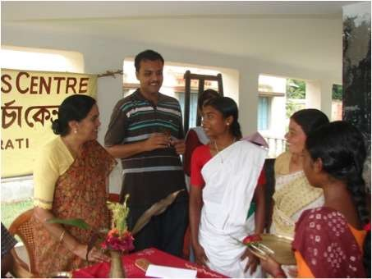



INTRODUCTION TO NGO
A Non Governmental Organization (NGO) is any non-profit, voluntary citizens' group which is legally constituted, organized and operated on a local, national or international level.
They are Task-oriented and driven by people with a common interest
Some are organized around specific issues:
Principles
Human rights
Environment
Health
Poverty eradication
Rehabilitation
Employment
Altruism
Voluntarism

Slide 53











NGOs
Classification
By the level of
Orientation
By the level of
Operation
Community Based Organizations
Charitable
Orientation
Service Orientation
City Wide Organizations
Participatory Orientation
National NGOs
Empowering Orientation
International NGOs

