Slide 1
Tetanus
Epidemiology and Prevention Control

Slide 2
TETANUS
Introduction
Causative agent
Epidemiology
Transmission, host factors, route of entry
Types of tetanus
Prevention – active & passive immunization

Slide 3
Introduction
Tetanos – a Greek word – to stretch
First described by Hippocrates & Susruta
Tetanus an neurological disease characterized by an acute onset of hypertonia, painful muscular contractions (usually of the muscles of the jaw and neck), and generalized muscle spasms without other apparent medical causes.
Only vaccine preventable disease that is infectious but not contagious

Slide 4
Epidemiology
Tetanus is an international health problem, as spores are ubiquitous. The disease occurs almost exclusively in persons who are unvaccinated or inadequately immunized.
Entirely preventable disease by immunization
Tetanus occurs worldwide but is more common in hot, damp climates with soil rich in organic matter.
More common in developing and under developing countries.
More prevalent in industrial establishment, where agricultural workers are employed.
Tetanus neonatorum is common due to lack of MCH care.

Slide 5
India-:
Tetanus is important endemic infection in India.
Causative factors
  Hand washing
  Delivery practices
  Traditional birth customs
  Interest in immunization
Since 1983 Nationwide EPI recommended 2 doses of TT for pregnant women during each pregnancy ( or one booster if <3 yrs have passed since the prev. pregnancy)
Prior to the national immunization programme estimated 3.5 lakh children were dying annually. 70,000 cases continue to occur largely in the states – Orissa, Bihar, MP, Assam, Rajasthan, UP, where TT immunization coverage is less than national coverage(70%) .
In addition to Immunization clean delivery centers at hospitals and a cadre of trained ANMs and other trained birth attendants have contributed to reducing the burden of NT in INDIA.

Slide 6
Depending on NT incidence rates, immunization coverage levels, proportion of clean deliveries by trained personals, Districts are divided into-:
NT High risk – Rate > 1/1000 live births or
TT2 coverage < 70% or attended deliveries < 50%
NT Control – Rate < 1/1000 live births or
TT2 coverage > 70% or attended deliveries > 50%
NT Elimination – Rate < 0.1/1000 live births or
TT2 coverage > 90% or attended deliveries > 75%

Slide 7
Agent Factors
Caused by CLOSTRIDIUM TETANI
    Anaerobic
    Motile
    Gram positive bacilli
    Oval, colorless, terminal spores – tennis racket or drumstick shape.
Two forms
  Vegetative form – in herbivores intestine
  Spore form – in dust, soil (every where in environment)

Slide 8
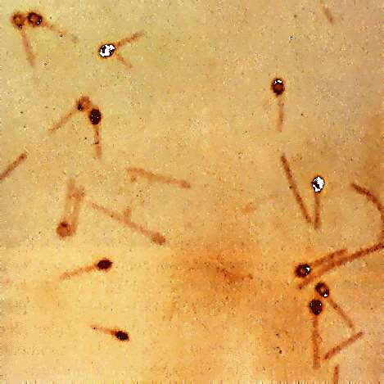
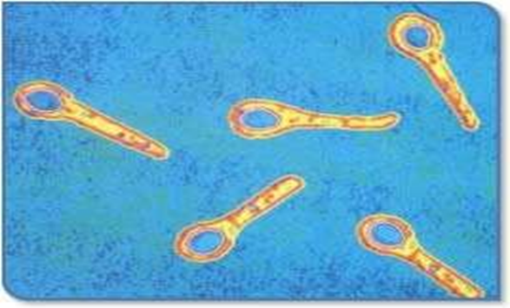
Clostridium tetani Gram Stain
NOTE:
Round terminal spores give cells a
“drumstick” or “tennis racket” appearance.

Slide 9
Susceptibility:
  Spores
    extremely stable : resistant to heat and chemical disinfectants
    Killed by autoclaving and Ethylene oxide sterilization
    Iodine(1% aqueous soon) and H₂O₂ (10 volume) kills spores within few hours.
  Vegetative form
    Easily killed by heat, chemical disinfectant
    Killed by B lactams and other anitibiotics

Slide 10
Reservoir :
    Vegetative form – Herbivorous animals
    Spores – Soil
    No human Reservoir
Source of infection:
    Soil – spores in soil infect human
    Cases of tetanus are not infective
Tetanus is caused by toxins, not by whole bacteria

Slide 11
Factor affecting germination of spores:
Anaerobic conditions
  Dirty wounds
  Infected wounds (Staphylococci/streptococci)
High iron content
  Hemolysis
  Lacerated wound
Warmth
  Inflammation with infection
  Dirty dressings
Toxin:
  Tetanolysis – cause hemolysis
  Tetanospasmin – attach to anterior horn cells of spinal cord

Slide 12
Astounding lethal toxicity, exceeded only by Botulinum Toxin.
Lethal Dose-: 0.1mg for a 70 kg-man
The toxin acts on 4 areas of nervous system-:
  Motor End Plates in Skeletal System
  Spinal Cord
  Brain
  Sympathetic System
Principal Action is to block inhibition of spinal reflexes.
4. Period of Communicability-: Upto 30 years

Slide 13
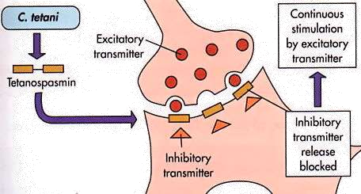
Mechanism of Action of Tetanus Toxin

Slide 14
Host Factors
Age : It is the disease of active age (5-40 years), New born baby, female during delivery or abortion
Sex : Higher incidence in males than females
Occupation : Agricultural workers are at higher risk
Residence: Incidence of tetanus in urban areas is much lower than in rural areas
Immunity :
No role of Herd immunity
Infection doesn't give protection

Slide 15
Environmental & Social Factors-:
Tetanus is a positive environmental hazard.
Depends upon man’s physical and ecological surroundings.
Factors Contributing-:
-Unhygienic custom habits
-Unhygienic delivery practices
-Ignorance of infection &
-Lack of primary health care services.

Slide 16
Routes Of Infections/Mode of Transmission-
-Trivial pin prick, Skin Abrasion
-Puncture wounds,Burns,Human Bites
Animal bites and stings
Unsterile Surgery,IUD
Bowel Surgery & Dental Extraction
Injections, Unsterile division of Umbilical Cord
-Compound Fractures,Otitis Media
-Chronic skin ulcers, Eye Infection
-Gangrenous Limb
All wound can predispose to tetanus
Thus tetanus is an wound infection “ NO WOUND, NO TETANUS”

Slide 17
Incubation Period-:
Usually incubation period ranges from 3-21 days but can range from the day of injury to several months.
Average incubation period is 7 - 10 days.
Depends on character, location, and extent of wound.

Slide 18
Incubation Period-:
Usually incubation period ranges from 3-21 days but can range from the day of injury to several months.
Average incubation period is 7 - 10 days.
Depends on character, location, and extent of wound.

Slide 19
Clinical Features

Slide 20
Prodromal symptom
  Fever (sudden onset, increase day by day)
      Not present in case of neonatal tetanus
  Headache
  Anorexia and malaise
Symptoms due to Muscle contraction
  Trismus (Lock Jaw)
  Risus sardonicus (all facial muscles spasm)
  Neck rigidity
  Opisthotonus (bow like body, extension of vertebrae
Symptoms due to excessive sensitivity of muscles
  Painful, severe, exhaustive spasm with fever
  Only partial relaxation
  Full consciousness during spasm
  Aspiration pneumonia
  Vertebrae fracture

Slide 21
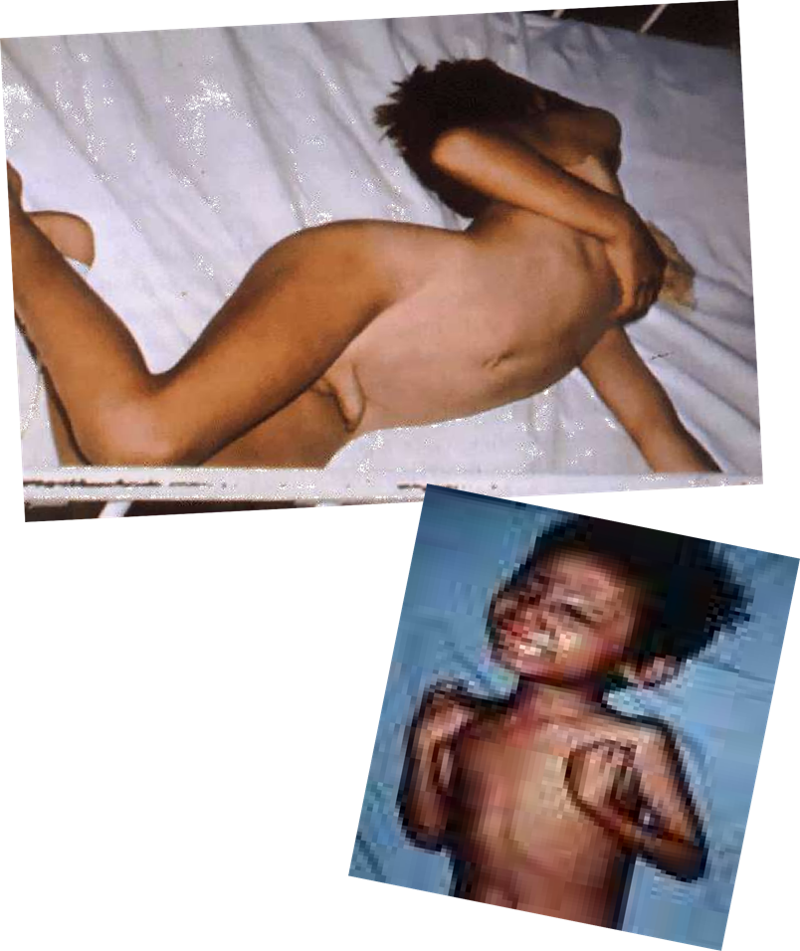


Slide 22
Types of tetanus
According to clinical severity
Localized
Cephalic
Generalized
According to cause of infection
Traumatic
Puerperal
Otogenic
Idiopathic
Tetanus Neonatorum

Slide 23
Diagnosis
Based on History and Clinical Sign & Symptoms
Adults – Generalized muscle spasm with fever along with h/o trauma, ear infection, delivery/abortion
+ dirty wound + no h/o tetanus immunization
According to WHO, Any Neonate
During first 2 days of life - Normal ability to suck and cry
Between 3 and 28 days – Difficulty in sucking normally and becomes stiff or has spasms
(i.e. jerking of the muscles)
Considered as a case of NEONATAL TETANUS

Slide 24
Laboratory Diagnosis And Treatment
Spatula Test – Highly Specific
Blood Analysis and Bacterial isolation – Not Conclusive.
Diagnosis is mainly based on History and Clinical Sign & Symptoms
ELISA – IgM against tetanus toxin

Slide 25
Treatment
Mainly Supportive therapy [Maintain ABC & catheterization]
Symptomatic Therapy
  Sedatives
  Anticonvulsive
Antibiotics – B lactames
Passive Immunization [Human Tetanus Immunoglobulin (HTIG)]
Wound management
Isolation ward
High nursing care
Active immunization

Slide 26
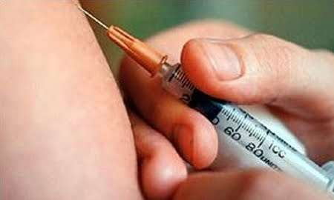
Prevention
Tetanus is completely preventable by active tetanus immunization.
Immunization is thought to provide protection for 10 years.
Active Immunization
Combined
Monovalent
Passive immunization

Slide 27
Tetanus prone wound
A wound sustained more than 6 hr before surgical treatment.
compound fractures
deep penetrating wounds
wounds containing foreign bodies (especially wood splinters)
wounds complicated by pyogenic infections
wounds with extensive tissue damage (e.g. contusions or burns)
any wound obviously contaminated with soil, dust
Re-implantation of an avulsed tooth is also a tetanus- prone event

Slide 28
1.Active-:
A. Combined (Pre exposure prophylaxis)
- Offered routinely in combination with diphtheria vaccine and Pertussis vaccine as DPT vaccine / dT vaccine / TdaP vaccine.
1st dose 2nd dose 3rd dose 1st booster
2nd booster
3rd booster -
4th booster –
6th week (DPT)
10th week (DPT)
14th week (DPT)
18th month (DPT)
5th completed year (DPT)
10th year (dT) 16th years (dT)

Slide 29
B.Monovalent vaccines (For post exposure prophylaxis)
Purified tetanus Toxoid ( adsorbed ) supplanted the plain Toxoid – higher & long lasting immunity response
Primary course of immunization – 3 doses
Each 0.5 ml , injected into arm given at intervals of 0,1,7 months
The longer the interval b/w two doses, better is the immune response
Booster doses : After Every 10 yrs
Stored between +2 to +8°c and must not be allowed to freeze at any time.

Slide 30
2.Passive immunization
Temporary protection – human tetanus immunoglobulin /ATS
Human Tetanus Hyper-immunoglobulin :
250-500 IU
Produces protective antibody level for at-least 4-6 weeks.
Does not cause serum sickness
Longer passive protection compared to horse ATS( 30 days / 7 -10 days )
Produced at Serum institute Pune.

Slide 31
ATS ( EQUINE ) :
If Human ATS not available
1500 IU s/c after sensitivity testing
Protection-: 7 – 10 days
High risk of serum sickness
It stimulates formation of antibodies to it , hence a person who has once received ATS tends to rapidly eliminate subsequent doses.

Slide 32
Active & Passive Immunization
(post exposure prophylaxis)
In non immunized persons
1500 IU of ATS / 250-500 units of Human Ig in one arm
+
0.5 ml of adsorbed Tetanus Toxoid (PTAP or APT) into other arm
After 6 wks later – 2nd dose of Tetanus Toxoid
6 months after 2nd dose - 3rd dose of Tetanus
Toxoid Again at every 5 yr / 10 yrs.

Slide 33
Prevention of neonatal tetanus
Clean delivery practices alone is effective.(about 90%)
6 cleans : clean birth canal, clean hands, clean delivery surface, clean cut, clean tie, clean cord care
Tetanus toxoid protects both mother & child
Unimmunized pregnant women : 2 doses tetanus toxoid (16th-36th week)
  1st dose as early as possible during pregnancy
  2nd dose – at least a month later / 3 wks before delivery
Immunized pregnant women : a booster is sufficient
No need of booster in every consecutive pregnancy.
To newborn of unimmunized mother, 750 IU (HTIG) within 6 hours of birth.

Slide 34
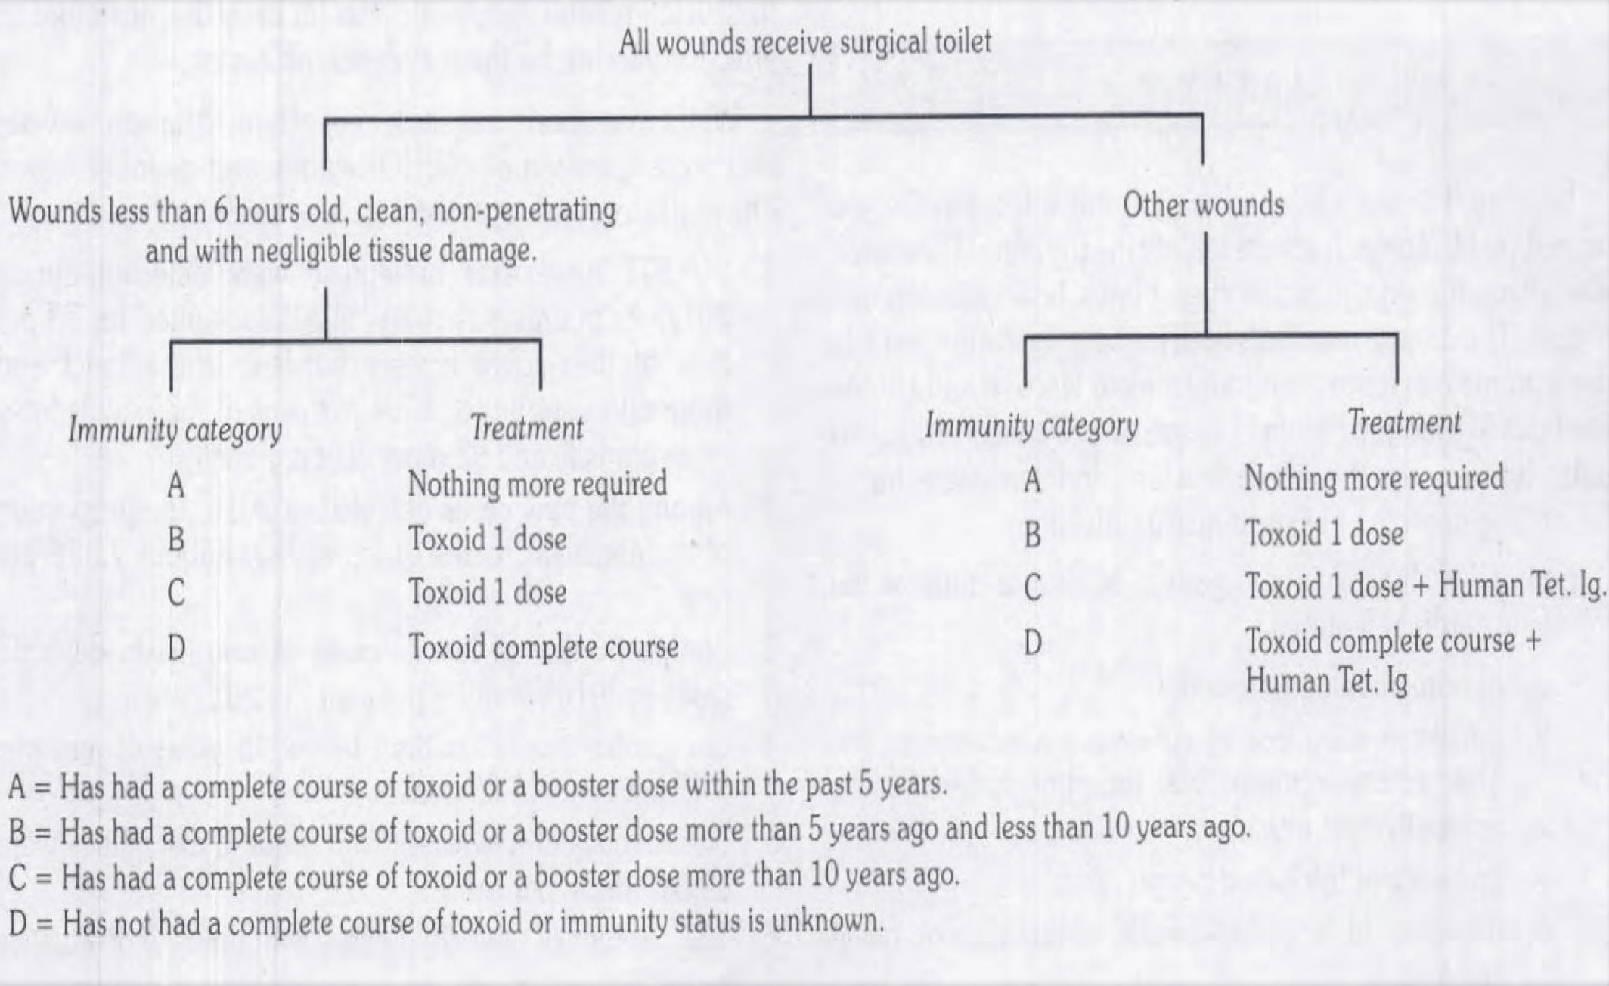
Post-exposure prophylaxis:

Slide 35


