Slide 1
SUSTAINABLE DEVELOPMENT GOALS
Dr. Rashmi Katyal
Professor
Department of Community Medicine
RMCH, Bareilly

Slide 2
SUSTAINABLE DEVELOPMENT GOALS

Slide 3
SUSTAINABLE DEVELOPMENT GOALS
On 25th September 2015, the UN General Assembly adopted a new development agenda for the period 2016 - 2030 that includes a set of sustainable development goals (SDGs)
There are 17 SDGs with 169 associated targets that are supported by three pillars of sustainability.

Slide 4
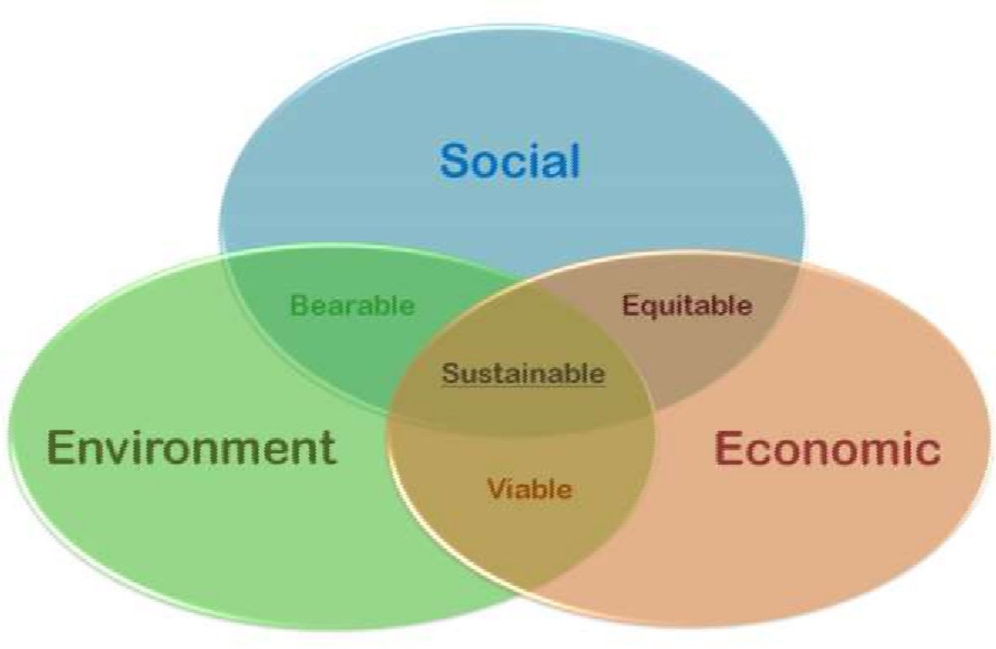

WHAT IS SUSTAINABLE
GOAL DEVELOPMENT

Slide 5

SUSTAINABLE DEVELOPMENT GOALS

Slide 6
17 SDGs
No poverty
Zero hunger
Good health and well being
Quality education
Gender equality
Clean water and sanitation
Affordable clean energy
Decent work and economic growth
Industry innovation and infrastructure

Slide 7
17 SDGs Cont…
10. Reduced inequality
11. Sustainable cities and communities
12. Responsible consumption and production
13. Climate action
14. Life below water
15. Life on land
16. Peace and justice strong institutions
17. Partnerships to achieve the goals

Slide 8

MILLENNIUM
DEVELOPMENT
GOALS
VS
SUSTAINABLE DEVELOPMENT GOALS

Slide 9
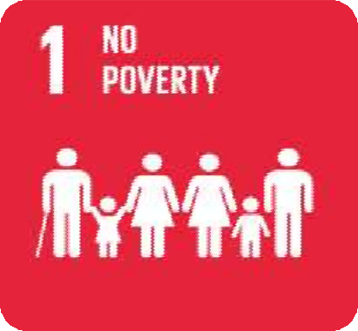

GOAL 1:NO POVERTY
TARGETS:
By 2030, eradicate extreme poverty for all people everywhere, currently
measured as people living on less than $1.25 a day
By 2030, ensure that all men and women, in particular the poor and the vulnerable, have equal rights to economic resources, as well as access to basic services, ownership and control over land and other forms of property, inheritance, natural resources, appropriate new technology and financial services

Slide 10
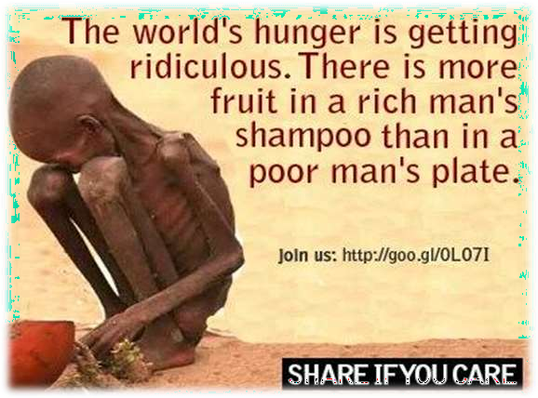

Slide 11

GOAL2:END HUNGER, ACHIEVE FOOD SECURITY AND IMPROVED NUTRITION AND PROMOTE SUSTAINABLE AGRICULTURE
TARGETS:
By 2030, end hunger and ensure access by all people, in particular the poor and people in vulnerable situations, including infants, to safe, nutritious and sufficient food all year round
By 2030, end all forms of malnutrition, including achieving, by 2025, the internationally agreed targets on stunting and wasting in children under 5 years of age, and address the nutritional needs of adolescent girls, pregnant and lactating women and older persons

Slide 12


GOAL 3:ENSURE HEALTHY LIVES AND PROMOTE WELL-BEING FOR ALL AT ALL AGES.
TARGETS:
By 2030, reduce the global maternal mortality ratio to less than 70 per 100,000 live births.
By 2030, end preventable deaths of newborns and children under 5 years
of age, with all countries aiming to reduce neonatal mortality to at least as low as 12 per 1,000 live births and under-5 mortality to at least as low as 25 per 1,000 live births
By 2030, end the epidemics of AIDS, tuberculosis, malaria and neglected tropical diseases and combat hepatitis, water-borne diseases and other communicable diseases
By 2030, reduce by one third premature mortality from non- communicable diseases through prevention and treatment and promote mental health and well-being

Slide 13

Strengthen the prevention and treatment of substance abuse, including narcotic drug abuse and harmful use of alcohol
By 2020, halve the number of global deaths and injuries from road traffic accidents
By 2030, ensure universal access to sexual and reproductive health-care services, including for family planning.

Slide 14


GOAL4: Ensure inclusive and quality education for all and promote lifelong learning
TARGETS:
By 2030, ensure that all girls and boys have access to quality early childhood development, care and preprimary education so that they are ready for primary education
By 2030, eliminate gender disparities in education and ensure equal access to all levels of education and vocational training for the vulnerable, including persons with disabilities, indigenous peoples and children in vulnerable situations

Slide 15

GOAL5: ACHIEVE GENDER EQUALITY AND EMPOWER ALL WOMEN AND GIRLS
TARGETS:
End all forms of discrimination against all women and girls everywhere
Eliminate all forms of violence against all women and girls in the public and private spheres, including trafficking and sexual and other types of exploitation
Eliminate all harmful practices, such as child, early and forced marriage and female genital mutilation
Ensure universal access to sexual and reproductive health and
reproductive rights

Slide 16


GOAL6:ENSURE ACCESS TO WATER AND SANITATION FOR ALL
TARGET:
By 2030, achieve universal and equitable access to safe and affordable drinking water for all
By 2030, improve water quality by reducing pollution, eliminating dumping and minimizing release of hazardous chemicals and materials, halving the proportion of untreated wastewater and substantially increasing recycling and safe reuse globally

Slide 17


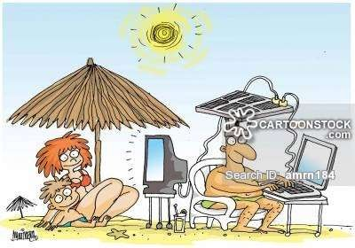
ENSURE ACCESS TO AFFORDABLE, RELIABLE, SUSTAINABLE AND MODERN ENERGY FOR ALL
TARGET
By 2030, ensure universal access to affordable, reliable and modern energy services

Slide 18
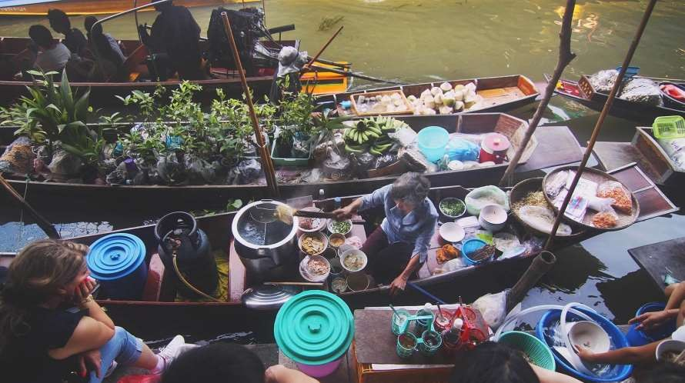
GOAL8: PROMOTE INCLUSIVE AND SUSTAINABLE ECONOMIC GROWTH, EMPLOYMENT AND DECENT WORK FOR ALL

Slide 19

9: BUILD RESILIENT INFRASTRUCTURE, PROMOTE SUSTAINABLE INDUSTRIALIZATION AND FOSTER INNOVATION

Slide 20
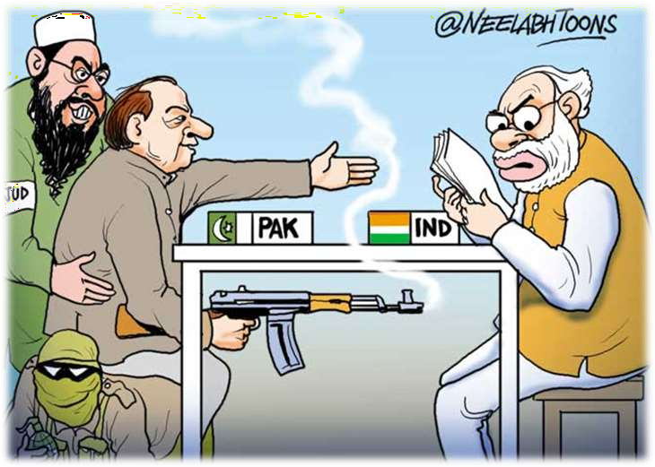
10: REDUCE INEQUALITY WITHIN AND AMONG COUNTRIES

Slide 21


GOAL 11: MAKE CITIES INCLUSIVE, SAFE, RESILIENT AND SUSTAINABLE
By 2030, ensure access for all to adequate, safe and affordable housing and basic services and upgrade slums.
By 2030, significantly reduce the number of deaths and the number of people affected and substantially decrease the direct economic losses relative to global gross domestic product caused by disasters, including water-related disasters, with a focus on protecting the poor and people in vulnerable situations

Slide 22
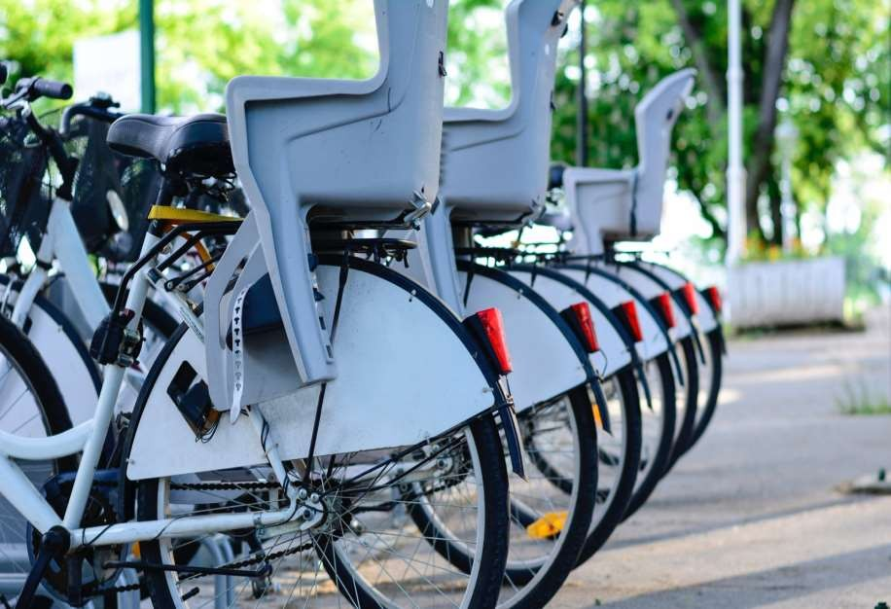
12: ENSURE SUSTAINABLE CONSUMPTION AND PRODUCTION PATTERNS

Slide 23


Slide 24

13: TAKE URGENT ACTION TO COMBAT CLIMATE CHANGE AND ITS IMPACTS*

Slide 25

GOAL14:CONSERVE AND SUSTAINABLY USE THE OCEANS, SEAS AND MARINE RESOURCES
By 2025, prevent and significantly reduce marine pollution of all kinds, in particular from land-based activities, including marine debris and nutrient pollution

Slide 26


GOAL 15: SUSTAINABLY MANAGE FORESTS, COMBAT DESERTIFICATION, HALT AND REVERSE LAND DEGRADATION, HALT BIODIVERSITY LOSS

Slide 27


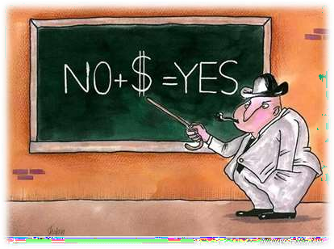
GOAL 16: PROMOTE JUST, PEACEFUL AND INCLUSIVE SOCIETIES
Significantly reduce all forms of violence and related death rates everywhere.
Substantially reduce corruption and bribery in all their forms.

Slide 28

17: REVITALIZE
THE GLOBAL PARTNERSHIP FOR SUSTAINABLE DEVELOPMENT

Slide 29
Mnemonic for SDG: 4(PC) 2(HIL) GEJ
P: No Poverty, Protect planet ,Peace &justice,Partnership
C:Clean water, Clean energy, Sustainable Cities, Reduce Consumption
H:No Hunger, Good Health(Goal 3)
I : Innovation, Reduce Inequalities,
L:Life on ocean, Life on land
G:Gender equality
E:Quality Education
J:Jobs and Economic growth

Slide 30
MDG | SDG
Drawn up by a group of expert | Evolved after a long & extensive consultative process
Originated in September 2000 | Originated in September 2015
For the period from 2000-2015 | For the period from 2015-2030
Focus was on basic developmental issues specially in developing countries | Focus was on overall development of humanity, applicable to both developed and developing countries
8 goals, 21 targets and 63 indicators | 17 goals, 169 targets and more indicators

Slide 32
ALMA –ATA DECLARATION
Health is a fundamental human right and that the attainment of the highest possible level of health is a most important worldwide social goal.
The existing gross inequality in the health status of the people particularly between developed and developing countries is politically, socially and economically unacceptable.
Economic and social development, based on a new international economic order is of basic importance to the fullest attainment of health for all

Slide 33
The people have the right and duty to participate individually and collectively in the planning and implementation of their health care.
Government have a responsibility for the health of their people which can be fulfilled only by the provision of adequate health and social measures.
All government should formulate national policies, strategies and plans of action to launch and sustain primary health care.

Slide 34
NATIONAL STRATEGY FOR HEALTH FOR ALL
As a signatory to alma- ata declaration in 1978.
In this connection two important reports appeared
Report of study group on “HEALTH FOR ALL – on alternative strategy” sponsored by Indian council of social science research (ICSSR) and Indian council of medical research( ICMR)
Reports of working group on “HEALTH FOR ALL by 2000 A.D. ’’ sponsored by Ministry of health and family welfare, Govt. Of India.
This health policy forms a basis of The National Health Policy Formulated By Ministry Of Health And Family Welfare, Govt . Of India In 1983.

Slide 35
NATIONAL STRATEGY FOR HFA/2000
Two reports:
Report of study group on “HEALTH FOR ALL-an alternative strategy” sponsored by ICSSR and ICMR.
Report of working group on “HEALTH FOR ALL BY 2000 AD” sponsored by MOH&FW, GOI
Both reports formed basis of NATIONAL HEALTH POLICY formed by Ministry of HEALTH & FAMILY WELFARE, GOI 1983

Slide 36
GOALS TO BE ACHIEVED BY 2000 AD
Reduction of IMR from level of 125(1978) to below 60
To raise expectation of life at birth from level 52 yrs to 64.
To reduce crude death rate from level of 14/1000 population to 9/1000 population.
To reduce crude birth rate from the level of 33/1000population to 21/1000 population.
To achieve net reproduction rate of 1.
To provide potable water to entire rural population.

