Slide 1
WATER CARRIAGE SYSTEM

Slide 2
WATER CARRIAGE SYSTEM
“Collecting and transporting of human excreta and waste water from residential, commercial and industrial area, by a network of underground pipes to place of ultimate disposal.”
TYPES OF WATER CARRIGE SYSTEM:
1 Combined system
2. Separate system

Slide 3
ELEMENTS OF WATER CARRIGE SYSTEM
1. Household sanitary fittings
2. House sewers
3. Street sewers or trunk sewers
4. Sewers appurtenances

Slide 4
HOUSEHOLD SANITARY FITTINGS:
1. water closet
2. Urinal
3. Wash basin

Slide 5
1. WATER CLOSET:
Two types:
a) Indian Squatting type
b) Western commode type

Slide 6
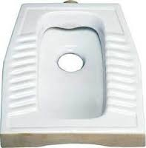
INDIAN SQUATTING SEAT

Slide 7
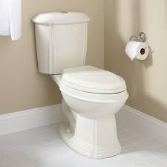
WESTERN COMMODE

Slide 8
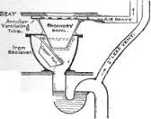
WATER SEAL

Slide 9
Water seal area should not be more than 7.5 cm. .
No sharp corners in trap design.
Volume of water in trap as little as possible, not exceeding 1.75 liters to maintain minimum 50 mm deep water seal.
Interior of bowl vertical at least 50-75 mm just above the surface of water seal.

Slide 10
Connected to a small cistern by a pipe 2.5-3.75 cm. in diameter.
Flushing cistern holds 15 liters of water.

Slide 11
HOUSE DRAIN:
10 cm. in diameter.
Laid in courtyard 15 cm. below ground level on a bed of cement concrete with sufficient gradient towards main drain.

Slide 12
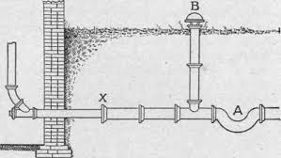
HOUSE SEWER

Slide 13
PUBLIC SEWER:
Not less than 22.5 cm. in diameter.
Laid on a bed of cement concrete about 3 meters below ground level with sufficient gradient to ensure “self cleansing velocity” varies 2-3 feet/sec.
Collect sewage and transport to place of final disposal.

Slide 14
SEWER APPURTANCES:
1. Manholes
2. Traps
1. MANHOLES
Opening built into sewage system placed at
A) whenever change in the direction
B) At the meeting point of 2 or more sewers
C) At distance of 100 meters

Slide 15
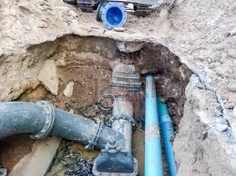
PUBLIC SEWER

Slide 16
2. TRAPS
Designed to prevent foul gases entering the houses and to remove sand, grit and greese.
Placed at
Under basin of water closets
House drain join public drain
Surface water enters the drain

Slide 17
SEWAGE
“Waste water from a community, containing solid and liquid excreta, derived from house, street and yard washing, factories and industries”
SULLAGE:
Waste water does not contain human excreta

Slide 18
Amount of sewage:
1. Habits of people
2. Time of day
The average amount of sewage which flows through sewage system in 24 hours –”dry weather flow”

Slide 19
HEALTH ASPECT
1. Creation of nuisance, unsightliness and unpleasant odors.
2. Breeding of flies and mosquitoes.
3. Pollution of soil and water supplies
4. Contamination of food and
5. Increase in incidence of disease

Slide 20
COMPOSITION OF SEWAGE
99.9% of water
Rest 0.1% solids containing organic and partly inorganic.
Offensive nature due to organic matter it contain.
With numerous living organisms. About 1,000 million of E.coli, 10-100 million of fecal streptococci and 1-10 million spores of Cl. perfringens/gram
Average adult person 100 gm. faeces /day.

Slide 21
AIM OF SEWAGE PURIFICATION
Raw sewage should not discharged into rivers, sea or other sources of water supply.
Aim is to stabilize the organic matter.
Test is biochemical oxygen demand (BOD)
Defined as “amount of oxygen absorbed by a sample of sewage during a specified period usually 5 days, at a specified temperature 20⁰C for the aerobic destruction or use of organic matter by living organism.”
Varies from 1 mg./liter-300 mg./liter

Slide 22
CHEMICAL OXYGEN DEMAND:
Oxygen equivalent of that portion of organic matter in a sample which is susceptible to oxidation by a strong chemical oxidizer.
If waste contain toxic substances only practical method for determining organic load

Slide 23
SUSPENDED SOLIDS:
Amount of suspended solids 100-500 p.p.m.

Slide 24
DECOMPOSITION OF ORGANIC MATTER
1. Aerobic process
2. Anaerobic process
1. AEROBIC PROCESS:
Require continuous supply of free dissolved oxygen.
2. ANAEROBIC PROCESS
Sewage highly concentrated and contains plenty of solids

Slide 25





















































SEWAGE TREATMENT
Sr.
No.
Type of Treatment
Type of Treatment Unit
Name of the Units
Function Type of Impurity Removed.
Large Suspended and Floating Matter
1
Physical Treatment
Physical
Screens
Physical
Grit Chamber
Grit
Physical
Clarifiers
Silt, Sand &
Other Matter
heavier
2
Chemical Treatment
Chemical
Chemical Reactors
Dissolved
Chemicals
3
Biological Treatment
Biological
Trickling filter Activated Sludge Rotating Biological Contractors Digesters
Dissolved Organic Chemicals

Slide 26
MORDERN SEWAGE TREATMENT
Based on biological principles of sewage purification.
By action of anaerobic and aerobic bacteria.
TWO STAGES:
1. Primary treatment
2. Secondary treatment

Slide 27
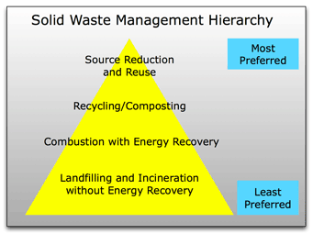

Slide 28
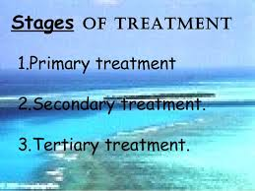

Slide 29
FLOW DIAGRAM OF MODERN SEWAGE TREATMENT PLANT
Primary treatment
Secondary treatment
Chlorine
screen
Grit
chamber
Primary sedimentation tank
Biological treatment
Final sedimentation tank
EFFULENT
DISPOSAL
Methane gas
Sludge digester
Sludge drying beds

Slide 30
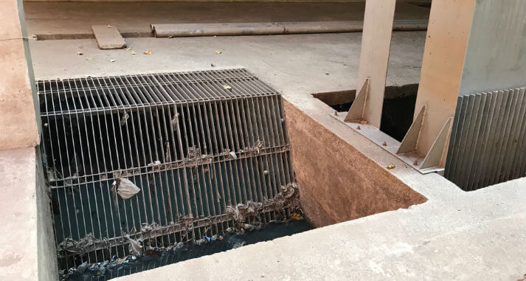
SCREEN OF MODERN SEWAGE TREATMENT PLANT

Slide 31
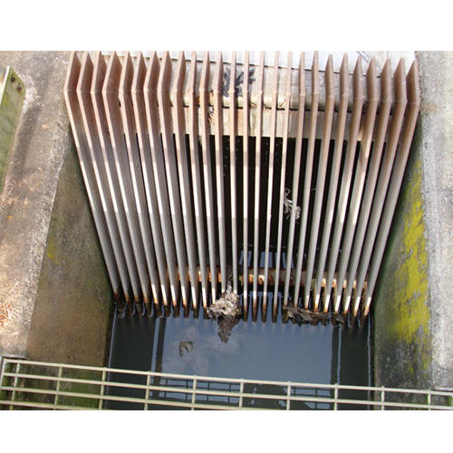
SCREEN OF MODERN SEWAGE TREATMENT PLANT

Slide 32
1. PRIMARY TREATMENT
a) SCREENING:
Passed through a metal screen.
Screen consists of vertical or inclined steel bars usually set 5 cm. apart.
May be of set type or moving type.
Intercepts large floating objects.
Removed manually or mechanically time to time.
Disposed off by trenching or burial.

Slide 33
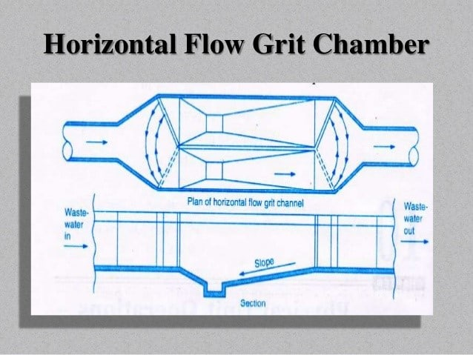

Slide 34
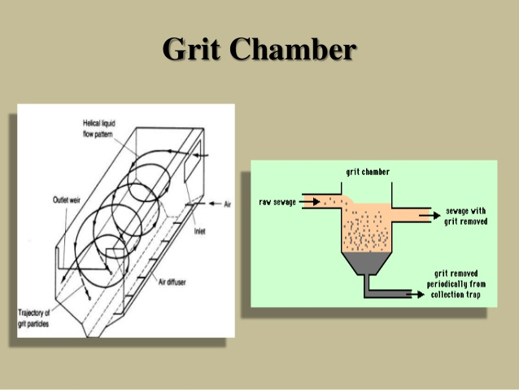

Slide 35
b) GRIT CHAMBER:
Narrow chamber.
10-20 meters in length.
Designed constant velocity about 1 foot per second, with a detention period of 30 seconds-1 minute.
Settle heavier solids-sand and gravel, permitting organic matter pass through.
Grit collected removed periodically or continuously.
Disposed off by plain dumping or trenching.

Slide 36
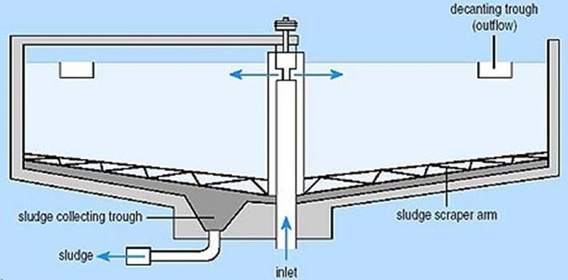

Slide 37
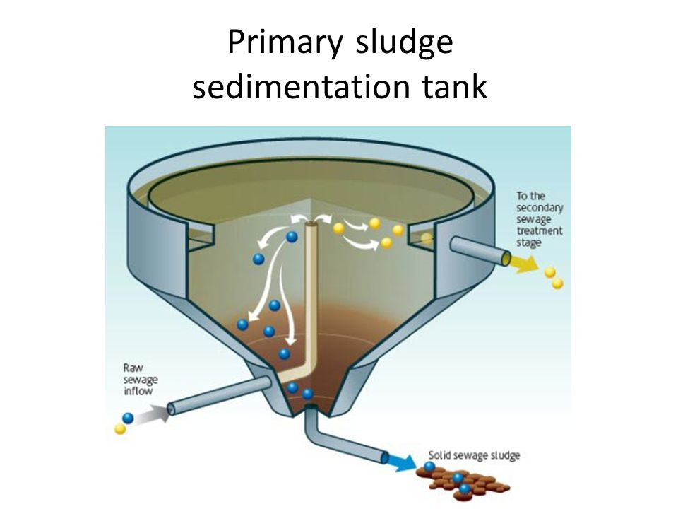

Slide 38
c) PRIMARY SEDIMENTATION:
Very large tank holding 1/3-1/4 dry weather flow.
Flow very slowly at a velocity of 1-2 feet per minute.
Spends 6-8 hours in tank.
Purification takes place through sedimentation.
50-70% solids settle down.
Reduction of 30-40% in number of coliform organism.

Slide 39
Settled organic matter-sludge (removed mechanically without disturbing operation in the tank).
Biological action-microorganism present attack complex organic solids and break into simpler solid substance and ammonia.
Grease and fat rise to the surface-scum-removed and disposed off.
Sewage with organic trade waste treated with lime, aluminium sulphate and ferrous sulphate precipitate animal protein.

Slide 40
2. SECONDARY TREATMENT:
By aerobic oxidation by
a) Trickling filter method
b) Activated sludge process

Slide 41
a) TRICKLING FILTER METHOD
Bed of crushed stones or cinker 1-2 meters (4-8ft.) deep and 2-30 m (6-100ft) in diameter depending upon size of population.
Effluent from sprinkled uniformly on the surface of bed by a revolving device.
Complex biological growth consisting of algae, fungi, protozoa and bacteria of many kinds (zoogleal layer)

Slide 42
Action of filter biological.
Oxidation takes place.
Zoogleal layer lives, grows and dies.
Dead matter humus, light green, flocculent material, sloughs off breaks away and washed down the filter.
Do not need rest pauses, wind blows freely supplying oxygen.
Oxidized sewage into secondary sedimentation tank or humus tank.

Slide 43
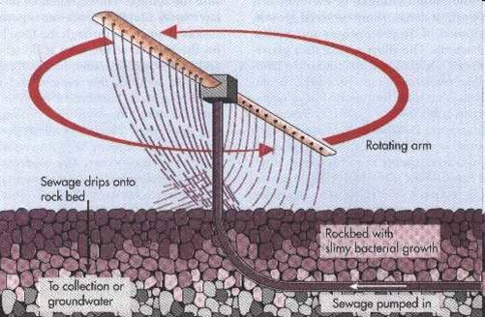
TRICKLING FILTER

Slide 44
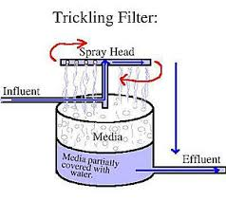

Slide 45
b) ACTIVATED SLUDGE PROCESS:
Modern method of purifying sewage.
“Heart” is aeration tank.
Effluent from primary sedimentation tank mixed with sludge drawn from final settling tank (activated sludge or return sludge, rich culture of aerobic bacteria).
Proportion is 20-30% of activated sludge to effluent.

Slide 46
In aeration chamber for 6-8 hours.
Either mechanical agitation of mixture or forcing compressed air continuously from bottom of aeration tank (diffuse aeration).
Organic matter of sewage gets oxidized into CO2, nitrates and water.
Typhoid and cholera organism destroyed and coliform reduced.
Occupies less space, required skilled operation.
One acre of activated sludge plant does work of 10 acre of percolating filter.

Slide 47
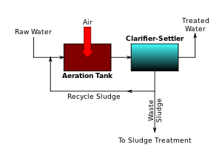

Slide 48
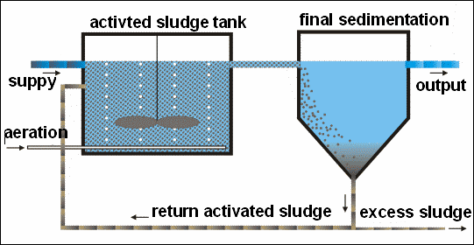

Slide 49
ACTIVATED SLUDGE PROCESS
Aeration
Tank
6-8 hours
detention
Primary
sedimentation
Final setting
Return sludge
20-30%
Sludge to
digester
alternate
Excess sludge
Excess sludge
To digester
Or thickener
Reurn and excess sludge

Slide 50
SECONDARY SEDIMENTATION:
Oxidized sewage from trickling filter or aeration chamber to secondary sedimentation tank.
Detained for 2-3 hours.
Valuable manure if dehydrated.
Part pumped back into “aeration tank”
Rest pumped into sludge digestion tank for treatment and final disposal.

Slide 51
SLUDGE DIGESTION:
One million gallon of sewage produces 15-20 tons of sludge.
Sludge-thick black mass containing 95% of water, and revolting odor.
METHODS OF SLUDGE DISPOSAL:
Digestion
Sea disposal
Land disposal

Slide 52
a) DIGESTION
Sludge incubated under favorable conditions of temperature and PH, it breaks up into water CO2, methane and ammonia.
3-4 weeks or longer for complete sludge digestion.
Residue is in-offensive sticky and tarry mud dry readily and form excellent manure.
Carried out in “sludge digestion tank”.
Methane gas produced used for heating and lighting purposes.

Slide 53
b) SEA DISPOSAL:
Sea coast tows and cities by disposing the sludge into the sea.

Slide 54
c) LAND DISPOSAL:
Disposed off by composting with town refuse.

Slide 55
DISPOSAL OF EFFLUENT:
a) DISPOSAL BY DILUTION:
Disposal into water-rivers and streams.
Disposed in body of water impurities oxidized by dissolved oxygen.
Diluting capacity of river or receiving body of water and its dissolved oxygen contents to be considered.

Slide 56
Water of river used for drinking, so effluent before discharging should be chlorinated.
Recommendations of ROYAL COMMISSION in ENGLAND-effluent should not have more than 30mg/L of suspended matter and 5 day B.O.D. including suspended matter should not exceed more than 20mg/L with dilution of 8:1

Slide 57
b) DISPOSAL ON LAND:
If suitable land available can be disposed off for irrigation

Slide 58
OTHER METHODS OF SEWAGE DISPOSAL:
Sea outfall
River outfall
Land treatment
Oxidation ponds
Oxidation ditches

Slide 59
a) SEA OUTFALL
Disposed off sewage by discharging it into sea cities of sea coast towns and cities.
Purification takes place by dilution.
Drawback-offensive solid matter washed back to the shore and create public nuisance.
To prevent sewage outfall designed to discharge sewage into deep water at many points

Slide 60
b) RIVER OUTFALL
Raw sewage should never discharged into rivers.
Purify sewage before.

Slide 61
c)Land treatment:
If sufficient and suitable land is available, applied after grit removal, screening and a short period of settlement-sewage farming or broad irrigation.
1 acre land for sewage of 100-300 persons.
Land laid into ridges and furrows.
Sewage fed into furrows intermittently and crops grown on ridges

Slide 62
Crop which does not come in contact with sewage.
Fodder grass and potatoes, trees which frits are high above.
Under direction of competent agricultural expert.
During rainy season not suitable.

Slide 63
d) Oxidation ponds:
Open, shallow pool of 1-1.5 m deep with an inlet and outlet.
Presence of algae, certain types of bacteria and sunlight.
Organic matter oxidized by bacteria to CO2, ammonia and water.
Algae utilizes CO2 water and inorganic matter.
So mutual beneficial.

Slide 64
Effluent used for growing vegetable crop or discharged into river.
Mosquito nuisance avoided by growing weed nearby

Slide 65
e) Oxidation ditches
Use of mechanical rotors for extended aeration.
For 5,000-20,000 population area of 1 acre

