Slide 1
SCREENING by Dr. Swati Khan
Professor
Department of Community Medicine
RMCH, Bareilly

Slide 2






Slide 3
LEARNING OBJECTIVES
At the end of class the students should know
What is screening?
What are the types of screening?
What are screening and diagnostic tests?
How to evaluate screening programme?
What are uses of screening?

Slide 4
INTRODUCTION
TYPES OF PREVENTION
PRIMORDIAL PREVENTION
prevention of development of risk factors.
PRIMARY PREVENTION
health promotion, specific protection
  SECONDARY PREVENTION
  early diagnosis and treatment
TERTIARY PREVENTION
-disability limitation, rehabilitation

Slide 5
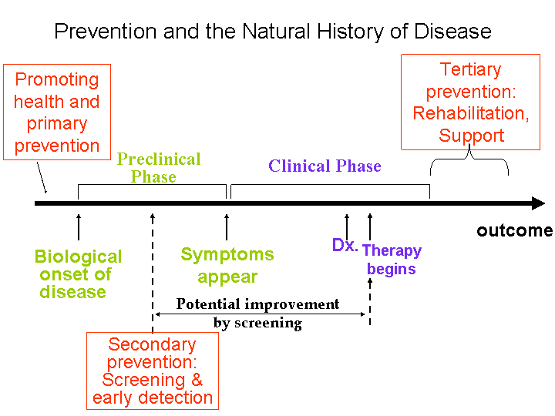

Slide 6


-
SCREENING
Search for unrecognized disease or defect by means of rapidly applied tests, examinations or other procedures in apparently healthy individuals.
For example
–breast
cancer screening using mammography
Case finding-
Use of a clinical and/or laboratory test to detect disease in individuals seeking health care for other reasons. For example-VDRL to detect syphilis in pregnant women

Slide 7
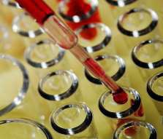
DIAGNOSTIC TEST
Use of clinical and/or laboratory procedures to confirm or refute the existence of disease or true abnormality in patients with signs & symptoms presumed to be caused by the disease.
Example: VDRL testing of patients with lesions suggestive of secondary syphilis.
Gold standard test is the best test available. It is often invasive or expensive.
Example: Breast biopsy for breast cancer.

Slide 8
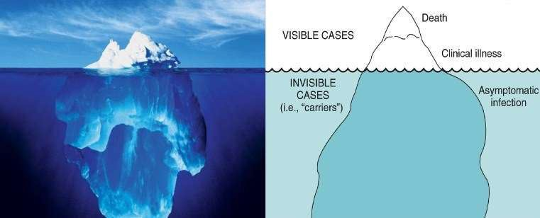
THE ICEBERG PHENOMENA OF DISEASE

Slide 9
Quarantine of cases of an infectious disease.
In an immunization programme, it might be necessary to screen out those already infected.
Detect disease at a phase in its development in which there is successful treatment.

Slide 10

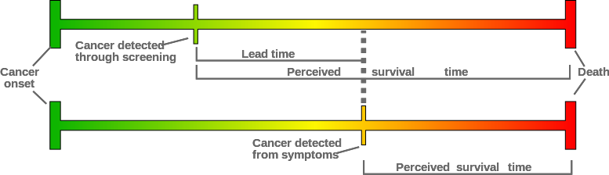
Advantage gained by screening i.e. the period between diagnosis by early detection and diagnosis by other means.

Slide 11
Apparently Healthy
(Screening tests)
Apparently Normal
(Periodic re-screening)
Apparently Abnormal
Normal – periodic – re-
screening
Intermediate - surveillance
Abnormal - treatment

Slide 12
1. CASE DETECTION
Prescriptive screening.
Presumptive identification of unrecognized disease.
Does not arise from patient’s request.
People screened for their own benefit.
For example- neonatal screening.
Bacteriuria in pregnancy, breast cancer, diabetes mellitus, iron deficiency anemia, etc.

Slide 13
2. CONTROL OF DISEASES
Prospective screening.
People examined for benefit of others.
For example –screening of immigrants for syphilis.
3.RESEARCH PURPOSES
  For example – screening to know the natural history of a disease(cancer).
  4. EDUCATIONAL OPPORTUNITIES

Slide 14
MASS SCREENING:
Screening of a large population or a sub group, eg. all adults.
HIGH RISK OR SELECTIVE SCREENING:
Applied selectively to high risk groups, the groups defined on the basis of epidemiological research, e.g., screening of cancer cervix in lower social groups.

Slide 15
MULTIPHASIC SCREENING:
Application of two or more screening tests in combination to a large number of people at one time. It is very expensive.

Slide 16
Screening tests
Diagnostic tests
SCREENING TEST
DIAGNOSTIC TEST
Done on apparently healthy
Applied to groups Results arbitrary and final
Based on one criteria or cut off point
Less accurate
Less expensive
Not a basis for treatment
Initiation comes from the investigator
Done on those with indications for disease
Applied to single patient Diagnosis is not final
Based on a number of findings
More accurate
More expensive
Used as a basis for treatment
Initiation comes from a patient

Slide 17
DISEASE
  Important health problem.
Recognizable latent or early symptomatic stage.
Natural history should be known.
Presence of a test that can detect the disease prior to onset of signs and symptoms.

Slide 18



Facilities for confirmation of diagnosis.
Effective treatment.
Policy on whom to treat as patients.
Reduction in morbidity and mortality with early
Ttreatment.
Expected benefits exceed the risks and costs.

Slide 19
2. SCREENING TEST
Acceptability
Repeatability/ Reliability/ Precision/ Reproducibility
Validity (accuracy)
Yield
Simplicity, safety, rapidity and cost

Slide 20
The test should be acceptable to the people at whom it is aimed.
It should not be painful, discomforting, or embarrassing.
For example – in prostate cancer, per rectal examination is not/less acceptable. But PSA(prostate specific antigen) levels is acceptable.

Slide 21
Reliability/precision/reproducibility.
Test must give consistent results when repeated more than once on same individual or material, under same conditions.

Slide 22
MAJOR FACTORS
MAJOR FACTORS
Observer variation
Biological variation
Errors related to technical methods

Slide 23
A. OBSERVER VARIATION
INTRA-OBSERVER VARIATION-
Variation between repeated observations by the same observer on the same subject at the same time.
INTER-OBSERVATION VARIATION-
Variation between different observers on the same subject.

Slide 24
B. BIOLOGICAL VARIATION
May be due to -
Changes in the parameters observed
Example: Cervical smears from a woman on different days.
Patient’s perception of symptoms.
C. ERRORS RELATED TO TECHNICAL METHODS
Erroneous calibration, defective instruments

Slide 25

To what extent the test accurately measures which it purports to measure.
Expresses ability of test to separate or distinguish those who have the disease from who do not.
Closeness with which measured values agree with true values.

Slide 26
SENSITIVITY
SENSIBILITY
Ability of test to identify correctly all those who have the disease, i.e., true positives.
Sensitivity is a fixed characteristic of the test.
SPECIFICITY
Ability of a test to identify correctly those who do not have the disease, i.e., true negatives.
Specificity is also a fixed characteristic of the test.

Slide 27

d true negatives
--- = --------------------
b+d disease -
Specificity =
Sensitivity=
-
+
DISEASE
a (True positives) | b (False positives)
c (False negatives) | d (True negatives)
+
TEST
-

Slide 28

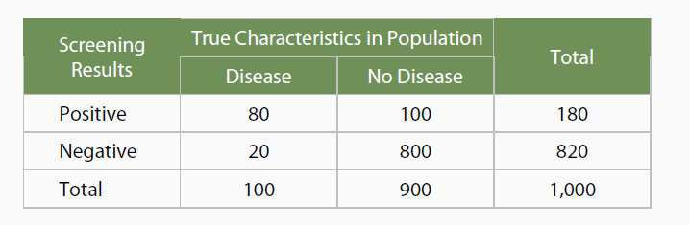

Slide 29
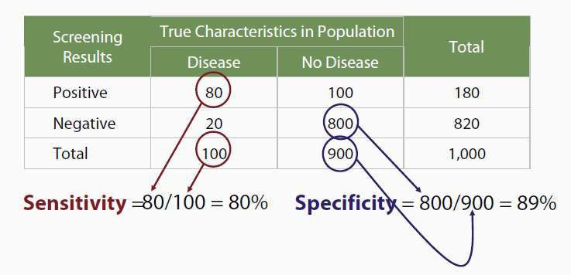

Slide 30
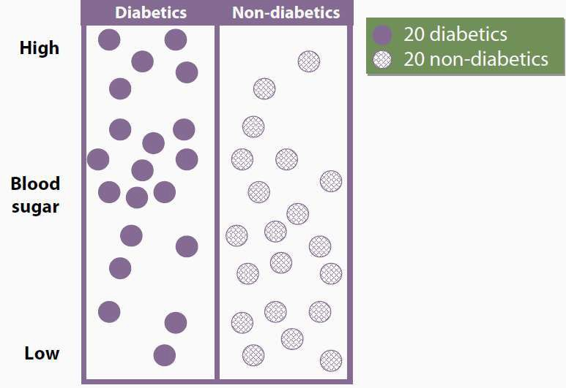

Slide 31
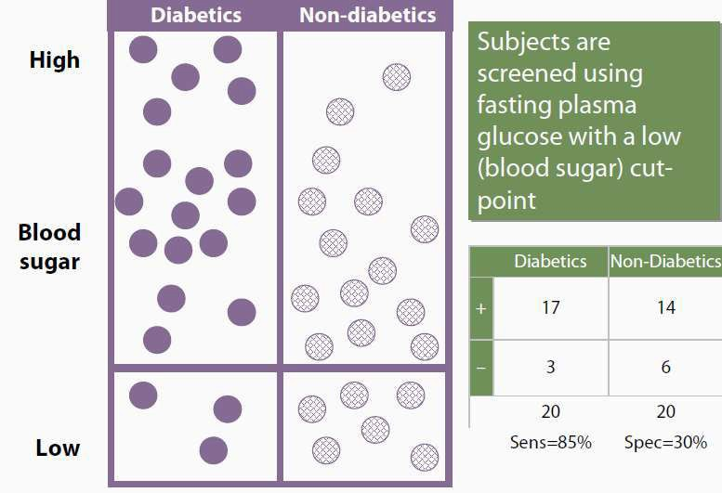

Slide 32
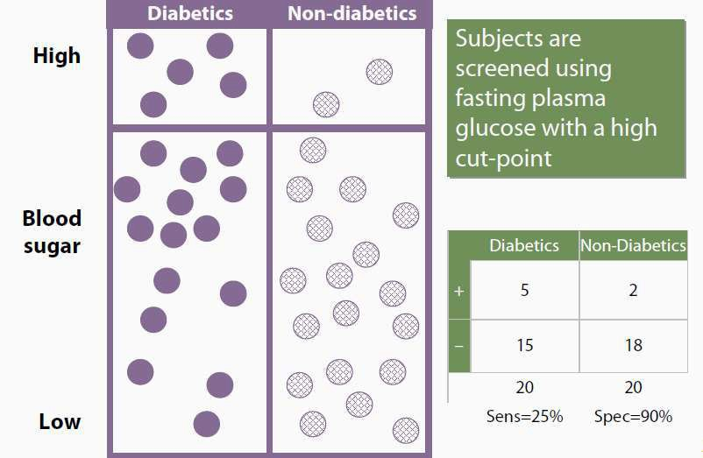

Slide 33
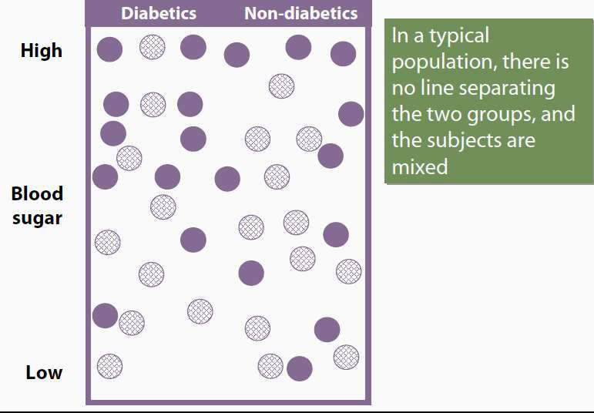

Slide 34
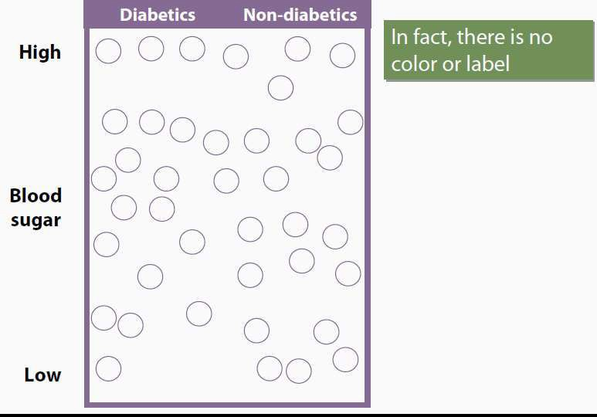

Slide 35
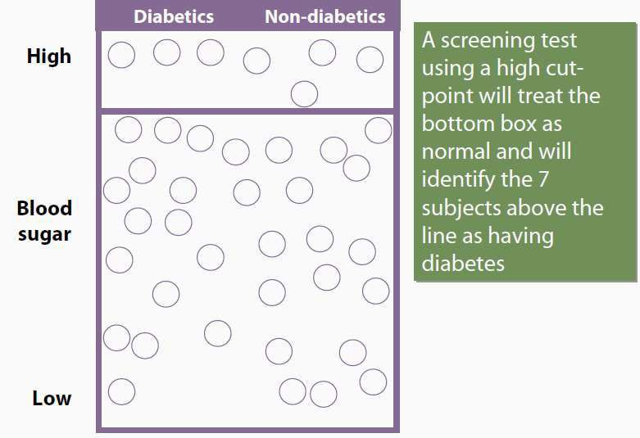

Slide 36


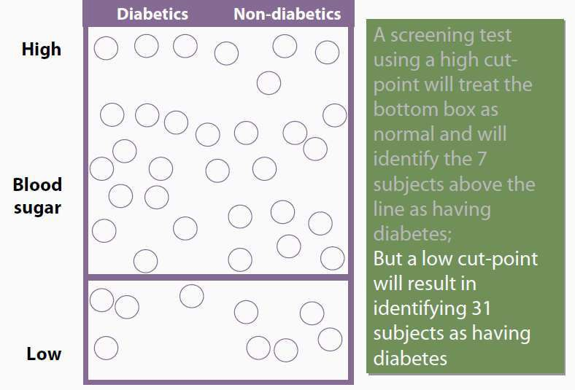

Slide 37
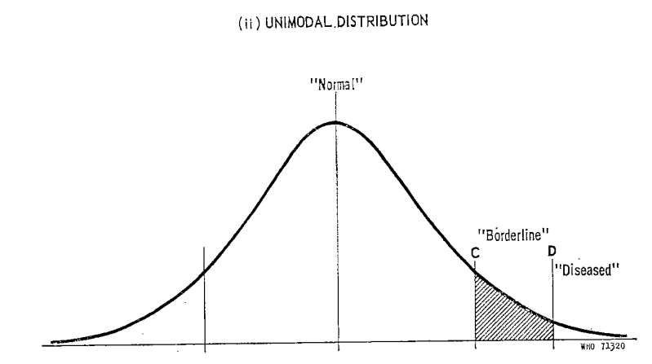
If cut-off point is set at level of C, test will be highly sensitive, but will yield many False Positives
If cut-off is set at D, it will increase specificity of the test

Slide 38
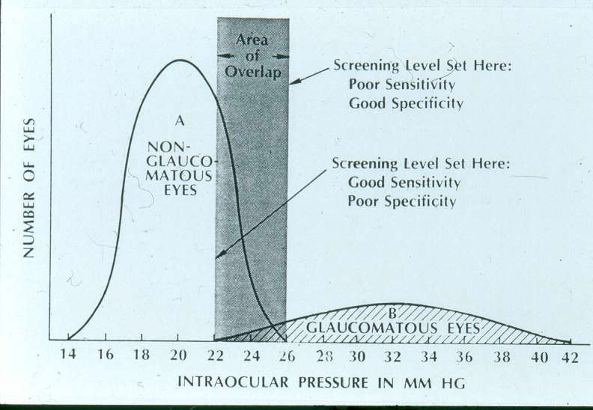

Slide 39

If the diagnostic (confirmatory) test is expensive or invasive
  Minimize false positives.
  Use a cut-point with high specificity.
If the penalty for missing a case is high (e.g., the disease is fatal and treatment exists, or disease easily spreads)
  Maximize true positives.
  That is, use a cut-point with high sensitivity.

Slide 40
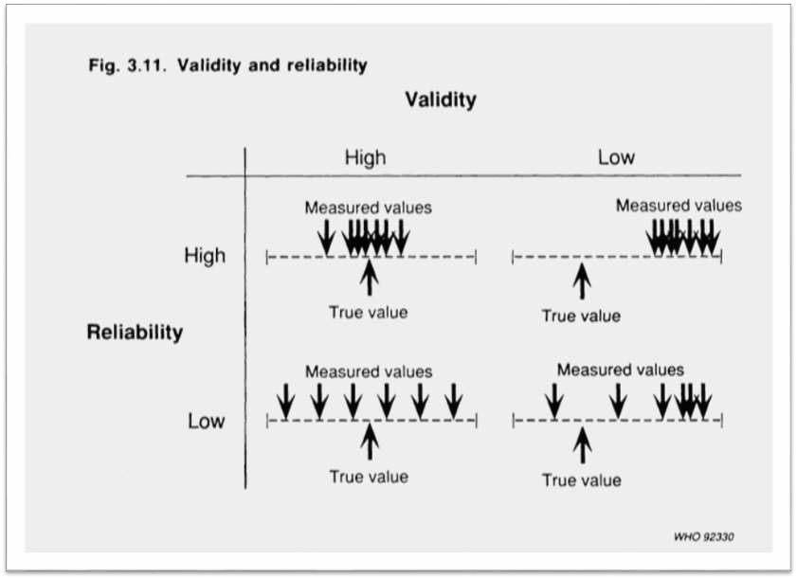

Slide 41
An ideal screening test would be 100% sensitive and 100% specific - that is there would be no false positives and no false negatives.
In practice, these are usually inversely related.
It is possible to vary the sensitivity and specificity by varying the level at which the test is considered positive.

Slide 42
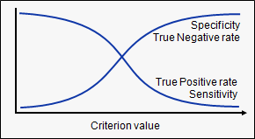

Slide 43
Positive predictive value-
The proportion of patients who test positive who actually have the disease.
Negative predictive value-
The proportion of patients who test negative who are actually free of the disease.
Note: PPV and NPV are not fixed characteristics of the test

Slide 44




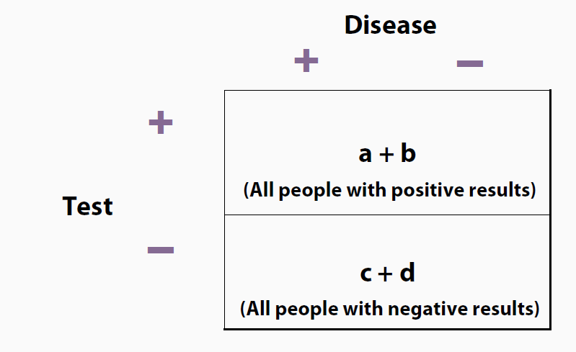

Slide 45
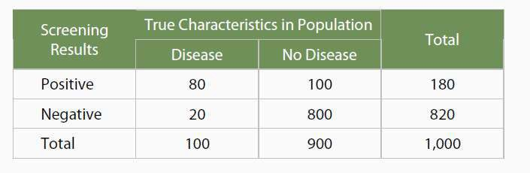

Slide 46
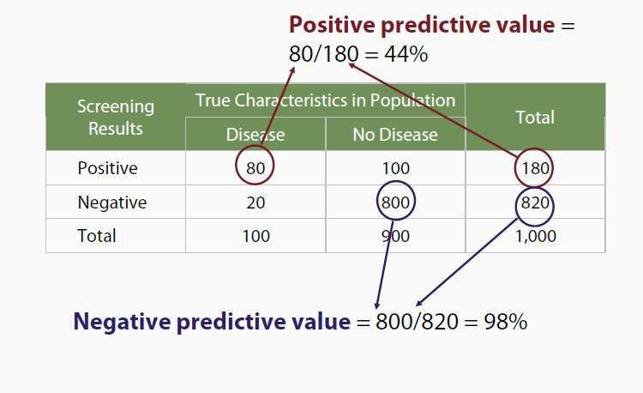

Slide 47
Prevalence (%) | PPV (%) | Se (%) | Sp (%)
0.1 | 1.4 | 70 | 95
1.0 | 12.3 | 70 | 95
5.0 | 42.4 | 70 | 95
50.0 | 93.3 | 70 | 95

Slide 48
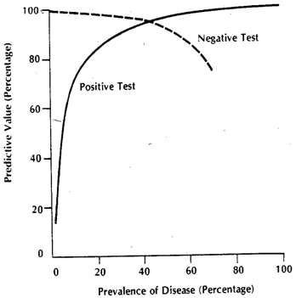

Slide 49

Amount of previously unrecognized disease that is
diagnosed as a result of screening effort.
Depends on
Sensitivit Specificity Prevalence
Participation of individuals
Calculated by
Prevalence of disease Positive predictive value

Slide 50

Receiver operating characteristic curves.
In a ROC curve the true positive rate (Sensitivity) is plotted in function of the false positive rate (1- Specificity) for different cut-off points.

Slide 51
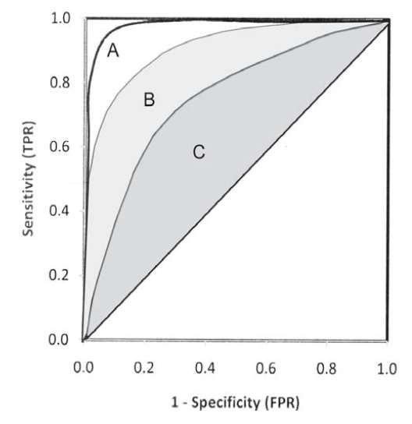
The overall performance of Test A is better than Test B as well as test C

Slide 52
A test with perfect discrimination (no overlap in the two distributions) has a ROC plot that passes through the upper left corner (100% sensitivity, 100% specificity).
Therefore the closer the ROC plot is to the upper left corner, the higher the overall accuracy of the test.

Slide 53
A test with perfect discrimination (no overlap in the two distributions) has a ROC plot that passes through the upper left corner (100% sensitivity, 100% specificity).
Therefore the closer the ROC plot is to the upper left corner, the higher the overall accuracy of the test.

Slide 54
  For comparing two or more diagnostic tests.
For selecting cut-off levels for a test.

Slide 55
Commonly done in medical practice.
Choice depends on cost, invasiveness, volume of test, presence and capability of lab infrastructure, urgency, etc.
Can be done sequentially or simultaneously.

Slide 56
When two (or more) tests are conducted in parallel.
The goal is to maximize the probability that subjects with the disease (true positives) are identified (increase sensitivity)
Consequently, more false positives are also identified (decrease specificity)
Used to rule-out serious but treatable conditions (example, breast cancer screening frequently employs a combination of mammography and breast physical examination . Any positive is considered positive)

Slide 57
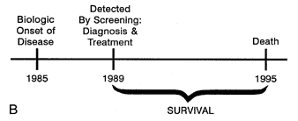
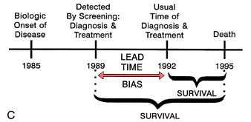
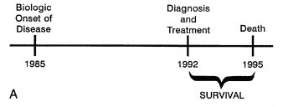
Lead time bias-
Overestimation of survival duration among screen detected cases when survival is measured from diagnosis.

Slide 58
LENGTH TIME BIAS-
Overestimation of survival duration among screen- detected cases due to the relative excess of slowly progressing cases.
These are disproportionally identified by screening because the probability of detection is directly proportional to the length of time during which they are detectable.

Slide 59
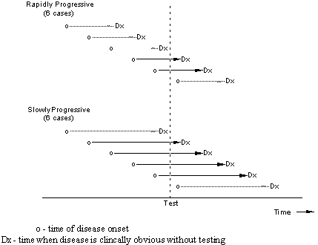

Slide 60
OVER DIAGNOSIS BIAS –
Over diagnosis occurs when all of these people with harmless abnormalities are counted as "lives saved" by the screening, rather than as “healthy people needlessly harmed by over diagnosis”
Screening may identify abnormalities that would never cause a problem in a person's lifetime. For example, prostate cancer screening; it has been said that “more men die with prostate cancer than of it”.

Slide 61
SELECTION BIAS-
There are factors that differ between those willing to get tested and those who are not.
For example , women with a family history
of breast cancer are more likely than other women to join a mammography program.

Slide 62
The tests used in screening are not perfect, so there are false positives and false negatives.
Screening involves cost and use of medical resources on a majority of people who do not need treatment.
Adverse effects of screening procedure (e.g. stress and anxiety, discomfort, radiation & chemical exposure).
Unnecessary investigations and treatment of false positive results.
Stress and anxiety caused by prolonging knowledge of an illness without any improvement in outcome.
A false sense of security caused by false negatives, which may delay final diagnosis.

Slide 63
EVALUATION OF A SCREENING
PROGRAMME
Randomized control trials
Uncontrolled trials
Other methods: like case control studies

Slide 64

Pap smear for cervical dysplasia or cervical cancer
Fasting blood cholesterol for heart disease
Fasting blood sugar for diabetes
Blood pressure for hypertension
Mammography for breast cancer
PSA test for prostate cancer
Fecal occult blood for colon cancer
Ocular pressure for glaucoma
PKU test for phenolketonuria in newborns
TSH for hypothyroid and hyperthyroid

