Slide 1
PSYCHOLOGY ENVIRONMENT

Slide 2


Slide 3
All that which is external to the host.
It can be divided into physical, biological, social and cultural factors, any or all of which can influence health status in populations.

Slide 4
DEFINITION OF ENVIRONMENTAL HEALTH (WHO)
Environmental health comprises those aspect of health including quality of life, that are determined by physical, biological and social factors in the environment
Also refer to the theory and practice of assessing correcting, controlling and preventing those factors in the environment that can potentially affect adversely the health of present and future generations.

Slide 5
CONTRIBUTORS OF ENVIRONMENT
PHYSICAL
Air, water, soil, housing, climate, geography, heat, light, noise, debris etc.
Air pollutants, toxic etc.
BIOLOGICAL
Virus, bacteria and other microbes, insects, rodents, animals and plants
Disease producing agents reservoir of infection and intermediate host

Slide 6
CONTRIBUTORS OF ENVIRONMENT Cont…
Social/psychological/socioeconomic
Culture values custom and habits, moral, religious, education, life style, community life, health services, social and political organization

Slide 7
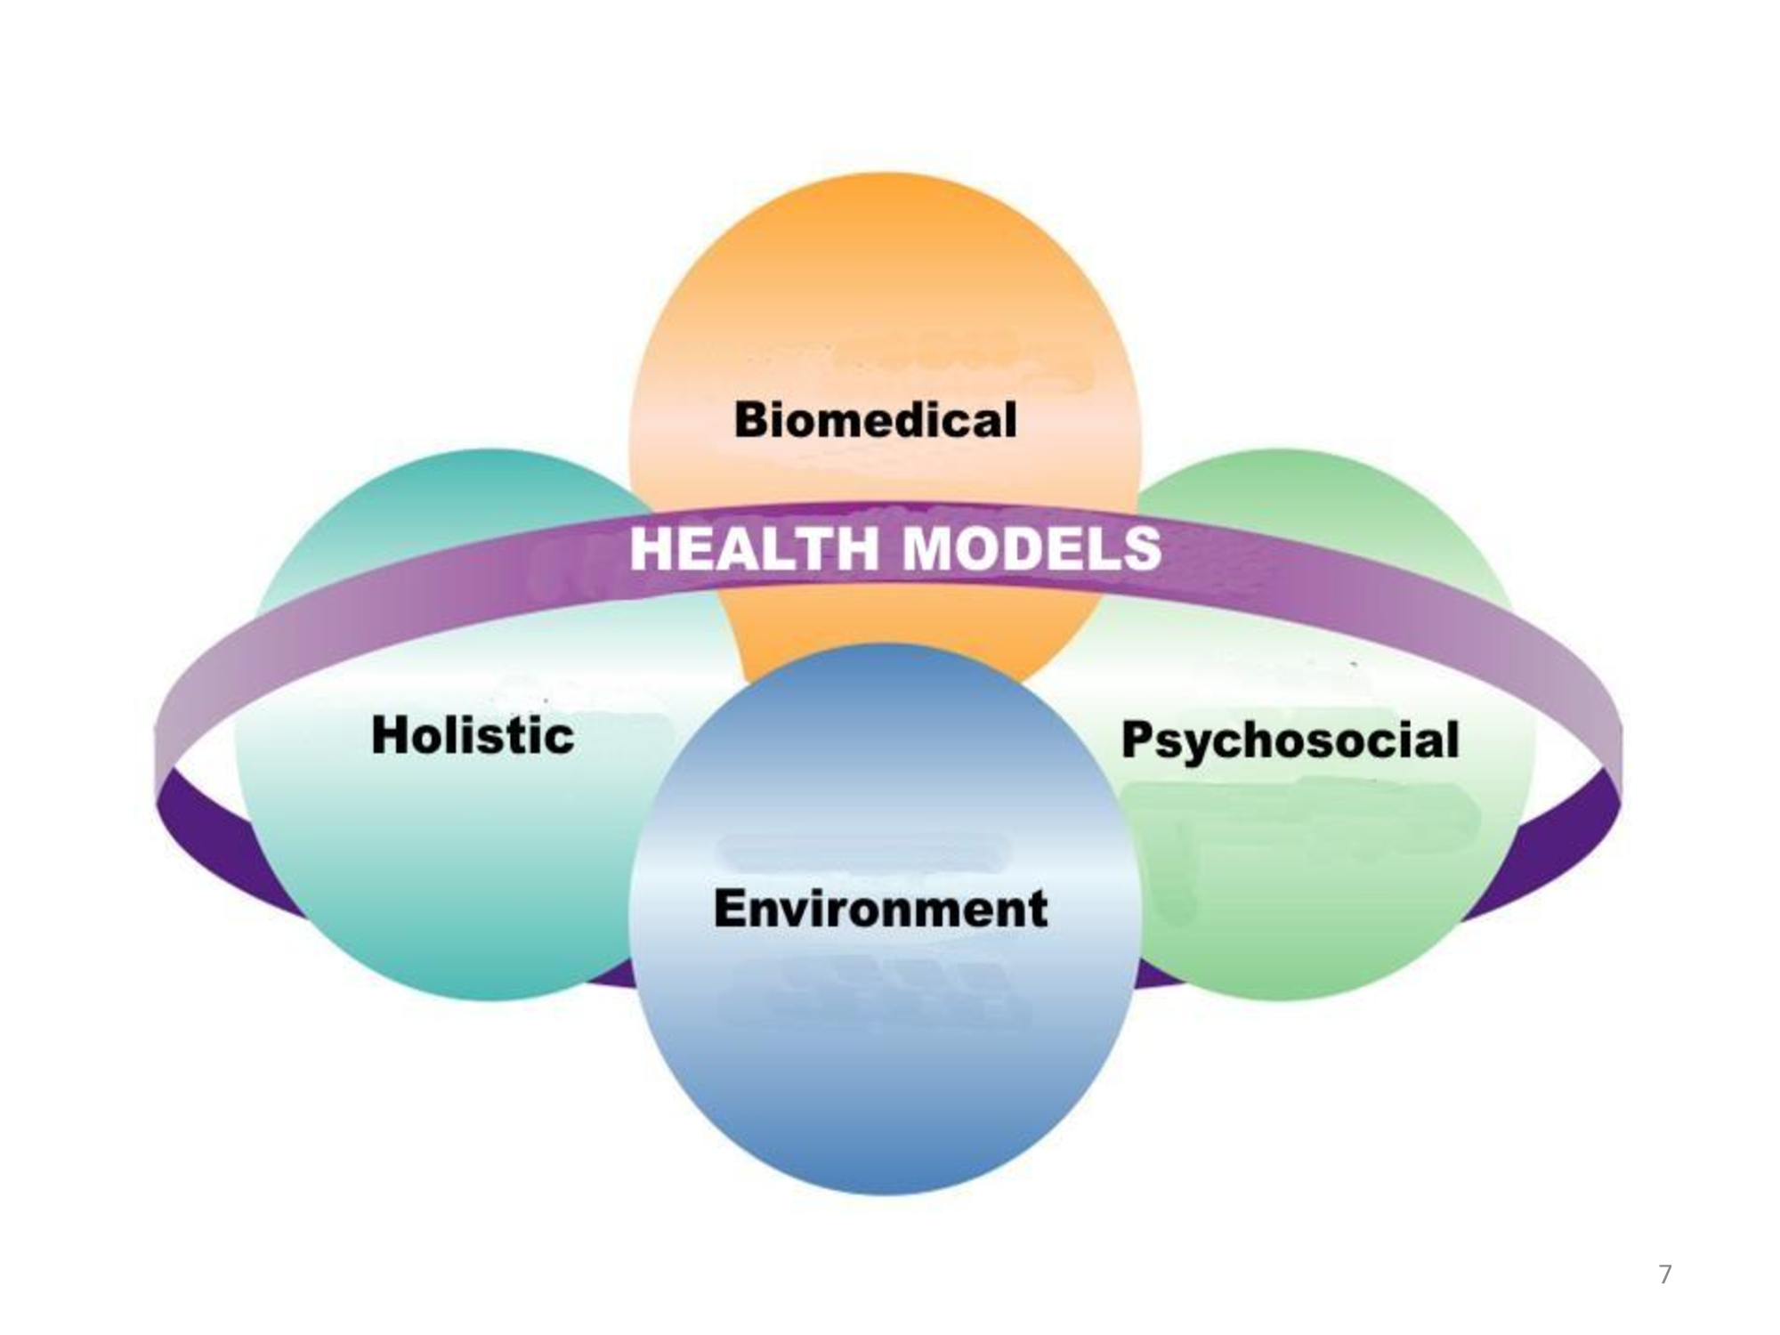

Slide 8
PSYCHOSOCIAL
Being mentally, emotionally and socially well
MENTALLY- Thinking
EMOTIONALLY-Feeling
SOCIALLY- Relating
Defines health as both biological and social phenomenon

Slide 9
HOLISTIC
Encompasses the physiological, mental, emotional, social, spiritual and environmental aspect of individual and community.
Multidimensional process involving the well being of whole person.
Implies that all sector of society have an effect on health.

Slide 10
Emphasizes the unity of mind, spirit and body. Therefore symptoms of illness and disease may be viewed as an imbalance in a person’s total state of being and not simply as the malfunction of a particular part of body.
Emphasizes self healing, the maintenance of health and the prevention of illness rather than the treatment of symptom and disease.
Integrates medical technology into a broader treatment that looks not only at a person’s symptoms but also at source of disharmony.

Slide 11
INFORMATION REGARDING CUSTOMS AND HEALTH PRACTICES
MENSTRUAL HEALTH
Menstrual health is normal physiological process Yes/ No
Any food restriction followed during menstruation Yes/ No
Any other restriction during menstruation (Custom/ Religious) Yes/ No

Slide 12
MARRIAGE
What is the legal age for marriage in India for boys ………………, for girls ……………
At what age were you married? ……………..
In your opinion, what should be the age for marriage in boys…….. Years and in girls……..years

Slide 13
CHILD BEARING (ANTENATAL)
Age of mother at the birth of first child…………
Number of children born………………
Age at last pregnancy ……………………

Slide 14
Detail regarding the last pregnancy and its outcome
Registered in antenatal clinic Yes/ No if yes, in which month (period of gestation)……..
Received antenatal care Yes/ No
Number of antenatal visits …………………
Whether food intake increased Yes/ No
Any food restriction………. Yes/ No if yes, mention …………………………

Slide 15
f. Any special/additional food item given? Yes/ No, if yes, mention…………..
g. Number of hours of rest in daytime Nil/…….
h. Any complications during pregnancy Yes NO if yes……………..
i. Anemia Present Absent (as per record/history)
j. Outcome of pregnancy Abortion/ Stillbirth/ Preterm/ Full term
k. Delivery- Institutional/ Home, Delivered by Doctor Nurse/ Trained Dai/ Untrained Dai Relatives or neighbors/ Self
l. Cord applicants Ash/ Cowdung Ghee Antiseptic others

Slide 16
No. of days of isolation during puerperium …….

Slide 17
CHILD REARING (POSTNATAL)
Colostrum given to new born Yes No Why/Why not?..................................
Breastfeeding started within how many hours and why?..........................
any prelacteal feeds given to child and why?..................
Do you give any other food than breast milk before six months of age Yes No

Slide 18
e. Do you give water to a child before six month of age Yes No
f. at what age complementary feeding should be started? ……………………
g. When did you start complementary foods for your child/………………..
h. Is your child vaccinated for the vaccines due for date? Yes No
If no, reasons……………………………………………

Slide 19
i. Did your child ever suffer from diarrhea?
Yes No If yes what action did you take
a. ORS given Yes No
b. Home available food given Yes No
If yes, specify …………..
Any other action, specify …………..
j. Did your child ever suffer from pneumonia
Yes No
If yes, could you recognize it? Yes No
What were the sign and symptoms?..................
What action did you take?............................

Slide 20
OTHER CHILD REARING PRACTICES
Application of kajal………… Yes No If yes, with common applicator Yes No
Massage with oil ………… Yes No
Exposure to sunlight …….. Yes No
Use of ghutti ………….. Yes No
Food prohibited during fever…… Yes No
Restrictions of fluids during diarrhea ……….
Yes No

Slide 21
FAMILY PLANNING
In your opinion how many children a couple should have? ……………….
What should be the gap between two children? ………………………
Name contraceptive methods you know …….
Which permanent sterilization method (

Slide 22
e. Are you using any method of contraception
Yes No, if yes, which one……. Since when
f. Reasons for not using any methods? …………..

Slide 23
HEALTH SEEKING BEHAVIIUR
In case of illness, preference of health facility/ facilities Hospital/ Dispensary/ MCH Centre/ Private practitioner (unqualified)/ Any other………………
Why? …………………..
Which system of medicine is preferred? Allopathy/ Homeopathy/ Ayurvedic/ Any other Specify…………………………

Slide 24
PROBLEMS IDENTIFIED

Slide 25
ADVISE GIVEN/ ACTION TAKEN

Slide 26
COMPREHENSIVE MANAGEMENT PLAN (FAMILY)
LEVEL OF PREVENTION | PRIMARY: HEALTH PROMOTION AND SPECIFIC PROTECTION | SECONDARY: EARLY DIAGNOSIS AND ADEQUATE TREATMENT | TERTIARY: DIABILITY LIMITATION AND REHABILITATION
INDIVIDUAL
2. FAMILY
3.COMMUNITY

