Slide 1
PROGRAMME RELATED TO ENVIRONMENT

Slide 2
INTRODUCTION
In India, pollution and environmental degradation levels are alarmingly high due to poverty, deforestation, and industrial development without adequate standard principles for conservation and sheer greed.
Governments have enacted Acts and regulations to diminish the rising danger of nature. Various schemes and policies for the conservation of nature have been proposed by the Government. To make the process rapid, great emphasis must be paid to environmental mental education, peoples’ participation, and population control.

Slide 3
INTRODUCTION
All organism from virus to man are obligatorily dependent on environment for food, energy, water, air, shelter and for other essential and non essential needs.
But when this environment is not available in its natural or suitable composition than organism whether plant or animal, living or non living component may change its form or disappear.
Environment is total sum of living, non living components, influences and events surrounding an organism.

Slide 4
CONSERVING THE ENVIRONMENT
Conservation of nature is an act of protecting the planet Earth for present and future generations.
The most obvious reason for conserving the environment is to protect wildlife and promote diversity.
For a human being to survive on the planet, there is an absolute need to preserve nature. Nature is the ultimate solution to saving mankind on the planet.
Nature is the only tool to fight against global warming, we can utilize nature’s contribution to avoid the catastrophic increase in temperature. Everything is interconnected, one thing saves another thing. Climate change is a great risk to the planet.

Slide 5
STEPS TAKEN BY THE INDIAN GOVERNMENT
World Nature Conservation Day is observed on July 28th every year
Nagar Van Udyan Scheme is to develop at least one City Forest in each city having Municipal Corporation or Class 1 Cities to accommodate a wholesome health environment and contribute to the growth of clean, green, and sustainable India. Create awareness about the plants and biodiversity.
Swachh Bharat Abhiyan- The Abhiyan motives lie in the cleanliness of the environment.

Slide 6
Project Tiger -was adopted in the year 1973 to improve the decreasing numbers of Tigers in India.
National Wetland Conservation Programme (NWCP) to conserve and make acute use of wetlands in the country, therefore, preventing its further degradation.
Green Skill Development Programme in June 2017-conserving and protecting the green of nature alongside creating awareness among the youth

Slide 7
National River Conservation Programme-sub-schemes of Conservation of Natural Resources and Ecosystems, Green India Mission, and National Afforestation Programme, National Coastal Management Programme, National Mission on Himalayan Studies under Climate Change Program

Slide 8
ACTS
The Wildlife (Protection) Act, 1972 adopted by all States except J&K having own acts also included the Constitution of the Indian Board of Wildlife (IBWL), of setting up wildlife natural parks and sanctuaries. To put restrictions on hunting or poaching wildlife animals and birds. The Act includes rehabilitation of endangered or threatened species.
Preservation of biological diversity by setting up sanctuaries and parks and granting permission to hunt the wildlife for specific purposes such as scientific research, scientific management, and collection of specimens for museums and zoological gardens, etc.

Slide 9
Forest Conservation Act,1980 promoting the elimination of deforestation and stating to encourage afforestation on the non-forest areas. It has imposed restrictions on the de-reservation of the forest without any prior Central government approval and prohibits allotment of any forest land for non-forest purposes.
Amended Forest Act, 1992: some provisions for allowing non-forestry activities with the prior approval of the central government. Wildlife sanctuaries, natural parks are entirely prohibited from being used for any exploration or survey without prior approvals from the Central Government. Cultivation of tea, coffee, spices, rubber, palms, oil-bearing plants, and cash crops comes under non-forestry activities.
Water (Prevention and Control of Pollution) Act, 1974 has set up two boards: Central and State. The Act restricts the disposal of any poisonous, polluting matter in the flow of the water, also includes punishment and fines.

Slide 10
CENTRAL POLLUTION CONTROL BOARD (CPCB)
CPCB advises the Central government in matters related to water purification and elimination of water pollution. CPCB lays down quality measures of water, manuals for the treatment and disposal of sewage and trade discharges, compiles and collects data and provides a statistical analysis of water quality and pollution, set up laboratories for the analysis of water quality, sewage, or trade discharges.

Slide 11
STATE POLLUTION CONTROL BOARD (SPCB)
SPCB advises concerning the establishment of the industry which may harm the water stream or river, lays down rules and regulations on the disposal of effluents in the flow of water.
The State Board take the sample and test in the laboratory to check the quality of the water, in any way harmful to the usage of water and to sanction or refuse the consent of the industry, to gain consent from the board. The Board focuses on the re-evaluation of the dumping outlets and re-structuring the way of disposal of sewage and trade discharges.

Slide 12
The Water (Prevention and Control) Cess Act, 1977 authorizes the Central Board to collect cess on the water that has been consumed by the person carrying out the industries and by the local authorities, who are responsible for the supply of water, was amended in 1991 with a view of expanding the resources of the board and removing the gaps in the Act, and providing concession to the industry for complying with the standard quality and consumption.
Water Board has no power to take direct actions against the defaulting party. The court proceedings are longer than expected, delays cause the prevention in action, defeating the only purpose of the Act. Amendments are enacted to provide strengthening yet the pollution of the water is still on high rise and the authorities lack the power to enforce it effectively and efficiently.

Slide 13
Air (Prevention and Control of the Pollution) Cess Act, 1981 was passed after the participation of India at the United Nations Conference in the Human Environment held in Stockholm, to take appropriate steps to preserve the environment. The Air (Prevention and Control of the Pollution) Cess Act, 1981 applies to the whole of the country. Air pollution can be defined as the presence of any solid, liquid, gaseous substance present in the atmosphere, in a concentration that may be injurious to any human or animal’s life and dangerous to nature.

Slide 14
Under Section 19, of the Act, can declare an area, an air pollution controlled area and no industrial plant shall be planted in that area without prior approval from the Government, have been redesigned into the Central Pollution Control Board and State Pollution Control Board. The State Board lay down rules and regulations for the prevention and control of air pollution.

Slide 15
Under Section 20, the government- to instruct the Authority in charge of the registration under the Motor Vehicle Act, 1939, to secure the standard emissions for automobiles. The boards press charges against the polluter in the court and punish him for polluting the air and incurred expenses as compensation for the damages that the board has to recover. Noise pollution also comes under the category of air pollution since 1987.

Slide 16
Environment Protection Act, 1986- includes necessary decisions and steps to be taken to protect the environment and to prevent hazards to humans, plants, or any living creatures, comprises 26 sections which are explained in 4 chapters and applicable to the whole of India.
The Act ensures the enactment of the regulations and Acts concerning pollution control, issues directions to shut down any industrial plant or process that can be harmful to the environment and the living beings around it, imposes strict penalties on the defaulter of the regulations.

Slide 17
Environment is not static, keeps changing.
Can be internal and external.
POLUTION- Any undesirable change in physical, chemical or biological characteristics of environment –air, water and soil that may or will adversely affects human or other species and life support system of our biosphere directly or indirectly
MAJOR CAUSES OF POLLUTION
Fossil fuel consumption
Motor transport
Modern agriculture
industries

Slide 18
LOSS OF BIODIVERSITY
27,000 species in tropical forest lost per year.
Other habitats- primarily coral reefs, wet lands, ice lands and mountain environment.

Slide 19
WATER AND SANITATION
80-90% of untreated sewage discharged directly into rivers and streams, main source of water supply in cities..
Human faeces most dangerous pollutants- typhoid, cholera, diarrheal illness, amoebiasis and other virulent disease.

Slide 20
TRAFFIC
Dangerous roads and heterogeneous traffic in urban areas common.
Injury every second minute and fatality every ninth minute.
7th leading causes of death.
Most productive age group (15-44 yrs)-3rd leading cause.
Most common in urban areas.
Available information and technologies for prevention and control.

Slide 21
INDUSTRILIZATION
Resulting in poor air quality in cities.
Use of chemicals increased chemical toxicity-infection, cancers, birth defects.
Large numbers of migrants settled in slums or remain in street, in factories.
Increased malignancies from exposure to chromium, nickel, cadmium and pollutants.

Slide 22
AIR
Organic Compounds (VOCs)-mix of benzene, toluene, xylene, styrene and butadine react with sunlight and Nox to give smog. Released from paint, thinners, dry cleaner solvents and some constituents of petroleum fuels.
Benzene levels increase from emissions from burning coal and oil motor, vehicle exhaust and evaporation from gasoline, tobacco contain high level of benzene. Exposure causes eye allergy, choke upper respiratory tract, lead to nasal congestion, rash, drowsiness, dizziness, nausea, rapid heart rate, headach, tremors, confusion and unconsciousness.
Benzene-carcinogen and long exposure- leukaemia.
Air pollution-affected by transport, industries, domestic fuel burning and tobacco smoking.

Slide 23
INDOOR AIR POLLUTION
India- 85% household and 97% rural population use biomass fuel and coal.
4-5.5 lakh premature deaths annually from indoor pollution among under5 and adult women.
12-20 million DALY lost.

Slide 24
NATIONAL CLEAN AIR PROGRAMME
India is committed to clean environment and pollution free air and water.
Acceleration of industrialization and urbanization for last 3 decades associated with increase in pollution more specially air pollution-a serious health concern not only human population but to floral, faunal and agriculture.
Effect felt in cities and towns far away from source.
Cities occupies 3% of land and responsible for 78% CO2 emission.

Slide 25
INITIATIVES OF GOI
Notification of National Ambient Air Quality Standards and effluent standards for industries
Setting up monitoring network for assessment of ambient air quality.
Introduction of cleaner gaseous fuels.
Launching National Air Quality Index (AQI)
Banning of burning biomass.
Promotion of public transport network.
Issuance of directions under air (Prevention and Control of Pollution Act 1981.)

Slide 26
8. Installation of online continuous (24X7) monitoring device by 17 highly polluting industrial sectors.
9. Ban of bursting sound emitting crackers between 10 PM to 6 AM.
10. Notification of graded response action plan for Delhi and NCR identifying source wise actions for various levels of air pollution

Slide 27
Some minor improvement.
GOI launches National Clean Air Programme (NCAP)-2019-2024.
102 cities in India chosen.

Slide 28
NACP (GOALS)
To meet prescribed annual average ambient air quality standards at all locations in a stipulated timeframe (2019-2024)
OBJECTIVES
To augment and evolve effective and proficient ambient air quality monitoring network across the country for ensuring comprehensive and reliable data base.
To have efficient data dissemination for prevention and mitigation of air pollution in 102 identified nonattainment cities.
To have feasible plan for prevention, control and abatement of air pollution.

Slide 29
APPROACH
Collaborative, multisectoral and cross sectional coordination between relevant central ministries, State Government and local bodies.
Intersectoral groups-Ministry of Road Transport and Highway, Ministry of Petroleum and Natural Gas, Ministry of New and Renewable Energy, Ministry of Heavy Industry, Ministry of housing and Urban Affairs, Ministry of Agriculture, Ministry of Health, NITI Ayog, Central Pollution Control Board (CPCB) experts from industry, academia and civic society.
Partner with multilateral , bilateral international organizations and philanthropic foundations and leading technical institutions

Slide 30
INITIATIVE/KEY COMPONENTS OF NACP
Tackling pollution from various sources-power plants, industry transport etc
Augmenting number of air quality monitoring stations-manual, continuous, sensor and satellite based techniques.
Expanding the network of monitoring stations.
Setting up of “Air Information Center” for data analysis, interpretation and dissemination through Geographical Information System (GIS) for all 102 non-attainment cities on basis of Air Quality Index (AQI)

Slide 31
Special Purpose Vehicle (SPV) for Afforestation
Fly Ash Utilisation Action Plan
Initiatives for improving the environmental performance of coal based stations
Clean Development Mechanism (CDM)
ISO 14001

Slide 32
SPECIAL PURPOSE VEHICLE (SPV) FOR AFFORESTATION
A Special Purpose Vehicle is being set up jointly by NTPC and other Central Power Sector Undertakings as a Registered Society to take up afforestation and environmental measures.
OBJECTIVES
Fruitful channelizing of investments to increase the national forest cover.
Identify suitable lands for afforestation for power projects of NTPC and other members through Ministry of Environment and Forests (MOEF) with the State Forest Departments/District Rural Development Authority etc.

Slide 33
3.Facilitate quick procurement of forest clearance for the forestland proposed by NTPC and other members for the future projects to be set up.
4.Interact with MOEF to score off the necessary compensatory afforestation required for projects of NTPC and other members, which needs diversion of forestland.
5.It is noteworthy that NTPC has already planted over 1.45 crore trees.

Slide 34
FLY ASH UTILISATION ACTION PLAN
Coal / Lignite based Thermal Power Generation has been the backbone of power capacity addition in the country.
A large quantity of ash is generated at Coal / Lignite based Thermal Power Stations in the country, which not only requires a large area of precious land for its disposal but is also one of the sources of pollution of both air and water.
All Coal / Lignite based Thermal Power are required to follow the Ministry of Environment, Forests (MoEF) Notifications on fly ash utilization to achieve 100%. Ministry of Environment, Forest and Climate Change (MoEF&CC) has now issued a revised Notification on 31st December 2021 in supersession of earlier Notifications in order to widen the scope of ash utilization.

Slide 35
No. of Thermal Power Stations from which data have been received | 200
Installed capacity (Mega watts) | 213620
Coal Consumed (Million tons) | 5759.02
Fly Ash Generation (Million tons) | 270.82
Fly Ash Utilization (Million tons) | 259.86
Percentage Utilization (%) | 95.9%
Average Ash Content (%) | 35.68
In line with the MoEF&CC Notification dated 31.12.2021, Ministry of Power had issued an Advisory on 22.02.2022 for all Coal / Lignite based Thermal Power to dispose of the ash in a transparent manner.

Slide 36
INITIATIVES FOR IMPROVING PERFORMANCE OF COAL BASED STATIONS
i. The monitoring of emissions by thermal power companies come under the purview of CPCB/SPCB. The emissions from thermal power plants is being monitored through online OCEMS portal of CPCB since 2017, for both central and state to keep a check on emission level from these power plants. However, Central Electricity Authority (CEA) compiles a CO2 database for all Grid connected Power stations in the country on annual basis and publish the same. The objective of this database is to establish authentic and consistent quantification of the CO2 emission baseline.

Slide 37
DATA OF CO2 EMISSION FROM GRID CONNECTED POWER STATIONS
2017-18 | 2018-19 | 2019-20 | 2020-21 | 2021-22
922.18 | 960.90 | 928.14 | 910.02 | 1,002.02

Slide 38
ii. The Thermal Power Stations are required to meet the environmental pollution standard set by MoEF&CC /CPCB/ SPCB from time to time. MOEF&CC has notified new environmental norms on 7th December 2015 for thermal power plants related to Particulate Matter (PM), SO2, NOx& Mercury emissions and also vide its notification dated 31.03.2021 had issued categorized thermal power plants in category A, B & C for compliance of new emission norms including provision of penalty for non-compliance. Further, MOEF&CC vide its notification dated 5th September 2022 has granted two year Extension to TPPs for compliance of SO2 emission norms
iii. Many TPPs have already adopted use of efficient technologies i.e. from subcritical to supercritical and now using ultra-supercritical technology in order to improve efficiency, thereby reducing coal consumption and thereby reducing emissions.

Slide 39
iv. The capacity of about 18,362.24 MW comprising 260 units of inefficient and old thermal power generation units has already been retired till 31.12.2022.
v. Ministry of Power on 08.10.2021 has issued revised policy on Bio-mass Utilization for Power Generation through Co-firing in Coal based Power Plants to use 5-10% blend of biomass pellets made, primarily of agro-residue along with coal after assessing the technical feasibility viz. safety aspect etc.
vi. Thermal Power Plants of total capacity of about 181 GW is covered under Perform, Achieve, Trade (PAT) scheme and they are given mandatory targets to reduce their specific energy consumption.
vii. Carbon Capture, utilisation and Storage (CCUS): CCUS refers to suite of technologies, which will help to remove CO2 before it enters atmosphere.

Slide 40
CLEAN DEVELOPMENT MECHANISM (CDM)
Services of Tata Energy Research Institute (TERI) have been engaged for providing consultancy services to the Ministry of Power on CDM.
The terms of reference include project formulation, base line surveys for each project, negotiations with the CDM parties, identification of the counterpart CDM parties from the developed countries, cost of CO2 monitoring and verification of CO2 emission reduction and supervision of project implementation.

Slide 41
ISO 14001
November 1975, nation's Sustainable Power Development, National Thermal Power Corporation Ltd. (NTPC) is established.
NTPC has recently diversified into the hydro sector and formed for joint venture companies for distribution. Environment Management is a high priority area in the company and several Policies have been formulated to ensure generation of green power. Through persuasion of sound environmental management systems and practices.
The focus and emphasis in future in the company will be on generation of power in line with global standards and in complete harmony with the environment and nature.

Slide 42
INITIATIVES OF MODI GOVERNMENT

Slide 43
NAMAMI GANGE PROGRAMME
The Centre allocated a total of Rs 20,000 crore to conserve and rejuvenate the river.
It involved the people living on the banks of the river, and helped them attain sustainable livelihoods and feel the impact first-hand.
It also roped in grass-root level institutions, including urban local bodies and Panchayati Raj institutions, to work for the same

Slide 44
Key achievements- creating sewerage treatment capacity, river front development and surface cleaning.
The programme is being implemented by the National Mission for Clean Ganga (NMCG) at the national level and State Program Management Groups (SPMGs) at the state level.
Moreover, 63 sewerage management projects are implemented in Uttarakhand, Uttar Pradesh, Bihar, Jharkhand, and West Bengal

Slide 45
GREEN SKILL DEVELOPMENT PROGRAMME
Moving away from technical or industrial skills, the Green Skill Development Programme was launched in June 2017 by the Ministry of Environment, Forest, and Climate Change.
‘Green skills’ refers to those that contribute to preserve and restore environment and create a sustainable future. Hence, the programme focuses on developing skills among the youth in the environment and forest sector.

Slide 46
SWACHH BHARAT ABHIYAN
The national cleanliness drive - Swachh Bharat Abhiyan.
Launched on Mahatma Gandhi’s birth anniversary on October 2, 2014, the movement had people coming out to clean the roads across India.
Over the years, different versions of the campaign- Gramin Swachh Bharat Mission and Bal Swachhata Abhiyan.

Slide 47
TOILETS BEFORE TEMPLES
‘Pehle shauchalaya, phir devalaya’
Implemented as part of the Swachh Bharat Mission, the government claims to have built over nine crore household toilets and 32 states or Union Territories have been declared open defecation-free since October 2, 2014.

Slide 48
COMPENSATORY AFFORESTATION FUND ACT (CAMPA)
Compensatory Afforestation Fund Act (CAMPA) in 2016.
National Compensatory Afforestation Fund and State Compensatory Afforestation Fund the same year.
Under this act, any individual or organisation intending to use forest lands for non-forest purposes will be charged. According to provisions in the act, payments include present net value of the forest, compensatory afforestation, and other specific projects relating to environment. Of this, national and state funds will receive 10 percent and 90 percent, respectively. Funds generated are then used on reviving the forest ecosystem and protecting wildlife.

Slide 49
SOLID AND BIOMEDICAL WASTE MANAGEMENT
0.2-0.5 kg/capita/day by Indian cities.
Civil authorities collect 35 tons of municipal solid waste every year
Less than 1% by health delivery system.
Urgent need to launch a waste minimization program and safe disposal of Biomedical waste.

Slide 50
E-WASTE
Waste from electronic and electrical appliances-computers, mobile phones, digital musical recorders/players, refrigerators, washing machines, television and other household consumer items.
India- 1,46,000 to 3.3 lakh tones of e-waste/year.
Ferrous and non-ferrous metals, plastic, glass, wood and rubber and other items.
Iron and steal-50%
Lead, mercury, arsenic, cadmium, selenium, barium and hexavalent chromium-hazardous waste-damage to central and peripheral nervous system, blood system and kidney, development of brain, teratogenic, respiratory and skin disorders, DNA damage, muscle weakness.

Slide 51
INTERVENTION
Technical-product designing and engineering
Waste minimization
Restructuring
Recycling
Policy level intervention
Take back policy
Capacity building
Protective protocol for workers
Awareness building

Slide 52
CHEMICAL DISASTER
Urban industries due to poor monitoring, mismanagement and lack of implementation of regulation.

Slide 53
RADIATION AND NUCLEAR POLLUTION
Serious risk of radiation, leakage from reactor.
Main effects-cancer of various part of body, blood cancers, skin diseases, cataract, immune system disorders etc.

Slide 54
NOISE POLLUTION
More sound sources giving higher and higher noise level.
Higher noise pollution due to insufficient study and ignorance of public about insidious and progressive health effect.

Slide 55
POPULATION EXPLOSION
India urban population 30%.
Absence of public transport number of vehicles increased leading to deteriorating environmental conditions.
Many provisions in constitution of India to safeguard environment and State is responsible.
International bodies to regulate country’s environmental pollution for safety of people and mitigate global effect.

Slide 56
ACTS
1. ENVIRONMENT (PROTECTION) ACT 1986
Constitution of India, Article 48A-State shall endeavor to protect and improve the environment and to safeguard the forests and wildlife of country and every citizen shall protect the environment (51A)
DUTY OF CITIZEN
To value and preserve rich heritage of our composite culture.
To protect and improve natural environment-forests, lakes, rivers and wildlife and compassion for living creatures.
United Nations Conference at Stockholm in 1972

Slide 57
DEFINITIONS DEFINES (SEC.2) IN ACT
“Environment” includes water, air, land and interrelationship among them
“Environment pollutant”-any solid, liquid or gaseous substance present in such concentration as may be or tend to be injurious to environment.
“Environmental pollution” –presence of any environmental pollutant.
“Handling” –in relation to any substance-manufacture, processing, treatment, package storage, transportation, use, collection, destruction, conversion, offering for sale, transfer or like of such substance.

Slide 58
5. “Hazardous substances”- any substance or preparation which by reason of its chemical or physiochemical properties or handling is liable to harm human beings, other living creatures, plants, microorganism property or environment.
6. “Occupier”-person who control over the affairs of factory or premises and includes any substance the person in possession of substance.

Slide 59
Act provides power to make rules to regulate environmental pollution, to notify standards and maximum limit of pollutants of air, water and soil for various areas and purposes, prohibition and restriction on handling hazardous substances and location of industries.
Central Government empowered to constitute authorities for purpose of exercising or performing such powers and functions
Appoint a person for inspection
For analysis of samples and for selection or notification of environmental laboratories.

Slide 60
No person carrying on any industry, operation or process shall discharge or emit or permitted to be discharged or emitted any environmental pollutant in excess of such standards.
Or handle hazardous substance without adequate safeguard.
Any person empowered by Central Government have a right to enter, at all reasonable times any place for purpose of examining/seizing and testing any equipment, industrial plant, record, register, document or any other material object or for conducting a search of any building in which he had reason to believe that an offence under this act or rules made there under has been or is being is about to be committed necessary to prevent or mitigate pollution.
Occupier must assist for carrying out gob.

Slide 61
Central Govt. or any officer empowered shall have power to take for purpose of analysis samples of air, water, soil or other substance from any factory premises or other place in such manner as may be prescribed.
Govt. establish/recognize one or more environmental laboratories and analysis for purpose of analysis give report in specified manner.
According to section 5 Central Govt. issue directions to any person or officer or authority to comply
There could be closure, prohibition of supply of electricity or operation or process or stoppage or regulation of supply of electricity or water or any other service.

Slide 62
Persons carrying on industry, operation etc. not allowed emission or discharge of environmental pollutants in excess of standards.
Persons handling hazardous substances must comply with procedural safeguards.
Occupiers furnish information to authority.

Slide 63
PENALITY
Liable for punishment for a term which may extend to 5 yrs. Or with fine which may extend to 1 lakh or both (Sec. 15, 16, 17)
If not comply with, a fine of Rs. 5,000/day extra, if not comply more than a year than imprisonment up to 7 yrs.
Section 17 Head of department/ in-charge of small unit liable for punishment if owner/occupier produce enough evidence of innocence.
CPCB or State boards have power to close or cancel or deny the authorization to run factory/institution/hospital causing pollution. No suit, Prosecution against officer exercise power in good faith. (Sec. 18).

Slide 64
1986-ENVIRONMENT (PROTECTION) RULES
Lays down procedures for setting standards of emission or discharge of pollutants.

Slide 65
1996- THE CHEMICAL ACCIDENTS(EMERGENCY PLANNING, PREPAREDNESS AND RESPONSE) RULES
Under Environment (Protection) Act 1986.
Mandatory preparation of On-Site Emergency Plans by industry and Off-Site Plans by district collector and constitution of four tier crisis groups at center, state, district and local levels for management of chemical disaster.

Slide 66
1989-HAZARDOUS WASTE (MANAGEMENT AND HANDLING) RULES
To control , generation, collection, treatment, import, storage and handling of hazardous waste.

Slide 67
Powers conferred by Sections 6, 8 and 25 of Environment(Protection) Act 1986-Central Govt. made rules.

Slide 68
WASTE CATEGORIES | TYPES OF EASTE | REGULATORY QUANTITIES
Number 1 | Cyanide wastes | 1 kg/year calculated as cyanide
Number 2 | Metal finishing wastes | 10 kg/year sum of specified substance calculated as pure metal
Number 3 | Waste containing water soluble compounds of lead, copper, chromium, nickel, selenium, barium and antimony | 10 kg/year the sum of specified substance calculated as pure metal.
Number 4 | Mercury, arsenic, thallium and cadmium bearing waste | 5 kg /year the sum of specified substance calculated as pure metal
Number 5 | Non-halogenated hydrocarbons including solvents | 200kg/year calculated as non-halogenated hydrocarbons
Number 6 | Halogenated hydrocarbons including solvents | 50 kg/year calculated as hydrocarbons
Number 7 | Wastes from paints, pigment glue, varnish and printing ink | 250 kg/year calculated as oil or oil emulsions

Slide 69
Number 8 | Wastes from dyes and dye intermediates containing inorganic chemical compounds | 200 kg/year calculated as inorganic chemicals
Number 9 | Waste from dyes and dye intermediates containing organic chemical compounds | 50 kg/year calculated as organic chemicals
Number 10 | Waste oil and oil emulsions | 1000kg/year calculated as oil and oil emulsions.
Number 11 | Tarry wastes from refining and tar residues from distillation or pyrolactic treatment | 200 kg/year calculated as tar.
Number 12 | Sludge arising from treatment of waste water containing heavy metals, toxic organics, oils, emulsions and spent chemicals and incineration ash | Irrespective of any quantity.
Number 13 | Phenols | 5 kg/year calculated as phenols.

Slide 70
Number 14 | Asbestos | 200 kg/year calculated as asbestos
Number 15 | Wastes from manufacturing of pesticides and herbicides and residues from pesticides and herbicides formulation units | 5 kg/year calculated as pesticides and their intermediate products
Number 16 | Acid/ alkaline/slurry wastes | 700 kg/year calculated as acids/alkalis.
Number 17 | Off specification and discarded products | Irrespective of any quantity
Number 18 | Discarded container and container liners of hazardous and toxic chemicals and wastes | Irrespective of any quantity

Slide 71
Occupier generating hazardous wastes given in list-take all practical steps to ensure proper handling-collection, reception, treatment, storage and its disposal without any adverse effects on human health and environment (Rule4).
Apply in prescribed format to SPCB or Committees of UTs (Rule5)
After appropriate and satisfactory verification authorization granted for 2 years and renewed before expiry.
SPCB-power to cancel authorization or suspended if Occupier not following the Provision of Rules.
State govt. maintain inventory of disposal sites and publish from time to time.
Occupier maintain records of operations and report to State Boards

Slide 72
All accidents related to hazardous waste reported in separate form.
Any type of importation not permitted for dumping or disposal except those wastes examined and approved by SPCB and communicated to Central Govt., Ministry of Environment and Forest (Rules 11[1,2])
Supreme Court-No import should be made or permitted to be made by Govt. of any hazardous waste material which already banned under International Basle Convention or to be banned by convention hereafter with effect from the date specified ther in.

Slide 73
1989- MANUFACTURE, STORAGEAND IMPORT OF HAZARDOUS CHEMICAL RULES
Defines the terms used in this context and sets up an authority to inspect once a year, the industrial activity connected with hazardous chemicals and isolated storage facilities.

Slide 74
1989-MANUFACTURE, USE, IMPORT, EXPORT AND STRAGE OF HAZARDOUS MICROORGANISMS/GENETICALLY ENGINEERED ORGANISM OR CELLS RULES
Introduced with a view to protect environment, nature and health in connection with the application of gene technology and microorganism.

Slide 75
1991-THE PUBLIC LIABILITY INSURANCE ACT AND RULES AND AMENDMENT 1992
To provide for public liability insurance for the purpose of providing immediate relief to person affected by accident while handing any hazardous substance.

Slide 76
ACCIDENT
Involving fortuitous or sudden or unintended occurrence while handling any hazardous substance resulting in continuous or intermittent or repeated exposure to death of, or injury to any person or damage to any property but does not include an accident by reason only of war or radioactivity(Sec 2).
INSURANCE
Insurance against liability and “Relief Fund” means the Environmental Relief Fund.
Death or injury to any person(other than a workman) or damage to any property resulted from accident, owner liable to give such relief.
Claimant not required to pleed and establish that death, injury or damage was due to any wrongful act, neglect or default of any person.

Slide 77
Central Government-establish fund- “Environmental Relief Fund”.
Utilized for paying, in accordance relief under award made by Collector.
Central Govt. in exercise of its powers and performance of its functions, issue directions in writing as it may deem fit for purpose of this act to any owner or person, officer, authority or agency and such owner, person, officer, authority or agency shall be bound to comply with such directions (Sec 12).

Slide 78
PENALITY FOR CONTRAVENTION OR FAILURETO COMPLY WITH DIRECTIONS
Punishable with imprisonment for a term not less than one year and six months but may extend to six years or with fine not less than one lac rupees or with both (Sec14).
Conviction for second time or any offence subsequent to second offence, punishable with imprisonment for not less than two years but extend to seven years and with fine not less than one lac rupees.

Slide 79
THE SCHEDULE [SECTION 3(1)]
Reimbursement of medical expenses incurred up to a maximum Rs. 12,500 in each case.
For fatal accidents relief Rs. 25,000/person in addition to reimbursement of medical expenses, if any, incurred on victim up to maximum Rs. 12,500.
Permanent total or permanent partial disability or other injury or sickness-reimbursement of medical expenses incurred up to 12,500 in each case, cash relief on basis of percentage of disablement as certified by authorized physician. Total permanent disability relief-Rs. 25,000.
For loss of wages due to temporary partial disability reduces earning capacity, fixed monthly relief not exceeding Rs.1,000/month up to maximum 3 months.
PROVIDED victim hospitalized for a period exceeding 3 days and above 16 years of age.
5. Up to Rs. 6,000 depending on actual damage, for any damage to private property.

Slide 80
1995-NATIONAL ENVIRONMENTAL TRIBUNAL ACT
To award compensation for damages to persons, property and environment arising from any activity involving hazardous substances.

Slide 81
1995-NATIONAL ENVIRONMENTAL TRIBUNAL ACT [ACT NO. 27 ]
Strict liability for damages arising out of any accident occurring while handling any hazardous substance and for establishment of a National Environment Tribunal for effective and expeditious disposal of cases arising from such accident, with a view of giving relief and compensation for damages to persons, property and environment and for matter connected therewith or incidental thereto.

Slide 82
Act-outcome of United Nations Conference on Environment and Development held at Rio de Janeiro in June 1992.

Slide 83
LIABILITY TO PAY COMPENSATION IN CERTAIN CASES ON PRINCIPLE OF NO FAULT
In case of death of, or injury to, any person(other than a workman) or damage to any property or environment has resulted from a accident, the owner shall be liable to pay compensation for such death, injury or damage under all or any of the heads specified in schedule (Sec3)
In any claim for compensation, the claimant shall not be required to plead and establish that the death, injury or damage in respect to which the claim has been made was due to any wrongful act, neglect or default of any person.

Slide 84
APPLICATION FOR CLAIM
By person who sustain injury.
By owner of property to which damage caused.
Where death has resulted from accident, by all or any of legal representatives of deceased.
By any agent duly authorized by such person or owner of such property or all or any legal representatives of deceased as case may be.
By any representative body or organization, functioning in the field of environment and recognized in behalf by Central Govt. under all or any of heads specified in schedule.
By Central or State Govt. or local authority under all or any of the heads specified in Schedule (Sec 4).

Slide 85
1997- THE NATIONAL ENVIRONMENT APPELLATE AUTHORITY ACT
To hear appeals with respect to restrictions of areas in which classes of industries carried out or prescribed subject to certain safeguards under EPA (Environment Protection Act)

Slide 86
1998-BIOMEDICAL WASTE(MANAGENT AND HANDILING) RULES
Legal binding on health care institutions to streamline the process of proper handing of hospital waste-segregation, disposal, collection and treatment.

Slide 87
LEGISTRATIVE FRAMEWORK
GOI passed “Biomedical waste (Management and Handling) Rules on July 28, 1998 amended on 2000 and 2003.
Administrative Medical Officer of health care facilities as biomedical waste generators.

Slide 88
SUMMARY OF BIOMEDICAL WASTE RULES
Apply to all persons who generate, collect, receive, store, transport, treat, dispose and handle biomedical waste.
Defined as waste which is generated during diagnosis, treatment or immunization of human being or animal or research activity pertaining thereto or in the production or testing of biological including categories mentioned in schedule I of biomedical waste.

Slide 89
3) Authorized person is an ‘occupier’ or ‘operator’ of any health care facility and has been authorized by prescribed authority to deal with all aspect of biomedical waste in accordance with rules.
4) Biomedical waste treatment facility is one where treatment and disposal of biomedical waste is carried out.
5) Every ‘Generator’ or ‘occupier’ of a health care facility has the duty to take step to ensure that waste generated is handled without any adverse effect on health and environment.
6) Every ‘occupier’ shall treat and dispose off biomedical waste in accordance of schedule I and V

Slide 90
7) Biomedical waste should not mixed with other waste. Should be segregated from other waste at the source, collected in color code container in accordance with schedule 2 and transported for disposal within 48 hours . The container labeled as per Schedule 3.
8) Transportation of biomedical waste outside occupier’s premises shall follow labeling procedure as per Schedule 3.
9) The Government of every State and UT shall establish a prescribed authority.
10) Every occupier of an institution shall apply in form 1 to prescribed authority for authorization along with prescribed fee.

Slide 91
11) On receipt of form 1 with grant or renew authorization for 3 years if satisfied.
12) Every occupier shall submit report in form 2 by 31st Jan. every year.
13) The authorized person of health care facility shall inform on form 3 to prescribed authority, any accident occurring during handling of biomedical waste.

Slide 92
CATEGORIES OF WASTE
Option | Waste category
Category 1 | Human anatomical waste (human tissues, organs, body parts, placenta, aborted fetus, amputated parts, tumors etc.
Category 2 | Animal waste (animal tissue organs, body parts, carcasses, waste generated in veterinary hospitals, colleges, discharge from animal houses)
Category 3 | Microbiology and biotechnology waste (laboratory cultures, specimens, vaccines, human and animal cell culture, toxins etc. )
Category 4 | Waste sharps (both used and unused) (needles, syringes, scalpels, blades, glass)
Category 5 | Discarded medicines and cytotoxic drugs

Slide 93
Category 6 | Soiled waste, (waste contaminated with blood and body fluids such as cotton swabs, bedding, dressings, plaster caste, linen etc.
Category 7 | Solid waste (catheters, IV sets, tubing's, blood bags etc.)
Category 8 | Liquid waste (waste generated from laboratories and washing, cleaning, housekeeping)
Category 9 | Incineration ash (ash generated from incineration of biomedical waste)
Category 10 | Chemical waste (wastes of disinfectants, insecticides etc.)

Slide 94
COLOR CODING OF WASTE CONTAINER
Types of waste | Contents | Color code of container | Remarks
1. General waste | All Domestic type: Non-infectious non-hazardous, e.g. (a) recyclable: all kinds of paper, cardboard packing materials, metal or aluminum tins, magazines, newspapers, ledgers. Non-recyclable: kitchen waste | White Container with black label “for general wastes only” | May be periodically sold at prevailing rates
2. Infectious waste: Category No. 1 Category No. 3 Category No. 6 | Human anatomical waste: human tissue, organs, body parts. Waste from laboratory Soiled waste: items contaminated with blood | Yellow With biohazard sign Red International infectious substance symbol | Segregate carefully into correct type of bag

Slide 95
(d) Category No. 4 (e) Category No. 7 (f) Category No. 5 | Waste sharps: Needles, syringes, scalpels, blade, glass etc. Solid waste: waste generated from disposable items IV tubes, catheters, IV and blood bags etc. Discarded and outdated medicines | Blue Blue Black | After treatment and mutilation these waste are recyclable May be infectious

Slide 96
TYPES OF WASTE
1. Liquid waste
2.Solid waste
3.Organic waste
4.Recyclable waste
5.Hazardous waste

Slide 97
BIOMEDICAL WASTE
Any waste which is generated during the diagnosis, treatment or immunization of human beings or animals or in research activities pertaining thereto or in the production or testing of biologicals or in health camps.

Slide 98
BIOMEDICAL WASTE STATISTICS
DEVELOPED COUNTRIES- 1-5kg/bed/day, with variation among countries.
INDIA
1-2kg/bed/day with variation among Govt. and private establishments.
Approximately 506.74 tons/day wastes generated.
Out of which only 57% waste undergoes proper treatment

Slide 99
UNIFORM GUIDELINES AVAILABLE
CODE OF PRACTICE APPLICABLE
Code of Practice applicable
Hospitals
Nursing Homes
Clinics
Dispensaries
Veterinary Institutions
Animal Houses
Pathology Laboratories
Blood Banks
AYUSH Hospitals
Clinical Establishments
Research Institutions
Educational Institutions
Health Camps
Medical Camps
Surgical Camps
Vaccination Camps
Blood Donation Camps
First Aids Rooms of Schools
Forensic Labs
Research Labs

Slide 100
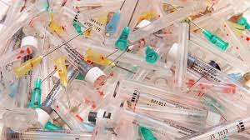
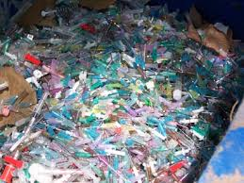
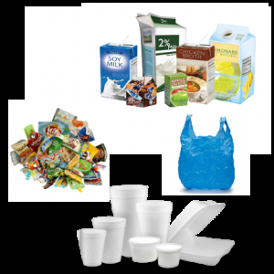
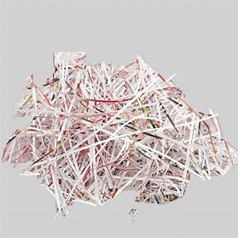
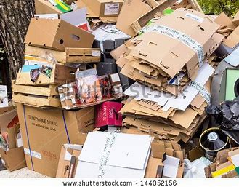
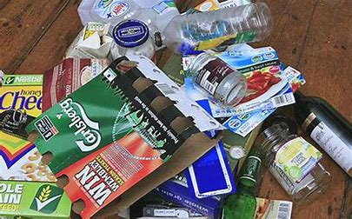
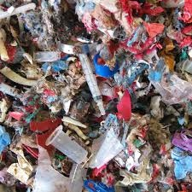
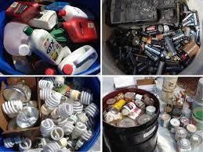


WASTES
BIOMEDICAL WASTES
MUNICIPAL SOLID WASTES

Slide 101
ENVIRONMENTAL AND HEALTH RISK
The improper management of biomedical waste causes serious environmental problems in terms of
Air,
Water and Land pollution.
Biomedical waste that generates air pollution is of three types-
Biological,
Chemical and
Radioactive.

Slide 102
AIR POLLUTION
Hospital Acquired Infections (Nosocomial infection)
Poor ventilation
The paints, carpet, furniture, equipment’s, etc., used in the rooms.
Use of chemicals, disinfectants, fumigants etc.

Slide 103
LAND POLLUTION
Open dumping of biomedical waste is the greatest cause for land pollution.
Soil pollution from bio-medical waste is caused due to infectious waste, discarded medicines, chemicals.
Heavy metals such as cadmium, lead, mercury, etc., which are present in the waste will get absorbed by plants and can then enter the food chain

Slide 104
HEALTH RISK
1. Infection ( G.I.T, RTI, Skin infection, Blood born infections- AIDS, Hep.B &C.
2. Genotoxicity and Cytotoxicity
3. Chemical toxicity
4. Radioactivity hazards.
5. Physical injuries
6. Public sensitivity.

Slide 105
MAJOR COMPONENTS OF WASTE MANAGEMENT ARE:
  Segregation of waste
  Reducing size of Waste
  Reducing use of hazardous substances or processes

Slide 106
BIOMEDICAL WASTE MANAGEMENT
AIM
To protect the public health and environment
OBJECTIVES
To reduce the magnitude of hazardous wastes
To reduce the health and environmental risks

Slide 107
STEPS OF BIOMEDICAL WASTES MANAGEMENT
Characterization
Quantification
Segregation
Storage
Transportation
Treatment
Disposal

Slide 108
BIO-MEDICAL WASTE MANAGEMENT RULES-2016
Schedules: 1 to 4
Form: 1 to 5
Rules: 1 to 18
CENTRAL POLLUTION CONTROL BOARD (CPCB)
http://cpcb.nic.in/bio-medical-waste-rules/

Slide 109
QUANTIFICATION, CHARACTERIZATION
BIOMEDICAL WASTES (15%)
MUNICIPAL SOLID WASTES 85%)
Infectious waste
Pathological waste
Sharps
Pharmaceuticals
Genotoxic waste
Chemical waste
Radioactive waste
Food waste
Vegetables & Fruits
Paper
Cardboard
Bottles, jars
Cans, foils,
Plastics, clothes

Slide 110
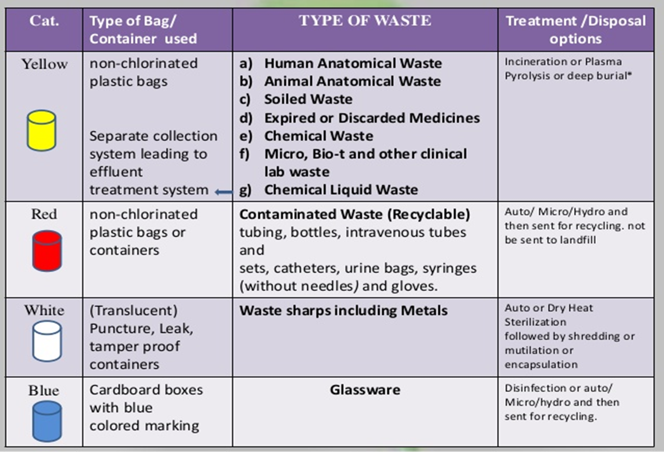
SEGREGATION

Slide 111
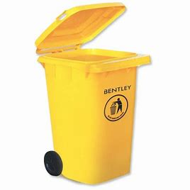

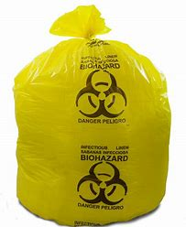
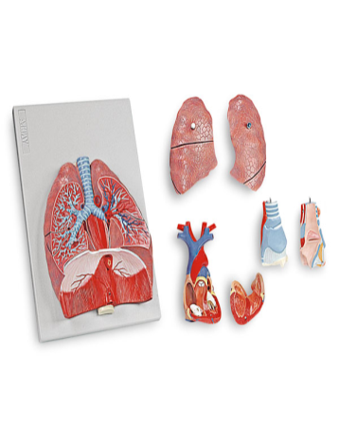
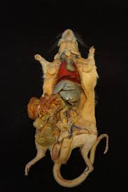
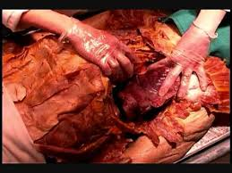
YELLOW BAG & BIN
Human anatomical wastes
Animal Anatomical wastes
Discarded or Expired Medicines
Chemical liquid waste

Slide 112
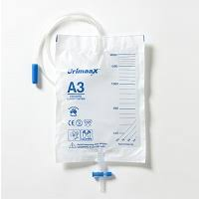
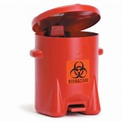
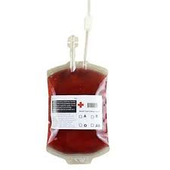


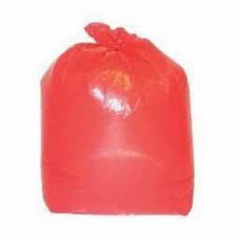
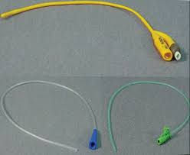
RED BAG & BIN
Recyclable
Tubing
Bags (Urine, Blood)
Bottles
Catheters
Syringes
Gloves

Slide 113
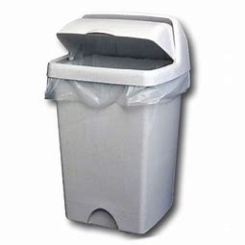
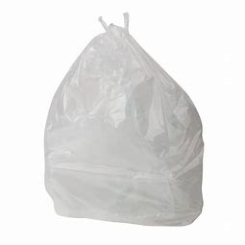



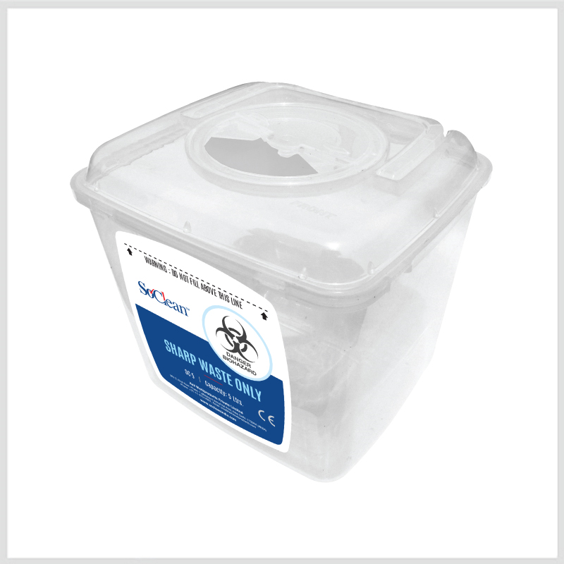


WHITE BAG & BIN
Waste Sharps
Metallic sharps

Slide 114

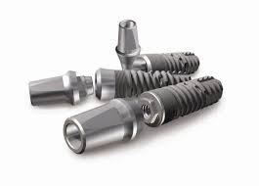

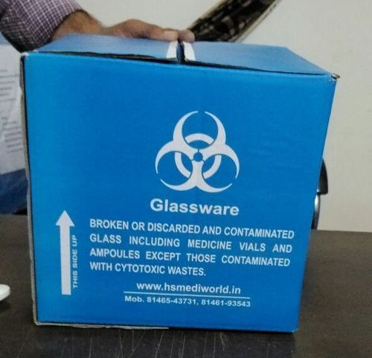
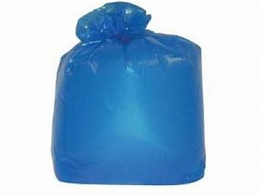

BLUE BAG & BIN OR CARDBOARD BOXES
Glassware, Medicine Vials, Ampoules
Metalic body implants

Slide 115
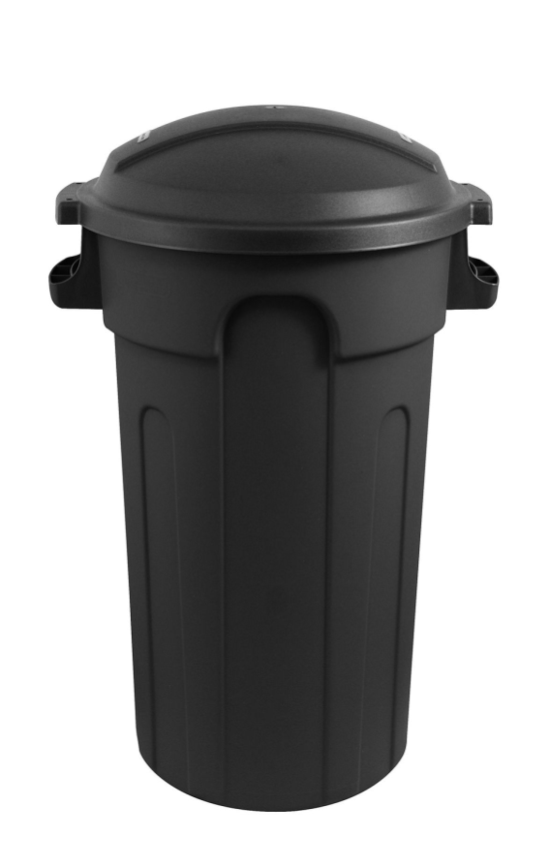
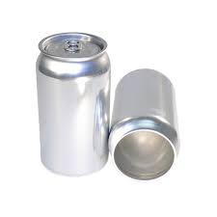
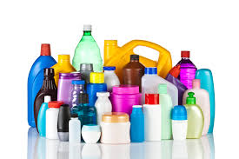
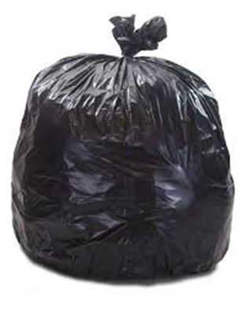

BLACK BAG BIN (15%)
Packaging of equipments
Paper
Cardboard
Cans
Foils
Plastics

Slide 116
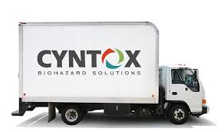
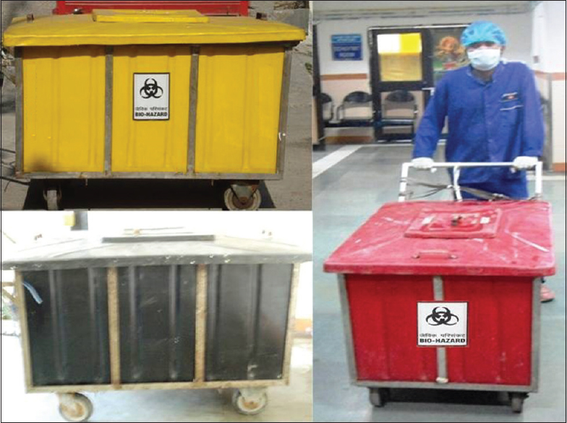
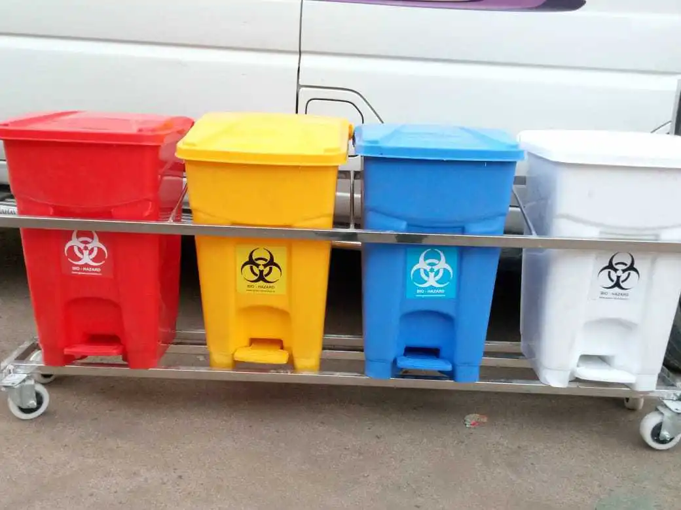
TRANSPORTATION

Slide 117
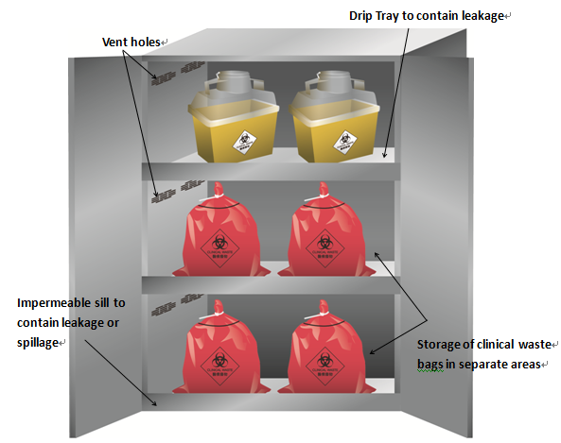
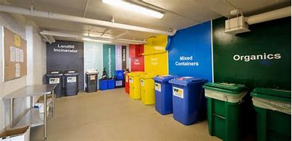
LOCAL STORAGE ROOM

Slide 118
DISPOSAL METHODS OF BIO-MEDICAL WASTES
Incineration ( High temperature dry oxidation)
Chemical disinfection
Inertisation ( 65% waste, 15% lime,15%cement,5% water)
Autoclave
Microwave
Shredder
Plasma pyrolysis
Deep burial

Slide 119
MUNICIPAL SOLID WASTE (MANAGEMENT AND HANDLING) RULES 2000
Generation of solid waste in urban areas increasing rapidly.
Characteristic of solid waste generated at developed countries different-more decompostable but low combustible because high moisture.
India-0.2-0.5 g/capita/day, 35 million tons/year.
Rules-responsibility of management of solid waste disposal and various standard for disposal of treated leachate (liquid that seeped through solid waste and other medium and has extracted dissolved or suspended material from it)- responsibility of municipal authority under Rule 4. D.M./Deputy Commissioner over all responsibility.

Slide 120
CHARACTERISTICS OF SOLID MUCIPAL WASTE
Developing country waste- very low calorie
Cost-6-8 times higher than composting
Control of air pollution very expensive and necessary but rarely well maintained.
Fails if debris and road dust in waste works against interest of recycling industry and thousand of waste dependent workers.

Slide 121
COMPOSTING AND RECYCLING
Should be a legal requirement.
Marketing must be pro-active.
Cities must use their own compost for their parks, gardens and public buildings.
No Sales Tax on soil bio-en-richer products.
Investor friendly policies like BOOT
National agriculture policy to use compost.
Provide decentralized sorting spaces.
Provide waste-pickers with IT cards.
Collect non-recyclable rejects for land filling.
Give recognition and facilities to recyclers.
Give power concessions for pollution control equipment.
Fill geographic gaps in recycling industries.

Slide 122
FOREST AND WILDLIFE

Slide 123
1927-INDIAN FORESR ACT, AMENDMENT 1984
Enacted to consolidate the law related to forest, the transit of forest produce and duty leviable on timber and other forest produce.

Slide 124
1972-wildlife protection act, rules 1973 AMENDMENT 1991
For protection of birds and animals and all maters connected to this whether be their habitat or waterhole or forest that sustain them.

Slide 125
1980-THE FORES(CONSERVATION) ACT AND RULES 1981
For protection and conservation of forest.

Slide 126
WATER

Slide 127
1882-THE EASEMENT ACT
Allows private rights to use a resource by viewing it as an attachment to land.
All surface water belongs to State and State property.

Slide 128
1897- INDIAN FISHERIES ACT
Government can sue any person who uses dynamite or other explosive substance in any way(coastal or inland) with intent to catch or destroy any fish or poisons fish in order to kill.

Slide 129
1956-THE RIVER BOARD ACT
Enables the States to enroll Central Government in setting up an Advisory River Board to resolve issues in inter state cooperation.

Slide 130
1970-MERCHANT SHIPPING ACT
Deal with waste arising from ships along the coastal areas within a specified radius.

Slide 131
1974-THE WATER(PREVENTION AND CONTROL OF POLLUTION) ACT
Establishes an institutional structure for preventing and abating water pollution.
Establish standard for water seek permission to discharge waste into effluent bodies.
The Pollution Control Board(CPCB).

Slide 132
1977-THE WATER(PREVENTION AND CONTROL OF POLLUTION) CESS ACT
For levy and collection of cess or a fee on water consuming industries and local authorities.

Slide 133
1978-THE WATER(PREVENTION AND CONTROL OF POLLUTION) CESS RULES
Contain the standard definitions and indicate the kind of and location of meters that every consumer of water required to affix.

Slide 134
1991-COASTAL REGULATION ZONE NOTIFICATION
Puts regulation on various activities including construction are regulated.
Gives protection to backwaters and estuaries.

Slide 135
AIR

Slide 136
1948-FACTORIES ACT AMENDMENT 1987
1st to express concern for working environment of workers.
Amendment 1987-sharpens its environment focus and expanded its application to hazardous processes.

Slide 137
1981-AIR(PREVENTION AND CONTROL OF POLLUTION) ACT
Control and abatement of air pollution.
Entrusts power of enforcing this act to Central Pollution Control Board.

Slide 138
1982-AIR(PREVENTION AND CONTROL OF POLLUTION) RULES
Defines procedures of meetings of the Boards and power entrusted on them.

Slide 139
1962-ATOMIC ENERGY ACT
Deals with radioactive waste.

Slide 140
1987-AIR(PREVENTION AND CONTROL OF POLLUTION)AMENDMENT ACT
Empowers the central and state pollution boards to meet with grave emergencies of air pollution.

Slide 141
1988- MOTOR VEHICLE ACT
All hazardous waste to be properly packaged, labeled and transported.

