Slide 2
Physical quality of life index (PQLI)
Various attempts have been made to reach one composite index from a number of health indicators.
The "Physical quality of life index" is one such index. It consolidates three indicators, viz. infant mortality, life expectancy at age one, and literacy.

Slide 3
These three components measure the results rather than inputs. As such they lend themselves to international and national comparison.

Slide 4
For each component, the performance of individual countries is placed on a scale of O to 100, where 0 represents an absolutely defined "worst" performance, and 100 represents an absolutely defined "best" performance.

Slide 5
The composite index is calculated by averaging the three indicators, giving equal weight to each of them. The resulting PQLI thus also is scaled 0 to 100.

Slide 6
It may be mentioned that PQLI has not taken per capita GNP into consideration, showing thereby that "money is not everything".
For example, the oil-rich countries of Middle East with high per capita incomes have in fact not very high PQLIs.
At the other extreme, Sri Lanka and Kerala state in India have low per capita incomes with high PQLIs.

Slide 7
Human Development Index (HDI)
Human development index (HDI) is defined as "a composite index focusing on three basic dimensions of human development : to lead a long and healthy life measured by life expectancy at birth; the ability to acquire knowledge, measured by mean years of schooling and expected years of schooling; and the ability to achieve a decent standard of living, measured by gross national income per capita in PPP US $.

Slide 8
Thus the concept of HDI reflects achievements in the most basic human capabilities, viz, leading a long life, being knowledgeable and enjoying a decent standard of living. Hence, these three variables have been chosen to represent those dimensions.

Slide 9
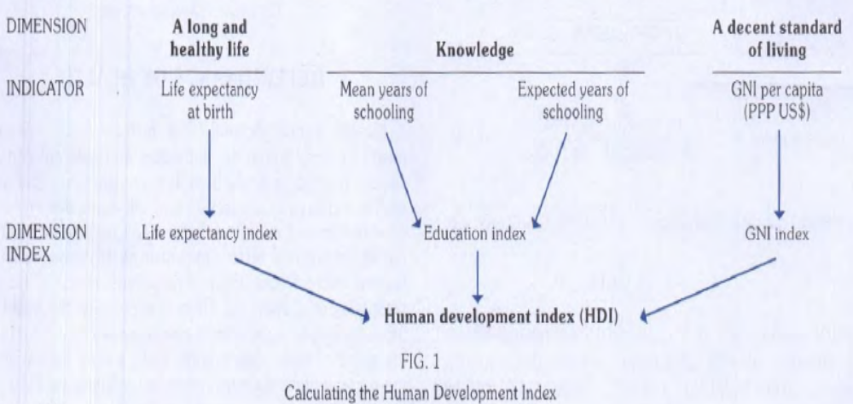

Slide 10
The HDI values range between 0 to 1. The HDI value for a country shows the distance that it has already travelled towards maximum possible value to 1. and also allows comparisons with other countries.

Slide 11
Minimum and maximum values (goalposts) are set in order to transform the indicators into indices between 0 and 1. The maximums are the highest observed values in the time series ( 1980-2011).
The minimum values can be appropriately conceived of as subsistence values. The minimum values are set at 20 years for expectancy, at 0 years for both education variables and at $163 for per capita gross national income (GNI).

Slide 12
