Slide 1
PLANNING A BALANCED DIET
DR. PIYUSH GUPTA

Slide 2


Slide 3
FIRST THING IS DAILY REQUIREMENT OF PROTEIN SHOULD BE MET (10-15% OF DAILY ENERGY INTAKE )
FAT REQUIRMENT (15-30% OF DAILY ENERGY INTAKE)
CARBOHYDRATE RICH IN NATURAL FIBRE WITH REQUIREMENT OF MICRONUTRIENT SHOULD CONSTITUTE THE REMAINING FOOD ENERGY.

Slide 4
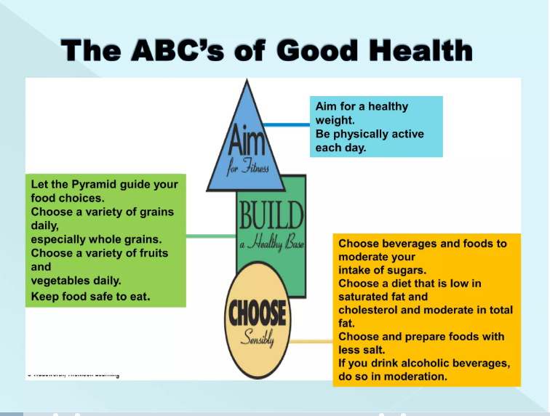

Slide 5
DIETARY GOALS
DIETARY FAT SHOULD BE LIMITED TO APROX. 15 -30 % OF TOTAL DAILY INTAKE.
SATURATED FATS SHOULD CONTRIBUTE NO MORE THAN 10 % OF TOTAL ENERY INTAKE , UNSATURATED VEGETABLE OILS SHOULD BE SUBSTITUTED FOR REMAINING FAT REQUIREMENT.
EXCESSIVE CONSUMPTION OF REFINED CARBOHYDRATE SHOULD BE AVOIDED.

Slide 6
CONTI..
SOURCES RICH IN ENERGY SUCH AS ALCOHOL AND FAT SHOULD BE RESTRICTED.
SALT INTAKE SHOULD BE REDUCED TO AN AVERAGE OF NOT MORE THAN 05 GM/DAY.(IN INDIAIT AVERGAE 15GM /DAY)
PROTEIN SHOULD ACCOUNT FOR 10-15 %OF DAILY INTAKE.
JUNK FOOD SUCH AS COLAS KETCHUPS AND OTHER FOODS THAT SUPPLY EMPTY CALORIES SHOULD BE REDUCED.

Slide 7
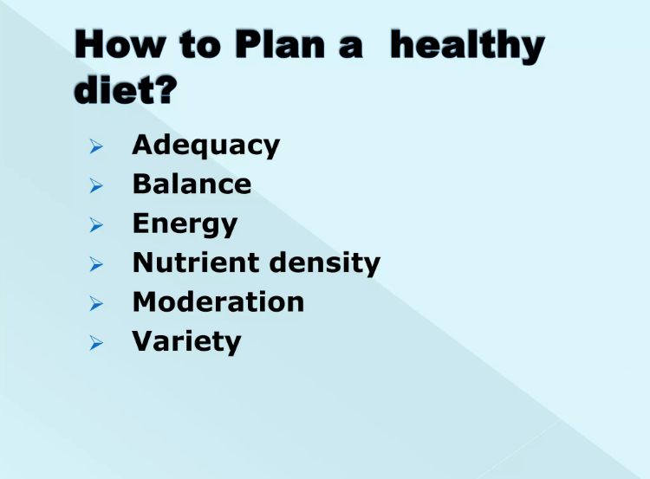

Slide 8
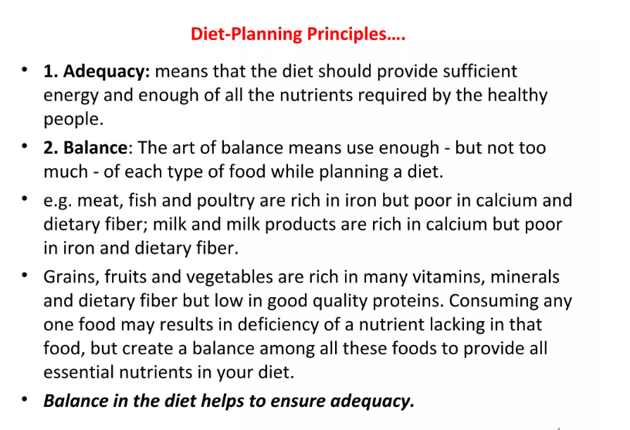

Slide 9
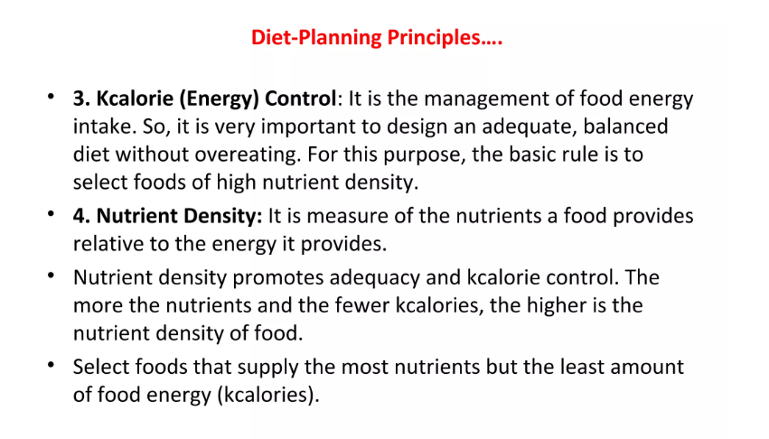

Slide 10
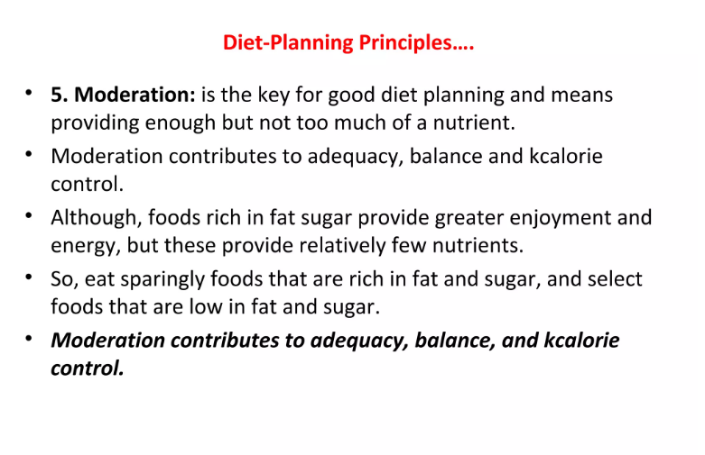

Slide 11
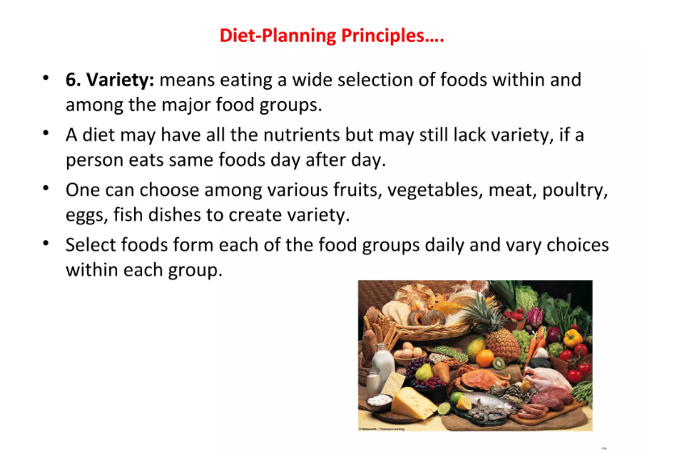

Slide 12
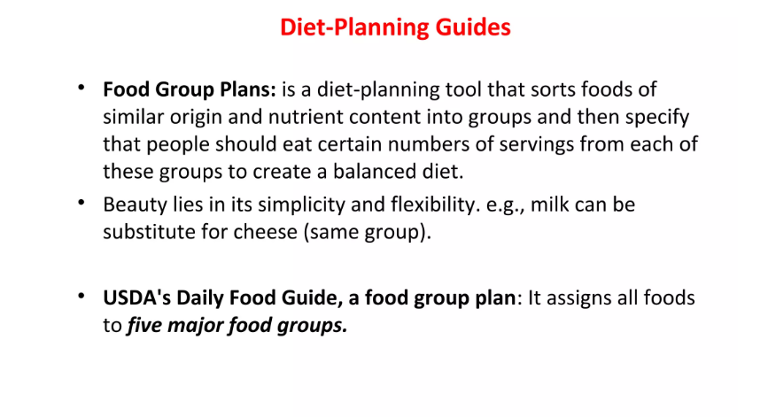

Slide 13
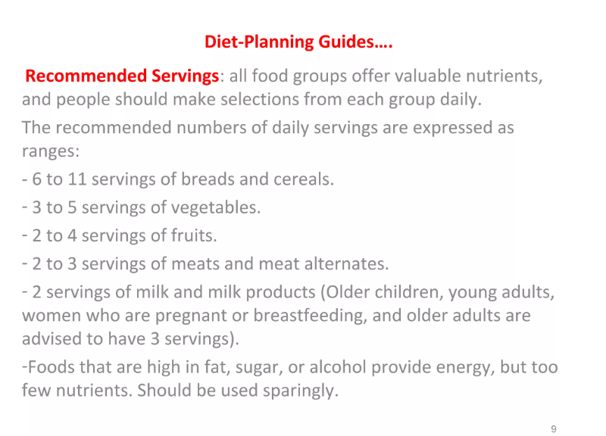

Slide 14
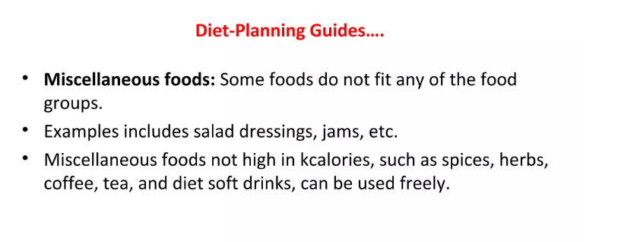

Slide 15
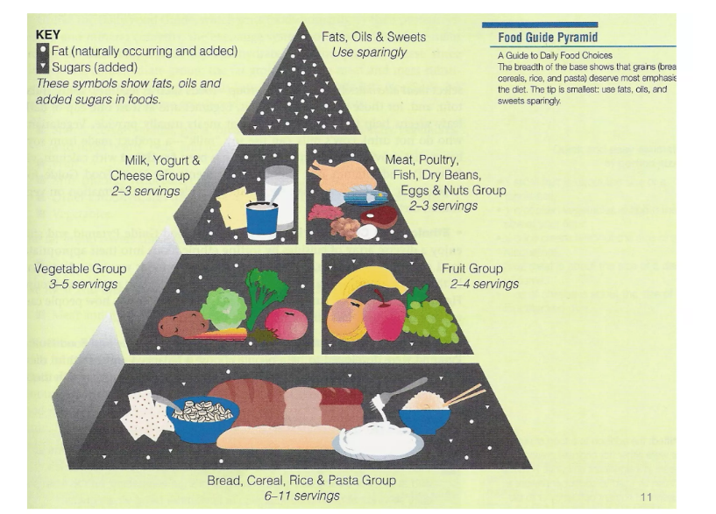

Slide 16
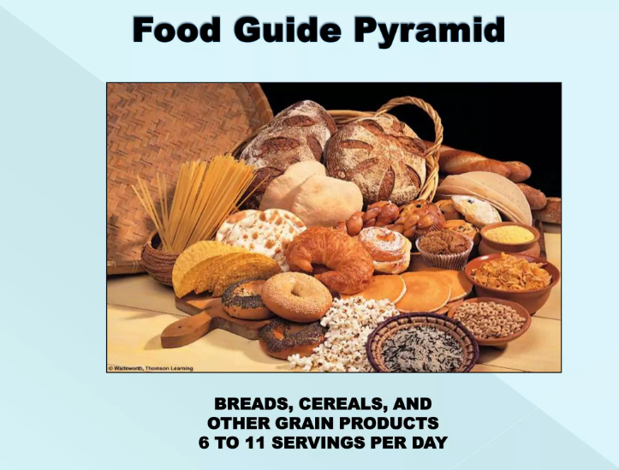

Slide 17
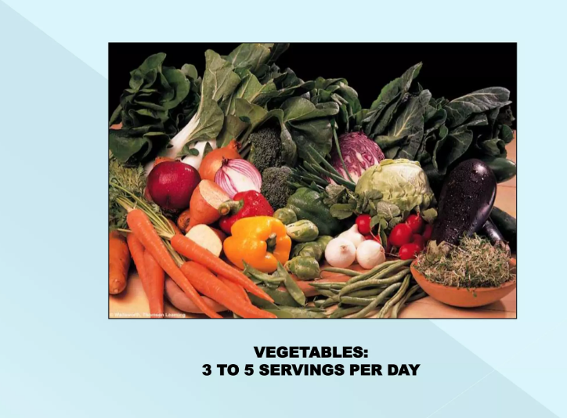

Slide 18
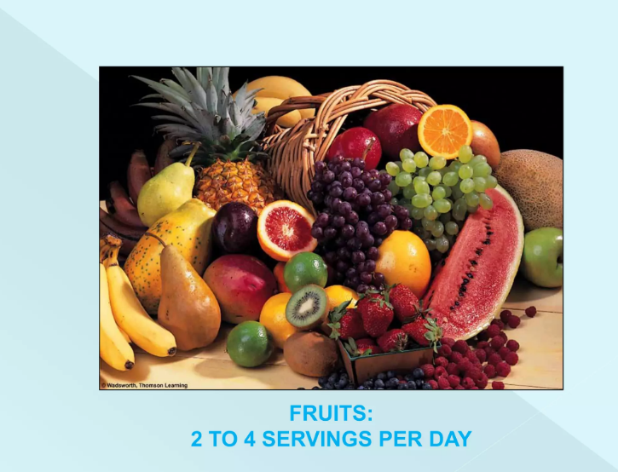

Slide 19
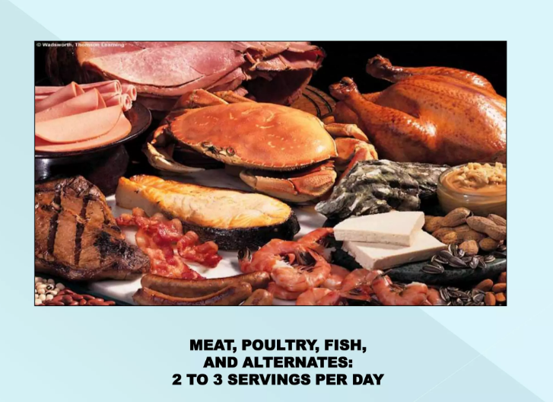

Slide 20
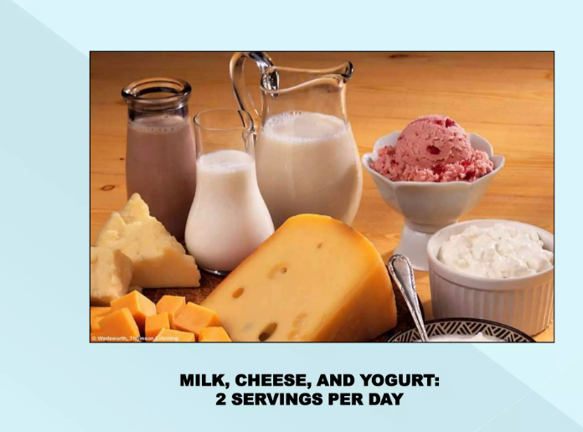

Slide 21
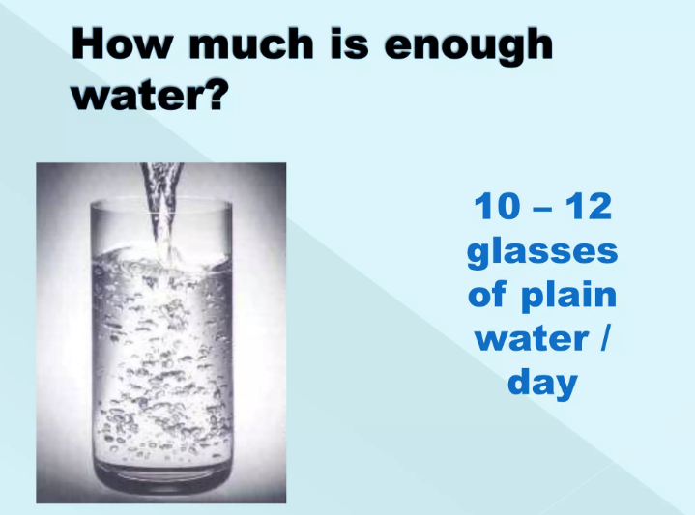

Slide 22
