Slide 1
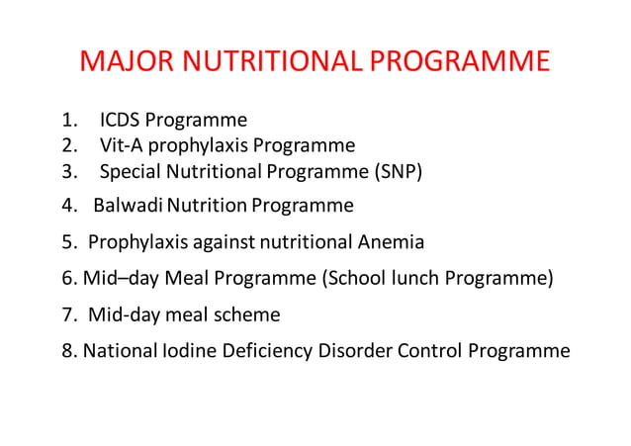

Slide 2
Nutrition programme in india
Vitamin A Prophylaxis Program
Covering Program: national program for control of blindness 1976,MOHFW
Strategy: Single massive dose of Vit A ( 2000,000 IU) every 6 months to pre-school children.

Slide 3
2. National Immunization Schedule
Covering Program: Reproductive and Child Health ( RCH) Programme 1997,MOHFW
Strategy …………..

Slide 4
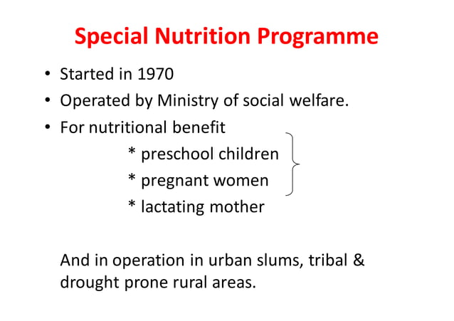

Slide 5
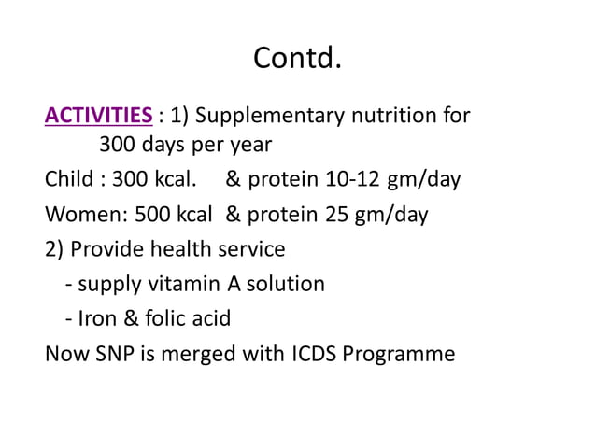

Slide 6
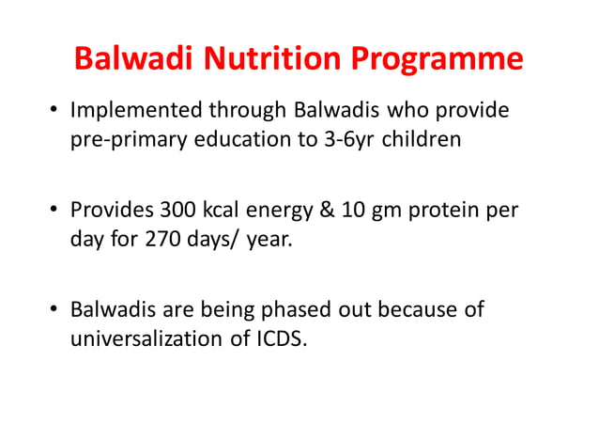

Slide 7
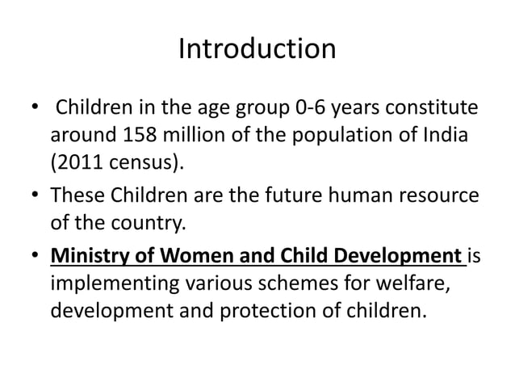
Integrated child development services ( icds)

Slide 8
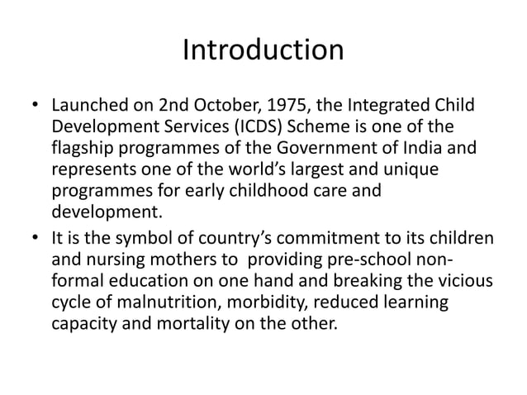

Slide 9
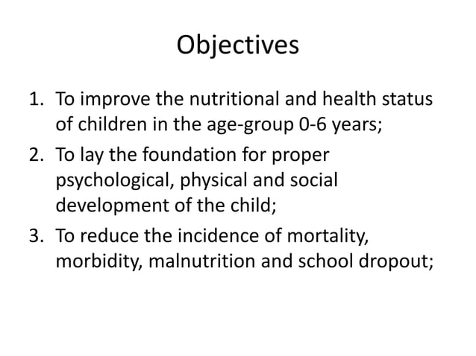

Slide 10
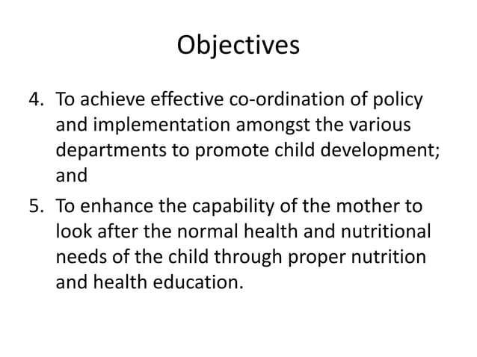

Slide 11
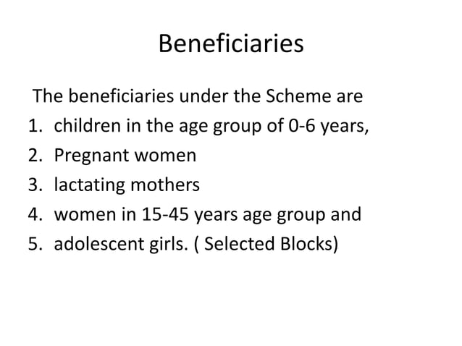

Slide 12
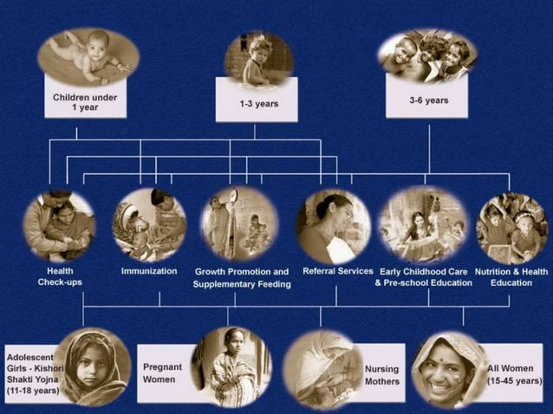

Slide 13
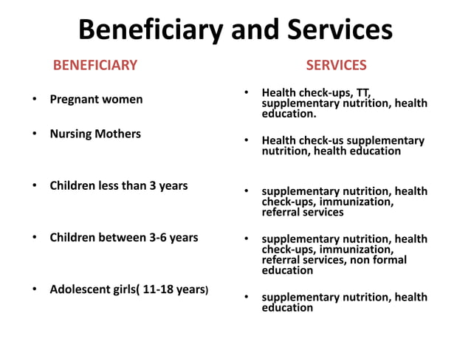

Slide 14
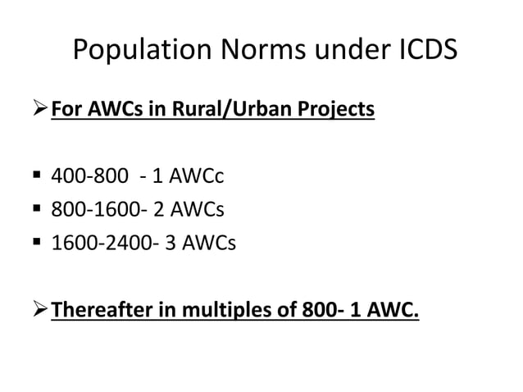

Slide 15
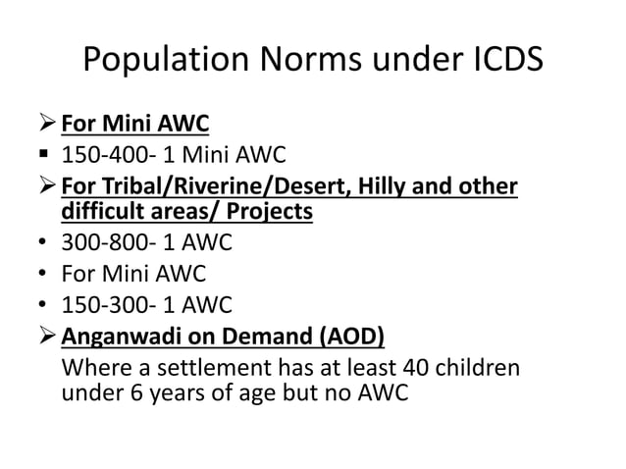

Slide 16
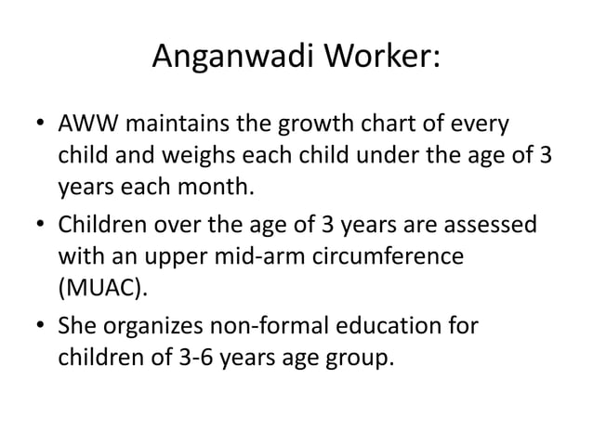

Slide 17
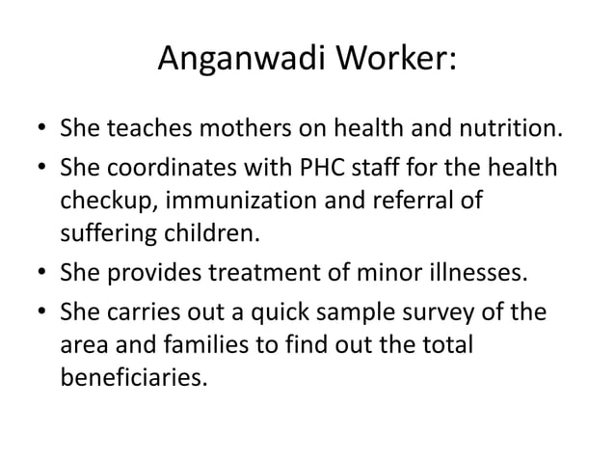

Slide 18
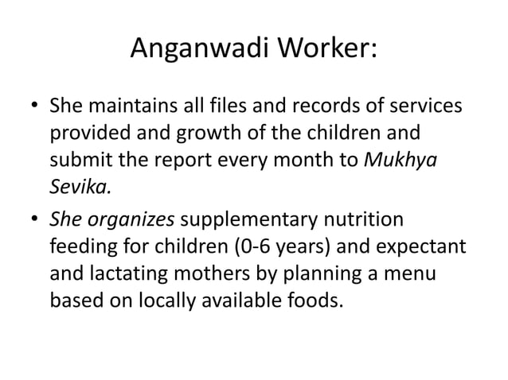

Slide 19
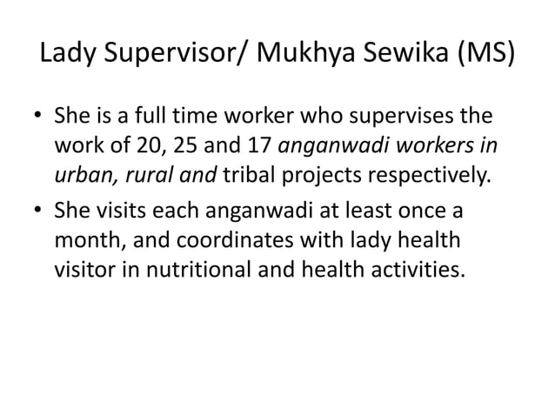

Slide 20
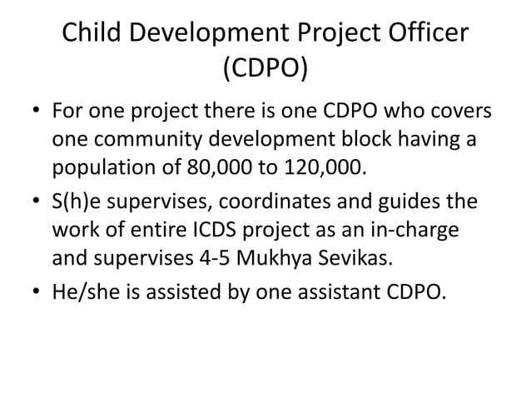

Slide 21


Slide 22
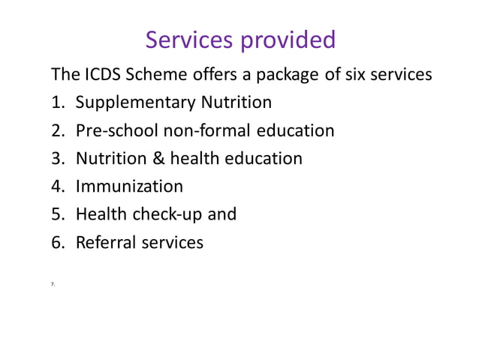

Slide 23
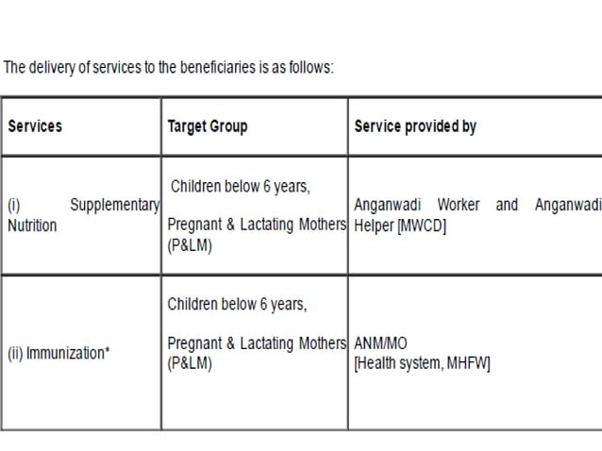

Slide 24
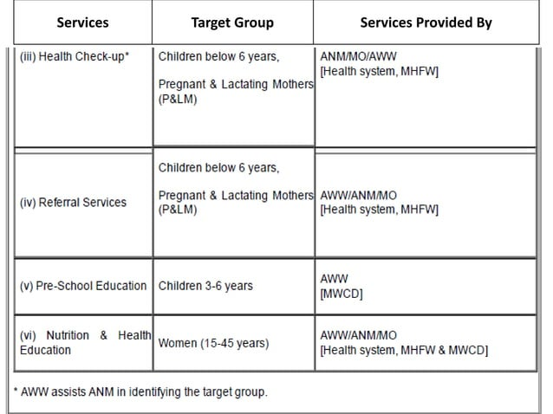

Slide 25
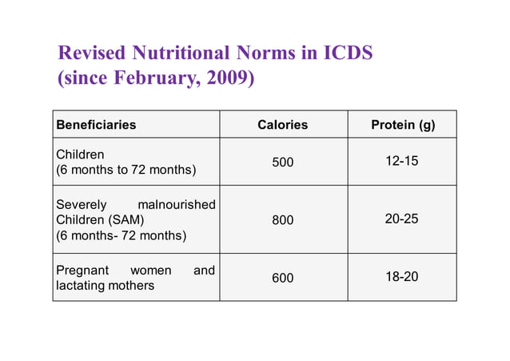

Slide 26
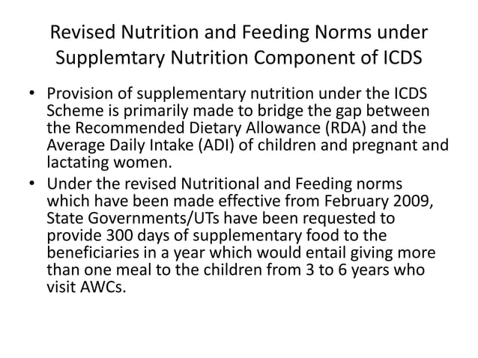

Slide 27
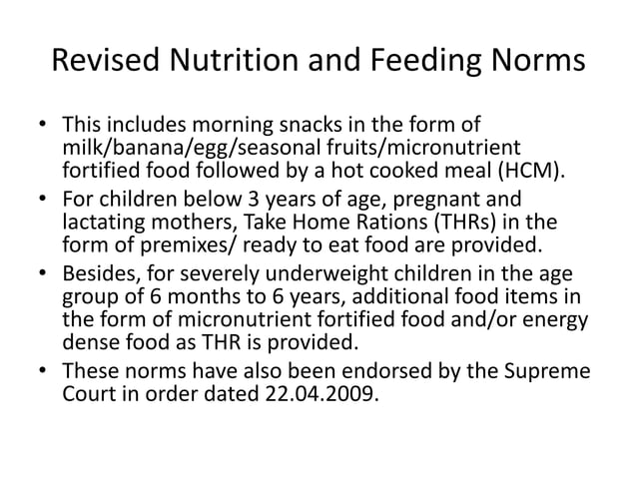

Slide 28
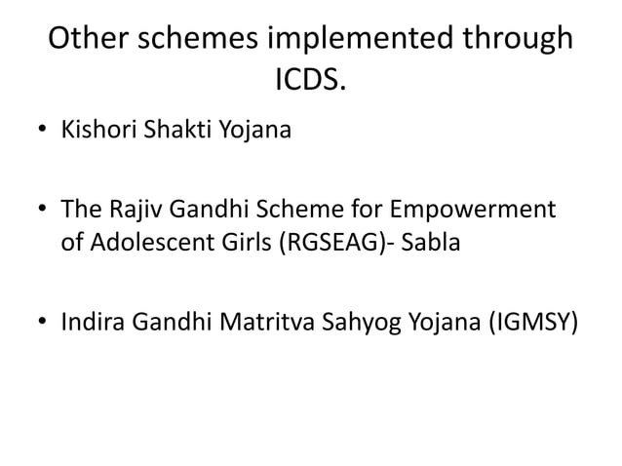

Slide 29
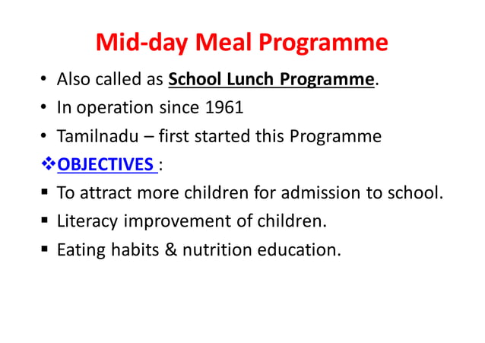

Slide 30
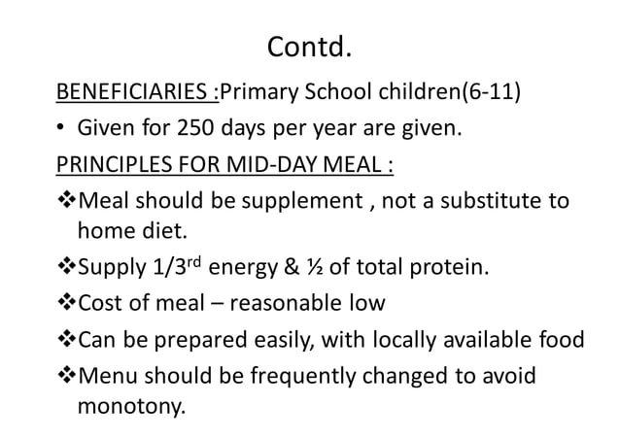

Slide 31
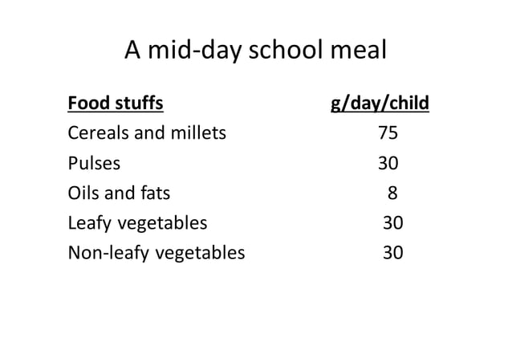

Slide 32
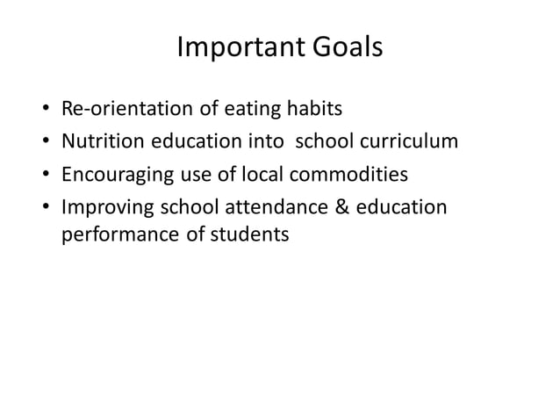

Slide 33
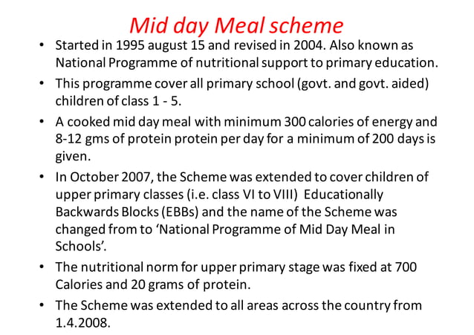

Slide 34
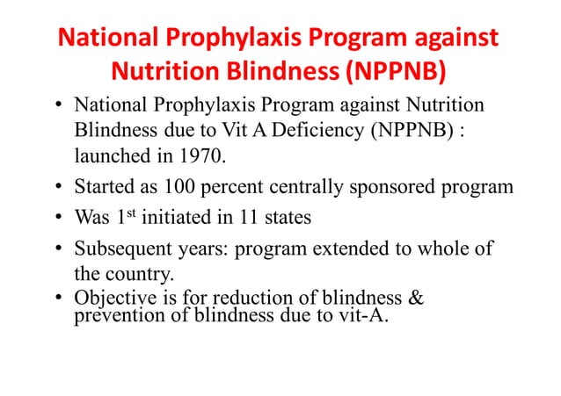

Slide 35
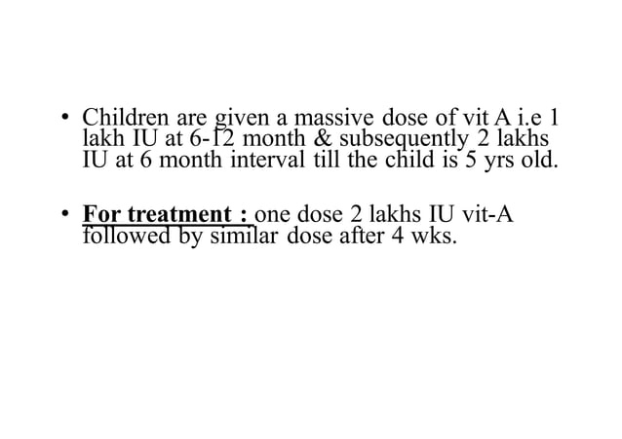

Slide 36
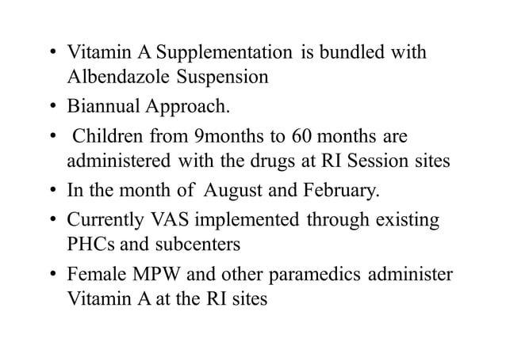

Slide 37
National nutritional anemia control programme
Objective : Significantly decrease incidence and prevalence of anemia in:
Reproductive age group women
Pregnant and lactating women
Preschool children
Adolescent girls
Strategies-
Promotion of regular consumption of iron rich foods
Provision of iron and folate supplements to high risk groups
Identification and treatment of severe anemia cases

Slide 38
Implementation of program:
PHC and subcentres : Multipurpose workers distribute supplementation tablets
ICDS :Anganwadi workers promote nutritious food consumption
Vandemataram scheme : involvement of private practitioners under NRHM ( RCH component) to provide free obstetric services include IFA distribution.

Slide 39


Slide 40
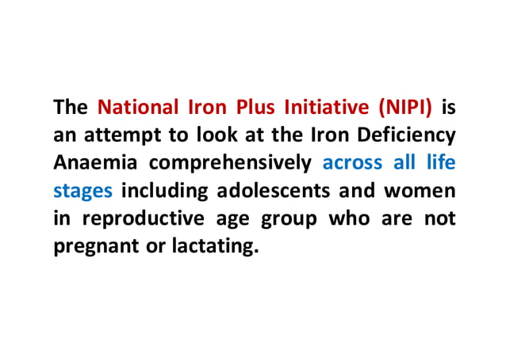

Slide 41


Slide 42
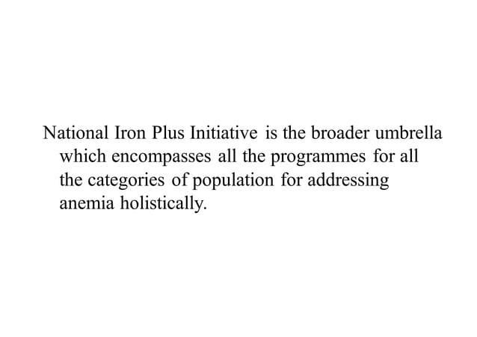

Slide 43
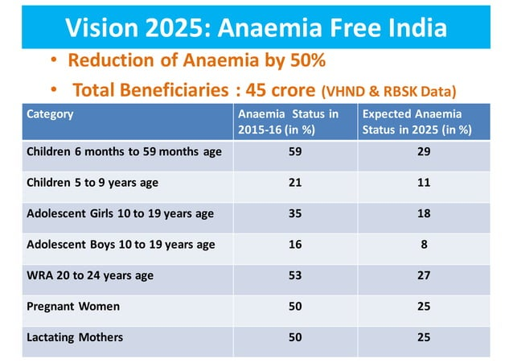

Slide 44
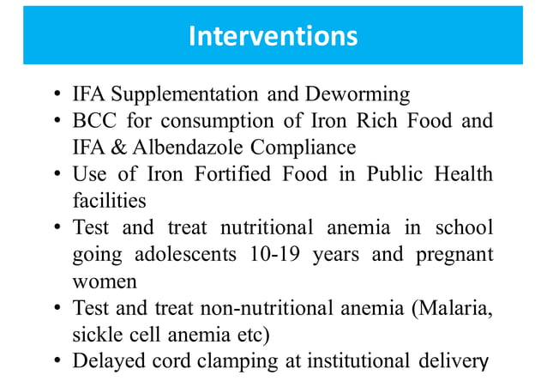

Slide 45
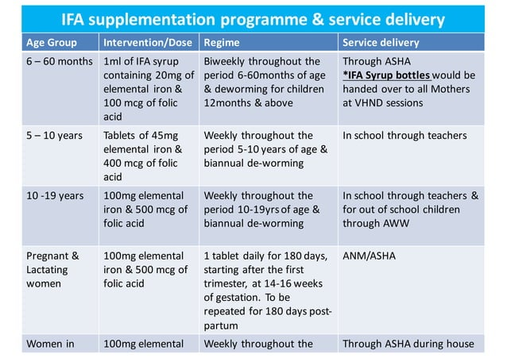

Slide 46
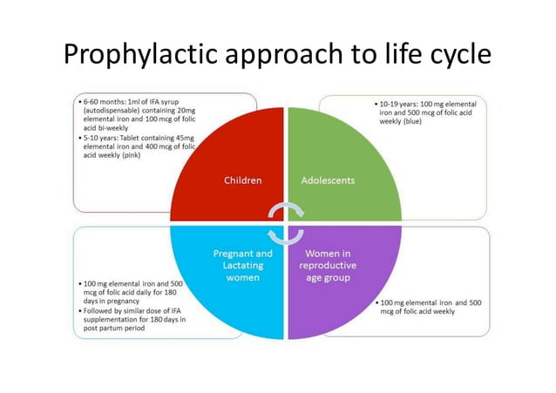

Slide 47


Slide 48
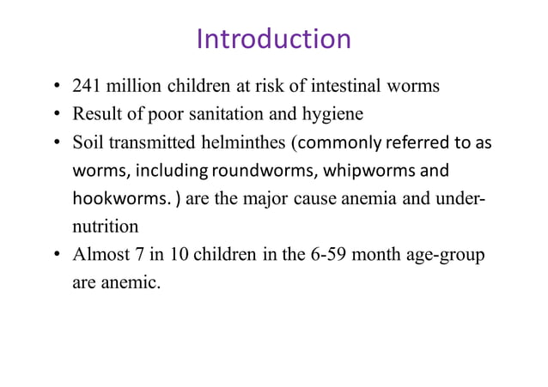

Slide 49
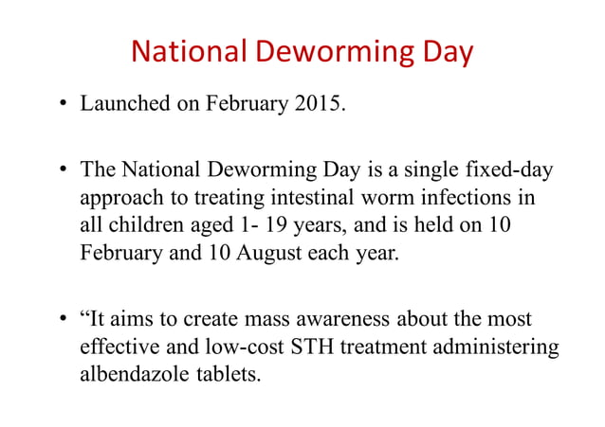

Slide 50
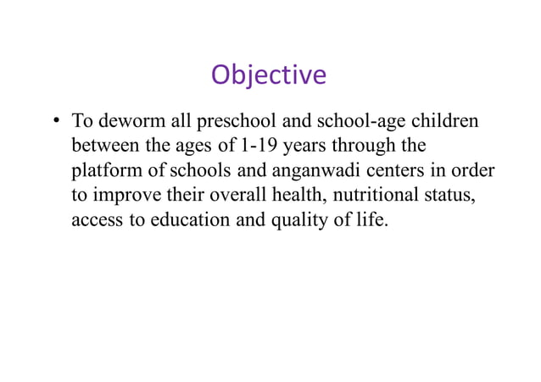

Slide 51
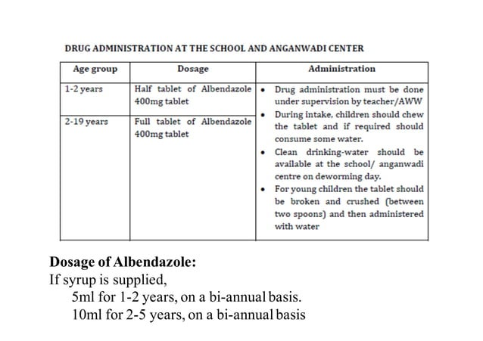

Slide 52


Slide 53
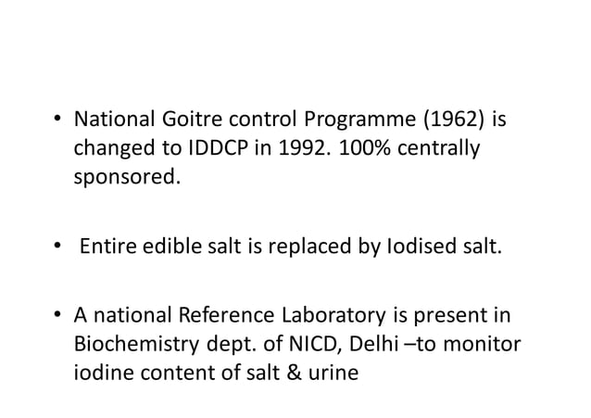

Slide 54
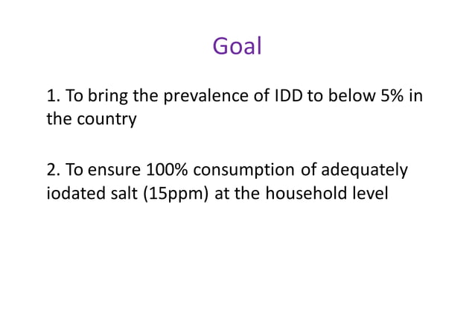

Slide 55
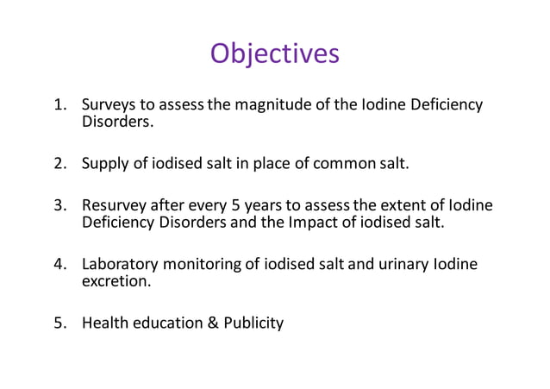

Slide 56
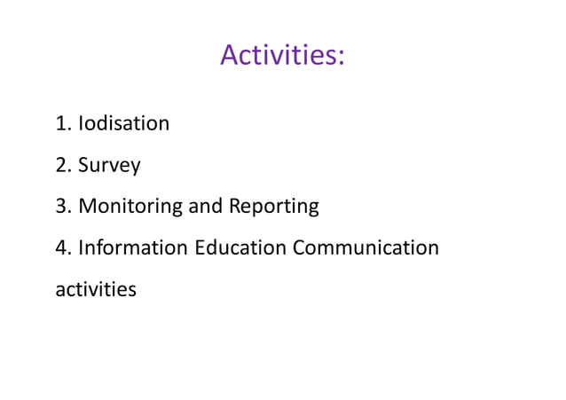

Slide 57
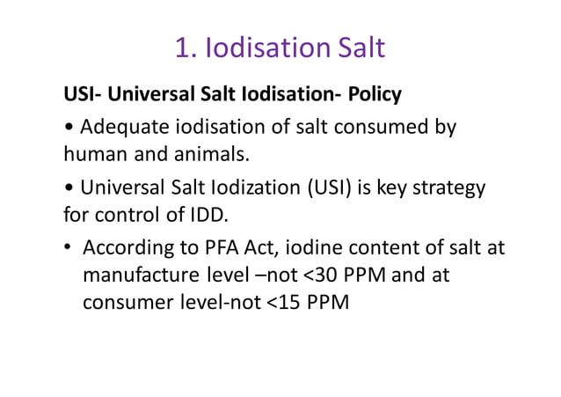

Slide 58
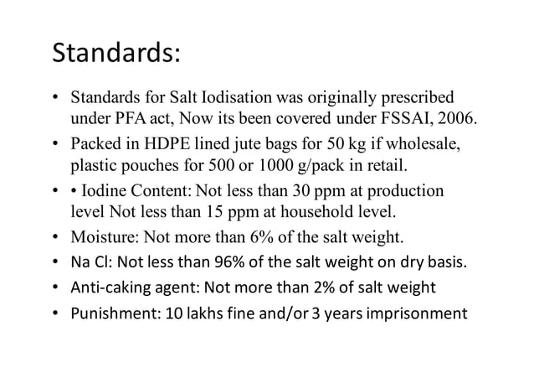

Slide 59
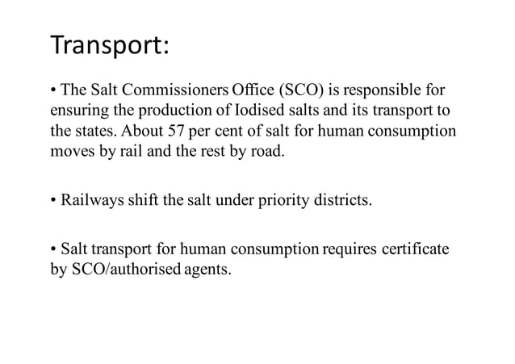

Slide 60


Slide 61


Slide 62


Slide 63


Slide 64


Slide 65


Slide 66


Slide 67


Slide 68


Slide 69


Slide 70


Slide 71


Slide 72


