Slide 1
Nutritional assessment of children in India.

Slide 2
Learning objectives
Nutritional assessment of family
Nutritional assessment of individual
Dietary advice for individual

Slide 3
NUTRITIONAL PROFILE OF INDIA
Under 5 children Stunted | 48%
Under 5 children Wasted | 19.8%
Under 5 children Underweight | 43%
Underweight children in the lowest wealth index category | 56.6%
Underweight children in the highest wealth index category | 19.7%
Male children (6 – 59 months) with any anemia | 69%
Female children (6 – 59 months) with any anemia | 69.9%
Pregnant women with anemia | 57.9%
Lactating women with anemia | 56.4%
Adolescent girls with anemia | 90%

Slide 4
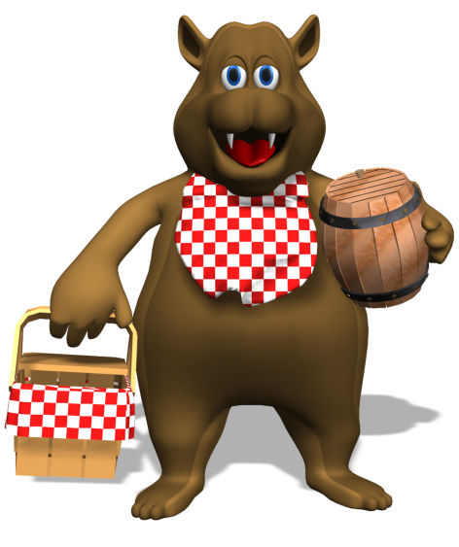
A Healthy Diet and Our Body
If our bodies are human machines food is our fuel. How well we eat, affects how well our bodies work, and how long we live.
It is especially important that we eat healthily as children, as we are still growing and developing; a young plant not given proper nutrients grows up to be a poor specimen ☹.
A healthy diet is sometimes called a balanced diet as it needs to consist of different types of foods.
Eating properly and regularly is really important; what we eat and drink now, affects our health in the future.
Foodie fact
Children that eat breakfast get better scores in tests than children that don’t!

Slide 5
RECOMMENDED DIETARY ALLOWANCES(RDA)
The RDA of a nutrient is the amount (of that nutrient) sufficient for the maintenance of health in nearly all people
It covers the requirement of 97.5% of the population

Slide 6
NUTRITIONAL STATUS ASSESSMENT
Done by
  Anthropometry
  Biochemical & lab methods
  Clinical assessment
  Diet survey

Slide 7
Clinical assessment-
There are many clinical signs ,some specific and many non specific , known to be associated with state of malnutrition.
Like – angular stomatitis, bitot’s spot , calf tenderness , absence of knee , ankle jerks (beri-beri), enlargement of thyroid (endemic goitre)

Slide 8
ASSESSMENT OF NUTRITIONAL STATUS THROUGH ANTHROPOMETRY
The commonly used methods are
  Height
  Crown-heel length(for Infants)
  Body weight
  Mid upper arm circumference
  Fat fold thickness
  Head and chest circumference (children under five years of age)

Slide 9
CLASSIFICATION OF NUTRITIONAL STATUS BASED ON WEIGHT & HEIGHT
Malnutrition grade according to Weight/Age ( Gomaz Classification), (without edema)
  Normal = >90%
  Grade I (Mild) = 75 – 89 %
  Grade II (Moderate) = 60 – 74 %
  Grade III (Severe) = < 60 %

Slide 10
Waterlow’s classification - THIS IS BASED ON THE WEIGHT OF THE CHILD AND PRESENCE OF OEDEMA , THE WEIGHT IN KG COMPARED WITH REFERNECE WEIGHT FOR AGE .
WEIGHT FOR AGE (%)= CURRENT WEIGHT OF THE CHILD X100
EXPECTED WEIGHT OF THE CHILD FOR THAT AGE

Slide 11
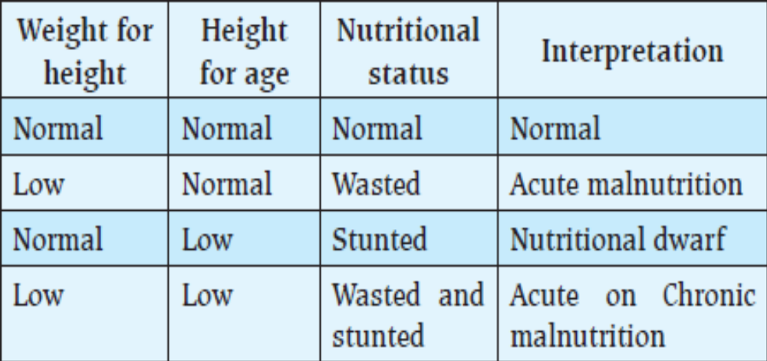
Malnutrition according to height & weight in relation to age

Slide 12
LABORATORY:
1. Hemoglobin, RBC count, Hematocrit, PCV, Blood smear.
2. Stool
3. urine
Biochemical-transferrin saturation, iron studies, sr. folic acid ,vitamin B12 levels, serum albumin, Prothrombin time,etc.

Slide 13
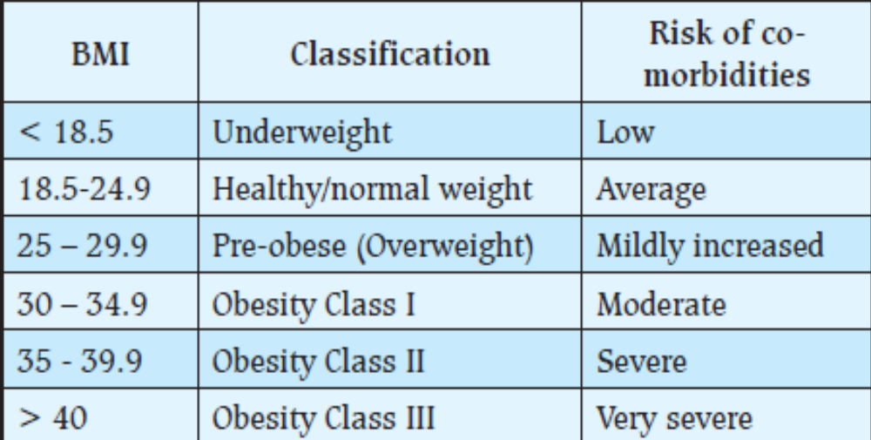
Malnutrition according to various anthropological parameters
  Body Mass Index

Slide 14
ACCORDING TO NEW GUIDELINES FOR INDIANS
< 18 | Underweight
18 – 22.9 | Normal
23 – 24.9 | Overweight
25 – 29.9 | Obesity I
30 – 31.9 | Obesity II
≥ 32 | Obesity III

Slide 15
Waist circumference
METHODOLOGY
  WC should be measured using non-stretchable flexible tape in horizontal position, just above the iliac crest, at the end of normal expiration, in the fasting state, with the subject standing erect and looking straight forward and observer sitting in front of the subject.
Both BMI and WC should be used together (with equal importance) for population and clinic-based risk stratification.

Slide 16
WAIST CIRCUMFERENCE CUT-OFFS FOR INDIANS
ACTION LEVEL 1
  Men: 78 cm
  Women : 72 cm
Any person with WC above these levels should avoid gaining weight and maintain physical activity to avoid acquiring any of the cardiovascular risk factor.
ACTION LEVEL 2
  Men: 90 cm
  Women : 80 cm
Subject with WC above this should seek medical help so that obesity-related risk factors could be investigated and managed.

Slide 17
MID UPPER ARM CIRCUMFERENCE(MUAC)
MUAC remains almost constant between 1 to 5 years of age
An efficient technique for screening
Easy to conduct and it is age independent till about 5 years of age
MUAC of less than 13.5 cm-low (malnutrition)
Simpler and usable at the grass root level (shaki’s tape)
Three color Zones
  Red ( <11.5 cm ) – Danger (Severe Malnutrition)
  Yellow (13.5-11.5 cm) – Caution (Moderate Malnutrition)
  Green (>13.5 cm) - Normal

Slide 18
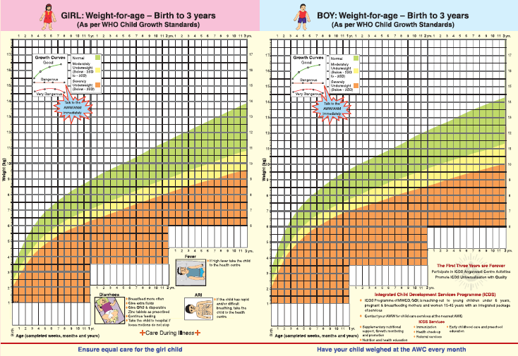
Growth Chart

Slide 19
ASSESSMENT OF NUTRITIONAL STATUS USING BIOCHEMICAL AND LABORATORY METHODS
HEMATOLOGICAL TESTS:
  Hb estimation
  Peripheral Blood Film
PARASITOLOGICAL TESTS
  Stool examination for intestinal parasites
BIOCHEMICAL TESTS
  For S. Protein, S. Electrolyte
  Test for vitamins level estimation

Slide 20
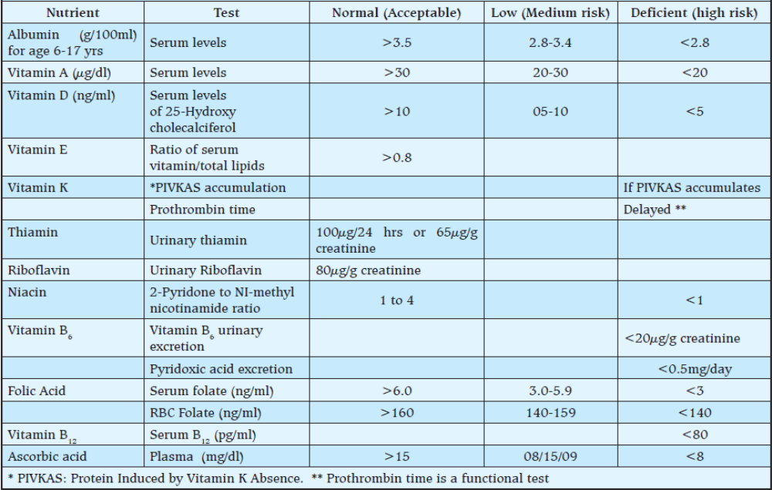
BIOCHEMICAL TESTS FOR ESTIMATION OF VITAMINS LEVEL

Slide 21
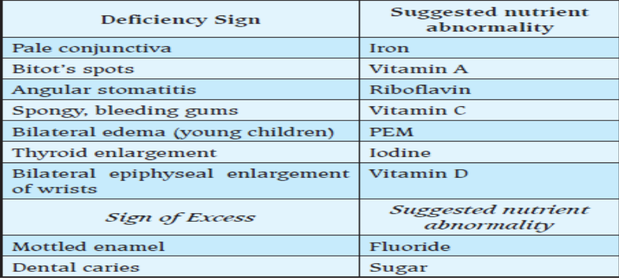
ASSESSMENT OF NUTRITIONAL STATUS USING CLINICAL SIGNS
GROUP 1 - Potentially Nutritionally Significant (Signs ‘strongly suggestive’ of dietary deficiency or excess)

Slide 22
GROUP 2
Signs that are of probable nutritional significance
  Signs with uncertain nutritional significance
  Xanthomata eye for high blood cholesterol,
  Corneal scar (previous infection, trauma, malnutrition, avitaminosis A)
  Fissure tongue, recession of gums
  Transverse ridging of nails

Slide 23
DIETARY ASSESSMENT FOR NUTRITIONAL STATUS
TO FIND OUT
  This nutritional deficiency is because of diet
  Which particular diet/Food Items need to include in diet
DIET SURVEY IS DONE BY
  Inventory method
  Weighment method
  24 hr Recall method (Questionnaire method)
  Food Frequency Questionnaire method

Slide 24
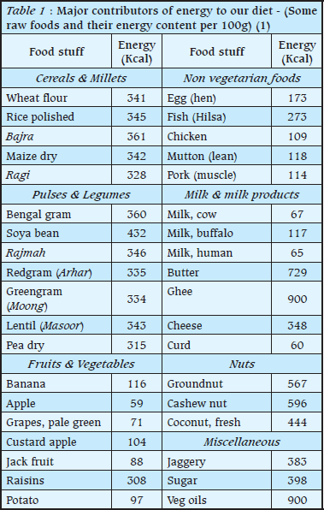
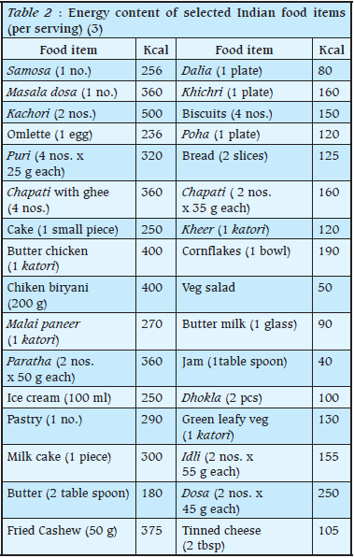

Slide 25
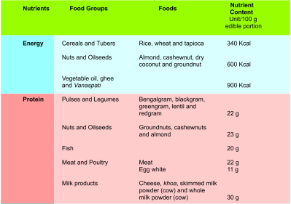
NUTRIENT RICH FOODS

Slide 26
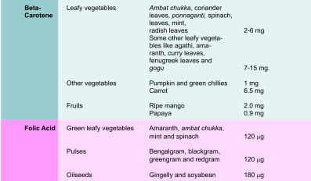

Slide 27
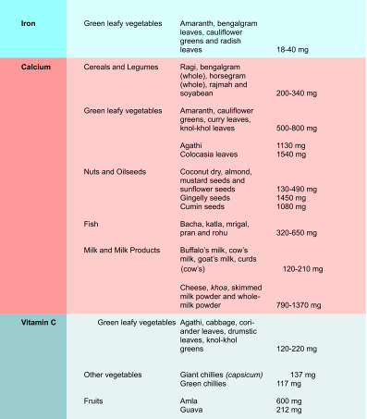

Slide 28
DIETARY ASSESSMENT OF FAMILY
Preferably by Stock – Inventory method
By calculating Energy / Protein consumption per Consumption unit
Consumption Unit is defined as energy of an sedentary adult as one unit and other coefficient are worked out on the basis of it
1 unit of Calorie coefficient consumption unit corresponds to 2318 Kcal / Day and 60 gm protein / day

Slide 29
AGE WISE AND SEX WISE CALORIE COEFFICIENT CONSUMPTION UNIT
PERSON / AGE |  | CONSUMPTION UNIT
Adult male | Sedentary | 1.0
 | Moderate | 1.2
 | Heavy | 1.6
Adult female | Sedentary | 0.8
 | Moderate | 0.9
 | Heavy | 1.2
Adolescent | 12 – 21 Years | 1.0
Children | 9 – 12 Years | 0.8
 | 7 - 8 Years | 0.7
 | 5 – 6 Years | 0.6
 | 3 – 4 Years | 0.5
 | 1 – 2 Years | 0.4

Slide 30
DIETARY ASSESSMENT OF INDIVIDUAL
Done by 24 hr recall method
History taken on 3 different occasions
Average intake is measured
Compare with recommended requirement according to age, weight and type of work
Compare individual nutrient against the recommended limit

Slide 31
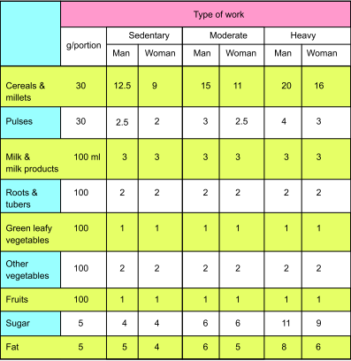
BALANCED DIET FOR ADULTS
(NO. OF PORTIONS PER DAY)

Slide 32
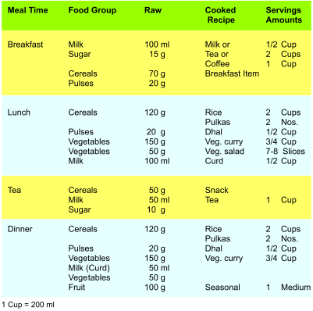
MEAL PLAN FOR ADULT MALE (SEDENTARY)

Slide 33
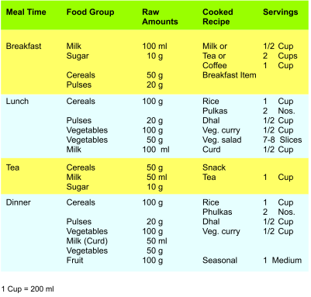
MEAL PLAN FOR ADULT FEMALE (SEDENTARY)

Slide 34
DIET OF PREGNANT LADY & LACTATING LADY
Nutrients | Pregnancy | Lactation (0-6 mths) | Lactation (6-12 mths)
Energy | + 350 kcal | + 600 kcal | + 520 kcal
Protein | +27 g | + 23 g | + 15 g
Fat | + 10 g | + 10 g | + 10 g
Iron | + 14 mg | + 5 mg | + 5 mg
Calcium | + 600 mg | + 600 mg | + 600 mg
Vit A | + 200 µg | + 350 µg | + 350 µg
Folic Acid | + 300 µg | + 50 µg | + 50 µg

Slide 35
BALANCED DIET FOR A PREGNANT WOMAN
FOOD GROUP | FOOD STUFF | AMOUNT PER DAY
Cereals | Rice, Wheat, Millets | 300 gm
Fats | Oil, Ghee, Butter | 30 gm
Sugars | Sugar, Jaggery | 20 gm
Milk | Milk & milk products | 500 ml
Pulses & Nuts | Pulses, Legumes, Beans | 60 gm
Fruits and vegetables | Fruits | 200 gm
 | Vegetables | 350 gm
 | Green leafy vegetables | 350 gm
 | Other vegetables | 120 gm
 | Root & tubers | 100 gm
Diet shown in table is a vegetarian diet for a pregnant women, for non vegetarian add 30 gm of flesh food or one egg in lieu of 30 gm pulses

Slide 36
ADVISE TO PREGNANT LADIES
Eat one extra meal a day, to ensure adequacy of all nutrients ( Frequent Diets )
Try and eat with the whole family and not alone
Prefer high fibre cereals and legumes - include sprouts
Include ample amounts of vegetables and fruits
Take meat, milk and eggs regularly
If vegetarian, insist on at least ½ lit of milk, and extra pulses
Prefer nutritious foods like groundnuts and soya beans
Take iron and folate supplements regularly
No un-prescribed medicines, alcohol and tobacco
Attend ANC clinic regularly and follow your doctor’s advise

Slide 37
DIETARY ADVICE TO CHILDREN
Early initiation of breast feeding after delivery (Ideally within ½ hr)
Exclusive breastfeeding for 6 months
Ensure good attachment of baby to breast
Ensure proper breastfeeding position
Ensure complete feeding
Weaning at age of 6 months
Continue breastfeeding for 2 yrs

Slide 38
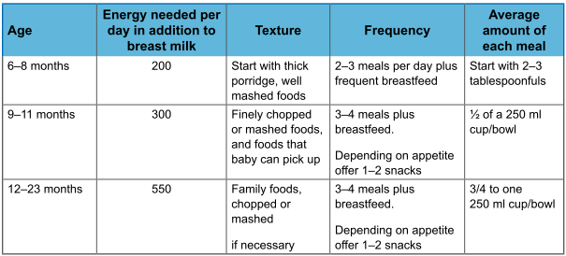
DIET ADVISED FOR INFANT AGE GROUP

Slide 39
NUTRITIONAL REQUIREMENT OF ELDERLY
Energy requirement of elderly person
  Decreased 5% from previous decade energy requirement during 5th and 6th decade of life
  Decreased 10% from previous decade energy requirement after 6th decade of life
Increase requirement of
  Anti oxidants ( Vit A, E, C & Selenium)
  Dietary fibres
Decrease requirement
  Fat
  Minerals

Slide 40
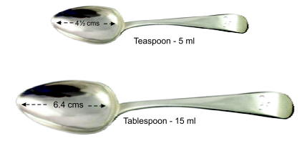
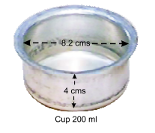
SIZE OF SPOON AND CUP

Slide 41
BALANCED DIET
Energy provided by
  Carbohydrate = 60 – 70 %
  Fat = 20 – 30 %
  Protein = 10 – 15%
Dietary fibres = 25 – 40 gm / day
Visible fat = 20 - 40 gm / day
Trans fat = Nil
Green leafy vegetable = 100 gm / day

Slide 42
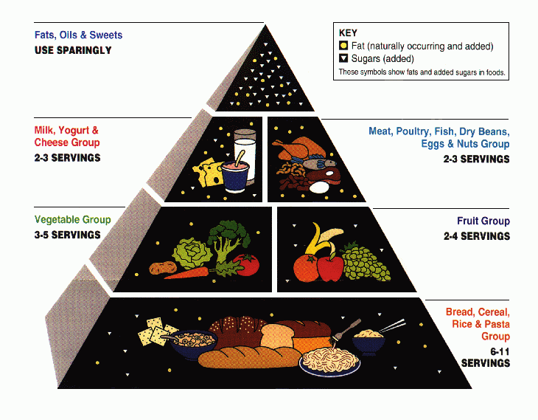

Slide 43
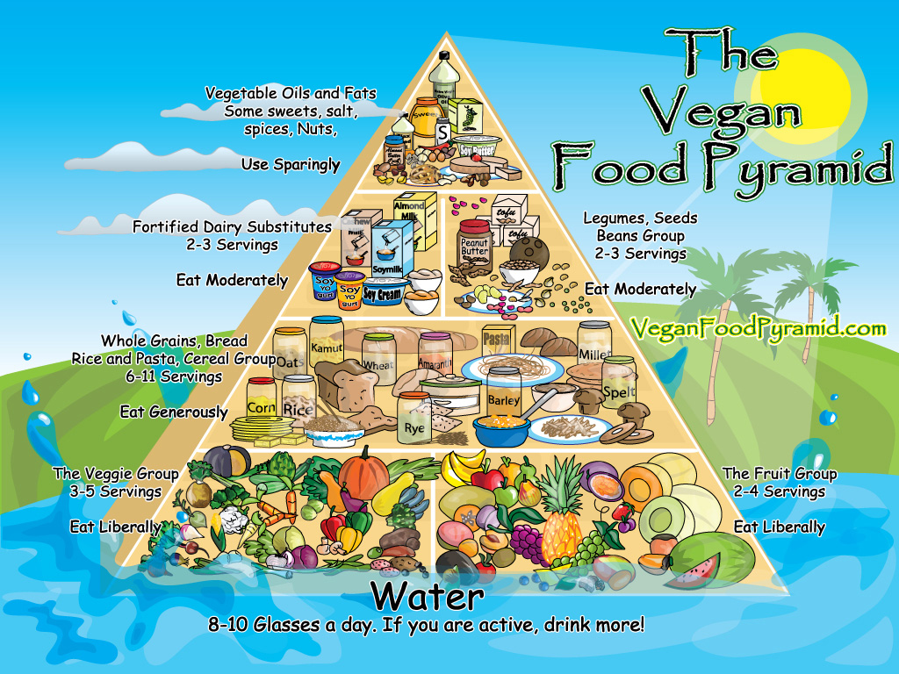

Slide 44
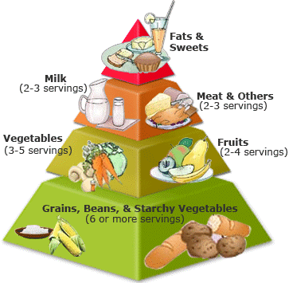
It’s a guide that helps us make healthy food choices.
It tells us all the food groups our bodies need and how many servings of each group we need.
Notes:
The Food guide pyramid helps us choose a healthy diet.
Why do you suppose it’s important to have a healthy diet?
Researchers have found that when you eat the right foods you are less likely to get sick. Your body can fight off diseases because it’s been getting all the nutrients to keep it strong..
The food pyramid is split into 6 groups.
The base of the pyramid is the group that we need the most servings of.
What is that group? The breads, grains and cereals. How many servings does it say we need?
The next layer up is the fruits and vegetables.
The next layer is the dairy product group. They’re especially rich in the mineral called calcium which makes our bones strong.. And The protein rich foods.
The top layer some people don’t even consider it a group. It is the very smallest. It has the sweets, fats, and salt. You wouldn’t even need to try to get anything from this group because if you ate things from the other 5 groups you would already get enough of these foods.

Slide 45
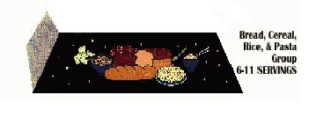
SO, WHY IS IT SHAPED LIKE A PYRAMID?
The base or the bottom of the pyramid is the grain, cereal and bread group. We need 6 to 11 servings of this group. The most of any of them.

Slide 46
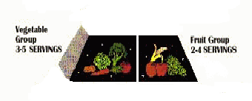
The next layer up is the fruits and vegetables group.You need 2 to 4 servings of the fruits and 3 to 5 servings of the vegetables.

Slide 47
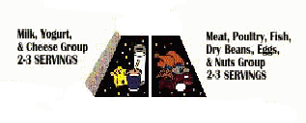
The next layer is the dairy and the protein groups. We need 2 to 3 servings a day of the dairy group and 2 to 3 servings of the protein group.

Slide 48

The tip-top of the pyramid is the sugar,fats, and salt group. Guess what? We don’t need to make choices for that group because if we eat foods from the other groups we get all the fats, sugars and salt our bodies need.
But that’s the fun group!!!
If you eat a little bit from this group it’s okay but concentrate on getting foods from the other groups.

Slide 49
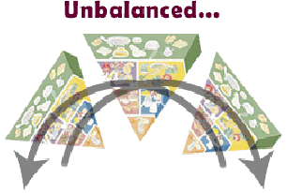
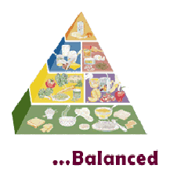
The shape of the Pyramid is balanced. If we make the best food choices our diets will be balanced, which means our health will be balanced.

Slide 50
If you built a pyramid and take out a few pieces in the middle or build it with the smallest part on the bottom, what will happen?
All of a sudden, it would come tumbling down!!

Slide 51
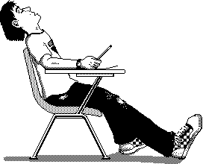
Our bodies don’t come tumbling down, but little things might happen like:
May be you’re too tired to do your work at school,
You’re cranky,
Cuts and injuries might take longer to heal,
Or it takes longer to get over a cold.

Slide 52
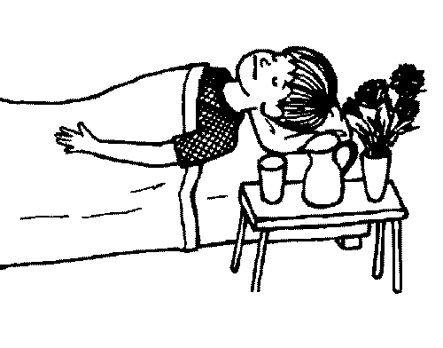
In the long run if we don’t choose a healthy diet we have a greater chance of getting some bad diseases like:
Heart disease
Diabetes
Obesity
Non Communicable Diseases

Slide 53
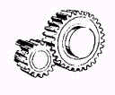
Our bodies are unique, complicated machines. Food is our fuel. It gives us energy, vitamins, minerals, and special compounds or nutrients that keep us running smoothly.

Slide 54


Each group on the Pyramid contains certain nutrients. If we eat foods from each group we’ll be sure to get all the nutrients we need.

Slide 55
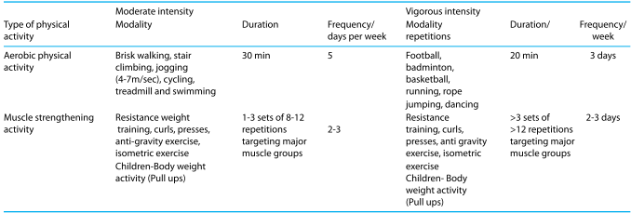
GUIDELINES FOR PHYSICAL ACTIVITY

Slide 56
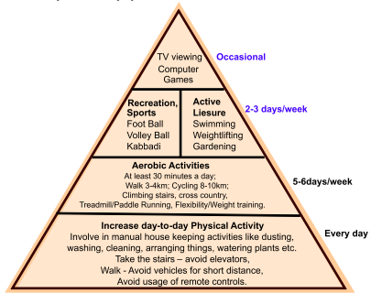
PYRAMID OF PHYSICAL ACTIVITY

Slide 57
NUTRITIONAL STATUS ASSESSMENT
CLINICAL EXAMINATION-
1. general appearance: normal/thin/sick
2. Hair: Normal/Thin/Sparse/Pluckable
3. Face: Normal
4. Eyes: Normal/Dry/Wrinkled/Bitot’s spot/
5. Cornea: Normal/Dry/Hazy/Opaque
6. Lips: Abnormal/Angular stomatitis/Chelitis
7.Tongue: Normal/Pale/Fissured

Slide 58
8. Teeth: Enamel/Carries/Attrition
9. Gums; Normal/Spongy/Bleeding
10. Glands: Normal/Thyroid enlargement/Parotid enlargement
11.Skin: Normal/dry and scaly/follicular hyperkeratosis/petechiae/pellagrous dermatosis/flanky paint dermatosis/ scrotal and vulval dermatosis
12. Nails: Koilonychia
13. Edema: in dependent parts
14. Rachitic changes: knock-knees or bow legs/epiphyseal enlargement/beading of ribs/pigeon chest

Slide 59
15. Internal system: Hepatomegely/psychomotor change/mental confusion/sensory loss/muscle wasting/motor weakness/loss of position sense/loss of vibration sense/loss of ankle and knee jerks/calf tenderness/cardiac enlargement/tachycardia
ANTHROPOMTRIC:
Weight (kg):
Height (cm):
Mid-upper-arm circumference (cm):
Head circumference (cm):
Chest circumference (cm):
Skinfold:

Slide 60
Thank You

