Slide 1

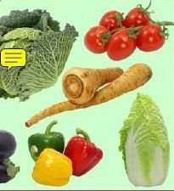
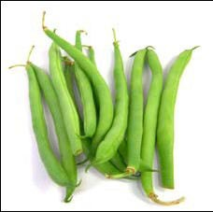
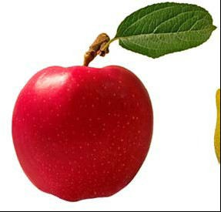

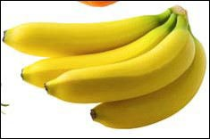
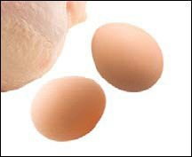


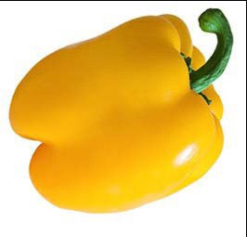
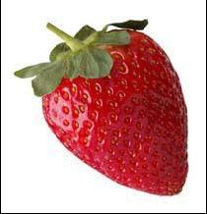
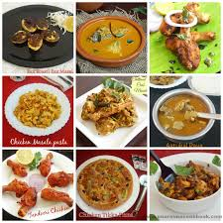
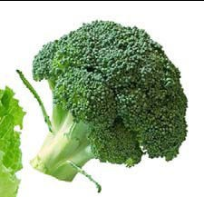
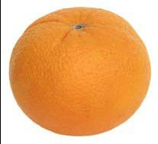
Nutrition and Health

Slide 2
FOOD
Food is any edible material that supports growth, repair and maintenance of the body.
Any edible substance that we consume to fulfill our daily requirement of nutrition is known as food.

Slide 3
NUTRITION
Nutrition is the process by which body utilizes food for growth and maintenance and healthy living.
A science of food and its relationship to health and concerned with the part played by food factor (nutrients) in body growth, development and maintenance.

Slide 4
OBJECTIVE OF NUTRITION
To promote the physical and mental growth and development of human beings
Building and repairing of tissues and cell damaged by infection and injuries.
To provide energy for doing works.
To protect the human beings from infections and deficiency disorders.

Slide 5

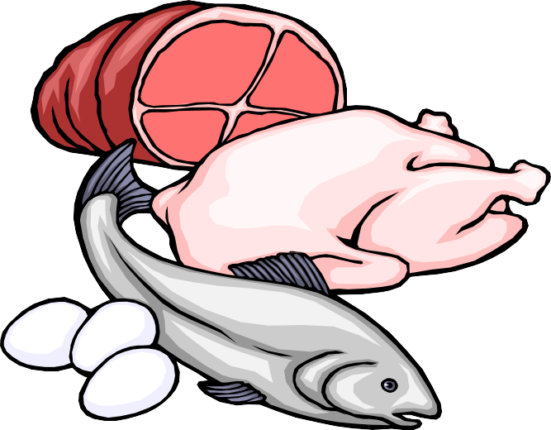
CLASSIFICATION OF FOODS
1. Classification of foods by origin
•
•
Foods of plants origin Foods of animal origin

Slide 6
CLASSIFICATION OF FOODS
2. Classification of foods by chemicals
•
•
•
•
•
Carbohydrates Proteins
Fats
Vitamins Minerals

Slide 7
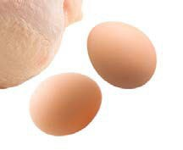
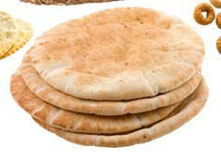

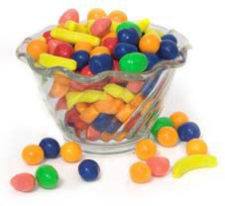
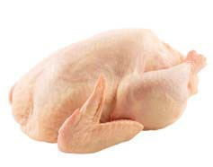



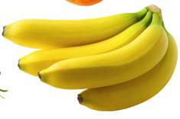
CLASSIFICATION OF FOODS
Classification of foods by pre- dominant functions
  Energy supplying food: cereals, sugars, roots, tubers, fats and oils.
  Body building foods: milk, meat, poultry, eggs, fish, pulses and groundnuts.
  Repairing and maintenance foods: Vegetables, fruits, milk.
9

Slide 9
CLASSIFICATION OF FOODS
Foods by sources:
  Cereals and millets,
  Legumes (pulses),
  Green vegetables,
  Fruits,
  Meat, Fish, eggs and milk,
Fats and oils,
Nuts and oil seeds,
Sugar and jiggery
Condiments and species
Others

Slide 10
BALANCED DIET:
A balanced diet is defined as one which contains a variety of foods in such quantities and proportions that the need for energy, amino acids, vitamins, minerals, fats, carbohydrates and other nutrients is adequately met for maintaining health, vitality and general well-being and also makes small provisions for extra nutrients to withstand short duration of leanness. A balanced diet is the accepted means to safeguard a population from nutritional deficiencies.

Slide 11
Conti.
The principles should be borne in mind during constructing balanced diet are-
The daily requirement of protein shuold be met (10-15% of daily energy intake )
The fat requirement of fat should be (15-30%)
Carbohydrate rich in natural fibre should constitute remaining energy and micronutrients requirement should also be met.

Slide 12
Concept of nutrition
The basic concept of human nutrition is mainly concerned with defining the nutrition requirement for the promotion , protection and maintenance of health in all groups of the population .
This is requires to asses the nutritional adequacy of diets for the growth of infants, children and adolescents and for maintenance of health in adults of both sexes and during pregnancy and lactation in wome.

Slide 13
Conti...
In this context term named Recommended dietary intake/allowance has been used 1- to define the amount of nutrients needed by the body .
2- The RDA is the average daily dietary nutrient intake level sufficient to meet the nutrient requirement of near all healthy individuals in a particular life stage and gender group.
3-The RDA is derived from –
a)Individual variability and b) nutritional bioavailability(release of nutrient from the food ,its absorption and bio-response has to be taken into account ) from the habitual diet.

Slide 14
conti..
3- The RDA presents the level of nutrient to be consumed daily to meet all the requirements of the most of individuals in a given population.
4- The RDA value of nutrient is valid only when all other dietary nutrient intake are satisfactory .

Slide 15
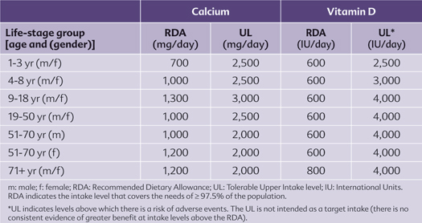

Slide 16
Reference body weight.
The age ,gender and body weight largely determine the nutritional requirement of an individual. Body weights and height of children reflect their state of health ,nutrition and growth rate while weight and height of adults represent what can be attained by an individual with normal growth.

Slide 17
Reference MAN
Aged 18-29 years, weight 60 kg, height 1.73metre, BMI of 20.3, free from disease, physically fit for active work, 8 hours occupation with moderate activities, 8 hours in bed, 4-6 hours sitting and 2 hours in walking and household duties

Slide 18
Reference WOMAN
Aged 18-29 years NPNL, weight 55 kg, height 1.61metre, BMI of 21.2, free from disease, physically fit for active work, 8 hours occupation with moderate activities, 8 hours in bed, 4-6 hours sitting and 2 hours in walking and in active recreation or household duties

Slide 19
NUTRIENTS
Organic and inorganic complexes contained in food are called as nutrients.
Useful chemical substances derived from food by the body are called nutrients.
Which provides energy, helps to grow well and normal development and repair of tissues

Slide 20
NUTRIENTS
51 different nutrients supplied by foods to our body.
Each nutrient has its own specific function.
Most of the foods contain more than one nutrient.
Nutrients are divided into two parts mainly as Macro-nutrients and Micronutrients.

Slide 21
The Known 51 Essential Nutrients for Sustaining Human Life*
Air, Water & Energy (3) | Protein (amino acids) (9) | Lipids-Fat (fatty acids) (2) | Macro-Minerals (7) | Trace Elements (17) | Vitamins (13)
Oxygen Water Carbohydrates | Histidine Isoleucine Leucine Lysine Methionine Phenylalanine Threonine Tryptophan Valine | Linoleic acid Linolenic acid | Na K Ca Mg S P Cl | Fe Zn Cu Mn I F Se Mo Co (in B₁₂) B Ni Cr V Si As Li Sn | A D E K C (Ascorbic acid) B₁ (Thiamin) B₂ (Riboflavin) B₃ (Niacin) B₅ (Pantothenic acid) B₆ (Pyroxidine) B₇/H (Biotin) B₉ (Folic acid, folacin) B₁₂ (Cobalamin)
*Numerous other beneficial substances in foods are also known to contribute to good health.

Slide 22
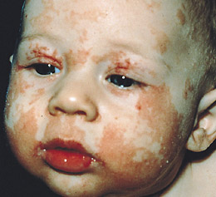
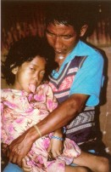
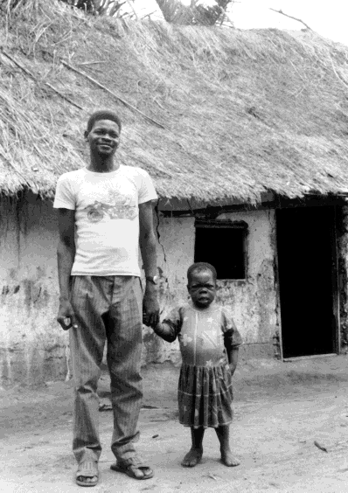
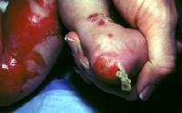
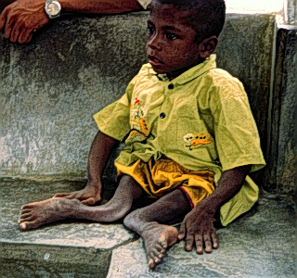
Each nutrient has its own specific function
Iron Deficiency
Zinc Deficiency
Iodine Deficiency
Ca Deficiency
Rickets

Slide 23
MACRONUTRIENTS
These are proteins, fats and carbohydrates which are often called “Proximate Principles” because they form the main bulk of food.
For proper utilization of macronutrients needs micronutrients.
They contribute to the total energy intake as:
Carbohydrates 60-80 %
Fats 10 - 30 %
Proteins 7-15 %

Slide 24
MICRONUTRIENTS
Requires in small quantity and so called micro-nutrients i.e. vitamins and minerals.
The quantity of nutrients required depends upon age, sex, weight, physical activity and health status of the body.

Slide 25
CARBOHYDRATE
Major component of food which is the main source of energy; providing 4 Kcal/gm
In balanced diet, carbohydrates provide 50-60% of total calories taken.
In excess, the carbohydrates are converted into body fat.

Slide 26
CARBOHYDRATE Functions:
Energy production in the body,
Protein sparing action
Useful in oxidation of fat,
Growth of useful bacteria,
Synthesis of vitamin B complex,
Absorption of minerals,
Prevention of constipation.
Stored as glycogen in liver and muscles
And excess of it converted as fats

Slide 27



CARBOHYDRATE
SOURCE
Starch: cereals, roots and tubers.
Sugars: white sugar, honey, glucose etc.
Cellulose: indigestible contributes to dietary fibers.
Daily requirements
Children:
Adolescents:
Men:
:
60-250 grams.
400 grams
300 - 700 grams.
240 rams.
Women
02/10/14
- 540 g
16

Slide 28
Calories in 1 Chapati (50g)
Calories | 106 | Sodium | 190 mg
Total Fat | 1 g | Potassium | 0 mg
Saturated | 0 g | Total Carbs | 22 g
Polyunsaturated | 0 g | Dietary Fiber | 3 g
Monounsaturated | 0 g | Sugars | 0 g
Trans | 0 g | Protein | 4 g
Cholesterol | 0 mg
Vitamin A | 0% | Calcium | 0%
Vitamin C | 0% | Iron | 0%

Slide 29
Rice one serving =100gms
Calories | 152 | Sodium | 0 mg
Total Fat | 3 g | Potassium | 0 mg
Saturated | 0 g | Total Carbs | 78 g
Polyunsaturated | 0 g | Dietary Fiber | 0 g
Monounsaturated | 0 g | Sugars | 0 g
Trans | 0 g | Protein | 8 g
Cholesterol | 0 mg
Vitamin A | 0% | Calcium | 0%
Vitamin C | 0% | Iron | 0%

Slide 30
Pulses one serving =150gms
Calories | 120 | Sodium | 300 mg
Total Fat | 3 g | Potassium | 585 mg
Saturated | 1 g | Total Carbs | 18 g
Polyunsaturated | 0 g | Dietary Fiber | 1 g
Monounsaturated | 1 g | Sugars | 1 g
Trans | 0 g | Protein | 7 g
Cholesterol | 4 mg
Vitamin A | 5% | Calcium | 2%
Vitamin C | 6% | Iron | 5%

Slide 31
Potatoes one serving =100gms
Calories | 77 | Sodium | 6 mg
Total Fat | 0.1 g | Potassium | 421 mg
Saturated | 0 g | Total Carbs | 17 g
Polyunsaturated | 0 g | Dietary Fiber | 2.2 g
Monounsaturated | 0 g | Sugars | 0.8 g
Trans | 0 g | Protein | 2 g
Cholesterol | 0 mg | Calcium | 1%
Vit-B6 | 15% | Magnesium | 5%
Vitamin C | 32% | Iron | 4%

Slide 32
PROTEIN
Protein is the building material for all body parts, such as muscle, brain, blood, skin, hair, nails, bones and body fluids.
Protein constitutes 20% of adult body weight and made up of amino acids.
Functions
Acts as Building blocks of cells and tissues.
Regulates hemoglobin.
Regulates muscle contraction, formation of enzyme, hormones and other secretions which help synthesis of enzymes and produces digestive juices and antibodies.
Act as a source of energy: 1 gm of protein gives 4
23/05/18

Slide 33



SOURCES OF PROTEIN
There are 2 main sources of protein.
Animal sources: Milk, eggs, meat, fish, cheese etc.
Plant sources: Pulses, cereals, beans. nuts, soya bean etc.

Slide 34
DAILY REQUIREMENTS
Infants <6 months:
Infants 6-12 months:
Child 1-3 yrs:
Child 4-6yrs:
Child 7-9 yrs:
Adolescents 13-15yrs Boys
Adolescents 13-15yrs girls
Adolescents 16-18yrs Boys
Adolescents 16-18yrs girls
Man:
Woman:
2 gm/day
1.50 gm/day 21 gm/day 29 gm/day 40 gm/day 67 gm/day 62 gm/day 75 gm/day 60 gm/day 60 gm/day 50 gm/day

Slide 35
DEFICIENCY DISEASES AND
DISORDERS
Protein deficiency malnutrition: Kwashiorkor (edema) and Marasmus (wasting) and also lead to Marasmic Kwashiorkor.

Slide 36
FATS
Composed of smaller units called fatty acids.
Saturated fatty acids: All animal fats except fish oil.
Unsaturated fatty acids: All vegetable oils except coconut and palm oils.
Saturated fatty acids are cholesterologenic, i.e. they increase blood cholesterol level.
Functions
Fats provide energy: 1 gram of fat provides 9 calories of energy.
Dietary fats supplies essential fatty acids needed for growth and maintenance of the integrity of the skin.
They maintain our body temperature.
Fats provide support for many organs in our body such as heart, kidneys, intestine etc.

Slide 37
FATS
Sources
Animal sources: ghee, butter, fat of meat, fish oils etc.
Vegetable sources: groundnut oil, ginger oil, mustard oil, cotton seed and nut oil and coconut oil etc.
Daily requirements
Man:
Woman:
Fats and diseases
20-60 gm
20-40 gm
Obesity, Phrenoderma (rough and dry skin “toad skin”), Coronary Heart Disease (high intake of saturated fats), Cancer (Some recent studies show that high intake of fats increase the risk of colon and
intestinal cancer) and Kwashiorkor .
22

Slide 38
VITAMIN A
It is a fat soluble vitamin generally found in two forms: Retinol and Beta carotene.
Retinol: Present in animal foods: liver, meat, fatty fish, eggs and milk fat and Beta carotene: Present especially in plants: dark green leafy vegetables, bright yellow fruits.
Functions of Vitamin A
Important nutrient for normal vision especially in the dark.
Maintain and help in rebuilding of glandular and epithelial tissues.
Necessary for normal skeletal growth of human beings.
It also acts as anti-infective agent.

Slide 39
VITAMIN A
An adult person (men/women/pregnancy) needs 600 µg of retinol or 2400 µg of β- carotene.
Deficiency:
Night blindness: inability to see in dim light.
Conjunctival Xerosis: conjunctiva becomes dry and non- wettable.
Bitot’s spots: Triangular, pearly-white or yellowish foamy spots on the bolbular conjunctiva.
Corneal xerosis: The cornea appears dull, dry and non wettable and in more advanced corneal ulceration.
Keratomalacia: The cornea may become soft and may burst open.
Corneal Ulcer: Keratomalacia can lead to perforation of the cornea and corneal ulcer leading to permanent blindness.

Slide 40
VITAMIN D
Fat soluble found in two important forms: Calceferol (D2) and Cholecalceferol (D3).
Calceferol may be derived by plant sterols & ergo sterols; where as cholocalceferol is found in animal fats and fish oils.
Sunlight (ultra- violet ray) also converts the cholesterol of the body skin to vitamin D.
Functions
Promotes the intestinal absorption of calcium and phosphorus; Promotes bones dissolution and mineralization; Prevent from Rickets in children, Increase the tubular reabsorption of phosphate and variable effect on reabsorption of calcium. And Facilitates in calcium deposition in the bones and teeth.

Slide 41
VITAMIN D
Sources
Sunlight: Vitamin D₃ is formed by the exposure of 7- dehydrocholesterol, which is present in the skin, to the ultraviolet ray of the sunlight
Foods: only in food of animal origin. Liver, egg yolk, butter, cheese and some species of fish.
Daily requirement:
Adult:
Deficiency:
Decrease calcium and phosphorus in the blood; low deposition of calcium phosphate in the growing bones; Rickets; Oesteomalacia.
2.5 mcg (100 IU)

Slide 42
VITAMIN E
Fat soluble vitamin also known as Tocopherol “a Anti-sterility Vitamin” .
Functions
Acts as an antioxidant and reduce oxidation of unsaturated fatty acids. Due to anti- neoplastic effect raises the concentration of high density lipids cholesterol. With Vitamin E, selenium plays the role of preventing destruction of lipids by oxidation. Maintains stability of cell membranes. when externally applied would minimize wrinkles, scars and scratch marks.

Slide 43
VITAMIN E
Sources of Vitamin E
Plants based foods: Vegetable oils, hydrogenated fats, dark green leafy vegetables, nuts, whole grain, and legumes. Food rich in polyunsaturated fatty acids are also rich in vitamin E.
Daily Requirements:
Adults:
Deficiency:
Deficiency is usually not found as in almost many vegetables foods have Vitamin E.
Loss of reflexes, ataxia of trunks and limbs, muscle weaknesses.
Among premature babies, presence of hemolytic anemia.
Associated with habitual abortion.
10 mg (15 IU)

Slide 44
VITAMIN K
Cofactor of enzyme and acts as the catalyst for the formation of prothrombin. Two types Phylloquinone – K1 and Manaquinone - K2.
Vitamin K1 is found in fresh and dark green leafy vegetables where as Vitamin K2 by the synthesis of bacterias in the intestines.
Destroyed by freezing, by mineral oils and rancid fats.
Functions
Essential Vitamin for the formation of prothrombin.
Stimulates the production of coagulation factors.
Synthesize the required protein for the human body.
Acts as the catalyst for activating the enzyme.

Slide 45
VITAMIN K
Deficiency
Hemorrhage, bleeding disorders.
Increased risk of hemorrhage among premature or in the new born babies with complicated labour.
Daily requirement:
0.03 mg/kg body weight for adults.
Sources:
Found in fresh green vegetables and fruits. Dark green leafy vegetables, Cabbage, Cauliflower, are richest source. Also found in liver and cow milk.

Slide 46
VITAMIN C
It is known as Ascorbic acid. It is a water soluble vitamin.
It is most unstable of all Vitamins and rapidly destroyed by high temperature, oxidation, drying or storage.
Functions: Vitamin C is the potent antioxidant and has an important role in tissue oxidation. It helps to increase the general resistance of the body to fight infections.
Involves in absorption, mobilization, distribution, and intoxication of metal ions.
Helps transfer of iron from plasma into tissues and store in bone marrow, spleen and liver
Protects eyes and lungs from oxidizing agents.
Reduces oxidation of low density lipoprotein and also Vitamin A & E.

Slide 47
VITAMIN C
Deficiency: Scurvy among children during 6 to 18 months of age; Conjunctival haemorrhage; Bleeding of gums and petechiae of skin (round , purplish red spot); Frequent diarrhoea, fever, vomiting due decrease in body’s general resistance to infections.
Sources: Almost all citrus fruits have Vitamin C. Also include tomatoes, green leafy vegetables, cabbage, germinating legumes Liver and kidney. It is destroyed by cooking
Daily requirements: 40 mg/day for adult

Slide 48
VITAMIN B1 (THIAMINE)
It is a water soluble vitamin. It is relatively stable at heat but is destroyed in neutral or alkaline solution.
Functions: It plays an important part in carbohydrate metabolism. It is essential for the proper functioning of the nervous system.
Sources: Richest source: unmilled cereals, pulses and nuts. Poor source: Meat, fish, eggs, liver, dark green leafy vegetables, fruits, dried yeast. Milk is important source for infants.
Daily Requirement: 1-2 Mg. per day or 0.5 mg. per 1000 kcal of energy intake.
Deficiency: Beri Beri (most common in only rice feeding community especially polished rice).

Slide 49
VITAMIN B2 (RIBOFLAVIN)
Functions: It involves protein, fat & Carbohydrate metabolism. Fundamental role in cellular oxidation . Cofactors of various enzymes which plays the metabolism to form the energy. Synthesize the glycogen and erythropoiesis which changes the pyridoxines and folic acids to the
coenzymes. Helps in oxidation of fatty acids and transport _{H}+
Sources: Milk and milk products, eggs, liver, green leafy vegetables are good sources. Wheat, millet and pulses are fair sources. Rice is a poor source. Germinating pulses also furnish riboflavin. Riboflavin is synthesized by bacteria is the large intestine.
Daily requirement is 1-2 mg or 0.6 mg. per 1000 Kcal intake.
Deficiency: confined skin (cracks), and mucosa, glossitis ,
s0c2/a10/l1y4
dermatitis, circumcorneal vascularization and kerati₃₄tis,

Slide 50
VITAMIN B3 (NIACIN)
Function: It is required by the body for the utilization of carbohydrates and tissue respiration. Essential for normal functions of skin, gastrointestinal and nervous system. Helps in synthesis of DNA and its repairment. Controls blood cholesterol and lipids.
Sources: Rich in whole grain cereals, nuts, pulses, meat, liver and chicken, dried yeast, ground nuts. Poor source in maize.
Daily Requirements: 20 mg. per day or 6.6 mg per 1000 calorie intake.
Deficiency: gastrointestinal disorder, diarrhoea, loss of appetite, nausea, vomiting, neurological manifestation, loss of memory, pigmented scaly skin, cracks of hand and neck.

Slide 51
VITAMIN B 6 (PYRIDOXINE)
It plays an important role in the metabolism of amino acids, fats and carbohydrates.
Daily requirements: 1.5 - 2 mg per day.
Sources: Liver, meat, fish, whole cereals and legumes.
Deficiency is generally unusual as most of the foods like meat, fish, legumes, and cereals contain pyridoxine. But in some cases may have clinical manifestation of convulsion, loss of weight and abdominal distress.

Slide 52
(CYNOCOBALAMINE)
It is necessary for synthesis of DNA and also fatty acids.
It is required for carbohydrate, fat and protein metabolism.
It is used for making red blood cells.
Sources: Liver, eggs, fish and milk. It loses its potency when over cooked.
Daily requirement:- 1 microgram for adult. And 0.2-1 microgram for children.
Deficiency: Megaloblastic anemia (pernicious anemia) and impairing of DNA thus leading to formation of immatured RBCs causing anemia.

Slide 53

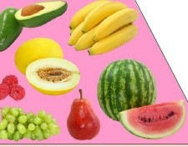
FOLIC ACID
It is essential for DNA Synthesis.
Needed for making red blood cells.
Sources: Green leaves, vegetables, liver, egg, pulses, cereals, nuts, whole grains and oil seeds.
Daily Requirements
Adults: 100 micro grams per day.
pregnant women: 300 micrograms
For lactating women additional 150 micrograms.
Children need 100 micrograms.

Slide 54
MINERALS
Inorganic chemical elements present throughout the body in varying amounts.
Act as co-factors of enzymes for metabolism.
Form part of the structure of body tissues, such as bones, teeth and nails, blood, nerves and muscles.
Vital to physical and mental development.
They also help protect the body against infections.
Meat, fish, milk, cheese, green leafy vegetables and legumes provide most of the minerals needed by the body.

Slide 55
Mineral
Function
Calcium
Mineralization of bones and teeth; regulator of many of the body’s biochemical processes; involved in blood clotting, muscle contraction and relaxation, nerve function, blood pressure and immune defenses.
Mineralization of bones and teeth; part of every cell; used in energy transfer and maintenance of acid-base balance.
Maintains normal fluid and electrolyte balance, assists nerve impulse initiation and muscle contraction.
Phosphor ous
Sodium
Chloride
Chromiu m Copper
Maintains normal fluid and electrolyte balance.
Works with insulin and is required for release of energy from glucose.
Necessary for absorption and use of iron in the formation of hemoglobin.

Slide 56
Fluoride
Involved in the formation of dental enamel and prevents
dental caries; involved in the formation of teeth and
skeleton and inhibits osteoporosis in old age.
As part of the two thyroid hormones, iodine regulates growth, physical and mental development and metabolic rate.
Essential in the formation of blood; involved in the transport and storage of oxygen in the blood and is a cofactor bound to several non-heme enzymes required for the proper functioning of cells.
Integral part of vitamins, biotin and thiamin, as well as the hormone insulin.
Essential for normal growth, development, reproduction and immunity.
Iodine
Iron
Sulfur
Zinc
Magnesi Involved in bone formation and tissue energy metabolism. um

Slide 57
The dietary goals recommended
by WHO
Dietary fats should be limited to approximately 15-30% of daily intake of energy.
Saturated fats should contribute no more than 10% of total energy intake. Remaining fats requirement should replace by the unsaturated fats.
Excessive consumption of refined carbohydrates should be avoided and some amount of carbohydrate rich in natural fibers should be taken.

Slide 58
The dietary goals recommended
by WHO
Sources rich in energy such as fats and alcohols should be avoided.
Salt intake should not increase more than 5 gm/day.
Protein should be at-least 15-20% of total energy intake.
Junk foods such as colas, ketchup that supply empty calories should be reduced.

Slide 59
RECOMMENDED BALANCED DIET
Food item Adult man (gm) Adult woman (gm)
Cereals | Sedimentary 460 | Moderate 520 | Heavy 670 | Sedimentary 410 | Moderate 440
pulses | 40 | 50 | 60 | 40 | 45
green leafy vegetable | 40 | 40 | 40 | 100 | 100
other vegetables | 60 | 70 | 80 | 40 | 40
Roots and tubers | 50 | 60 | 80 | 50 | 50
Milk and milk products | 150 | 200 | 250 | 100 | 150
Oils and fats | 40 | 45 | 65 | 20 | 25
Fruits | 60 | 60 | 60 | 60 | 60
Sugar and jaggery | 30 | 35 | 55 | 20 | 20

Slide 60
FOOD PYRAMID
The Food Guide Pyramid is an outline of what to eat each day based on the Dietary Guidelines. It provides a general guide that lets you choose a healthy diet that’s right for you. The Pyramid calls for eating a variety of foods to get the nutrients you need and at the same time, the right amount of calories to maintaining healthy and physical wellbeing.

Slide 61
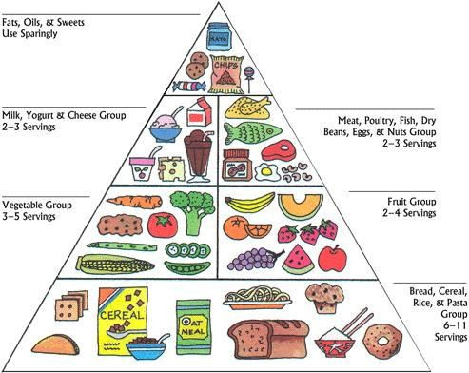
THE FOOD PYRAMID

Slide 62









Thank You…

Slide 63

FOOD HYGIENE
Food is the major source of infection and possible to contaminate by microorganism during its production, handling, distribution, storing, and serving of all types of food. Basic concept of food hygiene is to prevent food poisoning and food borne diseases.

Slide 64
FOOD HYGIENE
Food hygiene can be defined as “ all condition and measures that are necessary during the production, processing, storage, preparation and distribution of food to ensure that is safe, sound, wholesome and fit for human consumption.”
- World Health Organization
Food hygiene may be defined as sanitary science, which aims to produce food that is safe and good keeping quality. It implies hygiene in production, handling, distribution and serving of all kinds of foods.

Slide 65
FOOD HYGIENE
The primary aim of food hygiene is to prevent food poisoning and other food borne illness.
Safe food:
Containing no harmful microorganism
Containing no parasites
Containing no toxin such afalotoxins
Containing no harmful chemical such as pesticides
food and water became contaminated when micro organism are carried in food out by:
Hand; flies, cockroaches & other insects; rates, mites and other animals; and dirty container and dishes.

Slide 66

MILK HYGIENE
Source of infection: dairy animal , human handling , environment.
Milk borne diseases:
Infection of animals that transmits to man: Tuberculosis, Brucellosis, Staphylococcus infection, Staphylococcus enterotoxin poisoning, Salmonellosis, Q fever , Anthrax, Cow pox, foot and mouth disease, Leptosperosis, tick borne encephalitis.
Directly transmitting disease to man from milk: typhoid, paratyphoid, cholera, shigellosis, tuberculosis, viral hepatitis, diphtheria, staphylococcal, streptococcal food poisoning etc.

Slide 67

MILK HYGIENE
Cleanliness and safety of milk
Production of clean and safe milk
premises of cattle and sanitation of milking Methylene Blue Reduction test: adding MB to milk and kept at uniform temp. of 37⁰ c and observed the blue colour
Pasteurization of milk: heating a milk to such temperature and for such period of time as are required to destroy any pathogen that may present while causing minimal changes in the composition, flavor and nutritive value. Three methods: Holder method, High temperature short time (HTST) method and Ultra high temperature (UHT) method

Slide 68

MEAT HYGIENE
Problems associated with unhygienic meat: Tape worm: Tinea solium, T. saginata, T. spiralis, F. hepatica and Bacterial infection: Anthrax, actinomycosis and food poisoning.
Meat inspection: Purpose of ante-mortem rejection: exhaustion, pregnancy, sheep-pox, brucellosis, febrile conditions, diarrhea, and other infectious diseases and while postmortem rejection: cysticercus bovis, tape worm larva, liver fluke, abscesses, septicemia, parasitic and nodular infection .

Slide 69


MEAT HYGIENE
The characteristics of good meat are:
Neither pink nor deep purple
Should be firm and elastic to touch.
Should not be excess of fluids which indicates oedema
Has an agreeable odour
Reaction should be acidic
The characteristics of ill animal are: loss of appetite, offensive odour from breath, hanging head, slow movement, febrile, loss of gloss, dry nostril or abnormal discharge, dull, watery and congested eyes, dribbling saliva, blown abdomen, diarrhoea or blood in stool, nodules or wound in the skin.

Slide 70


MEAT HYGIENE
Slaughter houses:
1. location: away from residential area
2.
3.
4.
5.
6.
7.
8.
structure of the spot: clean floor and wall
disposal of wastes: no into public
sewers, collected separately.
water supply: independent,
adequate and continuous.
Examination of animals:
antimortem and postmortem
Storage of meat: temp. <5 degree C, fly proof, rat proof.
Transportation of meat: fly proof and covered van.
No entrance of other animals

Slide 71

FISH AND EGG HYGIENE
FISH HYGIENE:
Problems by unhygienic fish: Tape worm, viral hepatitis, oysters, schistosomiasis, fish poisoning.
Sign of fresh fish are: it is in a state of stiffness or rigor mortis, the gills are bright red and the eyes are clear and prominent.
EGG HYGIENE: salmonella can penetration from cracks and chances of contamination. Should be clean without fecal matters.

Slide 72


Food Hygiene during preparation,
processing and storage and consumption
Steps of preparation:
Cleaning with water
Chopping, cutting
Frying, cooking
Affects of food preparation:
Loss of water soluble vitamins
Loss of essential minerals
Loss of digestibility, absorption and metabolic inefficiency

Slide 73


Contd..
Processing and storage:
Milling, packing, drying, transporting
Processing of making jams, jelly, pickles and canned foods
Additives
Storing
Affects of processing on nutrients
Loss of nutrients, Food toxicities, Indigestion, Damages and adulteration

Slide 74


Contd..
Consumption
Personal hygiene, Utensils, spoon and fork, handling, Employees with infectious diseases and
Employees with External infections like wounds, otitis media, and skin diseases.
Affects during consumption
Infectious disease
Worm infestation

Slide 75


FOOD BORNE DISEASE
The term food borne disease defined as “A disease usually either infectious or toxic in nature, caused by agents that enter the body through the ingestion of food.”
Food borne disease can be classified as food borne infection and food borne intoxicants.

Slide 76
A. FOOD BORNE INFECTION
Groups Diseases
Bacterial Diseases
Typhoid fever, Paratyphoid fever, Salmonellosis, Staphylococcal intoxication, Cl. Perfringens illness, Botulism, B cereus, Food poisoning, E coli Diarrhoea, Streptococcal infection, shigellosis, Brucellosis etc.
Viral Diseases
Viral Hepatitis, Gastroenteritis
Parasitic Disease
Taeniasis, Hydatiosis, Trichinosis, Ascariasis, Amobiasis, Oxyuriasis

Slide 77
B. FOODBORNE INTOXICANTS
Due to naturally occurring toxin in some food
  Letharism: due Beta oxalyl amino-alanine (neurotoxin) caused by consumption of khesari daal.
  Endemic asitis: due to pyrolizine alkaloid (hepatotoxin) caused by consumption of Crotolaria (jhunjuniya).
  Epidemic dropsy: due to sangunarine (hepatotoxins) caused by consumption of Argimone oil (Argimona maxicana-prickly poppy).

Slide 78
FOODBORNE INTOXICANTS
Due to toxin produced by certain bacteria
  Staphylococcus food poisoning
  Batulism food poisoning
  Bacilus cerus food poisoning
  Cl. Perfringes food poisoning

Slide 79
FOODBORNE INTOXICANTS
Due to toxin produced by some fungi
  Aflotoxin: caused by myotoxins produced by certain species of Asperigilus ( A. flavus & A. parasiticus) during storage of food grains. Mostly it is potent hepatotoxins.
  Ergotism: caused by ergot fungus (Cleviceps fusiformis) due to due consumption of infected grains.
  Fusarium toxin: Caused by consumption of food grains infected with fusarism.

Slide 80
FOODBORNE INTOXICANTS
Food borne chemical poisoning:
  Heavy metal (Mercury: usually in fish),
  Oil & petroleum derivatives and solvents.
  Asbestos: certain types of fibrous materials
  Pesticides residues (DDT, BHC, Malathion)
  Migrant chemical from package materials (Cupper, Zinc & Antimony: leaching of containers by acid foods).

Slide 81
FOOD POISONING
Food poisoning is an acute gastroenteritis caused by ingestion of food and drink either living bacteria or their toxins or inorganic chemical substances and poisons derived from plants and animals.
It is characterized by:
History of ingestion of common food
Attack of many person at the same time
Similarity in sign and symptoms in the majority of cases
It is of two types:
Bacterial: living bacteria or their toxins
Nonbacterial: chemicals, fertilizers, pesticides, mercury, cadmium, arsenic etc.

Slide 82









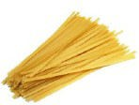


Thank you.

Slide 83
FATS
Fats are composed of Carbon, hydrogen and oxygen.
They are composed of smaller units called fatty acids.
Some fats such as ground nut oil, gingerly oil are liquid at room temperature.
Insoluble in water but soluble in organic compounds like ether, benzene or chloroform.

Slide 84
CLASSIFICATION OF
FATS
Fats are classified as
Simple lipids: triglycerides
Compound lipids: phospholipids
Derived lipids: cholesterol

Slide 85
FATTY ACIDS
Fats yield fatty acids and glycerol on hydrolysis.
Saturated fatty acids:
Unsaturated fatty acids:
Monounsaturated and
Polyunsaturated fatty acids.

Slide 86
FATTY ACIDS
All animal fats contain saturated fatty acids except fish oil.
All vegetable oils contain polyunsaturated fatty acids except coconut and palm oils.
Saturated fatty acids are cholesterologenic, i.e. they increase blood cholesterol level.
Since high blood cholesterol is a risk factor for coronary heart disease, diet rich in preformed cholesterol and saturated fat is to taken with caution after a certain age.

Slide 87
ESSENTIAL FATTY ACIDS
Those fatty acids which cannot be synthesized by human body and derived only from food are called EFAs.
These are linoleic acid, arachidonic acid, linolenic acids and eichosapentaenoic acids.

Slide 88
FUNCTIONS OF FATS
Fats provide energy: 1 gram of fat provides 9 calories of energy i.e., twice the number of calories from carbohydrates and proteins.
Carries of fat soluble vitamins: Vitamin A,D,E, and K.
Dietary fats supplies essential fatty acids are needed for growth and maintenance of the integrity of the skin.

Slide 89
FUNCTIONS OF FATS
They maintain our body temperature.
Fats provide support for many organs in our body such as heart, kidneys, intestine etc.
Foods containing fats provides taste to diet.

Slide 90

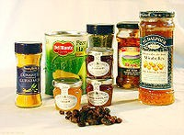

SOURCES OF FATS
Dietary fats are derived from 2 main sources.
Animal sources: ghee, butter, fat of meat, fish oils etc.
Vegetable sources: various vegetable oils such as groundnut oil, ginger oil, mustard oil, cotton seed and nut oil and coconut oil etc.

Slide 91
FAT REQUIREMENT
WHO Expert Committee on prevention of coronary heart disease has recommended only 20-30% of total dietary energy should be fats.
Indian council of Medical Research (1989) has recommended a daily intake not more than 20% of total dietary through fats.
Saturated fats should contribute no more than 10% of total energy intake.

Slide 92
DAILY REQUIREMENTS
Children:
Adolescents:
Man:
Woman:
Pregnant Woman:
Lactating women:
25 gm
22 gm
20 gm
20 gm
30 gm
45 gm

Slide 93
FATS AND DISEASES
Obesity, Phrenoderma (rough and dry skin “toad skin”), Coronary Heart Disease (high intake of saturated fats), Cancer (Some recent studies show that high intake of fats increase the risk of colon and intestinal cancer) and Kwashiorkor .

Slide 94
MEASUREMENT OF ENERGY
Calories are used to measure energy. We use calories to measure how much energy is there in certain foods. We use calories also to measure how much energy a person needs(energy requirements)
Nutrients that provide calories, and the amounts are as follows:-
One Gram of Carbohydrate provides 4 calories.
One Gram of proteins provides 4 calories.
One Gram of fats provides 9 calories.

Slide 95
MEASUREMENT OF ENERGY
Note that proteins are not including in “energy foods” because their main use is for body - building; what is left over from requirements for body building and repair can be used as fuel for energy.
02/10/14
81

Slide 96






Slide 97
RECOMMENDED BALANCED DIET
Food item Adult man (gm) Adult woman (gm)
Cereals | Sedimentary 460 | Moderate 520 | Heavy 670 | Sedimentary 410 | Moderate 440
pulses | 40 | 50 | 60 | 40 | 45
green leafy vegetable | 40 | 40 | 40 | 100 | 100
other vegetables | 60 | 70 | 80 | 40 | 40
Roots and tubers | 50 | 60 | 80 | 50 | 50
Milk and milk products | 150 | 200 | 250 | 100 | 150
Oils and fats | 40 | 45 | 65 | 20 | 25
Fruits | 60 | 60 | 60 | 60 | 60
Sugar and jaggery | 30 | 35 | 55 | 20 | 20

