Slide 1
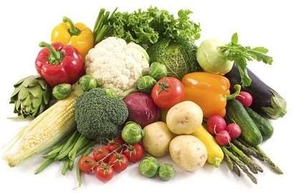
Public health aspects of food hygiene and sanitary regulations of eating establishments
Presenter: Dr Vaishnavi C
Post Graduate, Dept of Community
Medicine, MSRMC, Bangalore
2

Slide 2
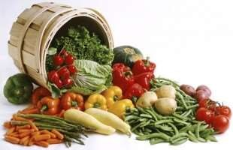
Contents
Introduction
Major Public Health issues of food safety
Five keys to safer food
Role of health workers in food safety
Laws and Regulations governing Food safety in India
Standards for eating establishments
Food handlers
2

Slide 3
Contents contd...
Food safety in anganwadis
Street food safety
Hazard analysis and critical control points (HACCP)
Food surveillance and monitoring system in India
Conclusion
References
2

Slide 4
Introduction
Food Safety and Standards Act 2006,
any substance, whether processed, partially processed or unprocessed, which is intended for human consumption.
does not include any animal feed, live animals unless they are prepared or processed for placing on the market for human consumption, plants prior to harvesting, drugs and medicinal products, cosmetics, narcotic or psychotropic substances.
2

Slide 5
Introduction contd
...
Important to sustain life
Can also result in ill health
Also may result from what a food contains rather it lacks
Potential source of infection
2

Slide 6
Food Safety
WHO,
“all conditions and measures that are necessary during the production, processing, storage, distribution and preparation to ensure that it is safe, sound and wholesome and fit for human consumption”.
Primary aim is to prevent food poisoning and other food borne illnesses
2

Slide 7
“Illness due to contaminated food is perhaps the most widespread
health problem in the contemporary world and an important cause of reduced economic productivity.”
-FAO & WHO, 1983
2

Slide 8
Major public health issues in food hygiene
1/3rd of the population in developed in countries affected
2.2 million death annually in developing countries
>10% of the world’s population at risk
Significantly affect people’s health and well-being
Impose a substantial burden on health-care markedly reduce economic productivity.
systems &
2

Slide 9
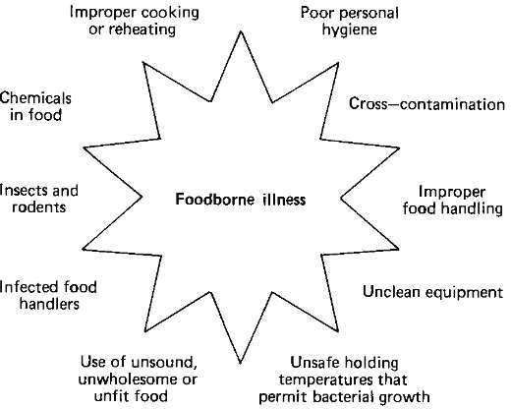
Causes of food borne illness:
18/5/2015
9

Slide 10
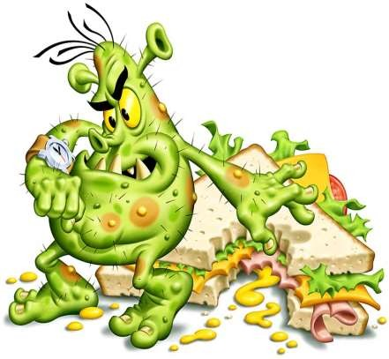
Microbiological hazards
-Three key factors generally contribute-
contamination
growth
survival
10

Slide 11
Microbiological hazards
Bacterial infections- E. coli (25%), C. Jejuni Shigella (5-15%)
(10-15%),
Parasitic infections - Giardia lamblia, Entamoeba histolytica, Toxoplasma gondii, Sarcocystis hominis, Fasciola hepatica, Taenia solium and T. saginata
Viral Infections – Polio, Hepatitis-A,E, Norwalk-like agents, Enterovirus and Rotavirus.

Slide 12
Chemical hazards
Natural toxicants or anti nutritional factors
Oxalic acid (rhubarb, spinach), solanine & glycol alkaloids (potatoes), dioscorine (yams), haemagglutinin (red kidney beans) protease inhibitors (legumes), amatoxin, psilocybin and others(toxic mushroom), environmental contaminants
51% of food commodities are contaminated with pesticide residues in India.

Slide 13
Physical hazards
Extraneous material or foreign objects that are not normally
found in foods
Care and vigilance are the best ways to avoid physical hazards.

Slide 14
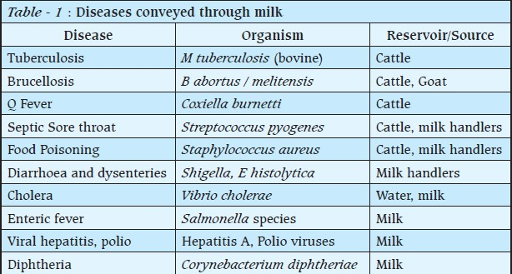
Milk Hygiene

Slide 15
Milk Hygiene
Methods of Pasteurization:
Holder (Vat) method
Continuous Flow Method
High Temperature Short Time (HTST) Method
Ultra high temperature (UHT) Method
Pasteurization in Bottles

Slide 16
Milk Hygiene
Laboratory Tests:
Specific Gravity
Chemical Tests
  Gerber’s Test
  Total Solids
  Methylene Blue Test
  Phosphatase Test
  Bacteriological Tests
Inspection of Dairies and Milk Depots
18/5/2015

Slide 17
Meat and fish hygiene
Inspection:
Smell
Appearance and Firmness
Colour
Skewer Thrust Test (Meat)
Eyes & Floatation Test (Fish)
18/5/2015

Slide 18
Tinned Meat
Tins / Cans to be Viewed with Suspicion
Damaged, dented or rusted tins
Leaking tins
Excessively convex tins
Blown tin (owing to the formation of gas from decomposition)
A bulging tin under pressure
Tainted, foul smelling or bad taste of contents
If in doubt, subject to laboratory analysis
18
18/5/2015

Slide 19
Slaughter House Sanitation
Structural soundness of the building
Fly proofing, rat proofing and dog proofing of the premises.
Method of disposal of offal, blood, discarded animal tissues
Sanitation of the lair
Separate slaughtering, skinning and hanging rooms
Availability of water for maintaining the sanitation
Maintenance of equipment of slaughtering, skinning & handling
finally the personal hygiene of the workers
18/5/2015
19

Slide 20
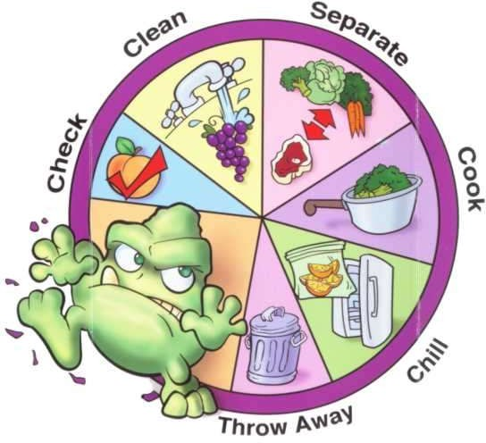
Five keys for safer food
Keep clean
Separate raw and cooked food
Cook thoroughly
Keep food at safe temperatures
Use safe water and raw materials

Slide 21
The role of health workers in food safety
Education in food safety
Focused and relevant to the target audience
Specific target groups for food safety education
HACCP-based approach
Surveillance of food borne diseases

Slide 22
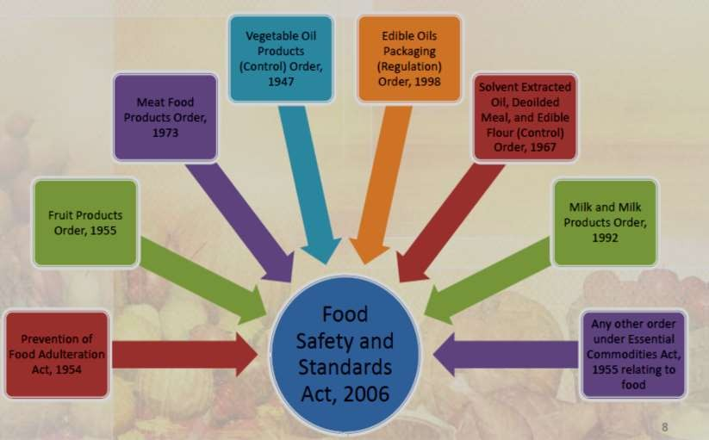
Food Standards and Safety Act,2006

Slide 23
Emphasis of the law
Safe and wholesome food for human consumption
Laying down Food Safety standards on scientific basis
Unified law
All issues are addressed comprehensively
Creation of infrastructure for testing and certification procedures
promote recognition, co-ordination with governmental and
nongovernmental organisation world over.
18/5/2015
23

Slide 24
Bureau of Indian Standards (BIS):
Cover raw materials and their quality parameters, hygienic conditions under which products are manufactured and packaging and labelling requirements.
Obtain the ISI Mark that can be exhibited on product packages
18/5/2015
23

Slide 25
Directorate of Marketing and Inspection (DMI) / AGMARK Standards
Ministry of Agriculture enforces the Agricultural Products
(Grading and Marketing) Act 1937
AGMARK - grading of an article in accordance with grade/standards
Use "AGMARK" labels on their products if they comply with standards
18/5/2015
23

Slide 26
National Codex Committee (India)
To advise government on the implications of various food
standardization
To provide important inputs to the government so as to assist in ensuring quality and safety of food
To appoint Shadow Committees
To meet as and when necessary to formulate national position.
18/5/2015
23

Slide 27
Standards for eating establishments
FSSAI ,
Premises where public is admitted for repose or for consumption of any food or drink or any place where cooked food is sold or prepared for sale
Excludes:
Food processing establishments, retail food stores, private homes where food is prepared or served for family consumption.
18/5/2015
23

Slide 28
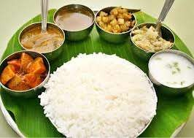
Eating establishments
Restaurants & Hotels
Dhaba
Snack Bars
Canteens (Schools, Colleges, Office, Institutions)
Food Service at religious places
Neighbourhood Tiffin Services / dabba walas
Street food vendors
18/5/2015
23

Slide 29
Eating establishments
Specific characteristics that make them potential focus of food
borne outbreaks or epidemics:
Single infection may affect many people simultaneously
Much of the food is prepared in advance of the normal mealtime rush
Hours tend to encourage poor and unsatisfactory methods of dish-washing
18/5/2015
23

Slide 30
Eating establishments
Improper holding temperatures
Inadequate cooking, such as undercooking raw shell eggs
Contaminated equipment
Food from unsafe sources, and
Poor personal hygiene
18/5/2015
23

Slide 31
Standards of eating establishments
Location and surroundings:
away from environmentally polluted areas and
industrial
activities
not be used for residential purpose
Layout and design of food establishment premises:
food preparation / manufacturing process are not subject to cross-contamination from receiving & pre processing
Area occupied by machinery shall not be more than 50% of the manufacturing area.
18/5/2015
23

Slide 32
Standards of eating establishments
Kitchen premises- General principles:
Spacious, lighted, fly proof, rat proof, airy and spotlessly clean
Floors: must have non slip surfaces should be impervious
Ceiling: should be smooth, resist condensation with provisions
for exhaust/chimney vents
Lighting: must be good both natural and artificial
Ventilation: both natural and artificial is necessary
Toilets: Foot operated flushes are more preferable

Slide 33
Standards of eating establishments
Kitchen proper
Kitchen equipment
Preparation room
Store room
Scullery
Dining Room

Slide 34
Washing arrangements
Good layout of washing-up area
Correct temperature of wash and rinse water
A good detergent suited to the type of water
Orderly methods of work in rinsing, stacking, racking, and storage

Slide 35
Standards of eating establishments
Washing Arrangements
One Sink Method
Two Sink Method
Dish washing machine

Slide 36
Standards of eating establishments
Waste disposal:
Within the kitchen - pedal-operated bins
Outside the kitchen
Environmental control:
Control of Flies
Cockroaches
Sprays and other insecticide formulations

Slide 37

Food Handlers
Immaculate personal hygiene of the cooks - prime importance
in the prevention of food borne infections
Cooks must be subjected to regular medical examinations for communicable diseases
Worthwhile doing a stool examination
They should also be vaccinated against the enteric group of
fevers.

Slide 38
Disease | Work status | Duration of Work Restriction / comments
Abscess, boils, etc | Relieve from direct contact and food handling. | Until drainage stops and lesion has healed or employee has negative culture.
AIDS or ARC (AIDS related complex) 18/5/2015 | May work (per CDC guidelines). No open lesions, upper respiratory diseases, or communicable diseases. | Employee will be counselled and educated. 38

Slide 39
Acute stage (aetiology known) | Relieve from food handling. | direct | Until symptoms resolve and infection with Salmonella, Shigella or Campylobacter is ruled out
Campylobacter | Relieve from food handling. | direct | Until symptoms resolve or after appropriate antibiotic therapy for 48 hours
Salmonella | Relieve from food handling. | direct | Until stool is free of the infecting organism in two consecutive cultures, not less than 24 hours apart

Slide 40
Shigella | Relieve from food handling. | direct | Until stool is free of the infecting organism in two consecutive cultures, not less than 24 hours apart
Hepatitis A | Relieve from food handling. | direct | Until seven days after onset of jaundice. Must bring note from physician upon return
Staphylococcus aureus | Relieve from food handling. | direct | Until lesions have resolved and the employee has negative culture

Slide 41

Personal cleanliness
Any cut or wounds - not come in direct contact
Wash their hands with soap and clean potable water
Refrain themselves from smoking; spitting; chewing or eating; sneezing or coughing over any food
Trim their nails periodically

Slide 42
Food hygiene in anganwadis
Pregnant mothers, infant and young children are especially vulnerable to infection
Local procurement - FIFO (First in First Out)
Storage of raw materials
Safety Measures during Cooking
Precaution taken before serving
Safety Measures while Feeding

Slide 43
Street food safety in India
Challenges to street food safety:
Lack of basic infrastructure and services
Difficulty in controlling the large numbers of street food vending operations
Insufficient resources for inspection and laboratory analysis.
General lack of factual knowledge
Poor knowledge in basic food safety measures.
Inadequate public awareness of hazards

Slide 44
Street food safety in India
Policies and provision on street foods:
National Policy on Urban Street Vendors - Ministry of Housing and Urban Poverty Alleviation in 2009
“Street Food Vendors- Food Safety Requirements”- BIS
More recently, 2012- schedule 4 of the FSSAI

Slide 45
Hazard Analysis and Critical Control Points(HACCP)
Approach to food safety focusing on identifying and controlling critical points
Food handlers are trained to implement key strategies to eliminate infection triggers at critical points
Specified by the Codex Alimentarius, 1997

Slide 46
HACCP
Seven basic principles:
Analyze hazards
Identify critical control points
Establish preventive measures
Establish procedures to monitor the critical control points
Establish corrective actions
Establish procedures to verify the system
Establish effective record keeping
18/5/2015
46

Slide 47
Food surveillance and monitoring system in India
To ensure that the food supplied in the market is safe
Allow the identification of potential area of focus to be tabled for subsequent action by the food authority
Organize the collection, retrieval and analysis of information
Plan and implement five yearly dietary surveys
Establish a data bank
Ensure that good agricultural, manufacturing and laboratory practices are followed
47
18/5/2015

Slide 48
Conclusion
Food - not only an agricultural or trade commodity, but also a
public health issue
Food safety - an essential public health function
Must be integrated with the three sectors— industry and consumers
government,
Necessary that food safety forms an essential component of health-based nutrition policies and nutrition education.
18/5/2015
48

Slide 49
References
Balwar R, Vaidya R, Tilak R, Guptha RK, Kunte R. Textbook of Public Health and Community Medicine. 1st ed. Department of community medicine, AFMC, Pune in collaboration with WHO India office.New Delhi (India); 2009. p.772-91
Park K. Park’s Textbook of preventive and social medicine. 22 ed. Jabalpur (India): BanarasidasBhanot Publishers; 2013. P.654-6
Operational guidelines for food safety and hygiene for supplementary nutrition under ICDS. Ministry Of Health and Family Welfare. Govt. Of India [Online] 2013 Dec 24 [cited on 2015 Apr 23]; Avialable from:URL: http://wcd.nic.in/order20122013/merged_document_3.pdf

Slide 50
References
Jacob M. Safe food handling – a training guide for managers of food
establishments. World Health Organisation [online] 1989 [cited on 2015 Apr 23]; Avialable from:URL: http://apps.who.int/iris/handle/10665/36870
Kaferstein FK. Food safety in food security and food trade. International food policy research institute [online] 2003 Sep [cited on 2015 May 2]; Avialable from:URL: http://www.ifpri.org/sites/default/files/publications/focus10.pdf
/ Final.pdf

Slide 51
References
A surveillance and monitoring system for food safety in India (under Food safety and standards Act, 2005). International Life Sciences Institute- India [online] 2007 [cited on 2015 May 2]; Avialable from:URL: http://www.ilsi-
india.org/PDF/Conf.%20recommendations
Food Safety and standards Act 2006. Ministry Of Law and Justice (Legislative Department) [Online] 2006 Aug 23 [cited on 2015 May 1]; Avialable from:URL: www.fssai.gov.in/portals/0/pdf/food-act.pdf

Slide 52
References
FSMS Program. Manual of Food Safety Management System, FSS Act, 2006 [Online] 2006 [cited on 2015 Apr 30]; Avialable from:URL: http://www.fssai.gov.in/Portals/0/Pdf/manual%20of%20food%20safet y%20management%20system,%20fss%20act%202006.pdf
Food borne Diseases. CD Alert. Monthly Newsletter of National Centre for Disease Control, Directorate General of Health Services, Government of India [Serial Online] 2009 [cited on 2015 Apr 26];13(4): p.1-12.Avialable from:URL: www.nicd.nic.in/writereaddata/linkimages/dec_091047732317.pdf

Slide 53
References
Chakravarty I. Street Food Vendors – Food Safety Requirements.
Bureau of Indian standards [online] 2011 [cited on 2015 May 6]:
Avialable from:URL: http://www.bis.org.in/sf/StreetFoodVendors.pdf
Food Regulatory Enforcement & Complience Through Inspection. The training manual for food safety regulators who are involved in implementing Food Safety and Standards act 2006 across the country. FSSAI [Online] 2009 [cited on May 2]; Avialable from:URL: http://www.fssai.gov.in/Portals/0/Training_Manual/Volume%20II%20 Food%20Safety%20Regulators%20and%20Food%20Safety%20Man agement.pdf

Slide 54
References
Adams M, Motarjemi Y. Basic food safety for health workers. World Health Organisation [online] 1999 [cited on 2015 May 6]; Avialable from:URL:
http://whqlibdoc.who.int/hq/1999/WHO_SDE_PHE_FOS_99.1.pdf
%3Fq%3Dfood-safety-when-cooking-better-health-channel
WHO- Global strategy on Food Safety. Food Safety Program -2002. World Health Organisation [online] 2002 [cited on 2015 May 6]; Avialable from:URL: http://www.who.int/fsf

Slide 55
When one’s food is pure, one’s being becomes pure
- Chandogya Upaniṣad 7.26.2
THANK YOU

