Slide 1
DEPARTMENT OF COMMUMITY MEDICINE
ROAD TO ELIMINATE TB: ROLE OF COMMUNITY MEDICINE IN A MEDICAL COLLEGE
NAME:-DR.DEEPAK SHARMA(JR-2)
MODERATOR:-DR.MEDHAVI AGRAWAL(PROFESSOR)

Slide 2


Slide 3
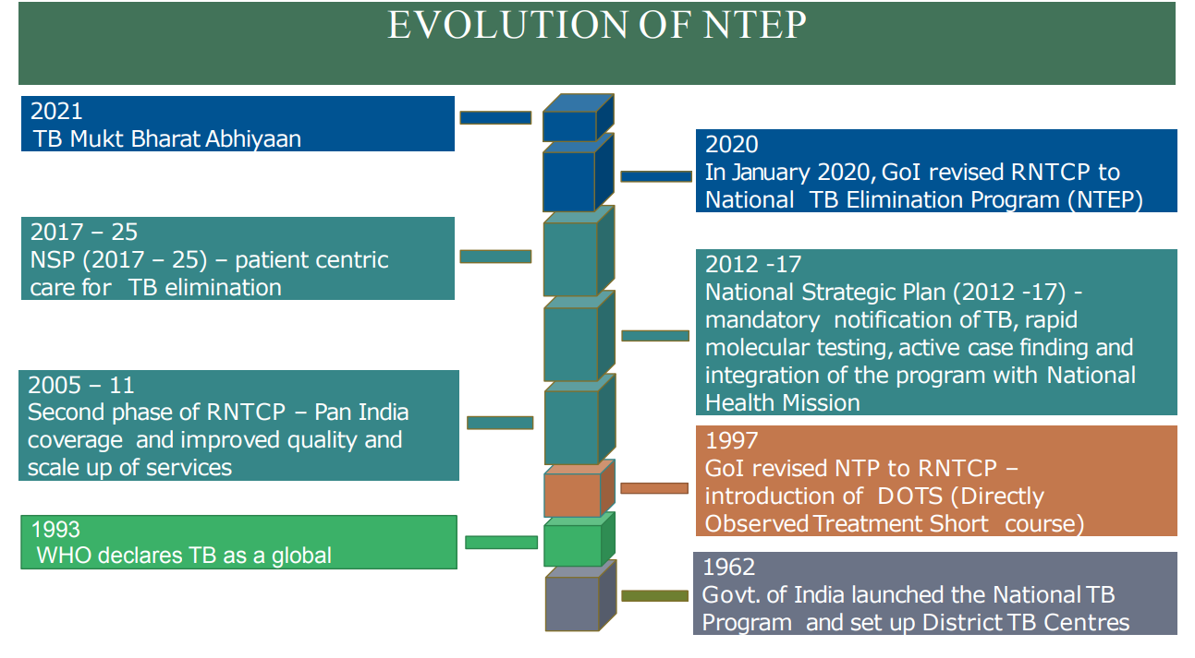

Slide 4
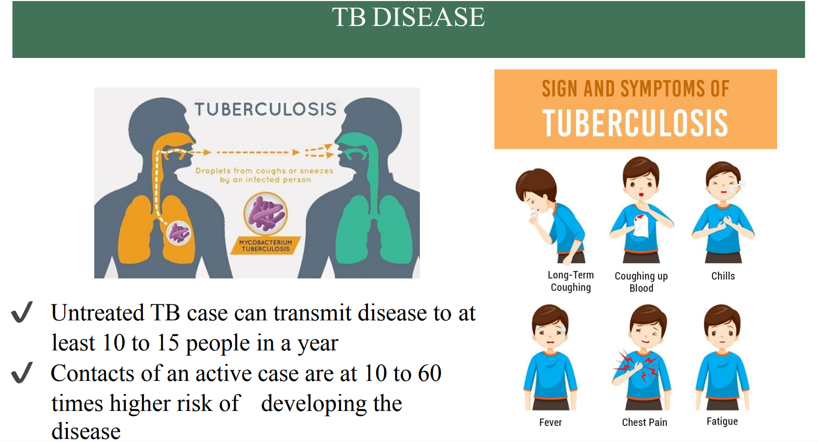

Slide 5
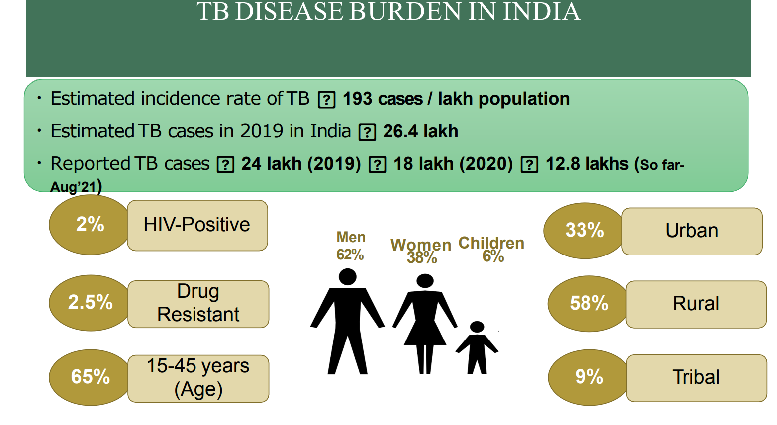

Slide 6
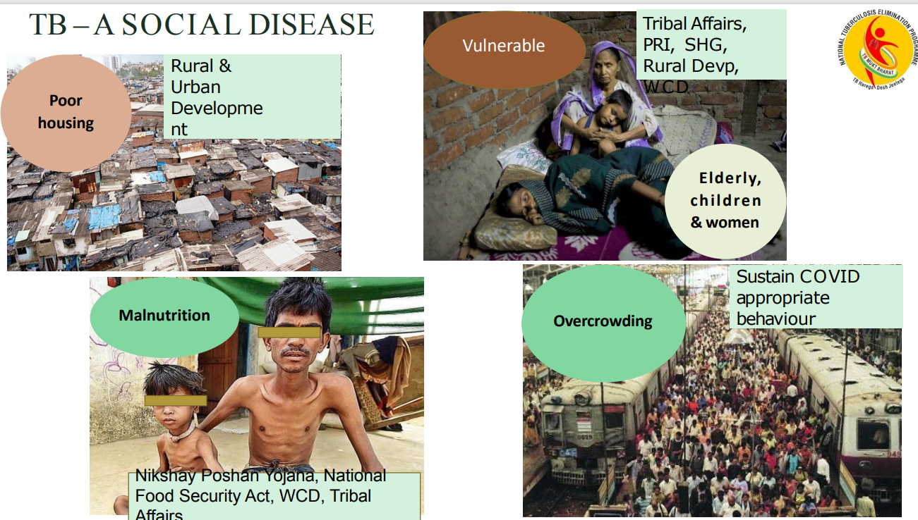

Slide 7
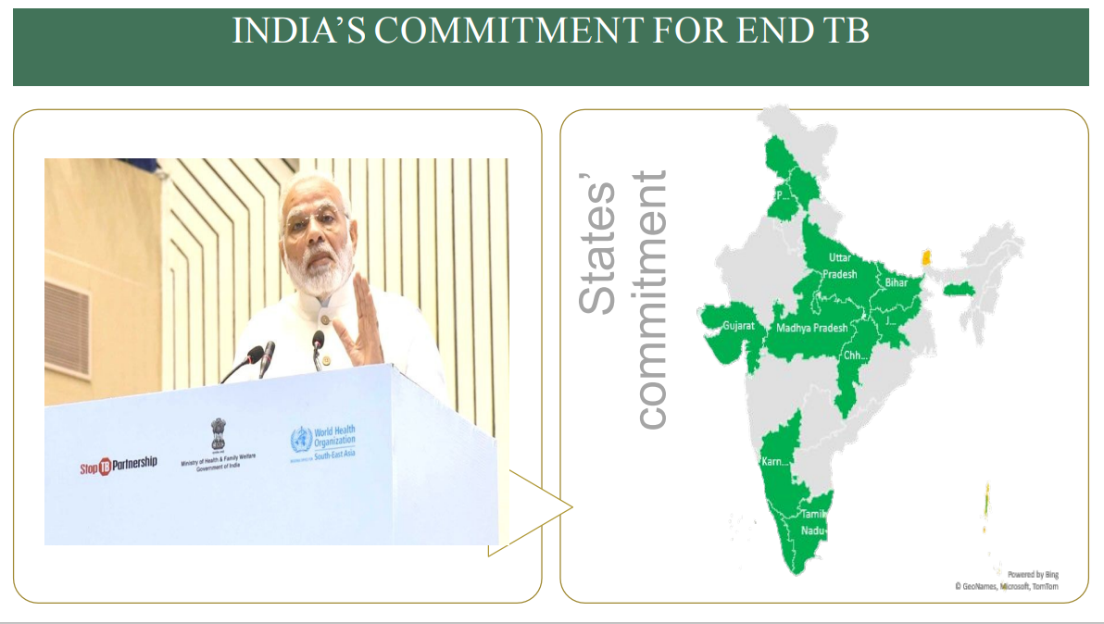

Slide 8
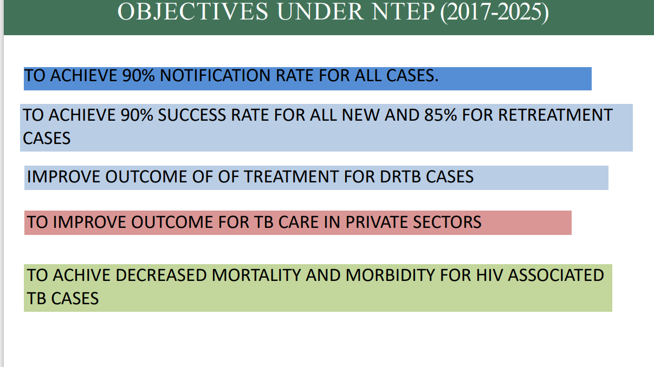

Slide 9
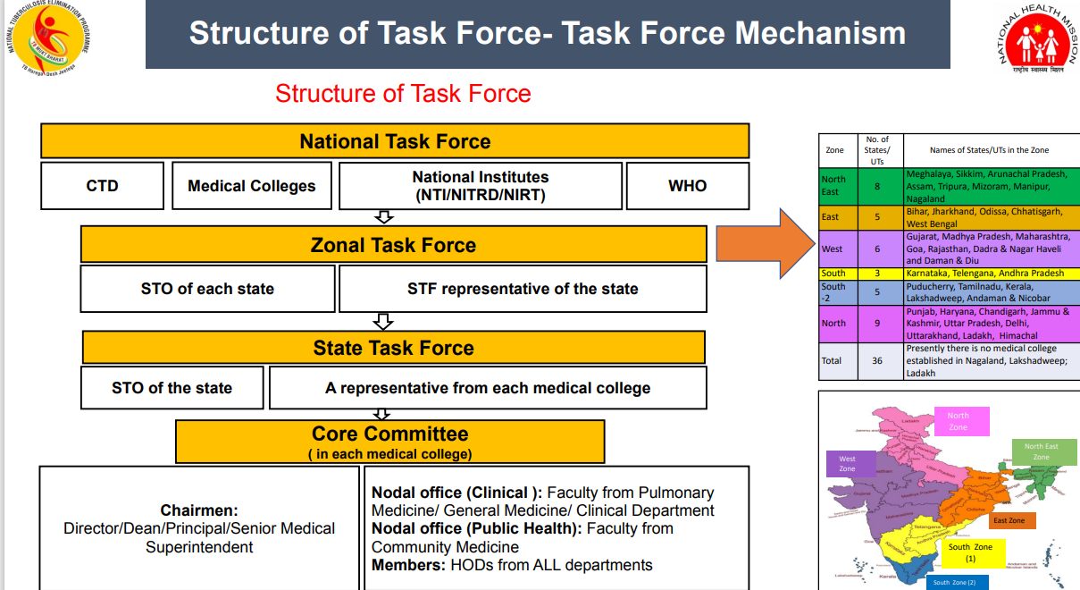

Slide 10
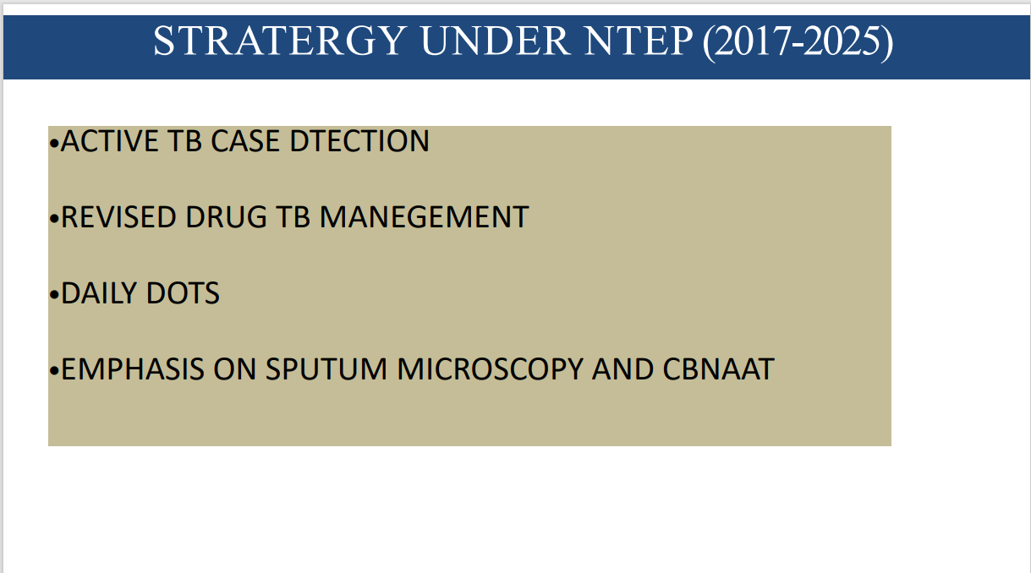

Slide 11
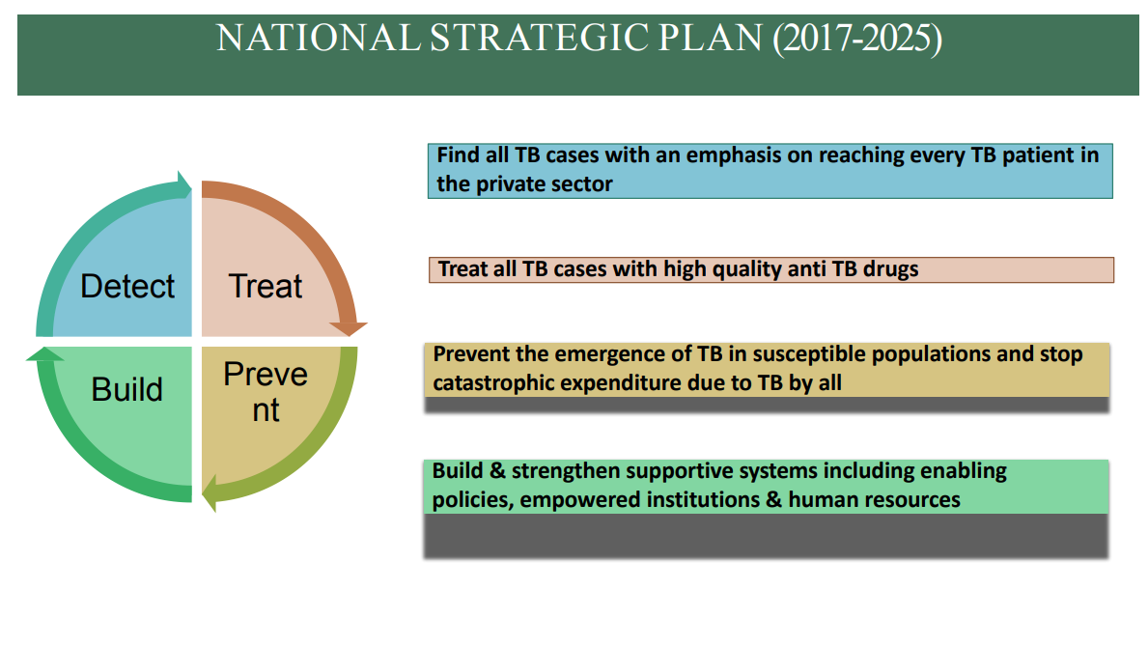

Slide 12
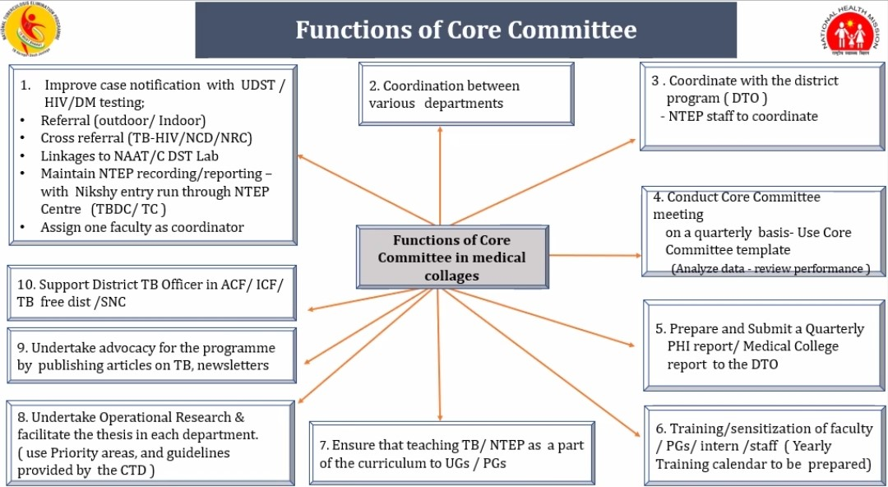

Slide 13
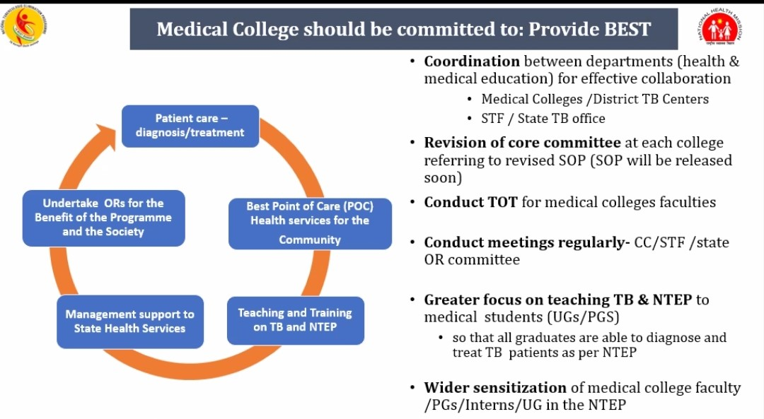

Slide 14
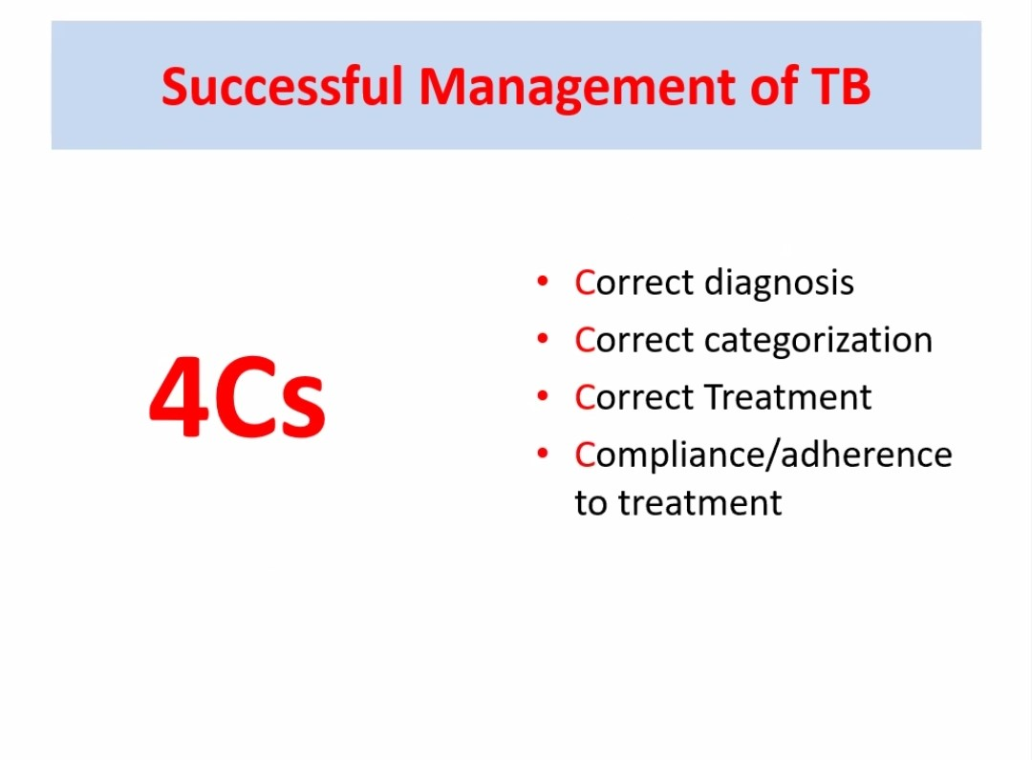

Slide 15


Slide 16


Slide 17


