Slide 1






Slide 2


NATIONAL MENTAL HEALTH PROGRAMME

Slide 3
“Mental health is a state of wellbeing characterized by the absence of mental or behaviour disorder whereby the person has made a satisfactory adjustment as an individual, and to the community, in relation to emotional, personal, social and spiritual aspects of there life”
K. park
2

Slide 4
According to WHO:
Mental health has been defined as a state of balance between the individual and the surrounding world, a state of harmony between oneself and others, a coexistence between the realities of the self and that of other people and that of the environment
3

Slide 5

INTRODUCTION
1. The Govt. of india launched the national mental health programme NMHP in 1962.
2. Heavy burden of mental illness in the community, and the absolute inadequacy of mental health care infrastructure in the country to deal with it.
3. Mental health is a level of psychological well-being.
4. Help the psychological state of someone who is functioning at a satisfactory level of emotional and behavioural adjustment.

Slide 6
National Mental Health Programme (NMHP)—The Beginning
As early as 1982, the highest policy making body in the field of health in the country, the Central Council of Health and Family Welfare (CCHFW) adopted and recommended for implementation, a National Mental Health Programme for India (NMHP)
4

Slide 7

DEFINITION
According to “K.P Neeraja”
National Mental Health Programme is a modern scientific knowledge can help to prevent and treat disabling mental illness.Mental Health skill can be used to improve the quality of general health science.
According to “Pawan sharma”
The national mental health programme improve the current health delivery system. It is improve the general health programme like family planning.

Slide 8

ERA OF MENTAL HOSPITALS
Establishment of mental hospitals
In 1947- Fifteen mental hospitals with 10,000 beds for 400 million
Bhore committee: For 2 beds/1000, 800,000 beds required!
Quantitative Gap
6

Slide 9


MENTAL HOSPITALS
Away from the community
Dumping ground for the mentally ill
Custodial rather than therapeutic
Run by ‘wardens’ rather than ‘doctors’
Later observations- Poor human rights record
Qualitative Gaps
7

Slide 10
INTEGRATION: 1975-1982
Efforts at integration of mental health with primary health care
Realization that PHC system is the vehicle to take mental health to people
Need to train non-professional staff
Need to train GP’s
Need to train more psychiatrists
8

Slide 11
There are at least five important factors which contributed to the drafting of the
national mental health programme for India during the early 1980s.
1.“The organization of mental health services in developing countries” – a set of recommendations by an expert committee of the World Health Organization.
2.Starting of a specially designated “Community Mental Health Unit” at the National Institute of Mental Health and Neuro Sciences (NIMHANS), Bangalore – 1975

Slide 12
3.World Health Organization (WHO) Multi-country project: “Strategies for extending
mental health services into the community” (1976-1981)
The “Declaration of Alma Ata”- to achieve “Health for All by 2000” by universal provision of primary health care (1978)
Indian Council of Medical Research – Department of Science and Technology (ICMR-DST) Collaborative project on ‘Severe Mental Morbidity’

Slide 13
THE ORGANIZATION OF MENTAL HEALTH SERVICES IN DEVELOPING COUNTRIES” – A SET OF RECOMMENDATIONS BY AN EXPERT COMMITTEE OF THE WHO
Expert Committee set up by the World Health Organization
strongly endorsed strategy of integrating mental health into primary care services
made recommendations about ways and means of delivering mental health services in developing countries which had acute shortage of trained mental health professionals

Slide 14
COMMUNITY MENTAL HEALTH UNIT” AT (NIMHANS), BANGALORE – 1975
Mental health needs assessment and situation analysis-Rural mental health centre at Sakalwara in Bangalore rural district covering a population of about 100,000
Simple methods of identification and management of persons with
mentally illness by primary care personnel.
Pilot training programmes in basic mental health care for primary health care (PHC) personnel were conducted

Slide 15
Draft manuals of instructions written & pilot tested.
CMHU at NIMHANS developed a strategy for taking mental health care to the rural areas through the existing primary health care network

Slide 16
WHO MULTI-COUNTRY PROJECT: (1976-1981)
Model of integrating mental health with general health services and providing basic mental health care by trained health workers and doctors, supported by Multi-country collaborative project initiated by the WHO and carried out in 7 geographically defined areas in 7 developing countries.
The department of psychiatry (PGIMER)in Chandigarh was the centre in India and the model was developed in the Raipur Rani block in Haryana state.

Slide 17
INDIAN COUNCIL OF MEDICAL RESEARCH–DEPARTMENT OF SCIENCEAND TECHNOLOGY (ICMR-DST)
During the late 1970s and the early 1980s, ICMR and the Department of science and Technology (DST) ,Government of India funded a 4 centre collaborative study to evaluate the feasibility of training PHC staff to provide mental health care as part of their routine work.
Evaluation was carried out for 1 year covering a population of 40, 000 in a PHC at four centres, one each from the South, North, East and West of the country, Bangalore, Patiala, Calcutta and Baroda.

Slide 18
At the end of one year period about 20% of the actual cases were identified and managed by the PHC personnel under the overall supervision of the centre staff

Slide 19
The above factors contributed in drafting of the NMHP.
The draft of the NMHP, written by an expert drafting committee consisted of some of the leading, senior psychiatrists in India
Reviewed and revised in two national workshops attended by a large number of mental health professionals and other stakeholders during 1981-82,
Adoption by the Central Council of Health and Family Welfare (CCHFW) in August 1982
The Government of India has launched the National Mental Health Programme (NMHP) in 1982

Slide 20
AIMS
Prevention and treatment of mental and neurological disorders and their associated disabilities.
Use of mental health technology to improve general health services.
Application of mental health principles in total national development to improve quality of life.

Slide 21
OBJECTIVES
1)To ensure availability and accessibility of minimum mental health care for all in foreseeable future, particularly most vulnerable and underprivileged section of population
Encourage application of mental health knowledge in general health care and social development
Promote community participation in mental health services development and stimulate efforts towards self-help in community

Slide 22


Prevention and treatment.
1.
Improve general health service.
2.
Improve quality of life.
3.

Slide 23

OBJECTIVE OF NATIONAL MENTAL HEALTH PROGRAME
To prevent and treat psychiatric disorder
To promote community participation
To identify Mental Health in toatal population To To improve knowledge and general health care
To improve Quality of life
General Health and Social Development

Slide 24

STRATEGIES OF NATIONAL MENTAL HEALTH PROGRAMME
Integration mental health with primary health care through the NMHP
Provision of tertiary care institutions for treatment of mental disorders District Mental Health Programme
Research and Training in Mental Health Programme Psychiatric Unit and Psychiatric Hospital

Slide 25
STRATEGIES
Integration mental health with primary health care through the NMHP
Provision of tertiary care institutions for treatment of mental disorders
Eradicating stigmatization of mentally ill patients and protecting their rights through regulatory institutions like the Central Mental Health Authority and State Mental health Authority.

Slide 26

APPROACHES OF NATIONAL MENTAL HEALTH PROGRAMMES
Intrgration of mental health care services
Training of the existing health staff The existing of general Health service

Slide 27
SPECIFIC APPROACHES
Diffusion of mental health skills to the periphery of health services
Appropriate appointment of tasks
Equitable and balanced distribution of resources
Integration of basic mental health care with general health services
Linkage with community development

Slide 28
GOALS OF NMHP
Within one year-
Each state will have adopted the plan
Govt of India will have appointed a focal point within the ministry of health specifically for MH action
National coordinating group will be formed comprising reps of each state, senior health adm, professionals from psychiatry, social welfare and education

Slide 29
GOALS OF NMHP
Task force will have worked out outlines curriculum of mental health workers and for MO’s at PHC level
Within 5 years-
5000 of target non-medical professionals will have undergone 2 weeks training in mental healthcare

Slide 30
GOALS OF NMHP
Creation of a post of psychiatrist in at least 50% of districts
Psychiatrist at the district level will visit all the PHC’s regularly at least once a month for supervision and education
To be fully operational in at least half of all districts in some states and UT

Slide 31
GOALS OF NMHP
Psychiatric units with in-patient facility will be made available in all medical college hospitals in the country

Slide 32
WHAT HAPPENED AFTER 1982
Adoption of the national mental health programme was a great achievement
Issues left unclear
No budgetary estimates or provisions
Lack of clarity regarding funding the programme – the federal government of India or the state governments who perpetually had inadequate funds for health care.
A very lukewarm response and almost rejection of the programme by psychiatrists.
Doubts were expressed about the feasibility of implementing the programme in larger populations.

Slide 33











BARRIERS TO THE IMPLEMENTATION
OF NMHP
Limited undergraduate training in psychiatry
Inadequate mental health human resources
Lack of policy driven epidemiological data and research driven mental healthcare policies
Limited number of models and their evaluation
Uneven distribution of resources across states
Non-implementation of the MHA, 1987
Privatization of healthcare in the 1990s.

Slide 34
1982-1990 – DEVELOPMENT OF THE PILOT DISTRICT MENTAL HEALTH PROGRAMME AT BELLARY DISTRICT IN KARNATAKA
NIMHANS developed a program to operationalize and implement the NMHP in a district.
Bellary district ,
population of about 20 lakhs,
located about 350 kms away from Bangalore
chosen for the pilot development of a (DMHP).

Slide 35
Components of the DMHP at Bellary were:
training for all primary care staff,
Provision of 6 essential psychotropic and anti epileptic drugs (chlorpromazine, amitryptaline, trihexyphenidyl, injection fluphenazine deaconate, phenobarbitone and diphenyl hydantoin) at all PHCs and sub centres,
A system of simple mental heath case records,
A system of monthly reporting,
Regular monitoring and feed back from the district level mental health team

Slide 36
The psychiatrist
Mental health clinic at the district hospital to review patients referred
from the PHCs.
Admit up to 10 patients at the district hospital for brief in patient treatment.
The mental health programme was reviewed every month at the district level by the district health officer during the monthly meeting of primary health centre medical officers

Slide 37
The Ministry of Health and Family Welfare, Govt. of India formulated District Mental Health Programme (under National Mental Health Programme)
The programme was to be implemented in two phases,
Phase I taken up during 1996-97,
Phase II be a continuation of the programme during the IX Five Year Plan period (1997-2002).
budget line for implementation of the DMHP as a major component of the
NMHP was created in 1996; 14 years after CCHFW approved the NMHP.
DMHP was to be implemented as a fully “centrally supported” project

Slide 38
Launched in 1996–97 in four districts, one each in Andhra Pradesh, Assam, Rajasthan, and Tamil Nadu
At present the program is in place in 127 districts
DMHP is also being started in 325 new districts
The central grant for implementation of DMHP per district with avg population of 20 lakh for five years will be Rs. 2.5 crore
35

Slide 39
DMHP OBJECTIVES
To Provide sustainable basic mental health services in community and integration of these with other services
Early detection and treatment in community itself
To ensure ease of care givers
To take pressure off mental hospitals
To reduce stigma
To rehabilitate patients within the community
To detect ,manage & refer cases of epilepsy

Slide 40

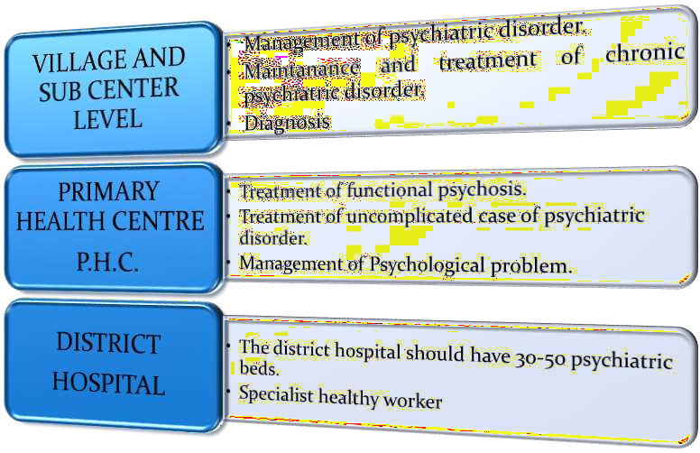
COMPONENT OF NATIONAL MENTAL HELATH PROGRAMMES

Slide 41

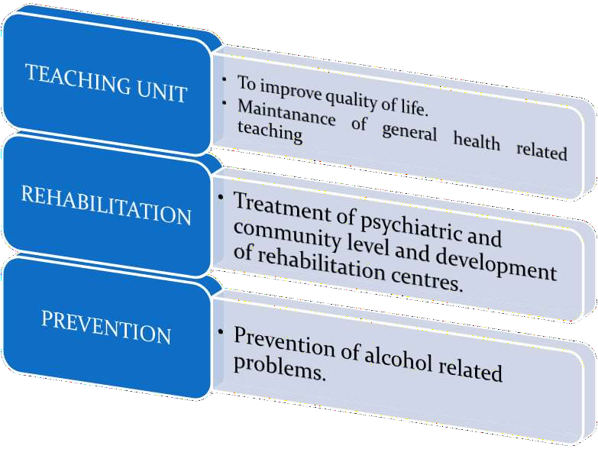
COMPONENT OF NATIONAL MENTAL HELATH PROGRAMMES

Slide 42


COMPONENT OF NATIONAL MENTAL HELATH PROGRAMMES

Slide 43

COMPONENTS OF DMHP
Training of medical, paramedical personnel and community leaders
Community Mental Health care through existing infrastructure of the health services
Information, Education and Communication (IEC) activities

Slide 44
DMHP—KEY FEATURES
The States will set in motion the process of finding suitable personnel for manning the DMHP teams.
They can take in service candidates who are willing to serve in this pilot project and provide them the necessary training in the identified institution
The patients will be from the district itself and the adjoining areas
District Mental Health Team expected to provide service to the needy mentally ill patients and their families, such as—daily out-patient service, ten bedded in-service facilities, referral service and liaison with the primary health centres, follow up service, awareness programmes, and also community survey if feasible.
38

Slide 45
The DMHP Provide valuable data & experience at the level of community to the state & centre for future planning & improvement in service & research.

Slide 46
The team of workers at the district under the program consists of a
Psychiatrist,
Clinical Psychologist,
Psychiatric Social worker,
Psychiatry/Community Nurse,
Program Manager,
Program/Case Registry Assistant and
Record Keeper.

Slide 47
THE TOP DOWN-BOTTOM UP APPROACH
State Mental Hospital
Look after mental patients who need prolonged in-patient care
Diagnose and manage difficult cases
Return the cases to community as soon as possible
District Hosp/Medical college Psychiatric team
Diagnose and manage typical cases
Refer difficult cases to District team
Monitor the follow-up of the patients on treatment
PHC Doctors
Multipurpose workers at
the PHC
Detect cases in the community
Refer cases to PHC
Conduct simple mental health education of the community
Follow-up the patients regularly
Epileptics and Psychiatric patients in the community

Slide 48
2002 TO 2007 - X FIVE YEAR PLAN PERIOD
The NMHP was re-strategized in the year 2003 (in X Five Year Plan) with the following components:
Extension of DMHP to 100 districts
Up gradation of Psychiatry wings of Government Medical Colleges/
General Hospitals
Modernization of State Mental hospitals
IEC
Monitoring & Evaluation

Slide 49
MODERNIZATION OF STATE RUN MENTAL HOSPITALS
The assistance under this scheme is provided for modernization of state run mental hospitals from custodial care to comprehensive management.
A one-time grant with a ceiling of Rs.3.00 crores per hospital is provided.
The grant covers activities such as
construction/repair of existing building(s),
purchase of cots and equipments,
provision of infrastructure such as water- tanks and toilet facilities etc.
Does not cover recurring expenses towards running the mental hospitals and cost towards drugs and consumables.
Grant is for modernization of the mental hospitals only and any increase in the number of beds in the hospital is not permitted.

Slide 50
UP GRADATION OF PSYCHIATRIC WINGS OF MEDICAL COLLEGES/GENERAL HOSPITALS
Every medical college should ideally have a Department of Psychiatry with minimum of three faculty members and inpatient facilities of about 30 beds as per the norms laid down by the MCI
scheme for strengthening of the psychiatric wings of government medical colleges/hospitals which provides for a one-time grant of Rs.50 lakhs for up gradation of infrastructure and equipment as per the existing norms.
aim of the scheme is to strengthen the training facilities for UG& PG at Psychiatry wings of government medical colleges/hospitals.
grant covers construction of new ward, repair of existing ward, procurement of items like cots, tables and equipments for psychiatric use such as modified ECTs.

Slide 51
IEC ACTIVITIES
NMHP has dedicated funds for IEC activities for the purpose of
increasing awareness and removal of stigma for mental illness.
The funds are allocated at central and state levels for IEC activities.
An amount of Rs. 25 crore is allocated for the purpose of IEC activities at central level.

Slide 52
2007 ONWARDS - IX FIVE YEAR PLAN, THE CURRENT PHASE
In the XI Five Year Plan, the NMHP has the following
components/schemes:
1. District Mental Health Programme (DMHP)
2. Manpower Development Schemes - Centers Of Excellence And Setting Up/ Strengthening PG Training Departments of Mental Health Specialities
3. Modernization Of State Run Mental Hospitals
4. Up gradation of Psychiatric Wings of Medical Colleges/General Hospitals
5. IEC
6. Training & Research
7. Monitoring & Evaluation
Manpower Development Schemes - Centers of Excellence and Setting Up/ Strengthening PG Training Departments of Mental Health Specialities are the new schemes/components.

Slide 53
MANPOWER DEVELOPMENT SCHEME
To improve the training infrastructure in mental health, Government of India has approved the Manpower Development Components of NMHP for XIth Five Year Plan.
It has two schemes which are as follows:
A. Centers of Excellence (Scheme A)
B. Setting Up/ Strengthening PG Training Departments of Mental Health Specialities (Scheme B)

Slide 54
A. CENTRES OF EXCELLENCE (SCHEME A)
Under Scheme-A,
at least 11 Centres of Excellence in mental health were to be established in the IXth plan period by upgrading existing mental health institutions /hospitals.
A grant of up to Rs.30 crores is available for each centre
The commitment to take over the entire funding of the scheme after the 11th five year plan period from the state government is required.
The proposal of the State Governments for these centres must include definite plan with timelines for initiating/ increasing PG courses in Psychiatry, Clinical Psychology, PSW and Psychiatric Nursing.

Slide 55
B. Setting Up/ Strengthening PG Training Departments of Mental Health Specialities (Scheme B)
To provide further impetus to manpower development in Mental Health, Government Medical Colleges/ Hospitals are supported to start PG courses in Mental Health or to increase the intake capacity for PG training in Mental Health.
The support involves capital work for establishing/improving mental health departments (Psychiatry, Clinical Psychology, Psychiatric Social Work, and Psychiatric Nursing), equipments, tools and basic infrastructure, support for engaging required/deficient faculty for starting/enhancing the PG courses.
The support of up to Rs. 51 lacs to Rs. 1 crore per PG department is available.

Slide 56
Based on the evaluation conducted by ICMR in 2008 and feedback received from a series of consultations DMHP has now incorporated promotive & preventive activities for positive mental health which includes:
School mental health service
College counseling services: through trained teachers/ counselors
Work place stress management: formal & informal sector, including farmers, women etc
Suicide prevention services: counceling center at district level, sensitization workshops, IEC, helpline

Slide 57
SCHOOL MENTAL HEALTH PROGRAM
In 2010, this program has been sanctioned to be implemented in all DMHP districts in the country

Slide 58
AIMS OF THE SMHP
Provide Class Teachers with Knowledge and Skills to Identify Emotional, Conduct Problems in their students
Provide Class Teachers with a system of referral for students with psychological problems to the District Mental Health Team for inputs and treatment.
Provide Class Teachers with Facilitative Skills to Promote Life Skills among their Students.

Slide 59
The life skills which need to be taught at the school level especially to adolescent as are
Critical thinking & creative thinking
Decision making & problem solving
Communication skills & interpersonal relations
Coping with emotion & stress
Self awareness & empathy

Slide 60

RURAL MENTAL HEALTH PROGRAMMES
1. Use of mental health technology to improve general health services.
Management of psychiatric emergencies.
Counselling in problem related to alcohol anddrug abuse

Slide 61

URBAN MENTAL HEALTH PROGRAMMES
1. To decrease psychosocial problems.
2. Improvement of quality of life.
3. To reduce psychiatric disturbances.
4. Management of psychiatric emergencies.

Slide 62
INVOLVEMENT OF ICDS SYSTEM IN NMHP
Most effective in dissemination of knowledge on mental health, identification of clients at earliest stage of morbidity
NIMHANS has rightly picked up the ICDS system to involve in NMHP, are imparted 5 days training programme at distt. level

Slide 63
ROLE OF NGO IN NMHP
IEC activities
Support for health promotion using life skill approach
Support for follow up of severely mentally ill persons in community
Support for mentally retarded children & their families
Organization of mental health camps

Slide 64
Networking with primary health care team
Facilitation of disability welfare benefits for the mentally ill & mentally challenged
Home care for severely mentally ill person

Slide 65
LEGISLATIONS SUPPORTING MENTAL HEALTH
Narcotic Drugs and Psychotropic Substances (NDPS) Act, 1985
Juvenile Justice Act, 1986
Mental Health Act (MHA), 1987
Persons with Disability Act, 1995
National Trust Act, 1999
Human rights of mentally ill persons, report of NHRC, 1999

Slide 66
REVISED GOALS FOR THE MENTAL HEALTH PROGRAMME
Redesigning DMHP around a nodal institution
Strengthening medical colleges to develop manpower, secondary facilities, encourage general hospital psychiatry
Modernization of mental hospitals
Strengthening of state mental health authorities
Research and training on epidemiology, course/outcome, needs, cost effective intervention models

Slide 67
REVISED GOALS FOR THE MENTAL
HEALTH PROGRAMME
Strengthening families and communities for the care of persons suffering from mental disorders
Organization of a wide range of mental health initiatives to support individuals and families
Special focus on immediate delivery of the most essential services to the ones with the greatest needs

Slide 68
PRIORITIES FOR FUTURE
Approach of NMHP should be adapted to changing need with strategies such as openness, continuous evaluation, learning from the experiences
The nature of mental health requires that actions and interventions be multidimensional, involving a number of sectors, professionals, approaches
The wide variations across the states of India, plans should be developed for each of the states and union territories, besides the national plan and programme

Slide 69
PRIORITIES FOR FUTURE
All the Psychiatric care institutions should be upgraded with trained personnel, treatment and rehabilitation facilities, community outreach activities
All the medical colleges should have independent Departments of Psychiatry to ensure UG & PG training in Psychiatry
Setting up of District and Sub-district Mental Health Team for adequate surveillance and monitoring of activities

Slide 70
PRIORITIES FOR FUTURE
The advances in understanding human behavior and mental disorders justify the optimism of developing meaningful and realistic mental health programmes. It is mandatory to bring the fruits of science to the total population of India.

Slide 71
Mental Health Helpline
A country wide 24 hours dedicated help-line to provide information to public on mental health resources, emergency situation and crisis management, information pertaining to destitute mentally ill patients, registration of complaints on Human Rights Violation of mentally ill and assistance on medico-legal issues.
Linked with district hospitals, medical college/hospitals, mental hospitals, private mental health facilities, NGOs and all other mental health service providers of the state.

Slide 72
CONCLUSION
In the IXth five year plans, NMHP got specific budgetary allocation of 28 crores and the major focus during these five years was on DMHP.
The Xth five year plans were introduced in 2003 after In-depth analysis and consultations with the stakeholders.
There was several folds increase in the budgetary allocation for the program.

Slide 73
XIth five year plan focused on centers of excellence in mental health and the manpower development in the field of mental health.
Over the years it has been observed that the focus on community mental health is of utmost importance and DMHP needs to be strengthened in view of its coverage and utilization of its service components.

Slide 74
Public awareness and IEC programs need to be the most important components for a change to happen at the community level as is true for many other public health programs.
Further NMHP had major focus in rural sector but the urban mental health needs to be addressed equally hence NMHP has been gradually been mainstreamed into National health mission.

Slide 75
The NMHP in the XIIth plan will have expansion of all existing components and additionally has a special focus on the vulnerable and marginalized sections of the society.
The monitoring and evaluation component is inbuilt in the program and the outcomes of the NMPH at the end of the XIIth plan will set the ball rolling for brainstorming over the success and the failures of the program

