Slide 1
Methods and Models of Health Education
Dr Deepak Upadhyay

Slide 2
What is ‘Method’ and ‘Model’
Method:
A procedure, technique, or way of doing something, especially in accordance with a definite plan.
It is operational. Model:
A standard or example for imitation or comparison.
It is abstract, theory, conceptual.

Slide 3
Methods of health education
Methods of health education are the techniques or ways in which series of activities are carried out to communicate ideas, information and develops necessary skills and attitude.

Slide 4
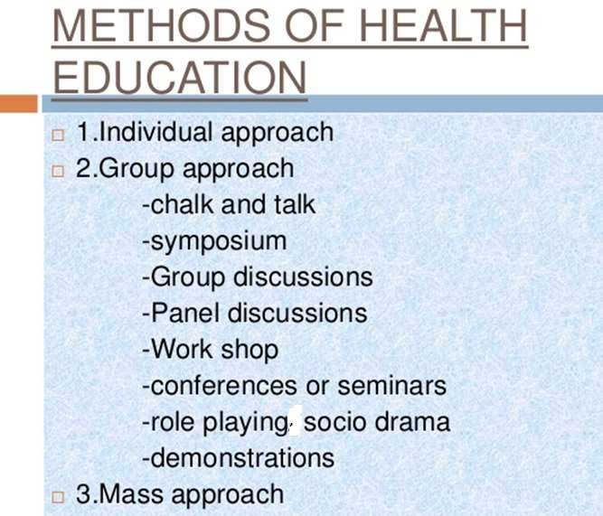

Slide 5
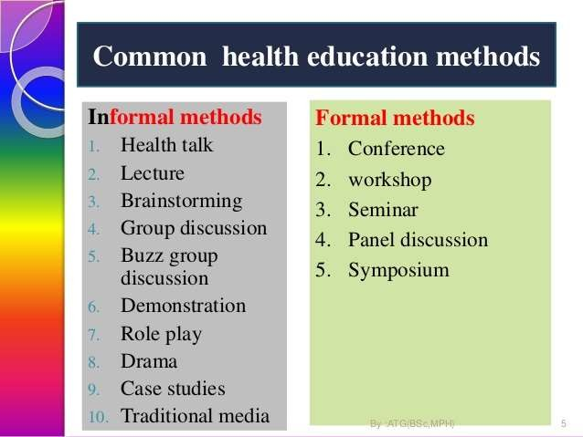
Methods of Health Education

Slide 6
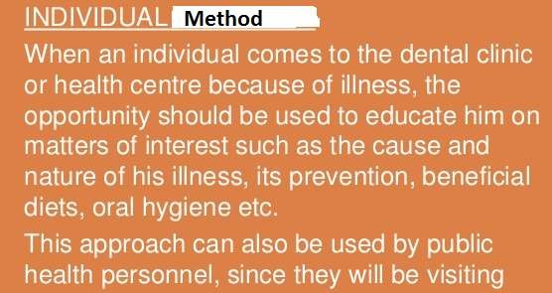
home and interacting with individual and family member

Slide 7
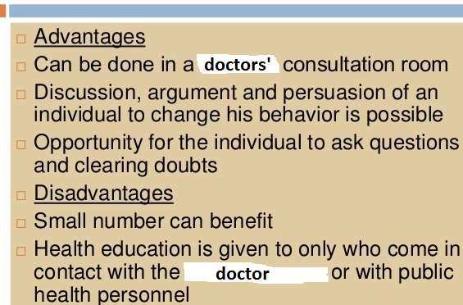

Slide 8
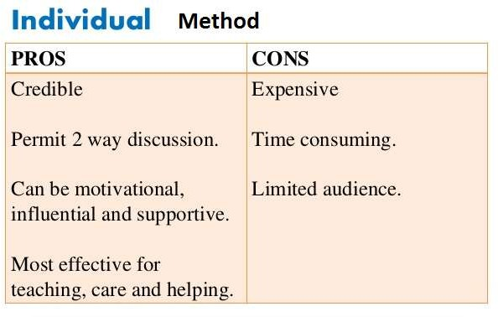

Slide 9
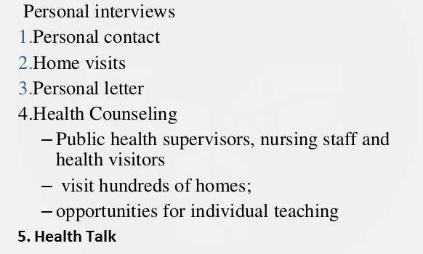
Types of Individual HE Method

Slide 10
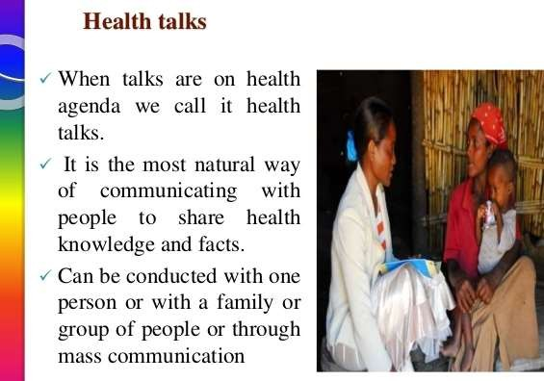

Slide 11
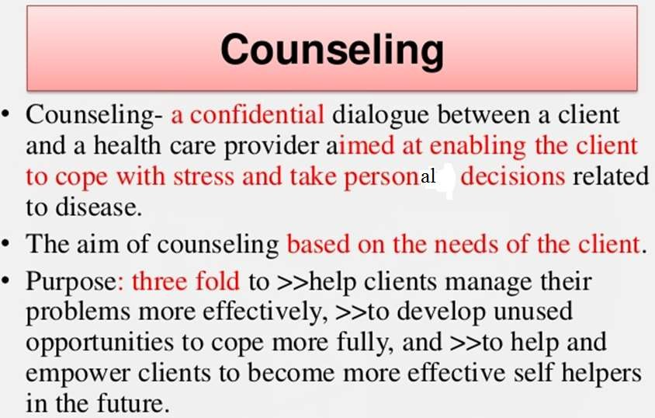

Slide 12
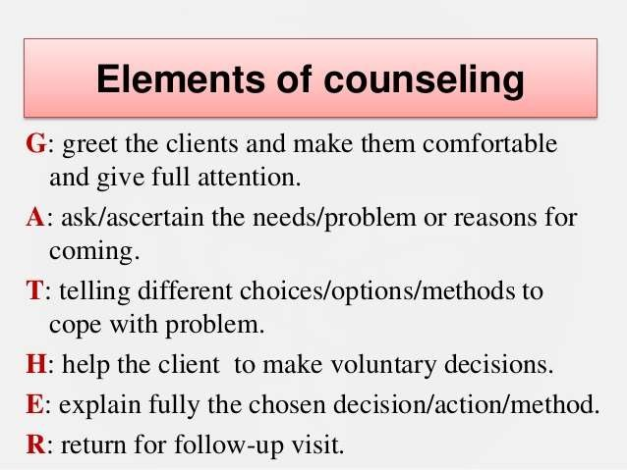

Slide 13
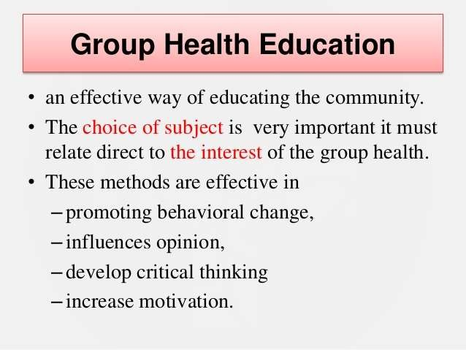

Slide 14
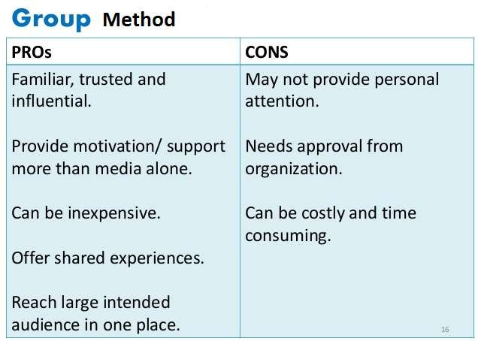

Slide 15
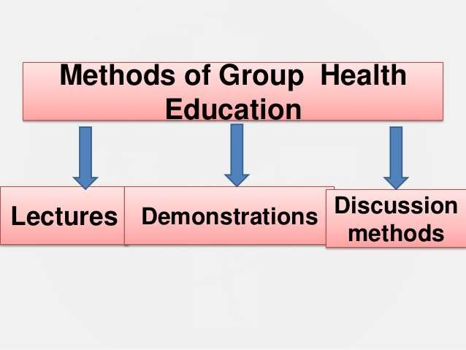

Slide 16
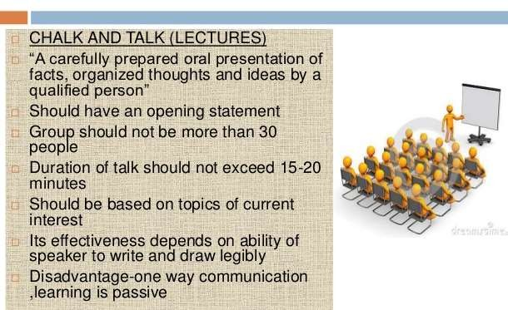

Slide 17
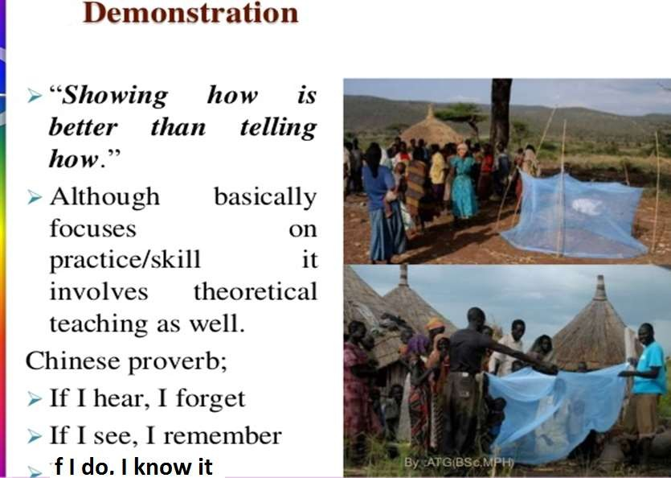

Slide 18
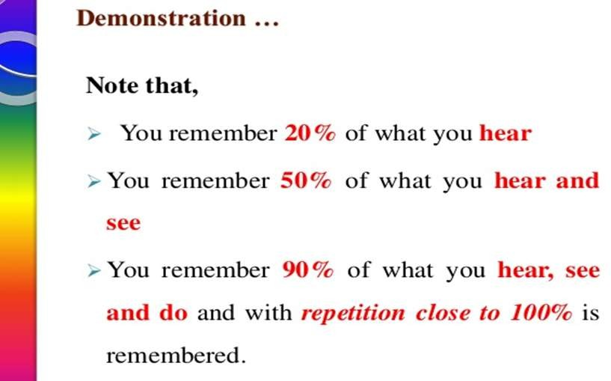

Slide 19
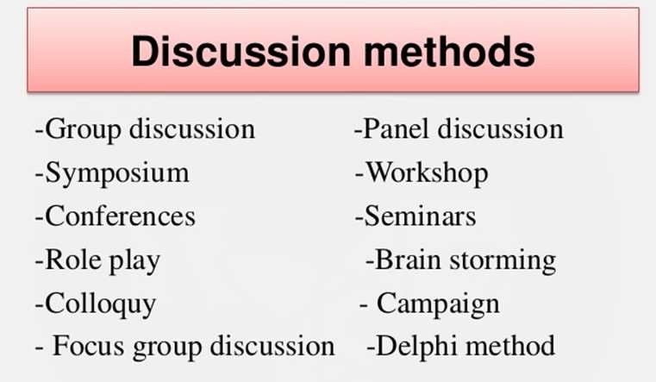

Slide 20
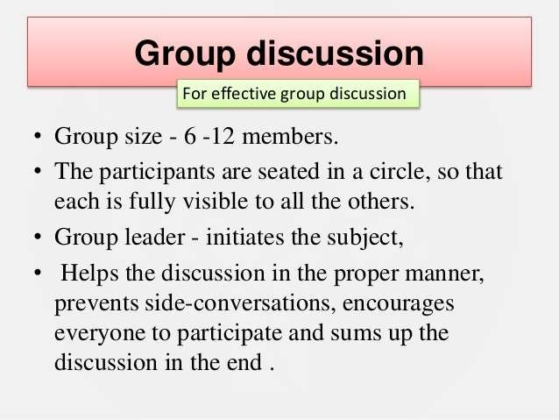

Slide 21
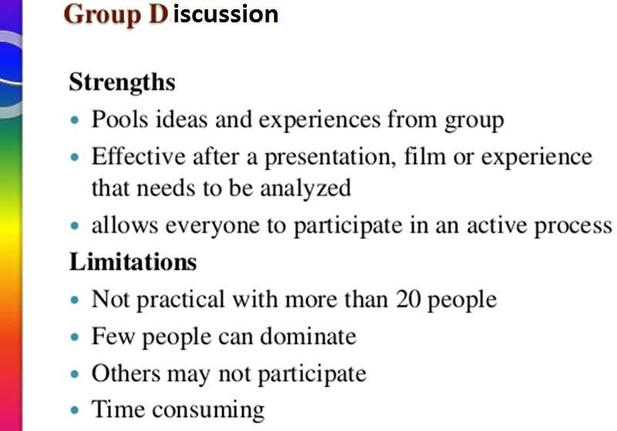

Slide 22
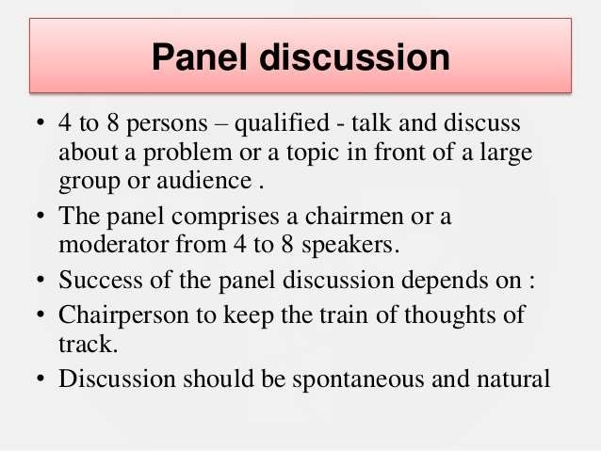

Slide 23

Ø Moderator summarizes and highlights the points
Ø Audience are allowed to put questions and seek clarification
Ø Example: Talk-Show in presence of audience

Slide 24
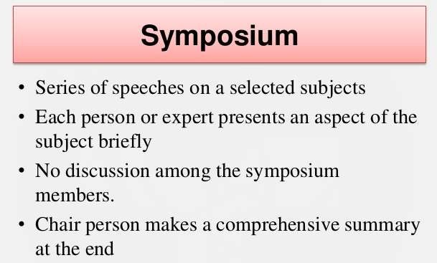
Ø In the end, audience may ask questions

Slide 25
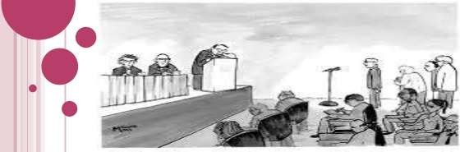
Example: Formation Study period

Slide 26
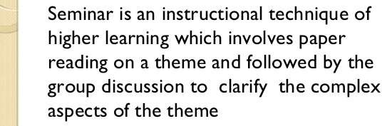

Seminar

Slide 27
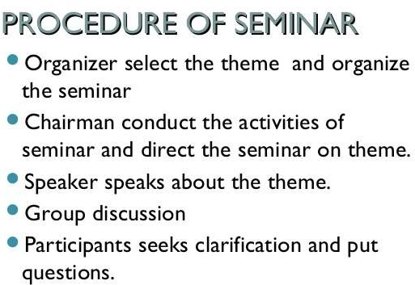
Example: Seminar on Bird Flu

Slide 28
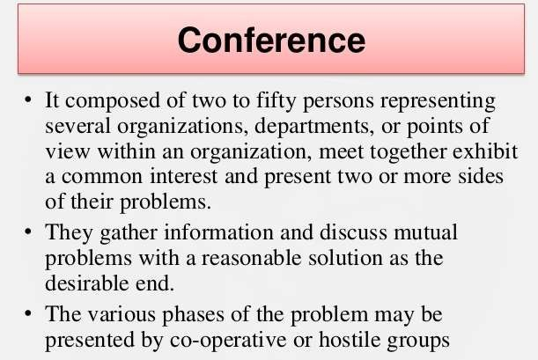
Large gathering of individuals or members of one or several organizations, for discussing matters of common interest.
Example: Annual General Meeting (AGM)

Slide 29
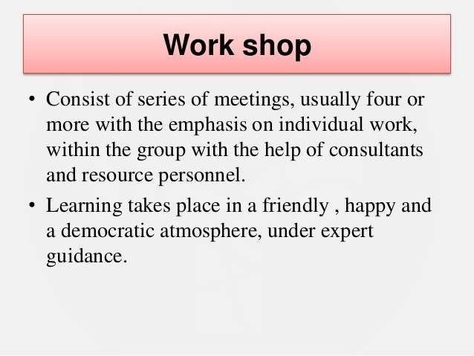
In workshops participants get fully involved in the learning process: small and large group discussions, activities & exercises, opportunities to practice applying the concepts that are presented.
Example: Workshop on CPR by presence of intensivists

Slide 30
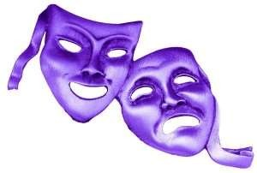
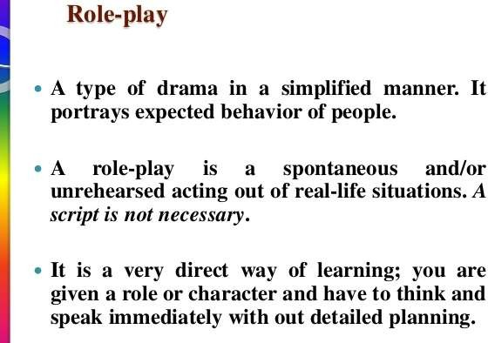

Slide 31
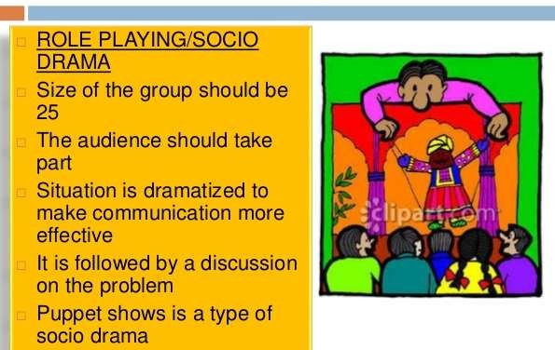

Slide 32
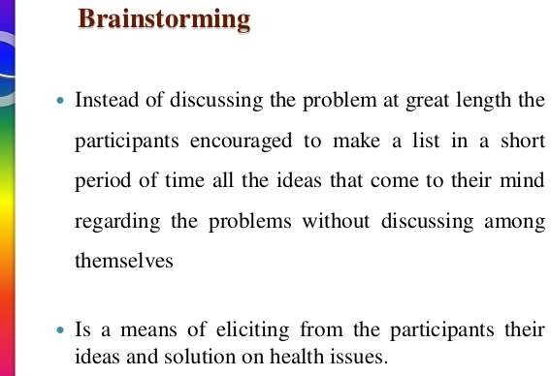
Brainstorming is a group creativity technique by which efforts are made to find a conclusion for a specific problem by gathering a list of ideas spontaneously contributed by its members.

Slide 33

BUZZ GROUP
A large group is divided into small groups, of not more than 10-12 people in each small group and they are given a time to discuss the problem.
Then, the whole group is reconvened and the reporters of the small groups will report their findings and recommendation

Slide 34
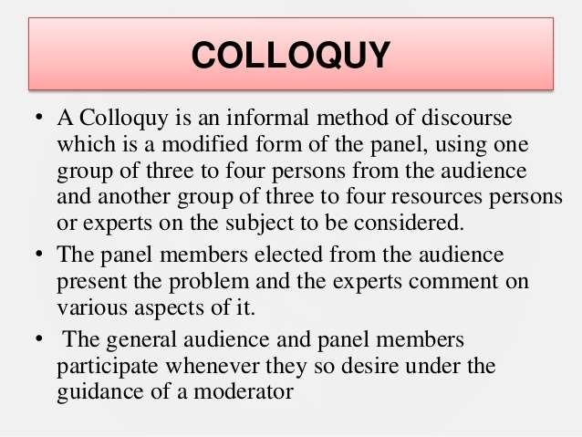

Slide 35

A campaign is an intensive activity undertaken at an opportune moment for a brief period, focusing attention in a concerted manner towards a particular problem so as to stimulate the widest possible interest in the community.
Campaign method is used only after found acceptable to the
local people.
Campaigns maximize their chances of success through the coordination of media efforts with a mix of other interpersonal and community-based communication channels.
Example: EPI Campaign

Slide 36

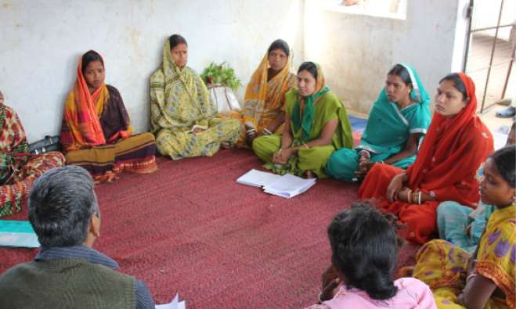

Slide 37
A focus group discussion (FGD) is a good way to gather together people from similar backgrounds or experiences to discuss a specific topic of interest.
Focus group discussion is one of the most popular qualitative research methods.
It is a discussion guided by the moderator according to the prepared interview guidelines.
The survey is carried out in several groups of not less than 6 and not more than 12 persons selected in accordance with the research aims.
Carefully developed 5-6 questions.
The optimal duration of a group discussion is 1.5 - 2 hours.

Slide 38
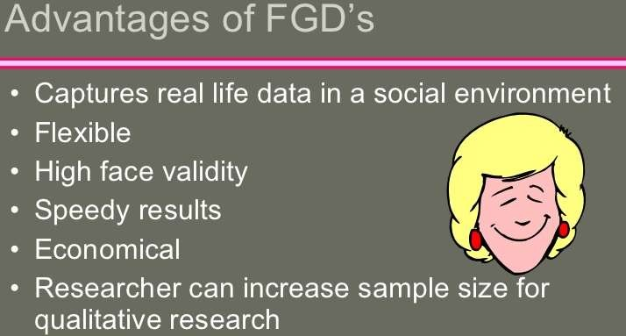
The warm atmosphere created during an interview and encouraged by the moderator allows disclosing participants' habits, convictions, opinions, preferences, tastes, associations, etc.
Consequently, the focus group discussion reveals mental maps, stream of consciousness, latent demands.

Slide 39
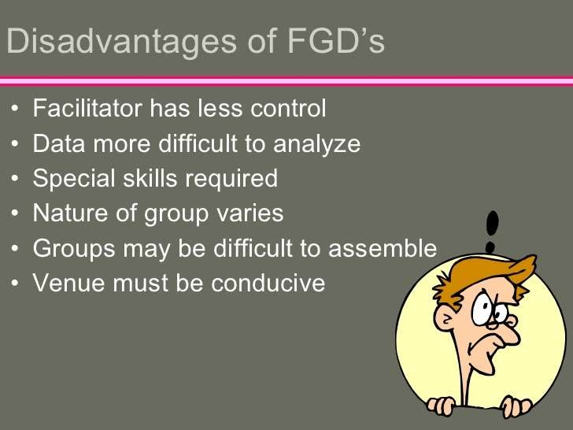

Slide 40

A systematic forecasting method that involves structured interaction among a group of experts on a subject.
The Delphi Technique typically includes at least two rounds of experts answering questions and giving justification for their answers, providing the opportunity between rounds for changes and revisions.
The multiple rounds, which are stopped after a pre- defined criterion is reached, enable the group of experts to arrive at a consensus forecast on the subject being discussed.

Slide 41
The Delphi Method seeks to achieve a consensus among the group members through a series of questionnaires.
The series of questionnaires sent either by email or via computerized system, to a pre-selected group of experts.
Nobody ‘looses face’, because the questionnaires are answered anonymously
The answers are summarized and sent back to the group members along with the next questionnaire.
This process is repeated until a group consensus is reached. This usually only takes two iterations, but can sometimes takes as as many as six rounds before any consensus is reached

Slide 42
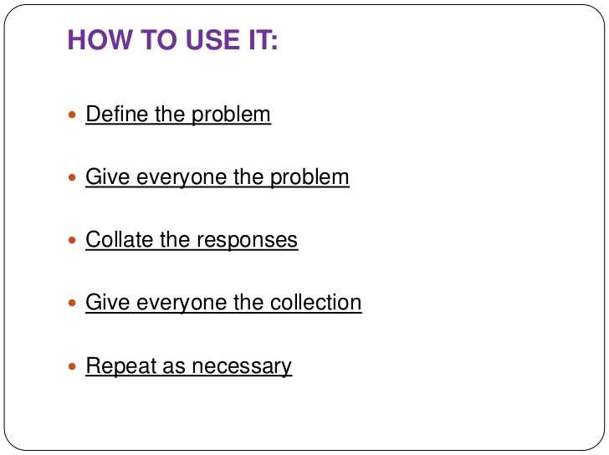
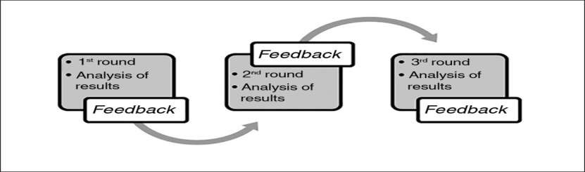

Slide 43
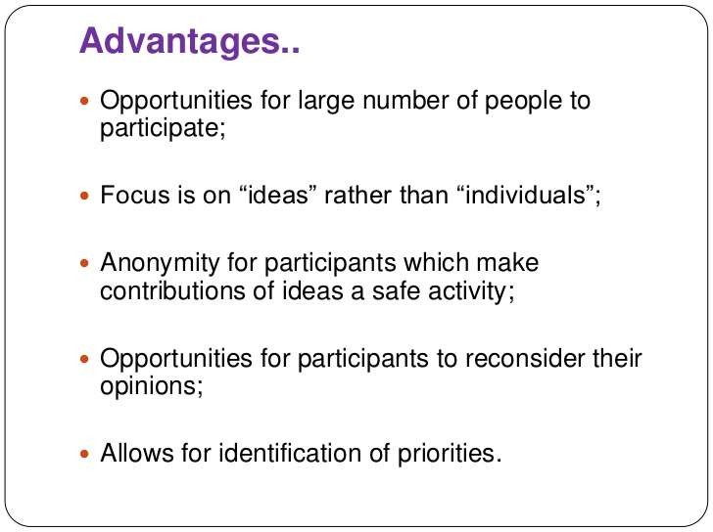

Slide 44
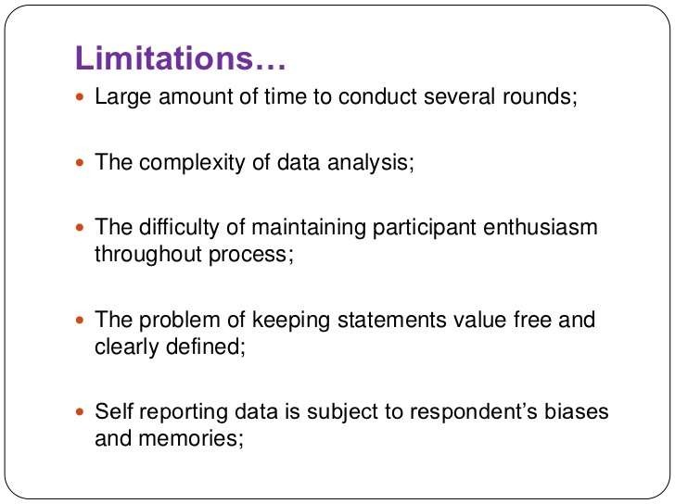

Slide 45
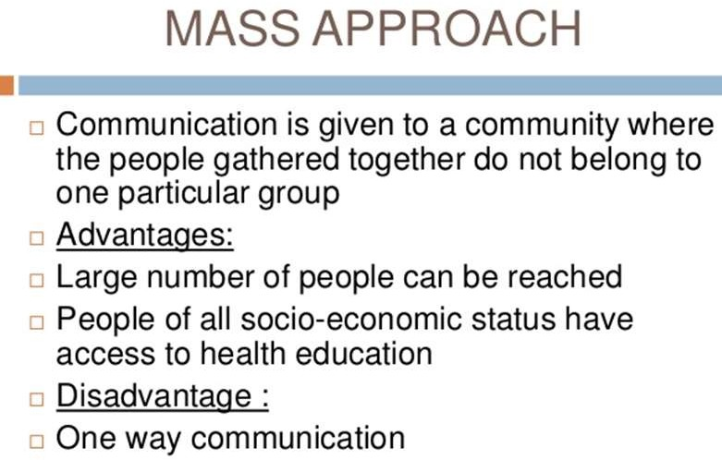

Slide 46
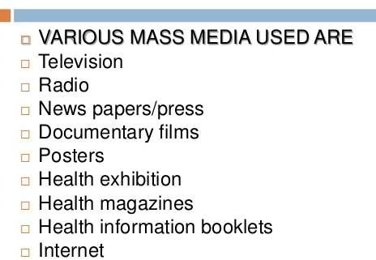
e-Health
m-Health

Slide 47
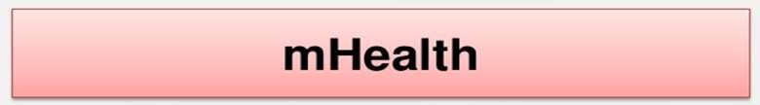
mHealth (mobile health) is a general term for the use of mobile phones and other wireless technology in medical care. The most common application of mHealth is the use of mobile phones and communication devices to educate consumers about preventive health care services.

Slide 48

E-Health is short for electronic health. E-health simply means the
application of the latest information and communication technologies in all
health-related fields such as collecting,
storing, restoring, analyzing and managing the information, unifying the electronic health records, disseminating and sharing medical information, surgeries and healthcare remotely.

Slide 49
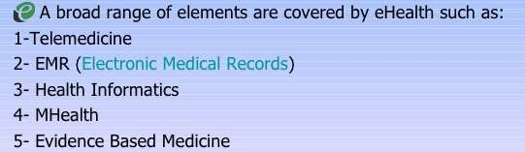

Slide 50
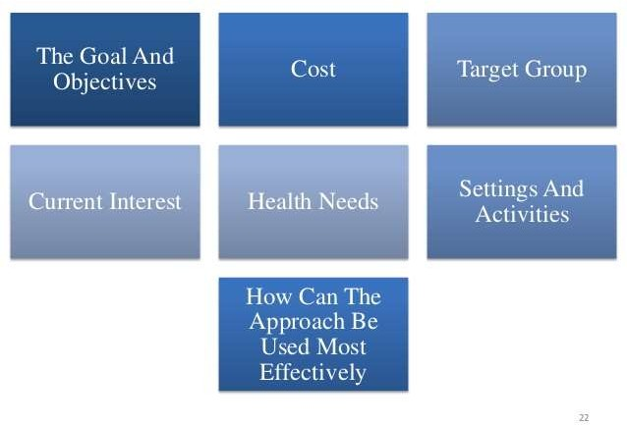
Which one is the right method of Health Education?

Slide 51

Medical Model
Motivational Model
Social Intervention Model

Slide 52
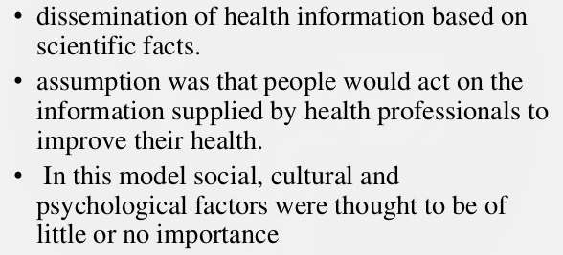
Medical Model
Did not bridge the gap between knowledge and behavior

Slide 53
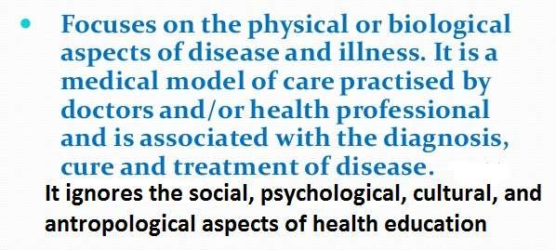

Slide 54
Motivation Model of Health Education
‘Motivation Model’
of Health Education people are motivated to
conceptualizes that
change behavior to healthy practices, when a particular health-behavior addresses or arouse their ‘need’. In other word, needs and wants of the individuals have to be tackled by framing an incentive plan.

Slide 55
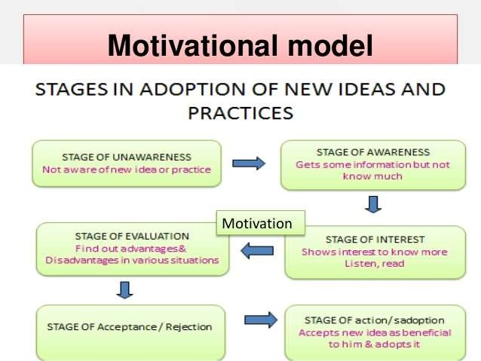

Slide 56
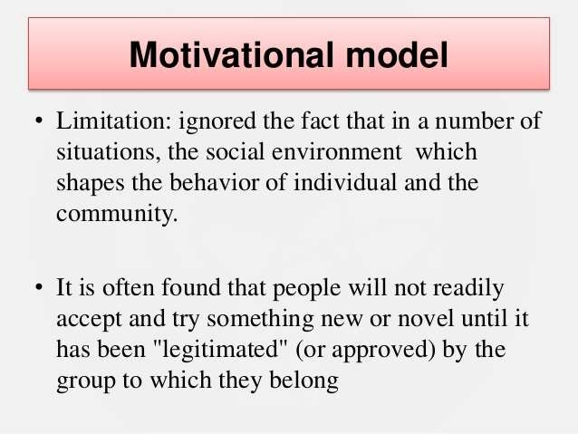

Slide 57
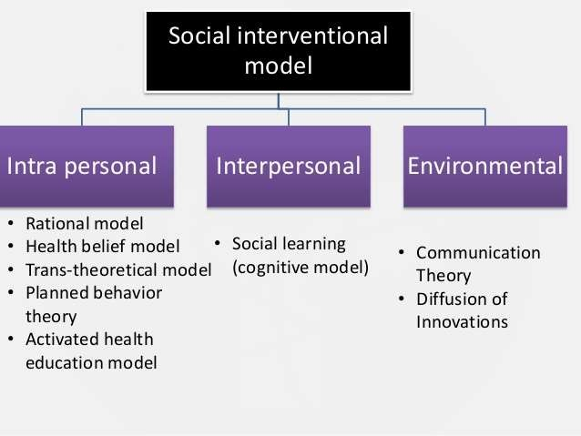

Slide 58
The Rational Model This model, also known as the “knowledge, attitudes, practices model” (KAP), is based on the premise that increasing a person’s knowledge will prompt a behaviour change.
The Health Belief Model (HBM): Human health decision- making and subsequent behaviour is based on the following six constructs:
  perceived susceptibility,
  severity,
  benefits and barriers,
  cues to action and
  self-efficacy.
This model proposes that people, when presented with a risk message, engage in two appraisal processes: a determination of whether they are susceptible to the threat and whether the threat is severe; and whether the recommended action can reduce that threat (i.e. response efficacy) and whether they can successfully perform the recommended action (i.e. self-efficacy).

Slide 59
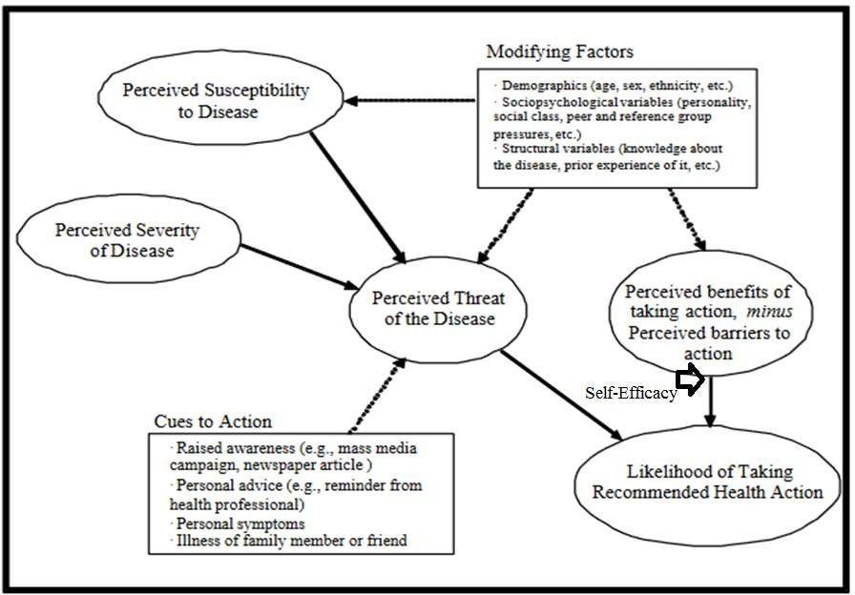
Health Belief Model (HBM)

Slide 60
HBM
Perceived susceptibility.
The subjective perception of the risk the individual is at from a state or condition.
Perceived severity.
Subjective evaluation of the seriousness of the consequences associated with the state or condition.
Perceived threat.
The product/sum of severity and susceptibility. This combined quantum might be seen as indicative of the level of motivation an individual has to act to avoid a particular outcome.

Slide 61
Perceived benefits.
The subjectively understood positive benefits of taking a health action to offset a perceived threat. This
perception will be influenced not only by proximal factors, but an individual’s overall motivation’.
specific ‘health
Perceived barriers.
The perceived negatively valued aspects of taking the action, or overcoming anticipated barriers to taking it.
Self -efficacy.
Belief in one’s ability to execute a given behaviour.

Slide 62
Expectations, which are the product/sum of perceived benefits, barriers and self-efficacy. This may be seen as indicative of the extent to which the individual will try to take a given action.
Cues to action.
Reminders or prompts to take actions consistent with an intention, ranging from advertising to personal communications from health professionals, family members and/or peers.
Demographic and socio-economic variables.
These may include age, race, ethnicity (cultural identity), education and income.

Slide 63
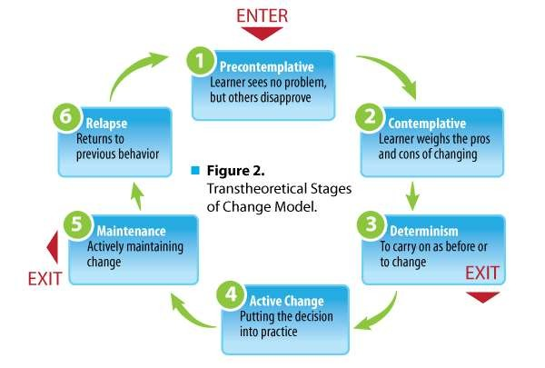
3. The trans-theoretical model of change. Behaviour change is viewed as a progression through a series of five stages: Pre- contemplation, Contemplation, Preparation, Action and Maintenance. People have specific informational needs at each stage, and health educators can offer the most effective intervention strategies based on the recipients’ stage of change.

Slide 64
The theory of planned behaviour: The theory holds that intent is influenced not only by the attitude towards behaviour but also the perception of social norms (the strength of others’ opinions on the behaviour and a person’s own motivation to comply with those of significant others).
The activated health education model: This is a three- phase model that actively engages individuals in the assessment of their health (experiential phase); presents information and creates awareness of the target behaviour (awareness phase); and facilitates its identification and clarification of personal health values and develops a customized plan for behaviour change (responsibility phase).

Slide 65
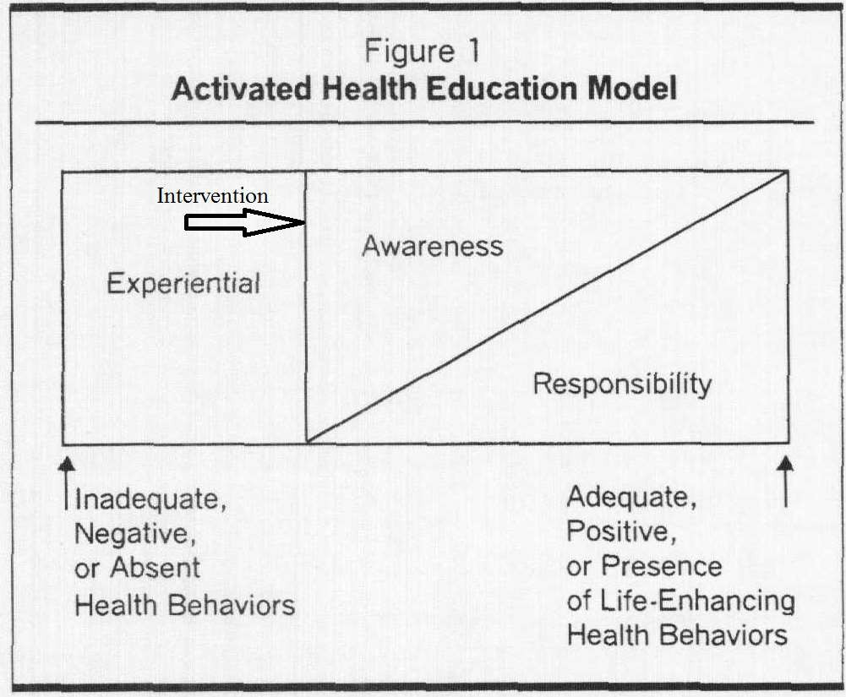

Slide 66

6. Social cognitive theory: According to this theory, three main factors affect the likelihood that a person will change health
behaviour: self-efficacy, goals and outcome expectancies. If individuals have a sense of self-efficacy,
they can change
behaviour even when faced with obstacles.

Slide 67
Communication theory: This theory holds that multilevel strategies are necessary depending on who is being targeted, such as tailored messages at the individual level, targeted messages at the group level, social marketing at the community level, media advocacy at the policy level and mass media campaigns at the population level.
Diffusion of innovation theory: This theory holds that there
are five categories of people:
innovators, early adopters, early majority adopters, late majority adopters and laggards; and the numbers in each category are distributed normally: the classic bell curve. By identifying the characteristics of people in each adopter category, health educators can more effectively plan and implement strategies that are customized to their needs.

Slide 68

Diffusion of Innovation
Early adopters tend to be integrated into the local social system more than innovators. People in the early adopter category seem to have the greatest degree of opinion leadership in most social systems. They provide advice and information sought by other adopters about an innovation. Change agents will seek out early adopters to help speed the diffusion process. The early adopter is usually respected by his or her peers and has a reputation for successful and discrete use of new ideas.

Slide 69


Slide 70


