Slide 1

Introduction to biosafety
Lab# 1
Daheeya Alenazi
Amenah alzailai
1442

Slide 2

Biosafety
The application of knowledge, techniques and equipment to prevent personal, laboratory and environmental exposure to potentially infectious agents or biohazards.
Objectives of studying biosafety:
to reduce the potential exposure of the laboratory worker, persons outside of the laboratory, and the environment to potentially infectious agents

Slide 3
Hazardous Agents in lab
Which have the potential to cause harm to humans, animals, or the environment, either by itself or through interaction with other factors.
Types of hazardous agents:
1-Chemical 2-Radiological or/ and physical 3-Electrical
4-Biological

Slide 4
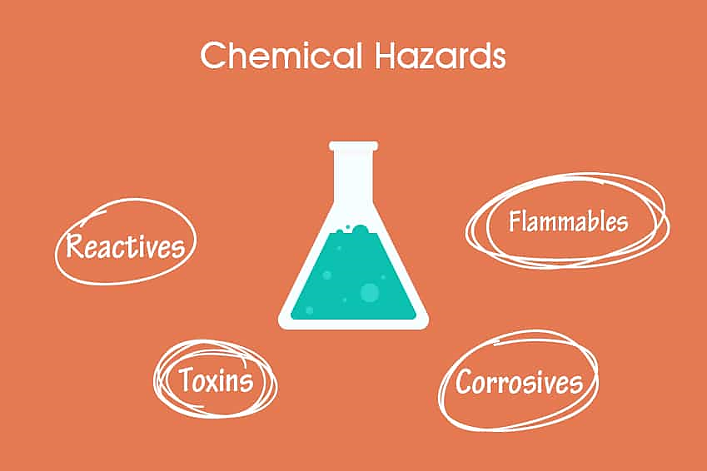
Chemical Hazards
Examples:
Spilled to your skin
Inhalation of chemical
Ingestion (pipetting)

Slide 5
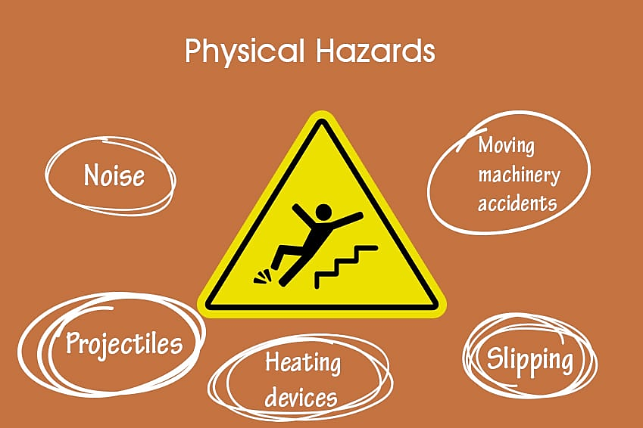
Physical hazards

Slide 6
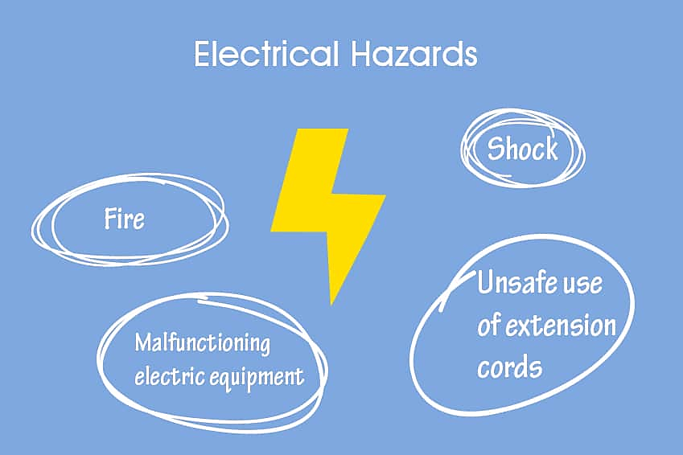
Electrical Hazards

Slide 7
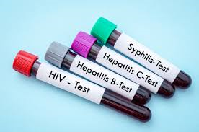
Biological Hazards
Samples have pathogens harmful to human and animal.
That can be transmitted via dealing with blood-fluids-urine
Cells and others.
Examples:
Brucella sp. , Shigella sp. , Salmonella sp. , Neisseria
Hepatitis C&B Viruses , HIV viruses.

Slide 8
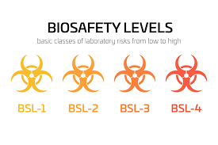
Biosafety levels

Slide 9
Biosafety level 1 (minimum risk)
Laboratory Types: Standard teaching and research laboratories.
Laboratory Practices Requirements: Standard Good Laboratory Practices (PPE), hand washing, and decontamination of work surfaces.
Safety Equipment Required:
Open bench , no need for Biological safety cabinets (BSCs).

Slide 10
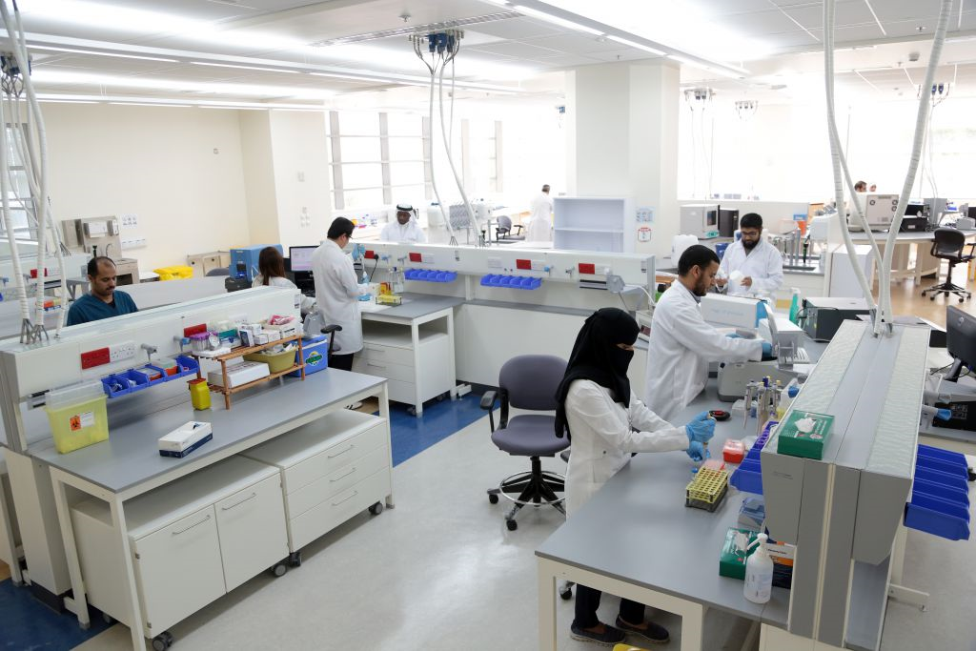

Slide 11
Biosafety level 2 (moderate risk)
Laboratory Types: Primary healthcare diagnostic and research laboratories.
Laboratory Practices Requirements: PPE, restricted access to laboratory areas.
Safety Equipment Required:
1-open bench + hood
2-Autoclave
3- Strict dealing with waste
4-stick biological symbols

Slide 12
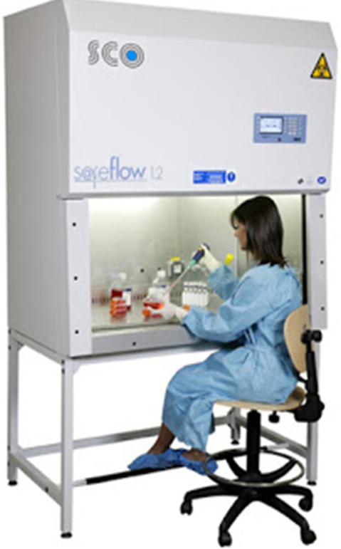
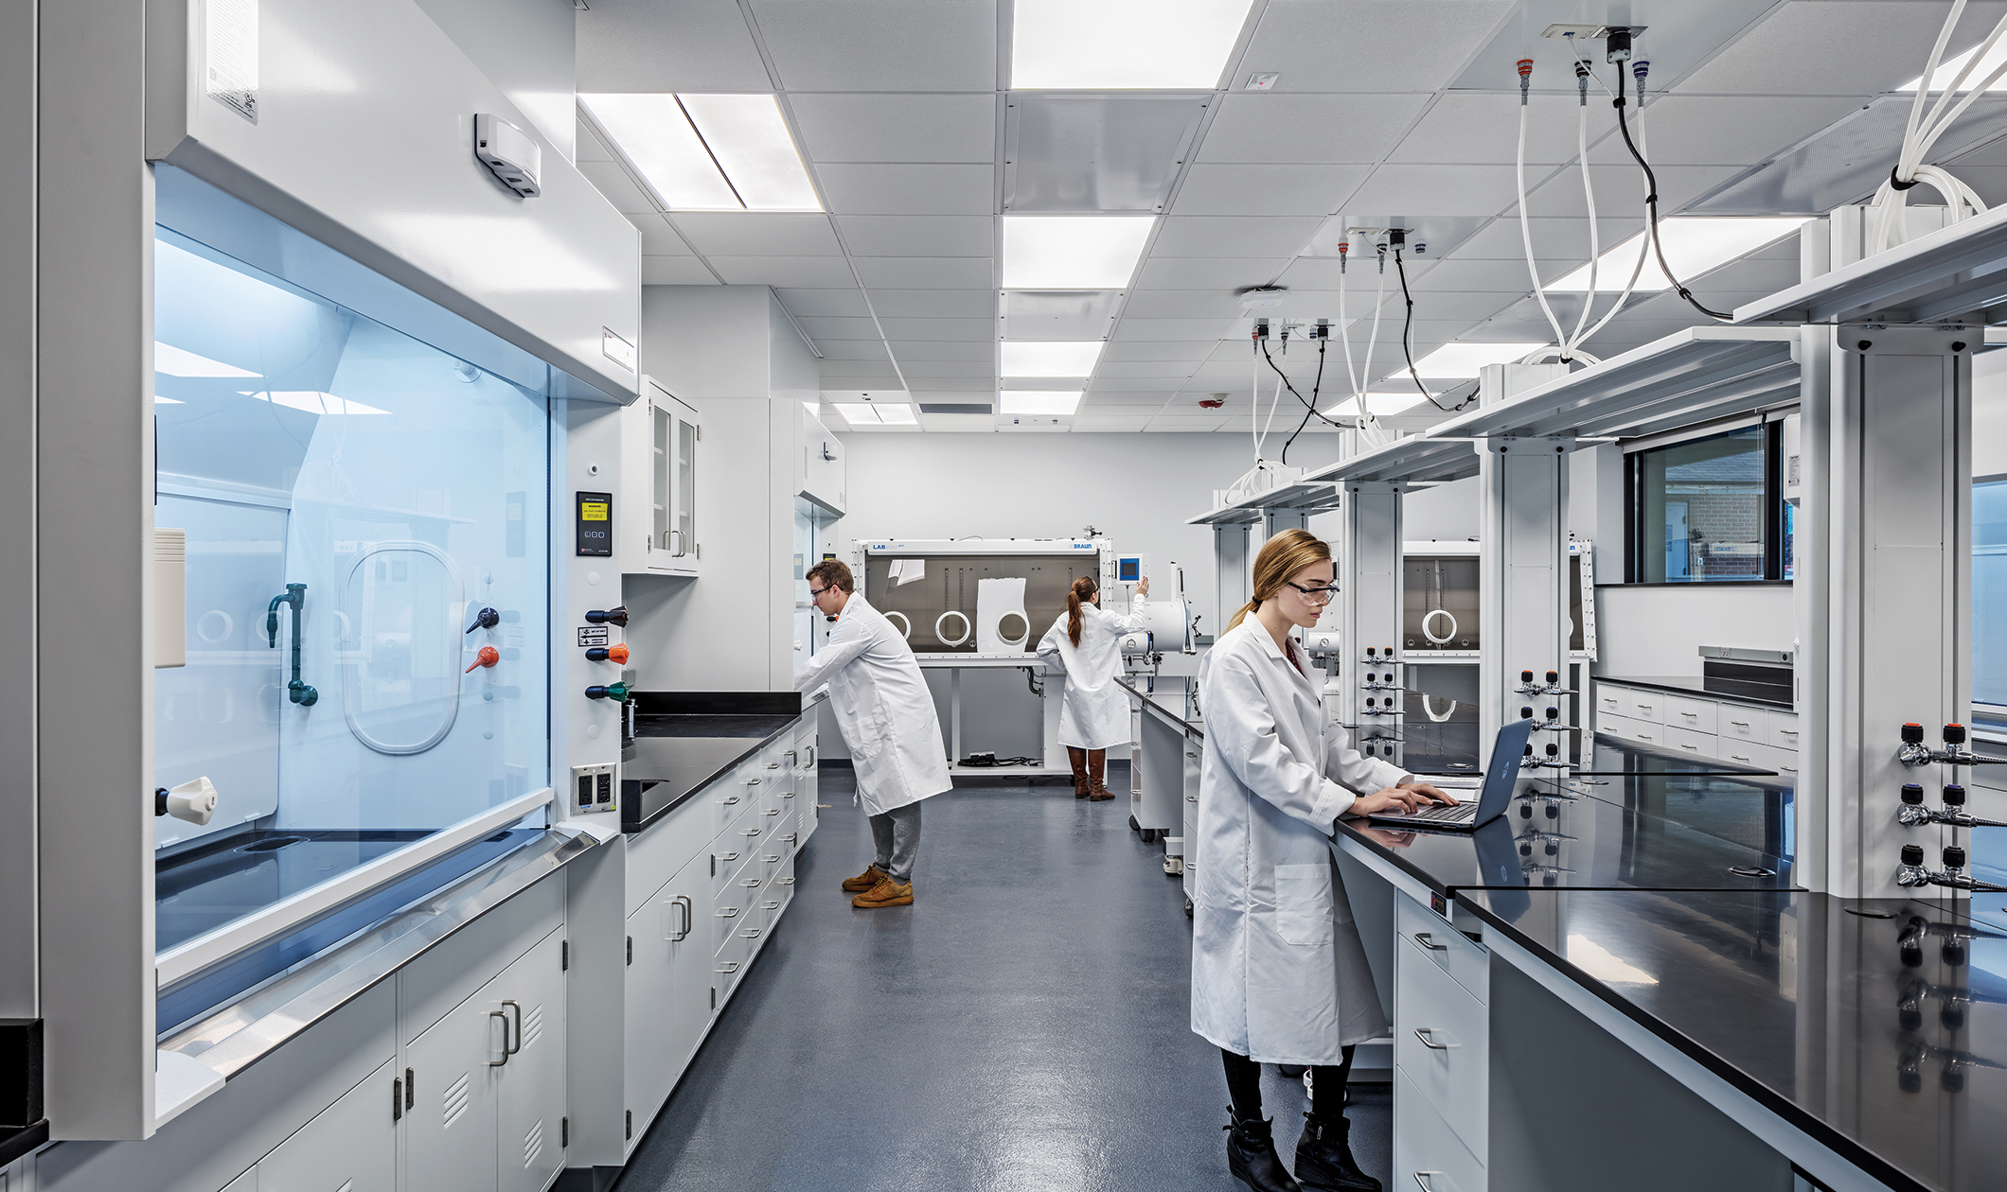
Hood
(safety cabinet) Open bench

Slide 13
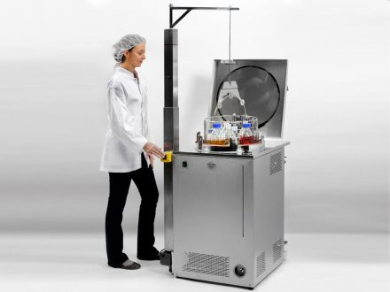
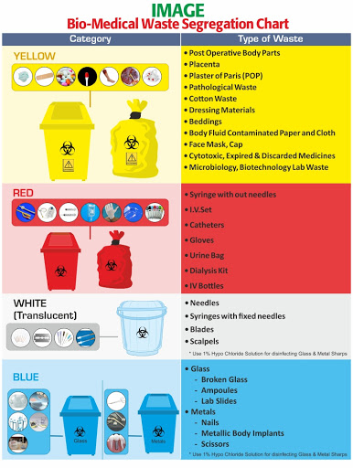

Autoclave Waste handle Biological symbols

Slide 14
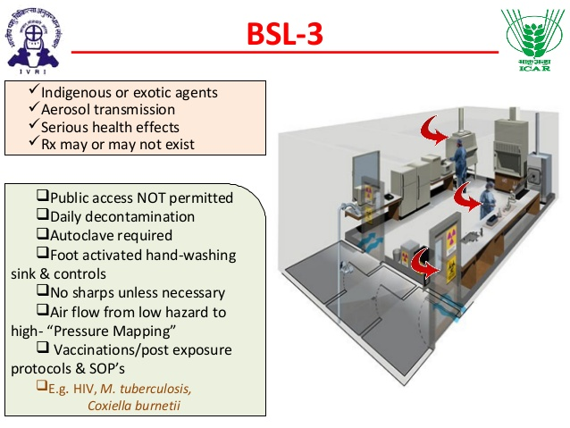
Biosafety level 3(highly risk)
Laboratory Types: Research and diagnostic lab.
Laboratory Practices Requirements: PPE, restricted access to laboratory areas, special clothing, directional air flow.
Safety Equipment Required:
Same of level2.

Slide 15
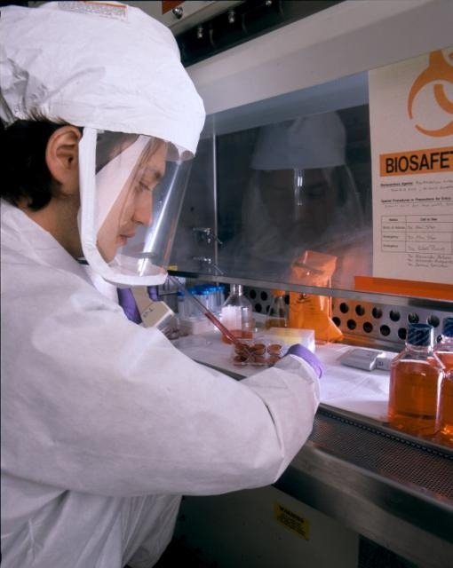
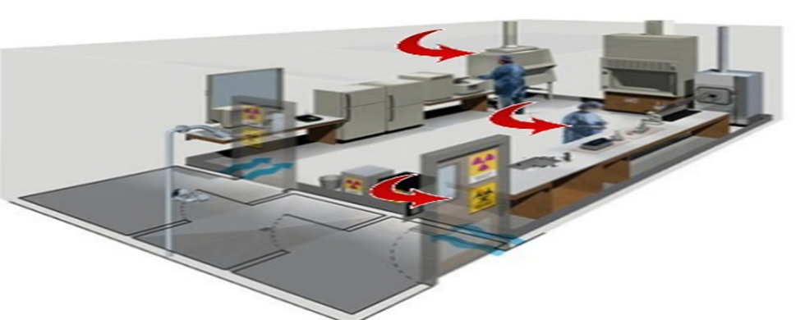
Special clothes Biosafety level 3
Air flow from clean area to contaminated area

Slide 16
Biosafety level 4 (life-threaten disease)
Laboratory Types: Dangerous pathogen unit
Laboratory Practices Requirements: PPE, restricted access to laboratory areas, special clothing, air lock entry, shower exit, special waste disposable.
Safety Equipment Required:
1-Autoclave
2- class III hood
3-filtered air

Slide 17
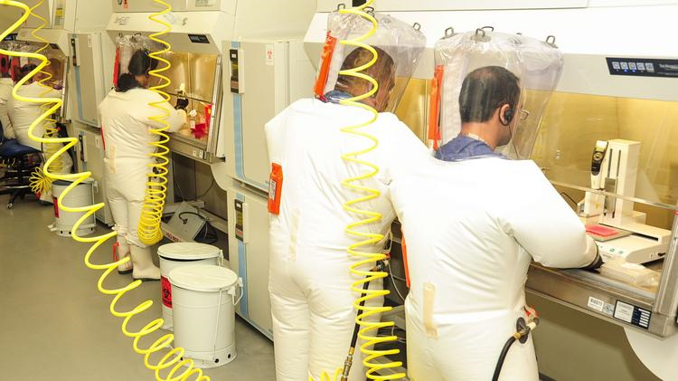
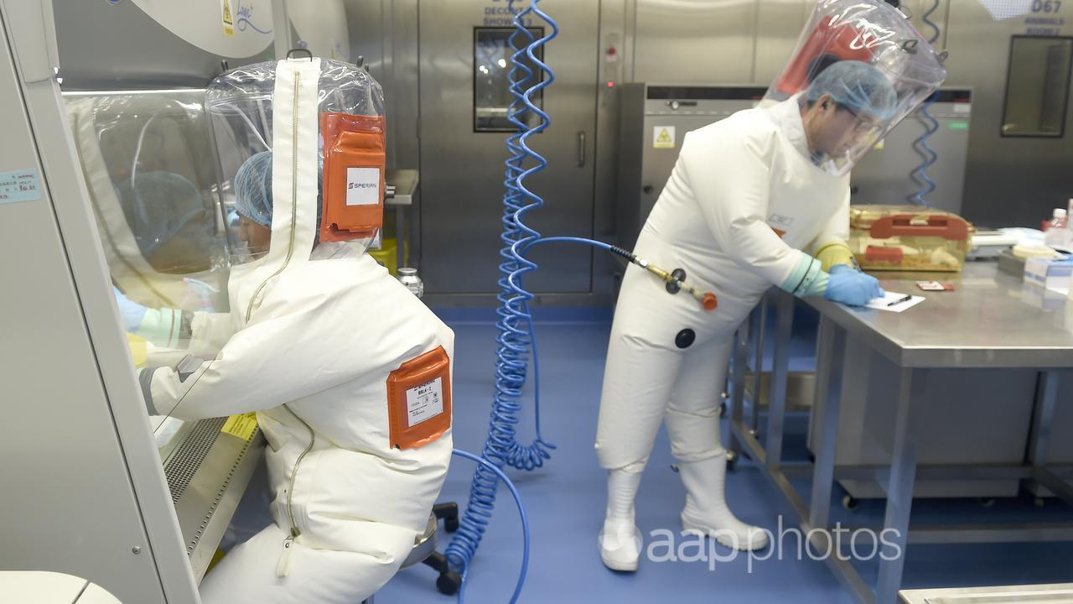
Biosafety level 4

Slide 18
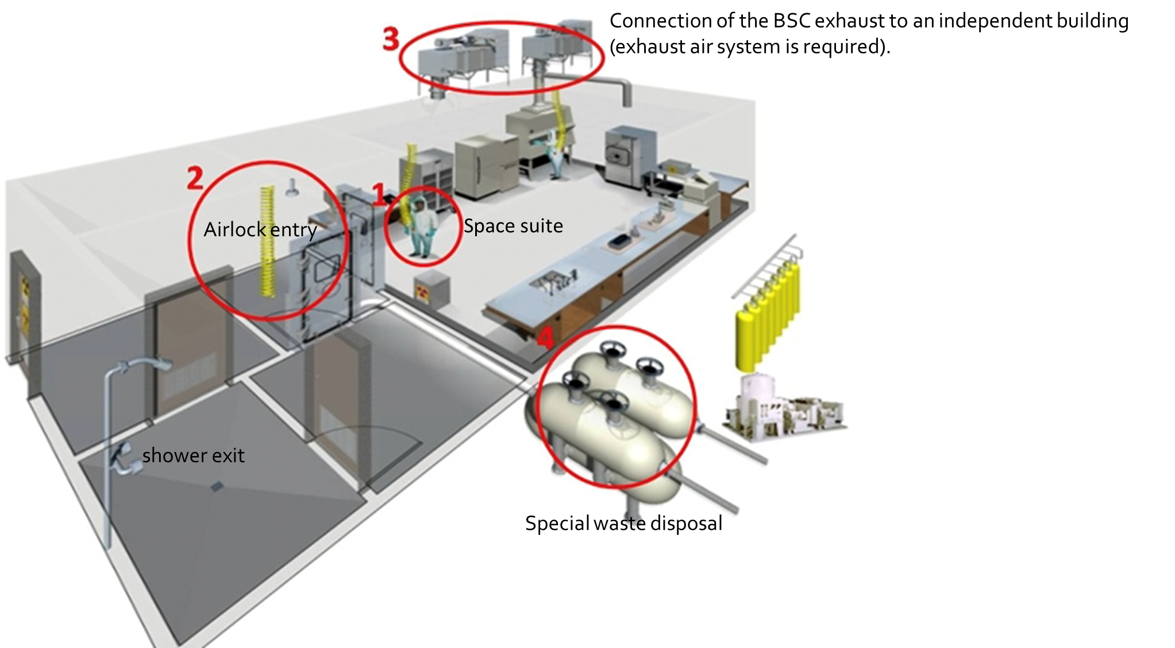

Slide 19
GMT
Good microbiological techniques

Slide 20
GMT
1-Do not eat or drink in the lab and don’t use fridge for food
2-Report any accident (spill, breakage, etc.) or injury (cut, burn, etc.) to the teacher immediately, Do not panic.
3-Never attempt unauthorized experiments
4-Keep work places clean and free of unwanted chemicals, biological specimens.
5- wear Gloves , lab coat, mask and glasses.
6- Tie hair and use closed shoes
7-Do not touch , taste, or smell any chemicals.

Slide 21



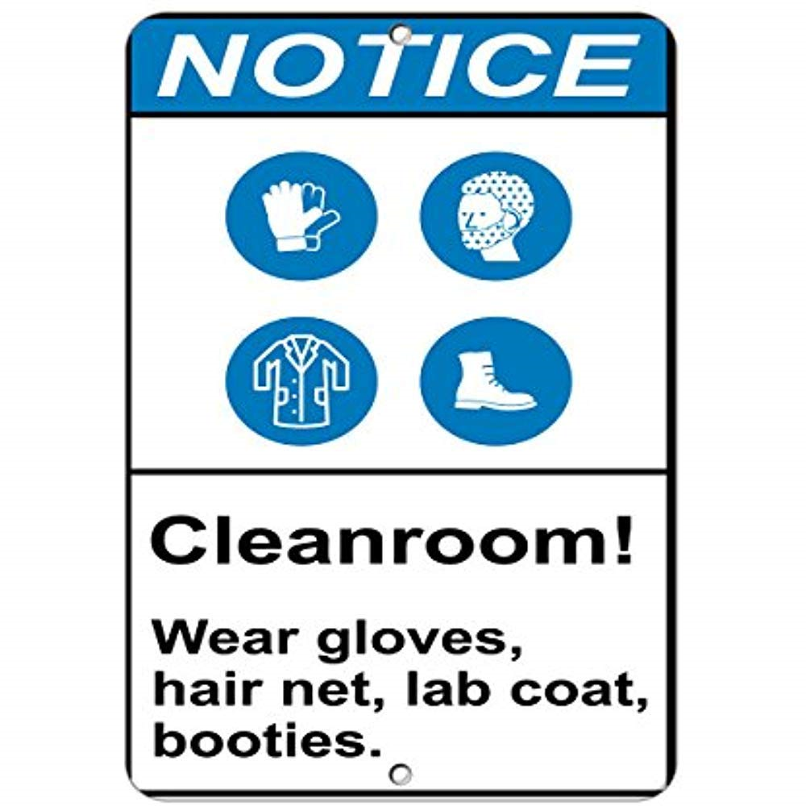



Slide 22
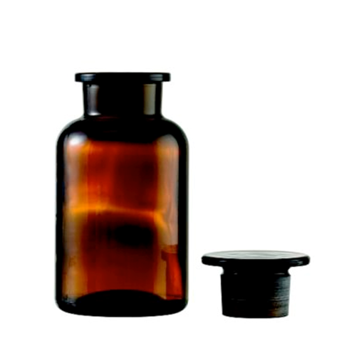
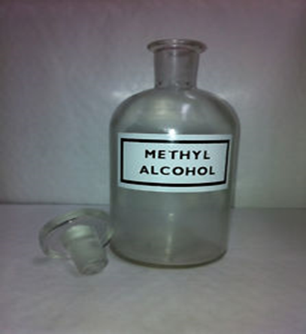
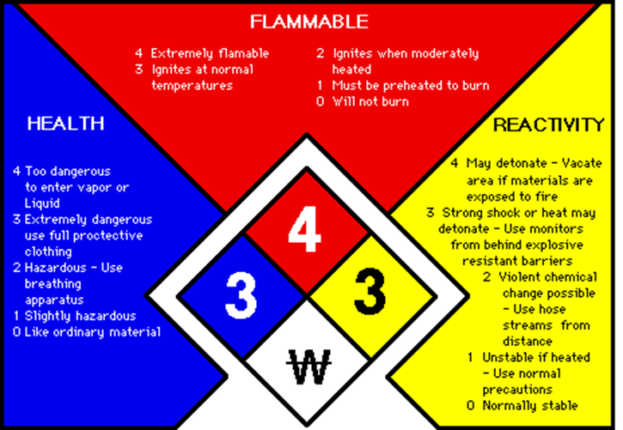
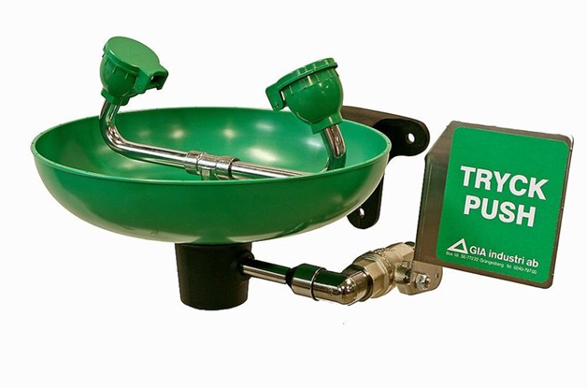
8-Do not use unlabeled bottle.
9-Work only with materials once you know their flammability, reactivity, toxicity, safe handling and emergency procedures.
10-Never pipette by mouth; use mechanical transfer devices.
11-Do not mix chemicals in the sink.
12-If a chemical was splashed in your eye(s) or on your skin, immediately flush with running water for at least 20 minutes.
Immediately (and loudly) yell out the teacher's name to get the teacher's attention.

Slide 23
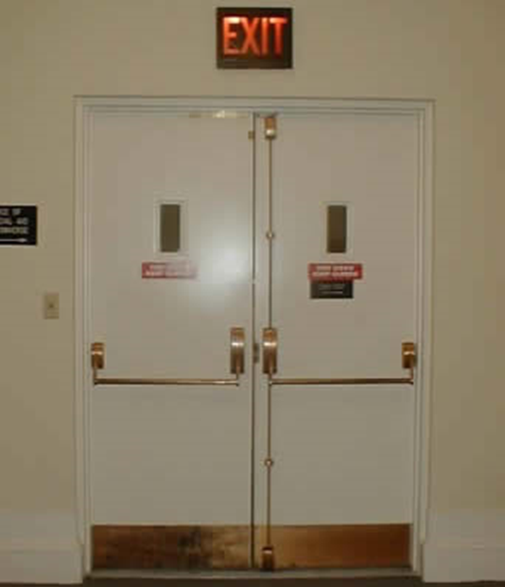
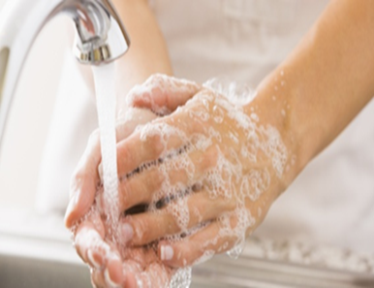
13-Walk DON’T run in the lab.
14-Keep exits and passageways clear at all times.
15-Turn of gas, water before leaving.
16-Wash your hands thoroughly before leaving the laboratory.

Slide 24
Any Question??
Daalenazi@ksu.edu.sa أ.ضحيه العنزي
Amalzailai@ksu.edu.sa أ. أمنة الزيلعي

