Slide 1
Tuberculosis of Hip
Dr. Javed Ahmad
( Assistant Professor )
Department of Orthopaedics

Slide 2
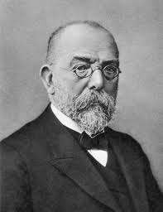
ROBERT KOCH discovered Mycobacterium tuberculosis in 1882

Slide 3
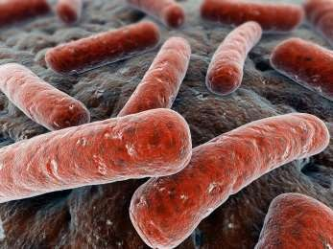
CAUSATIVE ORGANISM
◆ MYCOBACTERIUM TUBERCULOSIS M/C HUMAN PATHOGEN
◆ SIZE – 3X.3UM
◆ GRAM POSITIVE AFB
◆ HEMATOGENOUS DISSEMINATION FROM PRIMARY FOCUS
◆ BONE AND JOINTS TB DEVELOP GENERALLY 2-3 YRS AFTER PRIMARY FOCUS

Slide 4
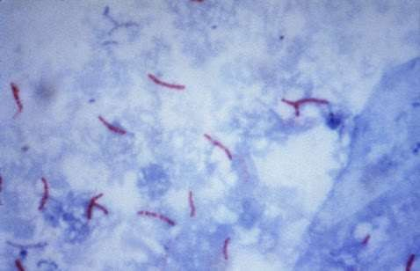
Organism ..
M.tuberculosis - rodshaped,gram positive
nonsporeforming, thinAEROBICbacilli 0.5µm × 3µm
Once stained ,the bacilli cannot be decolorised by acid alcohol- thus called ACID FAST BACILLI
Acid fastness is due to high content of MYCOLIC ACIDS,long chain cross linked fatty acids,other cellwall lipids

Slide 5
Pathogenesis & Pathology
Primary focus (Active/quiscent,Apparent/latent)
Hematogenous dissemination 2-3 yrs
Osteoarticular TB

Slide 6
Organism reaches joint space through either
Subsynovial vessels
Lesions in the epiphyseal bones
Articular cartilage destruction begins peripherally
TB Arthritis- doesnot form proteolytic enzymes in joint space central areas of articular cartilage preserved for long time

Slide 7
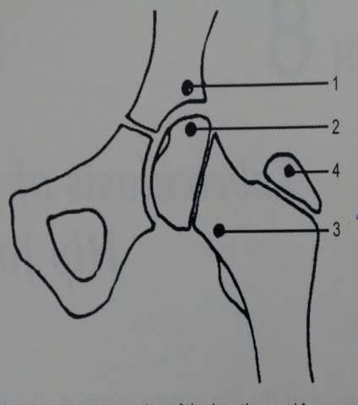
Common sites..
Initial focus may start in
Acetabular roof –m/c
Epiphysis/Femur Head
Metaphyseal region
Greater trochanter- least common

Slide 8
TB of GT may involve the overlying trochanteric bursa witout involving the hip joint for a very long time
Upper end of femur – intracapsular – joint involved rapidly
When initial focus starts in acetabular roof- joint involvement is late ,symptoms mild

Slide 9
Tubercle/Granuloma formation...
Initial stages of infection- usually asymptomatic
2-4wks after infection- 2 host responses 1.Macrophage activated CMI: T-cell mediated
response Activation of macrophages
Killing & digesting tubercle bacilli 2.Tissue damaging response
various bacillary antigens
- Destroys unactivated macrophages that contain multiplying bacilli

Slide 10
Insemination of infection
Accumulation of macrophages/monocytes
TB bacilli – phagocytosed,broken down Lipid dispersed throughout the cytoplasm
EPITHELOID cells – large pale cells
large vesicular nuclues Abundant cytoplasm
LANGHANS GAINT cells

Slide 11
Mass formed by reactive cells - Nodule/TUBERCLE
2wks central CASEOUS NECROSIS
Presence of caseous necrosis – SOFT TUBERCLE
No caseous necrosis – HARD TUBERCLE

Slide 12
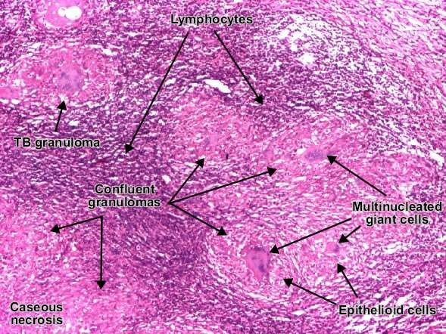
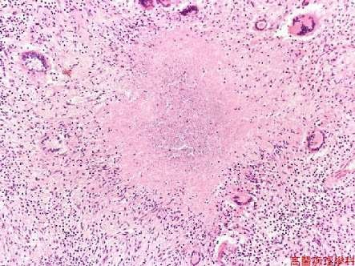

Slide 13
Cold Abscess
Collection of products of liquefaction & reactive exudation
Contains - serum,
leukocytes, caseous material,
bone debris,TB bacilli
Feels warm ,but temperature not raised as high as in acute pyogenic infection
Bursts Sinus/ulcer formation

Slide 14
Cold abscess forms within the joint – inferior weaker part of the capsule
Perforated
Cold abscess presents anywhere around the hip – femoral triangle
Medial,lateral/ posterior aspect of thigh Ishcio rectal fossa
Pelvis

Slide 15
Intra pelvic abscess
Below the levator ani
Ischiorectal fossa
Above levator ani
Upwards into inguinal region

Slide 16
Types of Disease
GRANULAR
Less destruction
Abscess formation rare
Insidious onset & course
DRY lesion
CASEOUS EXUDATIVE
More destruction
More exudation & abscess formation
Insidious onset
Marked constitutional features

Slide 17
Fate of tubercle
Resolve completely
Heal completely with residual deformities/ loss of function
Lesion completely walled off,caseous tissue – calcified
Low grade chronic fibromatous, granulating & caseating lesion may persist
Infection spreads – contiguous,systemically

Slide 18
Clinical features..
Commonest age : 1st 3 decades
Limping – earliest,commonest symptom
- Antalgic gait
Pain – reffered to medial aspect of knee
- max towards end of the day
Deformity
Fullness around the hip
Night cries sleep awakening

Slide 19
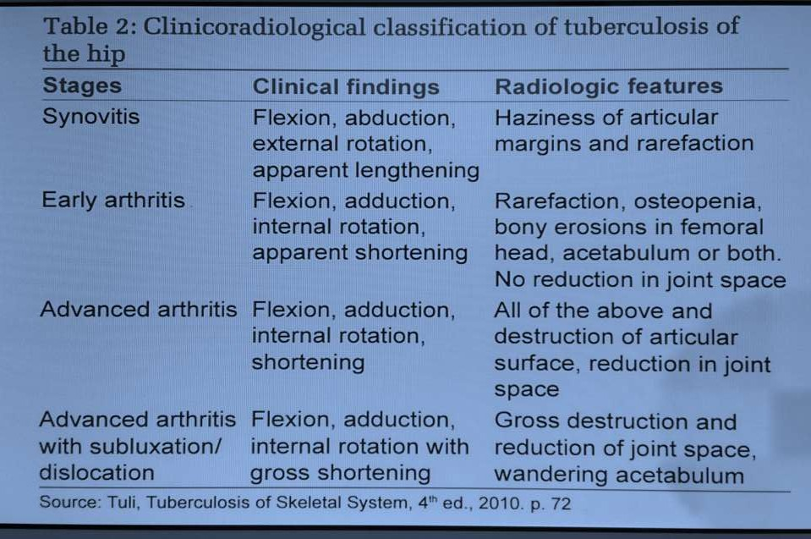
Classification

Slide 20
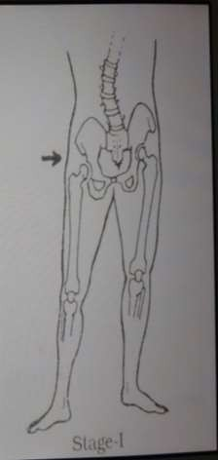
Synovitis stage..
Position of max joint capacity – FABER
Apparent LENTHENING
Only extremes of movement are painful
D/D – Traumatic synovitis
  Nonspecific Transient Synovitis
  Low grade pyogenic infection
  Perthes disease
  SCFE
X-Rays: soft tissue sweling,Rarefaction

Slide 21
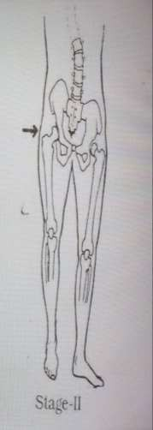
Early Arthritis stage..
Articular damage starts
Severe muscle spasm- FADIR
Apparent shortening
Restriction of movements in all directions
Appreciable muscle wasting
MRI – synovial effusion
  minimal ares of bone destruction
  osseous oedema
X-Rays: OSTEOPENIA, marginal bony erosions NORMAL JOINT SPACE

Slide 22
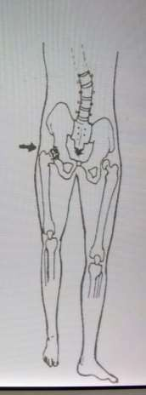
Advanced Arthritis ..
FADIR
True shortening
severity of symptoms
Capsule further dstroyed ,thickened & contracted
X-Rays : Destruction of articular surface
Joint space

Slide 23
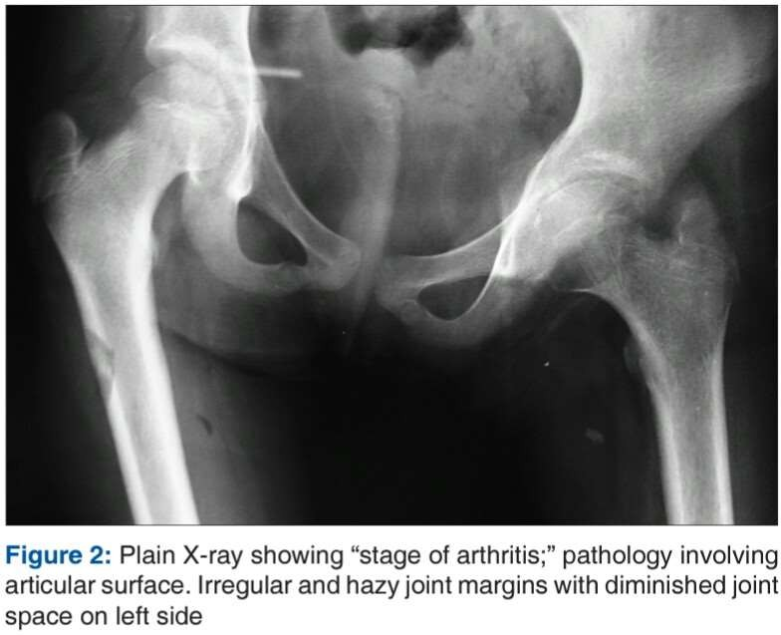

Slide 24
Advanced arthritis with Subluxation / Dislocation
With further destruction of acetabulum, femur head ,capsule & ligaments the upper end of femur is displaced upwards & dorsally in the wandering / migrating acetabulum leaving its lower part empty & broken – Pathological dislocation of femur head
Movements are grossly restricted

Slide 25
Classification - Radiological appearence
Shanmugasundaram in 1983 classified the radiological appearences as
Type 1 - normal (C)
Type 2 – Travelling/ wandering acetabulum(C,A)
Type 3 – Dislocating type(C)
Type 4 – Perthes type(C)
Type 5 – Protrusio acetabuli(C,A)
Type 6 – Atrophic(A)
Type 7 – Mortar & Pestle type(C,A)

Slide 26
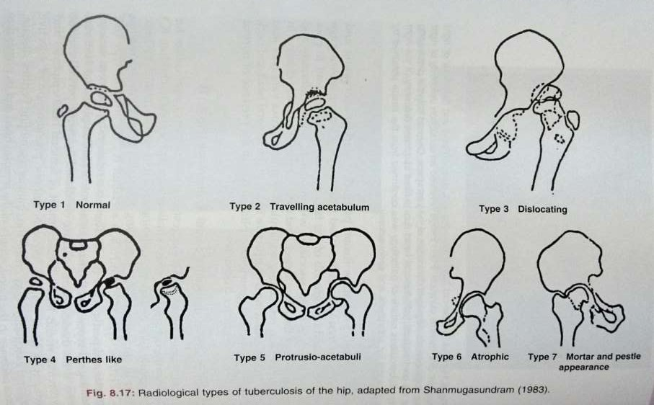
Shanmugasundaram’s Classification

Slide 27
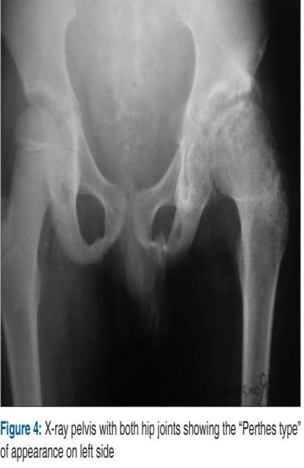
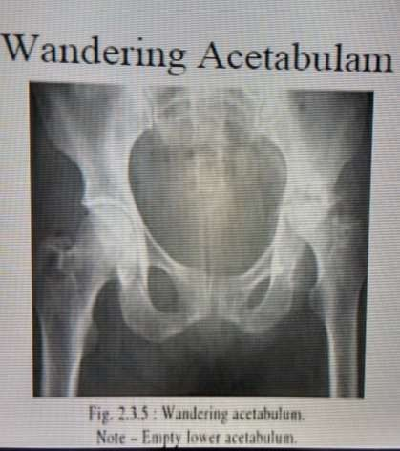

Slide 28
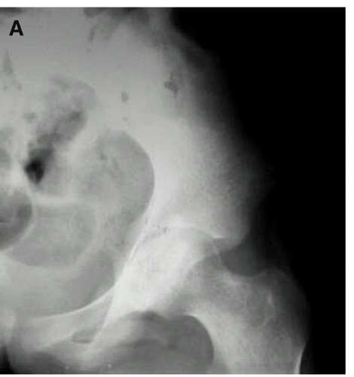
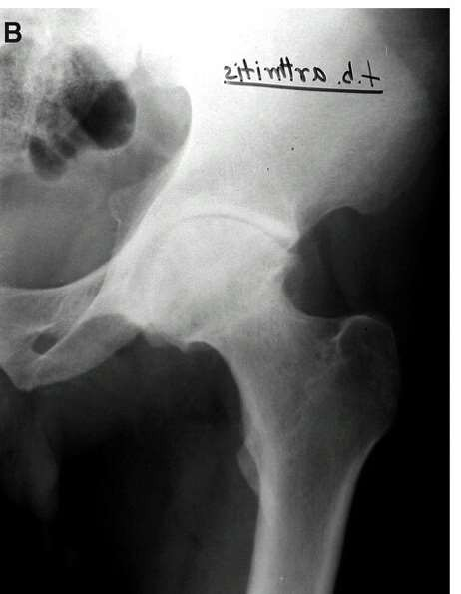
ATROPHIC TYPE
PROTRUSIO TYPE

Slide 29
If the disease occurs during chilhood
Chronic hyperaemia Enlarged femoral head epi & metaphysis COXA MAGNA
Thrombo embolic phenomenon of selective terminal vasculature changes similar to PERTHES disease
a)Gross blood supply of femoral head due to TE
b) Rapidly developing tense IC effusion (Tamponade effect)
reduced femoral head & neck size
COXA BREVA

Slide 30
Restricted growth of epiphyseal plate & normal trochanteric growth plate COXA VARA
Restricted trochanteric growth & normal femoral head COXA VALGA

Slide 31
Close relationship b/w radiological type & therapeutic outcome:
Normal type
Perthes type
92% good results
80% good results
Dislocating type – 50% good results
Travelling acetabulum & Mortar pestle type
- 29% good results

Slide 32
Evaluation
Hematological – ESR,relative lymphocytosis
Bacteriological –AFB staining & C/S
Serological – ELISA –serum IgG,IgM
Histology – HPE for ‘ TUBERCLE ‘
Molecular – PCR
Clinico –radiological : X-Rays,
CT Scan MRI USG

Slide 33
Synovial fluid aspiration
AFB positive in 10 – 20% of cases Cultures positive in 50% of cases
Aspiration of cold abscess for microbiology
Synovial Biopsy More reliable
Cultures positive in 80% cases
Histology : granulomatous inflammation

Slide 34
Bacteriological diagnosis..
Specimen stained for AFB & C/S
Stains used: - ZIEHL NEELSEN stain
- Auramine Orange fluorescence
Media used for growth: Lowenstein- Jensen
Conventional AFB C/S – 4wks
  requires live organism
  long incubation period
  low sensitivity in pts already on ATT
Newer rapid culture tech- BACTEC

Slide 35
BACTEC : Radiometric culture system
Detects Mycobac as early as 7-14 days
Based on release of radiolabelled CO2 from the growth of Mycobac in selective LIQUID media using C14 labelled substrate

Slide 36
Serology..
IgM – diagnostic of activity of the disease
IgG – diagnostic of chronic disease/healed disease
- levels remain high even after full Rx
ELISA antibody values are dependent on
  time of taking sample
  state / phase of the disease
Antibody titres donot correlate with recovery status of the patient.

Slide 37
Molecular diagnosis..
PCR – single test which amplifies the genome even if a single organism was present
Ideal for detection of paucibacillary TB case
Many target genes of Mycobacteria
16sr RNA – used as target sequence as it is universally present false negative
- genus specific marker

Slide 38
Advantages of PCR..
Highly efficient & rapid method for Dx – 3days
Great value in early Dx
Very sensitive tech – could detect as few as 1-2 mycobac in the specimen , and Rx initiated based on this result if clinical signs of disease present
Can differentiate typical from atypical mycobac
Requires very small quantity of specimen – even microlitres of FN aspirate can be tested

Slide 39
Disadvantages ..
Notable to differentiate live from dead org, as it is not dependent on bac replication
Doesnot tell about the activity of the disease
PCR positive results doesnot always confirm to culture results
PCR – not a substitute for culture

Slide 40
Culture – gold standard
CT guided FNAC – useful & minimally invasive method of ascertaining HP Dx
Screening tests :
Tuberculin skin test/Mantoux test
Interferon gamma release assay (IGRA)

Slide 41
Radiological ..
X-Rays
USG
CT – Scan
MRI

Slide 42
Management..
Early diagnosis , effective chemotherapy – vital to save the joint
Depends upon the stage of clinical presentation
Rx includes : ATT
Absolute bed rest Traction
Excision Arthroplasty Arthrodesis
THA

Slide 43
Traction..
Prevents /Corrects the deformity
Rest to the part
Relieves muscle spasm
Maintains joint space
Minimises development of migration of acetabulum
- B/L traction – if abduction deformity, to stabilise the pelvis

Slide 44
After 4-6 months of Rx – Ambulation with crutches / orthosis
Ambulation :
- 1st 12 wks – non weight bearing
- 2nd 12 wks – partial weight bearing
Unprotected wt bearing – 18-24 months after onset of Rx

Slide 45
MDR – TB
MDR –TB : Bacteriological Dx
- If the infecting organism is resistant to
INH
Rifampicin with/without resistance to other ATT
XDR-TB : MDR –TB strains resistant to FLUOROQUINOLONES & one of the Injectables – Kanamycin,Amikacin,

Slide 46
Resistant /therapeutically refractory case :
In clincal orthopedics –
No response to ATT / No progressive healing
Destructive process
Continuing discharging sinuses , ulcers
New cold abscess apearence
size of existing cold absces

Slide 47
Rx – Synovitis stage
Chemotherapy – ATT
Bed rest
Traction
Mobilisation exercises
prognosis – very good
Surgical intervention – usually not required

Slide 48
Rx – Early Arthritis
Chemotherapy – ATT
Traction
Analgesics supplementation
Non wt bearing ROM exercises started as permitted
Synovectomy & joint debridement
Passive exercise avoided
Prognosis in general - good
pain,spasm . Thus

Slide 49
Rx – Advanced Arthritis
All above &
ARTHROLYSIS –subtotal excision of pathological contracted fibrous capsule
Useful where limitation of movements is due to FIBROUS ANKYLOSIS
Aim – To achieve useful ROM
Posterior capsule undisturbed – vital blood supply

Slide 50
Rx – Advanced arthritis with subluxation / dislocation
Conservative traction regimen
If sound ankylosis ,in bad position – upper femoral corrective osteotomy
Excision arthroplasty
Arthrodesis
Hip replacement

Slide 51
In advanced arthritis usual outcome- FIBROUS ANKYLOSIS
Once fibrous ankylosis – anticipated / accepted – limb is immobilised in HIP SPICA for 4-6 months
Ideal position for ankylosis :
Neutral position b/w abduction & adduction
5-10 deg of external rotation
Flexion depending upon age :children- 10 deg
adults – 30 deg

Slide 52
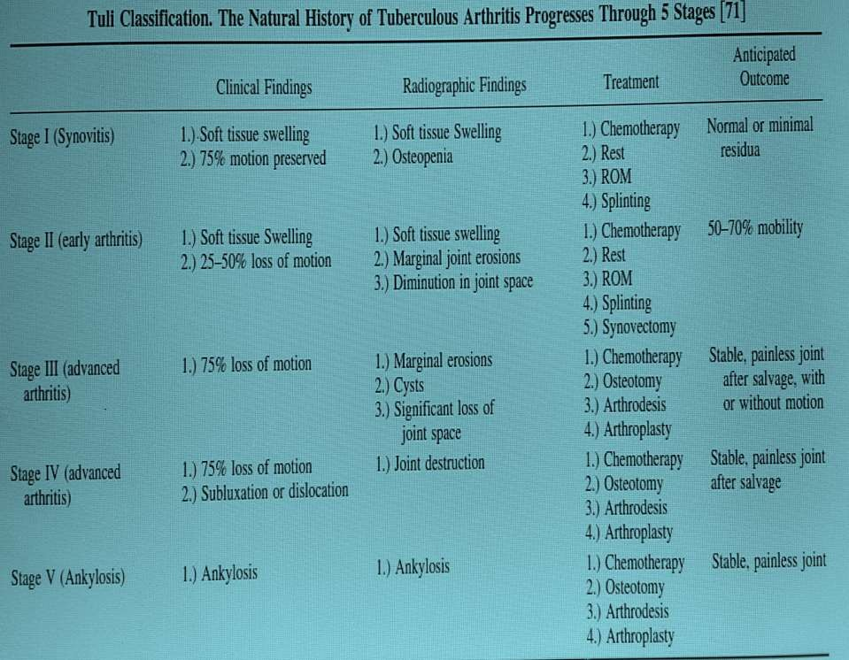

Slide 53
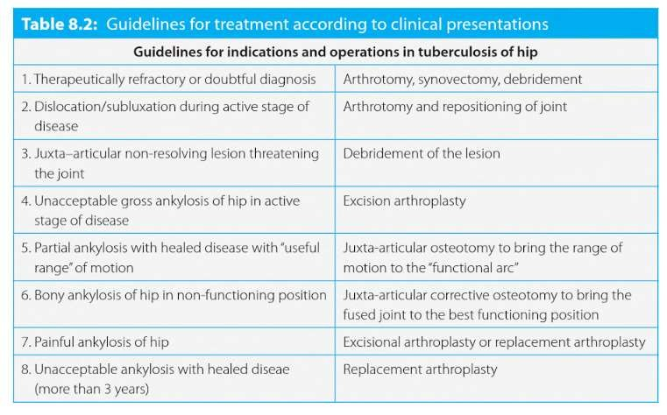

Slide 54
Arthrodesis..
Offered only for pt > 18yrs age
Types :
1.Intrarticular
2.Extra articular – If Adduction deformity- Ischio femoral
- If Abduction deformity- Ilio femoral

Slide 55
During extra articular arthrodesis ,upper femoral corrective osteotomy can also be performed – brings limb into functional position
Intraarticular arthrodesis permits
Exploration of joint
Excision of diseased tissue
Curretage of juxta articular infected tissue

Slide 56
Disadvantages of arthrodesis
Early development of degenerative osteo arthrosis in LS spine,ipsilateral knee, contralateral hip
Compensation for fused hip :
Rotation of pelvis
flexion of ipsilateral knee during stance phase

Slide 57
Activities max limited after fusion
bending,sitting on floor, cross legged sitting ,
Squatting,kneeling,bicycling
Thus no pt would accept a fused joint

Slide 58
Excision arthroplasty..
GIRDLESTONE – described excision of femoral head,neck,proximal part of trochanter & acetabular rim for chronic deep seated infections of hip joint
Can be safely carried out in healed / active disease after growth completion
Provides – mobile ,painless hip with control of infection ,correction of deformity

Slide 59
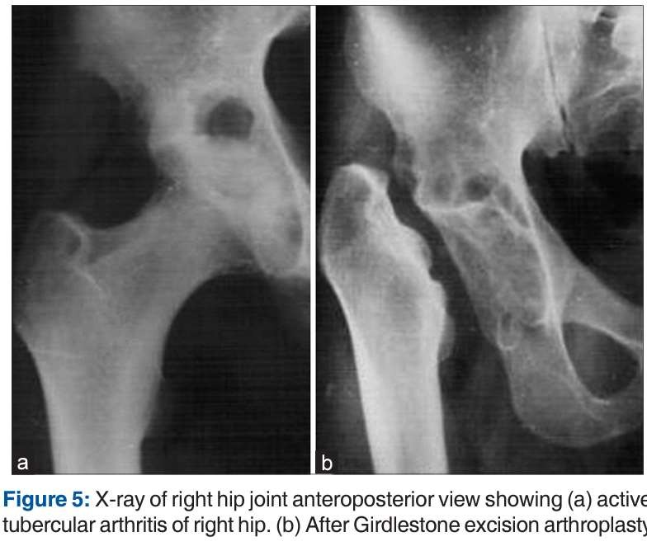

Slide 60
Some degree of SHORTENING, INSTABILITY
Mean loss of length – 1.5 cm
Shortening by postop prolonged TRACTION in 30-50 deg of abduction upto 3months
MILCH - pelvic support osteotomy at the level of ischeal tuberosity ,also reduces instability

Slide 61
Hip replacement in TB ..
THA in active infection – controversial due to risk of reactivation
Most authors suggest THA atleast 5-10 yrs after the last evidence of active infection
Reactivation of infection - 10-30% cases
THA in healed TB Hip is now accepted
Majority perform it in the stage of advanced arthritis / its sequelae, when joint is unsalvageable

Slide 62
Wang et al – combination of ATT for atleast 2wks preop & for atleast 12months post op
- THA in advanced active TB hip is a safe procedure with symptomatic relief & functional improvement
Sidhu et al – THA in active TB Hip is a safe procedure when perioperative ATT was used
- adequate surgical debridement , ATT Key for successful outcome
Kim et al – no difference in reactivation / healing with cemented /cementless implants

Slide 63
Rx in chidren..
Synovitis & early arthritis – ATT
  Traction
  bed rest
  supportive Rx
Management in advanced joint destruction , wandering acetabulum,or with pathological subluxation is difficult & controversial

Slide 64
Rx in children..
In children with arthritis –Traction
failure Open arthrotomy Synovectomy
Debridement of diseased joint
Arthrodesis deferred till growth completion

Slide 65
In children with healed disease & gross deformity ,(flexion -30,Adduction >30, Abduction >10 deg)
extra articular corrective osteotomy

Slide 66
THANK YOU

