Slide 1
INTERNATIONAL HEALTH

Slide 2
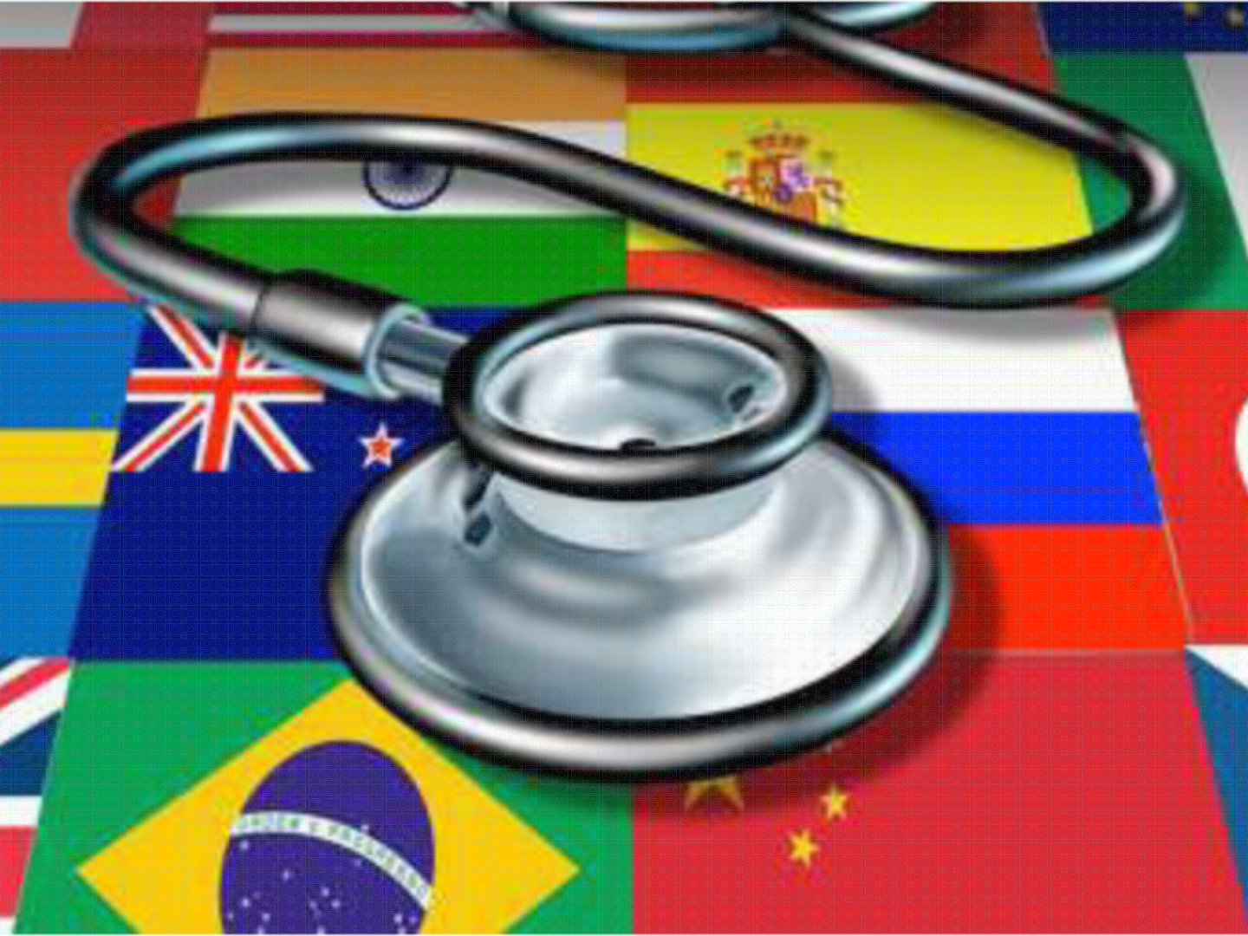
INTERNATIONAL HEALTH

Slide 3
INTRODUCTION
Health is an important fundamental human right and international goal, essential to lead a better quality of life

Slide 4
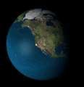
‘Nothing is more international
than a disease.’
- Paul Russel

Slide 5
INTERNATIONAL HEALTH
Also called ‘geographic medicine’ or “global health”, is a field of health care, usually with emphasis towards public health dealing with health across regional and/or international boundaries.

Slide 6
BACKGROUND
Disease in any part of the world is a threat to
other countries.
Many futile attempts had been made by several rulers and States to place barriers against infection by detection and isolation of travelers.
In 14th Century 40 days quarantine programme in Europe Protect against the importation of plague by travelers.
Accepted in many countries. Lead to the origin of International Health Work . but later opposition came from several quarters. 40 days long period and caused inconvenience.
Thus, International Conferences were held and organizations were set up to discussions, agreement and cooperation on matters of international health.

Slide 7
TYPES OF HEALTHCARE AGENCY
International agencies
Government agencies
Bilateral agencies
NGOs and donor agencies
Voluntary agencies

Slide 8
Multilateral agencies | Bilateral agencies | NGOs and donor agenciess
WHO UNICEF United Nations development Program (UNDP) World Bank Food and Agricultural Organization (FAO) ILO United Nation Fund for Population Activities (UNFPA) Joint Nation Program on HIV and AIDS (UNAIDS) Office of UN High Commissioner for Refugees (UNHCR) UN Fund for Drug Abuse Control (UNFDAC) | United States Agency for International Development (USAID) Colombo Plan Swedish International Development Agency (SIDA) Danish International Agency (DANIDA) | International Red Cross The Rockefeller Foundation Ford Foundation Cooperative for Assistance and Relief Everywhere (CARE) Aga Khan Foundation Bill and Malinda Gates Foundation

Slide 9
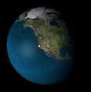
FIRST INTERNATIONAL SANITARY CONFERENCE (PARIS - 1851)
ATTENDED BY:
Austria, France, Great Britain, Greece, Portugal, Russia, Spain and four Sovereign States (Sardinia, the two Sicilies and Tuscany) & Turkey.
AIM:
To bring some order and uniformity in the
quarantine measures.

Slide 10
Prepared an International Sanitary Code containing 137 articles dealing with cholera, plague and yellow fever, but never came into existence.
10 other conferences were held between 1851 – 1902 for the same purpose but were equally unsuccessful.

Slide 11
PAN AMERCIAN SAITARY BUREAU
(PASB) (AMERICA – 1902)
FIRST INTERNATIONAL HEALTH AGENCY
Intended to coordinate quarantine procedure in American States.
Pan American Sanitary Code signed in 1924, Still in force between the states.
1947 Bureau was reorganized and was called the ‘Pan American
Sanitary Organization.’ (PASO)
1958 Again renamed, Pan American Health Organization
since then PAHO has grown as major health agency
headquarters in Washington, D.C.

Slide 12
OFFIC E INTERNATION AL D ’HYGIENE
PUBLIQUE (OIHP) (PARIS – 1907)
➢International Sanitary conference lead to the establishment of a Permanent International Health Bureau (1903)
OIHP aka “Paris Office” started to disseminate information on communicable diseases and supervised international quarantine measures.

Slide 13
OIHP and PASB joined together
British India and 60+ countries joined OIHP.
Continued to exist until the 1950 and was
taken over by the WHO.

Slide 14
THE HEALTH ORGANIZATIONS OF THE
LEAGUE OF NATIONS (1923)
After WW I (1914 - 1918) the League of Nations was established to build a better world.
‘Health Organization’ took steps in matters of international concern
for prevention and control of disease.
Not concerned only with quarantine.
Health organization branched out into various fields of nutrition, housing, rural hygiene, training of health workers etc.
Till second world war the three co-existed (OIHP, PASB and HO.)
Later, Health Organization only existed.

Slide 15
THE UNITED NATIONS RELIEF AND REHABILITATION ADMINISTRATION (UNRRA) (1943)
Purpose organize recovery from the effect of WW II.
Had a health division to cater to the millions displaced, to restore and help services and to revive machinery to aid the exchange of information on epidemic diseases.
Did outstanding work of preventing the spread of typhus
and other diseases.
Assistance to malaria control in Italy and Greece.
1946 taken over by Interim Commission of the WHO

Slide 16

BIRTH OF THE WHO
1945 Conference at San Francisco UN was formed.
7th April 1948 – WHO was born.
World Health Day - 7th April
Specific theme each year focus attention on specific aspect of public health.
OBJECTIVE:
“The attainment by all peoples of the highest level
of health.”

Slide 17
WORLD HEALTH ORGANIZATION
(WHO)
Headquarters – Geneva, Switzerland.
Specialized, non – political health agency of the UN.
It’s a part of UN, not subordinate to it.
Has its own constitution, governing bodies, members and
budget.
Open to all countries.
Each member contributes to the budget and is thus entitled to its services and also has a right to vote.

Slide 18
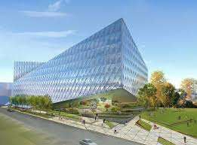

Slide 19
1. PREVENTION AND CONTROL OF SPECIFIC DISEASES
COMMUNICABLE DISEASES | NON-COMMUNICABLE DISEASES
Almost all have been the subject of WHO activities. E.g. Global eradication of Small pox International health cooperation Important work Epidemiological surveillance of communicable diseases. WHO collects information and send it to International Health Regulations and to Weekly Epidemiological Record . The aim of IHR is to ensure the maximum security against the international spread of • diseases with a minimum interference with World Traffic | Paid attention to non-communicable diseases such as cancer, diabetes, cardiovascular diseases, genetic disorders, mental disorders, drug addiction etc. Vector biology and control, Immunology, Quality control of drugs and biological products, Drug evaluation and monitoring and Health laboratory technology (Relevant to control CD’s and NCD’s) Immunization against common diseases of childhood

Slide 20
WORK OF WHO
CONSTITUTIONAL FUNCTION:
Acts as the directing and coordinating authority in all International health work.
Prevention and Control of specific Diseases
Development of Comprehensive Health Services
Family Health
Environmental Health
Health Statistics
Bio-Medical Research
Health Literature and Information
Cooperation with Other Organization

Slide 21
2. DEVELOPMENT OF
COMPREHENSIVE HEALTH SERVICES
Function is to promote and support national health policy
development.
Development of comprehensive National Health Programs.
Organizing health system based on PHC (main aim was to
achieve ‘Health for All’ by the year 2000.)
Development of health manpower.
Building of long term national capabilities.
E.g. Development of health infrastructure, build managerial capabilities and health service research.

Slide 22
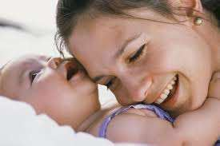
3. FAMILY HEALTH
Major programme activities of WHO since 1970
Subdivided into Maternal and child health care (MCH), human reproduction, nutrition, and health education.
Chief concern improvement of the quality of life of the family as a unit.

Slide 23
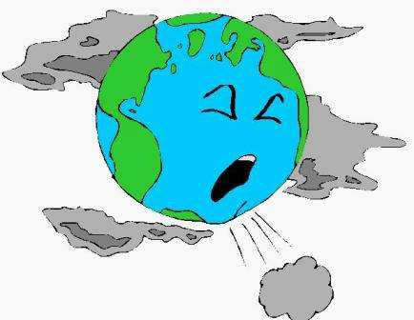
4. ENVIRONMENTAL HEALTH
Recent activities: Protection of quality of air, water and food.
Health conditions at work.
Radiation protection.
Early detection of new hazards originating from new technological developments.
Programs: WHO Environmental Health Criteria Programme WHO Environmental Health Monitoring Programme

Slide 24

HEALTH STATISTICS
Since 1947 morbidity and mortality statistics are published in
  Weekly Epidemiological Records
  World Health Statistics Quarterly
  World Health Statistics Annual
Statistics from different countries should be comparable hence, WHO publishes International Classification of Diseases.
Updated every 10yrs.
Assistance is provided to countries to improve their medical records and help in planning and operation of national health information systems.

Slide 25
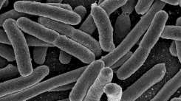
6. BIO-MEDICAL RESEARCH
WHO Stimulates and coordinates research work
Worldwide WHO collaborating centers
For promoting research WHO awards grants to researchers and research institutions
Two committees:
  Regional Advisory Committees define regional health priorities.
  Global Advisory Committees deals with policy issues.
Target of WHO special programs for research and training:
Six diseases malaria, schistosomiasis, trypanosomiasis, filariasis, leishmaniasis and leprosy.
To develop new tools, train workers and strengthen research institutions.

Slide 26

7. HEALTH LITERATURE AND INFORMATION
WHO LIBRARY
Satellite centers of Medical Literature Analysis and Retrieval System (MEDLARS)
Only fully computerized indexing system covering the whole of medicine on an international basis.
Public information services are found both at headquarters and regional offices.

Slide 27

8. COOPERATION WITH OTHER ORGANIZATIONS
Collaborates with UN and other specialized
agencies.
WHO maintains working relationships with a number of international government organizations.

Slide 28
STRUCTURE OF WHO
WORLD HEALTH ASSEMBLY
“Health Parliament” of Nations and the supreme governing body of the organization.
Meets annually at headquarters in Geneva, Switzerland.
Health Assembly appoints “Director general” on the nomination of Executive board.
Functions:
To determine international health policy and programs.
To review the work of the past.
To approve the budget for following year.
To elect Member States to serve for 3 years on the Executive Board.

Slide 29
STRUCTURE OF WHO
THE EXECUTIVE BOARD
30 - 31 members each designated by a “Member State”. Should have at least 3 persons from each WHO region.
Meets twice a year.
To give effect to the decisions and policies of the Assembly.
Has power to take decisions Emergencies.
E.g. Earthquakes, epidemics, floods etc.

Slide 30
STRUCTURE OF WHO
THE SECRETARIAT
Headed by Director General - chief technical and administrative officer of the organization.
Assisted by 5 Assistant Director Generals at the headquarters.
FUNCTION:
To provide technical and managerial support for their national
health development programs.
WHO Secretariat comprises of 14 different divisions:
Division of communicable diseases, Division of environmental health, Division of mental health, Division of budget and finance etc.

Slide 31
REGIONS
South East Asia-New Delhi
Africa - Harare (Zimbabwe)
America - Washington D.C. (U.S.A.)
Europe - Copenhagen (Denmark)
Eastern Mediterranean - Alexandria (Egypt)
Western Pacific - Manila (Philippines)
SEARO: (Bangladesh, Bhutan, India, Indonesia, Korea, Maldives, Timor- Leste, Myanmar, Nepal, Sri Lanka, Thailand)

Slide 32
UNICEF
(UNITED NATIONS INTERNATIONAL CHILD EMERGENCY FUND)

Slide 33

UNICEF
United Nations International Chil dren ’s Emergency Fund
Specialized agency of United Nations
Established 1946
To deal with rehabilitation of children in war ravaged countries.
30 nations executive board.
Now, United Nation’s Children’s Fund UNICEF
Head Quarters New York.
Works in collaboration with WHO, UNDP, FAO.
Early years, worked with WHO urgent problems Malaria, TB etc.
Country Health Program focuses on “whole child.”

Slide 34
SERVICES PROVIDED
Child Health
Child Nutrition
Family and Child Welfare
Education (Formal & Non-Formal)

Slide 35
1. CHILD HEALTH
i. Provides aid for the production of vaccines and sera.
Assisted environmental sanitation programs for safe and sufficient water for drinking and household work.
Providing Primary Health Care: Mother Sand Children (immunization, infant and young child care, family planning, safe water and adequate sanitation)
Local community participation planning personnel and material support.

Slide 36
INTRODUCTION
With shrinking of the world into a global village, the jet travel and human interaction increases the transmission of diseases from one country to other.
Several attempts for achieving universal agreement on health issues-WORLD HEATH ORGANIZATION.
Bilateral government agencies and NGOs plays important role.

Slide 37
FIRST INTERNATIONAL SANITARY CONFERENCE (1851)
In Paris.
European countries attended the conference.
Objective was to introduce uniformity into quarantine measures.
Ended into failure.
10 more conference held between 1851-1902.
Failed to achieve agreement on uniform quarantine-gaps in knowledge of natural history of disease and political differences.

Slide 38
PAN AMERICAN SANITARY BUREAU (1902)
World’s1st international health agency established in 1902, to coordinate quarantine procedure among American States.
American Sanitary Code 1924 still in force.
Recognized in 1947 and renamed as Pan American Sanitary Organization (PASO).
Later PASO will serve as WHO regional office for Americas.
1958 renamed as Pan American Health Organization (PAHO)-headquarter at Washington DC

Slide 39
PAHO-all 35 countries of America
Major efforts-polio eradication in 1985.
Decreared polio free in Sept. 1994.

Slide 40
OFFICE INTERNATIONAL D’HYGIENE PUBLIQUE (1907)
France-permanent health agency, permanent international health bureau-office international d’Hygiene Publique(OIHP) called as “Paris office” to discriminate information about communicable diseases and to evolve uniform quarantine procedure.
Agreement signed in Rome 1907-European organization covering 60 countries.
Served for 40 years, in 1950 wound up with WHO.

Slide 41
HEALTH ORGANIZATION OF LEAGUE OF NATIONS (1923)
League of Nations established after 1st world war(1914-18) to ensure peace and stability.
Not able to prevent 2nd world war-political failure.
Established health organization-1923 in field of health hygiene, nutrition, rural housing, training of health workers etc.
Quarantine and control of communicable diseases.
Eastern Bureau at Singapore.
Publish Weekly Epidemiological records.
1939 dissolved.
Activities continued for 16 years.

Slide 42
UNITED NATIONS RELIEF AND REHABILITATION ADMINISTRATION
Outcome of 2nd world war .
Health Organization of League of Nations isolated in Geneva during 2nd world war period(1939-45) and Paris office fallen in hands of German.
UNRRA 1943 for recovery of 2nd world war.
Inspiration from president Roosevelt-to offer control epidemics, health and rehabilitative services to displaced persons.
Existed 3 years.
Control of malaria in Greece and Itlay, eradicating malaria in Sardinia and preventing spread of thypus.

Slide 43
WORLD HEATH ORGANIZATION(WHO)
BIRTH:
After 2nd world war United Nations Organization (UNO) established 1945 to maintain peace and security.
Member countries-International Health Organization in conference held at San Francisco-1945.
International health conference held in New York in 1946 to draft constitution of proposed organization.
Ratified on April 7, 1948 and came in existance.
April 7 celebrated as WHO day with a special message.
Nonpolitical health agency.

Slide 44
CONSTITUTION
Headquarter at Geneva.
Constitution drafted by Dr Rene Sand of Brussels and Dr Brock Chisholm a Canadian psychiatrist 1st Director General of WHO.
Own constitution, own governing bodies, own membership and own budget.
An autonomous body.

Slide 45
OBJECTIVES
“Attainment of highest level of health by all people of world”
PREAMBLE OF CONSTITUTION:
Defines health- “State of complete physical, mental and social wellbeing and not merely absence of disease or infirmity”
Attainment of highest level of health is one of fundamental right of every human being without distinction of race, religion, political belief and economic and social condition.
Health of all people is fundamental to attainment of peace and security and to abolition of war.

Slide 46
4. Responsibilities on governments to provides adequate health and social welfare measures for benefit.
5. Understanding and active cooperation of people is utmost importance in improvement of health.
6. Health of one country is of benefit to all other countries.
7. Healthy development of child is of basic importance. The ability to live harmoniously in changing total environment is essential to such development.
8. Health education of all the people is essential to fullest attainment of health.

Slide 47
International conference held at Alma-Ata (capital of Kazakhstan)-1978, inflenced WHO to achieve Global Social Target “Health For All by 2000 AD”- primary health care as strategy.

Slide 48
MEMBERSHIP
Open to all countries.
Countries not maintain international relations-associate members.
Member countries contribute yearly to the budget and entitled to services of WHO.
1948- 56 members.
1996- 190 members and 2 associate members

Slide 49
ORGANIZATIONAL PROFILE
World Health Assembly, Cabinet, Executive Board and a Secretariat.
WORLD HEALTH ASSEMBLY:
Represent all member states, each member state can send 3 delegates and each delegatehas right of 1 vote.
Meets once a year usually in month of May, at headquarter, Geneva may hold meeting at other places.
Task is to lay down international health policy and programmes, to review progress of previous year, to approve budget and appoint Director General, nominated by Executive Board.
Technical discussion on topic of global interest.

Slide 50
EXECUTIVE BOARD:
30 Technically qualified expert members.
Designated by but do not represent their Govt.
1/3rd of membership renewed every year.
Meet twice a year one in Jan. and other soon after meeting of assembly.

Slide 51
SECRETARIAT:
Administrative wing headed by Director General, 5 Assistant Director General.
Looks after routine official work of WHO-extend technical and administrative support to member states in planning, programming and implementing their National Health Programmes.
Each Assistant Director General is incharge of various divisions.

Slide 52
INTERNATIONAL HEALTH REGULATIONS 2005
International law binding On 194 countries to enhance national, regional and global public health securities
AIM
To help international community prevent and respond to acute public health risks that have potential to cross borders and theathen people worldwide.

Slide 53
PURPOSE AND SCOPE
To prevent, protect against control and provide a public health response to the international spread of diseases in ways that are commensurate with and restricted to public health risks and which avoid unnecessary interference with international traffic and trade,

Slide 54
In globalized world, diseases can spread far and wide via international travel and trade.
A health crisis in one country can impact livelihoods and economics in many part of world.
Can also apply to other public health emergencies-chemical spills leaks and dumping or nuclear meltdowns.
Aims to limit interference with international trade and traffic while ensuring public health through prevention of disease spread.

Slide 55
IHR require member countries to report certain disease outbreaks and public health events to WHO.
Defines rights and obligations of countries to report public health events and establish a number of procedures that WHO must follow to uphold global public health security.
Require countries to strength their existing capacities for public health surveillance and response.
Timely and open reporting of public health events will help make the world more secure.

Slide 56
EVOLUTION
1851-originated at Paris with International Sanitary Regulations (ISR).
1948-WHO existence.
1969- 22nd World Health Assembly, ISR renamed as IHR, 34th WHA amended IHR to rule out smallpox from list of notifiable diseases (cholera, plaque and yellow fever)
1995- 48th WHA, revised by WHO because of narrow scope of these three notifiable diseases and emergence and re-emergence of infectious diseases

Slide 57
IHR 2005-June 2007 binding on 194 countries, in India on August 8, 2007.
IHR 2nd edition -10 parts, Part 5 -4 chapters dealing with public health measures.

Slide 58
CHAPTER I: GENERAL PROVISIONS
Article 23: Health measures on arrival and departure:
1. a, With regard to travelers:
i. Information concerning traveler’s destination, so that traveler may be contacted.
ii. Information concerning traveler’s itinerary to ascertain if there was any travel in or near an affected area or other possible contact with infection or contamination prior to arrival as well as review of traveler’s health documents.
iii. Noninvasive medical examination, least intrusive examination that would achieve public health objectives.

Slide 59
b. Inspection of baggage, cargo, container, conveyances, goods, postal parcels and human remains.
2. State parties may apply additional health measures, on the basis of evidence of public health risk.
3. No medical examination, vaccination, prophylaxis or health measures under these regulations shall be carried out on travelers without their prior expressed informed consent or that of their parents or guardians and in accordance with the law and international obligations of State party.

Slide 60
4. Travelers to be vaccinated or officered prophylaxis pursuant to these regulations or their parents or guardians shall be informed of any risk associated with vaccination or with non vaccination and with use or non use of prophylaxis.
5. Any medical examination or medical procedure, vaccination or other prophylaxis which involves a risk of disease transmission shall only be performed on or administered to a traveler in accordance with established national or international safety guidelines and standards so as to minimize such a risk.

Slide 61
CHAPTER III: SPECIAL PROVISIONS FOR TRAVELERS
Article 30: Travelers under public health observation
A suspect traveler who on arrival is placed under public health observation may continue an international voyage, if the traveler does not pose an imminent public health risk and the State Party informs the competent authority of the point of entry of destination, if known of the traveler’s expected arrival.
On arrival traveler should report to that authority.

Slide 62
ARTICLE 31: HEALTH MEASURES RELATING TO ENTRY OF TRAVELERS
If traveler refuse to provide the information or documents, the concerned State Party may deny entry to that traveler.
If there is an evidence of imminent public health risk, the State Party may compel the traveler to undergo or advise the traveler to undergo
Least invasive and intrusive medical examination.
Vaccination and other prophylaxis
Additional established health measures or placing the traveler under public health observation.

Slide 63
ARTICLE 32:TREATMENT OF TRAVELER
State Party shall treat traveler with request for their dignity, human rights and fundamental freedoms including by
Treating with courtesy and respect
Taking into consideration the gender, socio cultural ethnic or religious concern of travelers.
Providing appropriate accommodation, food, water, cloth and protection for their luggage, appropriate medical treatment, means of necessary communication in an understandable language and appropriate other assistances if necessary.

