Slide 1
SHAFT OF FEMUR FRACTURE
PRESENTED BY- Dr Vivek Malik(JR-1)
Moderator- Dr Ashutosh Kumar(AP)

Slide 2
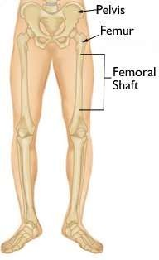
Femoral shaft fractures are among the most common fractures encountered in orthopaedic practice.
A femoral shaft fracture is defined as a fracture of the diaphysis occurring between 5 cm distal to the lesser trochanter and 5 cm proximal to the adductor tubercle
Most common in younger populations

Slide 3
Femur is the largest tubular bone in the body and is surrounded by the largest mass of muscle.
An important feature of the femoral shaft is its anterior bow.
The isthumus of the femur is the region with the smallest intramedullary nail diameter
The medial cortex is under compression while the lateral cortex is under tension.

Slide 4
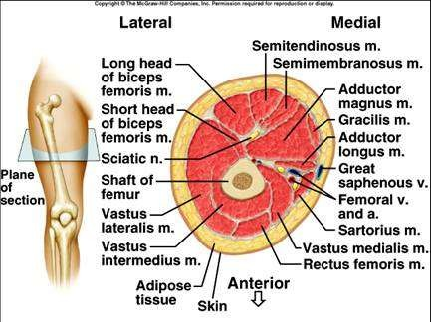

Slide 5
The thigh musculature is divivded into three fascial compartments :
Anterior compartment – It is composed of;
-Quadriceps femoris
-Iliopsoas
-Sartorius
-pectineus
-femoral artery , femoral vein
-Lateral femoral cutaneous nerve

Slide 6
Medial Compartment- It contains the
-Gracillis
-Adductor Longus
-Adductor brevis
- adductor magnus
- Obturator externus
- Profunda femoris artery
-Obturator artery ,vein,nerve

Slide 7
Posterior compartment- It is composed of;
- Biceps femoris
- semitendinosus
- semimembranosus
-portion of adductor muscle
- branches of profunda femoris aftery
- sciatic nerve
- posterior femoral cutaneous nerve

Slide 8
The vascular supply to the femoral shaft is derived mainly from the profunda femoris artery
One to two nutrient vessels usually enter the bone proximally and posteriorly along the linea aspera .
This artery then aborizes proximally and distally to provide the endosteal circulation to the shaft .
The periosteal vessels also enter the bone along the linea aspera and supply blood to the outer 1/3 of the cortex .
The endosteal vessels supply the inner two thirds of the cortex.

Slide 9
MECHANISM OF INJURY –
Femoral shaft fractures in adults are almost always the result of high energy trauma .
These fractures result from motor vehicle accidents, gunshot injury, fall from height.
Low energy trauma is commonly seen in elderly

Slide 10
Commonly shaft fractures can be divided into ;-
Transverse fractures – break is a horizontal line going across the shaft
Oblique fractures- break is a angled line across the shaft
Spiral fractures- fracture line encircles the shaft
Comminuted fractures- bone has broken into 3-4 fragments
Open fractures- bone break in such a way that bone fragments stick out through skin

Slide 11
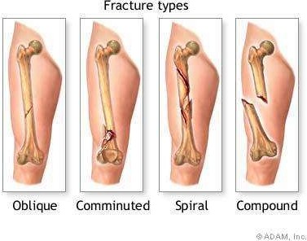

Slide 12
SYMPTOMS
Diffuse pain or ache,
Tenderness and swelling in the thigh or groin.
Bleeding and bruising in the thigh (uncommon).
Weakness and inability to bear weight on the injured leg.

Slide 13
A full trauma survey is indicated (ABC)
The patient is
–Non ambulatory with pain
–Variable gross deformity of thigh
–Swelling,
–Shortening of the affected extremity.
• A careful neurovascular examination is essential
A careful assessment of hemodynamic stability is essential,
Average expected Blood loss of 750-1500ml

Slide 14
BIOMECHANICS/ DEFORMING FORCES
Abductors(gluteus medius and minimus)- insert on the GT and abdduct the proximal femur following subtrochanteric and proximal shaft fractures
Iliopsoas- it flexes and externally rotates the proximal fragments by its attachment to the LT
Adductors- exert a strong axial and varus load to the bone by traction on the distal fragment
Gastrocnemius-acts on distal shaft fractures and supracondylar fractures by flexing the distal fragment

Slide 15
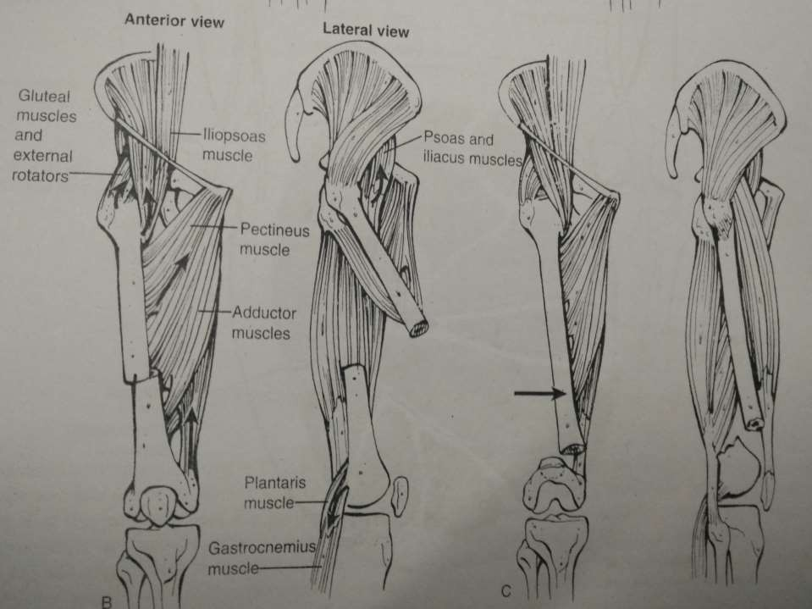
Fascia lata- acts as atension band by resisting the medial angulating forces of the adductors.

Slide 16
X-ray
Most commonly used for diagnosis of fracture shaft of femur
Will confirm the diagnosis and establish the sites ,line ,extent and displacement
AP and Lateral views of the femur, hip, and knee
AP view of the pelvis should be obtained
Look for evidence of an associated femoral neck or intertrochanteric fracture, knee injuries
Femur shaft fractures are commonly associated with injury to these sites.

Slide 17
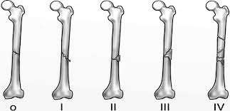
CLASSIFICATION-:
Winquist and Hansen
Type 1 - No commination or minimal
Type 2 – Cortices of both fragments at least 50% intact
Type 3 - 50% to 100% cortical comminution
Type 4 – Circumferential comminution with no cortical contact

Slide 18
AO classification-:
32A –Simple - A1- Spiral
A2 – Oblique, angle>30
A3- Transverse, angle <30
32B- Wedge- B1- spiral wedge
B2- Bending wedge

Slide 19
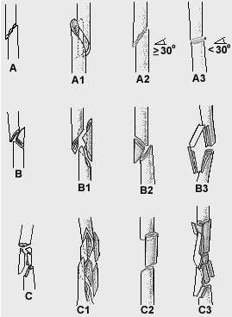
32 C- Complex C1-spiral
C2-Segmental
C3-Irregular

Slide 20
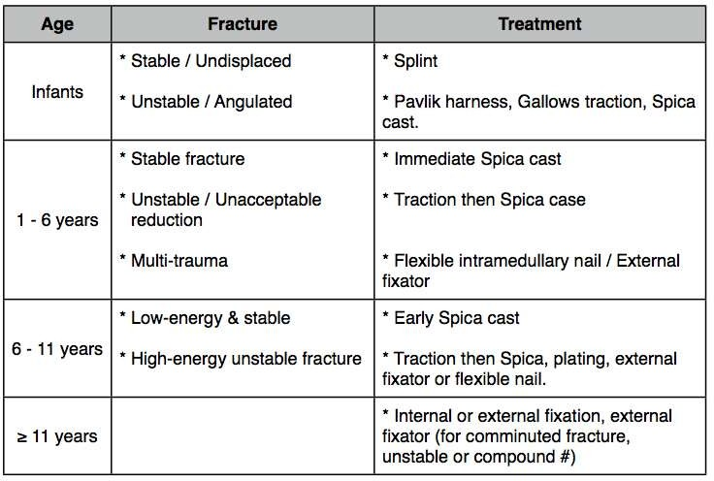
Management-paediatrics

Slide 21
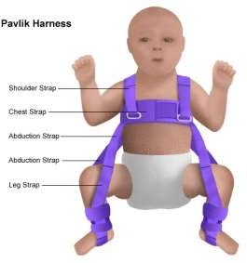
Pavlik Harness for Age < 6 months

Slide 22
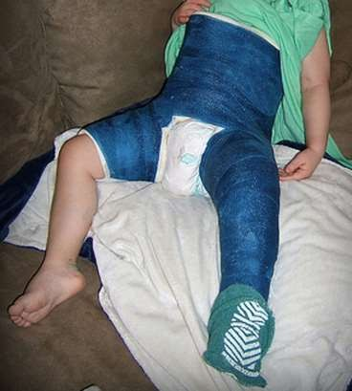
Hip Spica Cast for Age upto 5 years

Slide 23
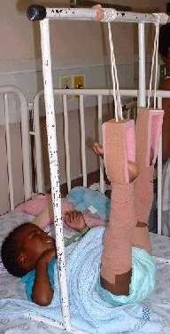
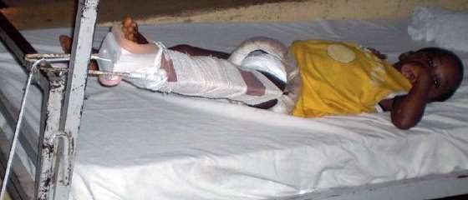
Gallows Traction
Paediatric Thomas Splint

Slide 24
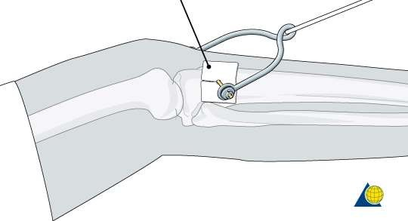
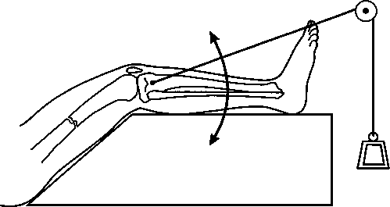
For patients in whom surgery needs to be delayed, temporary stabilisation with Skeletal traction is required

Slide 25
The goal of skeletal traction is to restore femoral length, limit rotation and angular deformities, reduce painful spasms, and minimize blood loss into the thigh.
Safe pin replacement is usually from medial to lateral at the distal femur (directed away from the femoral artery) and from lateral to medial at the proximal tibia (directed away from the peroneal nerve)
15% of body weight is generally applied for traction to the extremity
Fracture length should be assessed via a lateral radiograph.

Slide 26
Operative Fixation Options
Intramedullary nail Fixation
Open Reduction and Plate Fixation
External Fixation(For Open/ Infected Fractures)

Slide 27
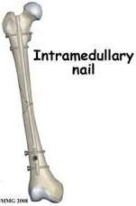
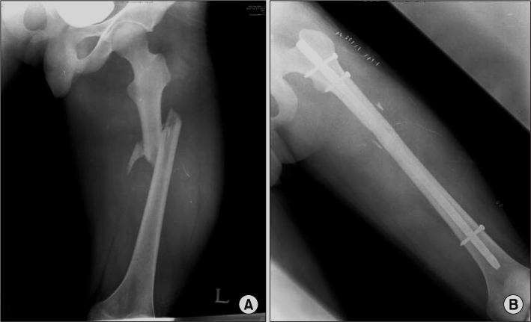

Slide 28
Intramedullary Nailing-
This is the standard of care for femoral shaft fractures .
Benefits of nailing include – less exposure
- lower infection rate
- less quadriceps scarring
- early functional use of extremity
- rapid and high union
Closed IM nailing has advantageof maintaining both fracture hematoma and attached periosteum

Slide 29
Antegrade intramedullary nailing-
Position of patient is supine or lateral
3 cm incision proximal to the greater trochanter in line with the femoral canal
Entry is made from the piriformis
Advantages of reaming- Increased periosteal blood flow
- ability to place a larger diameter nail with
increased union rates & decreased chance of
hardware failure.

Slide 30
All IM nails should be statically locked to maintain femoral length and control rotation
SURGICAL STEPS-
Incision starting 2-3 cm from the proximal tip of the graeater trochanter ,
Incise fascia of the gluteus maximus in line with its fibres
Identify subfascial plane of the gluteus maximus
Advance guide wire to the level of piriformis fossa

Slide 31
Place the reamer assembly , consisting of a 14 mm channel reamer , into the entry portal tool over guide wire
Ream assembly into the femur until it bottoms out of the entry portal tool
Place the reduction tool consisting of the reducer and t handle into channel reamer
Advance the reduction tool to the fracture site and use the tool to manipulate the proximal fragment .
When the distal fragment is reached and engaged ,advance the 3.0mm ball tipped guide wire across the fracture.

Slide 32
Confirm reduction and position of the guide wire with anteroposterior and lateral images at multiple levels .
Remove the reducer and ream the canal sequentially
Confirm the proper nail length by positioning the guide wire at the point of desired distal position,
Place the nail into the femur and advance it manually
For proximal and distal interlocking screws use 5 mm locking screws

Slide 33
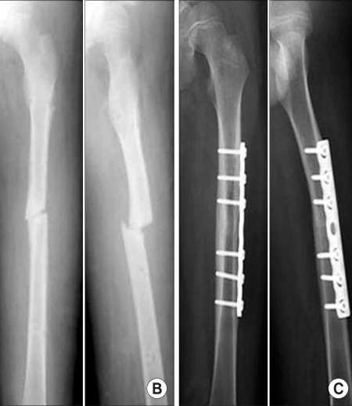
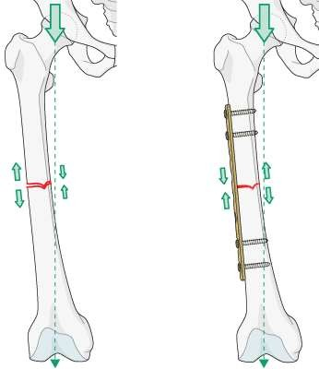
Plate Fixation

Slide 34
PLATE FIXATION-
INDICATIONS- extremely narrow medullary canal
-fractures occurring adjacent or through a previous
malunion
- obliteration of medullary cavity due to infection
- fractures with associated proximal or distal extension
into pertrochanteric or condylar regions
- in patient with associated vascular injury requiring
repair.

Slide 35
Disadvantages of plating-
extensive surgical approach with associated blood loss , risk of infections soft tissue damage.
Decreased vascularization beneath the plate and the stress shielding of bone spanned by the plate
The plate is a load bearing implants ,therefore a higher rate of implant failure .

Slide 36
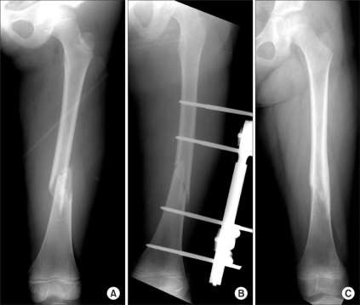
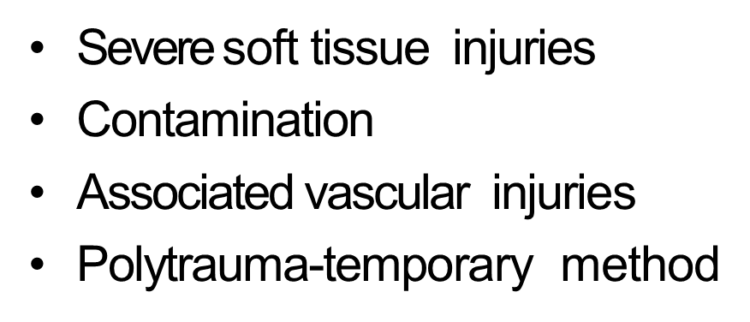
External Fixation

Slide 37
Advantages-
this procedure is majorly used for damage control
Vascular supply to the femur is minimally damaged during application.
It allows access to the medullary canal and the surrounding tissue in open fractures with significant contamination.
It can be converted to IM nail in a time of 2 weeks.

Slide 38
Disadvantages-
Pin tract infection may occur
Angular malunion and femoral shortening
Limited ability to adequately stabilize the femoral shaft

Slide 39
COMPLICATIONS-
VASCULAR INJURY-may result from tethering of femoral artery at the adductor hiatus.
COMPARTMENT SYNDROME- occurs only with significant bleeding presenting as a out of proportion pain , tense thigh , painfull quadriceps stretch
Fixation device failure- this occurs maximally with plate fixation
Non union and delayed union
Malunion- usually varus, internal rotation, or shortening owing to muscular deforming forces.
Infection – majorly in 3B and 3C fractures have a higher risk .

Slide 40
THANK YOU

