Slide 1
Pott’s Paraplegia
Dr. Javed Ahmad Khan
(Assistant Professor)
Department of Orthopaedics

Slide 2

Tuberculosis of spine (Broad Headings)
History
Anatomy
Pathogenesis
Clinical Features
Complications/sequelae
  Cold Abscess
  Pott’s paraplegia
    Classification, Staging, Clinical Features, Prognosis
Differential Diagnosis
Investigations
Management
  Medical
  Surgical- Goals, Indications, Procedures
  Middle path regime

Slide 3
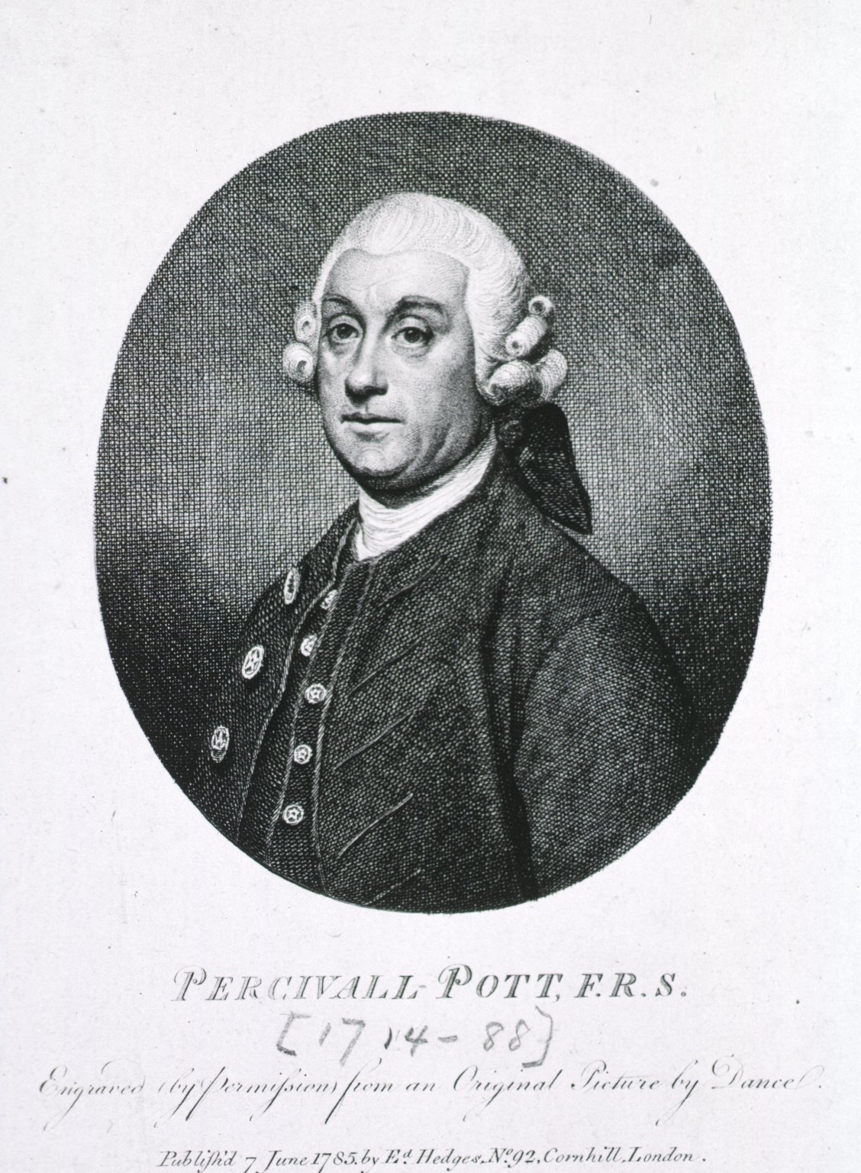
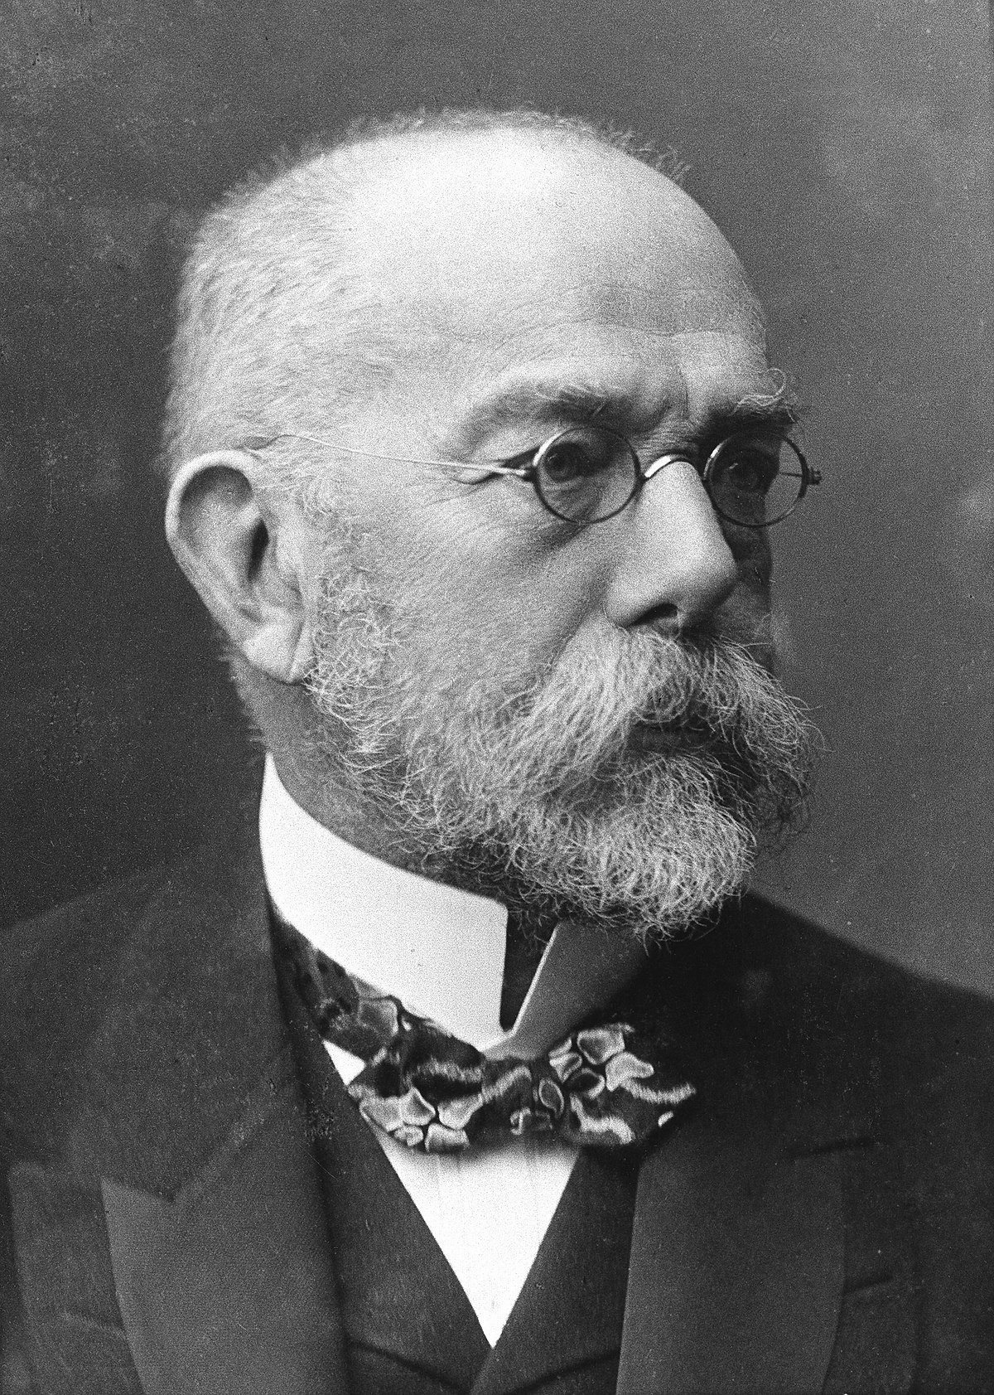
History
 | Sir Percival Pott | 1779 | First described spinal tuberculosis | Pott’s spine
 | Robert Koch | 1882 | Described Mycobacterium tuberculosis | Koch’s bacteria

Slide 4
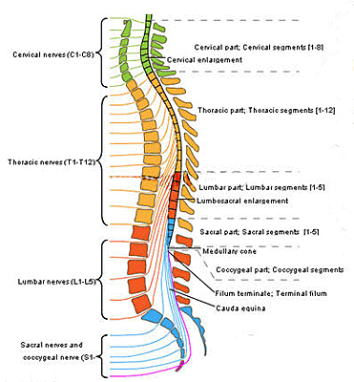
Anatomy
Vertebral level | Spinal Level
C1-C7 | Add one to know corresponding cord level
Upper Thoracic (T1-T6) | Add 2
Mid Thoracic (T7-T9) | Add 3
T10 | L1 and L2
T11 | L3 and L4
T12 | L5 and S1
L1 (Spinal cord ends at lower border of L1) | Rest Saccral and Coccygeal segments
Below L1 | Cauda equina
Important : Probable/Final diagnosis must include both the vertebral level and neurological (spinal) level

Slide 5
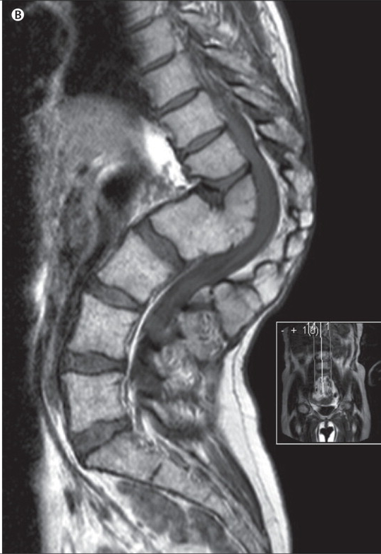
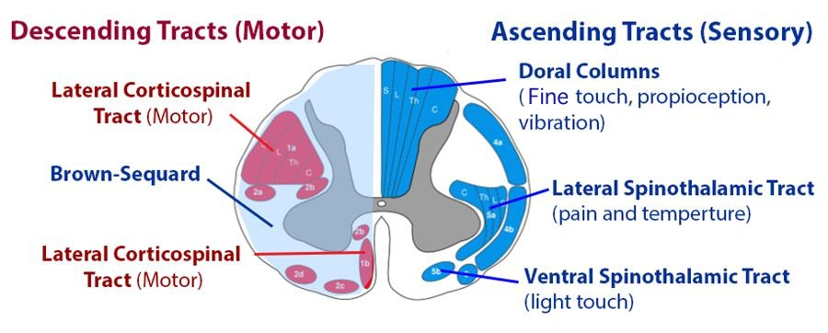
Anatomy
Motor is affected before sensory
Pain, crude touch and temperature affected before proprioception, vibration and fine touch
Anterior
Posterior

Slide 6
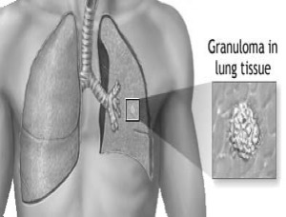
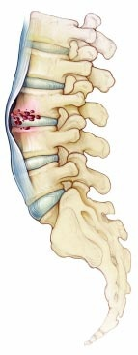
Pathogenesis
Any osteoarticular tubercular lesion, is the result of a hematogenous dissemination from a primary infected visceral focus.
  Pulmonary
  Genitourinary
  Lymph nodes
Through vascular channels,
  generally arteries as a result of bacillemia
    (Paradiscal)
  rarely through Batson’s plexus of veins
    (Central)

Slide 7
Pathogenesis
Osseous destruction-
  Due to lysis of bone
  Due to ischemic infarction of segments of bone (endarteritis and periarteritis)
Intervertebral disc is primarily not involved (avascular structure)
Paradiscal involvement of vertebrae jeopardizes its nutrition and may get invaded later on.
Types of disease-
  Caseous exudative type (more aggressive)
  Granular type (less destructive)

Slide 8
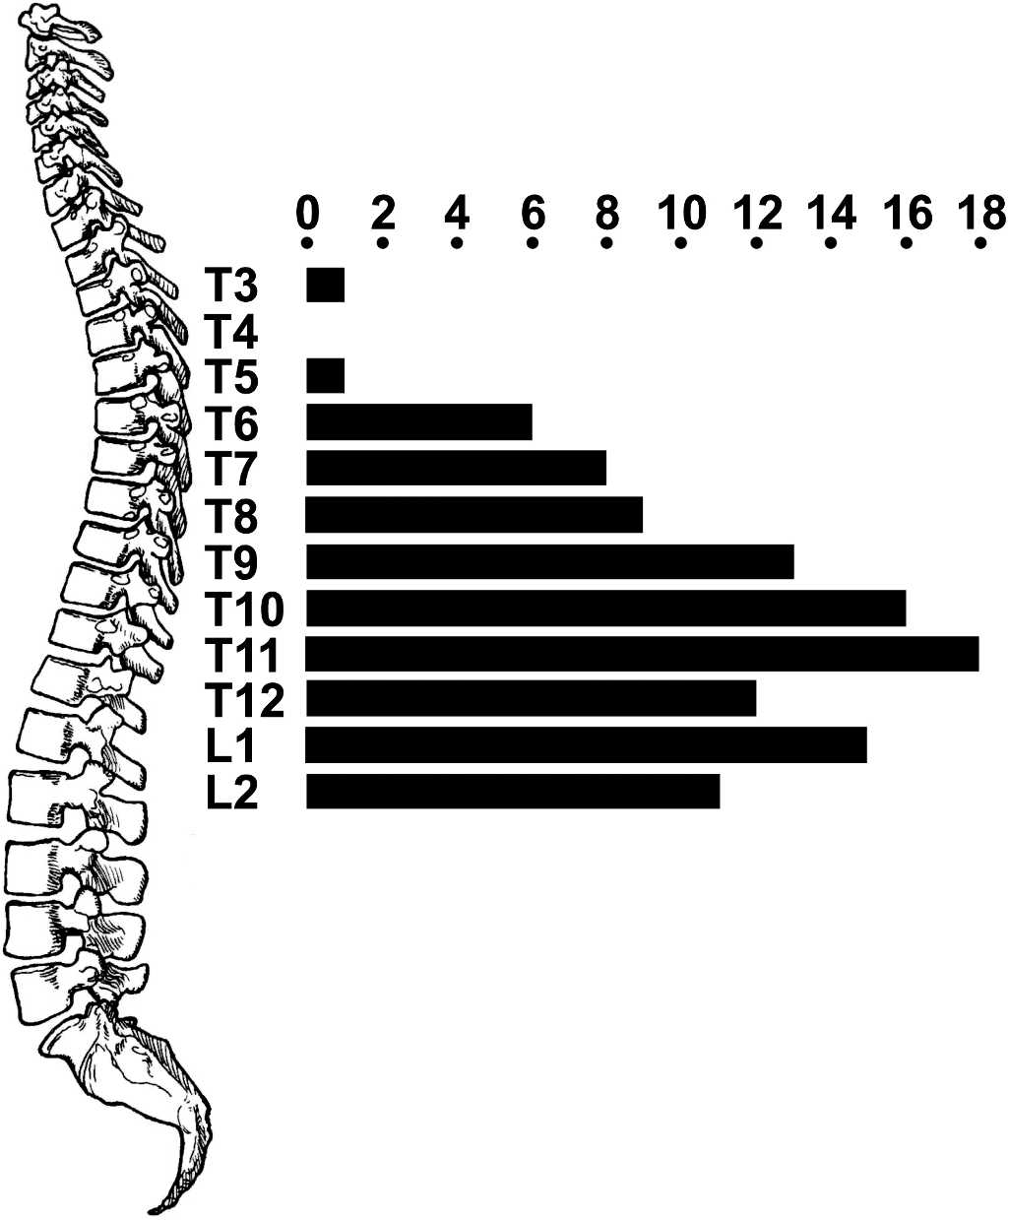
Regional Distribution
1965-74
Total:- 53 patients
Jutte P, Wuite S, The B, van Altena R, Veldhuizen A. Prediction of deformity in spinal tuberculosis. Clin Orthop Relat Res. 2007 Feb;455:196-201.
Tuli SM. Tuberculosis of the skeletal system. 6th Edition, Jaypee publishers, New Delhi, pp. 209

Slide 9
Why Thoracic spine?
Increased stress of weight bearing
More Spongy tissue
Cysterna chyli, Thoracic duct, Lymph nodes (lymphatic system)
Microtrauma (due to being junctional area)

Slide 10
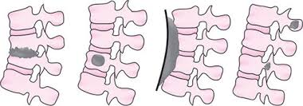
Type of involvement (based on part of vertebrae involved)
Paradiscal
Central
Anterior
Appendicular
Synovial

Slide 11
Clinical features (Symptoms)
Constitutional symptoms (20-38%)
  Malaise
  Loss of weight/appetite
    > 10% or > 10 pound in 6 months
    > 5% or > 5 pound in 1 month
  Night Sweats
  Evening rise of temperature
Specific symptoms
  Pain- MC symptom of presentation
    Axial/radicular
    Continuous
    Mechanical/instability
    Typical night cries- During sleep muscle spasm relaxes permitting movement between the inflamed surfaces.
  Stiffness
  Deformity
  Restricted ROM
  Enlarged Lymph nodes
  Cold Abscess- mass effect
  Neurological deficits

Slide 12
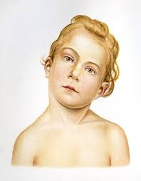
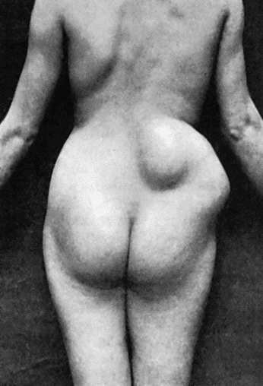
Clinical features (Signs)
Attitude
  Wry neck (Cervical)
  Military position (Upper Thoracic)
  Alderman’s gait (Lower Thoracic)
  Increased lordosis (Lumbar)
Stiffness of spine :- due to paravertebral muscle spasm
Spinal deformity
  Knuckle (1 vertebrae involvement)
  Gibbus (2-3)
  Kyphus (>3)
Soft tissue swelling :– cold abscess
Neurological deficit

Slide 13
Complications of Spinal Tuberculosis
Paraplegia
Cold abscess
Spinal Deformity
Sinuses
Secondary infection
A complication in medicine, or medical complication, is an unfavourable result of a disease, health condition or treatment.
Complications are not to be confused with sequelae, which are residual effects that occur after the acute (initial, most severe) phase of an illness or injury.

Slide 14
Cold Abscess
Formed by collection of products of liquefaction & reactive exudation from the infected vertebrae without surrounding inflammation.
Seen in 70% cases of Spinal TB
Slow growing, without proteolytic enzymes and spread subligamentously.
Their effects are largely related to mass effect, not inflammation.

Slide 15
Location and Spread of Cold Abscess
Cervical Spine
2. Thoracic spine
3. Lumbar spine
Retropharyngeal abscess
Presence of Hoarseness, Dysphagia, Respiratory stridor or Torticollis
Anterior and posterior triangles of neck
Fusiform paravertebral abscess
Posteriorly - compress the spinal cord
Laterally - extra pleural space – effusion
Anteriorly – pierces ALL & goes down, mediastinal abscess
Pass along thoracic spinal nerve to appear at anterior chest wall, midaxillary, or posterior chest wall
Along lateral aortic ligament – paravertebral lumbar abscess
Medial aortic ligament to psoas sheath – psoas abscess- may present in groin or thigh
Lumbar plexus – sciatic nerve – gluteal region – post aspect of thigh & calf.

Slide 16
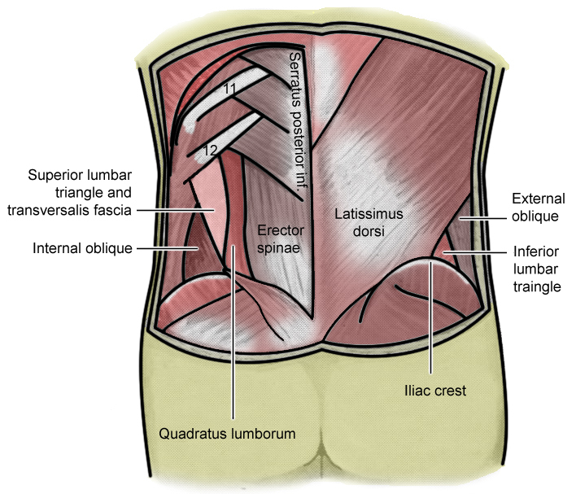
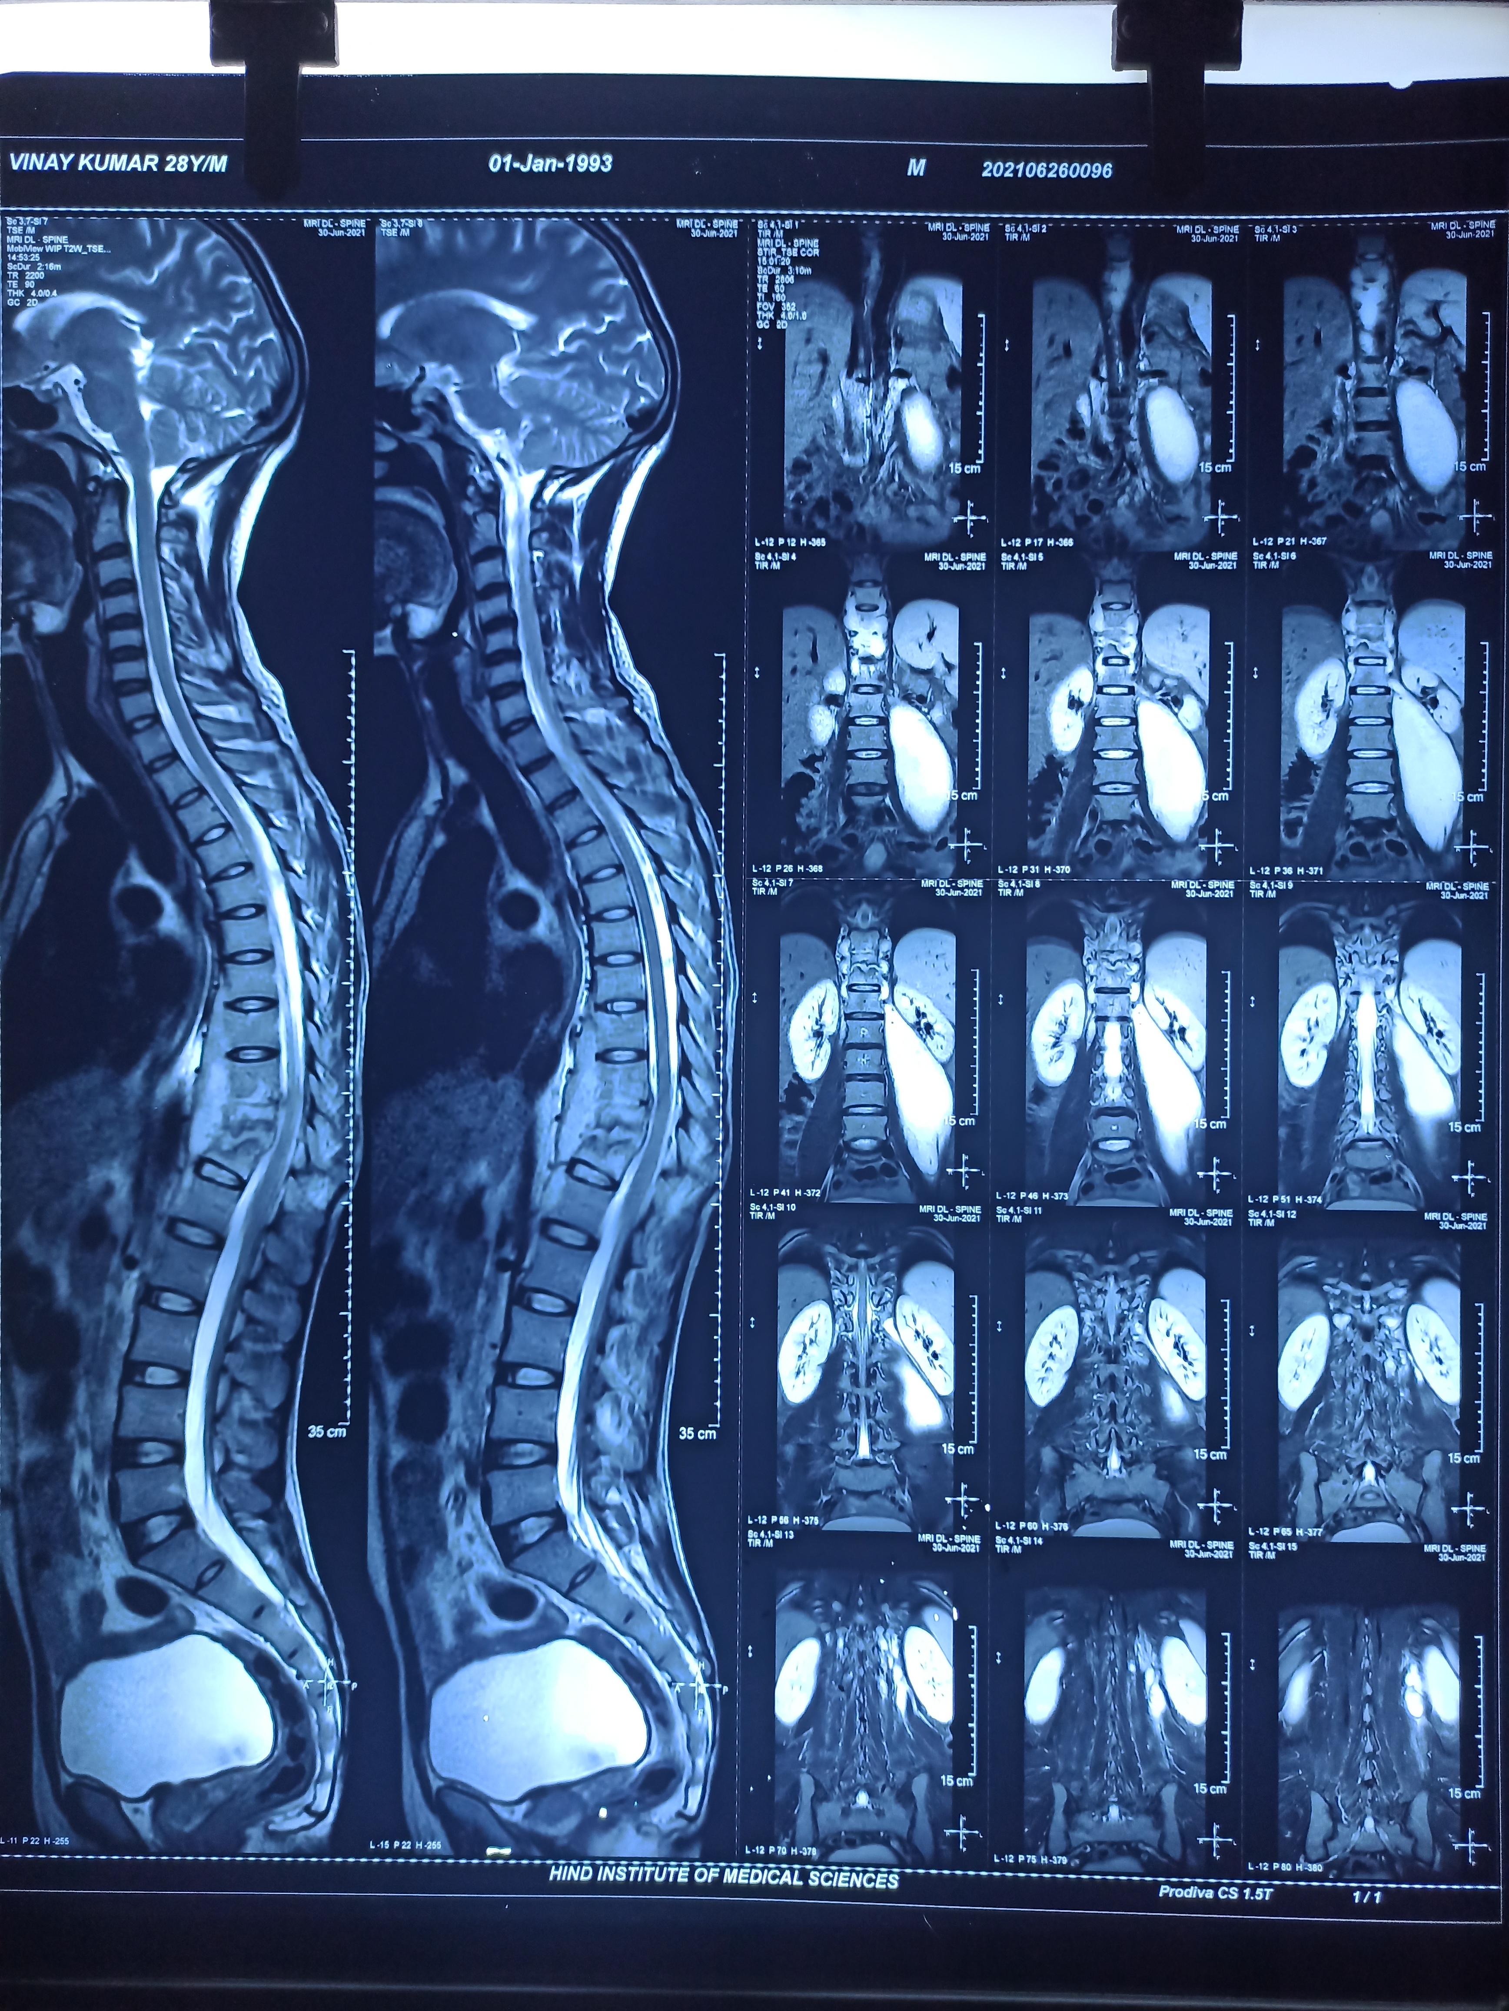
Psoas abscess
Abscess from the dorsolumbar and lumbar spine follow the well known pattern of tracking down the psoas sheath.
These abscess may be palpable in the
  Lumbar triangle of Petit
  Iliac fossa
  Upper part of thigh below inguinal ligament
  Even track downwards up to the knee
“Pseudo-Hip” – flexion deformity at the hip due spasm of iliopsoas.
  It does not show any limitation of external & internal rotation of the hip joint when tested in position of flexion deformity

Slide 17
POTT’S PARAPLEGIA
10%-30% cases develop neurological deficit.
Age- first 3 decades
Lower thoracic spine is most commonly affected
Motor functions affected> sensory

Slide 18
Why Thoracic spine?
Most commonly affected
Canal is narrowest and slightest pressure is enough
Normal curve of dorsal spine encourages marked kyphosis
Anterior longitudinal ligament in dorsal area loosely confines abscess.

Slide 19
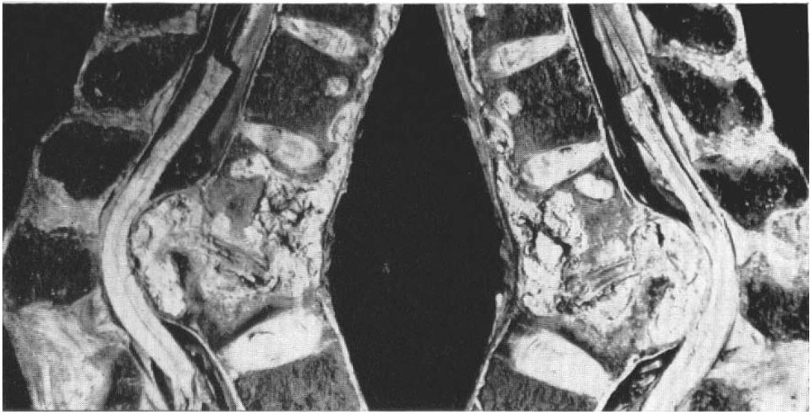
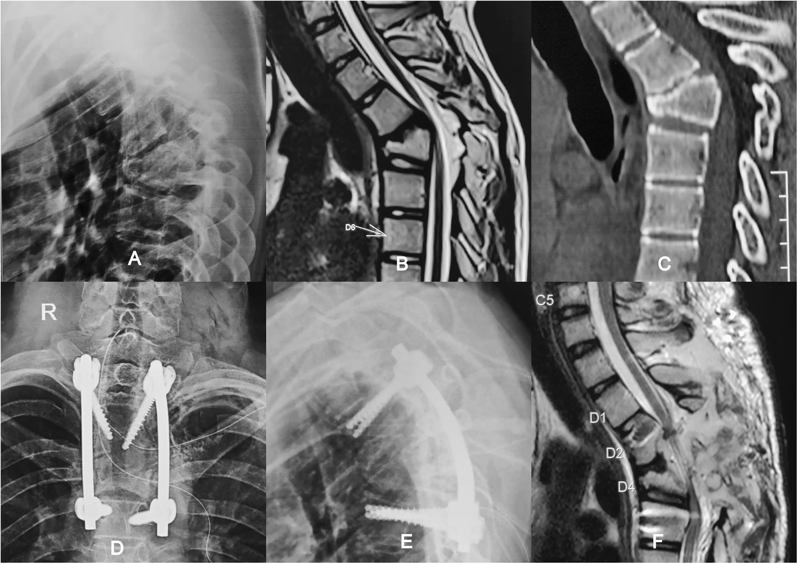
Classification (Hodgson, 1967)
Early-onset Paraplegia | Late-onset Paraplegia
Associated with active disease (Within 2 years) | Associated with healed disease (After 2 years)
Mainly due to inflammation | Mainly mechanical
Causes: Inflammatory edema Tuberculous Granulation Tissue Tuberculous pus Tuberculous caseous tissue Ischemic lesion of the cord (rare) | Causes: Severe kyphotic deformity Tubercular debris Sequestra from vertebral body and disc Internal gibbus Stenosis of the vertebral canal Peridural fibrosis
Better prognosis | Poor prognosis
Krishnan A, Patil S, Reddy C, Mayi S, Degulmadi D, Rai RR, et al. Ventral sculpting decompression: a novel bone scalpel-based technique in thoracic ventral stenosis/kyphosis with myelopathy. Egypt J Neurosurg 2020;35:4. https://doi.org/10.1186/s41984-020-00076-9.

Slide 20
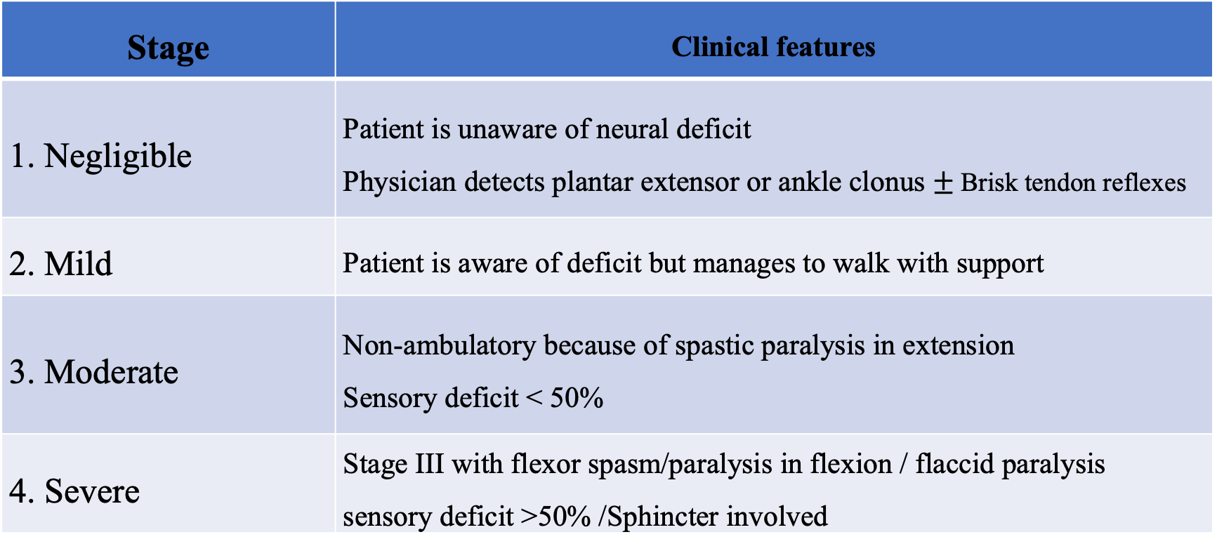
Staging of neurological deficit (Goel, Tuli and Kumar)
Stage | Clinical features
1. Negligible | Patient is unaware of neural deficit Physician detects plantar extensor or ankle clonus $±$Brisk tendon reflexes
2. Mild | Patient is aware of deficit but manages to walk with support
3. Moderate | Non-ambulatory because of spastic paralysis in extension Sensory deficit < 50%
4. Severe | Stage III with flexor spasm/paralysis in flexion / flaccid paralysis sensory deficit >50% /Sphincter involved

Slide 21
Clinical features of Pott’s paraplegia
Posterior
1st sign of interference with conduction of cord
  Spontaneous Twitching Of Muscles In Lower Limb
  Clumsiness While Walking
  Extensor Plantar Response
  Exaggerated Reflex
  Sustained clonus of ankle and patella
Motor function affected 1st than sensory
Compression from this side
Anterior

Slide 22
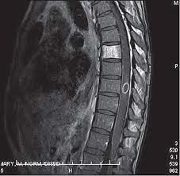
Clinical features of Pott’s paraplegia
Paralysis passes through following stages
Spastic motor paraparesis
Spastic paraplegia in extension
Spastic paraplegia in flexion
Advanced compression - bladder involvement
Sense of position and vibration are last to disappear
In extreme severe cases all spasticity disappears and paralysis becomes flaccid with anesthesia and loss of sphincter control
SPINAL TUMOUR SYNDROME- Rarely Pott’s paraplegia may present as this due to localized tuberculoma or diffuse granuloma or peridural fibrosis

Slide 23
Prognosis of recovery of cord functions
Cord involvement | Better prognosis | Poor prognosis
Degree | Partial (Stage I and II) | Complete (Stage III and IV)
Duration | Shorter | Longer (>12 months)
Type | Early onset | Late Onset
Speed of onset | Slow | Rapid
Age | Younger | Older
General condition | Good | Poor
Vertebral disease | Active | Healed
Kyphotic deformity | <60 degrees | >60 degrees
Cord on MRI | Normal | Myelomalacia
Peroperative | Wet lesion | Dry lesion

Slide 24
Differential diagnosis
Infectious disease
(pyogenic osteomyelitis) -
MC -Staph. Aureus
  Typhoid spine
  Brucella spondylitis
  Mycotic spondylitis
  Syphilitic infection
Tumorous conditions
  Primary benign tumor:
    Haemangioma
    GCT
    ABC
  Primary malignant tumor:
    Ewing's sarcoma
    Osteogenic sarcoma
    Chordoma
    Multiple myeloma
    Lymphomas
    Secondary neoplastic conditions
    Histocytosis - X
Developmental abnormalities of spine- Hemivertebrae,
block vertebrae, synostosis of neural arches
Osteoporotic conditions-
Senile OP
OI
Osteomalacia
Rickets
Steroid induced OP
Traumatic conditions
Spondylolisthesis
Hydatid disease
Spinal osteochondrosis (Scheurmann’s disease)

Slide 25
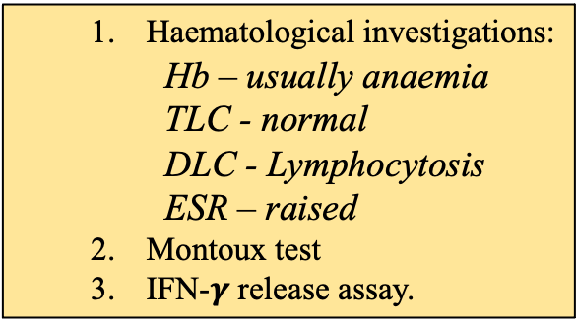
Investigations
Laboratory investigations
2. Radiological investigations
3. Biopsy and Tissue Diagnosis
  Haematological investigations:
    Hb – usually anaemia
    TLC - normal
    DLC - Lymphocytosis
    ESR – raised
  Montoux test
  IFN-$γ$ release assay.
  1.X ray - Diagnostic but not confirmatory
  2. CT scan
  CT guided biopsy
  3. MRI
  4. Bone Scan
  5. PET/
  PET/CT
Gold Standard diagnostic test of Pott’s spine
  1.Smear Ziehl−Neelsen Staining
  2. Culture using
  Lowenstein −Jensen culture media,(5-6 wks) BACTEC 12B,
  GeneXpert MTB/RIF (1-2 wks)
  3. Histopathology
  4. PCR

Slide 26
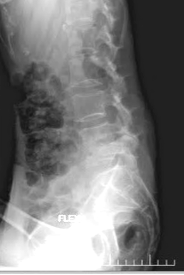
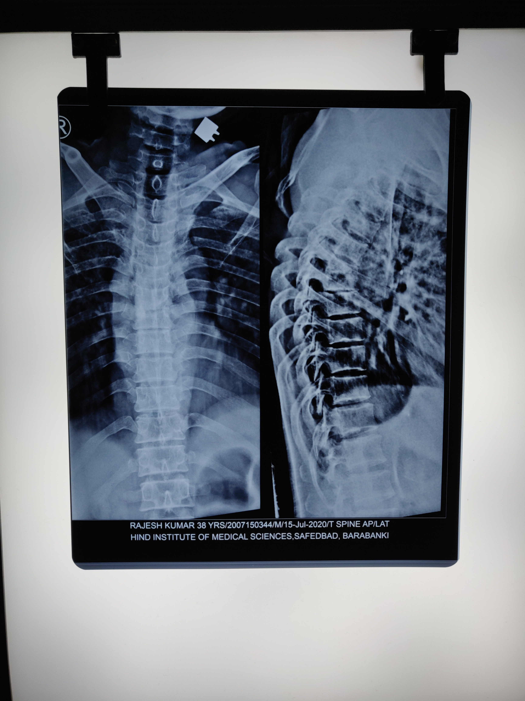
Investigations (X-Ray)
Narrowing of the disc is often the 1st radiological finding
Foci of < 1.5cm in diameter is not demonstrable
30 – 40% calcium must be removed from a particular area to show a radiolucent region in X-rays.
  (3-5 months)
Paravertebral shadows
  (Bird’s nest abscess)
Kyphotic deformity

Slide 27
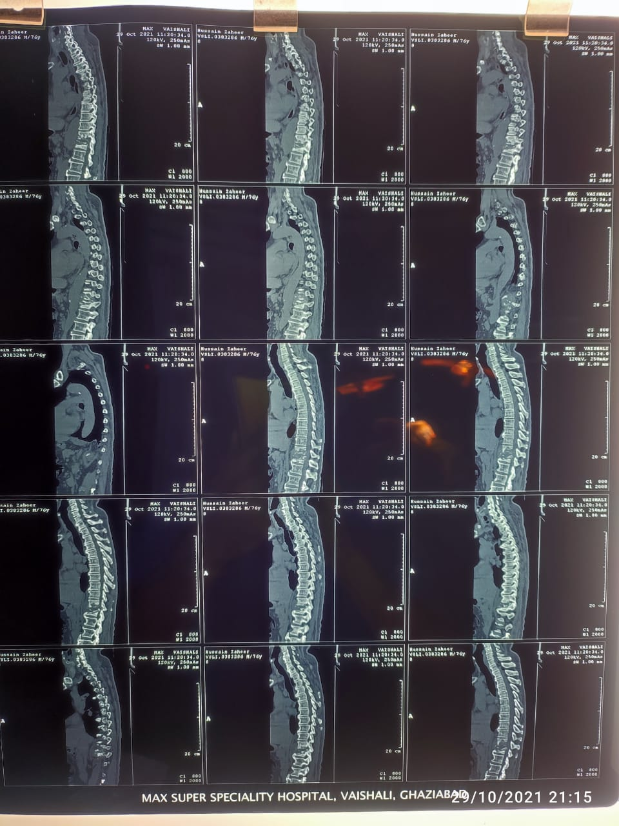
Investigations (CT scan/ CT guided biopsy)
Specially for
  posterior spinal disease
  T.B of craniovertebral & cervicodorsal region
  S.I joint
  Sacrum
Delineation of shape, extent and route of spread of a cold abscess
CT guided biopsy may be done for getting tissue sample for tissue diagnosis

Slide 28
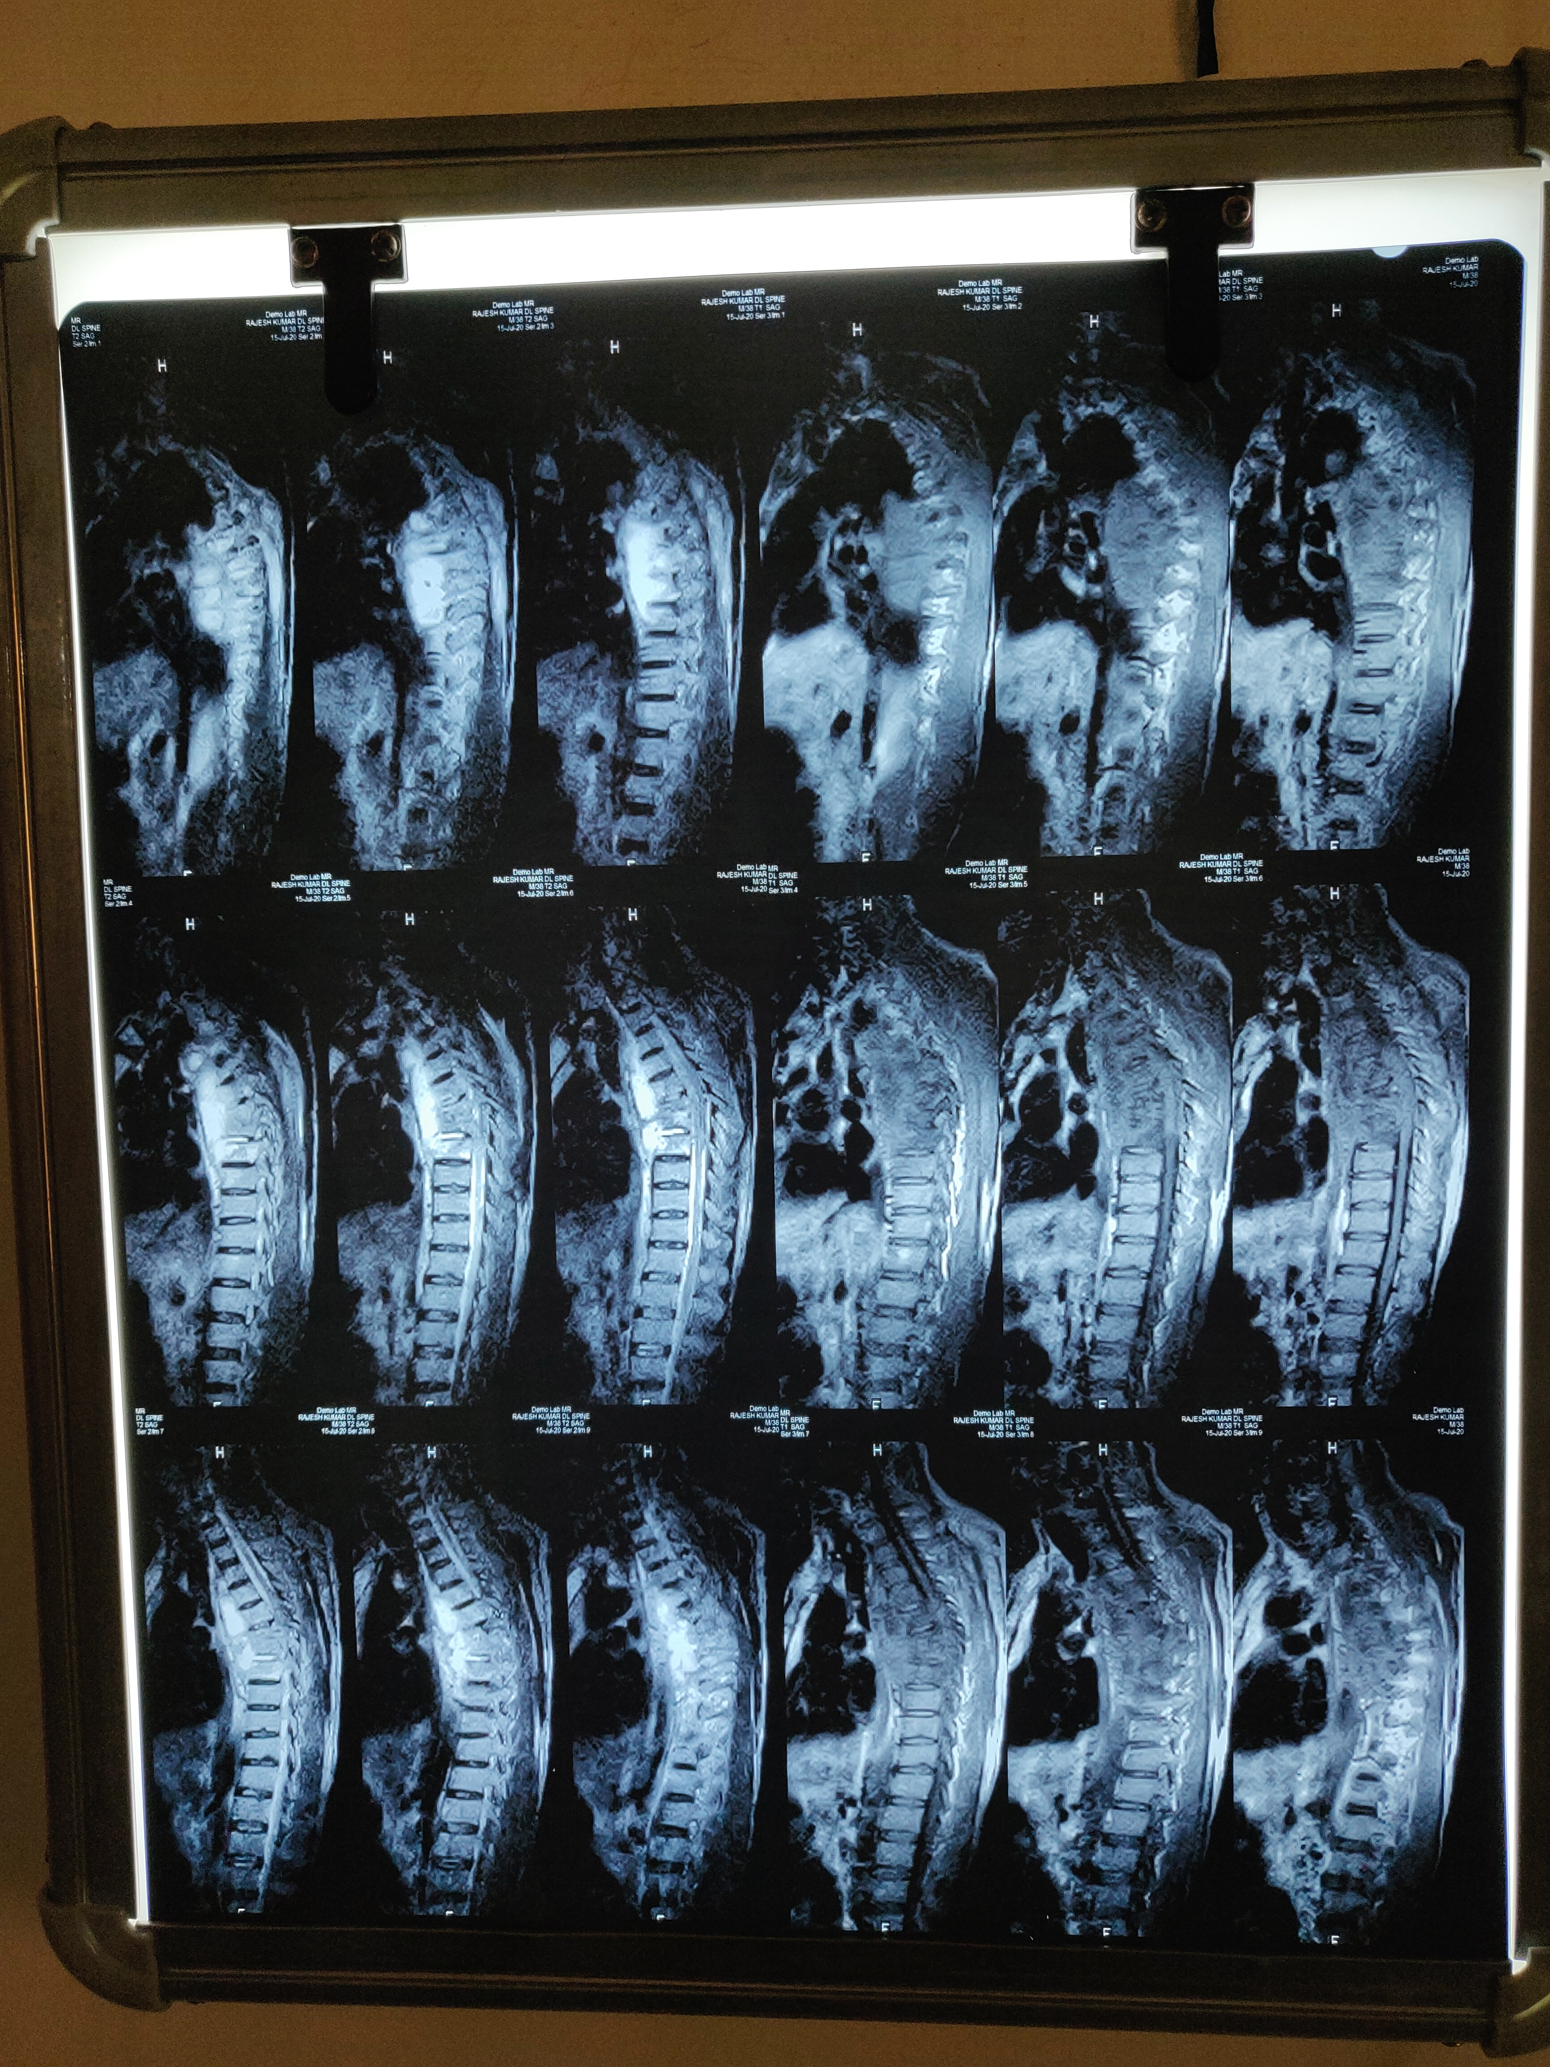
Investigations (MRI)
To find extent of vertebral destruction
To find extent of cold abscess
To find cause of paraplegia (abscess, granulation, sequestrum, gibbus)
Site of cord compression
Condition of cord
For diagnosing disease in rare & difficult sites
T2
T1

Slide 29
Investigations (Tissue Diagnosis)
Smear- To look for Acid Fast bacilli on ZN staining
Culture- LJ Media, BACTEC
Gene expert- capable of detecting mutations causing resistance against Rifampicin
Line probe assay- Can detect resistance against Rifampicin and Isoniazid

Slide 30
Medical management
General treatment
Rest - absolute bed rest in hard bed with soft mattress
Plaster jackets can be applied (MINERVA JACKET CAST) for 18- 24 months
Supportive therapy with
  Multivitamins
  Haematinics
  High Protein Diet
  Adequate Sunlight

Slide 31
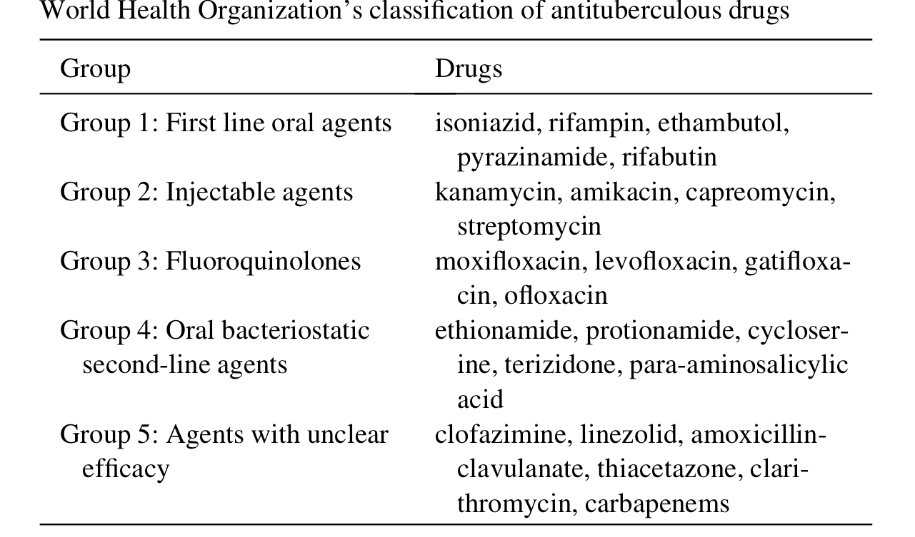
Medical management (1st line drugs)
Bactericidal drugs | Dose
Isoniazid (H) | 5 mg/kg
Rifampicin | 10-15 mg/kg
Pyrizinamide | 20 mg/kg
ATT
  HRZE for 2 months
  HRZ for next 4 months
  HR for next 1 year
STREPTOMYCIN replaces one of the drugs except INH in hospitalized patients
Bacteriostatic | Dose
Isoniazid (H) | 25 mg/kg
Streptomycin (not a 1st line now) | 20-25 mg/kg

Slide 32
Drug resistant Tuberculosis
Types of Drug resistant tuberculosis
MDR (Multi drug-resistant) TB | Resistance to at least both Isoniazid and rifampicin
XDR (Extensively drug-resistant) TB | Resistance to any fluoroquinolone and at least one injectable second-line antibiotic in addition to Isoniazid and Rifampicin

Slide 33
Surgical management (Goals)
Drain abscess
Debride sequestrated bone
Decompress spinal cord or dura
Stabilize the spine for prevention or correction of deformity

Slide 34
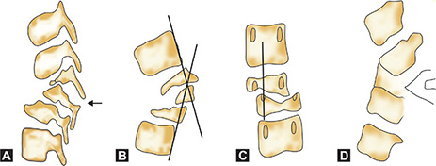
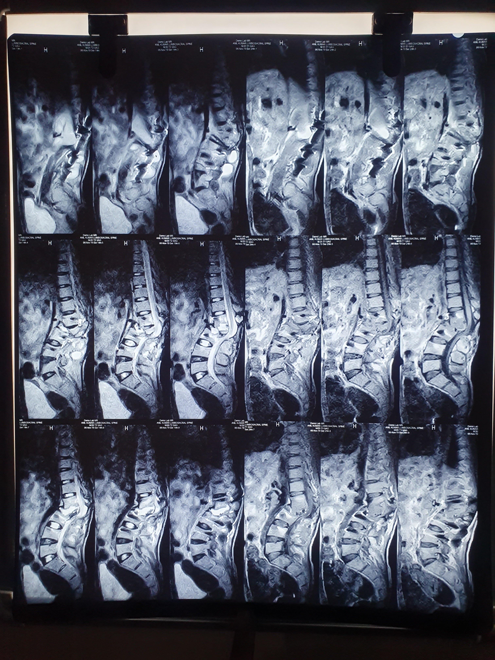
Indications for surgery (in patients without neurological deficit)
Progressive bone destruction in spite of ATT
Failure to respond conservative treatment/drug resistant TB
Evacuation of Para vertebral abscess when it has increased in size in spite of rest & ATT (period of 3 month observation is enough)
Uncertainty of diagnosis
Mechanical instability
Prevention of severe kyphosis in children with extensive dorsal lesions
Spinal deformity
Childhood spine tuberculosis- Spine at risk signs
      A. Separation of the facet joints
      B. Posterior retropulsion
      C. Lateral translation
      D. Toppling sign

Slide 35
Indications for surgery (in patients with neurological deficit)
Neural complication developing or getting worse or remaining stationary (no neurological recovery even after 4 weeks of ATT) or recurrence during the course of conservative treatment
Paraplegia of rapid onset
Spinal tumor syndrome
Neural arch disease
Severe paraplegia (Grade IV)
Painful paraplegia in elderly patients- to avoid prolonged recumbency

Slide 36
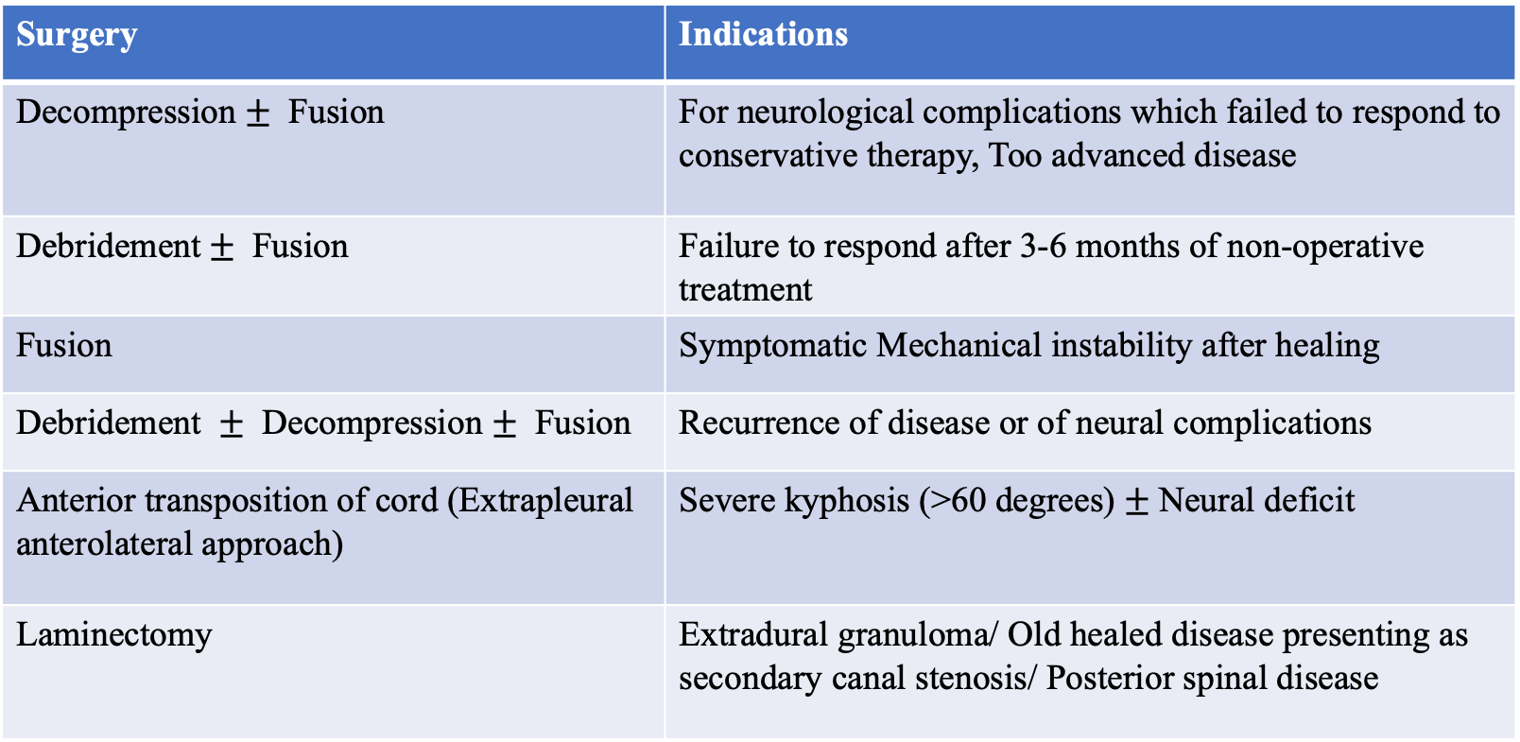
Indications for various surgical procedures
Surgery | Indications
Decompression $±$ Fusion | For neurological complications which failed to respond to conservative therapy, Too advanced disease
Debridement$±$ Fusion | Failure to respond after 3-6 months of non-operative treatment
Fusion | Symptomatic Mechanical instability after healing
Debridement $±$ Decompression $±$ Fusion | Recurrence of disease or of neural complications
Anterior transposition of cord (Extrapleural anterolateral approach) | Severe kyphosis (>60 degrees) $±$Neural deficit
Laminectomy | Extradural granuloma/ Old healed disease presenting as secondary canal stenosis/ Posterior spinal disease

Slide 37
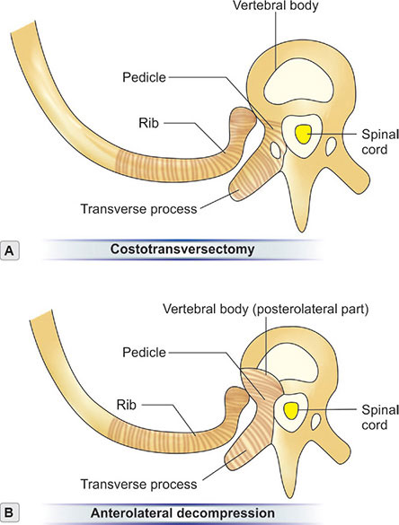
Few named surgeries (Important for exam)
Costotransversectomy
Anterolateral Decompression- for D2-L1 (Griffith, Seddon and Roaf )
  Patient is in right lateral position, approached from left side, semicircular incision, extrapleural approach, costotransversectomy, anterolateral surface of vertebrae exposed, debridement and decompression done
Hong Kong procedure (Hodgson and Stock, 1956)
  Radical debridement of spine with anterior strut grafting whereby spine is approached anteriorly (transpleural anterolateral approach to the thoracic spine)

Slide 38
Treatment flowchart
Khanna K, Sabharwal S. Spinal tuberculosis: a comprehensive review for the modern spine surgeon. Spine J. 2019 Nov;19(11):1858-1870. doi: 10.1016/j.spinee.2019.05.002. Epub 2019 May 15. PMID: 31102727.

Slide 39
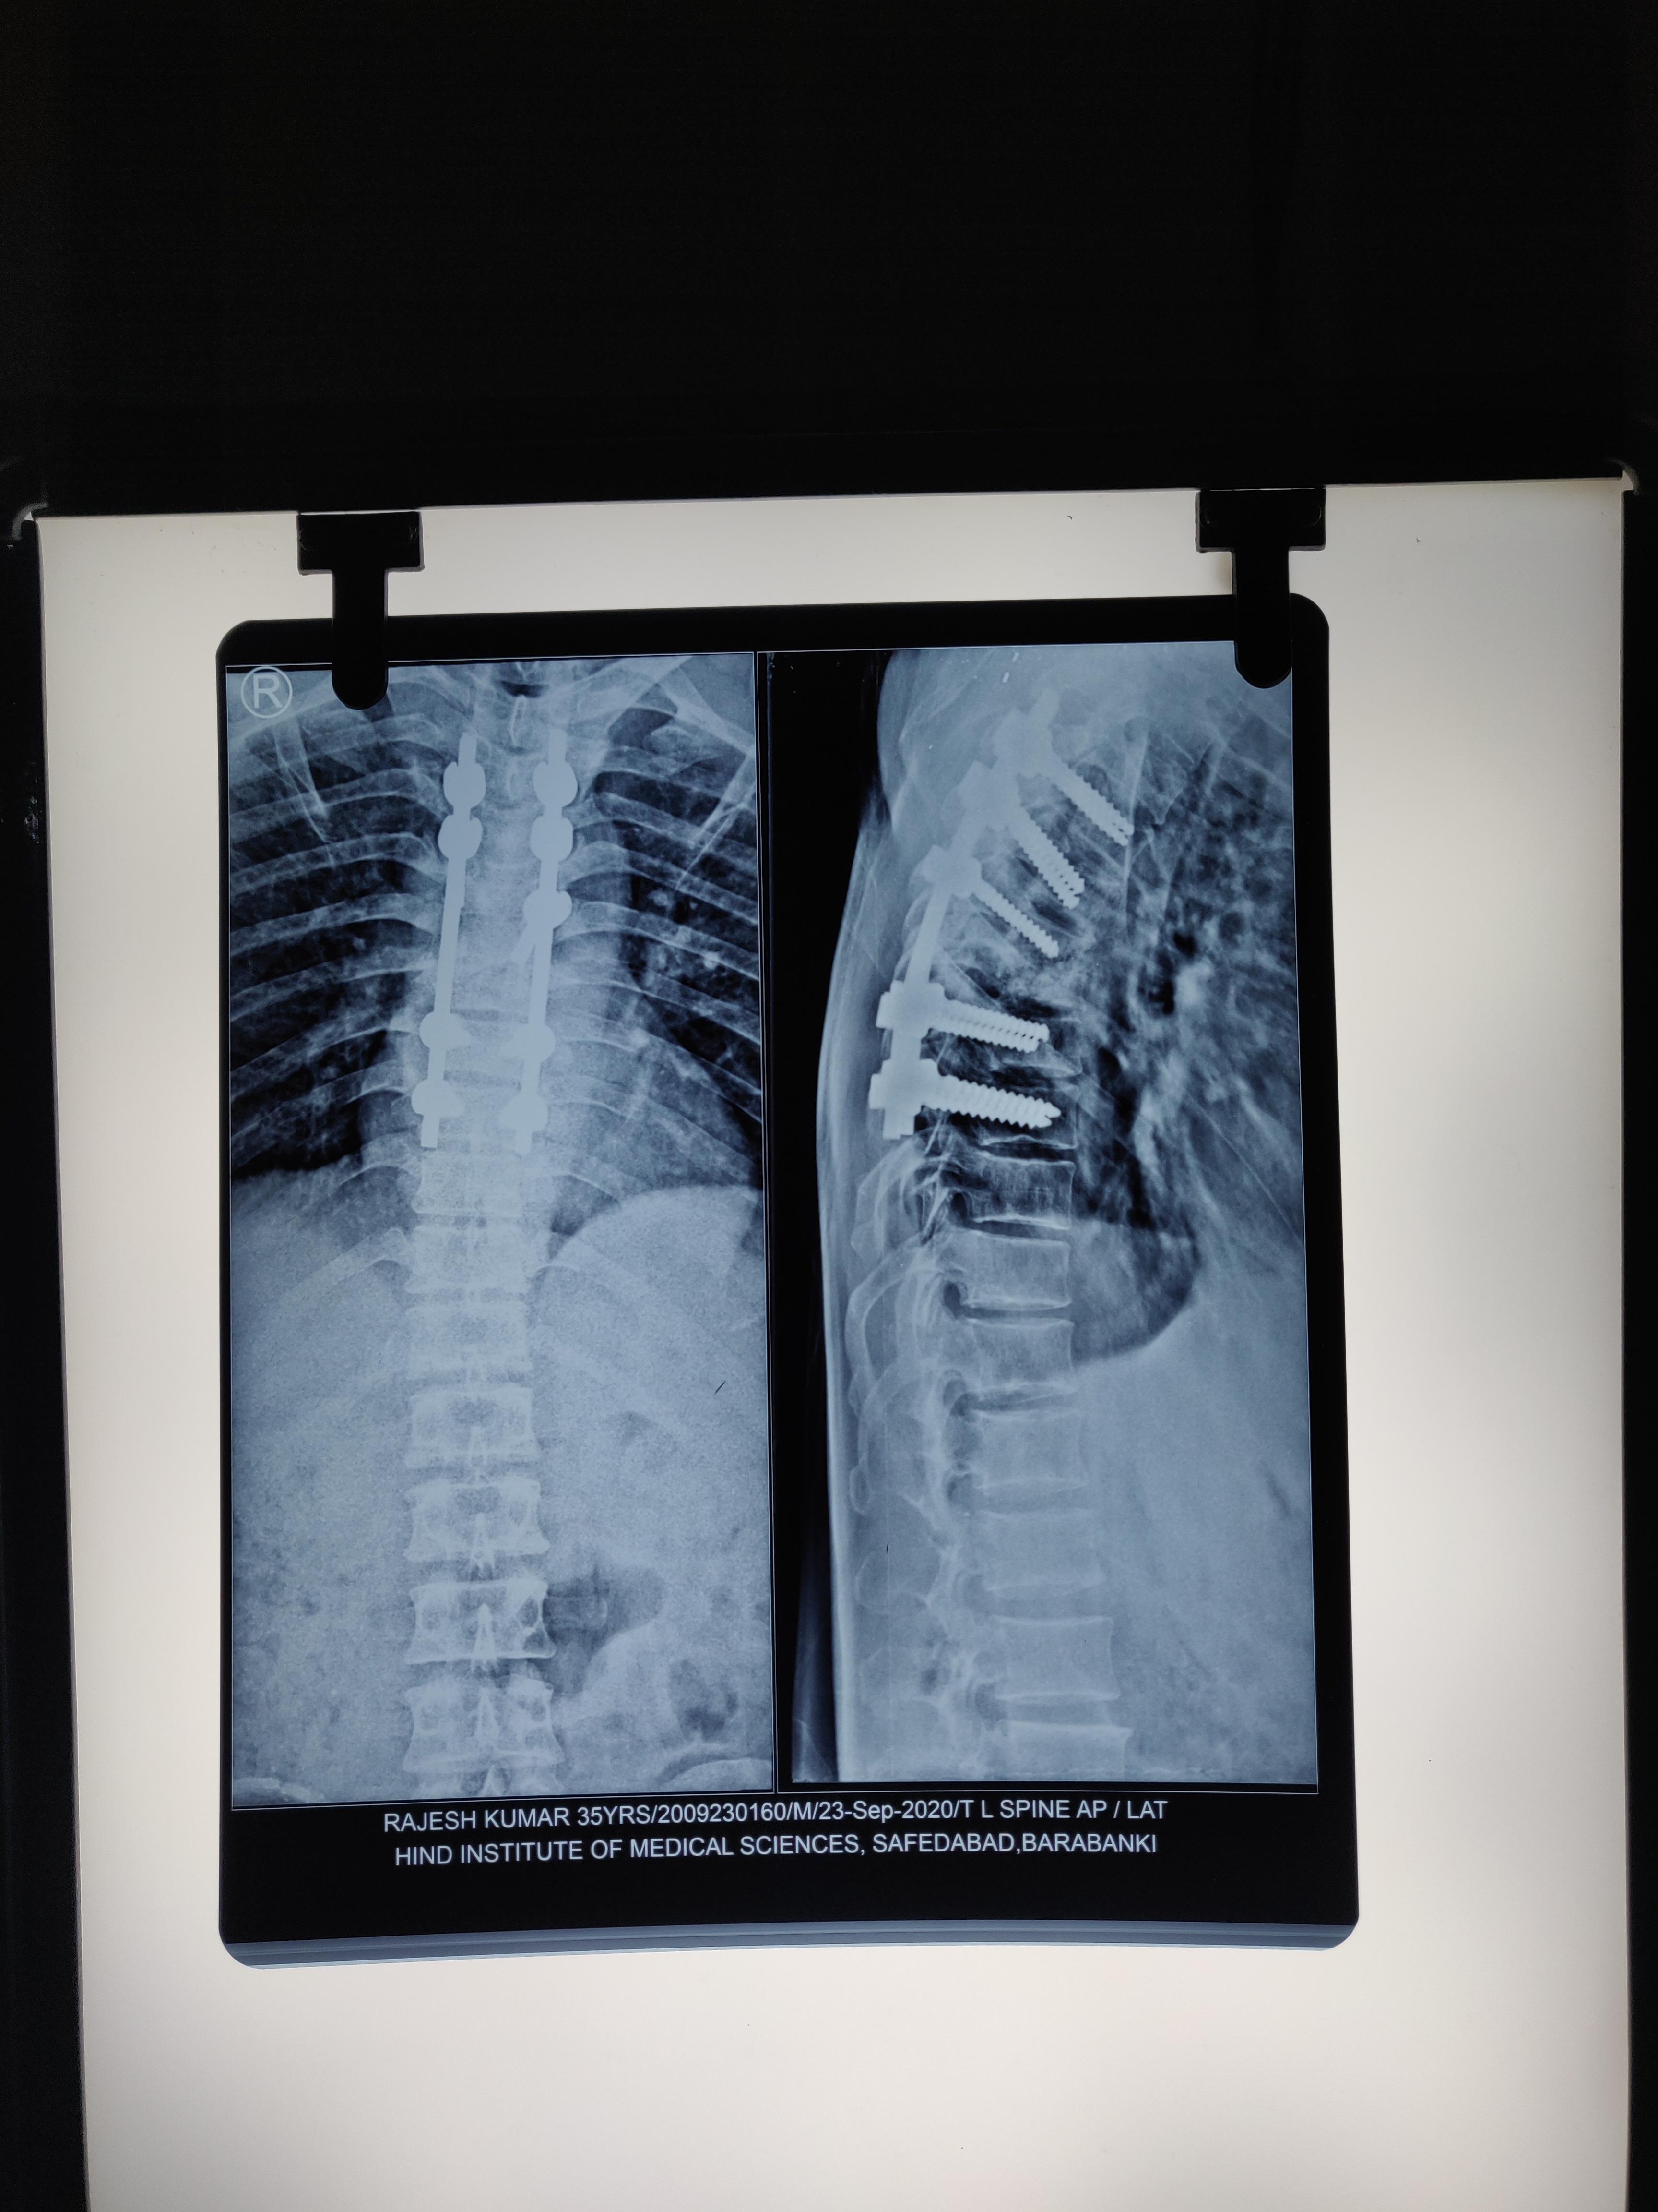
28 yr/M, D6-D7, Paraparesis (UMN type) with BBI
Transpedicular decompression and posterior fixation D4-D9
Courtesy: Dr. Neshar Ansari, Associate Professor, Hind Medical College, Lucknow

Slide 40
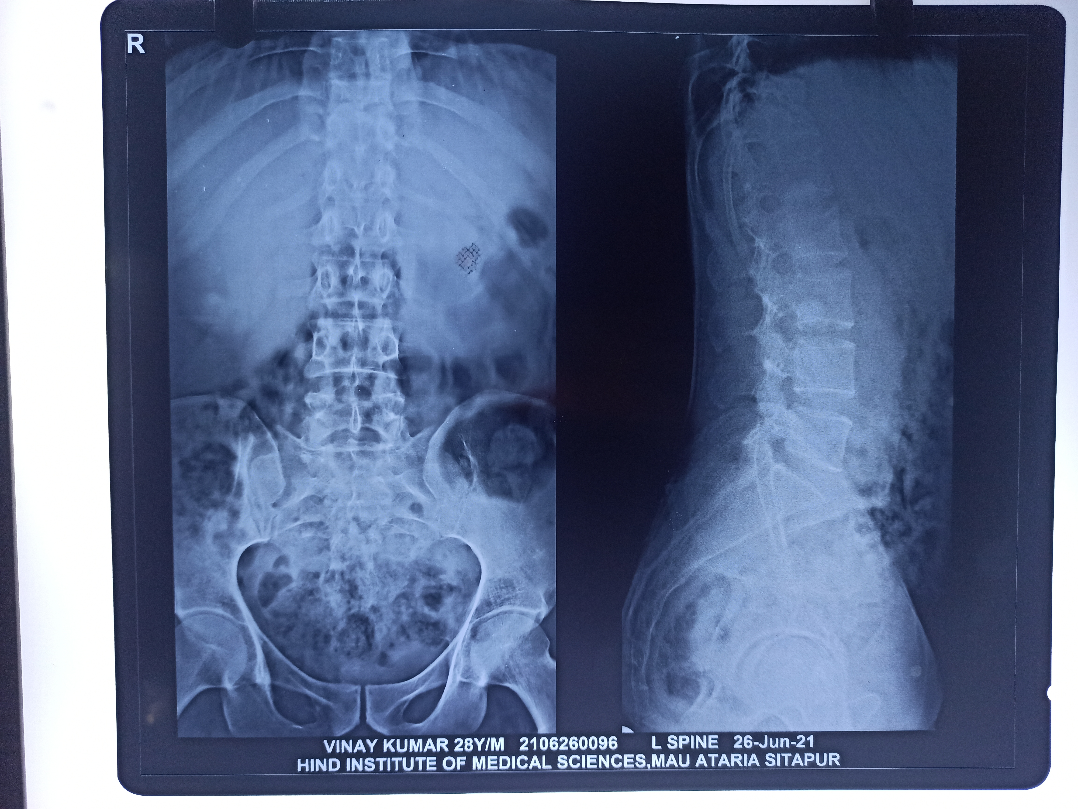
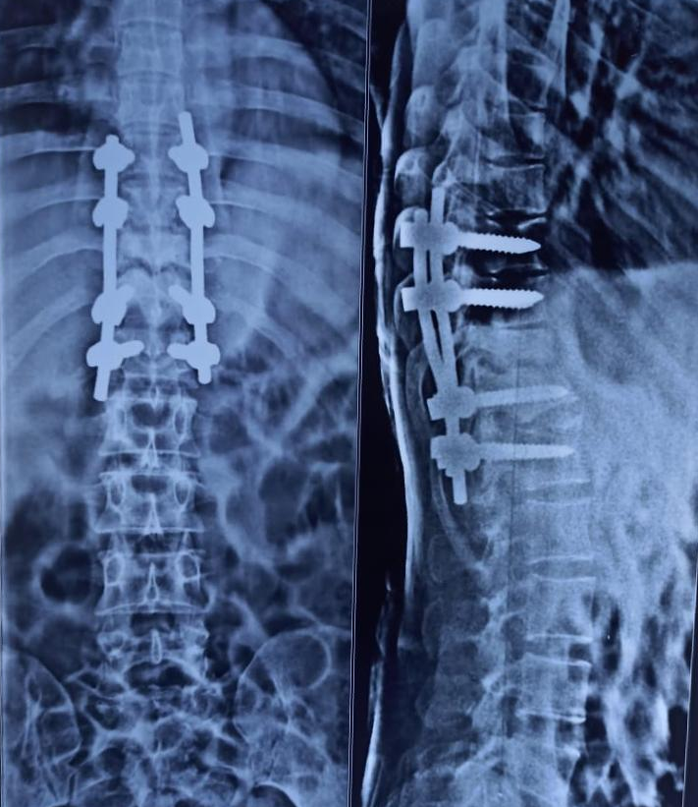
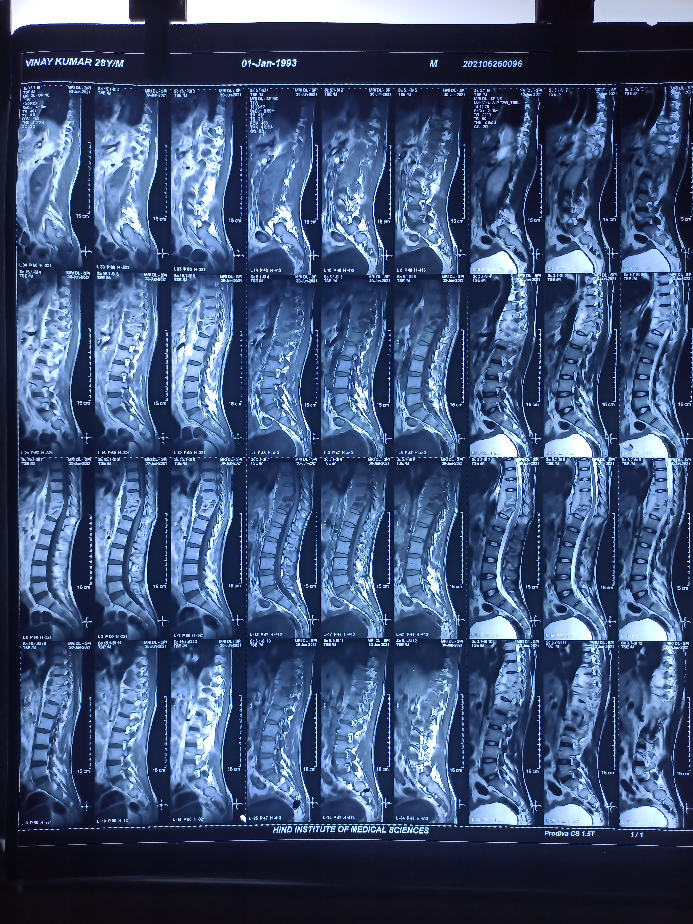
32 yr/M, D11-D12, Paraplegia (UMN+LMN) with BBI
Decompression and posterior instrumentation (T9-L1)
Courtesy: Dr. Neshar Ansari, Assistant Professor, Hind Medical College, Lucknow

Slide 41
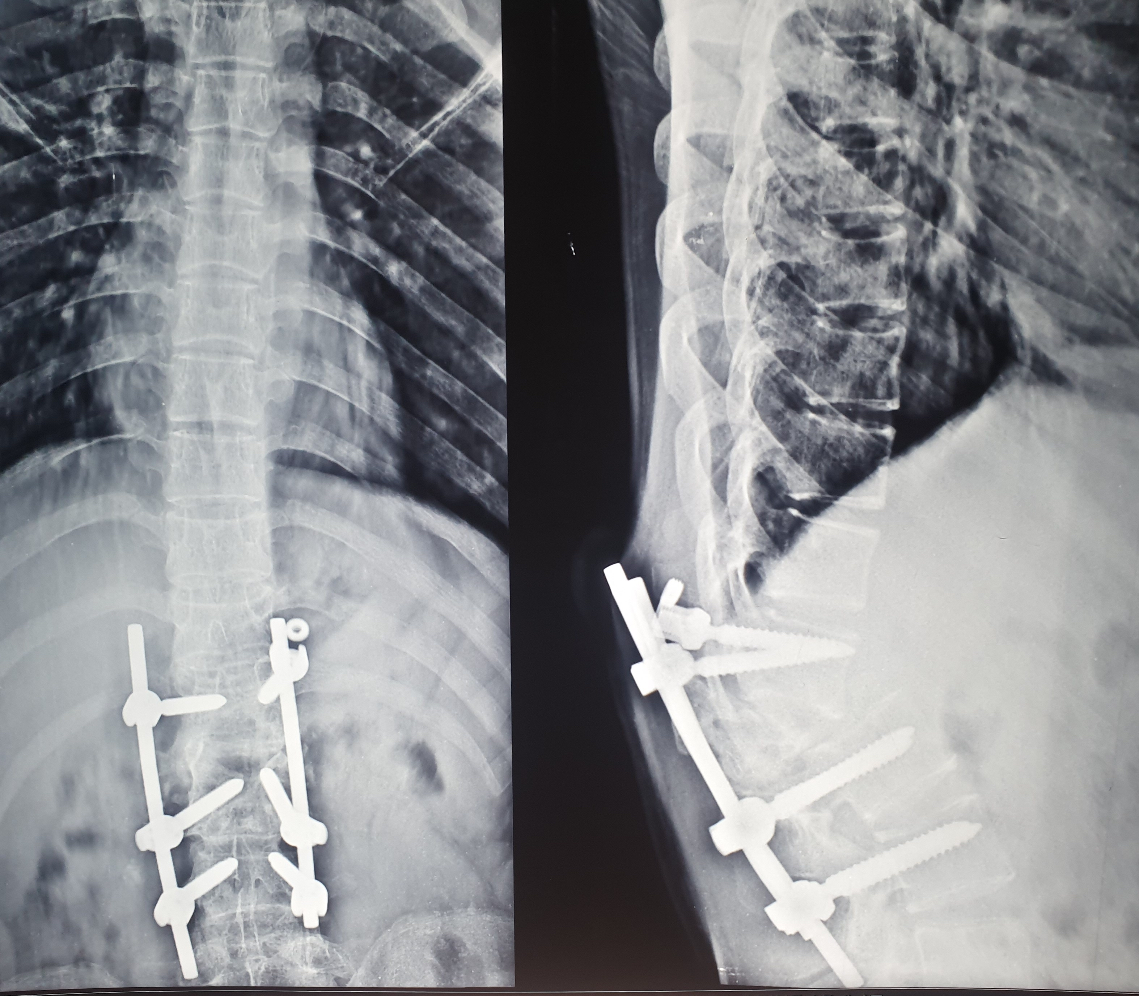
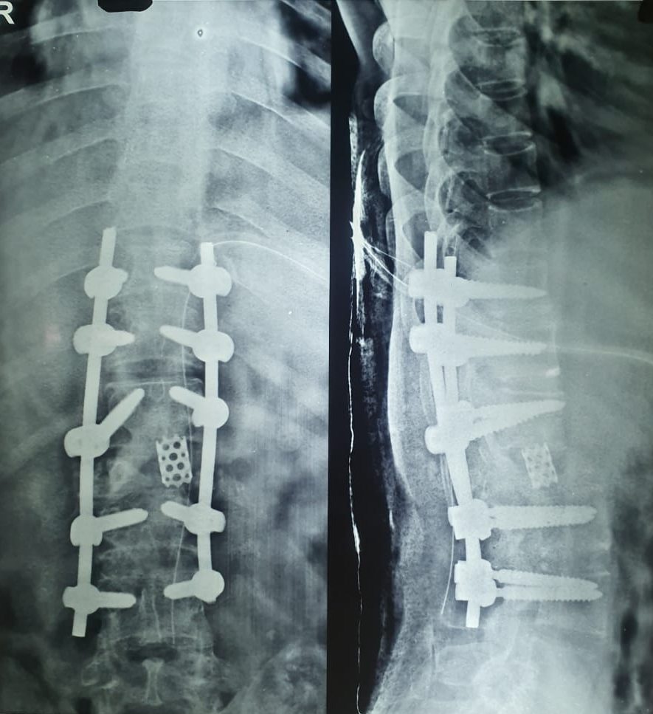
20 yr/F, L1-L3, Inadequate fixation in a case of suspected mechanical instability, later presenting with paraplegia and implant failure
Courtesy: Dr. Neshar Ansari, Assistant Professor, Hind Medical college, Lucknow

Slide 42
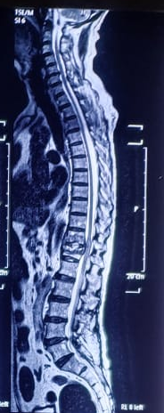
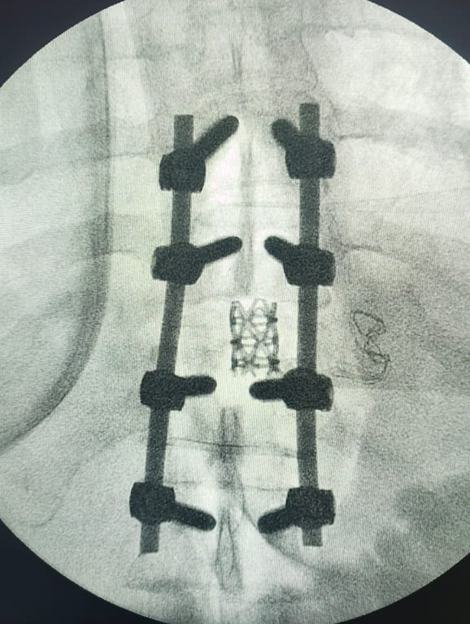
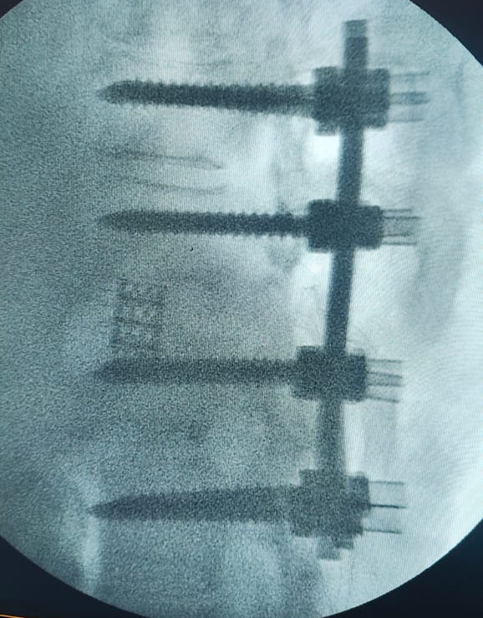
76 yrs/M, T11-T12, Paraparesis with BBI
Decompression, Debridement, posterior instrumentation (T9-L2) and T11-T12 interbody fusion
Courtesy: Dr. Anuj Gupta, Associate Consultant, Max superspeciality hospital, Vaishali, New Delhi

Slide 43

Middle path regime (Tuli, 1960)
Rationale – All TB spine cases do not require surgery; only those who do not respond to conservative measures should be operated upon.
Treatment is non-operative with ATT, rest & spinal braces
Rest in hard bed /plaster of Paris bed
Drugs: HRO(5-6 months) + HZ(3-4 months) + HR(4 months)+ HE (4-5 months)
Radiographs and ESR at 3-6 monthly intervals
Gradual mobilization with the help of braces
Aspiration of Abscesses
Surgery for selected cases- not responding in 4 weeks
Supportive therapy: Haematinics, Multivitamins, High protein diet

Slide 44

Take Home message
Important Topic- Long question, Short notes, Long case
Pott’s paraplegia is a complication of Pott’s spine
Must keep differential diagnosis in mind
Clinical examination entails both examination of spine and neurological examination
Medical treatment (ATT) is the mainstay
Don’t forget MDR and XDR TB as a possibility in non-responders
Specific indications of surgery
Middle Path Regime

Slide 45


