Slide 1
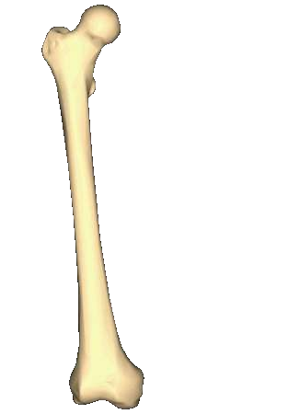
Intertrochanteric and sub trochanteric fractures of the femur
Dr. Praveen Garg
(Professor)
Department Of Orthopaedics

Slide 2
INTRODUCTION
Extracapsular fracture of Hip
Occur in the region between the greater and the lesser trochanters of the femur; often extending to the subtrochanteric region
Part of PERTROCHANTERIC fractures – extend from the extracapsular basilar neck region to the region along the lesser trochanter before the development of the medullary canal.

Slide 3
HISTORY
Cooper – Described an intertrochanteric fracture in his treatise of 1851 - recommended treatment was "moderate extension and steady support of the limb in its natural position.“
He recognized that extracapsular fractures united, whereas intracapsular fractures did not. His treatment consisted of bed rest, followed by the use of crutches and a cane, and then an elevated shoe, all in an attempt to save the patient's life if not the limb.

Slide 4
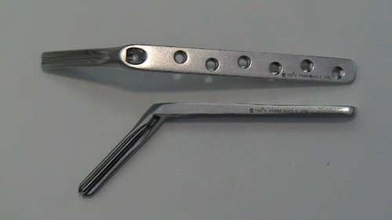
Royal Whitman (1902) first reported on the reduction of fractures with abduction, internal rotation, and traction under anaesthesia with immobilization in a spica cast from the nipple line to the toes.
Jewett in 1930 introduced the Jewett nail to provide immediate stability of
fracture fragments and early mobilization of the patient

Slide 5
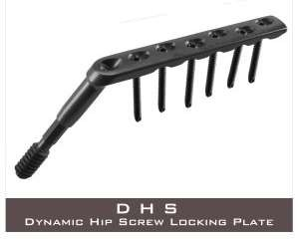
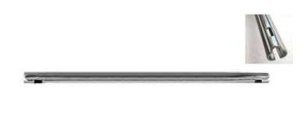
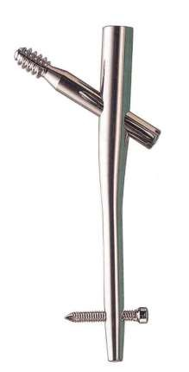
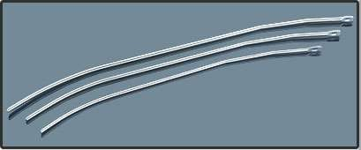
KUNTSCHNER NAIL
DYNAMIC HIP SCREW
ENDER’S NAIL
GAMMA NAIL

Slide 6
EPIDEMIOLOGY
Varies from country to country.
United States – 150,000 fractures annually with an annual incidence of 63 and 34 per 100,000 for elderly males and females respectively
India - Rising because of increasing number of senior citizens with osteoporosis. By 2040 the incidence is estimated to be doubled. In India the figures may be much more.

Slide 7
CONTRIBUTING FACTORS
Advancing age
Increased number of comorbidities
Increased dependency in activities of daily living
Increasing incidence of osteoporosis

Slide 8
ANATOMY
Occur in the region between the greater and lesser trochanters of the proximal femur, occasionally extending into the subtrochanteric region
Since they occur in cancellous bone with abundant blood supply – no problems of non- union and osteonecrosis
Deforming muscle forces will usually produce shortening, external rotation and varus position at the fracture

Slide 9
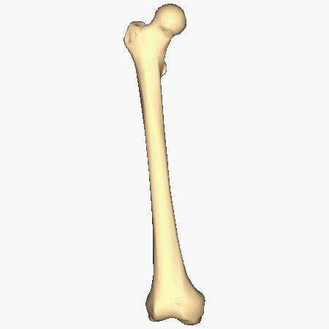



Abductors displace Greater Trochanter laterally and proximally
Iliopsoas displaces Lesser Trochanter medially and proximally
Hip flexors, extensors and adductors pull distal fragment proximally

Slide 10
MECHANISMS OF INJURY
YOUNGER INDIVIDUALS – High energy (relatively rare) - injury such as a motor vehicle accident or fall from height
More common in men less than 40 years of age
90% of intertrochanteric fractures in the elderly result
from a simple fall
The tendency to fall increases with patient age and is exacerbated by several factors, including poor vision, decreased muscle power, labile blood pressure, decreased reflexes, vascular disease, and coexisting musculoskeletal pathology.

Slide 11
CUMMINGS’ FACTORS DETERMINING
FRACTURE AT THE HIP
The faller must be oriented to fall or “impact” near the hip
Local soft tissues must absorb less energy than necessary to prevent fracture (inadequate soft tissue
– muscle/fat coverage)
Protective responses must be inadequate to reduce the energy of the fall beyond a certain critical threshold
Residual energy of the fall applied to the proximal femur must exceed its strength (ie. Bone strength at the hip must be insufficient)

Slide 12
HISTORY AND PHYSICAL
EXAMINATION
History of pain and inability to ambulate after a fall or other injury
Pain is localized to the proximal thigh; exacerbated by passive attempts at hip flexion or rotation
Drug use – contributing factor

Slide 13
EXAMINATION
Shortening of the extremity and deformity of rotation in resting position compared with the other extremity
Pain with motion/Crepitance testing – NOT elicited unless there are no obvious physical signs of deformity and radiographic studies are negative for an obvious fracture.
Pain with axial load on the hip – high
correlation with occult fracture

Slide 14
EXAMINATION
Auscultation Lippmann test – sensitive for detection of occult fractures of the proximal femur or pelvis
Bell of the stethoscope on symphysis pubis
and tapping on the patella of both
extremities – variation in sound conduction
determines discontinuity
 Decreased tone or pitch - fracture

Slide 15
IMAGING STUDIES - XRAYS
Pelvis with both hips – AP
X-ray of the affected hip – AP and cross-table lateral
Traction films (with internal rotation) – helpful in communited and high-energy fractures and in determining implant selection
Subtrochanteric extension – Femur AP and lateral

Slide 16
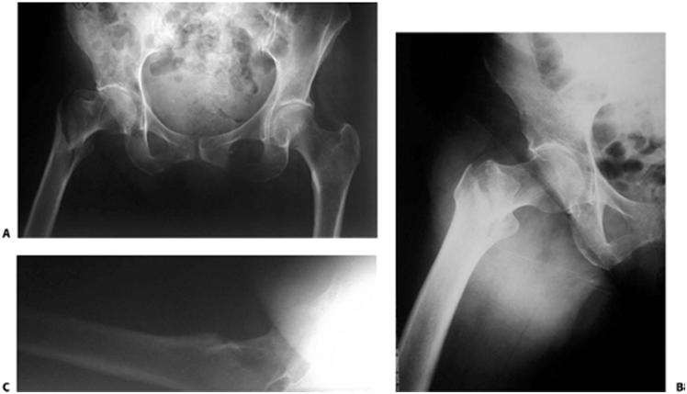

Slide 17
OTHER IMAGING STUDIES
Magnetic Resonance Imaging (MRI) – currently the imaging study of choice in delineating non-displaced or occult fractures that may not be apparent on plain radiographs – Preferred over CT due to higher sensitivity and specificity for a more rapid decision process
Bone scans or CT – reserved for those who have contradictions to MRI
Technetium bone scan

Slide 18
DIAGNOSIS AND CLASSIFICATION
 Increased surgical complexity and recovery are associated with UNSTABLE FRACTURE PATTERNS:
- Posteromedial large separate
fragmentation
Basicervical patterns
Reverse obliquity patterns
Displaced greater trochanteric (lateral wall
fractures)
Failure to reduce the fracture before internal fixation

Slide 19
BOYD AND GRIFFIN CLASSIFICATION
Stable (Two part)
Unstable with posteromedial communition iii.
Subtrochanteric extension into lateral shaft, extension
of the fracture distally at or just below the lesser trochanter (the term Reverse Obliquity was coined by Wright)
iv. Subtrochanteric with intertrochanteric extension with the fracture lying in atleast two planes
Type iii and iv are the most difficult types to manage
Account for one third of the trochanteric fractures

Slide 20
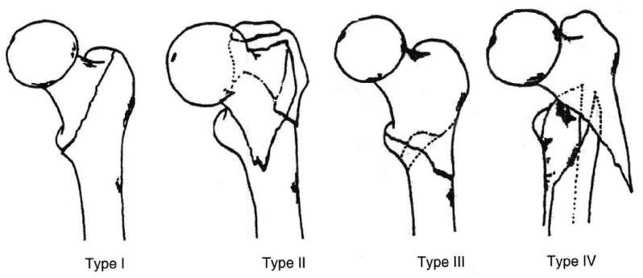
BOYD AND GRIFFIN CLASSIFICATION

Slide 21
EVAN’S CLASSIFICATION
In 1979 and 1980 Kyle et. al. and Jensen et. al. revised the Evans Classification incorporating the lateral radiographic position of the posteromedial fracture component and its relative stability with sliding fixation systems.
They showed an increasing rate of deformity and collapse with increasing instability classification.

Slide 22
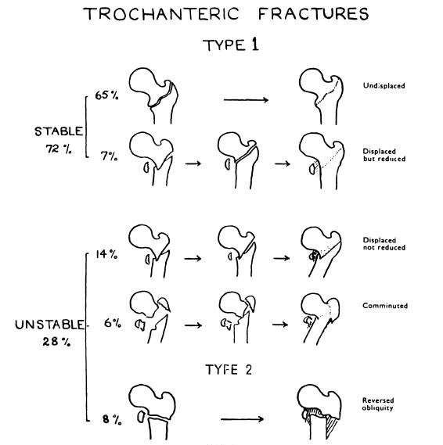
EVAN’S CLASSIFICATION

Slide 23
WHY WAS EVAN’S CLASSIFICATION IMPORTANT?
Because it distinguished stable from unstable fractures and helped define the characteristics of a stable reduction.
  Stable fracture patterns – posteromedial cortex remains intact OR has minimal communition
  Unstable fracture patterns – characterised by disruption or impaction of the posteromedial cortex- can be converted into stable if medial cortical opposition is maintained.
  Reverse Oblique – Inherently unstable due to the
tendency for medial displacement of the femoral shaft

Slide 24
OTA/AO CLASSIFICATION
 Group 1 fractures (31A1) – Pertrochanteric simple (two-part) fractures, with the typical oblique fracture line extending from the greater trochanter to the medial cortex; the lateral cortex of the greater trochanter remains intact.
A1.1 – Along intertrochanteric line A 1.2 – Through greater trochanter A 1.3 – Below lesser trochanter

Slide 25
OTA/AO CLASSIFICATION
 Group 2 fractures (31A2) – Pertrochanteric multifragmentary - comminuted with a postero- medial fragment; the lateral cortex of the greater trochanter however, remains intact. Fractures in this group are generally unstable, depending on the size of the medial fragment.
A2.1 – With one intermediate fragment A2.2 – With several intermediate fragments
A2.3 – Extending more than 1cm below lesser trochanter.

Slide 26
OTA/AO CLASSIFICATION
 Group 3 fractures (31A3) – TRUE INTERTROCHANTERIC - are those in which the fracture line extends across both the medial and lateral cortices; this group also includes the reverse obliquity pattern.
A3.1 – Simple oblique A3.2 – Simple transverse A3.3 - Multifragmentary

Slide 27
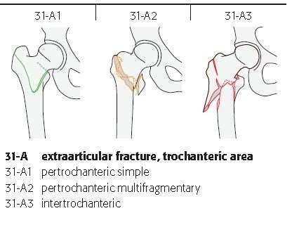
OTA/AO CLASSIFICATION

Slide 28
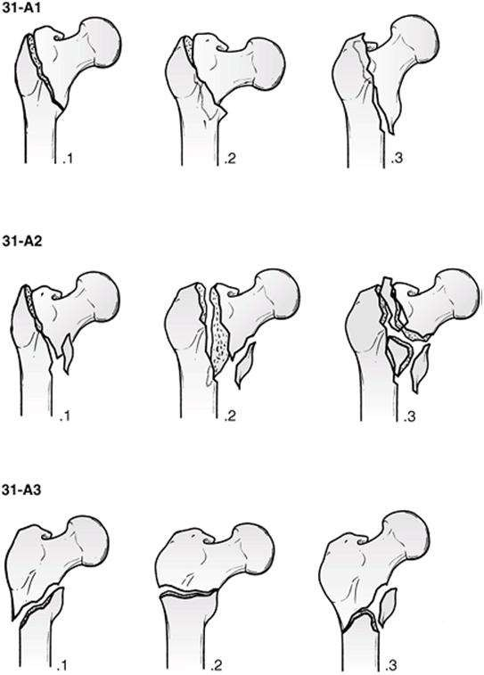
OTA/AO CLASSIFICATION

Slide 29
UNUSUAL FRACTURE PATTERNS – BASICERVICAL FRACTURES
Located proximal to or along the intertrochanteric line.
Although anatomically femoral neck fractures they are usually extracapsular and behave like intertrochanteric fractures.
At greater risk for osteonecrosis when compared to more
distal intertrochanteric fractures
Lack the cancellous interdigitation seen with fractures in the intertrochanteric region and are more likely to sustain rotation of the femoral head

Slide 30
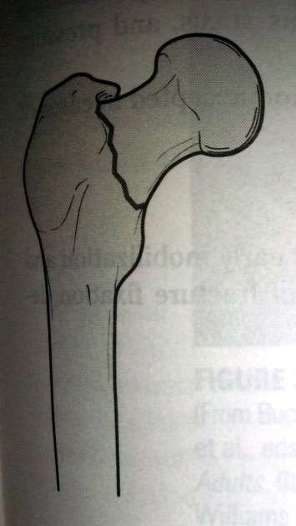
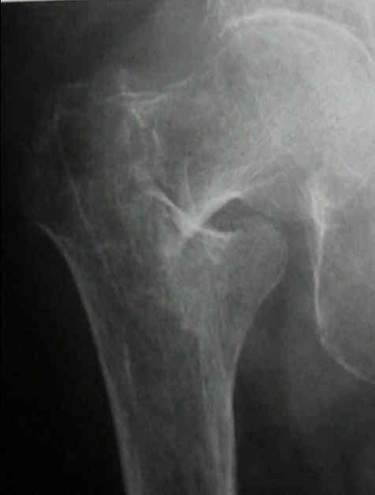

Slide 31
UNUSUAL FRACTURE PATTERNS –
REVERSE OBLIQUITY
 Oblique fracture line extending from the medial cortex proximally to the lateral cortex distally
 Tendency to medial displacement due to the pull of the
adductor muscles
 Should be treated as sub-trochanteric fractures

Slide 32
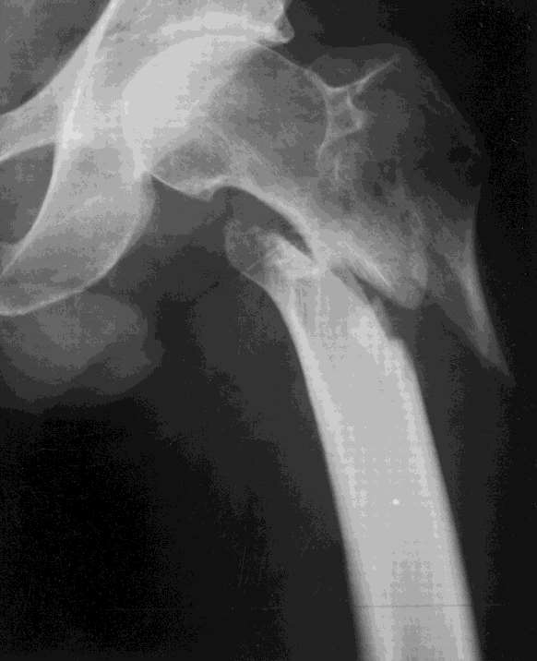

Slide 33
TREATMENT OPTIONS -
NON OPERATIVE
 Prolonged bedrest in traction until fracture healing occurred (usually 10 to 12 weeks),
followed by a lengthy program of ambulation
training.
 Can be done for:
An elderly person whose medical condition carries an excessively high risk of mortality from anaesthesia and surgery.
Nonambulatory patient who has minimal discomfort following fracture

Slide 34
TREATMENT OP TIONS
NON OPERATIVE
Buck’s traction or extension
Russell skeletal traction
Balanced traction in Thomas splint
Plaster spica immobilization
Derotation boot

Slide 35
COMPLICATIONS OF NON-
OPERATIVE TREATMENT
Decubitus ulcers, UTI, joint contractures, pneumonia, and thromboembolic complications resulting in a high mortality rate.
In addition, fracture healing is generally accompanied by varus deformity and shortening because of the inability of traction to effectively counteract the deforming muscular forces.

Slide 36
OPERATIVE TREATMENT
As soon as the general condition of this patient is under control, internal fixation should be carried out.
The goal of surgical treatment is strong, stable fixation of the fractured fragments

Slide 37
FACTORS THAT DETERMINE THE
STRENGTH OF THE FRACTURE FRAGMENT-IMPLANT ASSEMBLY
Bone quality
Fracture geometry
Reduction
Implant design
Implant placement

Slide 38
REDUCTION
Closed reduction
Open reduction

Slide 39
CLOSED REDUCTION
Longitudinal traction given in slightly adducted position
Depending on the fracture type, the amount
of internal rotation is decided
If proximal fragment – head and neck alone
– does not have muscle attachment, remains in neutral EXCEPT in case of slightly displaced fracture

Slide 40
CLOSED REDUCTION
Head and major part of GT form the proximal fragment – the external rotator muscles inserted into GT tend to rotate the proximal fragment laterally; hence we need to reduce with distal fragment placed in some degrees of internal rotation
In case of communited fractures, the posterior sag of the distal fragment may be corrected by lifting up with a HIP SKID under the fracture by an assistance or with the use of a crutch under the proximal thigh.
Post-op xrays – to confirm reduction with spl. Attention paid to cortical contact medially and posteriorly

Slide 41
INDICATIONS FOR
OPEN REDUCTION
Failed closed reduction
Large spike on proximal fragment with lesser trochanter intact
Reverse oblique fracture
If a gap exists medially or posteriorly

Slide 42
OPEN REDUCTION
TECHNIQUES
Anatomical Stable Reduction – applying a bone holding forceps across the fracture in an anteroposterior plane while adjusting the traction and rotation if the fracture is not severely comminuted.
Once achieved – compression hip screw or other device can be used to secure the reduction

Slide 43
NON-ANATOMICAL STABLE
REDUCTION TECHNIQUES
Medial displacement osteotomy a.k.a Dimon – Hughston osteotomy
Disadvantages of the technique include – limb shortening, level of
function and proximal migration of the GT significantly comprises
abductor function increasing the stress on the implant and impairing
patient’s ability to walk.
 Valgus Osteotomy (Sarmiento Osteotomy)
 Lateral displacement a.k.a Wayne County Osteotomy which involves lateral displacement of the femoral shaft to create a medial cortical overlap.

Slide 44
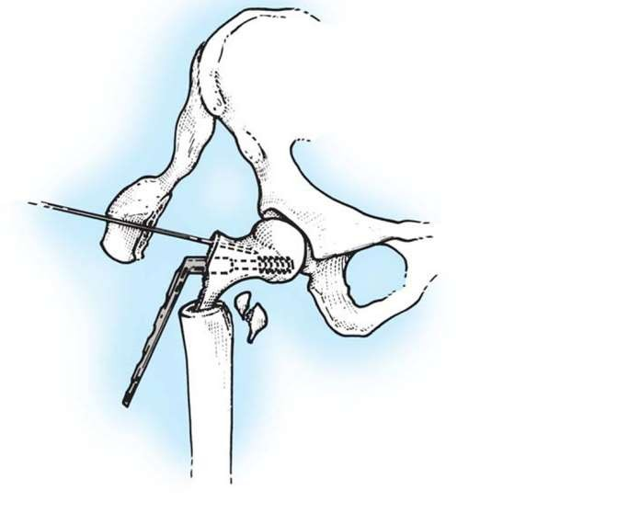
Dimon – Hughston technique

Slide 45
LATERAL APPROACH TO THE FEMUR
Most standard approach for plate fixation
Fracture table with leg and foot secured after a closed reduction
Incision based on the length of the proposed plate- shaft component, centered around the lesser trochanter (commonly 5-10cm length)
Incision of iliotibial band -> Vastus lateralis at its attachment posteriorly near the linea aspera and reflection of the vastus anteriorly to expose the lateral femoral shaft

Slide 46
INTRAMEDULLARY APPROACH
Intersection of a line from the anterior superior iliac spine directed posteriorly and a line parallel to the long axis of femur
Overlay a 3.2 guidewire over the skin and confirm alignment with proximal femur under c-arm guidance.
Skin proximal to GT is incised (3-5cm), fascia incised but the gluteus medius fibres are NOT dissected. A targetting guide and a trocar system protects the gluteus medius.

Slide 47
OPERATIVE METHODS
Plate Constructs
Cephalomedullary nailing
Condylo-cephalic nailing
External Fixation
Arthroplasty

Slide 48
PLATE CONSTRUCTS
Impaction class – Impacted nail-type plate devices eg. Blade plate and
fixed angle nail plate devices
Dynamic compression class – large single sliding screw or nail, femoral head components with side plate attachments eg. Sliding hip screws
Linear compression class – Multiple head fixation components controlling rotation and translation but allowing linear compression eg. Gotfried PCCP and the InterTAN CHS
Hybrid Locking Class – Multiple fixation components with compression initially for fracture reduction followed by locking screws which prevent further axial compression eg. Proximal Femoral Locking Plates – Synthes, Paoli, PA and Smith-Nephew

Slide 49
FIXED ANGLE PLATING
More commonly used for corrective osteotomies nowadays rather than as a primary treatment of hip fractures
Eg. Jewett Nail, Holt Nail, SP Nail and Plate, Thornton Nail, AO blade plate.
Consist of a triflanged nail fixed to a plate at
an angle of 130 to 150 degrees.

Slide 50
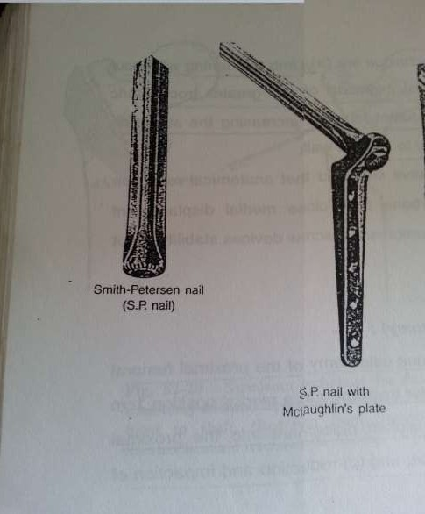
SMITH PETERSON NAIL WITH
MCLAUGHLIN PLATE

Slide 51
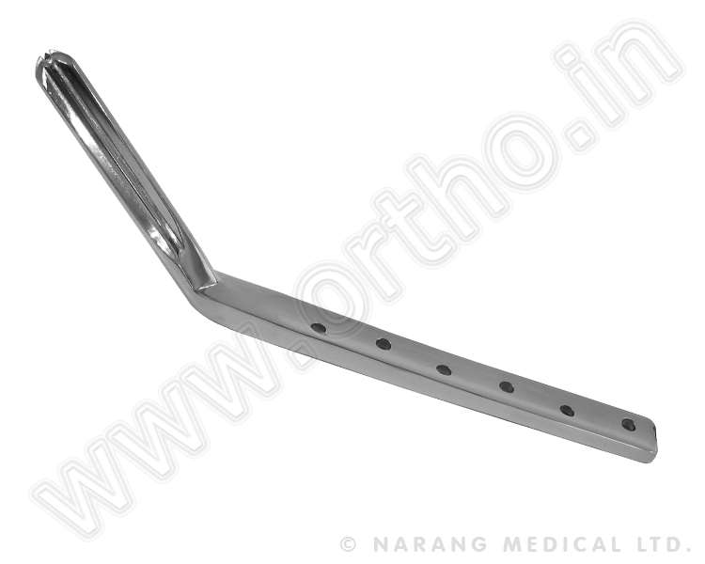
JEWETT NAIL

Slide 52
FIXED ANGLE PLATING -
DISADVANTAGES
Does not allow for fracture impaction
According to Chinoy et. al. (1999) – when compared with the sliding hip screw series, there was an increased risk of cutout, non- union, implant breakage and reoperation, in addition to higher mortality owing to the residual pain in the hip and impaired mobility

Slide 53
DYNAMIC COMPRESSION
PLATING
From the 1980s to 2000 – Sliding compression hip screws became the gold standard for hip fracture fixation.
Historically the most commonly used device for both stable and unstable fracture patterns. Available in plate angles from 130◦ to 150◦.
The 135◦ plate is most commonly utilized; this angle is easier to insert in the desired central position of the femoral head and neck than higher angle devices and creates less of a stress riser in the subtrochanteric region.

Slide 54
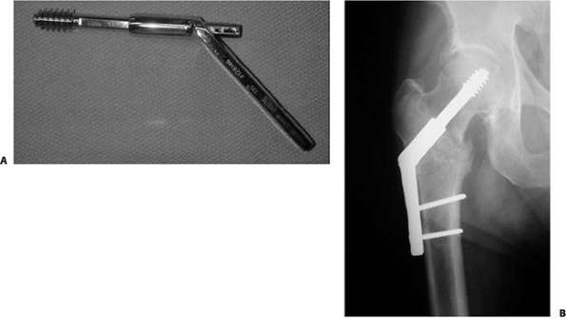
SLIDING HIP SCREW

Slide 55
DYNAMIC COMPRESSION
PLATING
The most important technical aspects of screw insertion are:
  Placement within 1cm of subchondral bone to provide secure fixation
  Central position in the femoral head (Tip- apex distance)

Slide 56
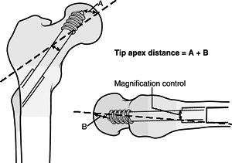
TIP-APEX DISTANCE
Sum of distances from the tip of the lag screw to the apex of the femoral head on both the anteroposterior and lateral radiographic views.
The sum should be <25mm to minimize the risk of lag screw cutout

Slide 57
MEDOFF PLATE
Designed by Medpac, Culver City, California US
Uses a biaxial sliding hip screw
Has a standard lag screw/barrel component for compression along the femoral neck.
In place of the standard femoral side plate – coupled pair of sliding components – enable fracture impaction parallel to longitudinal axis of femur
If a locking set screw is applied within the plate, then the plate can only slide axially on the femoral shaft – uniaxial dynamization.
If a surgeon applies the implant without placement of the locking set screw, sliding may occur along both the femoral neck and femoral shaft (biaxial dynamization) which is suggested.

Slide 58
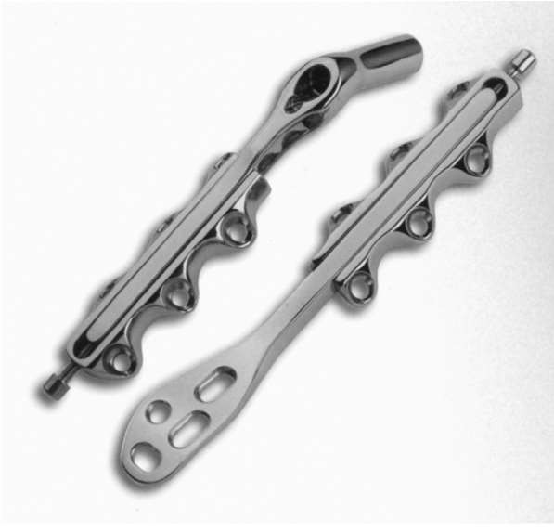
MEDOFF SLIDING PLATE

Slide 59
TROCHANTERIC STABILIZING
PLATE
The trochanteric stabilizing plate and the lateral buttress plate are modular components that buttress the greater trochanter.
These plates are placed over a four-hole sideplate and are used to prevent excessive slide (and resulting deformity) in unstable fracture patterns.
These devices prevent telescoping of the lag screw within the plate barrel when the proximal head and neck fragment abuts the lateral buttress plate.

Slide 60
HYBRID LOCKING PLATES
These devices offer maximal stability with initial compression and fixed angle stability from locking screws
Early failure rate with original plate designs and
three screw limitation
Newer devices with enhanced fixation – IT
fractures with subtrochanteric extension

Slide 61
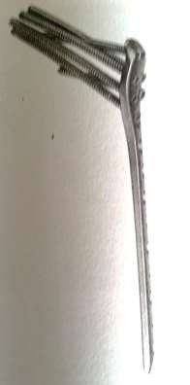
HYBRID LOCKING PLATE –
SMITH AND NEPHEW

Slide 62
CEPHALOMEDULLARY DEVICES
Inserted through the piriformis fossa OR lateral greater trochanter OR medial greater trochanter
Femoral head component – screw/blade
interlocked with nail component
Dissatisfaction with use of a sliding hip screw in unstable fracture patterns led to the development of intramedullary hip screw devices.

Slide 63
CEPHALOMEDULLARY DEVICES
Russell classified cephalomedullary nails into four classes:
Impaction/Y nail class – originated with Kuntscher nail and current TFN nail (Synthes)
Dynamic compression or Gamma Class – large head nail component with a single large lag screw
Reconstruction class – Russell and Taylor (Smith and Nephew)
Other IM devices – Ender’s nail, single rigid condylocephalic rod of Harris

Slide 64
CEPHALOMEDULLARY NAILS -
ADVANTAGES
Because of its location, theoretically provides more efficient load
transfer than does a sliding hip screw.
The shorter lever arm of the intramedullary device can be expected to decrease tensile strain on the implant, thereby decreasing the risk of implant failure.
Because the intramedullary fixation device incorporates a sliding hip screw, the advantage of controlled fracture impaction is maintained
Shorter operative time and less soft-tissue dissection than a sliding hip screw.

Slide 65
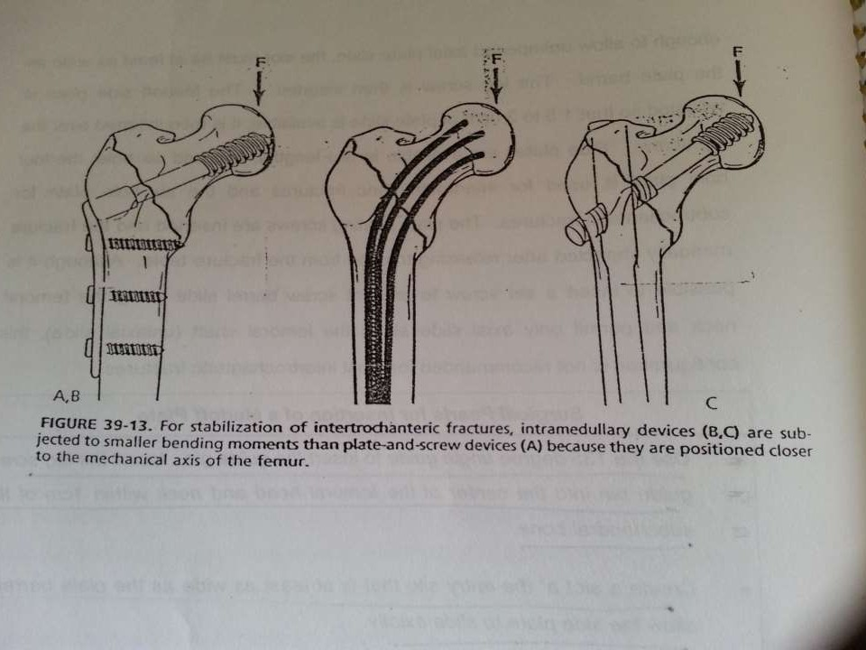

Slide 66
PROXIMAL FEMORAL NAIL
The PFN nail has been shown to prevent the fractures of the femoral shaft by having a smaller distal shaft diameter which reduces stress concentration at the tip.
Due to its position close to the weight-bearing axis the stress generated on the intramedullary implants is negligible.
PFN implant also acts as a buttress in preventing the medialisation of the shaft. The entry portal of the PFN through the trochanter limits the surgical insult to the tendinous hip abductor musculature only , unlike those nails which require entry through the piriformis fossa.

Slide 67
ARTHROPLASTY
Neoplastic fractures, severe osteoporotic disease, renal dialysis patients and pre-existing arthritis under consideration for hip replacement before the fracture occured
Hemiarthroplasty reported to have a lower dislocation rate
when compared to total hip arthroplasty
Better salvage operation for failed internal fixation rather than a first-line choice in geriatric patient.
No level-one evidence to show any difference between compression hip screw and arthroplasty except for a higher blood transfusion rate with arthroplasty

Slide 68
ARTHROPLASTY-
DISADVANTAGES
Morbidity associated with a more extensive operative procedure
Internal fixation problems with greater
trochanteric reattachment
Risk of postoperative prosthetic dislocation

Slide 69
POST-OPERATIVE CARE
AP and lateral radiographs while the patient is still in the surgical area
Patient mobilized to chair upright position
the day after the operative procedure
Ambulation – under supervision with weight bearing as tolerated with a walker or crutches – emphasis on heel-strike and upright balance exercises

Slide 70
COMPLICATIONS
Loss of fixation and implant failure
Nonunion
Malrotation deformity
Osteonecrosis
Medical, psychosocial, thromboembolic, Infection

Slide 71
COMPLICATIONS –
LOSS OF FIXATION
Commonly characterized by varus collapse of the proximal fragment with cut-out of the lag screw from the femoral head
Occurs within 3 months of surgery due to eccentric placement of lag screw within femoral head, improper reaming, unstable reduction, excessive fracture collapse which exceeds the sliding capacity of the device

Slide 72
Inadequate screw-barrel engagement which prevents sliding and severe osteopenia
Management – acceptance of the deformity, revision ORIF with PMMA or conversion to prosthetic replacement

Slide 73
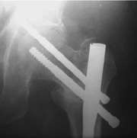
COMPLICATIONS –
MALROTATION DEFORMITY
Severe malrotation which interferes with ambulation – revision surgery with plate removal and rotational osteotomy of the femoral shaft should be considered.
Z-Effect – seen most commonly with dual screw CM nails – most proximal screw penetrates the hip joint and distal screw backs out of the femoral head

Slide 74
Subtrochanteric fractures
Fractures
•
Patients
•
Therapeutic options
•
Tips and tricks
•
Conclusions

Slide 75
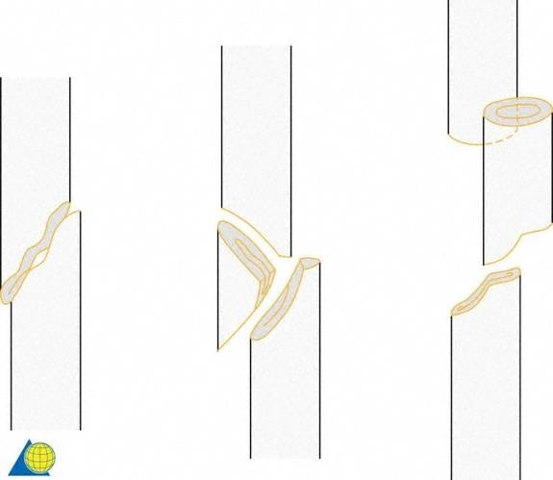
Müller AO Classification
A3
A1
32-A2
32-A3

Slide 76
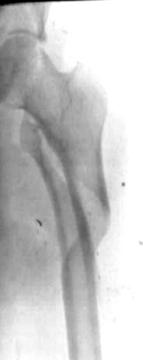
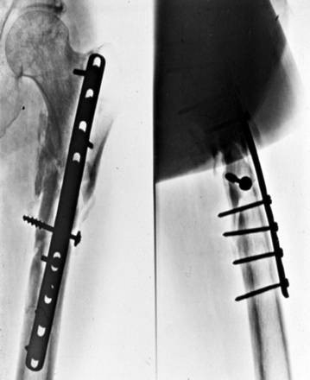
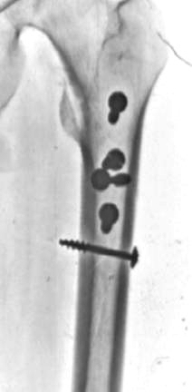
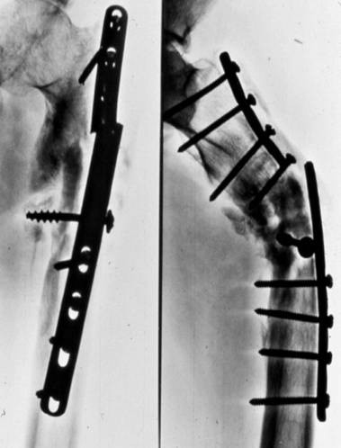
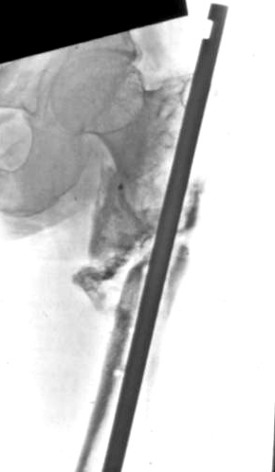
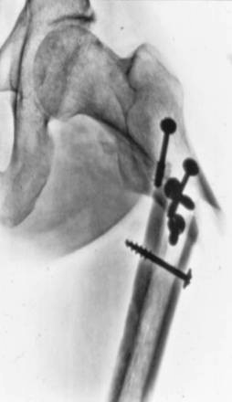
A biomechanical challenge

Slide 77
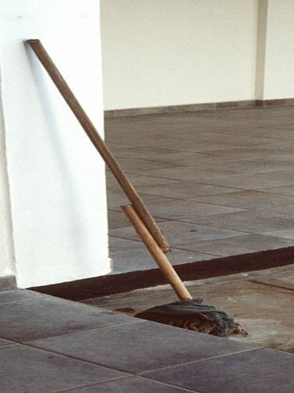
Biomechanical problems
Short proximal segment
•
Long lever-arm
•
Strong musculature
•
Eccentric load

Slide 78
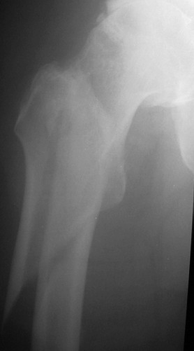
Typical dislocation

Slide 79
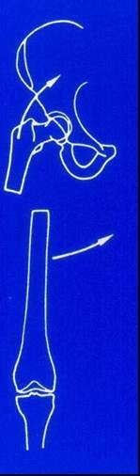
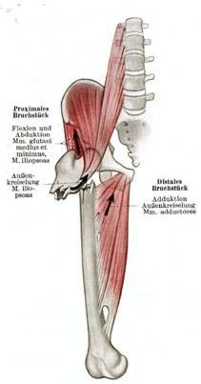
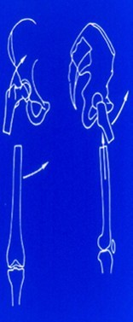
Gluteal muscles Iliopsoas muscle
→ abduction
→ flexion + external rotation

Slide 80
Two separate populations
High-energy trauma—often seen in polytrauma
•
Elderly—usually with osteoporosis and co-morbidities

Slide 81
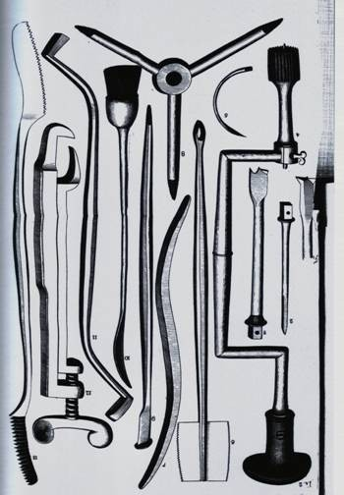
Therapeutic options

Slide 82
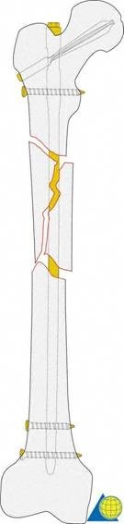
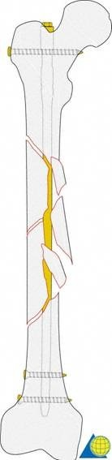
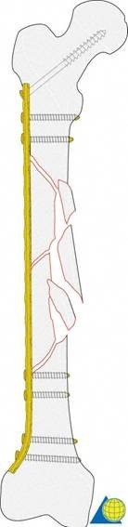
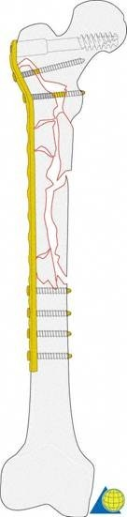
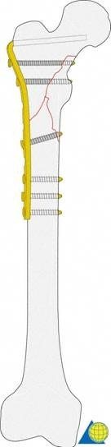

Slide 83
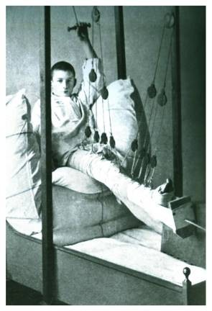
Therapeutic option 1
Traction?
- Very difficult to obtain and maintain reduction due to strong muscular deforming forces
Therapeutic option 2
Conventional plating

Slide 84
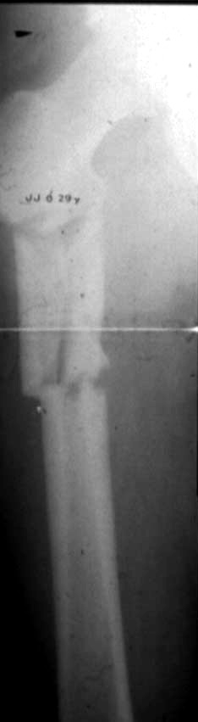
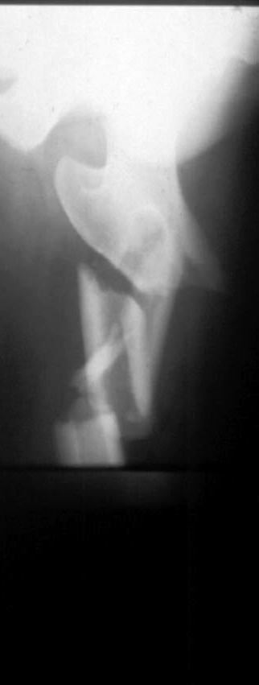

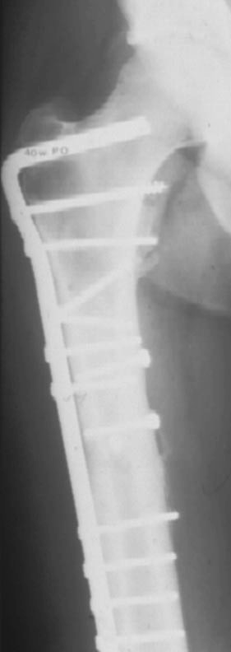
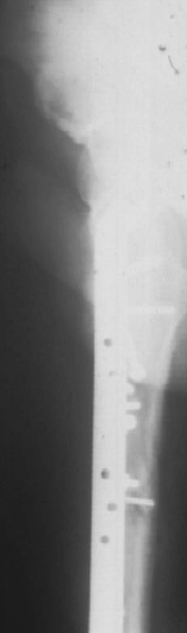
40-year-old female
29-year-old male

Slide 85
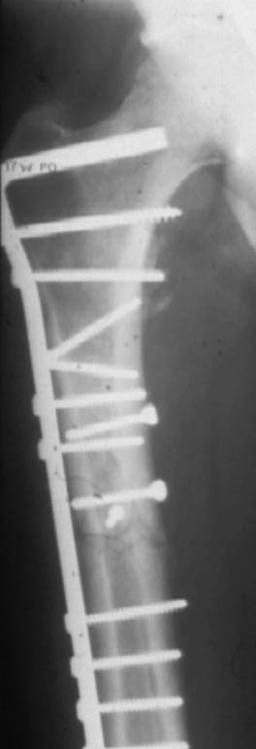
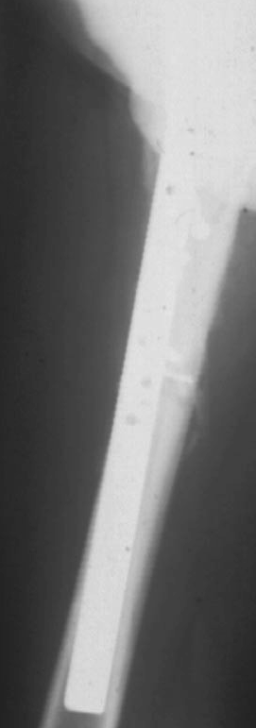
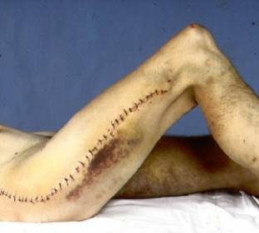
17-year-old women
Cons:
•
•
•
•
•
•
•
Approach Cosmetic Devascularization Bone-grafting Demanding surgery Plate removal
Refracture after plate removal

Slide 86





Therapeutic option 3
Biological plating
3 m
Postop
0

Slide 87


Biology and biomechanics
Preservation of viability is more important than restoration of stability

Slide 88


Therapeutic option 4
Intramedullary nailing (IM), antegrade or retrograde
Reaming medullary canal
Accurate fitting
Gerhard Küntscher 1900–1972

Slide 89

Conventional nailing
Simple/stable fracture Narrow part medullary canal Isthmus

Slide 90

Reamed nailing of shaft fractures
Cons:
Massive interruption to endosteal blood supply
•
Adds to the trauma by the fracuture

Slide 91







Nailing of subtrochanteric fractures
The solid femoral nail
1
1
2
2
2
3
3

Slide 92
Nailing of subtrochanteric fractures
Essential in unreamed femoral nailing:
•
Sufficient reduction
•
Correct entry point

Slide 93




Nailing of subtrochanteric fractures
•
•
Poor reduction Wrong entry point

Slide 94




Therapeutic option 5
Proximal femoral nail (PFN, standard size)

Slide 95



Long PFN
Long PFN
-
-
-
proximal angle oval locking hole
hip screw for locking

Slide 96



Long PFN

Slide 97





Long PFN
59y m

Slide 98

Tips and tricks

Slide 99


Fracture fragments are devitalized by
Trauma
Surgery
Impaired healing
Risk of infection

Slide 100


Positioning

Slide 101



Typical dislocation of proximal fragment
Patient positioning
leg in strong adduction
nail introduction is problematic
!
abduction

Slide 102

Nailing
UFN
Insertion point
Fossa piriformis
Long PFN
Insertion point
Trochanter tip

Slide 103




Nailing
Temporary fixation
- forceps, cerclage wires
Open reduction

Slide 104

Use of IM nail as a reduction tool

Slide 105

Conclusion
Option 1: IM nail
•
Closed reduction will be difficult
•
Don’t be afraid to open fracture to obtain a reduction
•
Correct entry point is crucial
•
Long PFN has some advantages

Slide 106

Summary
Good reduction is essential
•
Correct entry point
•
Open reduction is often required
•
Plating is better than poor nailing

Slide 107


THANK YOU!

