Slide 1
IHR
Dr. Rashmi Katyal
Professor
Community Medicine

Slide 2
AIM
To prevent, protect, control and provide a public health response to the international spread of disease in ways that are commensurate with and restricted to public health risks, and which avoid unnecessary interference with international traffic.

Slide 3
International Health Regulations IHR 2005
The International Health Regulations are a formal code of conduct for public health emergencies of international concern.
They're a matter of responsible citizenship and collective protection.
They involve all 193 World Health Organization member countries.

Slide 4
They are an international agreement that gives rise to international obligations.
They focus on serious public health threats with potential to spread beyond a country's border to other parts of the world.
Such events are defined as public health emergencies of international concern, or PHEIC.
The revised International Health Regulations outline the assessment, the management and the information sharing for PHEICs.

Slide 5
IHR serve a common interest.
First of all, they address serious and unusual disease events that are inevitable in our world today.
They serve a common interest by recognizing that a health threat in one part of the world can threaten health anywhere, or everywhere.
And they are a formal code of conduct that helps contain or prevent serious risks to public health, while discouraging unnecessary or excessive traffic or trade restrictions for, quote, "public health," purposes.

Slide 6
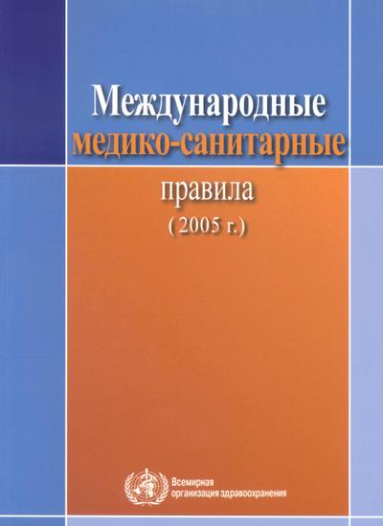
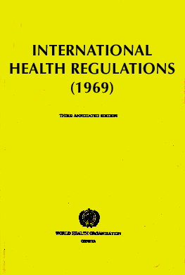
History of IHR
1851: first International Sanitary Conference, Paris
1951: first International Sanitary Regulations
(ISR) adopted by WHO member states
1969: ISR replaced and renamed the
International Health Regulations (IHR)
1995: call for Revision of IHR
2005: IHR (2005) adopted by the
World Health Assembly
2006: World Health Assembly vote that IHR (2005) will enter into force in June 2007

Slide 7
Why IHR nesseccery ?
Serious and unusual disease events are inevitable
Globalisation - problem in one location is everybody’s headache
An agreed International Public Health code of conduct for a global approach

Slide 8
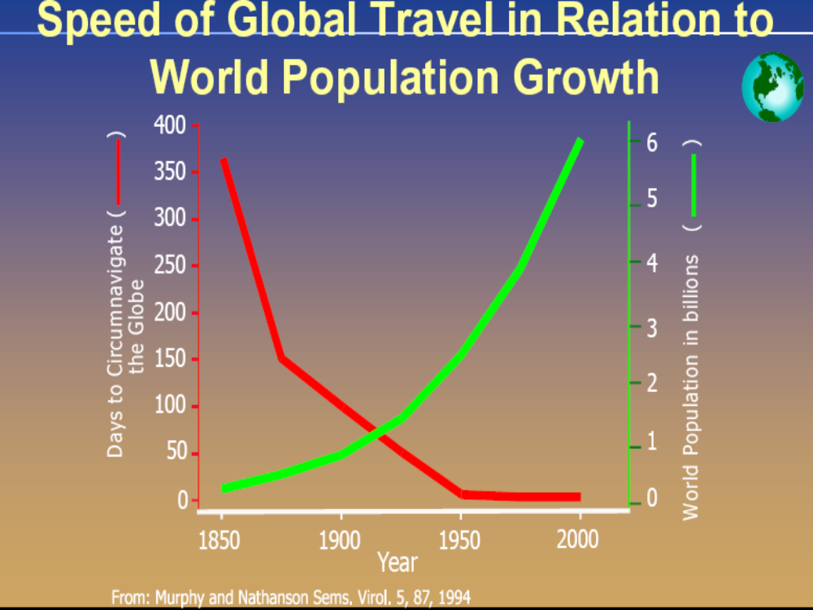

Slide 9
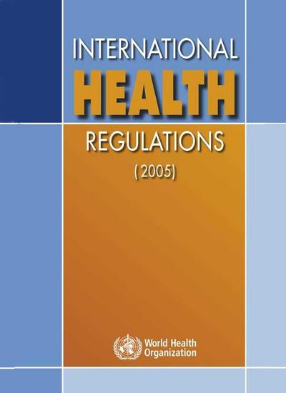
What’s new?
From three diseases to all public health risks
From preset measures to tailored response
From control of borders to also include containment at source
Notes:
The IHR are innovative because
they move from purely a list of diseases to a dynamic process of risk identification, assessment and management
they move from a concept of static defence at borders, airports and ports to the concept of early detection, reporting and containment at source
they built on the concept that international health security is based on strong national public health infrastructure connected a global alert and response system.

Slide 10
Major Changes in IHR (2005)
Widened scope: to report all major events, that may constitute Public Health Emergency of International Concern.
Notification by designated National IHR Focal Points
National core capacities for detection and response
Real time event management system

Slide 11
Decision instrument of IHR (2005) for Assessment and Notification
4 diseases that shall be notified polio (wild-type polio virus), smallpox, human influenza new subtype, SARS.
Disease that shall always lead to utilization of the algorithm: cholera, pneumonic plague, yellow fever, VHF (Ebola, Lassa, Marburg), WNF, others….

Slide 12
What do the IHR call for?
Strengthened national capacity for surveillance and control, including in travel and transport
Prevention, alert and response to public health emergencies of international concern
Rights, obligations and procedures,
and progress monitoring
Global partnership and international collaboration

Slide 13
Recommendations
1. Health Measures
Temporary recommendations (Art 15)
Standing recommendations (Art. 16)
Examples of health measures for persons (Art. 18)
  Review travel history and proof of medical examination, lab analysis, vaccination or other prophylaxis;
  require medical examination, vaccination or other prophylaxis;
  Public health observation, quarantine, isolation and contact tracing
  Entry and exit screening
  Refuse entry of suspect and affected persons
  Refuse entry of unaffected persons to affected area.

Slide 14
Examples of health measures for baggage, cargo, containers, conveyances, goods and postal parcels (Art. 18)
  Review manifest, Proof of measures taken on departure or in transit, Routing and implement inspections
  Implement treatment to remove infection and contamination, vectors and reservoirs.
  Isolation and quarantine, seizure and destruction
  Refuse departure or entry.

Slide 15
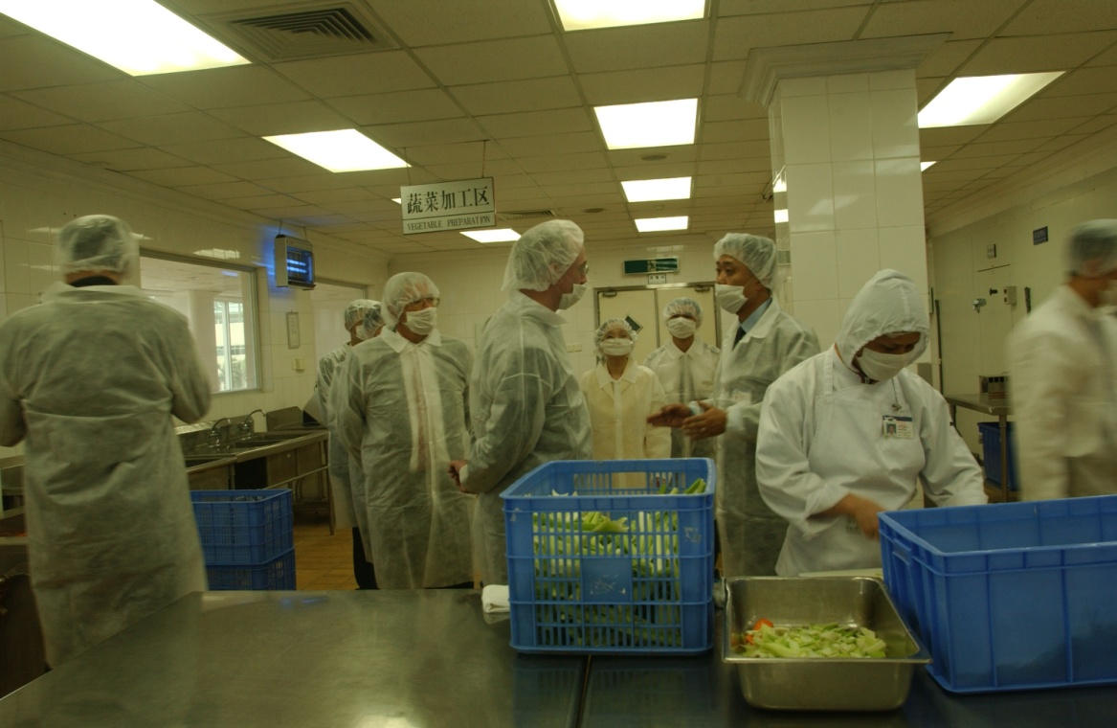
2. Protections for travellers
Overarching rights
Sanitation and hygiene of transport
Charges
Data protection
Unjustified measures

Slide 16
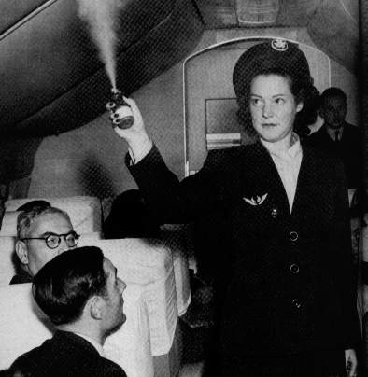
3. Health Measures - General application
General-
  Arrival and departure
    Information about travellers itinerary, destination, non-invasive medical examination
    Inspection of baggage, cargo, containers, conveyances, goods, postal parcels and human remains
Specific -
  Yellow fever vaccination
  Vector control - Disinfection of conveyances

Slide 17
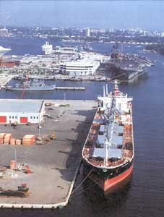
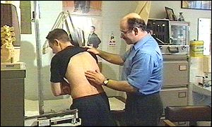
4. Affected conveyances and imported cases
Affected or diverted conveyances and emergencies
Imported cases

Slide 18
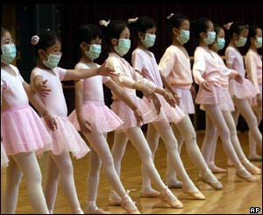
4. Health Measures - additional
Additional (National and International Law) health measures

Slide 19
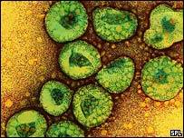
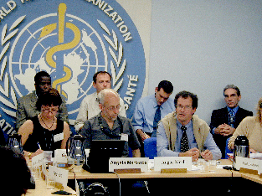
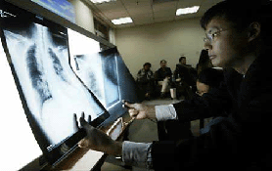
Learning from experience: the example of SARS
Identification of the problem
Linking events in different countries
Co-ordinating international response
    Field Teams
    Laboratory
    Epidemiology
    Clinical
    Travel advice, entry and exit screening
    at PoE
Timely information & recommendations for control
Provision of direct support and assistance
Notes:
SARS demonstrates the limitations of current IHR
What WHO & MSs did to collaborate
What needed to be included in a legal framework for working in this manner

Slide 20
Strengthen national disease surveillance, prevention, control and response system
Requires a commitment of States Parties
  Mobilization of national resources: e.g. staff, infrastructure, budget
  Development of national action plans, integrated and coordinated with
  intermediate and local levels like points of entry (ports, airports, ground crossings)
Builds on existing national and regional strategies
Requires sustained multisectorial approach and international collaboration

Slide 21
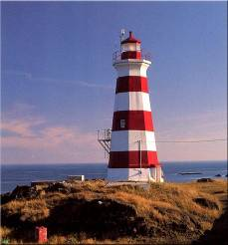
IHR Strategic Implementation Plan
if IHR was a lighthouse …
NATIONAL SURVEILLANCE AND RESPONSE
WHO GLOBAL ALERT AND RESPONSE SYSTEM
International initiatives and networking
National Capacity Strengthening
THREAT-SPECIFIC CONTROL PROGRAMMES
INTERNATIONAL TRAVELS AND TRANSPORTS
LEGAL PROCEDURES
AND MONITORING
GLOBAL PARTNERSHIP

Slide 22
IHR Implementation Plan
Global partnership
Foster global partnerships
Strengthen national capacity
Strengthen national disease surveillance, prevention, control and response systems
Strengthen public health capacities in travel and transport, including routine measures and emergency preparedness at points of entry
Prevent and respond to international public health emergencies
Strengthen who global alert and response system
Strengthen threat-specific international control programmes
Legal issues and monitoring
Sustain rights, obligations and procedures
Conduct studies and monitor progress

Slide 23
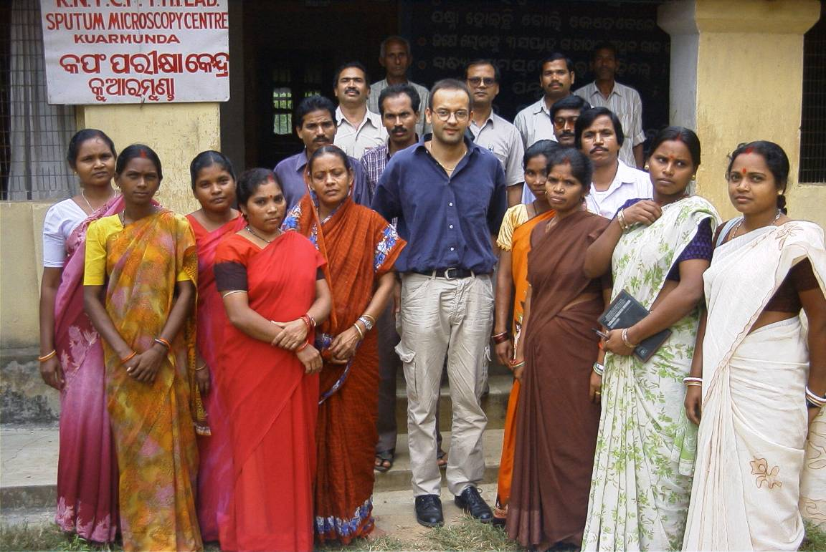
The IHR foster global partnership
Other intergovernmental organizations:
  UN system (e.g. FAO, IAEA, ICAO, IMO, UNWTO)
  others: regional (e.g. EU, ASEAN, MERCOSUR), technical (e.g. OIE)
Development agencies:
  governments, banks
WHO Collaborating centres
Academics & professional associations
Industry associations (e.g. IATA, ISF)
NGOs and Foundations
Notes:
The IHR provide for cooperation between WHO and other competent intergovernmental organizations or international bodies in the implementation of the Regulations.
WHO will therefore continue to foster its longstanding working relationships with a number of organizations such as the International Atomic Energy Agency, the International Air Transport Association, the International Civil Aviation Organization, the International Maritime Organization, the World Tourism Organization, Food and Agriculture Organization of the United Nations, the Office International d'Epizooties (World Organisation for Animal Health) and the World Trade Organization.
In addition to these specialized organizations, WHO will work with regional economic integration organizations such as the European Union and the Mercado Común del Sur (MERCOSUR) in implementing the Regulations in the countries of their respective regions.

Slide 24

Containment at source
Rapid response at the source is:
The most effective way to secure maximum protection against international spread of diseases
key to limiting unnecessary health-based restrictions on trade and travel
Notes:
The extent of international travels is an extraordinary opportunity for disease transmission.

Slide 25
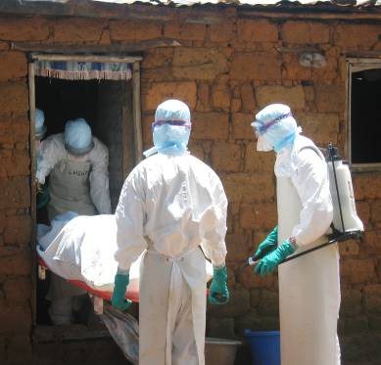
Importance of national capacity
The best way to prevent international spread of diseases is to detect public health events early and implement effective response actions when the problem is small
  Early detection of unusual disease events by effective national surveillance (both disease and event based)
  Systems to ensure response (investigation, control measures) at all levels (local, regional, and national)
  Routine measures and emergency response at ports, airports and ground crossings.
Notes:
Increasing recognition that WHO cannot replace or make up for weak or missing capacity at national level

Slide 26
Core capacity requirements for designated points of entry
Designation of points of entry
  States Parties shall designate Airports and Ports for developing capacities
  States Parties where justified for PH reasons, may designate ground crossings for developing capacities taking into consideration volume and frequency of international traffic and public health risks of the areas in which international traffic originates.

Slide 27
  States Parties sharing common borders should consider:
    - Bilateral and multilateral agreements
    - Joint designation of adjacent ground crossing for capacities
  Identify competent authority for each designated point of entry
WHO certification for airports and ports
  Under request of State Party WHO may arrange to certify it
    Need to develop procedures and guidelines by WHO

Slide 28










Point of Entry Core capacity requirements at all times (routine)
Capacity Strengthening at Points of Entry
(a) Assessment and Medical care, staff & equipment
(b) Equipment & personnel for transport ill travellers
(c) Trained personnel for inspection of conveyances
(e) Trained staff and programme for vector control
(d) ensure save environment: water, food, waste, wash rooms & other potential risk areas - inspection programmes

Slide 29

Point of Entry Capacity requirements for responding to potential (emergency)
Provide assessment & care for affected travellers, animals: arrangements with medical, veterinary facilities for isolation, treatment & other services
b
Provide space, separate from other travellers to interview suspect or affected persons
Public Health Emergency Contingency plan: coordinator, contact points for relevant PoE, PH & other agencies
c
a
Provide for assessment, quarantine of suspect or affected travellers
d
g
Provide access to required equipment, personnel with protection gear for transfer of travellers with infection/ contamination
To apply recommended measures, disinsect, disinfect, decontaminate, baggage, cargo, containers, conveyances, goods, postal parcels etc
e
f
To apply entry/exit control for departing & arriving passengers

Slide 30
Points of entry
Key public health functions
PREVENTION EARLY WARNING RESPONSE
risk management inspection contingency
routine control screening plans
Detecting public
health events
of international
concern
Controlling events
& responding
to emergencies
Controlling known
public health risks
at ports, airports,
ground crossing

Slide 31
What does WHO do under the IHR?
Designate WHO IHR contact points
Support States Parties in assessing their public health risks, through the notification, consultation, and verification processes
Inform State Parties of relevant international public health risks
Recommend public health measures
Assist States Parties in their efforts to investigate outbreaks and meet the IHR national core capacities requirements for surveillance and response and points of entry

Slide 32

WHO to help countries managing events
New WHO global Event Management System
WHO Regional Alert and Response teams
Train countries’ NFPs and WHO contact points for event management
Expand Global Outbreak and Alert Response Network GOARN and other specialized and regional support networks
Develop new tools and standard operating procedures
Carry out IHR exercises
Notes:
WHO wide-exercise tests the global system for international health security
On, 15 June 2007, the day of the IHR’s entry into force, WHO will hold the first exercise to test its preparedness to successfully manage and support States during public health emergencies of international concern. As part of WHO's increased responsibilities under the revised IHR, considerable effort has been made to establish procedures, technological and human resource infrastructures to ensure WHO is ready to receive, analyse and disseminate information and make recommendations for dealing with public health emergencies of international concern.
The exercise on 15 June is the first of a series meant to test the mechanisms in place, their compliance with the IHR and opportunities for improvement. It consists of notifying a public health event involving multiple regions. This is an occasion to validate policy direction and coordination, information management and risk assessment capacity as well as the ability to utilize communications methods to report events from the country level through the Regional Offices to Headquarters.
Participants will span many levels of WHO across the globe, including selected country office staff, WHO IHR contact points, Regional Directors, Regional Advisors, WHO Emergency and Preparedness and Response group at Headquarters, and the office of the Director-General.

Slide 33
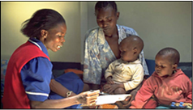
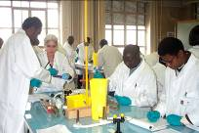
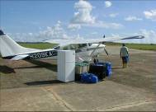

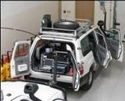
Countries’ challenges for IHR implementation
Mobilize resources and develop national action plans
Strengthen national capacities in alert and response
Strengthen capacity at ports, airports, and ground crossings
Maintaining strong threat-specific readiness for known diseases/risks
Rapidly notify WHO of acute public health risks
Sustain international and intersectoral collaboration
Monitor progress of IHR implementation

Slide 34
Serious Impact on Public Health?
There is potentially high morbidity and/or mortality
The geographic scope is large or spreading over a large area (e.g. multi-state or regional); is in area of high population density
The agent is highly transmissible/pathogenic
The event has compromised containment or control efforts
Therapeutic/prophylactic agents are unavailable, absent, or ineffective
Cases occurring among health care staff
Assistance for investigation & response required

Slide 35
Unusual or Unexpected?
The disease-causing agent is yet unknown or a new (emergent) pathogen
The population affected is highly susceptible
The event is unusual for the season, locality or host
There is a suspicion that this may have been an intentional act
Agent had been eliminated or never reported
in U.S.

Slide 36
Significant Risk for International Spread?
Epidemiologic link to a similar event outside the U.S.
  International travel or gathering
  Contact with traveler or mobile population
Potential cross-border movement of pathogen/agent/host
Conducive transmission vehicles: air, water, food or environmental

Slide 37
Risk for Trade or Travel Restrictions?
There is a history of similar events in the past that have resulted in restrictions
The event is associated with an international gathering or a tourist area
The event is or has gained significant government or media attention
There is a zoonotic disease or the potential for an epizootic event, or exported/imported food/water-related

Slide 38
Public Health Emergency- Multi-sectoral Approach
Public health services
Health care system
Veterinary services
Agriculture
Education
Communication
Transport
Trade
Security
Army, air force, defense…
Prime Minister’s Office / Presidential Cabinet

Slide 39
Interim technical advice for inspection and issuance of Ship Sanitation Certificates
Ship Sanitation Control Exemption Certificate issued when
No evidence of a public health risk is found on board and
The competent authority is satisfied that the ship is free of infection and contamination, including vectors and reservoirs.
This certificate shall normally be issued only if the inspection has been carried out when the ship and holds are empty.
Valid for six month period

Slide 40
TRAVEL AND TRANSPORT IHR(2005)
Challenges
Designation of authorized ports to issue SSC
Designation of Point of entry to develop, maintain and strength core capacities
Assessment of core capacities for designated points of entry
Implementation of WHO Certification for IHR core capacities requirements for ports and airports
Integration of points of entry activities to national surveillance system

Slide 41
Development of Intersectorial approach of Public Health concerns at point of entry
Development of integrated emergency contingency plans for PoE
Development of strategic approach for international communication and cooperation for response to events involving points of entry, travel and transport

Slide 43

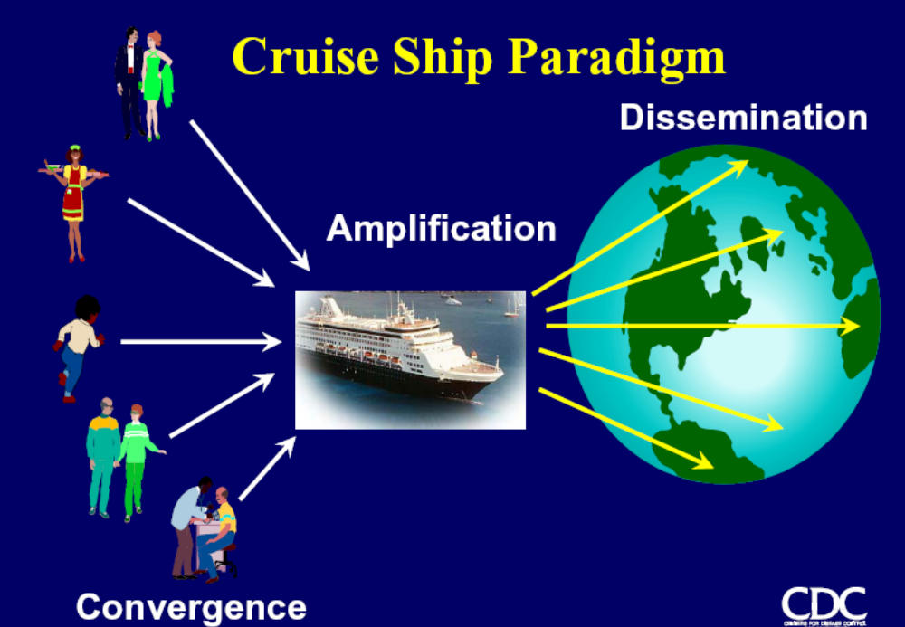
Thank you

