Slide 1
Fracture Neck of Femur
Dr. Kunal Singh
(Assistant Professor)
Department of Orthopaedics

Slide 2
Introduction
A fracture through the intra articular part of the femoral neck is usually referred to by the term femoral neck fracture.
Another term is intracapsular proximal femoral fracture.
About 80% of these fractures are displaced

Slide 3
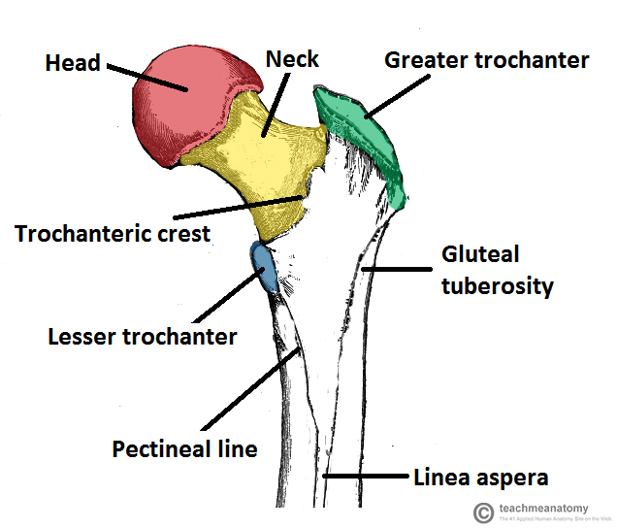
Femoral Neck Anatomy
Neck connects head with shaft and is about 3.7 cm long.
It makes angle with the shaft 130+/- 7 degree( less in female due to their wider pelvis).
It facilitates the movements of hip joint.
It is strengthened by calcar femorale (bony thickening along its concavity).

Slide 4
2 Borders and 2 Surfaces
Upper border –concave and horizontal meets the shaft at greater trochanter.
Lower border – straight and oblique meet the shaft at lesser trochanter.
Anterior surface- flat and meets the shaft at intertrochanteric line. Entirely intra capsular.
Posterior surface- convex from above downwards and concave from side to side and meets the shaft at intertrochanteric crest.

Slide 5
MCQ
1. a patient came with complaint of difficulty in climbing upstair when he is made to stand on his right leg left side of pelvis fellow to lower level when he stand on left leg than right side of pelvis can be drawn up which of the following nerve of him has got affected
A right inferior gluteal
B right superior gluteal
C left superior gluteal
D left inferior gluteal

Slide 6
Blood supply:
Femoral artery
Profunda femoris artery
Medial circumflex artery
Lateral circumflex artery
EXTRACAPSULAR ARTERIAL RING
EXTRA CAPSULAR ARTERIAL RING
Metaphyseal branches
Retinacular arteries
Epiphyseal branches
SUBSYNOVIAL
INTRACAPSULAR ARTERIAL RING
Artery of ligament teres

Slide 7
MCQ
Blood supply to head and neck of femur is mainly from?
A. Superficial epigastric artery
B. Medial circumflex femoral artery
C. Lateral circumflex femoral artery
D. Artery of ligamentum teres

Slide 8
Patho-Anatomy
Most fracture are displaced with
Distal fragment – Externally rotated, adducted,
and proximall migrated.
These displacement are less marked than in interacapsular fracture because the capsule of hip joint is attached to distal fragment and prevent extreme rotation and displacement of distal fragment.

Slide 9
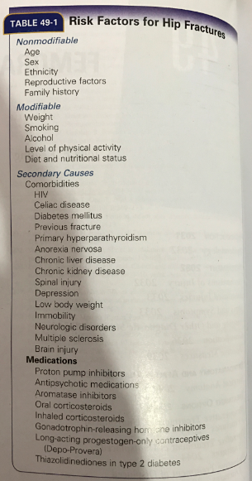
Risk Factors for Femoral Neck Fractures

Slide 10
2. Most common complication of intertrochanteric fracture
A Malunion
B Nonunion
C Osteoarthritis
D Nerve injury

Slide 11
Mechanism of Injury
Trivial fall – direct blow over the greater trochanter
Lateral rotation of the extremity Posterior communition of the neck.
Cyclical loading due to muscle force and torsion

Slide 12
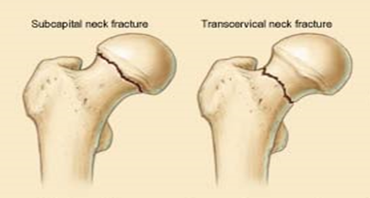
Classification
ANATOMICAL LOCATION
Subcapital
Transcervical
Basicervical (base of the neck fracture)

Slide 13
3. Most common complication of transcervical fracture of neck of femur is
A vascular necrosis
B malunion
C non union
D none

Slide 14
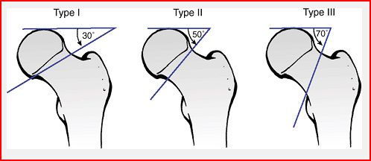
Pauwel Classification-
This is based on the angle of fracture from the horizontal
Type I: 30 degrees
Type II: 50 degrees
Type III: 70 degrees

Slide 15
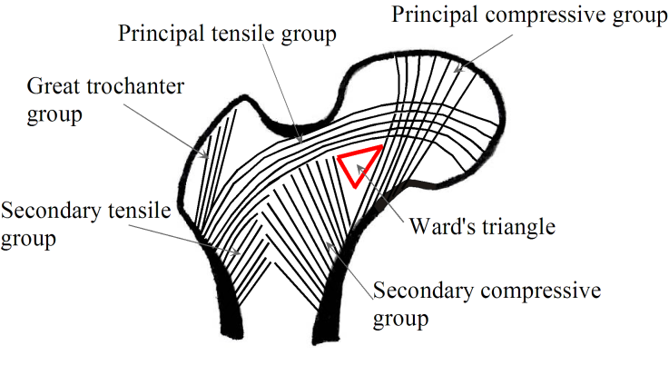
Trabecular Pattern-

Slide 16
Garden’s Classification-
This is based on the degree of valgus displacement-
Type I: Incomplete/valgus impacted
Type II: Complete and nondisplaced on AP and lateral views
Type III: Complete with partial displacement; trabecular pattern of the femoral head does not line up with that of the acetabulum
Type IV: Completely displaced; trabecular pattern of the head assumes a parallel orientation with that of the acetabulum

Slide 17
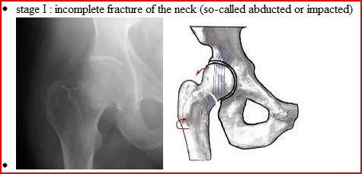
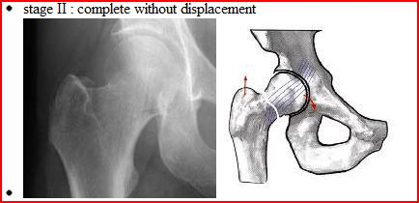

Slide 18
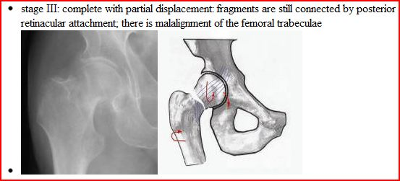
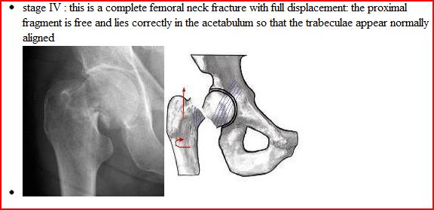

Slide 19
Clinical Features
H/O fall
Pain
Restriction of Movements
O/E-
External Rotation deformity
Tenderness over anterior hip joint line
Shortening

Slide 20
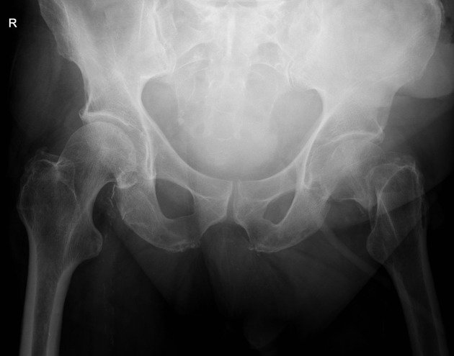
An 80-year-old woman falls at home and is subsequently unable to weight bear and has severe pain in her left groin. An AP pelvis plain radiograph is taken in the emergency department and is shown in the image below.Based on the findings on the plain radiograph, which of the following management options would be most appropriate?
A dynamic hip screw
B girdlestone procedure
C hemiarthroplasty
D hip arthrodesis
E intramedullary nail

Slide 21
Investigations
Radiography-
It is the preferred initial imaging modality in evaluating femoral neck fractures.
It tells us about the-
Extent of Fracture
Fracture Angle
Break in Shenton’s line
Posterior wall communition
Osteoporosis

Slide 22
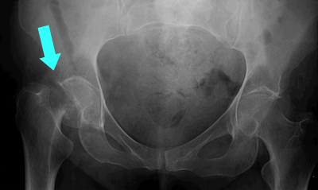
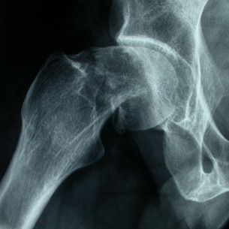
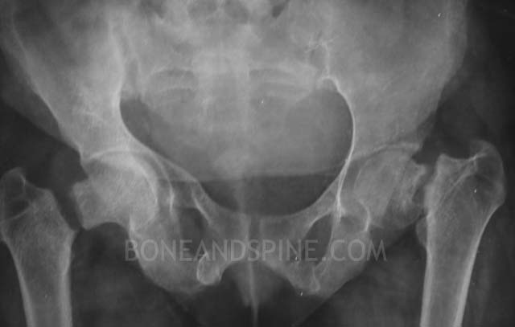

Slide 23
4. Non union is a very common complication of intra capsular fracture of neck of femur which of the following not a very important cause for the same
A inadequate immobilization
B inadequate blood supply
C inhibitory effect of synovial fluid
D stress at the #side due to the muscles pass
E vertical fracture line
F absence of cambium layer of the periosteum

Slide 24
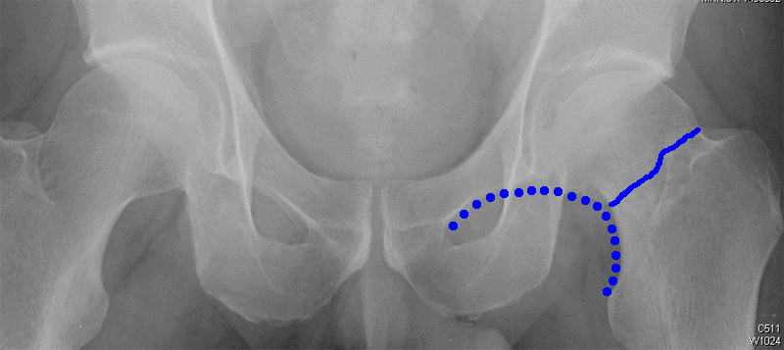
Shenton’s Line-
It is the line drawn from the superior margin of the obturator foramen to the margin of neck.

Slide 25
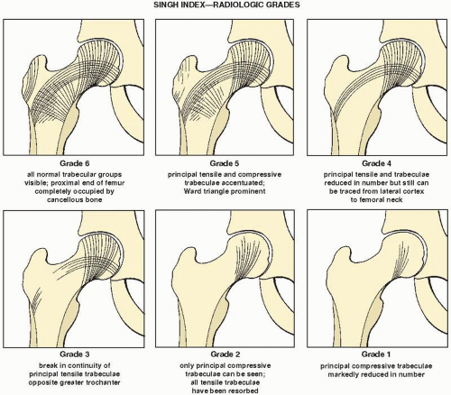
Singh’s Index-

Slide 26
5. 40 year old female history of fall complaint of pain in right hip, inability to work and on examination tenderness in the scarps triangle x-ray is normal next investigation is
A MRI
B bone scan c aspiration
D CT

Slide 27
Limitations of Radiography:
Spiral fractures are difficult to assess on a single view.
Comminution is also not as easily demonstrated as it is with CT.
Some stress fractures are simply not visible on plain images at all.
However, radiography will likely remain the mainstay in the evaluation of these injuries in the near future, and cross-sectional imaging will play an increasing but supplementary role.

Slide 28
Computed Tomography-
  CT plays an increasingly important role in evaluating the hip after a fracture.
  CT is exquisite useful for imaging abnormalities of the bone itself.
  Because of its superior resolution, cross-sectional capabilities, and amenability to image reconstruction in the coronal and sagittal planes, CT is useful for assessing fracture comminution preoperatively and in determining the extent of union (or lack thereof) postoperatively.

Slide 29
6. A 33 year old male has history of RTA now complaint of left hip pain ,on examination there is flexion and external rotation of the left lower limb there is 7 cm shortening of left lower limb ,there is a gluteal mas felt when move with movement of the femoral shaft, which of the following is the diagnosis
A anterior dislocation of hip
B center fracture dislocation
C poster dislocation
D Pipkin type 4#

Slide 30
MRI-
MRI is both sensitive and specific in the detection of femoral neck fractures, because it can show both the actual fracture line and the resulting bone marrow edema.
The superior contrast of MRI when appropriate pulse sequences are used, the intrinsic spatial resolution, and the ability to image in multiple planes (coronal, axial, and less commonly, sagittal) makes MRI the premiere imaging modality, especially in the setting of stress fractures, which can appear normal on initial plain images.
The fracture line can be visualized as linear low-signal-intensity areas surrounded by bone marrow edema, which is hypointense relative to normal marrow on T1-weighted images or hyperintense on T2-weighted images

Slide 31
Drawbacks-
Drawbacks of MRI include its longer imaging time, its relative lack of widespread availability,
Its higher costs, and the exclusion of patients with cardiac pacemakers and certain metal hardware in their body.
.

Slide 32
Treatment
Aims of Treatment-
Early anatomical reduction – prevents further vascular damage.
Impaction of fracture fragments
Rigid internal fixation: enables the vascularization from the surrounding soft tissues and uninjured bones – early callus formation.

Slide 33
Treatment plans as per Garden’s Classification
Garden I:
Conservative Hip Spica for - old fracture.
- unfit for surgery.
Surgical- By cannulated screws.
Garden II:
Fracture fixed with DHS, multiple cannulated cancellous screws.
Gardens III/IV:
Conservative treatment rarely indicated.
Surgical Management is the treatment of choice.

Slide 34
Conservative Treatment
Fractures at this level have a poor capacity for union due to the following factors-
Interference with the blood supply to the proximal fragment.
Difficulty in controlling the small proximal fragment.
The lack of organisation of the fracture haematoma due to the presence of the synovial fluid.

Slide 35
Surgical Treatment :
Two essential principles to be followed in the surgical management of this fracture are
(a) Perfect anatomical reduction.
(b) Rigid internal fixation.
The fracture is reduced by manipulation with the patient on a traction table.

Slide 36
Broad Treatment Guidelines
Age group Undisplaced
More than 70 years DHS
Young adults DHS
Children Hip Spica
Displaced
Prosthesis
THR
DHS
Osteotomy or prosthesis
Multiple Cancellous Cannulated screws
Osteotomy
arthrodesis

Slide 37
Dynamic Hip Screw
Most commonly used device for both stable and unstable fracture patterns.
Plate angle is variable 130 to 150 degrees.
Has to be positioned centrally in the femoral head.

Slide 38
7. Flexion addaction and internal rotation is characteristic posture in
A anterio dislocational
B poster dislocation
C femur head #
D intertrochanteric #

Slide 39
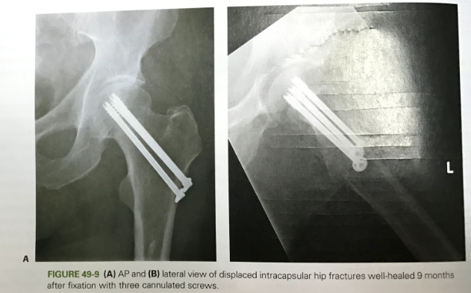
Cancellous Cannulated Screws
Indications-
Age <65 yrs
No fracture comminution seen
Good Bone Stock

Slide 40
Hemiarthroplasty
Indications:
- Poor general health thay would prevent a second operation;
- Pathological hip fractures
- parkinson's disease, hemiplegia, or other neurological disease;
- Physiologic age > 70 yrs;
- Severe osteoporosis w/ loss of primary trabeclae in femoral head
- Inadequate closed reduction;
- Displaced fracture which is several days old;
- Pre-existing hip disease
Contraindications:
- Preexisting sepsis
- Young patient
- Pre-existing disease of the acetabulum;

Slide 41
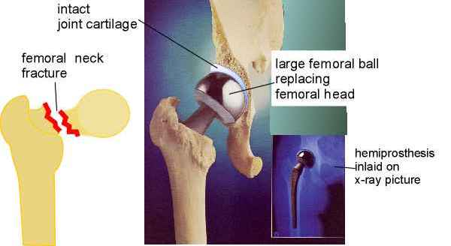

Slide 42
Total Hip Replacement
In a total hip replacement (also called total hip arthroplasty), the damaged bone and cartilage is removed and replaced with prosthetic components.
The damaged femoral head is removed and replaced with a metal stem that is placed into the hollow center of the femur. The femoral stem may be either cemented or "press fit" into the bone.
A metal or ceramic ball is placed on the upper part of the stem. This ball replaces the damaged femoral head that was removed.
The damaged cartilage surface of the socket (acetabulum) is removed and replaced with a metal socket. Screws or cement are sometimes used to hold the socket in place.
A plastic, ceramic, or metal spacer is inserted between the new ball and the socket to allow for a smooth gliding surface.

Slide 43
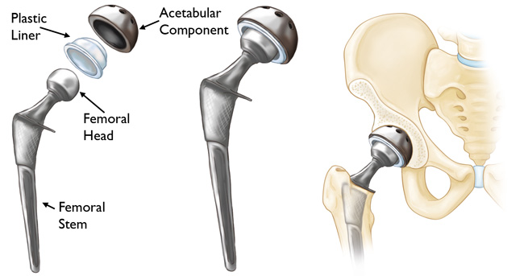

Slide 44
Complications
Thromboembolism : - leading cause of death within first 7 days ( 40 % )
Nonunion
Avascular Necrosis

Slide 45
THANK YOU…!!

