Slide 1
Ankle Fractures
Presented by-
Dr.M.M Nagar
M.S.(ORTHO;)L.L.B.

Slide 2
Ankle fractures
Which classification to use
X rays and special investigations
Non operative vs Operative
Timing of op
Which implant to choose
traditional or antiglide plate
Controversies in syndesmotic fixation
Early or delayed mobilisation
Special situations: Diabetes etc
Outcome measures
Factors associated with failure
Complications/pitfalls

Slide 3
Ankle fractures
Most common types of fractures treated by Orthopaedic surgeons
Often the first fractures operated by trainees
Increased prevalence in last two decades
Increased prevalence of complex injuries
complex bio-mechanics
Very few RCT
Foot & Ankle : 40% Ortho medical negligence (Glyn Thomas, The Foot, 1999)
No uniform scoring system

Slide 4
Special investigations
Stress radiographs
Tomography
CT scan
MRI
Isotope bone scan
Arthrography
Arthroscopy

Slide 5
Classification
Lauge-Hansen (1949) classification
AO classification
(Danis 1949, Weber 1972)
Both Lauge-Hansen and Weber systems are not predictive of prognosis
Moderate reproducibility (40-60%)
No classification gives information about stability

Slide 6
Lauge - Hansen classification
Primary advantage :
Characteristic fibular # pattern
useful for reconstructing the mechanism of injury
a guide for the closed reduction
Sequential pattern – inference of ligament injuries
Disadvantages:
complicated, variable inter observer reliability
doesn’t signify prognosis
internal rotation injuries (Weber A3) missed
doesn’t indicate stability

Slide 7
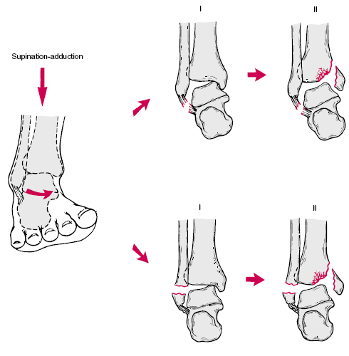
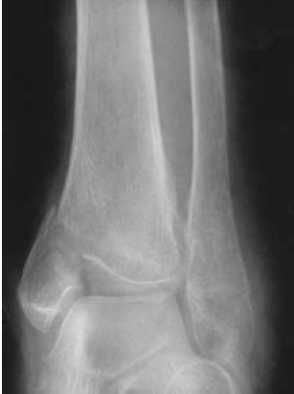
Supination Adduction (SA)

Slide 8
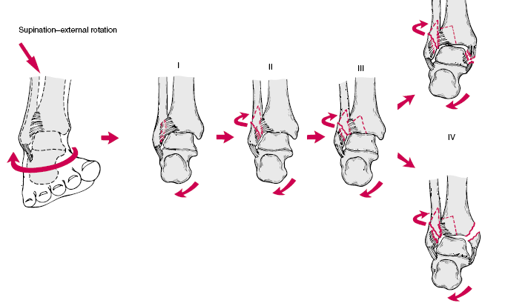
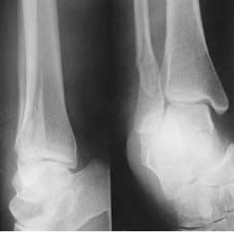
Supination External rotation (SER)
45-65%

Slide 9
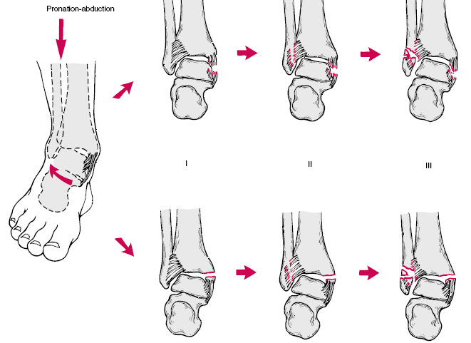
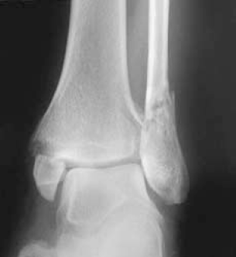
Pronation Abduction (PA)

Slide 10
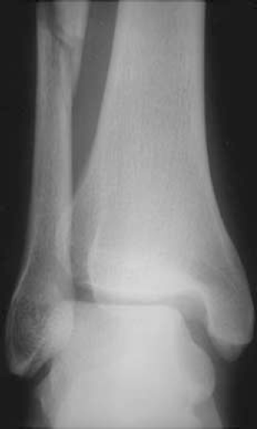
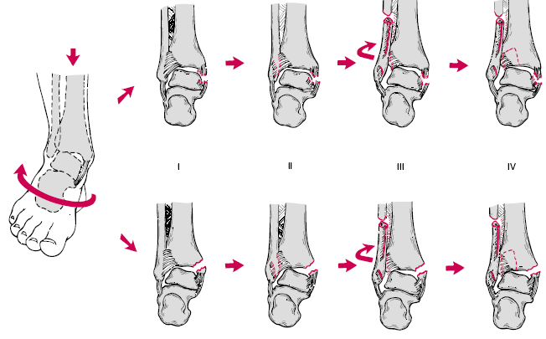
Pronation External Rotation (PER)

Slide 11
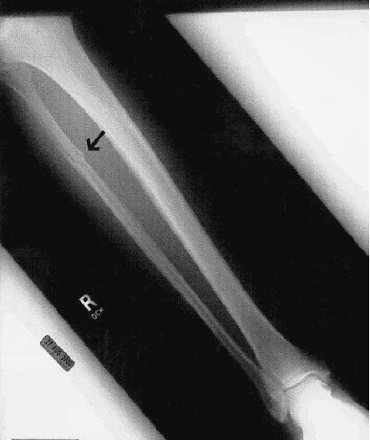
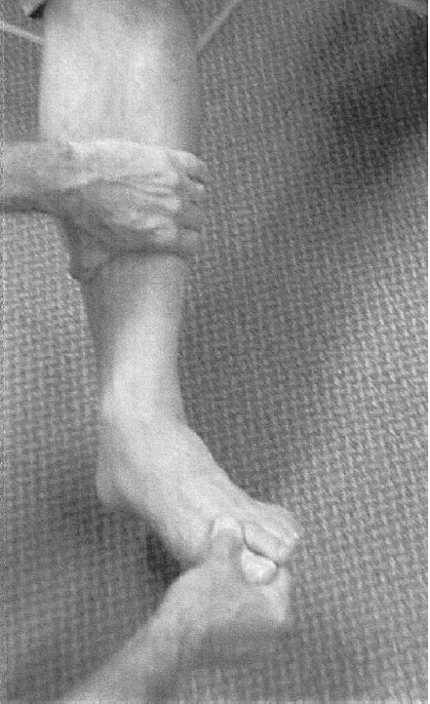

Slide 12
Weber classification
Advantages:
easy to use
provides information about the lateral fracture
Disadvantages:
ignores the medial injury
The AO classification system
a modification of the Weber system
subdivided on the basis of the presence of medial or posterior injury

Slide 13
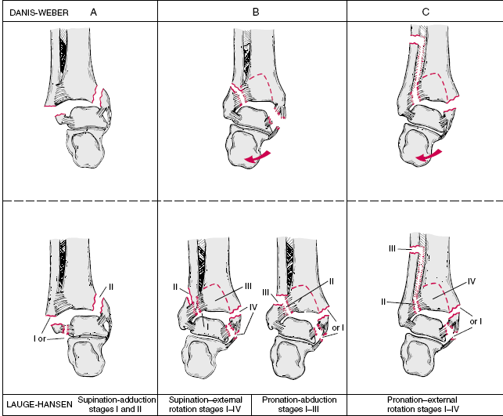
Correlation between the two

Slide 14
Management
Majority of
clinical decisions
regarding ankle fractures
are not made on the basis of
a formal classification

Slide 15
Surgeon’s judgment

Slide 16
Management priorities
Provisional reduction
Care of open fracture
Soft tissues
Precise definitive reduction
rehabilitation

Slide 17
Goals of treatment of Ankle fractures
Healed fracture
Ankle that moves and functions normally without pain

Slide 18
Conservative vs operative
Stable fractures
Isolated lateral malleolar fractures
Majority of ankle fractures
Conservative treatment
Immobilization is primarily aimed at protecting ankle from further injuries
Surgical treatment:
1-3% chance of significant wound complications
greater long term swelling around ankle

Slide 19
Conservative vs operative
Unstable fractures
In a patient with lateral fractures and medial tenderness, any lateral talar shift signifies instability
In the absence of talar shift, individual clinical judgment dictates treatment
Closed reduction yields satisfactory results in up to 65% cases
Routine repair of deltoid does not improve outcome and may lead to worse long term outcome

Slide 20
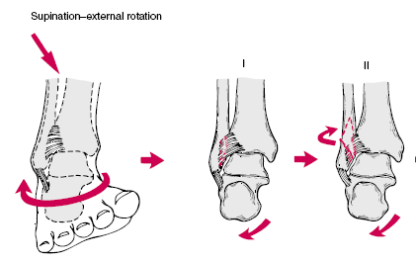
Isolated lateral malleolar #s
Mobilise or POP?
Port AM et al 1996:
65 consecutive patients
Two conservative methods
Weber B1, LH sup- ext rot 2
Immediate wt bearing vs 4 wks POP
No significant difference in pain, complications

Slide 21
Displaced fractures
Conservative vs Operative treatment
Because even small changes significantly influence the joint contact area, restoration of the anatomy of the fibula and consequently the ankle joint is important
BUT
How anatomical should the reduction be??
Neither clinical or bio mechanical studies give absolute values
Values range from mandatory anatomical reduction to acceptable 2-3mm

Slide 22
Displaced #
Conservative vs operative
RCT from Leicester
47 patients over 55 yrs age
displaced #
anatomical reduction: less reliable and more likely to loose with plaster group
Operative group : higher functional outcome, better range of movements
Makwana MK et al, Injury 1993

Slide 23
Stability
Depends on
The deep deltoid ligament
The lateral malleolar length and rotation
Stability assessment
Recognition of injury pattern
>4mm of static displacement
A stress test -- >4mm displacement
No instability : Up to 50% of post malleolar fragment on lateral view
Yablon et al 1977 Role of the lateral malleolus in the displaced # of the ankle JBJS 59A 169-73
Michaelson et al An axially loaded model of the ankle after pronation external rotation injuries CORR 328, 285-93
Harper et al 1989 Posterior instability of the talus: an anatomic evaluation. Foot & Ankle 10, 36-9

Slide 24
Instability
Most reliable criteria:
a lateral talar shift in AP or mortise view medial clear space measurably larger than superior clear space

Slide 25
Incongruity
Ramsey and Hamilton study
1-mm lateral shift of the talus decreased the contact area by 42%
3 mm of lateral shift, the contact area decreased by more than 60%
The fibula is essential in providing stability and preventing displacement of the talus
A shortened or malrotated fibula will allow the talus to shift or tilt even if the medial ligaments are intact

Slide 26
Early vs delayed operation
Carrage et al 1991:
the rate of major complications
op > 24 hrs 44%
op < 24 hrs 5.3%
If skin condition is not good, delay up to
7-10 days
Delay more than 2 wks unsatisfactory outcome

Slide 27
Tourniquet trial (RCT)
Maffulli et al 1993
Tq | Number of patients | Op time | Possible infection | Frank infection
Yes | 40 | 41 +/- 9 | 11 | 3
No | 40 | 53 +/- 12 | 4 | 0

Slide 28
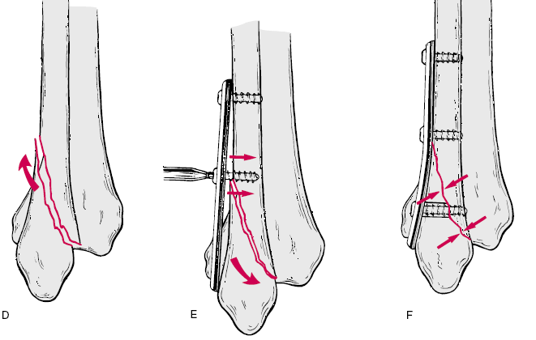
Antiglide plate

Slide 29
Posterior malleolar fragment on lateral x ray
Hartford’s experiment
size Decrease tibio talar contact area
25% 4%
33% 13%
50% 22%
Hartford et al 1995 Tibiotalar contact area: contribution of posterior malleolus and deltoid ligament CORR, 320, 182-7

Slide 30
ORIF of Post malleolus
fragment more than one-fourth to one-third of the articular surface
A step – off or gap more than
2-3mm after reduction of the lateral and, if present, the medial fractures
Residual posterior subluxation of the talus

Slide 31
Syndesmotic injury
most commonly occurs in
pronation-external rotation (PER),
pronation-abduction (PA),
rarely supination-external rotation (SER)
(type-C and some type-B injuries)

Slide 32
Syndesmotic injuries
Burns et al., biomechanical study
only the syndesmotic ligaments were cut
- no change in the loading of the ankle
both the syndesmotic and the medial ligaments were cut:
- increase in talar shift
- increase in joint-contact pressure
- 39 per cent decrease in joint-contact area

Slide 33
Medial injury and level of syndesmotic injury
no medial injury
minimum widening of syndesmosis,
regardless of the proximal extent of the syndesmotic injury.
Syndesmotic injury less than 3.5cm proximal to the joint:
No changes in the loading characteristics
medial injury + syndesmotic injury more than 4.5 centimeters:
widening of syndesmosis and changes in the loading of the ankle.
Boden, S. D et al
Mechanical considerations for the syndesmosis screw. A cadaver study.
J. Bone and Joint Surg., 71-A:1548-1555, Dec. 1989.

Slide 34
Principles of syndesmosis fixation
Anatomical reduction is necessary
If the fibula is fractured, its length, rotation, and alignment are restored first,
If the medial malleolus is fractured, it should be reduced and fixed as well
The reduction of the tibio fibular joint must be maintained during trans-syndesmotic fixation.
1.5-2cm proximal to plafond, 30⁰ angle
3.5mm, 4.0mm, 4.5mm cortical or cancellous screws, three or four cortices

Slide 35
Syndesmosis – the controversy
Dorsiflexion of the ankle when fixing the syndesmosis
(Tornetta et al)
Three versus four cortices
Hook test: Which direction, coronal or sagittal?
Candal-Couto JJ et al: Injury 2004 Aug;35(8):814-8
what type of syndesmotic fixation is needed
eg: k wires, sutures, screws (metal or absorbable), endo buttons
how the patient should be managed postoperatively
Removal of syndesmotic screw

Slide 36
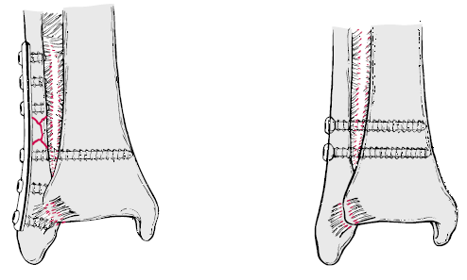
Syndesmosis fixation

Slide 37
Syndesmotic injury
Clinical tests
Squeeze test, Point test, ER test
Radiographic parameters
widening of the medial clear space >4mm
stress test (medial clear space >4mm)
MRI

Slide 38
Syndesmotic screw removal?
The syndesmotic screw prevents the normal physiologic motion of the fibula, particularly external rotation
Several studies have shown that weight bearing with the syndesmotic screw in place had no adverse effects with no increased incidence of pain or syndesmotic ossification, provided a functional range of motion had been regained.
Others have recommended that the syndesmotic screw be removed before weight bearing to restore the physiologic movement of the fibula and prevent fatigue failure of the screw.

Slide 39
Syndesmotic fixation
? ankle in full dorsiflexion
Advocates say :
to avoid over tightening of the mortise and loss of dorsiflexion postoperatively
But, (Tornetta)
the mortise is in its widest position
the fibula is shifted laterally,rotated externally
There is concern that persistent widening predispose to instability

Slide 40
Early or delayed mobilisation
The clinical evidence to support early mobilisation or splinting of any ankle fracture treated operatively is inconclusive
Godsiff et al 1993: a comparative study of early motion and immediate plaster splintage after internal fixation of unstable fractures of the ankle. Injury, 24, 529-30
Tropp and Norlin 1995 Ankle performance after ankle fracture: a randomized study of early mobilization

Slide 41
Post op management
Early mobilisation?
Stable ankle fractures: early mobilisation has got no long term benefit over weight bearing on a cast/brace
Wound problems with early mobilisation
Ankle fractures with deltoid lig injury: no early mobilisation

Slide 42
Special circumstances
Diabetes mellitus:
often older pts with vascular problems or neuropathy
Complication rate 40% with relative risk 2.76
Inadequate reduction and immobilization leads to neuropathic destruction of joint
Both closed and open methods have role to play
Osteoporotic ankle fractures:
Antiglide plate
Hooked fibular plate and tibia-pro-fibula screws
Locking plates
Open fractures
Sudek’s osteodystrophy

Slide 43
Outcome
Poor outcome if:
Large medial space
Large post malleolar fracture with step
Delayed surgery >2 wks
Missed or improperly treated syndesmotic injury
Elderly females have less satisfactory results
Commonly used outcome measures:
AOFAS ankle score (Kitioka et al 1994)
Olerud and Molander score (CORR, 1986)
SF36

Slide 44
Factors associated with failure
Patient factors:
non compliance
systemic medical conditions
Obesity
substance abuse
Factors associated with Fracture:
Instability
soft tissue damage
soft tissue interposition
Technical factors:
inadequate reduction
poor casting and molding
improper type or duration of immobilization
Clinical follow up:
infrequent
inadequate radiographs
indecisions about change of treatment

Slide 45
Complications
Mal union
Non union
Wound problems:
Oedema, prolonged Tq time, poor handling/dissection, wound closure without tension;
haematoma;
constrictive dressings.

Slide 46
Complications
Degenerative changes:
10% of fractures that were adequately reduced
85% of those inadequately reduced
radiographic changes were usually present
within 18 months of injury.
Considering the frequency of ligament and
bony injuries involving the ankle, the incidence
of degenerative arthritis of the ankle is
surprisingly low.

Slide 47
Complications
Heterotopic bone after injuries to the syndesmosis :
vary from a few islands of bone to complete synostosis
Osteochondral fractures of the talus can occur after any type of injury to the ankle, including "simple sprains."

Slide 48
Pitfalls
Experiments vs real life
variables involved in producing an injury
dynamic forces of muscles
different magnitudes and rates of loading
different degrees of weight bearing
differences in the quality of bone and soft tissues

Slide 49
Thank you
DR.M.M.NAGAR
M.S.(ORTHO;) L.L.B.

