Slide 1
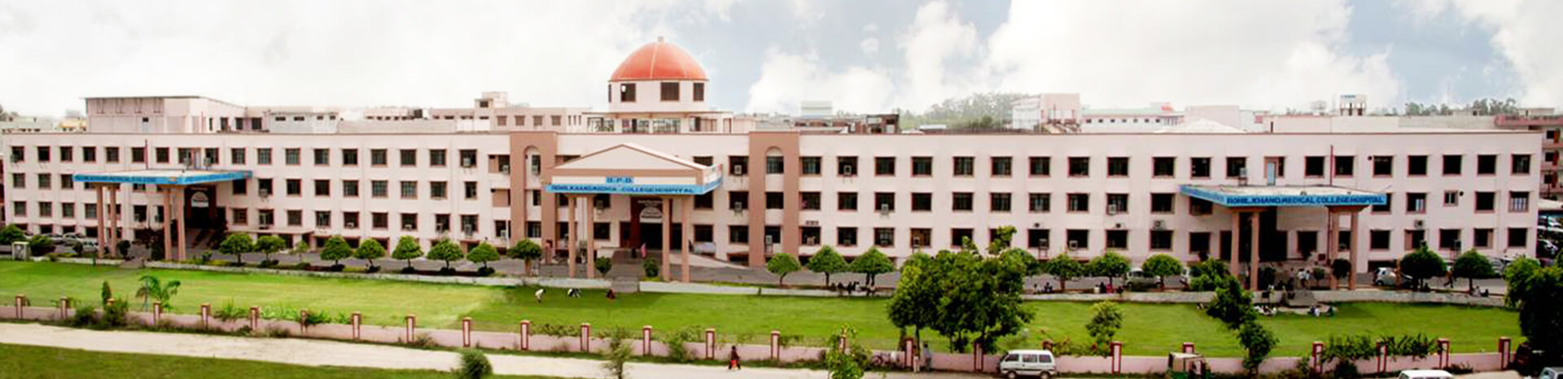
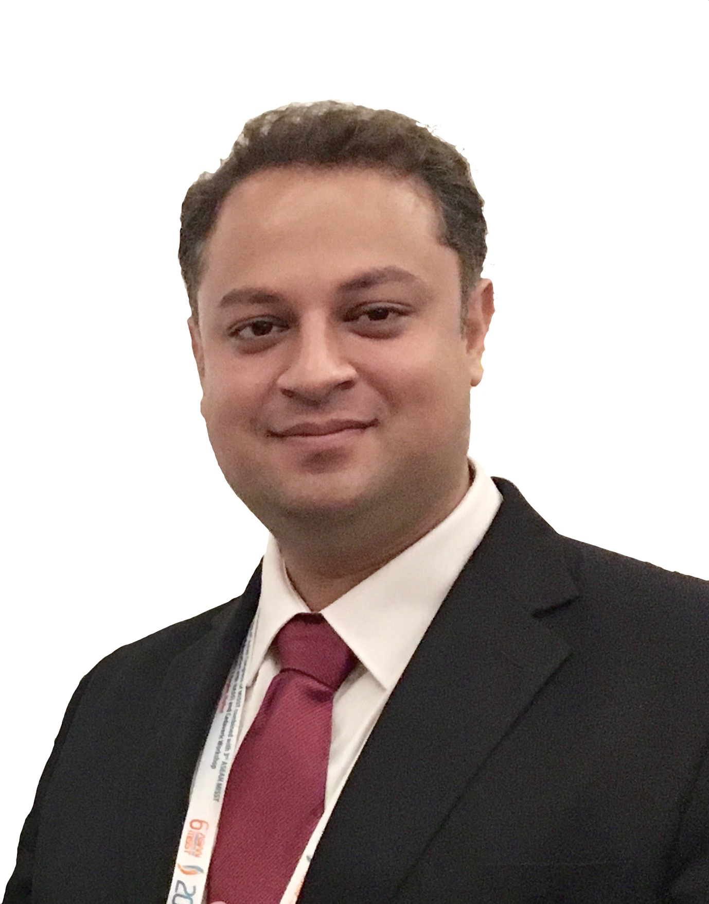

ACUTE OSTEOMYELITIS
Dr. Varun Kumar Agarwal
MBBS, D.Ortho, MS (Ortho)
Fellowship & Training in Spine Surgery (Austria / Switzerland / Mumbai)
Consultant Orthopaedic And Spine Specialist
Keshlata Hospital, Bareilly (UP)
Associate Prof. Orthopaedics
Rohilkhand Medical College and Hospital

Slide 2


⦿ RELEVANT ANATOMY
⦿ DESCRIPTION OF ETIOLOGY , PATHOLOGY , PATHOPHYSIOLOGY
⦿ EXPLAINING THE CLINICAL PRESENTATION OF
OSTEOMYELITIS
⦿ OUTLINE OF MANAGEMENT ( INVESTIGATIONS AND TREATMENT)
⦿ DIFFERENTIAL DIAGNOSIS
⦿ COMPLICATIONS

Slide 3
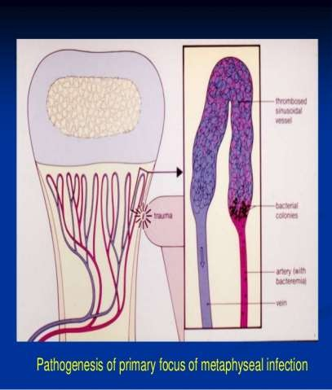
⦿ Metaphysis of the long bone –
highly vascularised zone
hair pin arrangement
But sluggish blood supply
common site of osteomyelitis

Slide 4
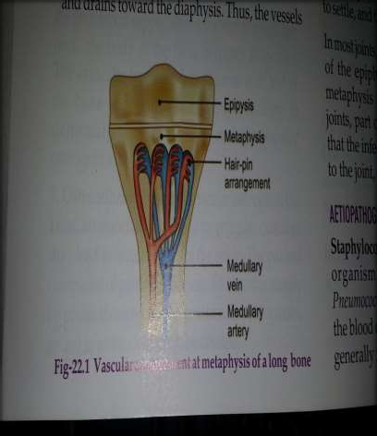
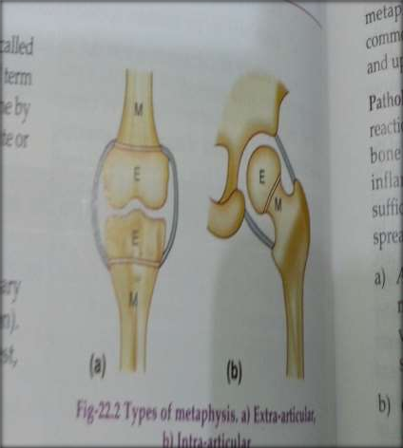

Slide 5

⦿ Staphlococcus aureus is the commonest organism in all age group.
⦿ Salmonella and Staphylococcus aureus are the most common
causes of osteomyelitis in children with sickle cell anaemia.
⦿ Pseudomonas aeurogenosa is the culprit in drug abusers.
⦿ Group B streptocoocus and E.coli are prominent pathogens in
neonates (neonatal osteomyelitis)
⦿ Strept pneumoniae is a common cause of osteomyelitis in children less than 24 months of age.
⦿ Open injuries -> staphlococcus
⦿ Foot injuries -> Pseudomonas
⦿ Kingella kingae is a common cause of musculoskeletal infections
(arthritis and osteomyelitis).

Slide 6

⦿ Most common mode of infection is hematogenous.
⦿ In children metaphysis of long bone (usually lower end femur > upper end tibia) is earliest and most commonly involved.
⦿ In adults commonest site of infection is thoracolumbar spine.

Slide 7





⦿ Defective phagocytosis in metaphysis (inherently depleted reticuloendothelial system ).
⦿ Rich blood supply.
⦿ Hair pin bend of metaphyseal vessels ( leads to vascular stasis- slow circulation).
⦿ Metaphyseal hemorrage due to repeated trauma (acts as culture media )

Slide 8




- indirect spread via blood(haematogenous) from far focus of infection(tonsils, skin infections)
- direct introduction. ( open wound, surgical infection, pinprick, injection----)
- direct spread from nearby infection.

Slide 9






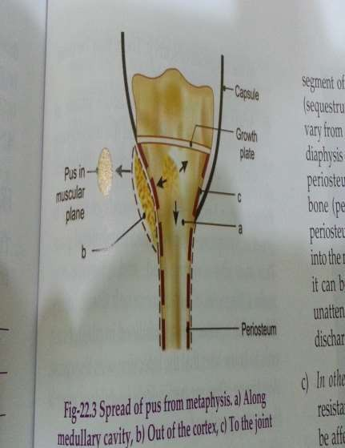
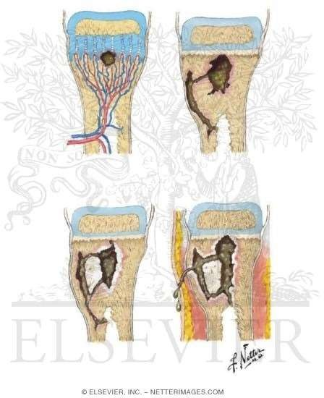

Slide 10
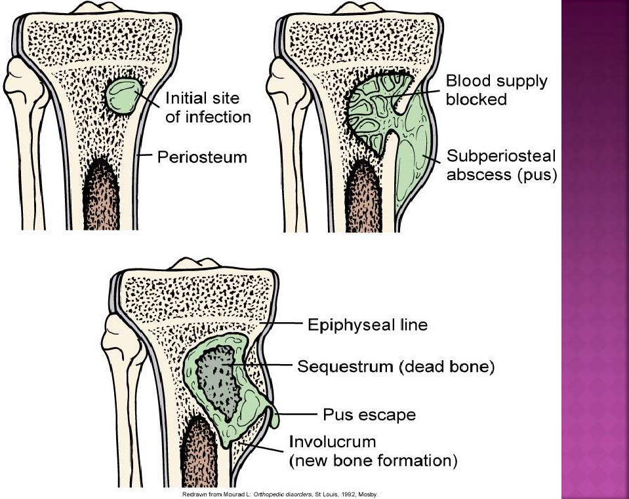

Slide 11
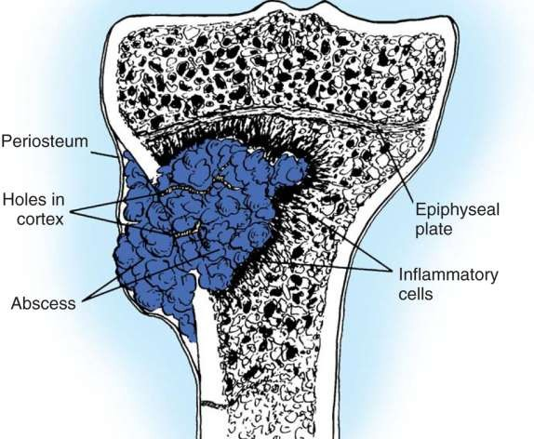

Slide 12





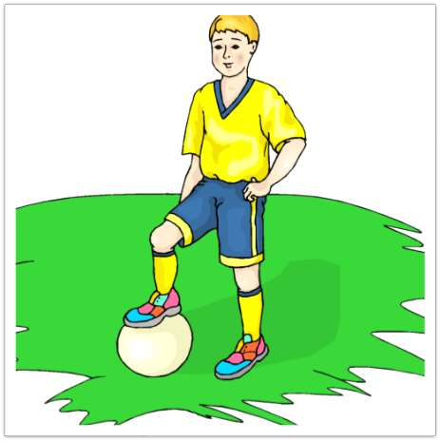
-DIAGNOSIS OF ACUTE
OSTEOMYELITIS IS BASICALLY CLINICAL
-DISEASE OF CHILDHOOD
- BOYS ARE AFFECTED MORE

Slide 13
⦿ CHILD PRESENTS WITH
(TOXIC CHILD)
GENERAL SIGNS of
infection (fever >38.3 degree Celsius, vomiting, chills , ill looking )
LOCAL MANIFESTATION OF INFECTIONS ( like calor , rubor , tumor , dolor )
Limp and refusal to
bear weight
EXAMINATION
- CHILD IS FEBRILE with
signs of inflammation.
POINT TENDERNESS over the metaphysis of long bones.
LATER STAGES shows
ABSCESS in muscular or subcutaneous plane associated with swelling of adjacent joint

Slide 14

⦿ Total leucocyte count-
LEUCOCYTOSIS
⦿ ESR
⦿ CRP
⦿ X- RAY
normal ,
- RAISED
RAISED
<24 HRS is
1st change on X ray is soft tissue loss , 1st bony change is periosteal reaction seen on day 7 – 10 (2nd week r day 10 ) solid periosteal reaction .

Slide 15
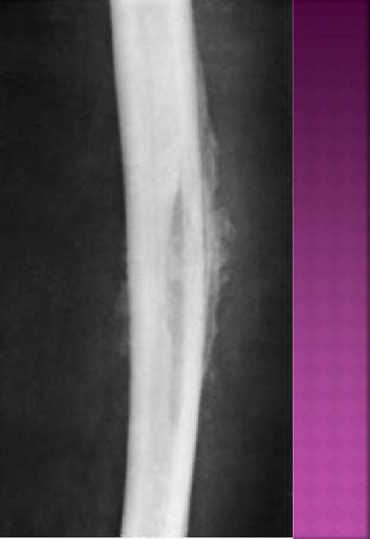

⦿Soft tissue swelling
⦿Periosteal reaction
⦿Bony destruction (10-12 days)

Slide 16
⦿ MRI (1st best radiological investigation) coz it can identify marrow edema (seen within 6 hrs ) and soft tissue extension in bone infections).
Tc99 – MDP ,Ga-67-citrate or Indium 111 labelled leucocytes (2nd best radio inv)
GOLD STANDARD – always tissue culture( from the lesion)
BLOOD CULTURE is positive in 60 % cases.

Slide 17
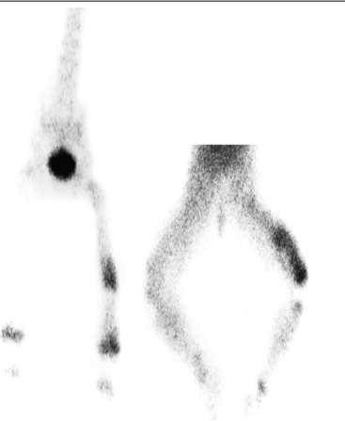


Can confirm diagnosis
24-48 hrs after onset

Slide 18



⦿ A . “Morrey and Peterson’s criterion “
DEFINITE : Pathogen isolated from bone or adjacent soft tissue or there is histologic evidence of osteomyelitis.
PROBABLE : Blood culture positive + clinical (absent movements of the limb) + radiological
diagnosis .
LIKELY :Typical clinical findings and definite radiographic evidence of OM + Response to
antibiotics.

Slide 19

“PELTOLA AND VALVANEN’S CRITERIA”
⦿ (B)
Diagnosis when 2/4 are present
Pus from bone
Bone/Blood culture
Clinical diagnosis
Radiological diagnosis

Slide 20
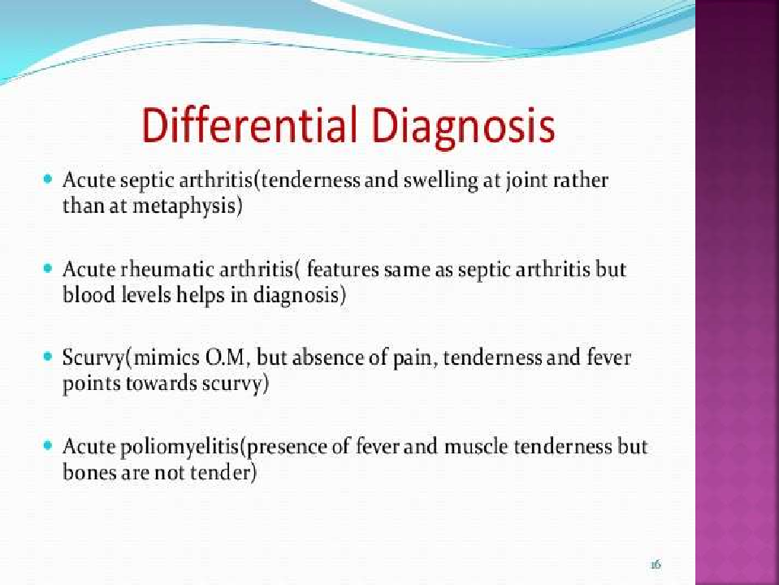

Slide 21
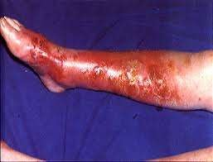
Differential diagnosis
Cellulitis
Widespread superficial redness and lymphangitis.
MRI
Oral or intravenous antibiotics

Slide 22
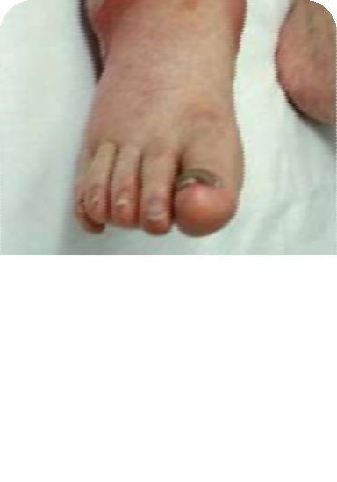
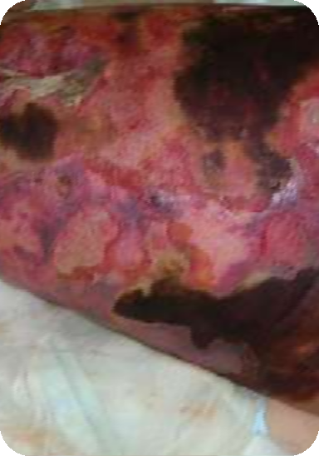
Acute suppurative arthritis
Diffuse tenderness
Joint movement abolished
Streptococcal necrotising myositis
Intense pain ,board-like swelling
MRI :muscle swelling, signs of tissue breakdown.
Intravenous antibiotics surgical debridement , amputation

Slide 23
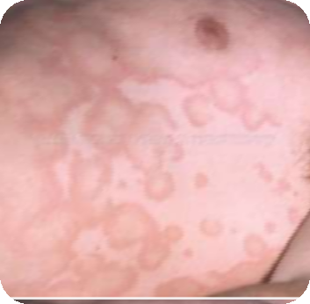
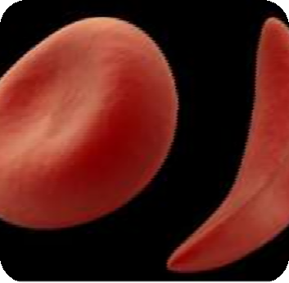
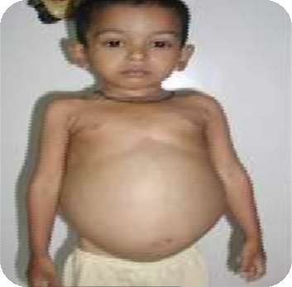
Acute rheumatism
Less severe migratory pain
signs of carditis, rheumatic nodules or erythema marginatum
Sickle-cell crisis
Salmonella
Gaucher’s disease
  “Pseudo-osteitis’
enlargement of the spleen and liver.

Slide 24
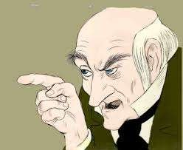
REMEMBER – clinical suspicion of bone and joint infections is important indication for treatment.

Slide 25

⦿ Osteomyelitis is a medical condition , with possible need of surgical intervention in certain conditions.
⦿ The main treatment of osteomyelitis is : delivery of correct antibiotic in he appropriate dose for an adequate period of time.
⦿ Obtain cultures (from affected area or blood)

Slide 26
1- supportive treatment for pain and dehydration; analgesia, rest, antipyretics, fluid therapy, septicemia managemenet
splintage; skin traction, back slab or slings .
Antibiotics: intravenous antibiotics to be started immediately on clinical bases and then changed on cultures and sensitivity. Antibiotics should cover expected microorganism especially staphylococcus.

Slide 27
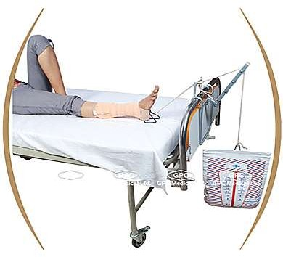

Slide 28

⦿ Depends on age of the child and choice of the doctor.
⦿ In childrens less than 4 months of age – A
COMBINATION of CEFTRIAXONE and VANCOMYCIN in
appropriate dose is preferred.
⦿ In older childrens- combination of Ceftriaxone and
Cloxacillin is given.
⦿ Evaluation of treatment is done by 4th hourly temperature and pulse record is maintained & CRP , ESR (take longer time to return to normal)
⦿ Weight bearing is restricted for 6-8 weeks.
⦿ After 2 weeks of IV antibiotics 6 wks oral antibiotics
are advised

Slide 29
Age Group | Types of antibiotics
Neonates up to 6months | Flucloxacillin + 3rd gen cephalosporin Flucloxacillin + benzylpenicillin + gentamycin
Children 6months- 6years | IV flucloxacillin + cefotaxime / cefuroxime
Older child & previously fit adults | IV flucloxacillin + fusidic acid For known strep infection : benzylpenicillin Allergic to penicillin : 2nd- or 3rd- gen of cephalosporin like cefotaxime
Elderly & previously unfit patient | Combination of flucloxacillin + 2nd-/3rd- gen cephalosporin

Slide 30
Condition | Types of Antibiotics
Sickle-cell disease patient | Chloramphenicol, Third-generation cephalosporin /fluoroquinolone
Heroin Addicts & immunocompromized patient | Third-generation cephalosporins Flouroquinolone (ciprofloxacin)
Patient to be risk at MRSA with acute hematogenous OM | IV vancomycin + 3rd- gen of cephalosporin

Slide 31

If antibiotics start early in first 48 hours drainage may be
unnecessary.
- Surgical drainage indicated if:
condition not improved after 36 hours of treatment.
sign of pus collection present in delayed presentation ( swelling, edema, fluctuation).
if pus aspirated .
Drainage done by open operation under general anesthesia, window done in cortex by using drill, splintage applied post operatively.
Weight bearing delayed for one month or even more , rest,
antibiotics(continued for 6mths) and hydration is continued.

Slide 32
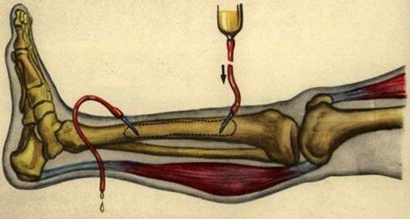
Drainage
When ?
  Clinical features do not improve within 36 hours
  Signs of deep pus
  Pus is aspirated
Drained by open operation under general anaesthesia.
(no obvious abscess) drill into medullary cavity
(extensive intramedullary abscess) cut a small window in the cortex.
Close wound without drain,
Reapplied traction ,
Encourage movements (crutches)

Slide 33


GENERAL AND LOCAL COMPLICATIONS.
GENERAL COMPLICATIONS :– In early stage child develops septicaemia and pyaemia.
LOCAL COMPLICATIONS :-
Chronic osteomyelitis (most common complication). There is hardly any evidence in radiological features in early stage .
Acute pyogenic arthritis- joints where metaphysis is intra articular (hip & shoulder)

Slide 34


Pathological fracture – basically it is caused by weaking of the bone by disease proper or by the widow made during surgery
– this is prevented by splitting of the limb
Growth plate disturbances – any damage to this causes complete or partial cessation of growth – this may lead to shortening or deformaity of the limb.

Slide 35



