Slide 1



Acetabular Fracture
Dr. Irfan Hussain
( Assistant Professor)
Department of Orthopaedics

Slide 2
Introduction
Elderly pt.-
  Due to fall
  As isolated injury
Younger pt.-
  MVA
  High incidence of major associated injuries

Slide 3
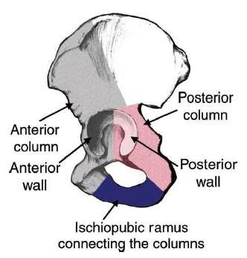
Anatomy
Can be conceptualized as being built from essentially six principal components
  Anterior column
  Posterior column
  Anterior wall
  Posterior wall
  Acetabular dome or tectum (Latin for roof)
  Medial wall
Provides coverage to approximately 170° of the femoral head

Slide 4
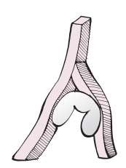
Anatomy
Incomplete hemispherical socket
  Inverted horse-shoe shaped
articular surface
  Non articulating cotyloid fossa.
The articular surface is composed of and supported by two columns of bone (described by Letournel and Judet) as an
inverted ‘Y’

Slide 5
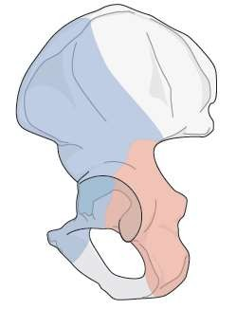
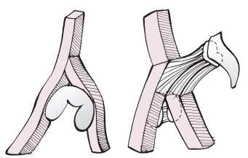
Column theory of Judet and
Letournel
Anterior column
  AKA iliopubic component and extends from the iliac crest to the pubic symphysis
Posterior column
  AKA ilioischial component, extends from the superior gluteal notch to the ischial tuberosity.

Slide 6
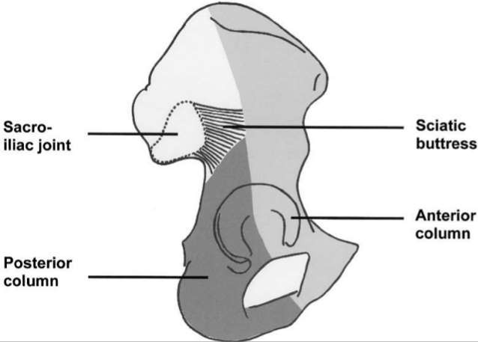
Anatomy
Sciatic buttress
Quadrilateral plate – lateral border of pelvic cavity
Roof or wt bearing dome- Sup. portion of articular surface

Slide 7
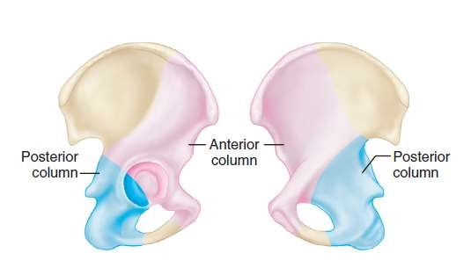
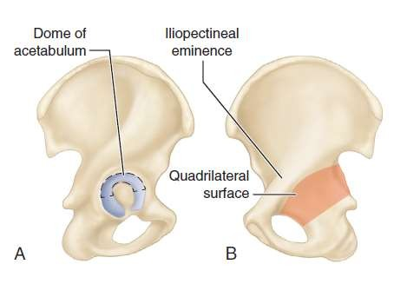

Slide 8
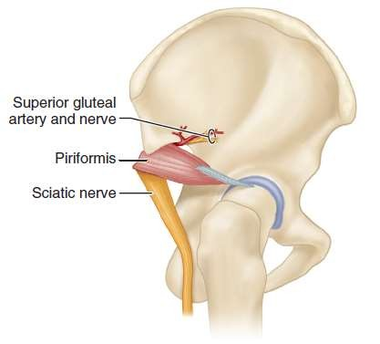
Neurovascular structure
Sciatic nerve
 Frequently injured with Post. # dislocation
Sup. Gluteal artery and Nerve
Corona mortis – “Circle of Death”

Slide 9
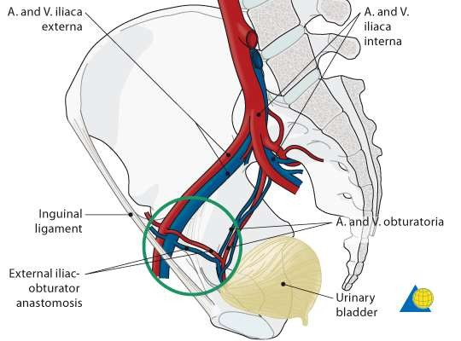

Slide 10
The classification of acetabular fracture
Letournel and Judet - commonly used
5 elementary and 5 asscociated types
Simple types –
  Posterior wall #
  Posterior column #
  Anterior wall #
  Anterior column #
  Trasverse #

Slide 11
· Associated # types
Posterior column and posterior wall #
Transverse and posterior wall #
Anterior column (or wall) and posterior hemitransverse #
T-shaped #
Both-column #

Slide 12
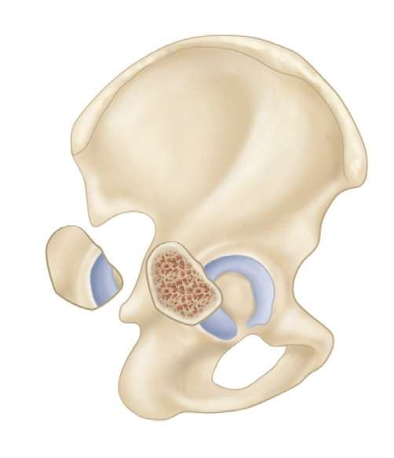
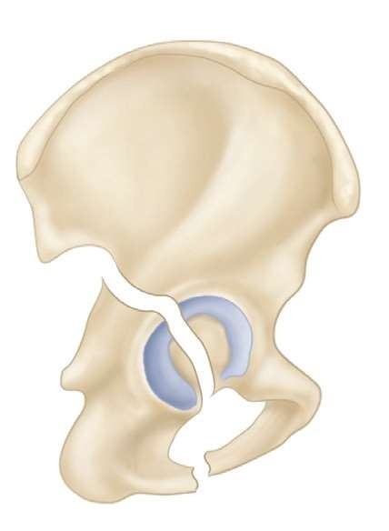
Posterior wall #
Posterior column #

Slide 13
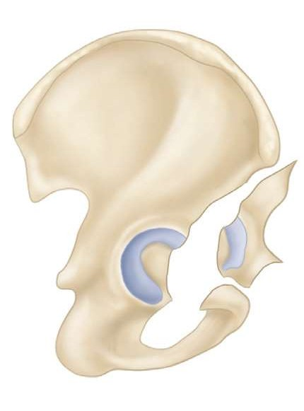
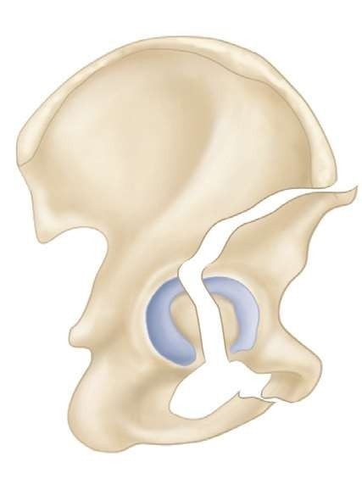
Anterior wall #
Anterior column #

Slide 14
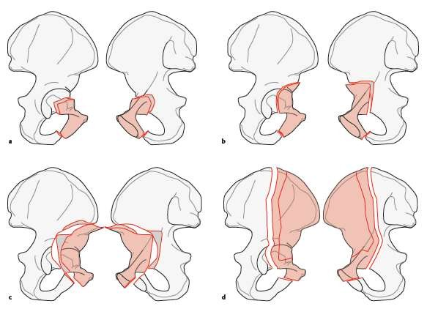

Slide 15
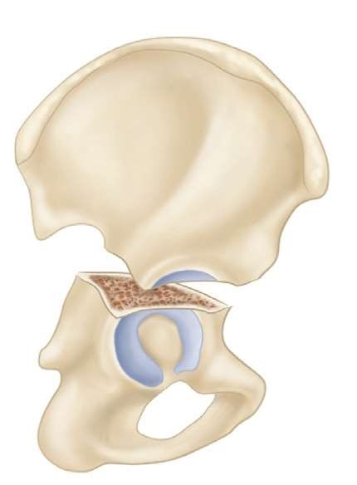
Transverse #

Slide 16
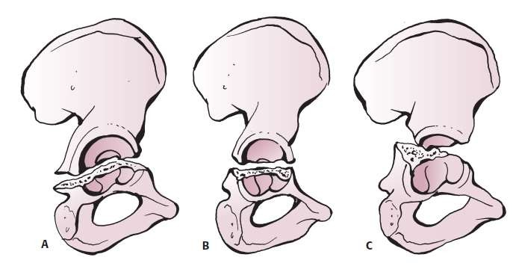
Infratectal
Juxtatectal
Transtectal

Slide 17
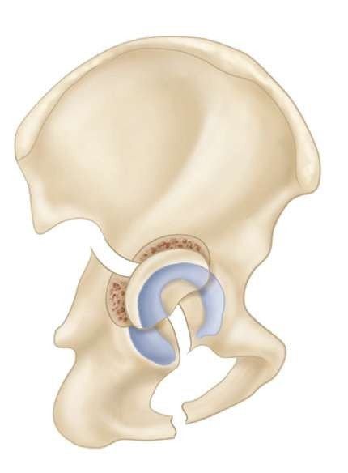
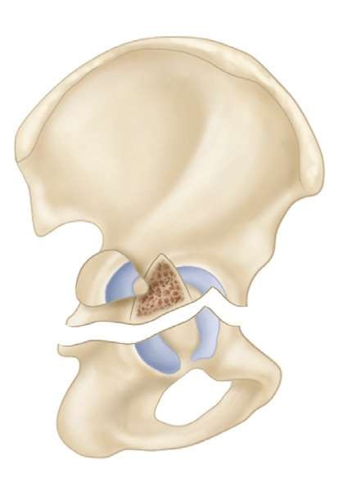
Posterior column and posterior wall #
Transverse and posterior wall #

Slide 18
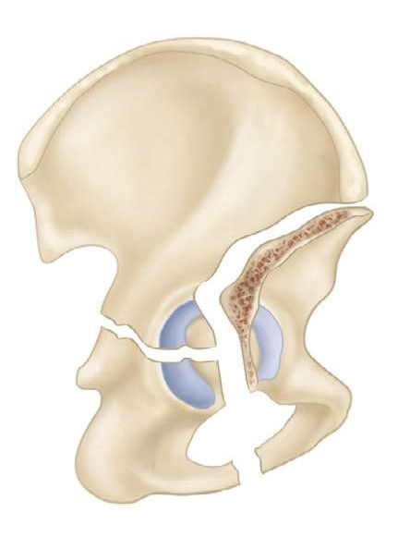
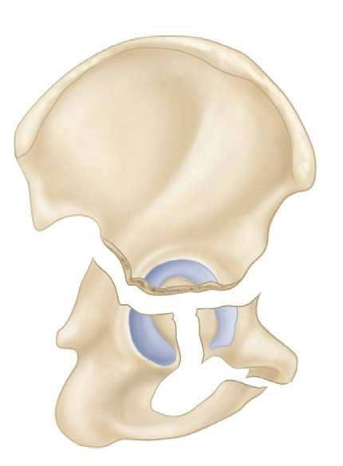
Ant. Column and post. Hemitransverse #
T – shaped #

Slide 19
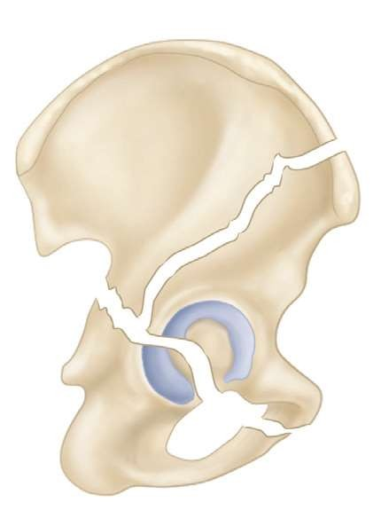
Both column #

Slide 20
Comprehensive classification
Type A: Partial articular fractures, one column involved
  A1: Posterior wall fracture
  A2: Posterior column fracture
  A3: Anterior wall or anterior column fracture

Slide 21
Comprehensive classification
Type B: Partial articular fractures (transverse or T-type fracture, both columns involved)
  B1: Transverse fracture
  B2: T-shaped fracture
  B3: Anterior column plus posterior hemitransverse fracture

Slide 22
Comprehensive classification
Type C: Complete articular fracture (both column fracture; floating acetabulum)
  C1: Both column #, high variety (anterior column fracture extends to the iliac crest)
  C2: Both column #, low variety (anterior column fracture extends to the anterior border of the ilium)
  C3: Both column # involving the sacroiliac joint

Slide 23
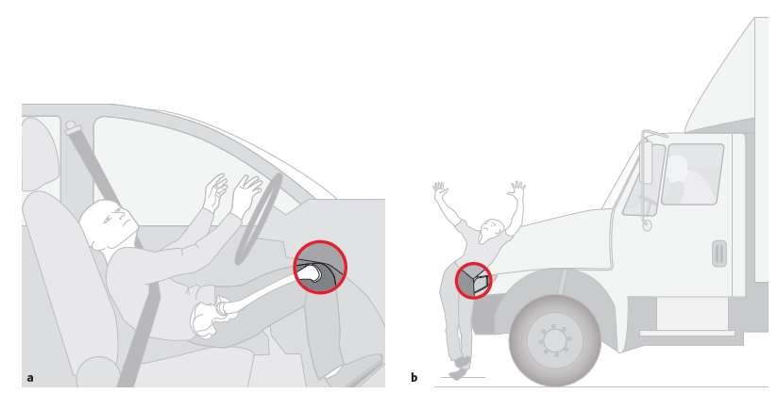
Mechanisms of Injury for Acetabulum Fractures
Impact of the femoral head with the acetabular articular surface
  GT(along the axis of the femoral neck)
  Anywhere along the long axis of the femoral shaft.

Slide 24
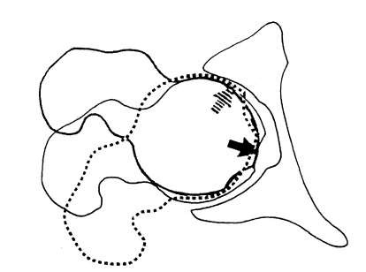
Type of # depends upon position of femoral head in acetabulum and magnitude of force
A

Slide 25
Signs and symptoms
History – cause of injury
ATLS protocol
Visceral injuries common
Associated fractures common
Elderly pt. (underlying cardiac or neurologic condition)
Assess and document NV status

Slide 26
Signs and symptoms
Shortening present if hip is dislocated
Flexion, adduction, and internal rotation of the hip may not be present

Slide 27
Radiographic Evaluation
X-Rays- 3 views
  Standard AP view
  45⁰ Obturator oblique view
  45⁰ Iliac oblique view
CT scan

Slide 28
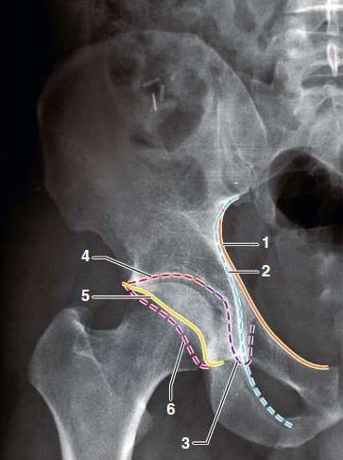
Landmarks of standard AP radiograph
of hip
1.liopectineal line 2.Ilioischial line 3.Radiographic teardrop 4.Roof of acetabulum.
Edge of anterior lip of acetabulum
Edge of posterior lip of acetabulum.

Slide 29
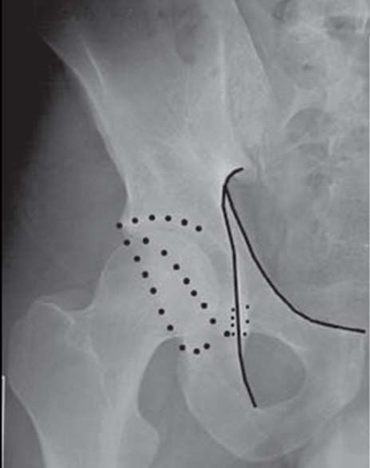

Slide 30
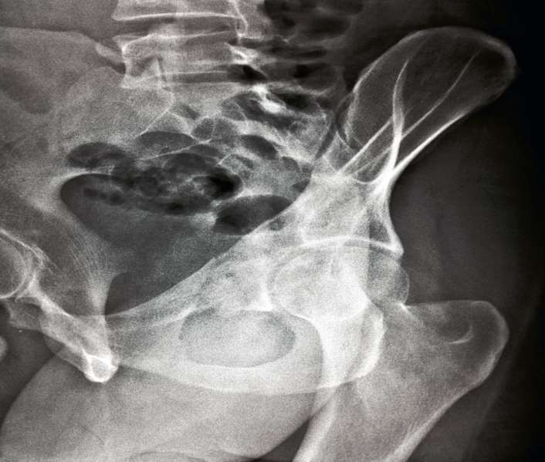
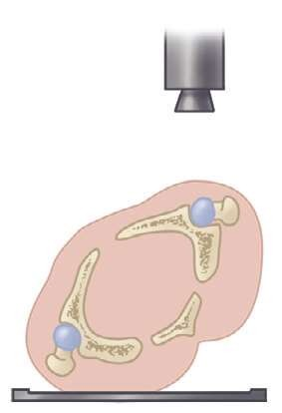
Obturator oblique view
Obturator foramen
Anterior column
Posterior lip or wall of the acetabulum

Slide 31
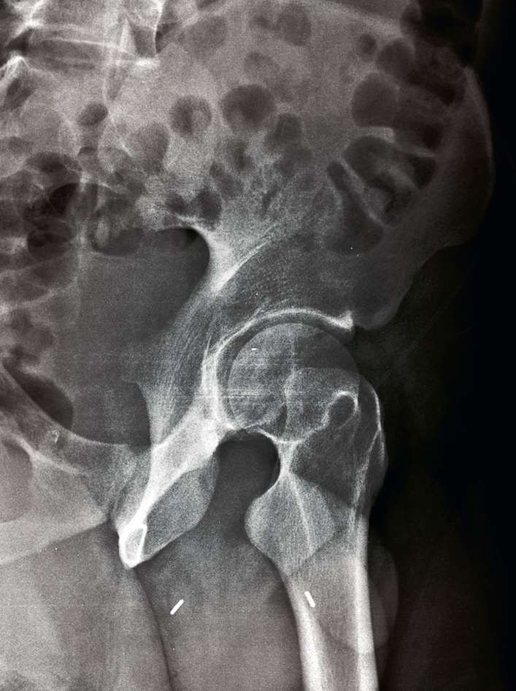
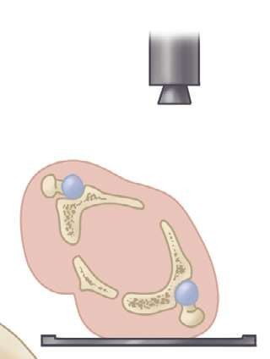
Iliac oblique view
Iliac wing in its largest dimension
Posterior column

Slide 32
CT scan
Axial cuts should be taken with thin slices
Extent and location of acetabular wall fractures
Presence of intra-articular free fragments
Orientation of fracture lines and Marginal impaction
Femoral head defect
Rotation of fracture fragments
Pelvic hematoma
Sacroiliac joint integrity

Slide 33
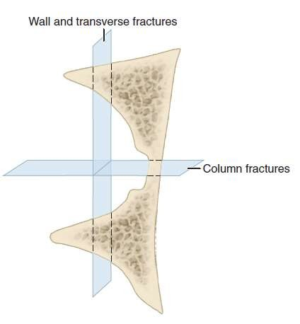
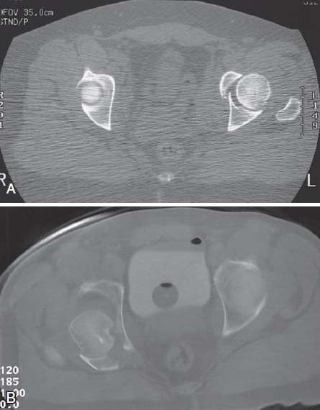

Slide 34
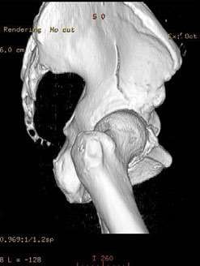
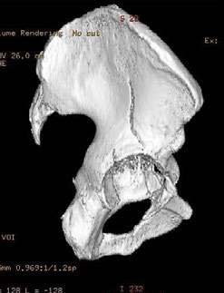
3-D CT
Better understanding of the fracture patterns.
Planning the operative approach
Ability to subtract unwanted structures

Slide 35
Management
Initial treatment – follow ATLS protocols
Operative treatment are usually not performed as an emergency
Closed reduction of hip dislocations should be performed → Skeletal traction
  Allow soft tissue healing initially
  Maintain limb length
  Maintain femoral head reduction

Slide 36
Management
The goal of the treatment is restoration of articular surface, prevent post traumatic arthritis and to mobilise the patient as early as possible

Slide 37
Management
Factors to be considered are-
Patient factors
Fracture factors
Expertise available

Slide 38
Patients factors
Age
Pre injury activity level
Medical comorbidities
Associated injuries
Functional demands

Slide 39
Non-operative Indications
Hip stable and congruous.
Patient factors
  Medical contraindications
  Severe osteoporosis in elderly
Undisplaced/Minimally displaced fractures
Fractures with secondary congruence (both-column)
Preexistent arthritis of hip
Local soft tissue problems
  Morel Lavelle’ lesion
  Open wound
  Suprapubic catheter (C/I to Ilioinguinal and Stoppa)

Slide 40
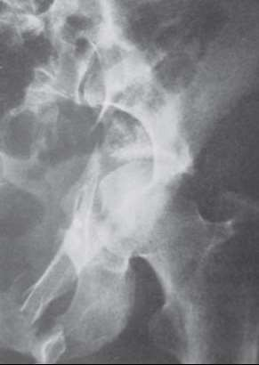
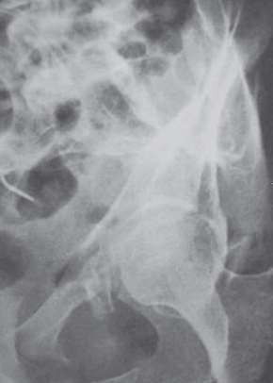
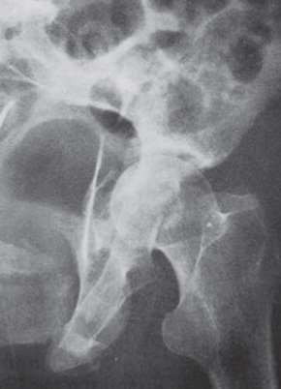

Slide 41
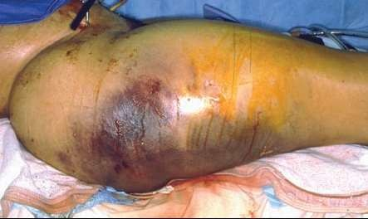
Morel Lavalle lesion
Localized area of subcutaneous fat necrosis over the lateral aspect of the hip
Operating through it has been associated with a higher rate of postoperative infection

Slide 42
Non operative Treatment
Bed rest is necessary in the acute injury phase only
Mobilization as soon as symptoms allow
Patients should begin with touch-down partial weight-bearing
Radiographs at frequent intervals
Gradually progress to full weight bearing when there is adequate fracture healing, usually by 6 to 12 weeks
Joint mobilization should be continued throughout the rehabilitation period

Slide 43
Operative Treatment
Instability
Incongruity.

Slide 44
Instability
Usually associated with posterior fracture types
Less commonly anterior
May be central if large fragment of quadrilateral plate is fractured

Slide 45
Incongruity
The curve of femoral head should fit exactly in to dome of acetabulum in all three radiographic views
Matta has recommended use of roof arc measurements to measure incongruity

Slide 46
Roof arc angle
Is an estimation of amount of WBD involved
Measured on all three radiograph views with the leg out of traction
Medial roof arc angle is measured on AP view
Anterior roof arc angle is measured on obturator oblique view
Posterior roof arc angle is measured on Iliac oblique view
WBD is considered to be intact and hip joint congruous if measurement > 45º (Matta)

Slide 47
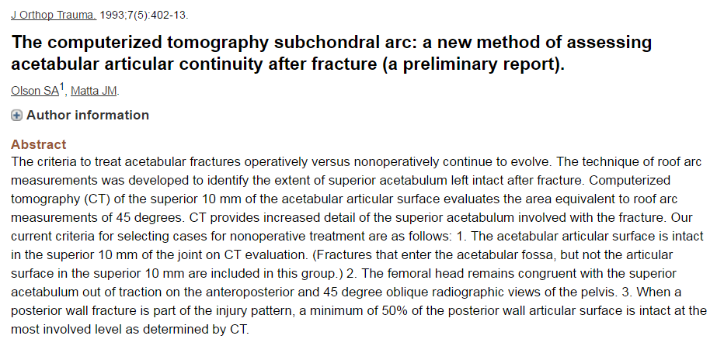
Criteria for non operative treatment
CT subchondral arc is intact in the superior
10 mm of the acetabulum
Femoral head remains congruent with the superior acetabulum in AP and 45 degree oblique views (out of traction)
No evidence of posterior hip instability

Slide 48
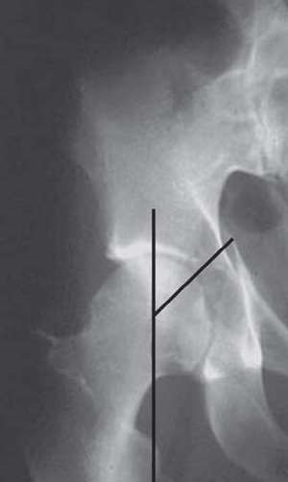
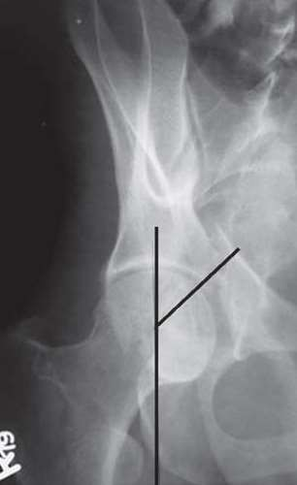
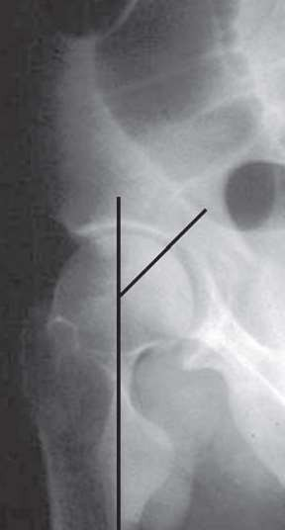

Slide 49
Operative Indications
Hip joint instability and Incongruity
  Significant displacement (≥ 2 mm) of the weight-bearing dome on any of the three standard x-rays
  Fractures judged to be unstable on image intensification stress examination under anesthesia
  Posterior wall fractures involving more than 50% of the posterior wall
  Incarcerated bone fragments in the joint
  Lack of secondary congruence
  Displaced associated femoral head fractures

Slide 50
Timing of surgery
Delay of 3-5 days advisable to allow
patient’s general condition to stabilize

Slide 51
Indications for Emergency ORIF
Recurrent hip dislocation following reduction despite traction
Irreducible hip dislocation
Progressive sciatic nerve deficit
Associated vascular injury
Open fractures
Ipsilateral femoral neck fracture

Slide 52
Surgical Approaches
Main determinants
  Fracture type
  Elapsed time from injury
  Magnitude and location of maximal fracture displacement
Single surgical approach is generally selected

Slide 53
Surgical approaches
Posterior (Kocher-Langenbach) approach
Ilioinguinal approach
Stoppa’s approach
Combined approach
Iliofemoral approach
Extended Iliofemoral approach
Triradiate approach

Slide 54
Kocher-Langenbeck approach
Position- Prone or lateral with hip in slight extension and knee flexed
Provides access to posterior column and entire posterior wall
Advantages-
  Familiarty to most surgeons
  Muscle dissection and blood loss minimal
Disadvantages are-
  Limited exposure
  Possible injury to sciatic nerve and superior gluteal artery& nerve,Pudendal nerve, medial circumflex femoral artery
  Increased risk of HO

Slide 55
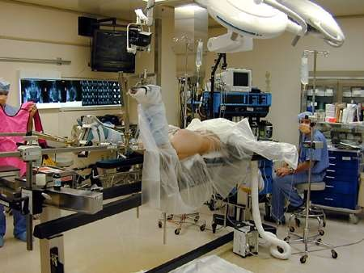

Slide 56
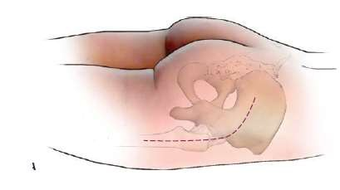
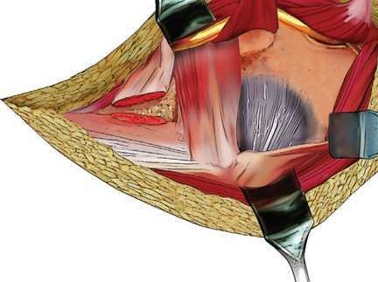

Slide 57
Ilioinguinal approach
Position- Supine
Approach of choice for all anterior wall and anterior column fractures
Creates three working portals or windows
Lateral window exposes entire iliac fossa, S I joint, sacral ala, and the superior iliopectineal eminence
Middle window exposes the pelvic brim and quadrilateral surface
Medial window provides access to pubic ramus, pubic symphysis and the retropubic space of Retzius

Slide 58
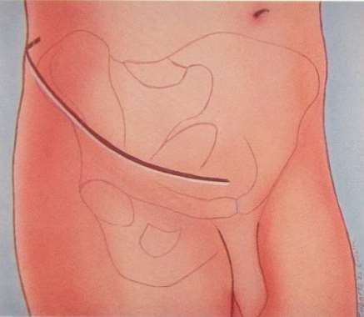
Ilioinguinal approach
Advantages
Excellent access is to the anterior and internal aspects of the entire pelvis and acetabulum.
HO is minimal
Disadvantages
Approach is extraarticular, reduction achieved almost entirely by indirect means
Possible damage to the femoral nerve, ext. iliac vessels, femoral lat. cutaneous Nerve,inguinal canal contents

Slide 59
Extended Iliofemoral approach
Indicated for selected complex acetabular fracture types and for surgery delayed more than 2 weeks following injury
Direct access to the iliac crest and the entire internal iliac fossa
Position- Lateral and the knee in flexed position to relax the sciatic nerve
Provides access to entire posterior column, external ilium, S I joint, and anterior column up to iliopectineal eminence

Slide 60
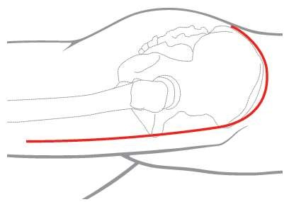
Extended Iliofemoral approach
Advantage
Exellent access to
entire hemipelvis
Disadvantages
High incidence of
HO
Possible damage to superior gluteal and femoral NV bundles

Slide 61
Modified Stoppa Approach
Position- Supine
Provides improved exposure of the quadrilateral surface and posterior column
Commonly used in conjunction with the lateral window
Advantage over the ilioinguinal is that dissection of the iliac vessels is not required
Risk of injury to Corona mortis and bladder

Slide 62
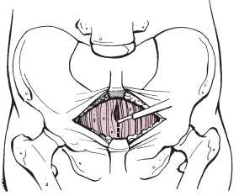
Modified Stoppa approach

Slide 63
Treatment of specific fracture pattern
Posterior wall fractures
  Kocher–Langenbeck approach is ideal for posterior wall fractures
  Special circumstances like large wall fragments incarcerated in the joint trochanteric flip osteotomy may be needed

Slide 64
Treatment of specific fracture pattern
Posterior column fracture
  Kocher–Langenbeck
Anterior Column Fractures and Anterior Wall Fractures
  Ilioinguinal approach
  If the quadrilateral surface is comminuted the modified Stoppa approach may be a better choice

Slide 65
Treatment of specific fracture pattern
Transverse Fractures
  Kocher–Langenbeck approach as posterior column usually is the site of greatest fracture displacement
Transverse and Post. Wall Fractures
  Kocher–Langenbeck approach

Slide 66
Treatment of specific fracture pattern
Anterior Column (or Wall) and Posterior Hemitransverse Fractures
  Posterior column component is only minimally displaced in this fracture type. Therefore ilioinguinal approach is used.
  Modified Stoppa approach alternative
  Posterior column is widely displaced (more than 5 mm), or it cannot be reduced through the anterior approach, the Kocher– Langenbeck is added

Slide 67
Treatment of specific fracture pattern
T- shaped Fractures
  Kocher–Langenbeck approach
  If the anterior column fracture cannot be reduced ,subsequent patient repositioning and an anterior approach is required (Ilioinguinal or Modified Stoppa)
Both column Fractures
  Commonly operated on using an anterior approach (ilioinguinal or modified Stoppa) with the patient supine

Slide 68
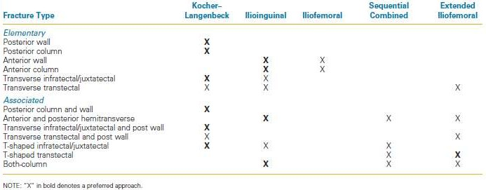
Standard surgical approaches for each fracture pattern

Slide 69
Methods of Reduction
Traction-
With Traction table
Manual Traction-
  Traction on extremity by manual pull
  Corkscrew
  Large sharp hook
  Schanz pin

Slide 70
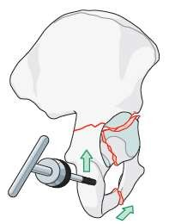
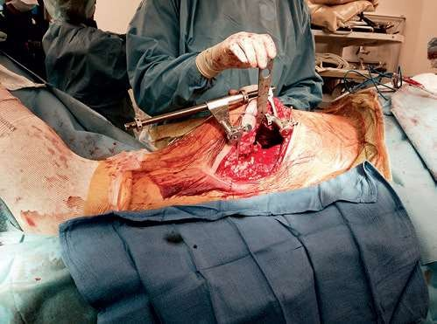

Slide 71



Slide 72


Slide 73
Post operative care
Suction drain
Antibiotic for 48 – 72 hours
Thromboprophylaxis- Mechanical compressive device with LMWH
Indomethacin 25 mg tds beginning within 24 hours of surgery and continued for 4 to 6 weeks to prevent HO
Passive motion of the hip on the 2nd or 3rd day.
Touch down ambulation & crutches on 2nd to 4th day
Progression to FWB must be tailored to the individual

Slide 74
Complications
Early:
Mortality (0-3.6%)
Thromboembolism
Infection
Neurological injury
Vascular injury
Intraarticular hardware
Malreduction
Loss of reduction
Late:
Avascular necrosis
Heterotopoic ossification
Pseudoarthrosis
Post traumatic arthritis

Slide 75
Complications
Thromboembolism
  Risk of PE 1%- 5 %
  Use of intermittent compression device plus a form of chemical anticoagulation (eg- LMWH or Warfarin) recommended for prophylaxis

Slide 76
Complications
Infection
  1-10 % patients
  Incidence of infection related to surgeons experience
  Other factors -skin necrosis, hematoma formation, and obesity
  Prophylactic antibiotics should be administered within 1 hour before the skin incision and continued for 24-48 hours after surgery
  Multiple suction drains should be used

Slide 77
Complications
Nerve Injury
  Sciatic nerve
  Preoperative incidence 12-31 %
  Prevalence of postoperative sciatic nerve injury is 2– 16%
  Peroneal division commonly involved
  Management of sciatic nerve injury is expectant and prognosis is variable
  Iatrogenic injury to the femoral nerve is very rare with a prevalence of 0.2% to 0.4%

Slide 78
Complications
Heterotropic ossification
  Incidence varies from 3–69%
  Related to extensile surgical exposures, male gender, associated head injury, significant delays to surgery, fracture type, the severity of the injury
  Rare with ilioinguinal approach
  “Significant HO” -loss of active range of motion
>20% of normal.
  Indomethacin 25 mg tds for 6 weeks or 75 mg SR capsule OD for 6 weeks
  Radiation therapy- 7–8 Gy in a single dose or 10 Gy in five doses

Slide 79
Complications
Posttraumatic Arthritis
  Prevalence of osteoarthritis 4–48%
  Quality of the fracture reduction main determinant
  Incidence following perfect reduction was 10%
  Anatomical reduction and restoration of joint congruency is the best prophylaxis

Slide 80
Conclusion
High velocity injuries with significant accompanying injuries
ATLS protocol
Fracture management depends on
  Proper case selection for surgical and conservative
treatment
  3 dimensional understanding of anatomy,
  Proper interpretation of radiographs
  Realistic expectations
  Specialized instrumentation
  Surgical expertise

Slide 81
Conclusion
Many perioperative complications are a consequence of the injury
Acetabular fracture fixation surgery is complex and demanding and has the potential for many serious complications
Anatomical reduction of the WBD , congruent reduction of the femoral head and timely surgical intervention are the keys to success

Slide 82



Slide 83



Which sign is this ?
Gull wing sign
Spur sign

Slide 84
Which of th following statement are true ?
Widespread availability of CT and MRI has rendered plain radiograph almost obsolete for acetabular fracture.
Undisplaced fractures are treated by a period of 4- 6 weeks on skeletal traction.
Fracture of anterior wall and column make up over 60 % of displaced acetabular fractures
Recovery is complete in 50 % patients with sciatic nerve palsy associated with acetabular fractures and posterior dislocation of hip
Heterotopic ossification can occur in 25-30 % of cases of posterior or extensile approaches for displaced fractures of acetabulum

Slide 85
Criteria for non operative management of acetabular fracture includes all except :
Stability demonstrated by dynamic stress radiographs
Femoral head subluxation of 3 mm
Congruence of femoral head with acetabular roof on AP and judet views
Roof arc measurement of greater than or equal to 45
Acetabular articular surface is intact in the superior 10 mm of the joint on CT evaluation

